Slide 1
Introduction to Python

Slide 2
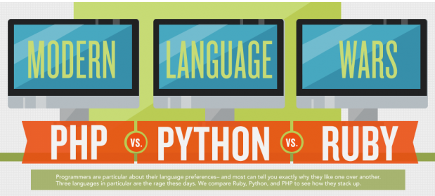
Which is better??
Notes:
Taken from the Udemy site..
Note that Perl is not even in the count..

Slide 3
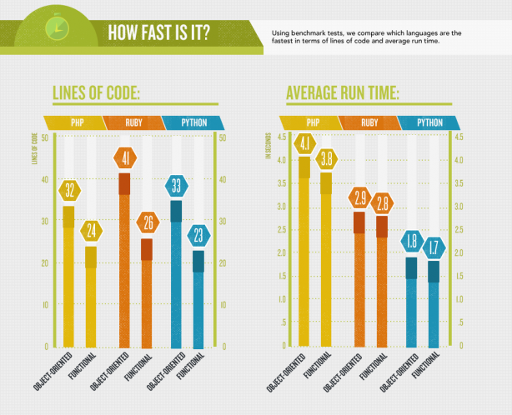

Slide 4
Python 2 or 3 ?
3 is incompatible with 2!
But well written v2 is easy to port to Python 3
Many libraries have been ported.. some have not!
Porting older packages is a non-trivial task, some systems (fewer and fewer) may be stuck with Python 2 for some software
Lots of documentation is still in 2.x – but 3.x is gaining
We will use v3 but be aware of how it has changed from v2.x
Notes:
What is really different is tons of minutae !!

Slide 5
Why is Python so blooming excellent?
1 - Software quality
Readability
Unambiguous and easy to understand thus re-usable and maintainable—much more so than traditional scripting languages.
The uniformity of Python code makes it easy to understand, even if you did not write it.
Deep support for more advanced software reuse mechanisms, OOP.
Notes:
By uniformity we mean that there is typically one obvious way to do anything..

Slide 6
2 -Developer productivity
Python is optimized for speed of development!
Many times faster development than compiled or statically typed languages such as C, C++, and Java.
Python code is typically one-third to one-fifth the size of equivalent C++ or Java code.
less to type, less to debug, and less to maintain after the fact.
Python programs also run immediately, no compiling and linking..
But Python is slower than C & C++
Notes:
Execellent for prototyping!

Slide 7
3- Program Portability:
Typically runs unchanged on all major computer platforms.
Porting Python code between Linux and Windows is usually just a matter of copying a script between machines.
Offers multiple options for coding portable GUIs, db access programs, www systems, and more.
OS interfaces (eg program launches and directory processing) are as portable in Python as they can possibly be.
Notes:
Multiple options must mean multiple libraries..

Slide 8
4-Support libraries
Comes with a large collection of prebuilt and portable functionality - the standard library.
Supports an array of app-level programming tasks, from text pattern matching to network scripting.
A vast collection of third-party application support software.
Tools for web site construction, numeric programming, serial IF access, game development, mobile platforms etc. etc.
Ex: the NumPy extension has been described as a free and more powerful equivalent to the Matlab numeric programming system.

Slide 9
5- Component integration
Python scripts can easily communicate with other parts of an application, using a variety of integration mechanisms.
Allows Python to be used as a product customization and extension tool.
Python code can call and be called by C and C++ libraries, Java components, use frameworks like COM and .NET, SOAP, XML, RPC, and CORBA.
Notes:
Python as a “control” language
SOAP - In response to these proprietary and complex protocols, a number of people in the Internet community have created SOAP, the Simple Object Access Protocol, that makes it extremely easy to create distributed applications. Two of the biggest proponents of SOAP have been Dave Winer (famous for his Scripting News “weblog”) and Microsoft, which is not usually associated with open standards and cross-platform protocols. Regardless of what we in the Linux community might think, Microsoft has publicly embraced SOAP, making it a cornerstone of its .NET effort.
Distributed-object technology and remote-procedure calls have existed for many years on a variety of platforms. In almost every case, this technology was restricted to a particular language or platform. DCOM (Distributed Component Object Model) allows objects of any language to communicate but only under Windows. Java's RMI (Remote Method Invocation) can only communicate with other Java objects. CORBA is an exception to this, allowing objects to communicate across platforms and languages, but CORBA is complex, has taken awhile to get off the ground and isn't yet a part of most programmers' knowledge base.

Slide 10
Primary difference from Perl..
Python created by a mathematician -> language with a high degree of uniformity—its syntax and toolset are remarkably coherent.
Most of the language follows from a small set of core concepts.
The creator of the Perl is a linguist, its design reflects this.
There are many ways to accomplish the same tasks in Perl, and language constructs interact in context-sensitive and sometimes quite subtle ways—much like natural language.

Slide 11
Primary difference from Perl..
Python adopts a somewhat minimalist approach.
There is usually just one obvious way to code
Python doesn’t make arbitrary decisions for you
Explicit is better than implicit, and simple is better than complex.
Perl motto: “There’s more than one way to do it.”
Perl culture: “freedom of expression”

Slide 12
The Python implementation is under “Python Software Foundation License”
Open source license that makes it freely usable and distributable, even for commercial use. But there are restrictions mostly having to do with control of the core language itself.
Open, but not GPL.
Notes:
Open but under their control.. Including the ability to break out!

Slide 13
Python is a “scripting” language..
Ambiguous meaning
Shell language?
Control Language?
Ease of use??
-> “simple language used for quickly coding tasks”
Notes:
Its all of the above but mostly its about ease of use!!

Slide 14
Python is an interpreted language..
No compiling necessary.. the Python interpreter “interprets” the script
But.. No compiled version.. Which could have financial implications
Notes:
The Low Level Virtual Machine (LLVM) is a compiler infrastructure, written in C++, which is designed for compile-time, link-time, run-time, and "idle-time" optimization of programs written in arbitrary programming languages. Originally implemented for C/C++, the language-agnostic design (and the success) of LLVM has since spawned a wide variety of front ends, including Objective-C, Fortran, Ada, Haskell,Java bytecode, Python, Ruby, ActionScript, GLSL, Clang, and others.

Slide 15
The downside/upside
Python compiles (i.e., translates) source code statements to intermediate format “byte code”
Byte code is run in the interpreter.
Byte code provides portability, it is platform-independent
Because Python is not compiled all the way down to machine code some programs will run more slowly
Notes:
Unladen swallow ended around 2010 with mixed results

Slide 16
There still are some domains that do require optimal execution speeds.
i.e. numeric programming and animation
Py can split off those parts of the app into compiled extensions, and link those to Python scripts.
This is really just an instance of the Python-as-control-language
Example: is the NumPy numeric programming extension for Python;

Slide 17
Google makes extensive use of Python in its web search system, and employs Python’s creator.
YouTube is largely written in Python.
BitTorrent
Intel, Cisco, Hewlett-Packard, Seagate, Qualcomm, and IBM use Python for hardware testing.
Industrial Light & Magic, Pixar, and others use Python in the production of movie animation.
JPMorgan Chase, UBS, Getco, and Citadel apply Python for financial market forecasting.
NASA, Los Alamos, Fermilab, JPL, and others use Python for scientific programming tasks
The NSA uses Python for cryptography and intelligence analysis.
Cisco NS-OX support Python
Notes:
Jpl – jet propulsion lab

Slide 18
System Programming:
Python’s built-in interfaces to OS services make it ideal for writing portable apps
Python’s standard library comes with POSIX bindings and support for all the usual OS tools: environment variables, files, sockets, pipes, processes, threads, regular expression pattern matching, command-line arguments, shell-command launchers, and more.
The bulk of Python’s system interfaces are designed to be portable; for example, a script that copies directory trees typically runs unchanged on all major Python platforms
Notes:
Windows is Posix compliant.

Slide 19
GUIs
Python comes with a standard OO interface to the toolkit GUI API called Tkinter, which allows Python programs to implement portable GUIs with a native look and feel.
Python/Tkinter GUIs run unchanged on MS Windows, X Windows (on Unix and Linux), and the Mac OS
Notes:
Tk is an open source, cross-platform toolkit that provides a library of basic elements for building a graphical user interface (GUI) in many different ... Tk (tcl) is a language..
Tkinter GUIs have extensions for all OSs

Slide 20
Internet Scripting
Python comes with standard Internet modules that allow Python programs to perform a wide variety of networking tasks, in client and server modes.
communicate over sockets; extract form info from server-side CGI scripts; transfer files by FTP; process XML files; manipulate email; fetch web pages; parse HTML and XML ..
Also lots of third-party tools available for doing Internet programming in Python.

Slide 21
Component Integration
Embedding Python in a product enables onsite customizations to be coded without having to recompile the entire product, or ship its source code at all.

Slide 22
Other Python specialties..
Database programming
Rapid prototyping
Numeric and scientific programming
Gaming, Images, AI, XML, Robots
Mobile apps!

Slide 23
Everything in Python is an Object.. but..
Python built from the ground up as OO
BUT.. OO tools are optional.. can be applied if and when needed
You can go far without having to become an object guru all at once.
Much like C++, Python supports both procedural and object-oriented programming modes.
This is especially useful in tactical development modes, which preclude design phases.

Slide 24
Its Powerful:
Dynamic typing
It doesn’t require complicated type and size declarations in your code.
Automatic memory management
Automatically allocates objects and reclaims (“garbage collects”) them, most grow and shrink on demand.
Programming-in-the-large support for building larger systems
Modules, classes, and exceptions.
Provides commonly used data structures
Data structures can grow and shrink on demand, can be arbitrarily nested to represent complex information

Slide 25
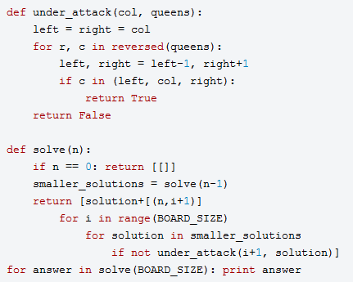
One more thing.. no bracketing for code blocks!
Notes:
Sample code showing indents..

Slide 26
FIN

