Slide 1
ROBOT+HOTEL = ROBOTEL
Batch Number : 10
Batch Members :
PRASANNA KUMAR R (13BIC012)
MATHIVANAN D (13BIC020)
SANTHOSH N (13BIC030)
VIGNESH V (13BIC035)
Guide: Mr.P.Kathirvel,M.E.,
Assistant Professor, Department of ICE.

Slide 2
OBJECTIVE
The main objective of the project is to replace the hotel servants with the robotel robots.
It may help us to reduce the man power with good efficiency and without any ignorance.

Slide 3
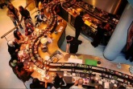
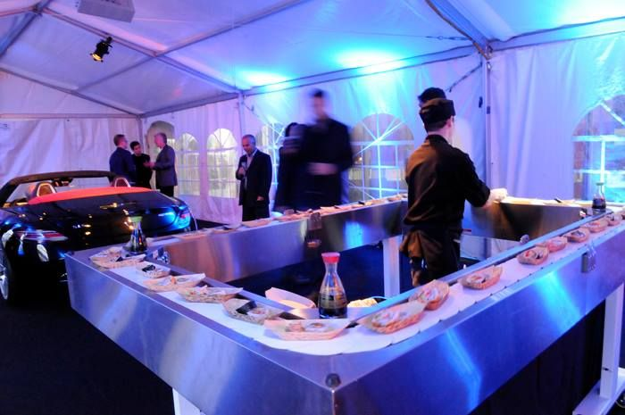
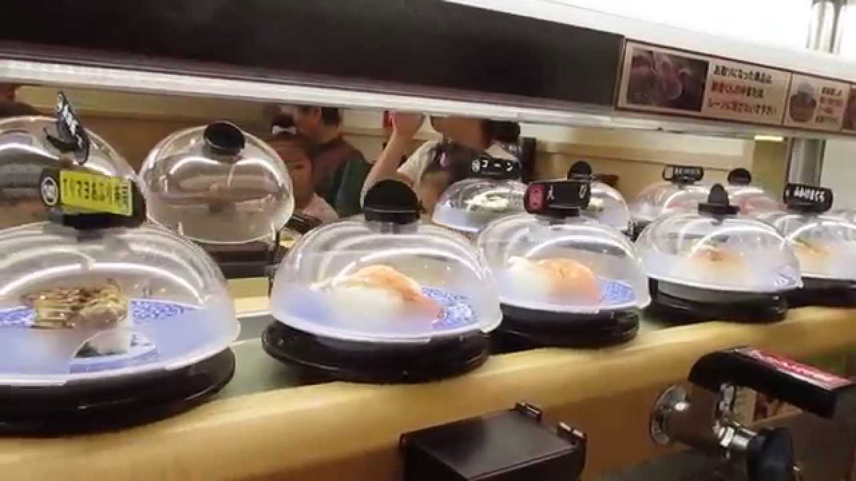
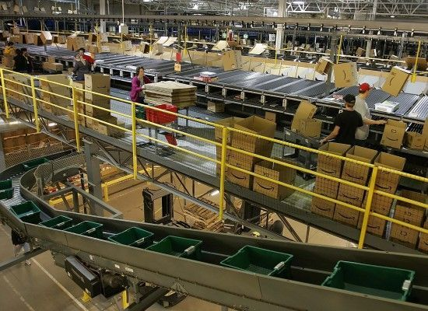
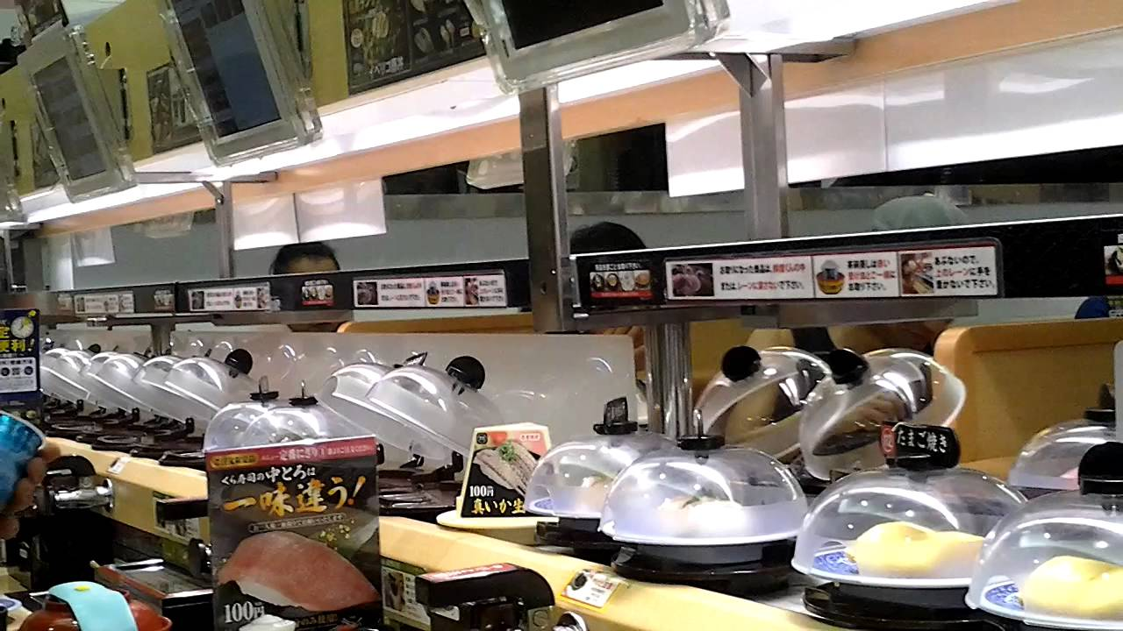
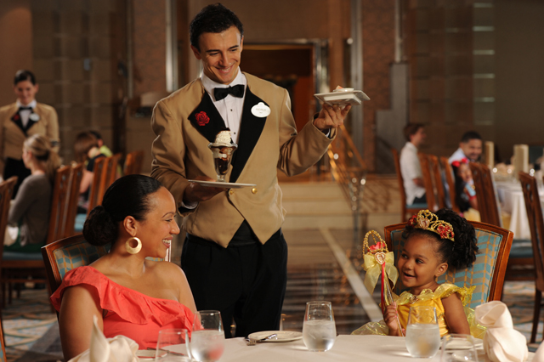
EXISTING MODEL

Slide 4
DISADVANTAGES OF EXISTING MODEL
Costly
More space occupation
Energy loss
Wrong delivery
Labour
Human values goes down

Slide 5
PROPOSED MODEL
Block diagram(Robot):
6V SUPPLY
SPEAKER
LED
ROBOT ARM
LCD
SERVO MOTOR 1
SERVO MOTOR 2
SERVO MOTOR 3
AMPLIFIER
(LM380)
ULTRASONIC
CONTROLLER
Sound sensor
DRIVER
(L293D)
DC
MOTOR
IR SENSOR
BATTERY
5V
BLUETOOTH
MODULE
SD
CARD
SD
MODULE
MOBILE
PHONE
(ROBOTEL, BLUE TERMS APP)
BATTERY
12V

Slide 6
HOTEL FLOOR
Table 2
Table 3
Robot
workspace
White floor
Table 1
Table 4
Black boarders
Control Room/Kitchen

Slide 7
FLOWCHART:
Start
Connect with
Mobile phone
Turn on the
Robot
Sound sensor
Input
Turn on the
LED
Select any table for
Food Delivery

Slide 8
TABLE-1
1
Table-1
(001)
Robot speech
Instructions
Servo operation
Robot Arm
YES NO
if W.F==1
Kitchen
(101)
Kitchen
(101)
Robot arm
operation

Slide 9
TABLE-2
2
Table-2
(010)
Robot speech
Instructions
Servo operation
Robot Arm
if W.F==1
YES NO
Kitchen
(101)
Kitchen
(101)
Robot arm
operation

Slide 10
TABLE-3
3
Table-3
(011)
Robot speech
Instructions
Servo operation
Robot Arm
if W.F==1
YES NO
Kitchen
(101)
Kitchen
(101)
Robot arm
operation

Slide 11
TABLE-4
4
Table-4
(100)
Robot speech
Instructions
Servo operation
Robot Arm
if W.F==1
YES NO
Kitchen
(101)
Kitchen
(101)
Robot arm
operation

Slide 12
CLEARING THE TABLE:
Select any table number for
Clearing the table
Robot goes to that
Particular table
Robot arm
operation
Kitchen
(101)
Robot arm
operation

Slide 13
PHASE-I PROGRESS
Floor design
Robot moment towards each table
Robot speech instructions
PHASE-II
Planned work | Completed work
Mobile Application Robot arm Assembling the robot with arm LCD display LED design Triggering of the robot Final outlook | Robot arm Assembling the robot with arm Outline of the mobile application

Slide 14
COMPONENTS USED
Microcontroller
Servo motor
DC motor(60rpm)
Motor driver(L293D)
Audio amplifier(LM380)
IR sensor and ultra sonic sensor
Bluetooth module, SD card module and SD card
Battery 5v, 6v and 12v
Speaker, Sound Sensor and Buzzer
LCD
Connecting wires

Slide 15
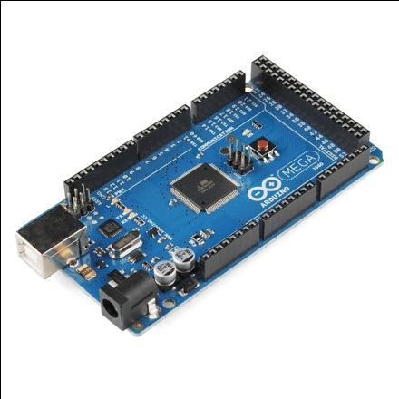
ARDUINO MEGA MICROCONTROLLER
Micro controller(ATmega2560)
Operating voltage = 5v
Input voltage = 7-12v(recommended)
Input voltage = 6-20v(limits)
Digital I/O pins = 54(15 PWM)
Analog Input pins = 16
DC current per I/O pin = 40mA
DC current for 3.3v pin = 50mA
Flash memory = 256kB
SRAM = 8kB
EEPROM = 4kB
Clock speed = 16MHz

Slide 16
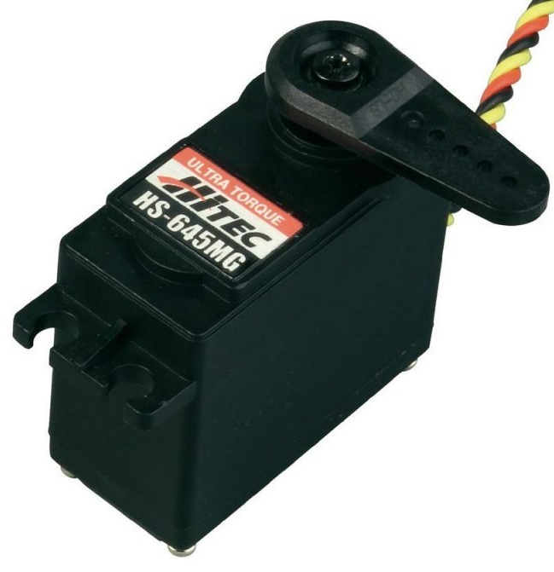
SERVO MOTOR
Weight = 55g
Dimension = 40.7x19.7x42.9mm
Stall torque = 11kgf.cm
Operating speed = 0.14s/60˚
Operating voltage= 6v
Running current = 500mA-900mA
Stall current = 2.5A
Dead band width = 5µs

Slide 17
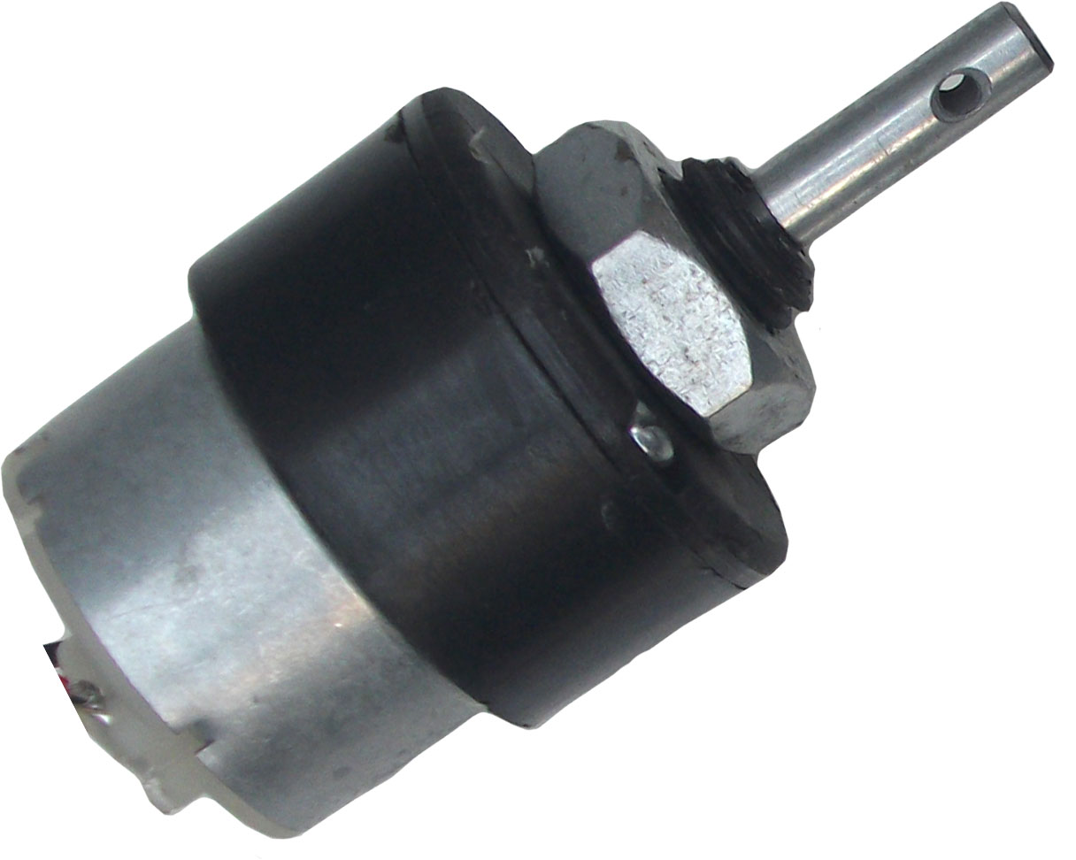
DC MOTOR
12v DC Motor with gear box
Motor speed = 60rpm
Base motor speed = 3000rpm
Shaft diameter = 6mm(with internal hole)
Weight = 125gm
Torque = 2kgcm
No-load current = 60mA(max)
Load current = 300mA(max)

Slide 18
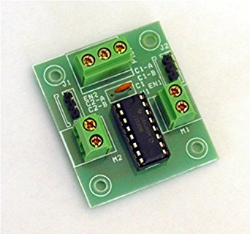
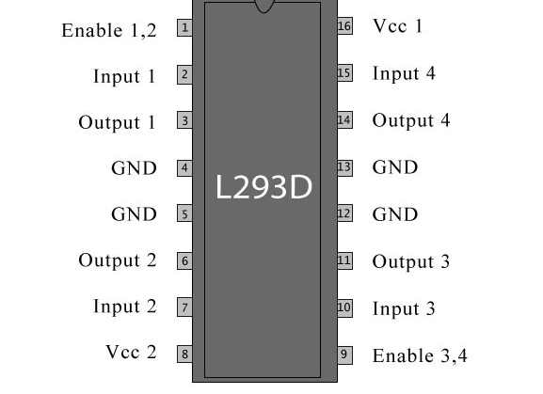
MOTOR DRIVER(L293D)
Supply voltage = 5-12v
Compatible = 2 DC motor
Supply voltage = 12v
Input voltage = 5v
Output voltage = 12v
Enable pins = 2
Input pins = 4
Output pins = 4

Slide 19
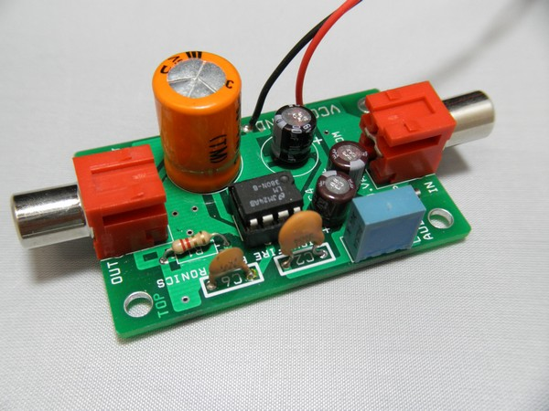
AUDIO AMPLIFIER(LM380)
Voltage range = 10v-22v
Power drain = 0.13W(Vs=18v)
Voltage gain fixed = 50
Peak current capability = 1.3A
Input referenced to Gnd
Standard dual-in-line package
High input impedance = 150kΩ

Slide 20
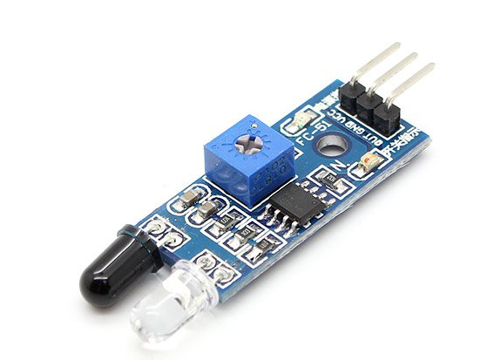
INFRA RED SENSOR
Sensitive area = 2 elements
Spectral response = 5-14µm
Supply voltage = 3-15v
Output voltage = 20mv peak-peak
Operating temperature = 30-70˚C
Viewing angle = 95˚
Detection angle = up to 30 feet
Noise = 20µV peak-peak

Slide 21
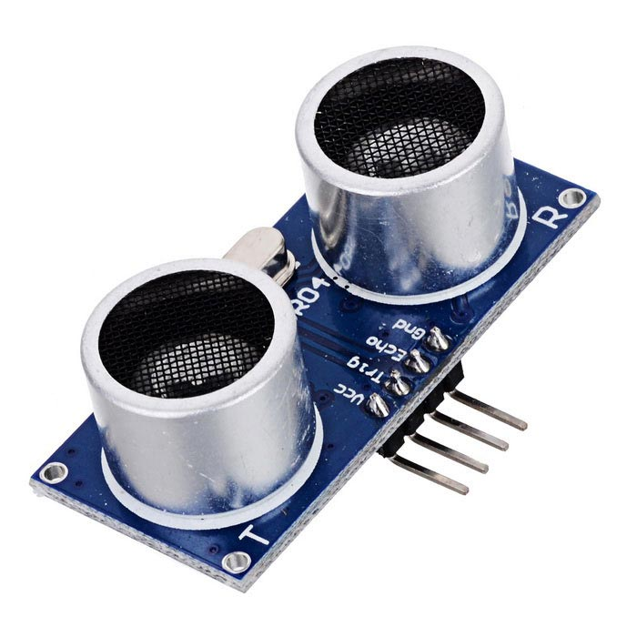
ULTRASONIC SENSOR
HC-SR04 Ultrasonic module
Operating voltage = DC-5v
Operating current = 15mA
Operating frequency = 40KHz
Farthest Range = 4m
Nearest Range = 2cm
Measuring angle = 15˚
Input trigger signal = 10us TTL pulse
Output echo signal = output TTL level signal,
proportional with range
Dimensions = 45*20*15mm

Slide 22
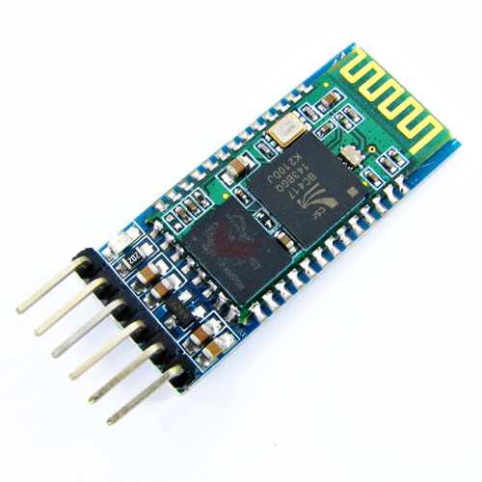
BLUETOOTH MODULE
Frequency = 2.4GHz
Modulation = GFSK(Gaussian Frequency Shift Keying)
Emission power = ≤ 4dBm, class 2
Sensitivity = ≤ -84dBm
Speed = asynchronous(2.1mbps/160kbps),
synchronous (1mbps/1mbps)
Power supply = 3.3v DC, 50A
Dimension = 26.9mmx13mmx2.2mm

Slide 23
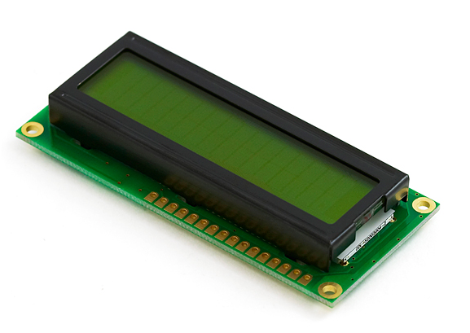
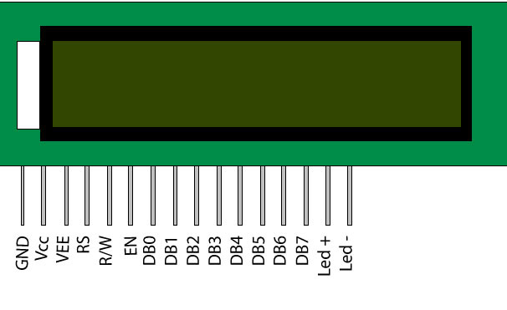
LIQUID CRYSTAL DISPLAY(LCD)
Supply voltage = 4.7-5.3v
Backlight Vcc = 5v
8bit data pins = DB0-DB7
Contrast adjustment through variable resistance
Command register selection = low
Data register selection = high
Low to write to the register
High to read from the register
Sends data to data pins when a high to low pulse
is given

Slide 24
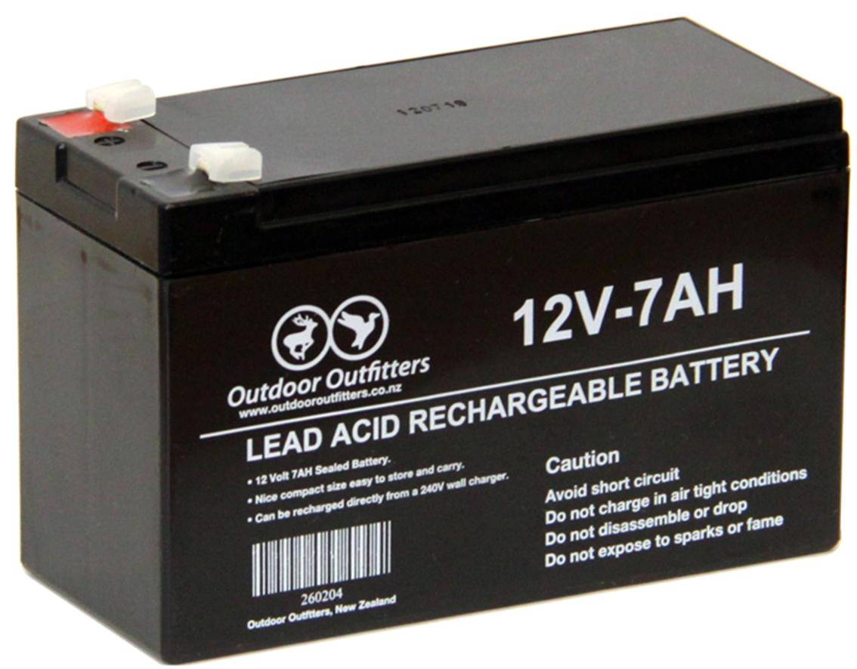
BATTERY
Weight = 1.96kg
Voltage = 12v DC
Capacity = 7AH
Technology = seal Lead Acid
Cycle use = 14.5 to 14.9v DC
Standby use = 13.6 to 13.8v DC
Initial current = <2.8A
Standby charge voltage = 13.8v
Estimated standby time = 7hrs

Slide 25
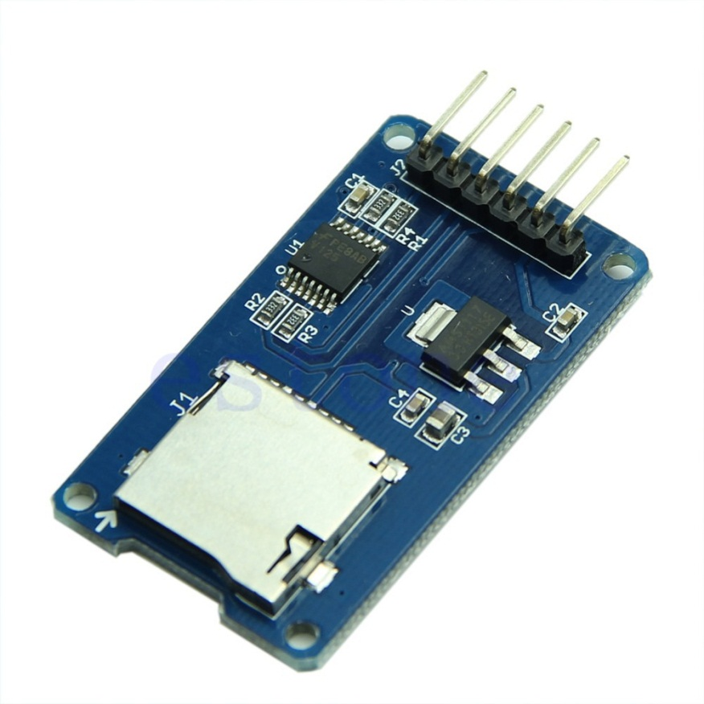
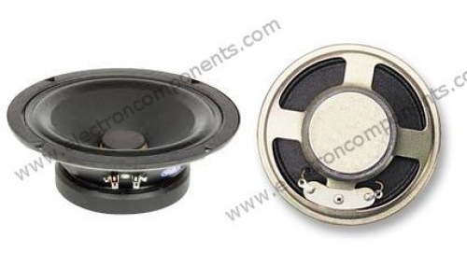
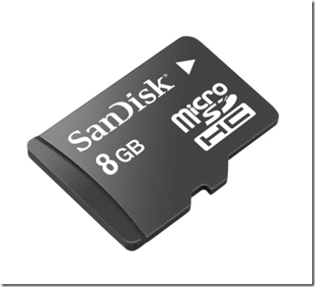
SD CARD MODULE+SD CARD
SPEAKER
8Ω, 0.5W

Slide 26
ADVANTAGES
It may control any crowds with priority constrains.
Low maintenance
It gives its entire dedication and maximum work capacity even 24*7.
Initial investment is enough.

Slide 27
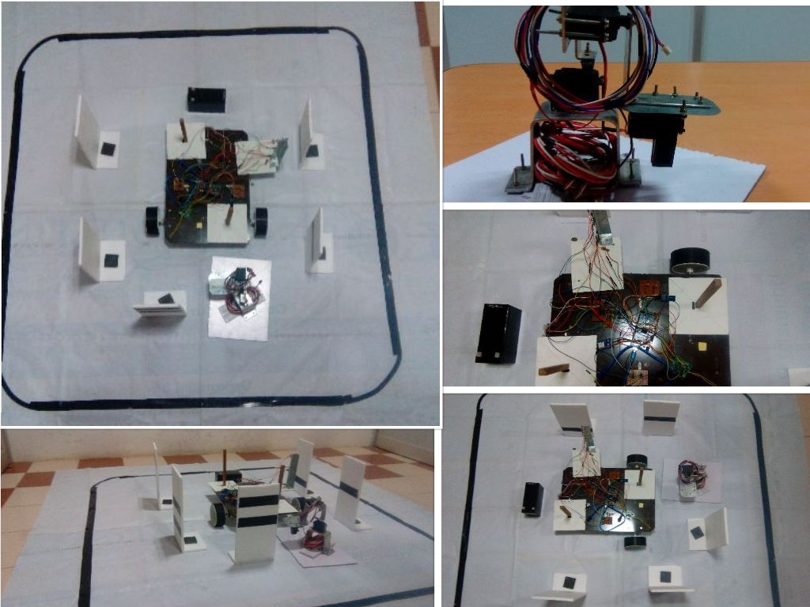
PROGRESS (WORKS COMPLETED)
Floor design
Robot moment towards each table
Robot Arm
Robot speech instructions
Outline of mobile application
Assembling the robot with arm

Slide 28
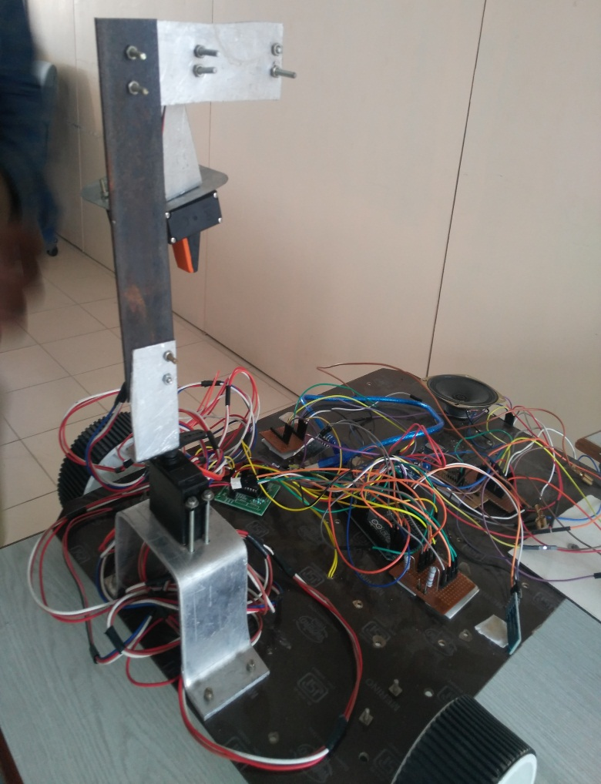
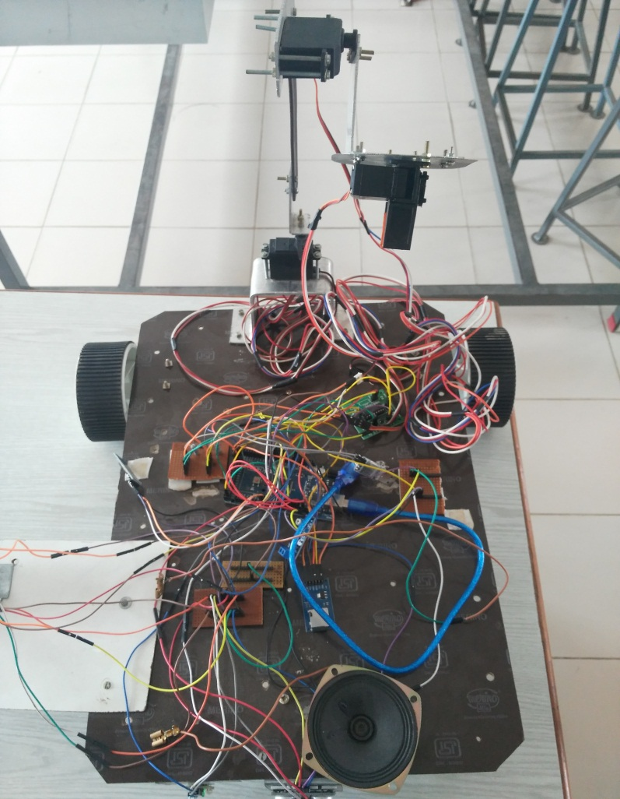
Assembling the robot with ARM

Slide 29
WORKS TO BE COMPLETED
Mobile application
LCD display
LED design
Robot triggering
Final outlook

Slide 30
Thank you
panel members

