Slide 1



KONGU ENGINEERING COLLEGE
PERUNDURAI ERODE-638060
MASTER OF COMPUTER APPLICATION
MINI PROJECT
PET CARE MANAGEMENT SYSTEM
Team Number : 36
Team Members : Rithanya R R (24MCR081)
Santhosh P (24MCR091)
Vaishnavi D (24MCR121
Team Guided by :
Dr. K. Chitra (MCA., M.Phil., PhD)
ASSISTANT PROFESSOR(Sr.G)

Slide 2


ABSTRACT
The project focuses on developing a Pet Adoption Web Application designed to streamline the process of adopting pets, benefiting both users and administrators.
The main objective is to create a secure, efficient, and user-friendly platform where users can browse and apply for pet adoptions, while providing administrators with tools to manage users, pet posts, and adoption requests effectively.
The system automates key processes such as pet posting, adoption applications, and approval workflows, reducing manual delays and improving overall efficiency. Users can filter pets by type and status, making it easier to find suitable pets for adoption.
For enhanced security, a One-Time Password (OTP) verification system ensures secure user registration and login, minimizing the risk of fraudulent accounts. Additionally, the platform tracks adoption history and provides detailed analytics to admin, ensuring transparency and better decision-making.
Overall, the proposed web application aims to improve the pet adoption experience, enhance administrative control, and build trust between users and the platform.

Slide 3
EXISTING SYSTEM
Existing pet adoption platforms rely on manual processes, limited browsing filters, and slow adoption workflows. Admin face inefficiencies in approvals, analytics, and data management, while user verification is often weak. Communication options are minimal, and adoption history tracking is usually absent, leading to poor efficiency and user experience.
Drawbacks of the Existing System
Manual Processes: Slow pet posting and adoption approval.
Limited User Features: Few filters for browsing pets.
Inefficient Admin Tools: Lack of centralized management and analytics.
Security Issues: Weak user verification and authentication.

Slide 4
PROPOSED SOLUTION
The proposed system streamlines pet posting, adoption applications, and approvals, reducing manual delays. Users can filter pets by type and status, improving the browsing experience. Admin have a centralized dashboard to manage users, pet posts, and analytics securely. Secure OTP-based registration enhances user verification, and adoption history is tracked for transparency.
Advantages of the Proposed System
Faster adoption process through automation.
Improved user experience with better filters and secure registration.
Centralized admin control for easy management.
Enhanced security with OTP verification.

Slide 5
Technologies used
HTML
CSS
JAVA SCRIPT
REACT JS
NODE JS
MONGO DB

Slide 6
MODULES DISCRIPTION
1. User Authentication Module:
Allows users to securely sign up and log in using OTP verification for account creation and authentication. This ensures that only verified users can access the platform and apply for pet adoption.
2. Pet Posting and Approval Module:
Enables users to post pets for adoption, with two categories: home pets and homeless pets. Admin can review and approve or reject these posts based on set criteria.
3. Pet Browsing and Filtering Module:
Provides users with advanced filters to browse available pets based on type (dog, cat, etc.) and status (home/homeless). This helps users quickly find pets that meet their preferences.

Slide 7
4. Adoption Application Module:
Detailed Application Form: Users can submit adoption applications that include personal details, previous pet experience, living situation, and contact information. This ensures that only qualified users apply for adoption.
Admin Review Process: Admin review adoption applications and make decisions based on the details provided, ensuring that pets are adopted by responsible owners.
5. Admin Dashboard Module:
Centralized Management: Admin have a single interface to manage users, track pet posts, and review adoption applications, improving workflow efficiency and control.
Analytics and Insights: Displays adoption statistics, pet type distribution, and trends, allowing admin to monitor platform performance and make data-driven decisions for future improvements.

Slide 8
6. Adoption History and Tracking Module:
Tracking Adopted Pets: The system keeps a record of all adopted pets, including pet names, previous owners, and adoption details, ensuring transparency in the adoption process.
History Access: Admin can access past adoption records to monitor progress, follow up with adopters, and track the success of each adoption.
7. Communication Module:
Contact Page: Provides users with an easy way to contact admin for support, inquiries, or assistance, enhancing customer service and user engagement.
Notifications System: Sends automatic notifications to users about their adoption application status, new pet listings, and updates, keeping them informed throughout the process.

Slide 9
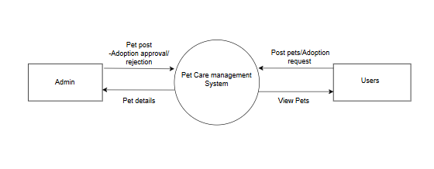
Data flow diagram
DFD Level 0 :

Slide 10
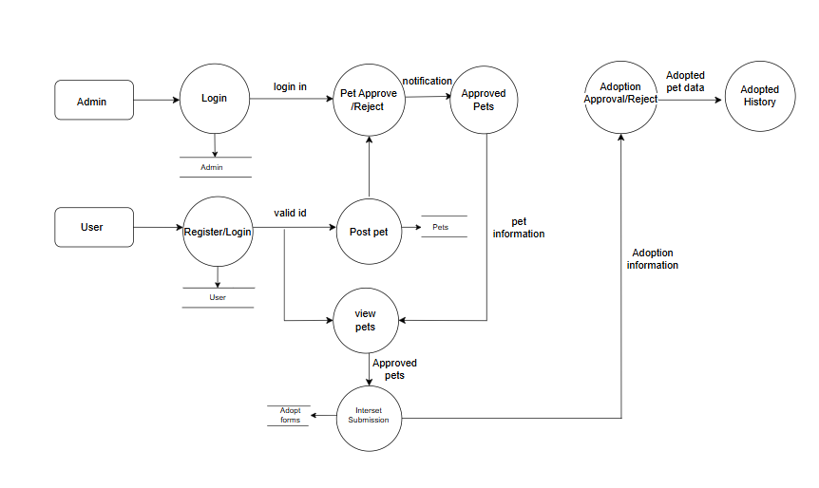
DFD Level 1:

Slide 11
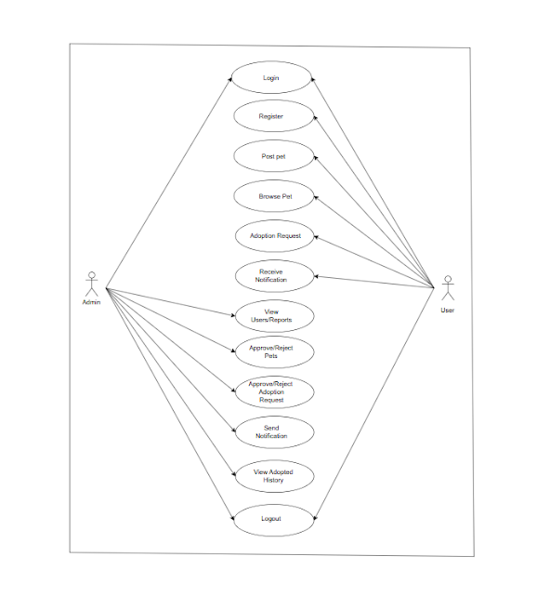
USE CASE DIAGRAM

Slide 12
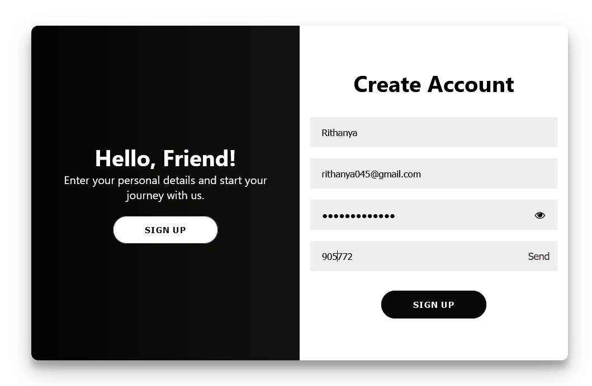
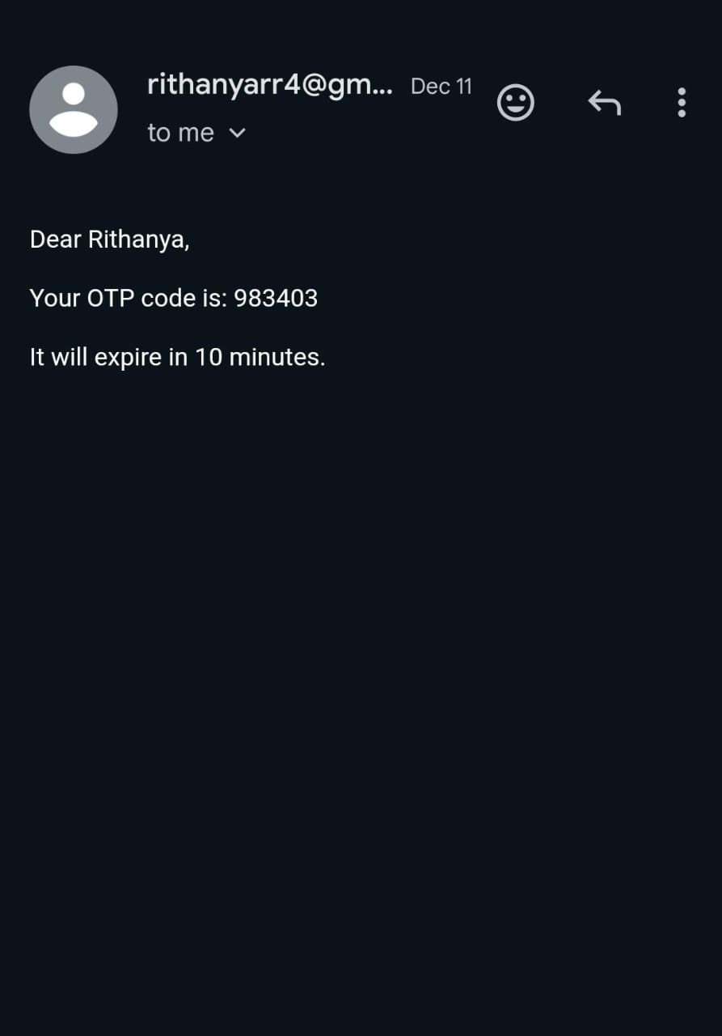
SCREEN SHORTS
Account Creation Module
OTP Verification

Slide 13
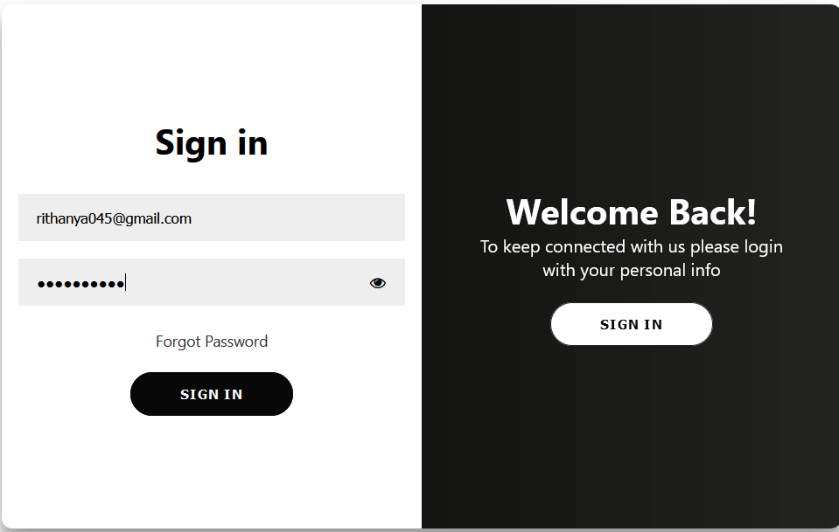
Sign In Module

Slide 14
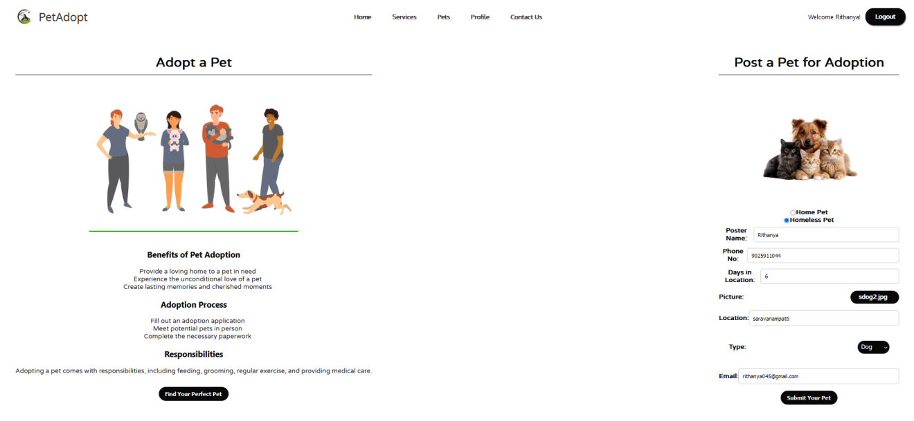
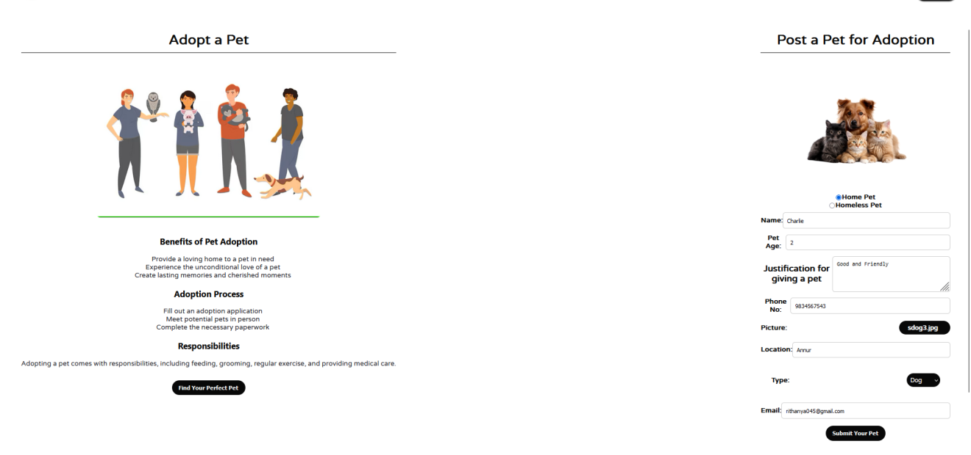
Homeless Pet Request
Submission form
Home Pet
Request
Submission form

Slide 15
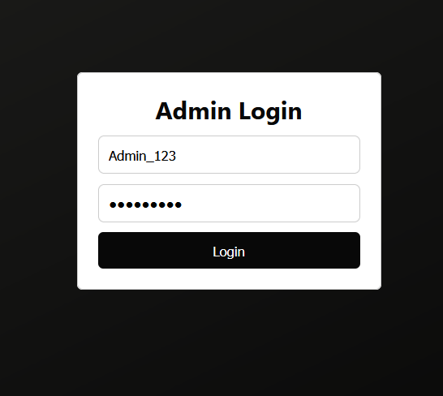
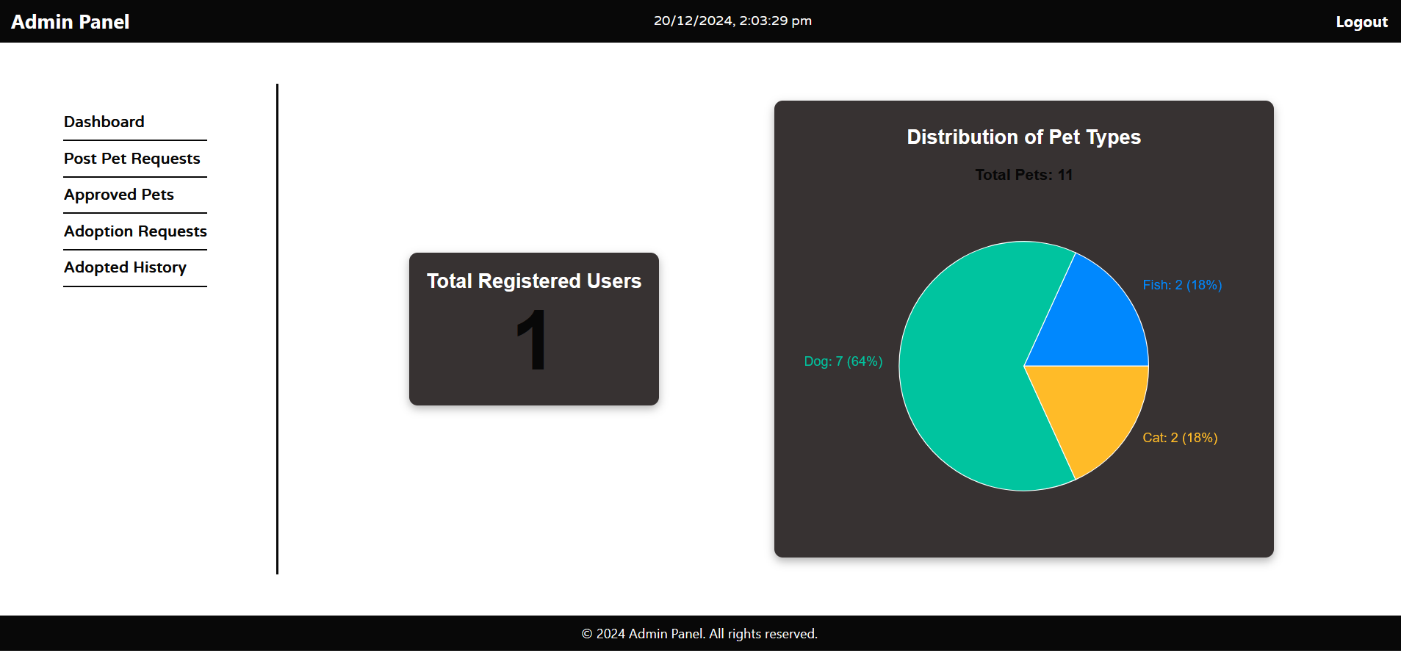
Admin Login
Admin dashboard

Slide 16
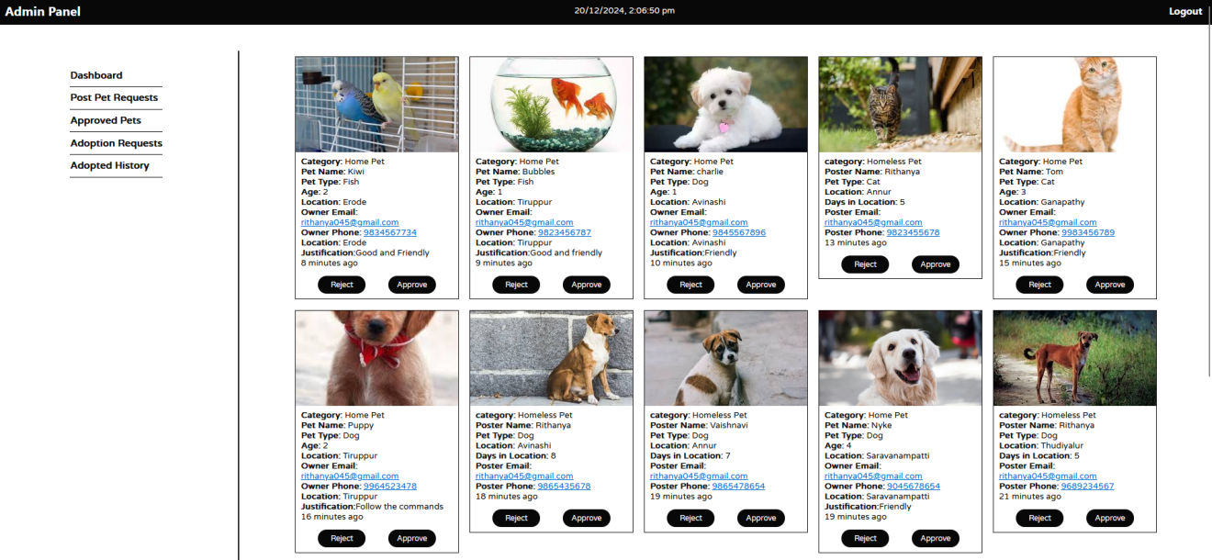
Admin panel : Request Approval Page

Slide 17
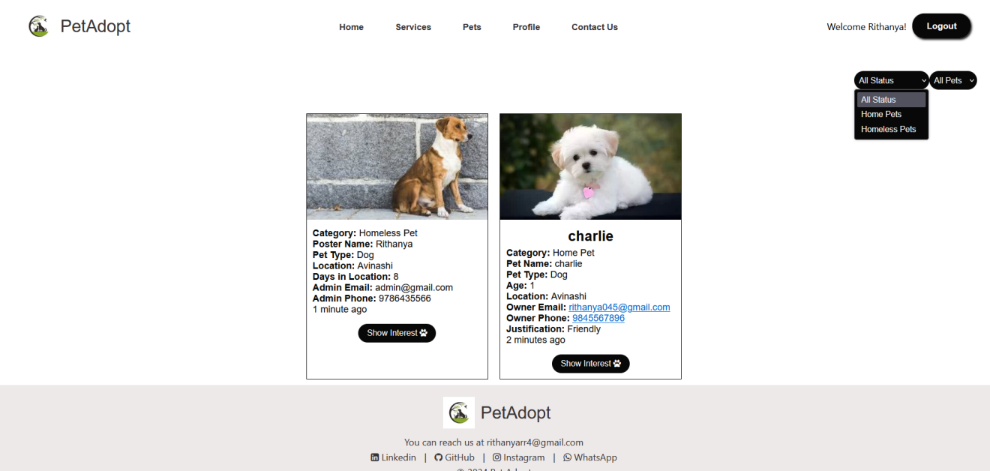
Show Interest Page

Slide 18
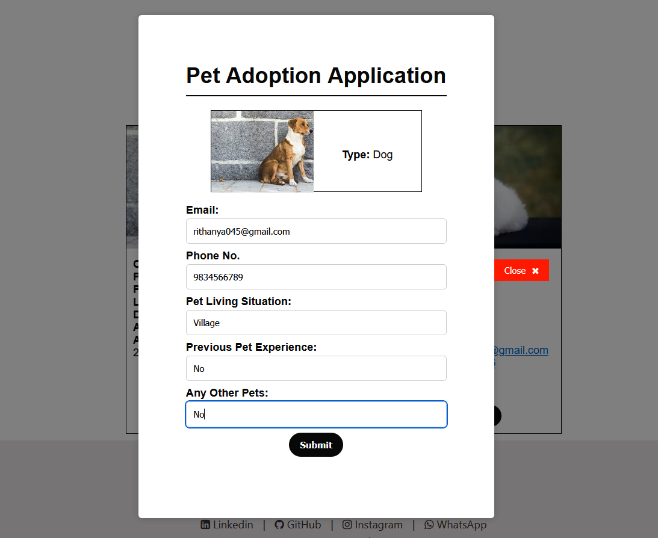
Pet Adoption application

Slide 19
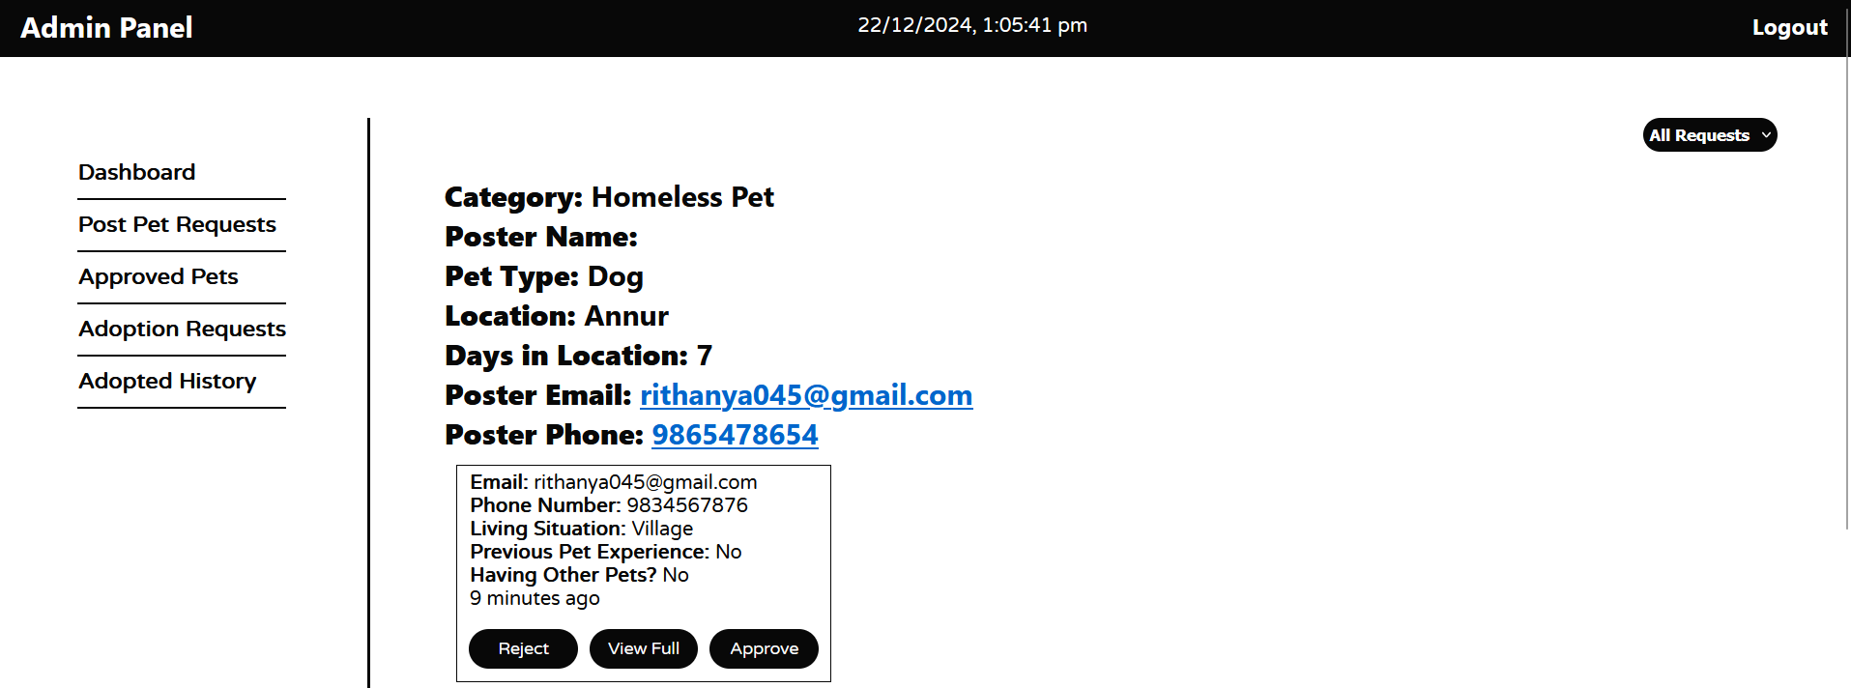
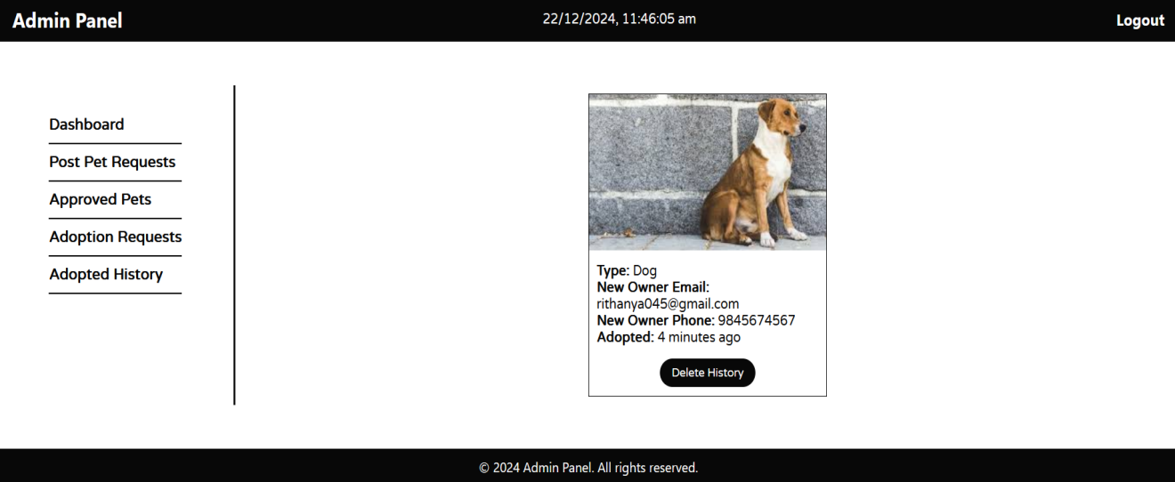
Admin panel :
Request Management
Adopt history

Slide 20
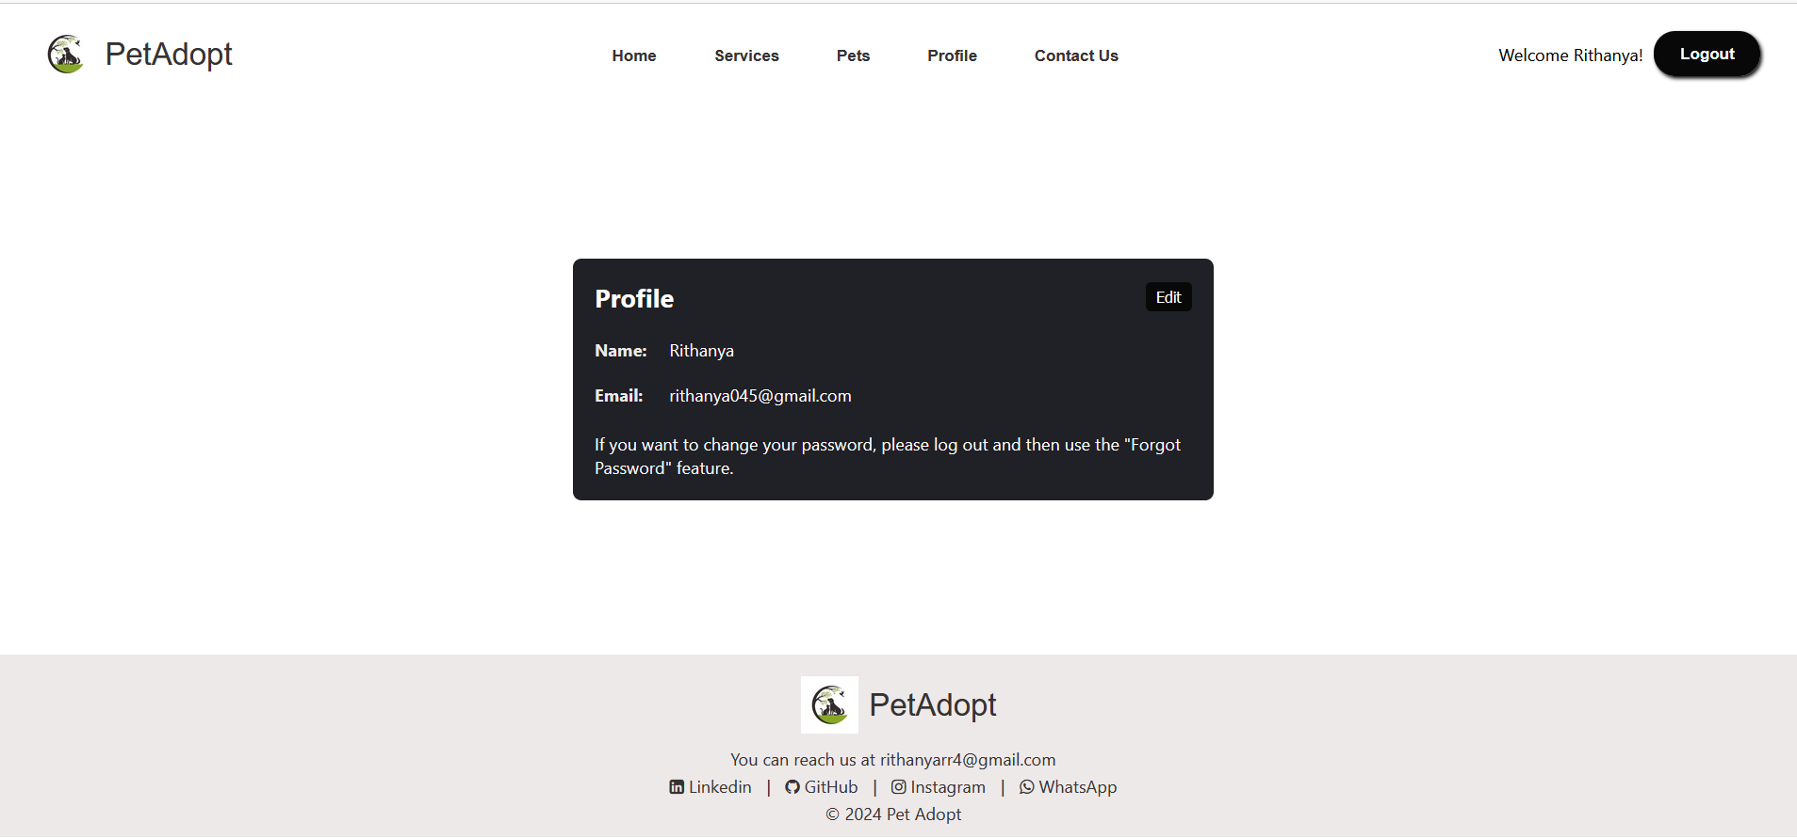
Profile Page

Slide 21
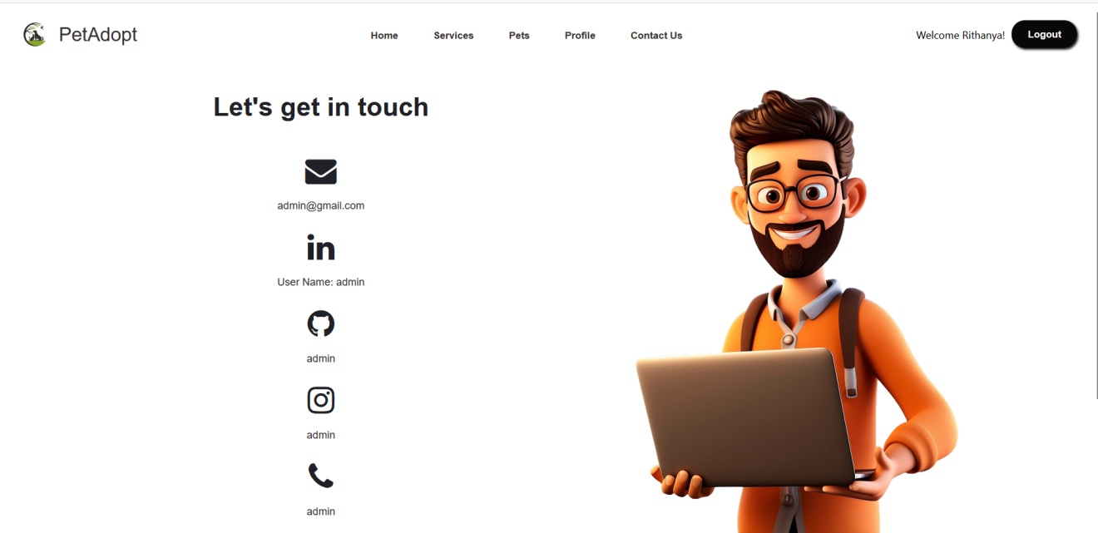
Contact Module

Slide 22
conclusion
The Pet Adoption Digital Platform revolutionizes pet adoption by offering a seamless, user-friendly experience. With secure authentication, real-time adoption requests, and transparent communication, it ensures efficiency and trust. Key features like profile management, post-submission approvals, educational resources, and personalized recommendations empower users to make informed decisions. As it evolves, the platform aims to become a leading solution in the digital pet adoption space.

Slide 23


