Slide 1



SOFTWARE ENGINEERING
FinEdge Case Study
Navigating Third-Party Dependency Challenges
SANTHOSH RAMESH(23ITR145)

Slide 2

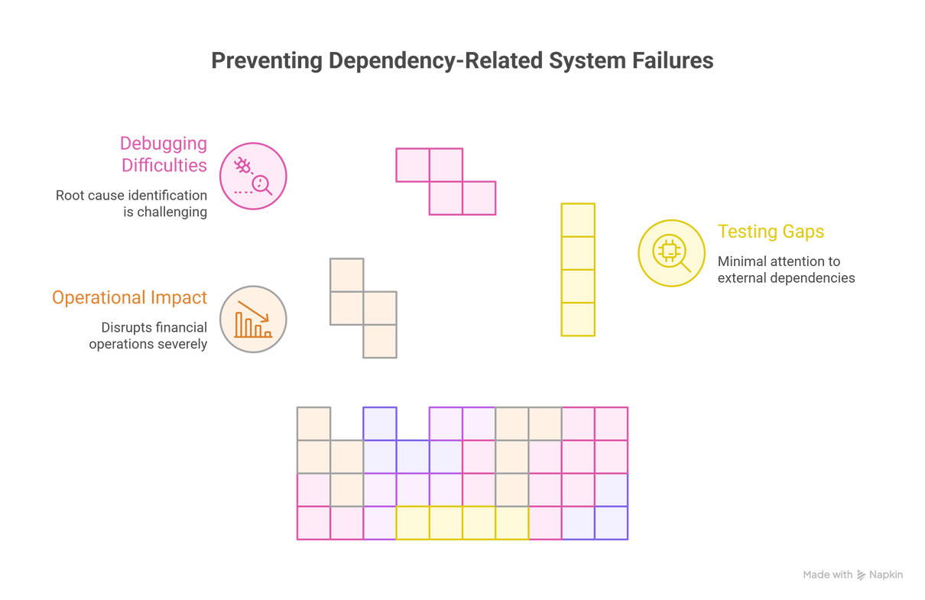
Scenario Overview - A Critical Dependency Failure
🔴 Dependency Crisis
FinEdge experienced critical failures when a new update caused system crashes in client environments due to an undocumented third-party library dependency.
⚠️ Operational Impact
System crashes severely disrupted financial operations for multiple clients, causing transaction failures and data processing delays.
🔍 Testing Gaps
Testing focused only on internal components with minimal attention to external dependencies and integration with diverse client environments.
🐛 Debugging Difficulties
Incomplete logs and absence of dependency version tracking made root cause identification extremely challenging.

Slide 3
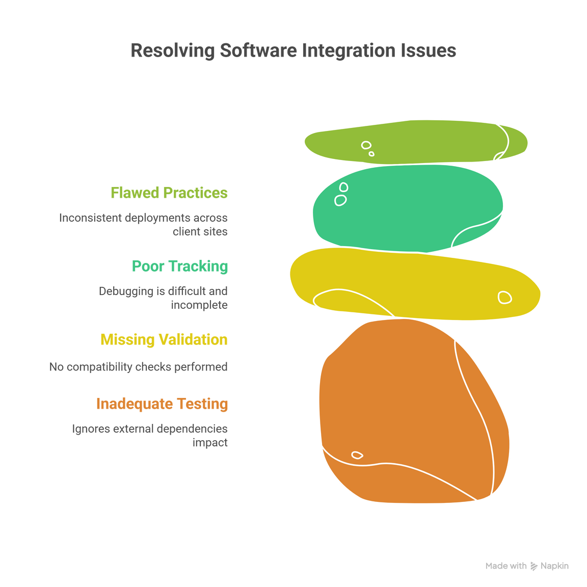
Unpacking the Core Problems
1️⃣ Inadequate Testing Strategy
Software testing focused on internal components only, completely ignoring external dependencies and their integration behavior in real-world client environments.
2️⃣ Missing Compatibility Validation
Validation and system testing lacked comprehensive compatibility checks with third-party libraries across diverse client environments and configurations.
3️⃣ Poor Dependency Tracking
Debugging was difficult due to incomplete logs and complete absence of dependency version tracking across different deployment scenarios.
4️⃣ Flawed SCM Practices
SCM process did not track third-party library versions or configurations, leading to inconsistent deployments across client sites.

Slide 4
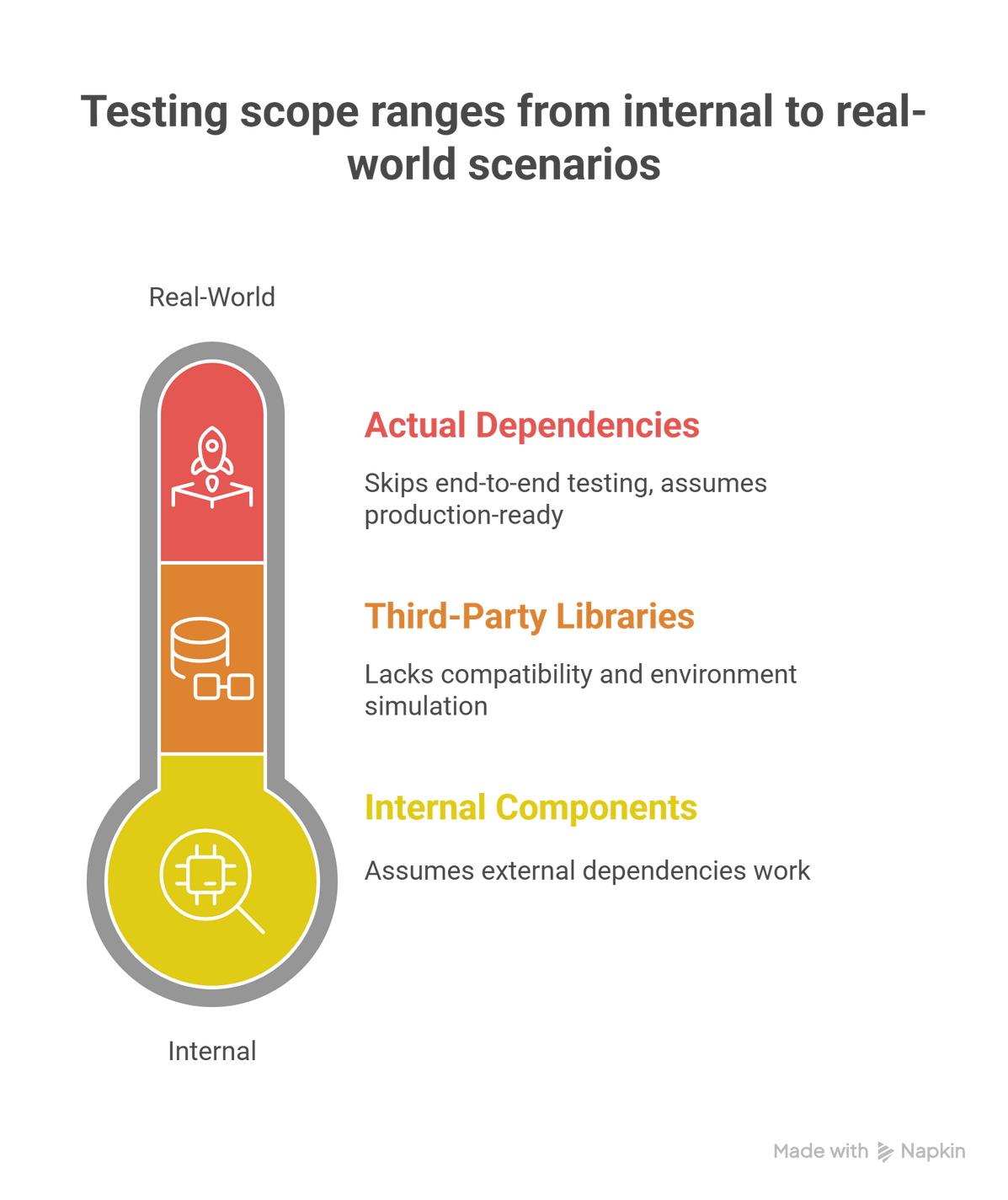
Root Cause Analysis - Testing & Validation Failures
Internal Focus Only
  Testing strategy concentrated solely on internal components
  External dependencies were assumed to work without validation
  No consideration for diverse client environment configurations
Missing Integration Tests
  No compatibility testing with third-party libraries
  Client environment variations were not simulated
  Real-world deployment scenarios were never tested
Rushed Deployment
  Pressure to deliver quickly bypassed thorough validation
  End-to-end testing with actual dependencies was skipped
  Assumption that "it works in dev" meant production-ready

Slide 5
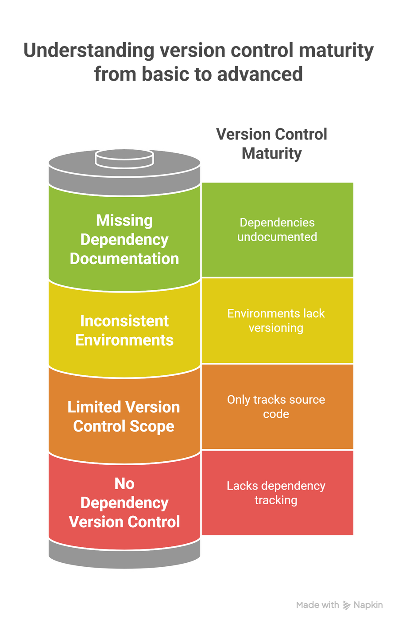
The SCM Crisis - Configuration Management Breakdown
No Dependency Version Control
  Third-party library versions were not tracked in SCM
  Different clients ended up with different library versions
  No standardized dependency management across deployments
Inconsistent Environments
  Development, testing, and production had different library versions
  No environment configuration versioning or documentation
  Client-specific configurations were not properly managed
Missing Dependency Documentation
  External dependencies were not documented adequately
  Version compatibility matrices were never created
  No clear tracking of which library versions worked together
Limited Version Control Scope
  Version control was limited to source code only
  Environment variables and configurations were ignored
  Deployment scripts and dependency manifests were not versioned

Slide 6
Strategic Solutions Implemented
🧪 Enhanced Testing Strategy
Expanded Dependency Validation
  Implemented comprehensive testing strategies to include dependency validation and compatibility testing
  Created test suites covering various third-party library versions and configurations
Environment-Specific Testing
  Strengthened validation and system testing with environment-specific tests covering third-party components
  Simulated diverse client environments in staging area
Integration Test Suites
  Developed automated integration tests for all external dependencies
  Regular compatibility checks with library updates
🔍 Improved Debugging Capabilities
Comprehensive Logging
  Implemented comprehensive logging system including dependency version tracking
  Added detailed logs for all third-party library interactions
  Created centralized log aggregation for easier debugging
Dependency Traceability
  Built dependency version tracking into all deployments
  Automated version compatibility reports
  Real-time monitoring of library behavior
⚙️ Overhauled SCM Practices
Dependency Management Tools
  Integrated dependency management tools and environment configuration versioning
  Implemented strict version tagging for all third-party components
CI/CD Enhancement
  Adopted continuous integration pipelines with automated dependency checks and compatibility tests
  Automated validation of library versions before deployment
Configuration as Code
  All environment configurations now version-controlled
  Infrastructure and dependency configurations stored in repositories
  Reproducible deployment processes across all environments

Slide 7
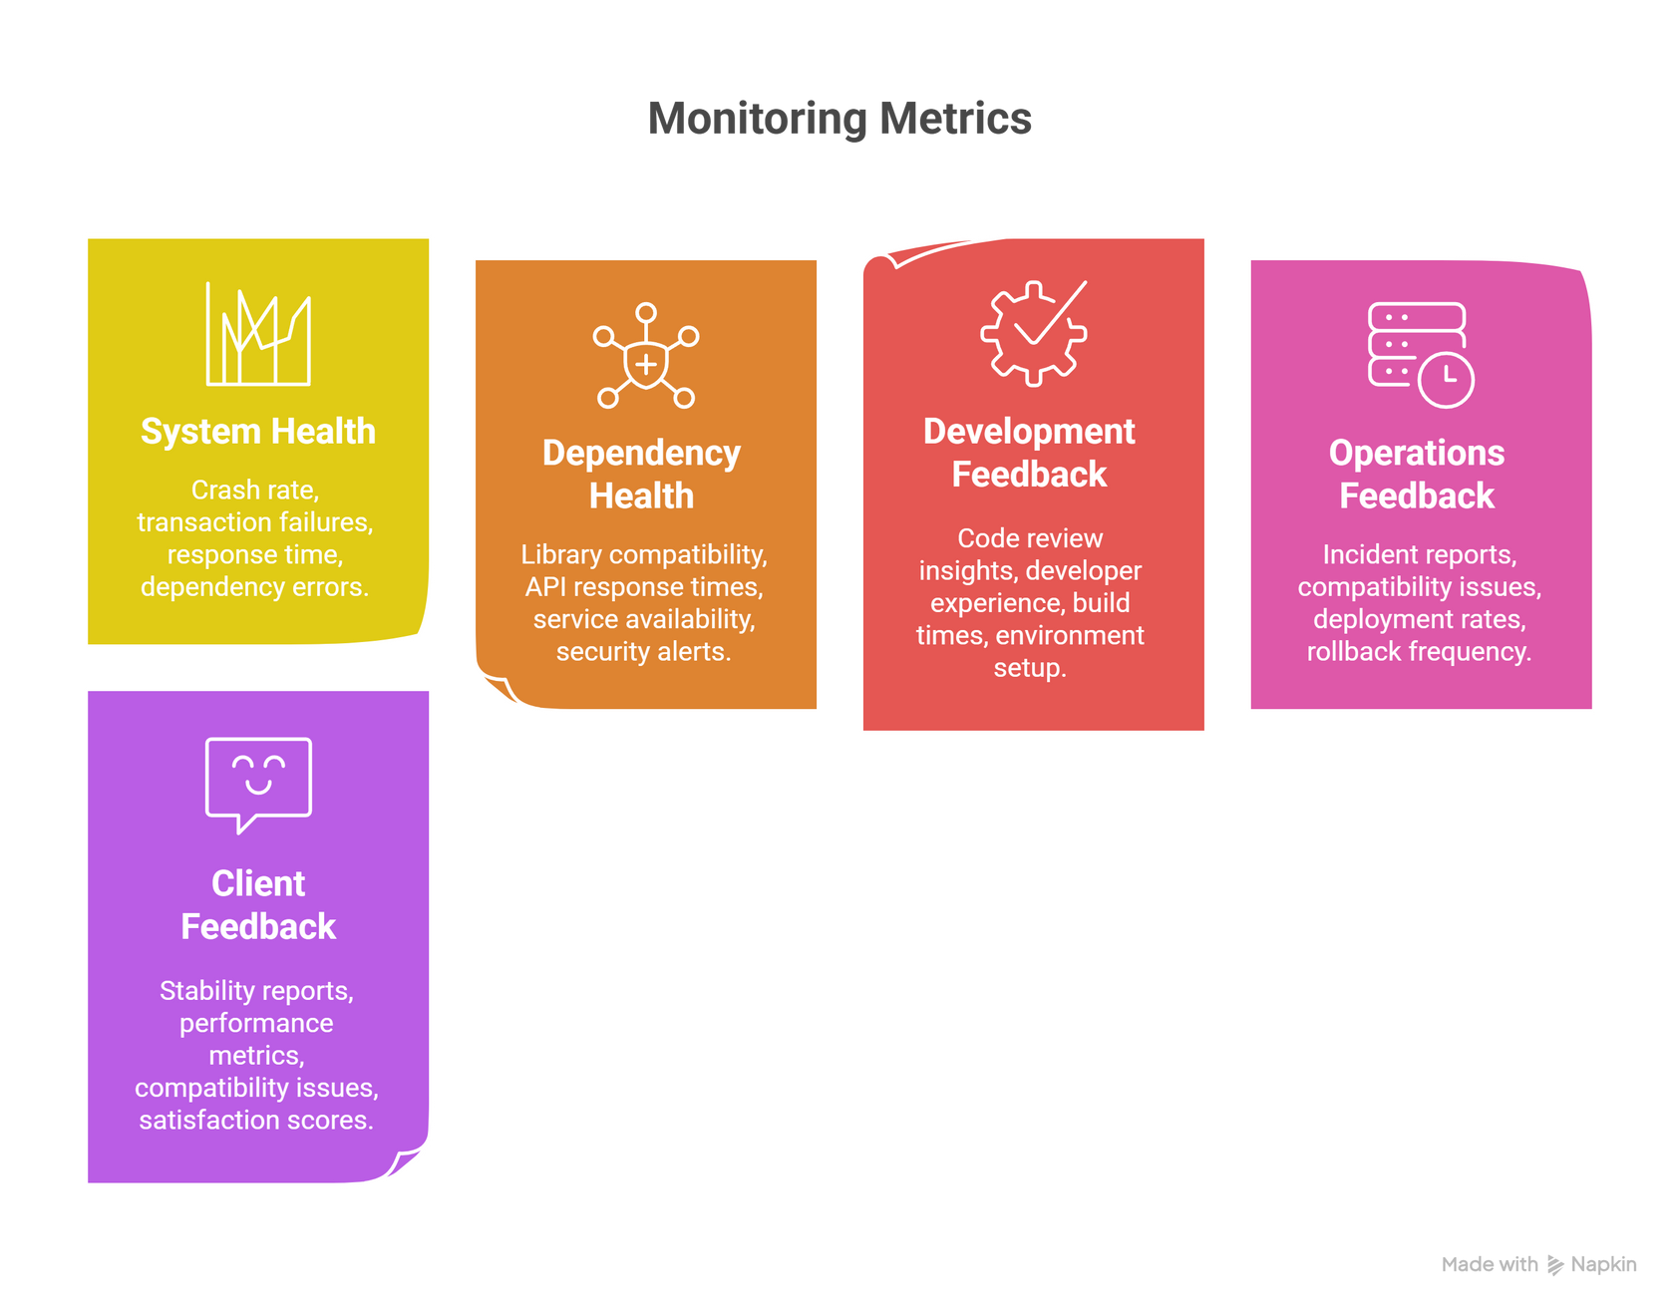
Metrics & Feedback Loops for Continuous Improvement
Real-Time Monitoring Metrics
System Health Indicators
  Crash rate per deployment
  Transaction failure rates
  System response time degradation
  Dependency-related error frequency
Dependency Health Tracking
  Library version compatibility scores
  Third-party API response times
  External service availability metrics
  Security vulnerability alerts
Staff Feedback Integration
Development Team Feedback
  Code review insights on dependency usage
  Developer experience with library integrations
  Build and deployment time metrics
  Local environment setup success rates
Operations Team Feedback
  Production incident reports
  Client environment compatibility issues
  Deployment success/failure rates
  Rollback frequency and reasons
Client Feedback Loops
  System stability reports from clients
  Performance metrics from production
  Client-reported compatibility issues
  User satisfaction scores

Slide 8
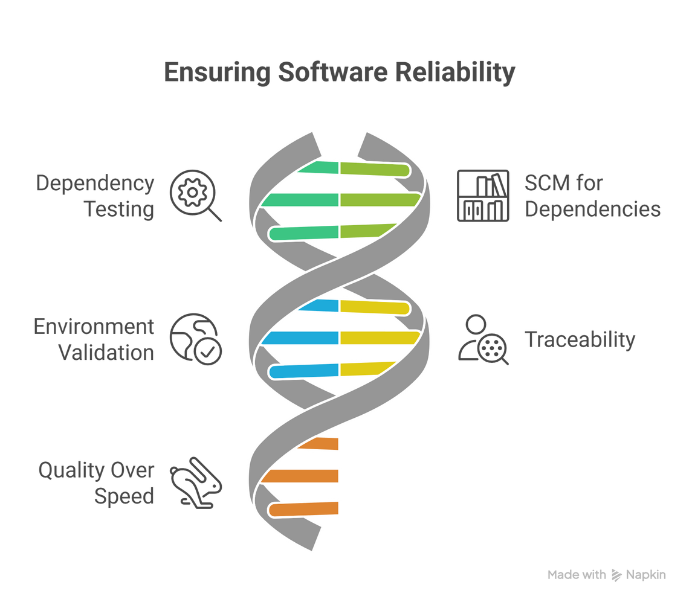
Key Takeaways - Preventing Future Failures
1️⃣ Comprehensive Dependency Testing
Thorough testing of third-party dependencies is crucial to prevent system crashes and ensure compatibility across diverse client environments.
2️⃣ Robust SCM for Dependencies
Proper version control must extend beyond source code to include all dependencies, configurations, and environment specifications.
3️⃣ Environment-Aware Validation
End-to-end testing must simulate real client environments with actual third-party libraries and various configuration scenarios.
4️⃣ Traceability is Essential
Comprehensive logging and dependency version tracking are vital for rapid debugging and root cause analysis.
5️⃣ Quality Over Speed
Rushed validation and deployment shortcuts lead to exponentially higher remediation costs and client dissatisfaction.

Slide 9
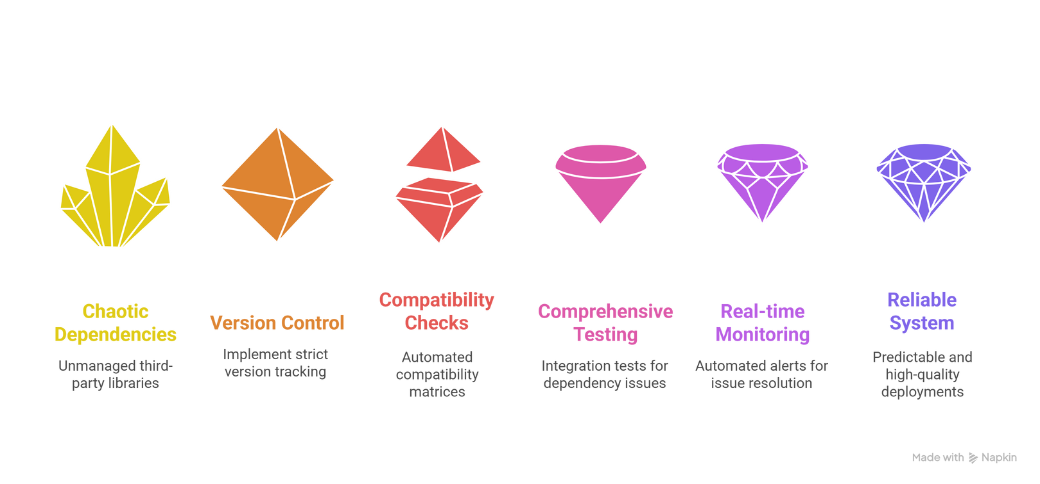
Operational Excellence Through Best Practices
🎯 Clear Dependency Management
Before: Third-party libraries were treated as black boxes with no version tracking
After: Complete dependency visibility with automated version management and compatibility matrices
🔒 Controlled Library Versions
Before: Poor SCM practices led to version confusion and inconsistent deployments
After: Strict version control ensures predictable and reliable deployments across all client sites
✅ Improved System Quality
Before: Missing integration tests allowed dependency issues to reach production
After: Comprehensive testing and mandatory compatibility checks maintain high system quality
📊 Reliable Feedback Systems
Before: No systematic way to identify or prevent dependency-related failures
After: Real-time monitoring and automated alerts enable proactive issue resolution

Slide 10
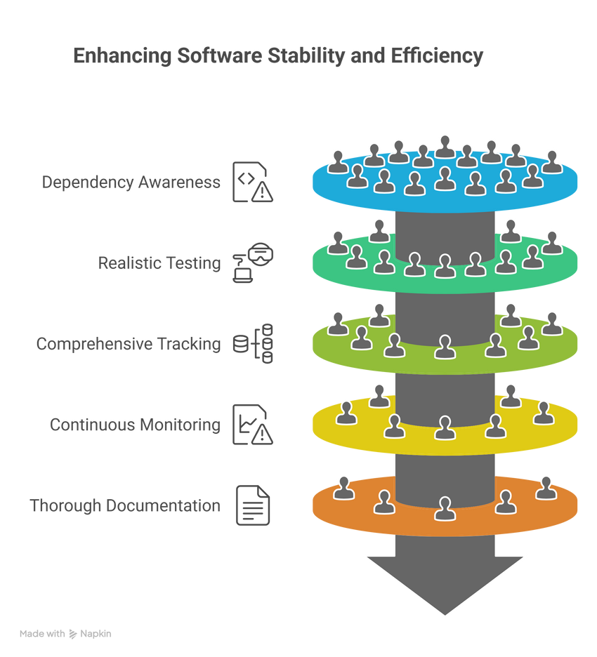
Lessons Learned & Future Roadmap
Critical Success Factors
✅ Dependency Awareness: Never treat external libraries as guaranteed stable components
✅ Test Realistically: Testing must include actual client environment configurations
✅ Track Everything: Version control extends to all dependencies and configurations
✅ Monitor Continuously: Real-time feedback prevents issues from escalating
✅ Document Thoroughly: Comprehensive documentation saves hours of debugging time
Ongoing Improvements
  Implementing AI-driven dependency conflict prediction
  Building automated client environment replication systems
  Creating self-healing deployment mechanisms
  Developing predictive analytics for library compatibility
  Establishing industry partnerships for early vulnerability alerts
Key Metrics Achieved Post-Implementation
  95% reduction in dependency-related crashes
  80% faster debugging and issue resolution
  100% tracking of all third-party library versions
  60% improvement in client satisfaction scores
  Zero critical failures in the last 6 months

Slide 11
.
THANK YOU

