Slide 1


GKM College of Engineering and Technology
Blind Spot Monitoring Using YOLOv8 and IoT
Santhosh. S – 410821104024
Surender Raj. R - 410821104029

Slide 2
Index
Abstract
Introduction
Literature Review
Problem Statement
Objectives
Block Diagram / Flow Chart
Hardware & Software Requirements
Methodology (Flow & Logic)
Implementation – Hardware Integration
Circuit diagram
Implementation – Software Integration
Results & Discussion
Advantages
Future Enhancements
Conclusion
References

Slide 3
Abstract
Blind spot accidents pose a serious risk in traffic. Our project proposes a Smart Blind Spot Monitoring System that combines YOLOv8 computer vision with IoT components for real-time alerts.
YOLOv8 Computer Vision for Object Detection: Utilizes YOLOv8 to analyze camera feeds and detect high-risk objects (people, vehicles) in the blind spot (ROI).
Real-time Multi-modal Alerts: Triggers immediate visual (LEDs) and audible (buzzer) alerts when a high-risk object is detected in the danger zone.
Ultrasonic Sensor for Distance & TTC: Incorporates an ultrasonic sensor for continuous, precise distance measurement and calculates Time-To-Collision (TTC) using relative speed.
Python GUI for Driver Monitoring: Provides a user-friendly GUI displaying real-time risk status and dynamic plots of distance data.
Low-Cost IoT Platform: Implemented on a cost-effective IoT platform, making the system practical and accessible.
Enhanced Road Safety & Accident Mitigation: Aims to significantly improve road safety by reducing blind spot accidents.

Slide 4
Introduction
Blind spot accidents are one of the major causes of road fatalities, especially in multi-lane traffic environments. Blind spots refer to the areas around a vehicle that are not visible to the driver through rear-view or side mirrors. Conventional methods like manually adjusting mirrors or using convex attachments provide only a partial solution. Drivers often fail to notice pedestrians, cyclists, or fast-approaching vehicles in these zones, leading to critical mishaps during lane changes or turns.
With the advancement of embedded systems, computer vision, and IoT, it's now possible to implement intelligent monitoring solutions that enhance driver awareness. This project aims to design and develop a Smart Blind Spot Monitoring System that combines YOLOv8 (You Only Look Once) object detection and IoT-based sensors like ultrasonic and vibration sensors to detect potential threats and alert the driver in real time. A dedicated GUI shows live risk, distance, system status, and plots, making it suitable for both educational and industrial applications.

Slide 5
Title | Authors | Year | Description/Notes
SOD-YOLOv8: Enhancing YOLOv8 for Small Object Detection in Traffic Scenes | B. Khalili and A. W. Smyth | 2024 | Focuses on improving YOLOv8's performance specifically for detecting small objects within complex traffic environments, which is crucial for applications like blind spot monitoring where distant or partially obscured objects might be small in the frame.
YOLOv8-Based Visual Detection of Road Hazards: Potholes, Sewer Covers, and Manholes | O. M. Khare, S. Gandhi, A. M. Rahalkar, and S. Mane | 2023 | Demonstrates the application of YOLOv8 for identifying various road hazards. While not directly about blind spots, it highlights YOLOv8's versatility and effectiveness in real-time object detection for safety-critical automotive applications, applicable to detecting other vehicles or objects.
Real-Time Flying Object Detection with YOLOv8 | D. Reis, J. Kupec, J. Hong, and A. Daoudi | 2023 | Explores the use of YOLOv8 for detecting flying objects in real-time. This paper reinforces YOLOv8's capability for high-speed detection, which is essential for a real-time blind spot monitoring system requiring rapid response to moving targets.
Perception Reinforcement Using Auxiliary Learning Feature Fusion: A Modified YOLOv8 for Head Detection | J. Chen, G. Wang, W. Liu, X. Zhong, Y. Tian, and Z. Wu | 2023 | Introduces modifications to YOLOv8 for enhanced head detection, This demonstrates how YOLOv8 can be adapted and optimized for specific object types, relevant to our project's need to detect "people" in the blind spot.
Literature Review

Slide 6
Problem Statement
Blind spots in vehicles pose a serious threat to road safety, especially during lane changes and overtaking. Traditional solutions like mirrors and basic proximity sensors fail to reliably detect fast-approaching or partially visible objects. These systems lack intelligence to classify the type of obstacle (human, car, bike) and predict collision risk. Drivers are often unaware of critical objects in blind zones until it’s too late, leading to accidents. There is no low-cost solution that integrates real-time vision and proximity data for blind spot detection. Existing systems do not calculate relative speed or Time-To-Collision (TTC) to assess danger accurately. Furthermore, most lack an intuitive interface to visualize risk levels and system status. This gap calls for a smart, real-time blind spot monitoring system using modern AI and IoT tools. The system must detect threats visually, measure distance, analyze risk, and alert the driver immediately. Our project addresses this by combining YOLOv8 object detection, ultrasonic sensing, and a live GUI to enhance driver awareness and safety.
Our project addresses this by dynamically detecting, classifying, and alerting on potential blind spot threats, enhancing driver safety.

Slide 7
Objectives
To detect objects in a blind spot using a real-time camera feed and YOLOv8 object detection.
To define a Region of Interest (ROI) where detection is considered critical for alerting.
To measure the distance of nearby objects using an ultrasonic sensor.
To calculate relative speed and Time-To-Collision (TTC) to predict the likelihood of a collision.
To categorize the threat level as HIGH, LOW, or NONE based on object type and position.
To alert the driver using a buzzer and LED when a high-risk condition is detected.
To display all real-time data (risk, distance, system status) through a GUI.
To log data for analysis and testing in CSV format.
To ensure system activation only when the vehicle is in motion (via vibration sensor).
To provide a low-cost, scalable solution for two-wheelers, cars, or autonomous platforms.

Slide 8
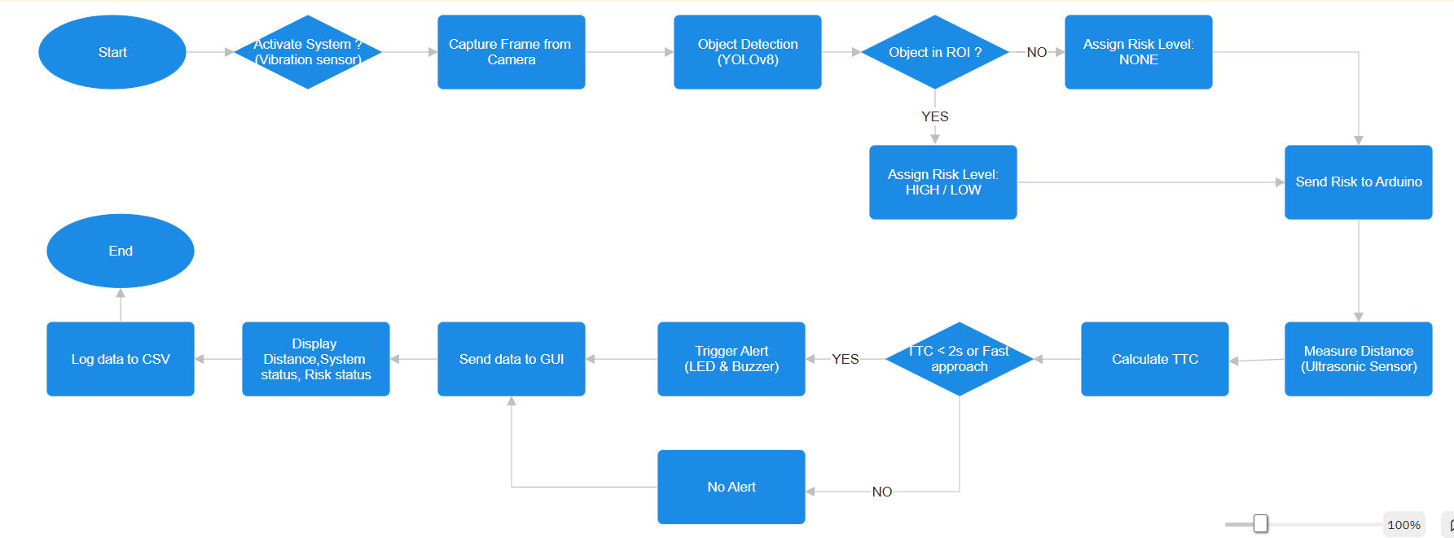
Block Diagram / Flow chart
YES
NO

Slide 9
Requirements
Hardware Requirements | Software Requirements
Arduino UNO | VS Code
HC-SR04 Ultrasonic Sensor | Python (3.8 or later)
SW-420 Vibration Sensor | Ultralytics YOLOv8 Environment
Buzzer | Arduino IDE
LED
Jumper Wires & Breadboard
Power Supply (5V)

Slide 10
Methodology (Flow & Logic)
Object Detection: YOLOv8 processes each camera frame. If a detected object's bounding box intersects the ROI, a risk level is set: HIGH (person), LOW (vehicle), or NONE (no object).
Ignition Check: Vibration sensor ensures the system activates only when the vehicle is on (ignition).
Distance & Speed Calculation: The ultrasonic sensor continuously measures distance. The Arduino logs consecutive distances over time to compute relative speed (Δdistance/Δtime) and estimates TTC.
Risk Assessment: If an object is in the ROI and TTC < 2 seconds (or distance is below a threshold with fast approach), the system flags a collision risk.
Alerts: On high risk, Arduino activates the buzzer and LED to warn the driver. For low risk (e.g., distant vehicles), it may signal with a different alert pattern.
Data Logging & Visualization: Distance and speed data are logged to a CSV. The Python GUI receives YOLO risk and sensor data, updating the on-screen feed, risk color indicator, and plotting live distance-time graphs.

Slide 11
Implementation – Hardware Integration
Connect HC-SR04 ultrasonic sensor: trig to Arduino pin 5, echo to pin 6.
Vibration sensor (ignition detector) to Arduino pin 4 (activates system when vehicle is on).
LED on pin 13, Buzzer on pin 10 (digital outputs).
Ensure reliable power supply to Arduino and sensors, stable to avoid noise.
Use jumper wires and breadboard for connections.
Integrate camera on a mount facing the blind spot (e.g., side of vehicle) via USB or direct capture to host processor.

Slide 12
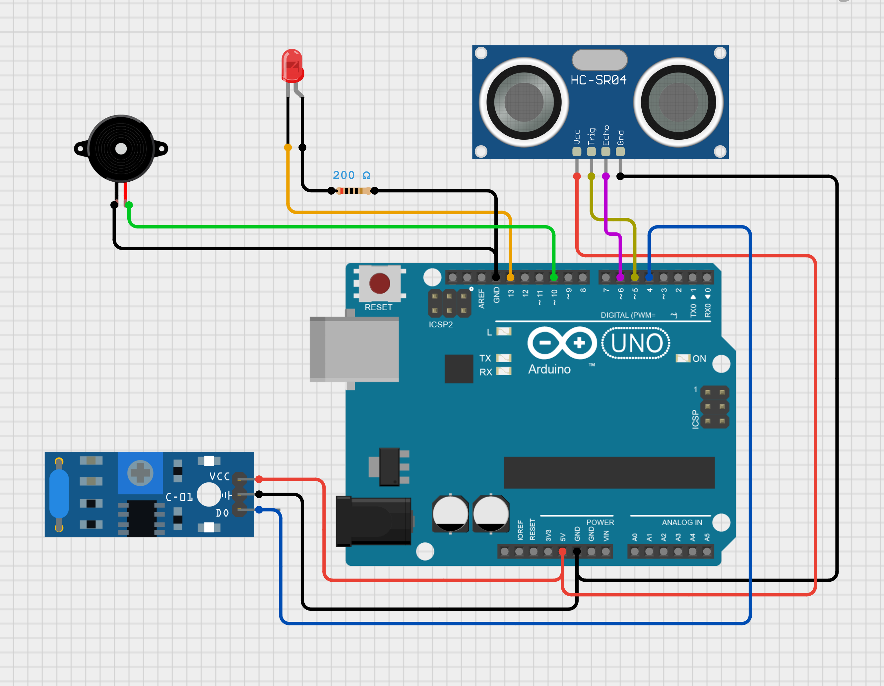
LED
Ultrasonic Sensor (HC-SR04)
Buzzer
Circuit
Diagram
Arduino UNO
Vibration Sensor (SW-420)

Slide 13
Implementation – Software Integration
Arduino :
Written in Embedded C using the Arduino IDE, developed entirely within VS Code using its Arduino extension.
Measures distance via ultrasonic pulses, calculates Time-To-Collision (TTC), and sends distance/system status to Python over serial.
Listens for risk-level commands (HIGH, LOW, NONE) from Python and activates LED or Buzzer accordingly.
Python (Developed using VS Code):
Captures live video using OpenCV, draws bounding boxes, and overlays a predefined Region of Interest (ROI).
Executes the YOLOv8 model (Ultralytics) for object detection in real time, classifying objects (e.g., person, car, bike).
Applies logic to categorize risk levels based on object type and position (inside ROI).Sends the corresponding risk level (HIGH, LOW, or NONE) to the Arduino via pySerial.

Slide 14
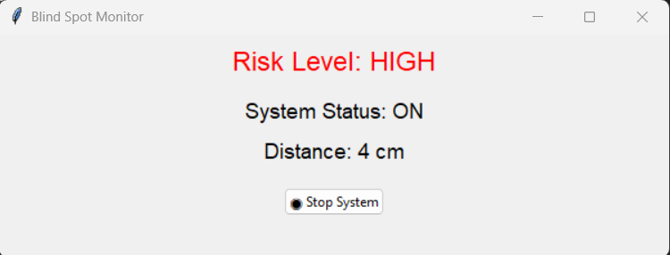
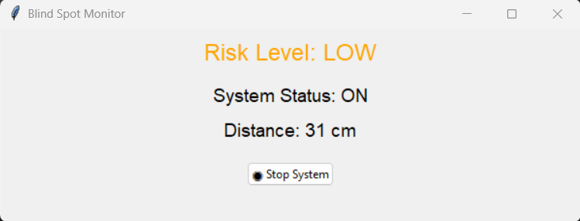
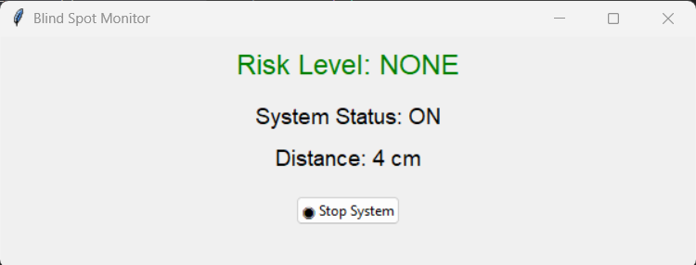
Results & Discussion
The system successfully detects objects in the blind spot ROI (people, cars) and differentiates risk levels. Alerts are generated dynamically when an object approaches rapidly (TTC < 2s) or enters the ROI.
Serial communication between Arduino and Python proved stable (consistent data exchange).
The GUI updates in real time: showing live camera with overlays.

Slide 15
Advantages
Real-Time Object Detection: Utilizes YOLOv8 for fast and accurate detection of humans, vehicles, and obstacles in blind spots.
Combined Vision + Sensor Fusion: Integrates computer vision and ultrasonic sensing to assess threats both visually and by distance, increasing reliability.
Intelligent Risk Classification: Differentiates between high-risk and low-risk objects based on object type, position (ROI), and approach speed.
Time-To-Collision (TTC) Logic: Calculates TTC based on relative speed, allowing predictive alerting instead of reactive alerts.
Low-Cost Hardware: Built using affordable components like Arduino UNO, HC-SR04, and basic sensors, making it suitable for budget deployments.
Data Logging for Analysis: Automatically logs distance, system status, and risk levels in CSV format for future analysis, testing, or training.
System Activation Logic: Uses a vibration sensor to ensure the system activates only when the vehicle is in motion — reducing false positives.

Slide 16
Future Enhancements
GPS & GSM Integration: Add a GPS module and GSM/GPRS unit to send real-time location and alert data to a remote device or cloud platform for fleet tracking or emergency response.
Cloud-Based Data Monitoring: Connect the system to an IoT platform (like Firebase or ThingSpeak) for real-time data visualization, alerts, and historical analytics via mobile or web dashboard.
Rear and Side Blind Spot Expansion: Extend the system to monitor rear and side blind spots by using additional cameras and sensors.
Smart Brake/Light Activation: Trigger automatic brake lights, hazard lights, or horn when a critical object is detected in the danger zone.
Object Distance Prediction with AI: Enhance the current system by adding AI models to predict object trajectory and collision probability more accurately.
Environmental Adaptability: Include weather-resistant housing and night-vision compatible cameras for all-weather operation.
Battery & Power Management: Design a standalone version with a rechargeable battery and solar power support for continuous operation on bikes or e-rickshaws.

Slide 17
Conclusion
The proposed Smart Blind Spot Monitoring System successfully combines the power of real-time computer vision (YOLOv8) with IoT-based sensing to enhance driver safety. By intelligently detecting and classifying objects in the vehicle's blind spot, the system provides timely alerts based on risk levels, object distance, and predicted collision probability.
The integration of a vibration sensor ensures that the system only activates when the vehicle is in motion, reducing false alerts. A user-friendly GUI further improves usability by displaying live video, risk indicators, and a real-time distance graph.
This project proves that with low-cost components and smart software integration, it is possible to build a scalable, efficient, and intelligent blind spot monitoring system — suitable for two-wheelers, cars, or even autonomous vehicles.
The system is modular, extensible, and lays a strong foundation for future enhancements like mobile alerts, cloud data sync, and edge AI deployment.

Slide 18
References
[1] J.Chen, G. Wang, W. Liu, X. Zhong, Y. Tian, and Z. Wu,“Perception Reinforcement Using Auxiliary Learning Feature Fusion: A Modified YOLOv8 for Head Detection,”Oct. 2023.
[2] Kumar, J. Jaiswal and N. Tiwari, "Blind Spot Monitoring System Using Ultrasonic Sensor," 2023 International Conference on Disruptive Technologies (ICDT), Greater Noida, India, 2023, pp.
[3] P. Pyykonen, A. Virtanen and A. Kyytinen, "Developing intelligent Blind Spot Detection system for Heavy Goods Vehicles," 2015 IEEE International Conference on Intelligent Computer Communication and Processing (ICCP), Cluj- Napoca, Romania, 2015, pp.
[4] Kundu, R. “YOLO (You Only Look Once): A Brief History,” V7 Labs Blog, Apr 2024.v7labs.com
[5] Bailley, D. “How IoT is Revolutionizing Vehicle Safety,” Clean Fleet Report, Apr 2025cleanfleetreport.com.
[6] Ultralytics, “YOLOv8 Documentation” (YOLO object detection overview)v7labs.com

