Slide 1
DAX

Slide 2
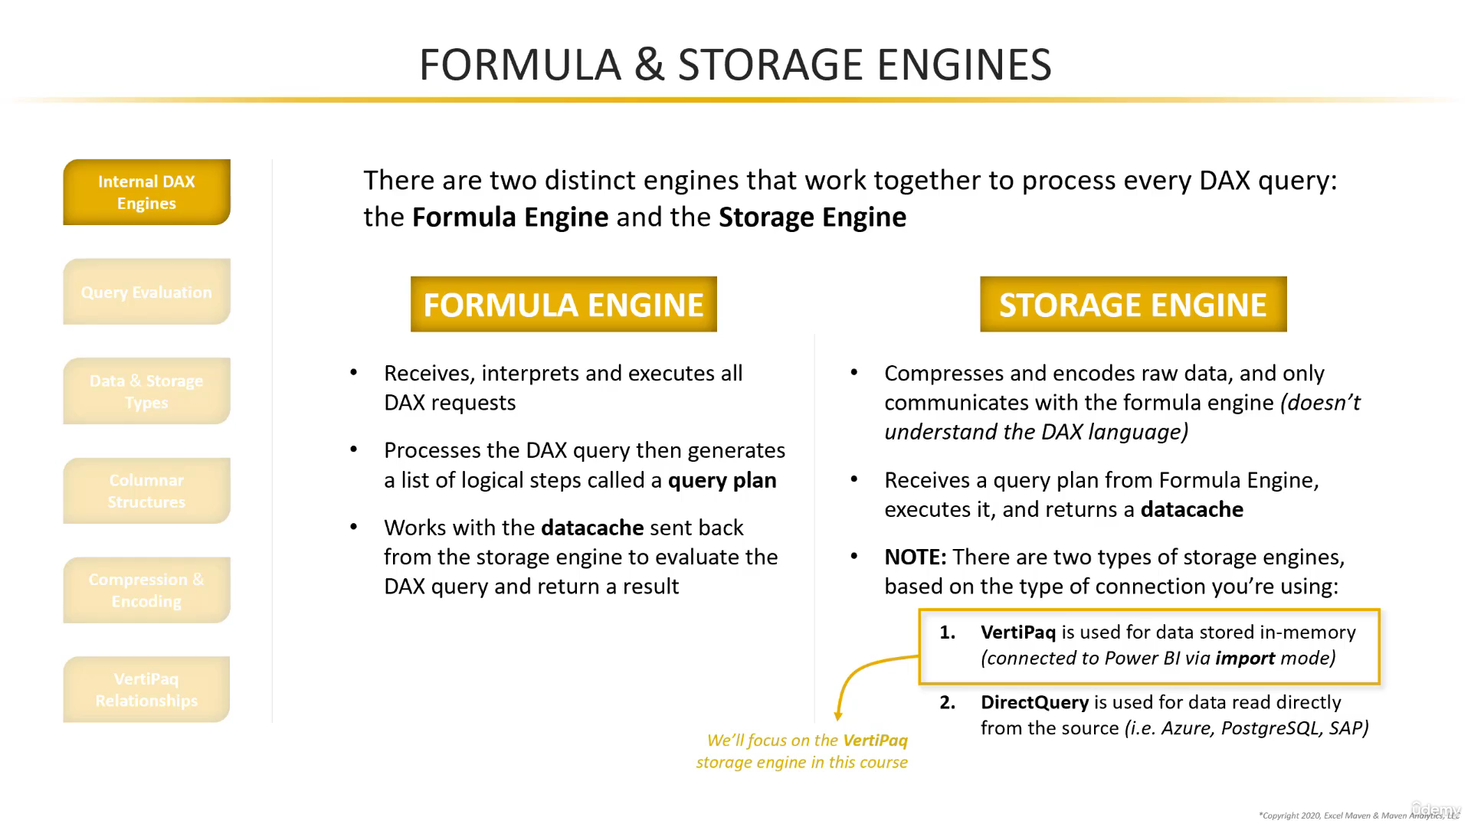

Slide 3
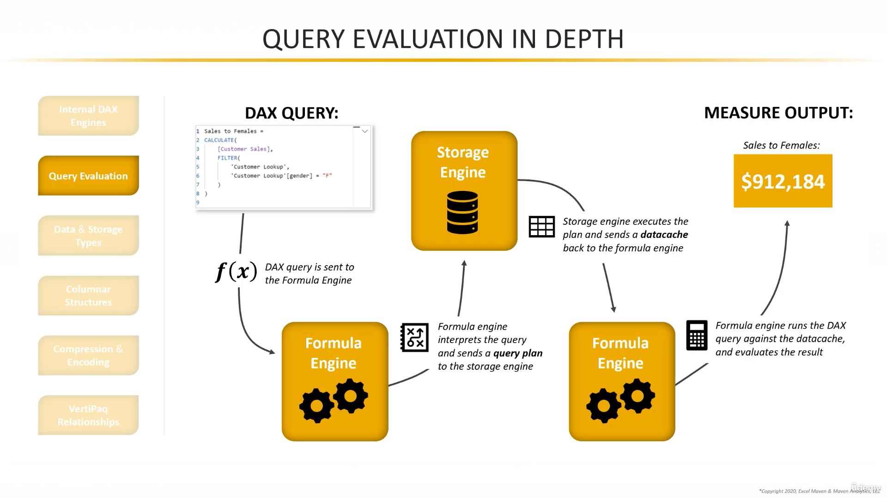

Slide 4
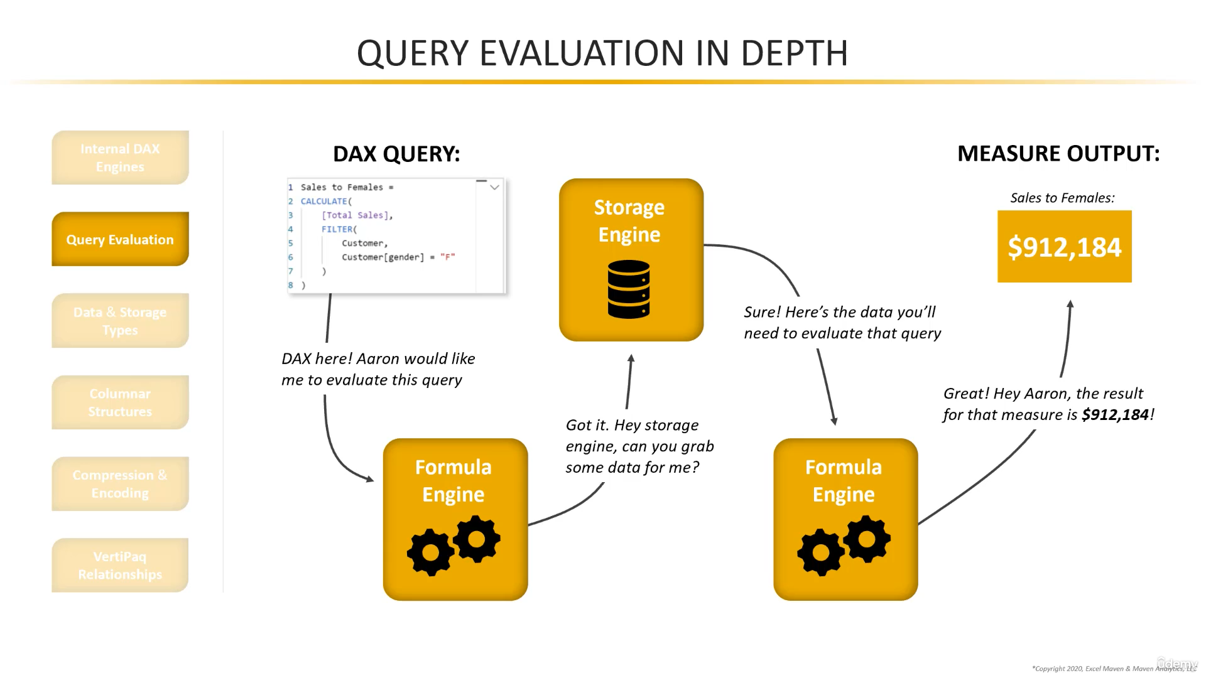

Slide 5
DAX Data Type | Power BI Data Type | Storage Type | Example
Integer | Whole Number | 64-bit value | Max: 9,223,372,036,854,775,807
Decimal | Decimal Number | Double-precision floating-point value | 64-bit precision
Currency | Fixed Decimal Number | Fixed Decimal Number (Stored as Integer) | 317.9988 (4 digits after period)
DateTime | DateTime, Date, Time | Floating-point number | 1/1/2020 12:00 pm = 43830.50
Boolean | True/False | True/False | True/False
String | Unicode String | 16-bit characters | “Maven Analytics” = “MAVEN ANALYTICS”
Data Types represent how values are stored in DAX storage engine
Formatting represents how values appear to end users (%, date, $, etc.)

Slide 6
Vertipaq Compression and encoding
Goal of compression and encoding is to reduce the amount of memory needed to evaluate a DAX query.
Columnar storage
Based on sample of data of a column, one or more of the following encoding methods will be used to compress the data
Value encoding
Uses different mathematical processes to reduce the number of bits needed to store integer values
Hash encoding (Dictionary encoding)
Identifies the distinct string values and creates a new table with indexes
Run length encoding (RLE)
Reduces the size of the dataset by identifying repeated values found in adjacent rows
Actual storage algorithms are proprietary, so not all details are available

Slide 7
Value encoding
Value encoding uses a mathematical process to determine relationships between the values in a column, and convert them into smaller values for storage
Value encoding only works for integer values (including currency), and cannot be applied to strings or floating-point values

Slide 8
Hash Encoding (Dictionary Encoding)
Hash encoding builds a “dictionary” of distinct items in a column, assigns a unique integer value (index) to each item, and stores the data using the index values rather than the full text strings.
With hash encoding, storage requirements are defined by the number of unique items in the column (cardinality), NOT by the length of the string values themselves
Could also be applied to 64-bit integers and floating-point numbers

Slide 9
Run Length Encoding RLE
Reduces the size of the column by replacing duplicate rows with a table containing each distinct value and the count of instances
Note: RLE only works when the same value is repeated in consecutive rows, but the Vertipaq engine automatically sorts data on import and refresh to find the optimal compression

Slide 10
RLE + Hash encoding
Columns can have Run Length and either Hash (dictionary) or Value encoding
Compression type is determined by cardinality, number of repeat values, row count, and data type

Slide 11
Vertipaq Relationships
Vertipaq has a special way of mapping relationships between columns in your data model, which allows it to evaluate complex, multi-column queries
NOTE: This is not the same as creating a table relationships in your data model; this is essentially a blueprint that Vertipaq uses to map pairs of primary and foreign keys across related tables.
E.g. => Find Quantity Sold of a specific product
Step 1 – Search in product dictionary to find number from product lookup
Step 2 – Use relationship to find all rows in sales where product line matches above number
Step 3 – Returns a datacache containing filtered sales table and sends to formula engine
Step 4 – Formula engine evaluates the [Quantity Sold] measure against datacache.

Slide 12
Summary
DAX uses 2 engines
Formula Engine
Formula engine interprets and evaluates DAX.
Storage Engine
Storage engine compresses and encodes
Storage Engines – both create data cache and send them to formula engine for DAX query evaluation
Vertipaq – used for in-memory storage
DirectQuery – used for direct connection to external sources
Vertipaq stores data using a columnar database setup
Data is stored in individual columns that can be accessed quickly, but queries that call multiple tables may require more complex logic to produce a datacache.
Raw data is compressed and encoded to optimize processing.
Data can be compressed using Value, Hash (Dictionary) or Run Length encoding (RLE) based on cardinality, repeat values, row count, and data type

Slide 13
Evaluation order
Individual functions typically evaluate from left to right starting with the first parameter (followed by the second, third, etc.)
Nested functions evaluate from the inside out, starting with the innermost function and working outward from there

Slide 14
DAX Variables
Variables (VAR) are DAX expressions which can be reused multiple times within a query, and are commonly used for 2 key purposes
Readability – makes complex code more human readable
Performance – Only evaluated once no matter how often they are used within a query.
Variables can
Simplify and streamline DAX code
Improve efficiency by eliminating redundant expressions
Evaluate in the order they’re written (variables can only reference previously declared variables within the query)
Store either table or scalar values
Variables cannot
Start with a number
Include spaces or special characters (except underscores)
Share the name of another table in the model
Be accessed outside of the query in which they are declared
Contain only certain keywords reserved for DAX (SUM, Date, CALCULATE , etc.)

Slide 15
Variable Evaluation Order
Variables are “locked in” as soon as the DAX engine reads them; this means you cannot modify how a variable is defined later in your query (i.e. through a CALCULATE function)

Slide 16
Common Scalar Function
Aggregation | Rounding | Information | Conversion | Logical
Dynamically aggregrate values within a column | Round values to different levels of precision | Used to analyze the data type or output of expression | Force a specific data type conversion | Returning information about values in a conditional expression
SUM | FLOOR | ISBLANK | CURRENCY | IF
AVERAGE | TRUNC | ISERROR | INT | AND
MAX | ROUNDDOWN | ISLOGICAL | FORMAT | OR
MIN | MROUND | ISNONTEXT | DATE | NOT
COUNT | ROUNDUP | ISNUMBER | TIME | TRUE/FALSE
COUNTA | CEILING | ISTEXT | DATEVALUE | SWITCH
DISTINCTCOUNT | ISO_CEILING |  | VALUE | COALESCE
PRODUCT | ROUNDUP
ITERATOR (“X”) FUNCTIONS | INT
 | FIXED

Slide 17
Coalesce function
Replaces “IF + ISBLANK()” pattern, making your code more readable, and can be optimized by the engine.
Returns the first argument or expression that does not evaluate to BLANK. If all arguments/expressions evaluate to BLANK, BLANK is returned.

Slide 18
Modifiers
Modify Filters | Use Relationships | Change Filter Propagation
ALL | USERELATIONSHIP | CROSSFILTER
ALLSELECTED
ALLNOBLANKROW
ALLEXCEPT
KEEPFILTERS
REMOVEFILTERS

Slide 19
CALCULATE – interprets its filter arguments as table irrespective of Boolean or a function
=CALCULATE(Expression,[Filter1],[Filter2],…)
CALCULATE filter expressions accept both Boolean and table functions (individually or at the same time!), but all filter arguments are automatically converted into a table
E.g. = CALCULATE ([Customer Sales],’Store Lookup’[store_id]=1)
E.g. = CALCULATE ([Customer Sales],ALL(‘Store Lookup’))
Filter portion is internally read as a table – DAX interprets this as a table.
Any time you write a function that contains a logical statement (IN, <, >, =, etc.) you’re creating a table (internally processed with FILTER & ALL

Slide 20
REMOVE FILTERS
Clears filters from specified tables or columns
Alias for ALL, but can only be used as a CALCULATE modifier (not as a table modifier)
=REMOVEFILTERS(TableNameorColumnName, [ColumnName],[…])
TableNameorColumnName
Table or column you want to clear filter from
E.g. = CALCULATE([Customer Sales],REMOVEFILTERS(‘Store Lookup’))
[ColumnName]
Repeatable column names that allow you to specifically remove filters from individual columns within the base table
E.g. = CALCULATE ([Customer Sales],REMOVEFILTERS(‘Store Lookup’[Store_id]))

Slide 21
KEEP FILTERS
Does not remove an existing column or table filter for an individual CALCULATE expression
Allows you to control which specific filters are applied to a calculation
KEEPFILTER does not actually modify existing filters, but adds new filter context (think inner join)
= KEEPFILTERS(Expression)

Slide 22
Cumulative Total
Cumulative Total =
CALCULATE(
SUM(
‘Sales by Store’[quantity_sold]
),
FILTER(
ALL(
‘Calendar’[Transaction Date]
),
‘Calendar’[Transaction Date] <= MAX(‘Calendar’[Transaction_Date]
)
)

Slide 23
Overall Total
Overall Total =
CALCULATE(
SUMX(
‘Sales by Store’,
‘Sales by Store’[unit_price] * ‘Sales by Store’[quantity_sold]
),
ALL(
‘Sales by Store’
)
)

Slide 24
Percent of Total
Percent of Total Sales =
VAR CurrentSales =
SUMX(
‘Sales by Store’,
‘Sales by Store’[unit_price] * ‘Sales by Store’[quantity_sold]
)
VAR AllStoreSales =
CALCULATE(
SUMX(
‘Sales by Store’,
‘Sales by Store’[unit_price] * ‘Sales by Store’[quantity_sold]
),
ALL(
‘Sales by Store’
)
VAR Ratio =
DIVIDE(
CurrentSales,
AllStoreSales
)
RETURN
Ratio

Slide 25
Common Table and Filter Functions
Filter Data
ALL
FILTER
DISTINCT
VALUES
ALLEXCEPT
ALLSELECTED
Add Data
SELECTCOLUMNS
ADDCOLUMNS
SUMMARIZE
Create Data
ROW
DATATABLE
GENERATESERIES
() Table Constructor

Slide 26
Calculated Tables
DAX functions with table arguments can typically accept either physical tables or calculated, virtual tables (with functions like FILTER, VALUES, etc.)
TOTAL SALES =
SUMX(
‘Sales by Store’,
‘Sales by Store’[quantity_sold]
)
TOTAL SALES =
SUMX(
FILTER(
‘Sales by Store’,
‘Sales by Store’[quantity_sold]>3
)
‘Sales by Store’[quantity_sold]
)
Physical Table
Generated by the DAX engine for the duration of the calculation

Slide 27
FILTER
FILTER(Expression, [Filter1],[Filter2]…)
Returns a filtered table based on one or more filters
Filter is both a table and an iterator function
When using as an iterator, keep in mind the # rows that you want when using filter
When calling very large number of rows in a table, it would impede measure performance
Used commonly to reduce the number of rows to scan

Slide 28
ALL
=ALL(Table or ColumnName, [ColumnName1]…)
Returns all of the rows in a table or all of the values in a column and it ignores or clears any initial filters
ALL is both a table filter and a CALCULATE modifier
Removes initial filter context
Does not accept table expressions (only physical table references)

Slide 29
Review FILTER (Example)
Step 1 – Measure is written
Sales where Order Qty more than 3 =
CALCULATE(
[Customer Sales],
FILTER(
‘Sales by Store’,
‘Sales by Store’[quantity_sold]>3
)
)
Step 2 – FILTER creates a virtual, calculated table
Step 3 – DAX evaluates [Customer Sales] against the filtered table (qty sold > 3)

Slide 30
DISTINCT
Returns a single column table of unique values when a column name is given.
If a table is supplied, DISTINCT returns all unique combinations of values
=DISTINCT(ColumnName or TableExpression)
Usually used in combination with another counting measure
ColumnName –Column you want to extract unique values from
Table – Table you want to extract combination of unique values from

Slide 31
