Slide 1
santhosh s
813821104087
COMPUTER SCIENCE AND ENGINEERING

Slide 2
SENTIMENT ANALYSIS
Sentiment analysis, a branch of natural language processing (NLP), involves computationally identifying and categorizing subjective information from text data. It plays a pivotal role in understanding public opinion, customer feedback, and market trends. One effective approach to sentiment analysis involves utilizing Convolutional Neural Networks (CNNs), originally designed for image recognition, to extract features from textual data and classify sentiments.
Application:
CNN-based sentiment analysis finds wide-ranging applications across industries:
1. Social Media Monitoring: Businesses use CNN-based sentiment analysis to monitor social media platforms for brand mentions, customer feedback, and sentiment trends. By analyzing social media conversations in real-time, companies can gauge public opinion, identify emerging issues, and respond promptly to customer concerns.
2. Customer Feedback Analysis: CNNs enable organizations to analyze large volumes of customer reviews, survey responses, and feedback forms efficiently. By categorizing sentiments expressed in textual data as positive, negative, or neutral, businesses gain valuable insights into customer satisfaction levels, product strengths, and areas for improvement.

Slide 3


AGENDA
1. Introduction
2. Objectives
3. Data Collection
4. Data Preprocessing
5. Feature Engineering
6. Model Development
7. Model Evaluation
8. Deployment and Integration
3/21/2024 Annual Review

Slide 4

PROBLEM STATEMENT
Develop a sentiment analysis model to analyze customer feedback on social media platforms and customer review websites, aiming to classify sentiments as positive, negative, or neutral. The objective is to provide businesses with actionable insights to understand customer satisfaction levels, identify areas for improvement, and enhance overall customer experience.

Slide 5

PROJECT OVERVIEW
1. Objective: Develop a sentiment analysis model to classify customer feedback into positive, negative, or neutral sentiments.
2. Key Steps:
- Data Collection: Gather diverse textual data from social media platforms and customer review websites.
- Model Development: Build and train sentiment analysis model using machine learning or deep learning techniques.
- Deployment and Integration: Deploy the model into a production environment and integrate with existing systems.
3. Impact: Provide actionable insights for businesses to enhance customer satisfaction and improve overall customer experience.

Slide 6

WHO ARE THE END USERS?
1. Business Stakeholders: Including marketing managers, product managers, and customer service representatives who require insights into customer sentiment to make informed decisions, refine marketing strategies, and improve products or services.
2. Data Analysts and Researchers: Who utilize sentiment analysis results to conduct market research, track trends, and understand consumer behavior, enabling them to generate reports and recommendations for organizational growth and development.

Slide 7

YOUR SOLUTION AND ITS VALUE PROPOSITION
Our solution offers a sophisticated sentiment analysis model tailored to meet the needs of businesses seeking to understand customer sentiment. Key aspects include:
1. Accurate Sentiment Classification: Our model utilizes state-of-the-art machine learning and natural language processing techniques to accurately classify customer feedback into positive, negative, or neutral sentiments. This ensures businesses receive reliable insights into customer sentiment.
2. Actionable Insights: By leveraging our sentiment analysis solution, businesses gain actionable insights that enable informed decision-making. Whether it's refining marketing strategies, improving products or services, or enhancing customer experiences, our solution provides valuable guidance for driving business growth.
3. Efficiency and Scalability: Our solution is designed for efficiency and scalability, capable of handling large volumes of textual data from diverse sources such as social media platforms and customer review websites. This allows businesses to analyze customer sentiment at scale, empowering them to stay ahead in today's competitive market landscape.

Slide 8

THE WOW IN YOUR SOLUTION
1. Real-time Insights: Our solution provides real-time sentiment analysis, enabling businesses to stay agile and respond promptly to emerging trends and customer sentiments. This rapid feedback loop empowers businesses to adapt their strategies in near real-time, leading to more effective decision-making and competitive advantage.
2. Customization and Adaptability: We offer a highly customizable sentiment analysis model that can be tailored to specific industry verticals, target demographics, or unique business needs. This level of customization ensures that businesses receive insights that are directly relevant and actionable, maximizing the impact of sentiment analysis efforts.
3. Predictive Analytics: Beyond analyzing historical data, our solution incorporates predictive analytics capabilities to forecast future trends in customer sentiment. By leveraging advanced machine learning algorithms, businesses can proactively anticipate shifts in customer preferences and market dynamics, enabling them to stay ahead of the curve and drive innovation.
3/21/2024 Annual Review

Slide 9
MODELLING
Data Preprocessing: Tokenization, padding, and word embeddings.
Model Architecture: CNN with layers for convolution, max pooling, and dense connections.
Model Compilation: Choose loss function, optimizer, and evaluation metrics.
Model Training: Train the CNN model on training data, validate, and adjust hyperparameters.
Model Evaluation: Assess performance on test data using metrics like accuracy.
Deployment: Deploy the model for real-time sentiment analysis.

Slide 10
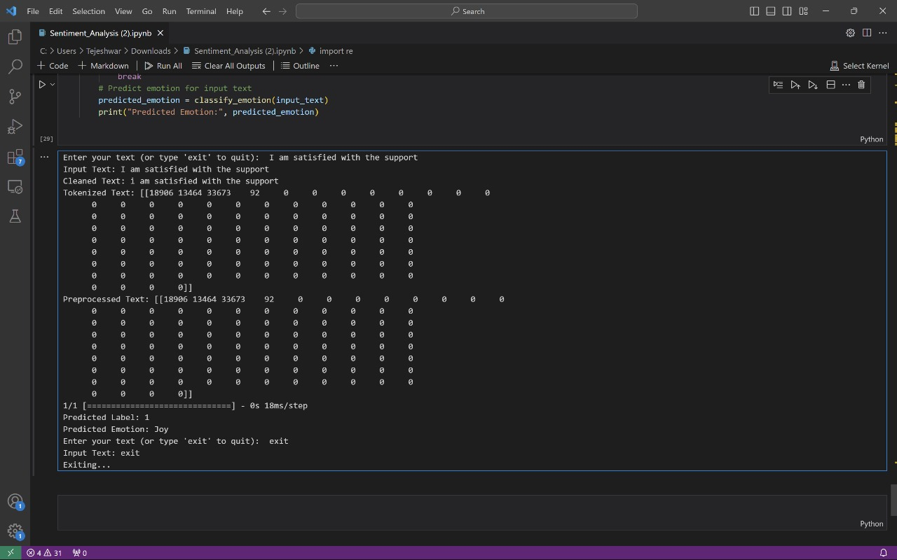
RESULTS
Project_Link

