Slide 1

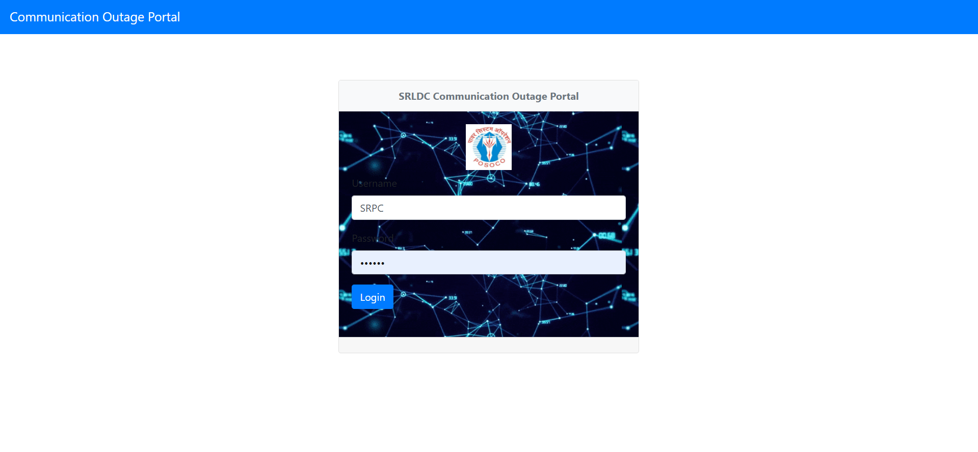

Slide 2

Roles
Admin Role (SRPC)
Supervisor Role (SRLDC)
User Role
Operator Role

Slide 3
Flow of Website (Planned)
SRPC creates the COMSR Meeting and the same meeting will be sent to all
User can apply Planned outages for the month by furnishing various details during Meeting Request Period and the same applied outage will be sent through mail to SRLC and SRPC.
User can edit his applied outages till end of Closing Date of Requests
SRLDC can provide comments for Planned Outages.
On meeting Date SRPC can Approve or Reject the applied Outages

Slide 4
Flow of Website cont.…(Planned)
SRPC can change decision of Approved Requests till D-1
User need to Intimate about availing outages before D-3 through the portal
On Dth Day User need to take code from Operator for Availing Outages.

Slide 5
Flow of Website cont.…(Emergency & Forced)
User can apply Emergency outages for D+1 day onwards. The same applied Emergency Outage will be sent through Mail.
User can report Forced outages for previous Month till 12th of the current Month. The same reported Forced Outage will be sent through Mail.

Slide 6
Outage Entry
For the Approved Planned Outages and Emergency Outages User need to submit the outage Start and End Date before 12th of the Month for the previous Month
In case of not availing the outage user need to Mark it as Not availed
On 12th whose outage entry for previous month is not made. Outage timings will be assumed as Approved Timings.
(On 10th remainder mail will be sent to submit the Outage Entry feature yet to be provided)

Slide 7
Reports
COA1 ( Communication Outage Approval Links)
COA2 ( Communication Outage Approval Equipment's)
COD1 ( Communication Outage Deviation - Links)
COD2 ( Communication Outage Deviation Equipment's)
COD3 ( Communication Outage Rolling 12 Months Deviation - Links)
COD4 ( Communication Outage Rolling 12 Months Deviation Equipment's)
All Reports can be downloaded in Excel Format

Slide 8
Deviation Rules
If Rolling 12 Months Outage Time > 48hrs
Outage Started earlier than Approved Start Date
Outage Ended after the Approved End Date

Slide 9

Addition of New Links and Equipment's to Database
User can request to add New links and equipment's through Portal.
SRLDC or SRPC can verify and approve the addition of Elements.

Slide 10
THANKS!
Any questions?
You can find me at: mdileepkumar@posoco.in

