Slide 1

HOTEL MANAGEMENT SYSTEM

Slide 2
TEAM Members
AKASH
RIYASKHAN.A
HELEN KIRUBA.M
SANTHOSHI KUMARI Mungi. M

Slide 3


PROJECT INTORDUCTION
Hotel Management System is a web-based application that allows the hotel manager to handle all hotel activities online. Interactive GUI and the ability to manage various hotel bookings and rooms make this system very flexible and convenient.
Customers can view and book room online. Admin has the power of either approving or disapproving the customer’s booking request.

Slide 4
Module
Admin
Customer
Place
Hotel
Room
Facilities
Booking

Slide 5




software
Back-end
front-end
Spring-Boot
Spring Core
JPA
Rest API
Angular
Node js
Visual studio code
TypeScript
database
My-SQL

Slide 6
hardware requriements
windows 10 or abouve
ram: 4gb above

Slide 7
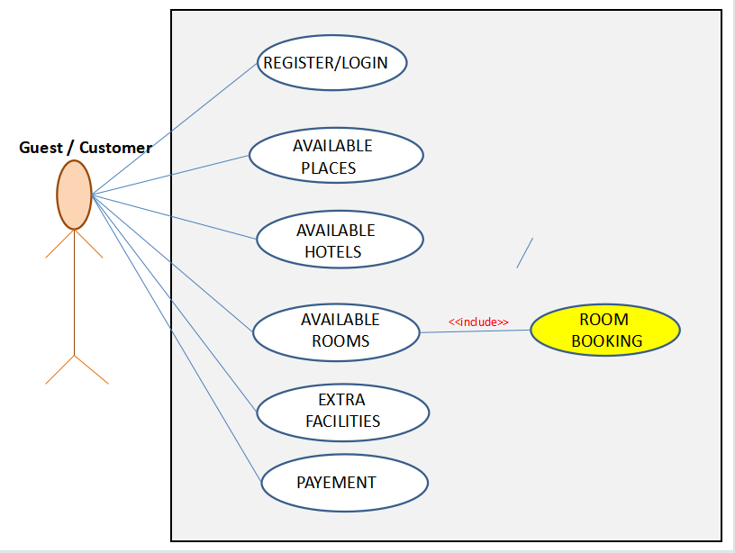
hotel management use-case

Slide 8
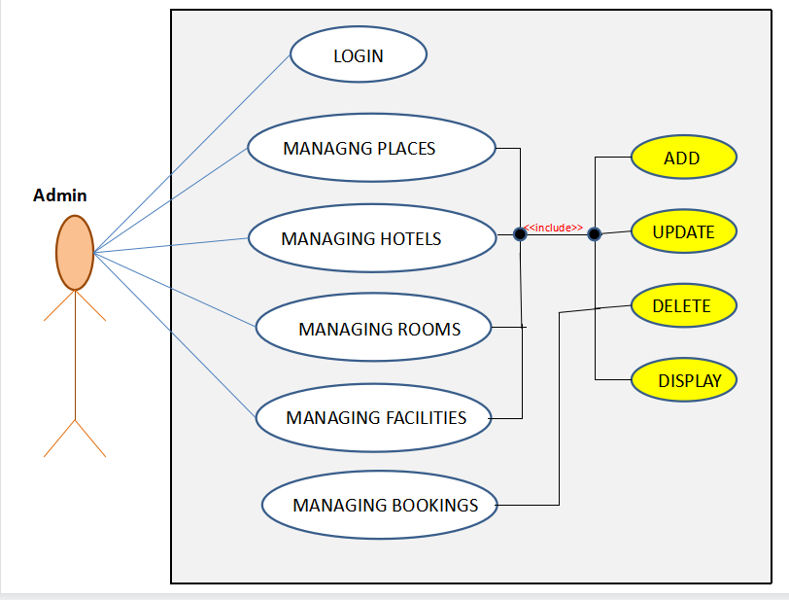
hotel management use-case

Slide 9
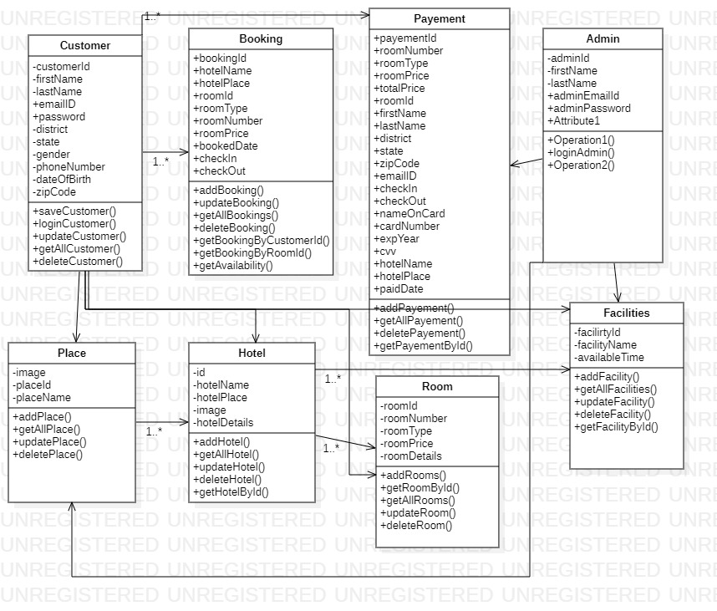
class diagram

Slide 10
Conclusion
A Hotel management system is a computerized management system.
This system keeps the records of hardware assets besides software of this organization.
This system is completely secure since every user is provided with a user ID and Password so there is no chance of any unauthorized access. Online Payment, Booking,
So, using this system will help in reducing the labor and provide more facility for Customer to like Hotel and visit again and again.

Slide 11
Reference
google
youtube

Slide 12
thank you!

