Slide 1
INFO 5707 INVENTORY MANAGEMENT SYSTEM

Slide 2
TEAM MEMBERS
Gaurav Gupta Murikipudi – 11594251
Bakht Singh Basaram – 11546730
Santhoshi Indrakanti – 11610865
Shanthi Sharon Kolluri – 11603616
Hemkiran reddy nalamalpu – 11602301
Alekhya Nimmala – 11647588

Slide 3
General Description
We are building a SQL project to sustain and maintain the records of product inflow and outflow. We are going to build relational database that contains eight different tables, with each table defining one particular part of the process. The objective in building this system is to enable efficient tracking and management of inventory levels, and product inflow and outflow. This system will benefit managers, and other employees involved in inventory management to set inventory thresholds.
This system can also be used to:
Generate reports about inventory levels, product sales, and supplier and customer relationships.
Choice of DBMS: We are going to use Relational Database management system - MySQL 8.0

Slide 4
Table of contents
01
User Requirements
02
Business Rules
03
Entity-Relationship Diagram (ERD)
04
Data dictionary

Slide 5
User Requirements
Business Rules
a. User need to view all the tables with their respective data.
b. Users need to add, update, and delete suppliers, products, customers, and orders.
c. User need to view supplier details and products supplied by a specific supplier.
d. User need to view product descriptions and filter them by category.
e. User need to search for customers by name, address, or other details.
f. Users need to view all orders placed by a specific customer or orders containing a specific product.
g. Users need to monitor stock levels and receive notifications when stock levels reach the reorder level.
h. Users need to place orders for products with quantities that do not exceed stock availability.
i. Users need to view customer age and order history to understand customer preferences and target marketing efforts.
a. Each supplier has unique ID and must have a name.
b. Each supplier has unique address, phone number, and email.
c. Suppliers are in Dallas by default but can be in other cities too
d. Each product has a unique ID and must need a description.
e. Each product has price and belongs to category.
f. Each product supplied by 1 supplier, and a supplier can supply multiple products.
g. Each customer has unique ID and must have a name.
h. Each customer has unique address, phone number, email.
i. A customer's date of birth should be before the current date.
j. Each order has unique ID, date, customer ID, product ID, and quantity.
k. An order must have at least one item.
l. Each product's stock has a quantity, reorder level, and minimum order.

Slide 6
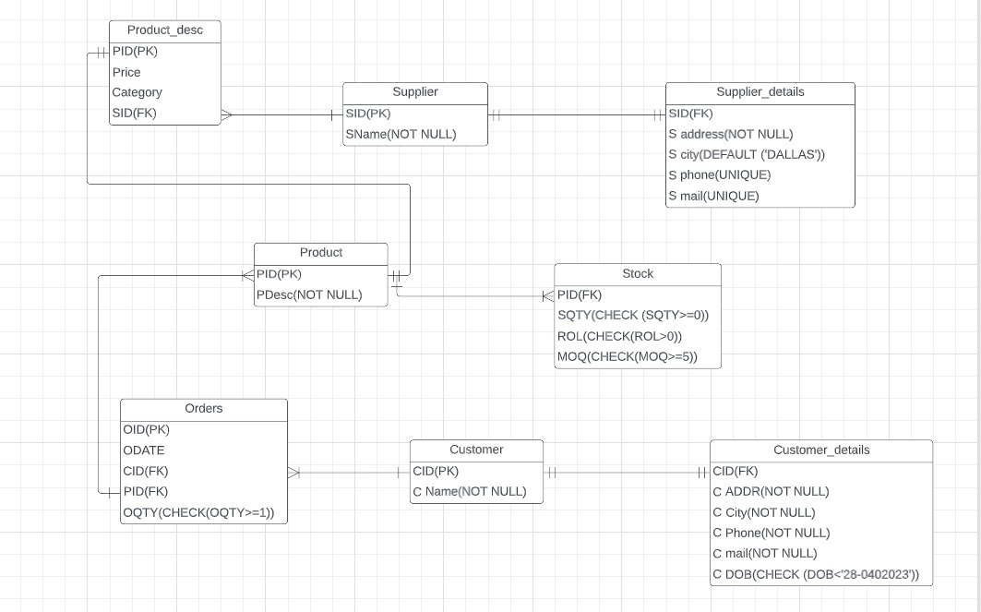
Entity-Relationship Diagram (ERD)

Slide 7
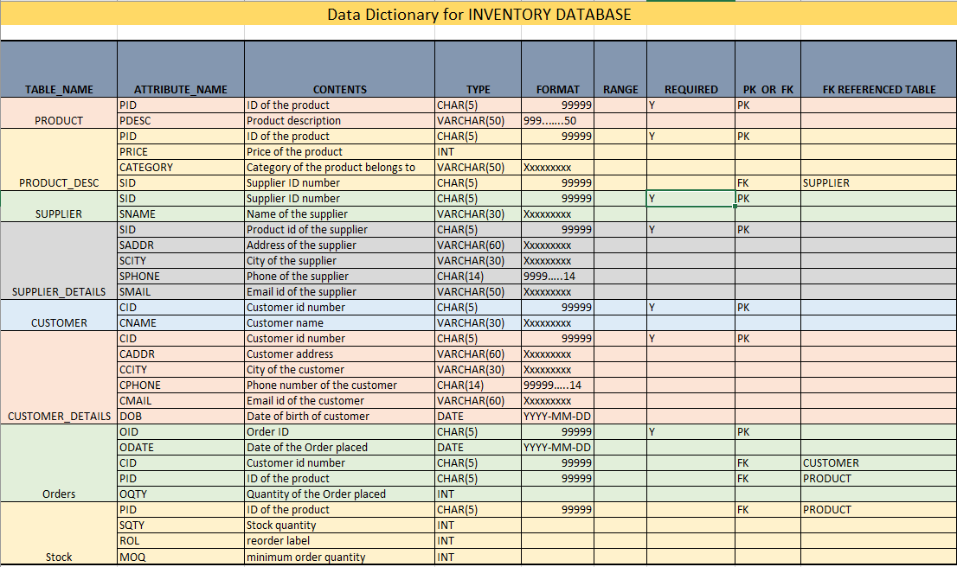
Data dictionary

Slide 8
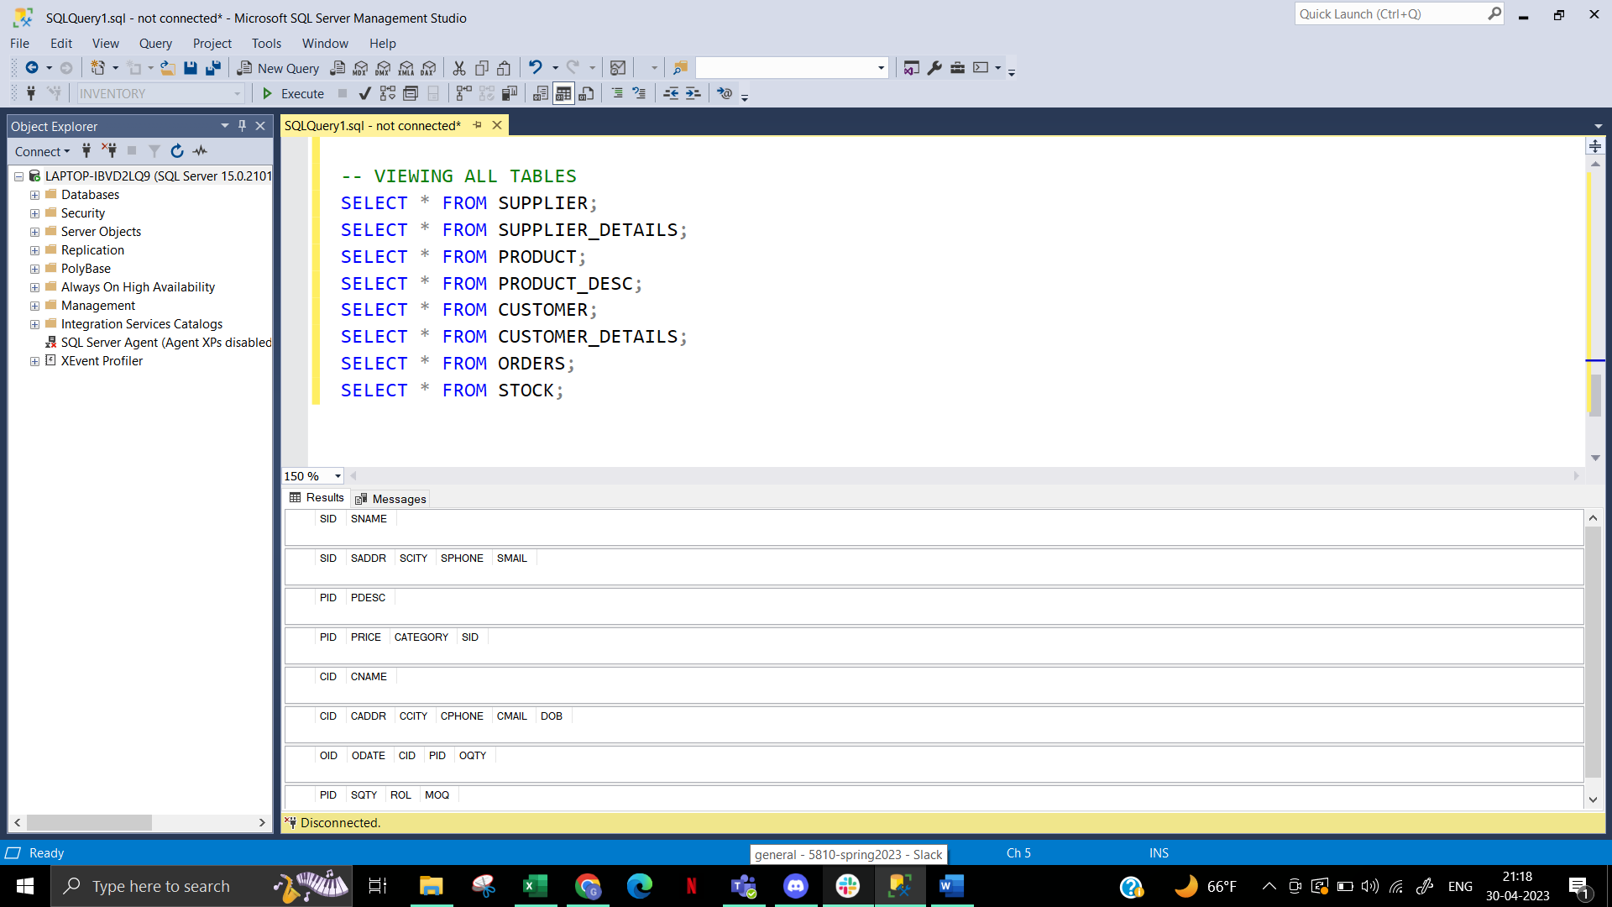
DISPLAYING TABLES WITHOUT CONTENT

Slide 9
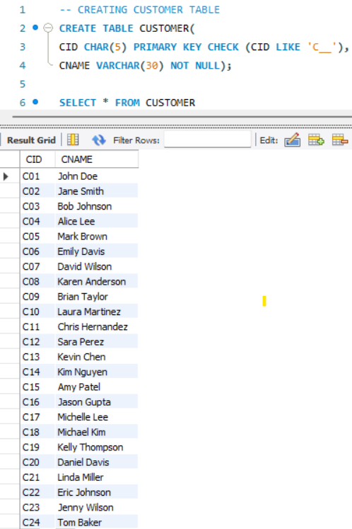
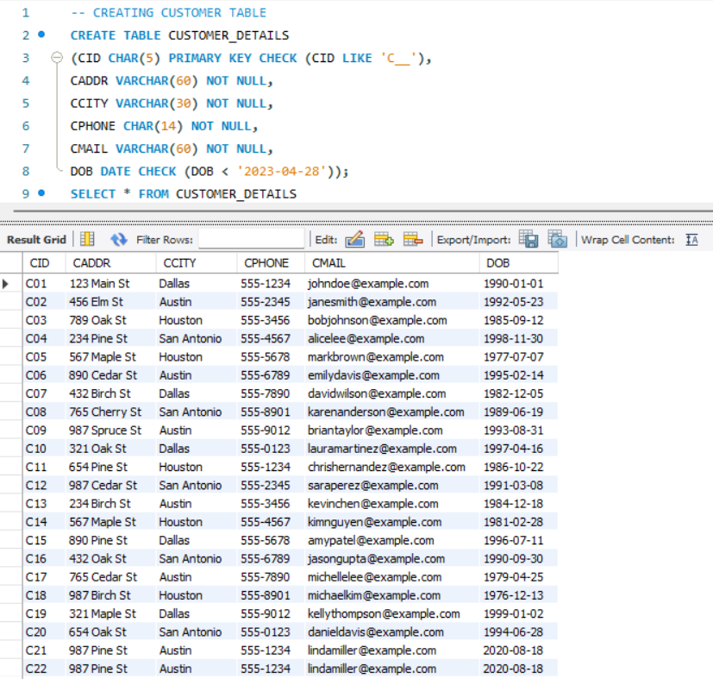
TABLES AFTER DATA ENTRY

Slide 10
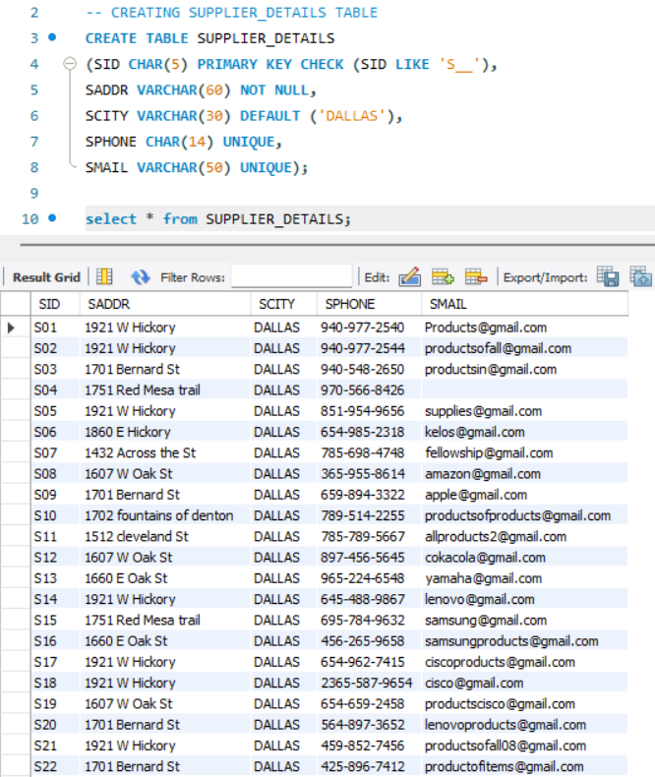
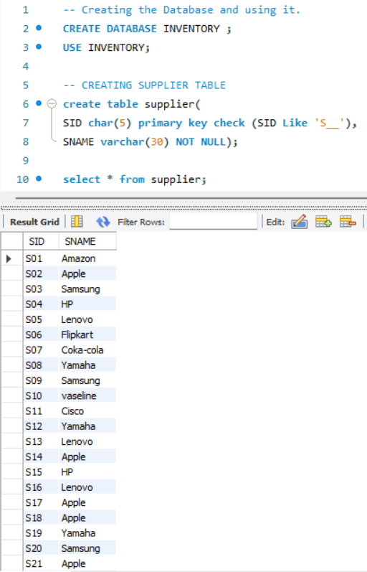
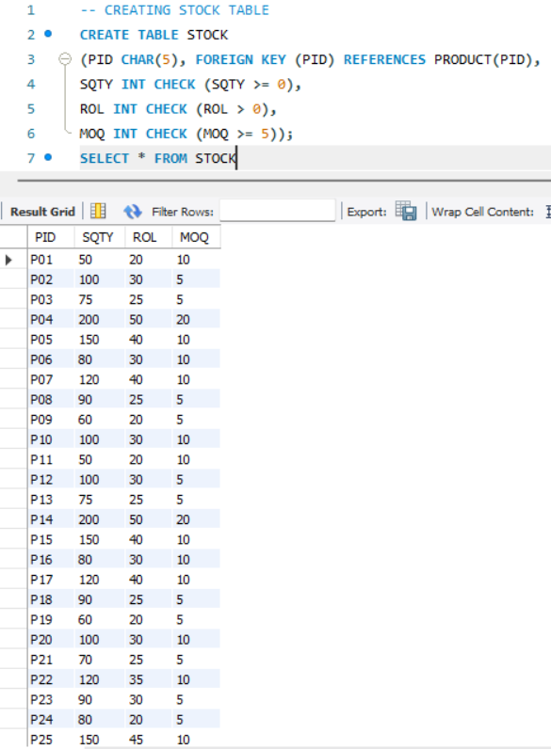
TABLES AFTER DATA ENTRY

Slide 11
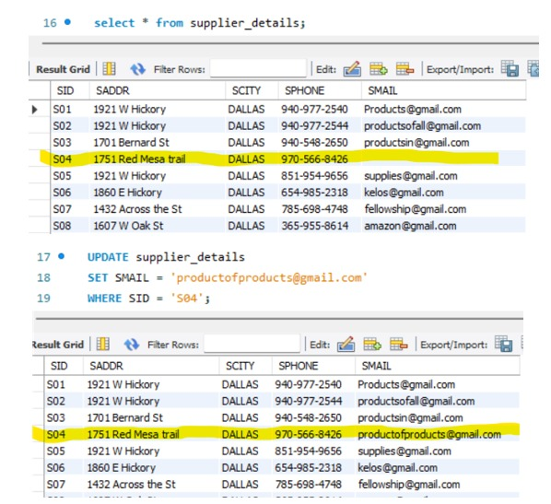
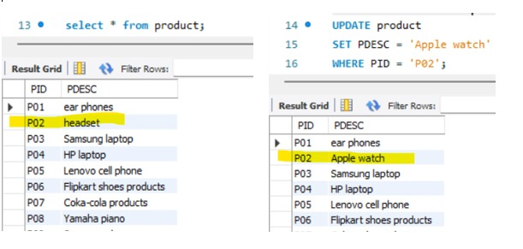
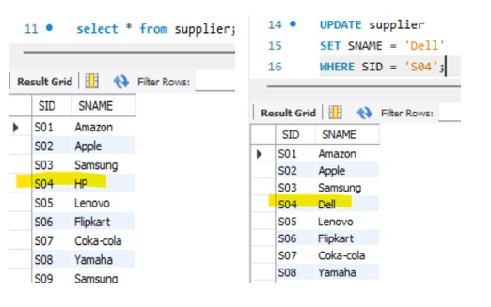
TABLES AFTER DATA UPDATION

Slide 12
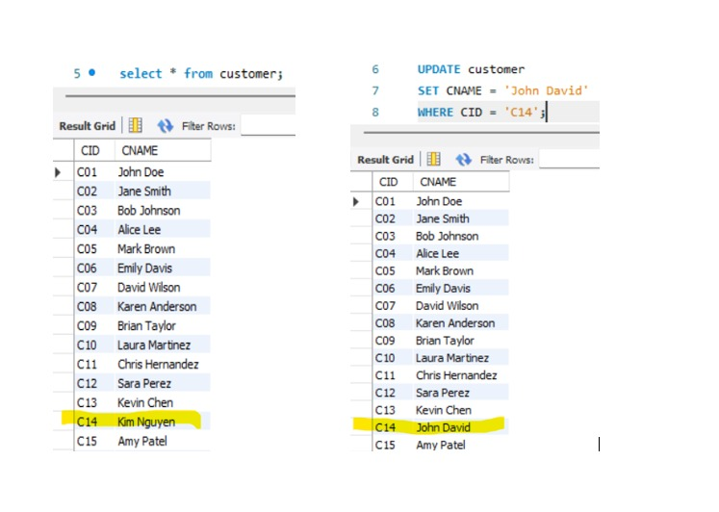
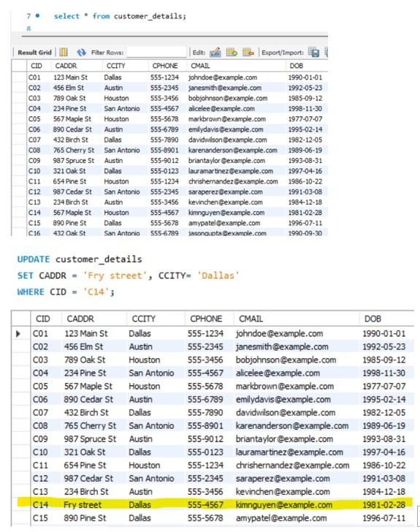
TABLES AFTER DATA UPDATION

Slide 13
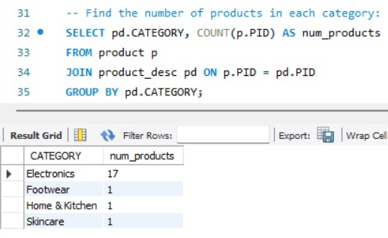
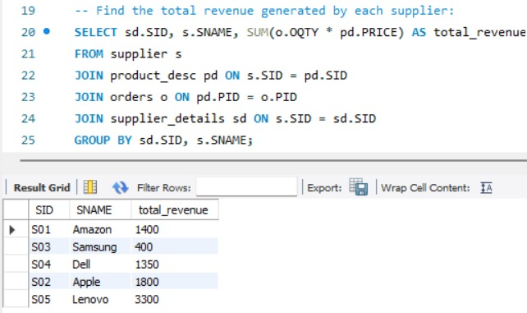
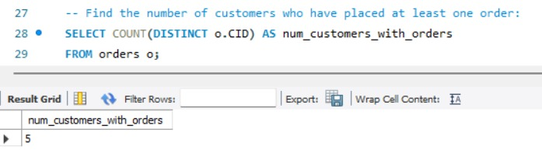
GENERAL REPORTING

Slide 14
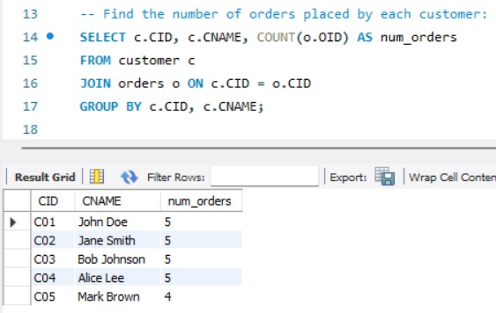
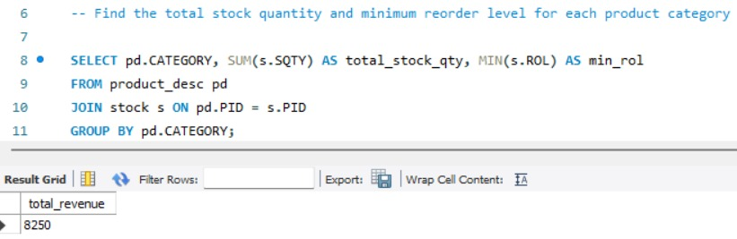
GENERAL REPORTING

Slide 15
THANK YOU

