Slide 1
Google Play-Store Data Analysis
SANTHOSHI INDRAKANTI
(46019298)

Slide 2

Contents
Introduction
About the data
Cleaning
Normalizing
Creating Dimension and Fact tables
Loading in Hadoop and Hive
Analysis

Slide 3
Introduction
The Google Play Store is the largest and most popular Android app store.
The purpose of project is to gather and analyze detailed information on apps in the Google Play Store in order to provide insights on app features and the current state of the Android app market.
We focused on the following 11 categories: Business, Food & Drink, Books & Reference, Travel & Local, Health & Fitness, News & Magazines, Education, Social, Finance, Medical, and Entertainment.

Slide 4
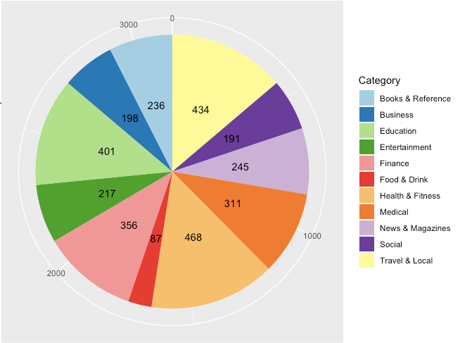
Number apps by Category

Slide 5
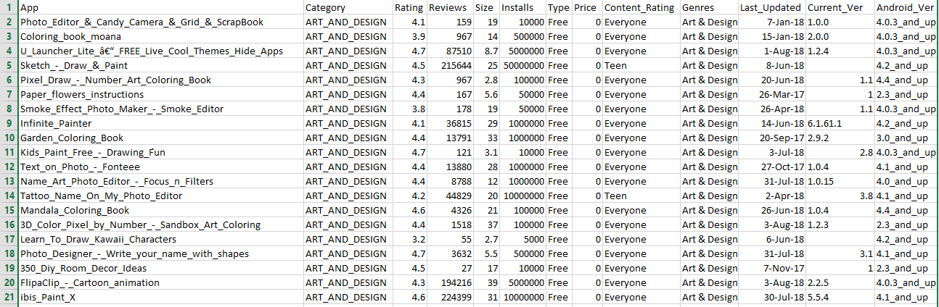
About The Data
Content: Each row has values for app name, category, rating, reviews, size, version, and more.
Columns: 13
Rows: 10,842

Slide 6
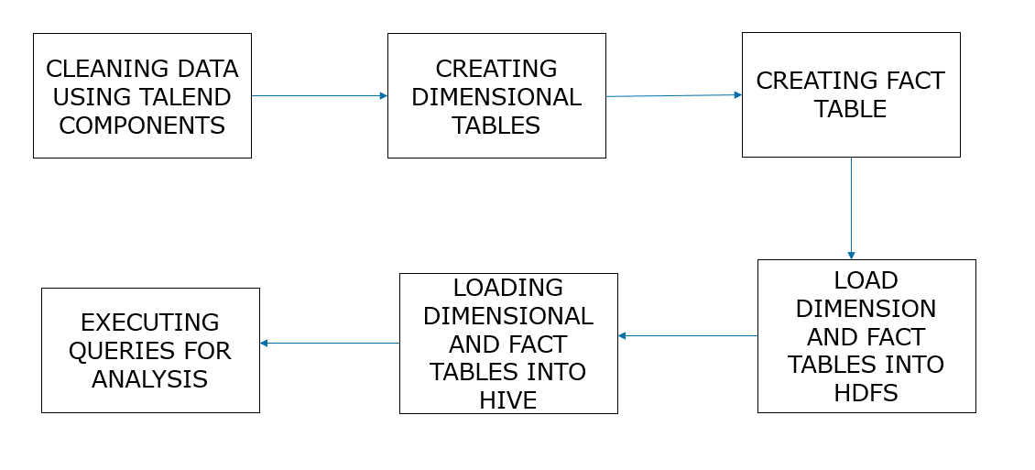
Workflow

Slide 7
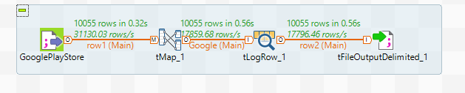
Cleaning The Dataset With Talend
Each row has values for app name, category, rating, reviews, size, version, and more.

Slide 8
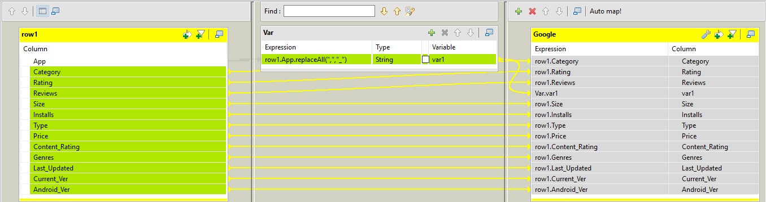
tMap for Cleaning

Slide 9
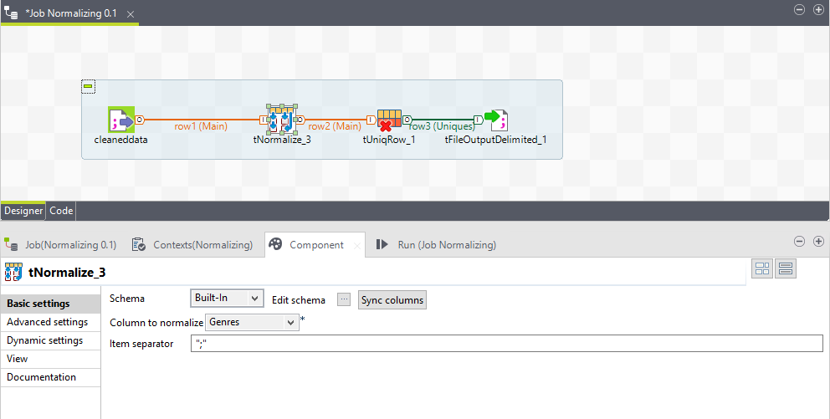
Normalizing

Slide 10
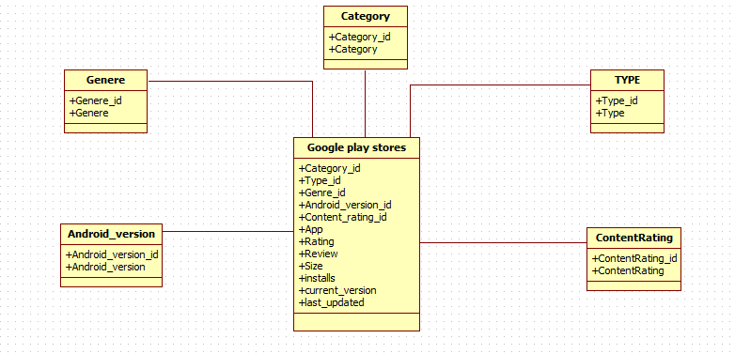
Schema

Slide 11
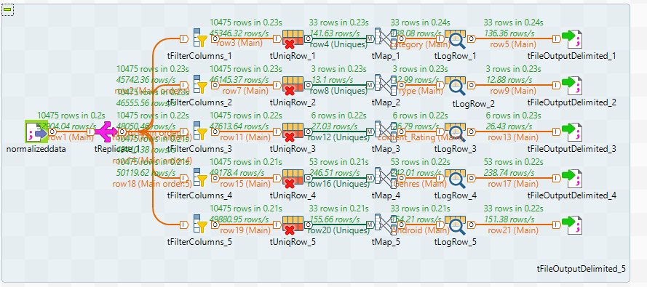
Creating Dimension Tables Using Talend

Slide 12
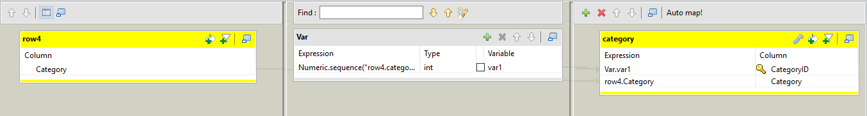
tMap for Category Dimension Table

Slide 13
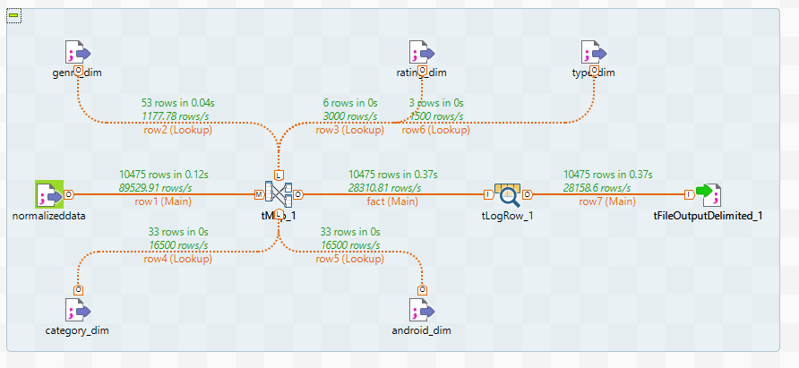
Creating Fact Table Using Talend

Slide 14
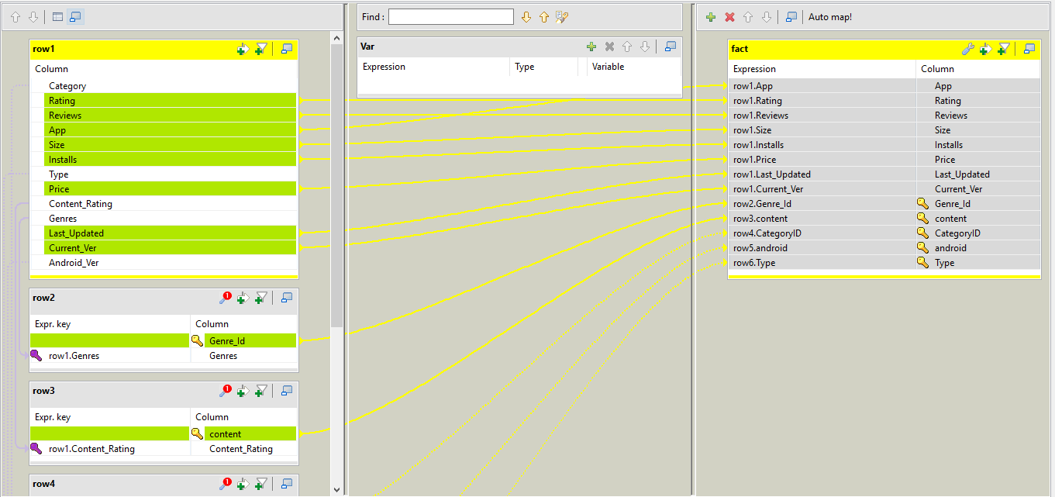
tMap for Fact Table

Slide 15
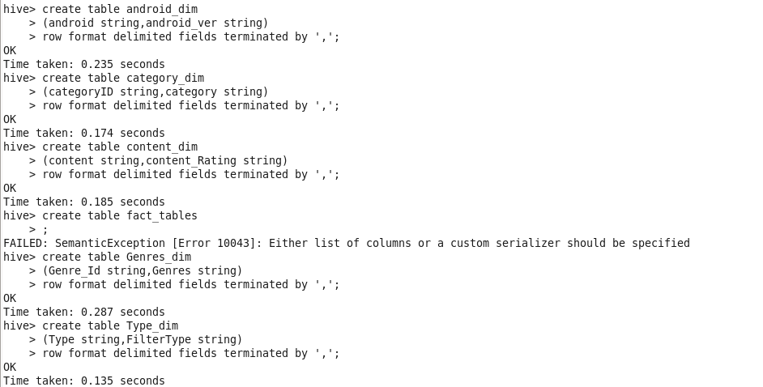
Creating tables

Slide 16
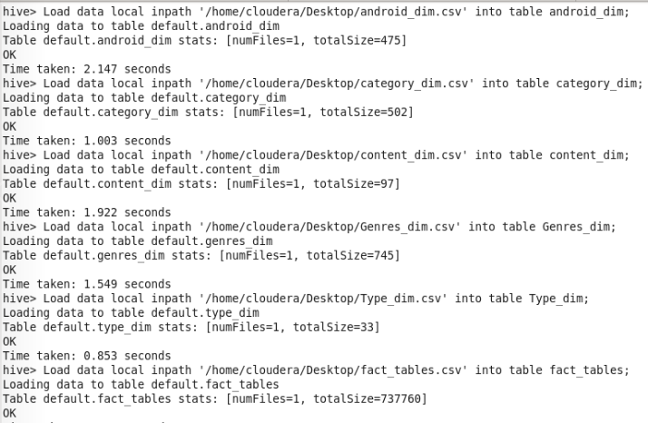
Loading data into tables in Hive

Slide 17
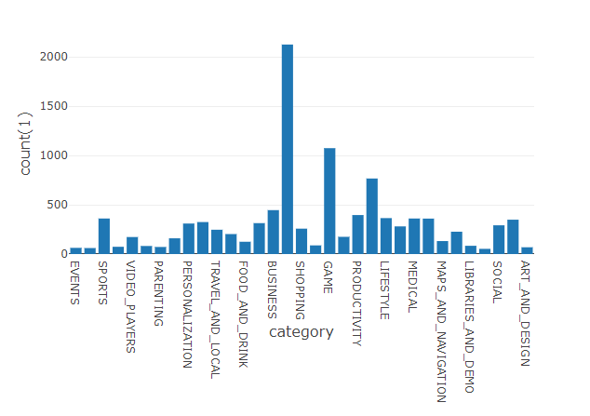
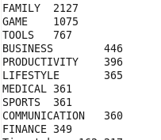
Query-1 Output

Slide 18

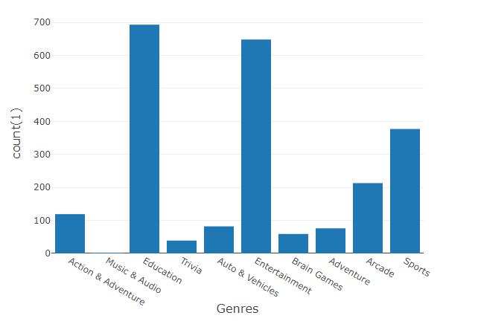

Query-2 output

Slide 19

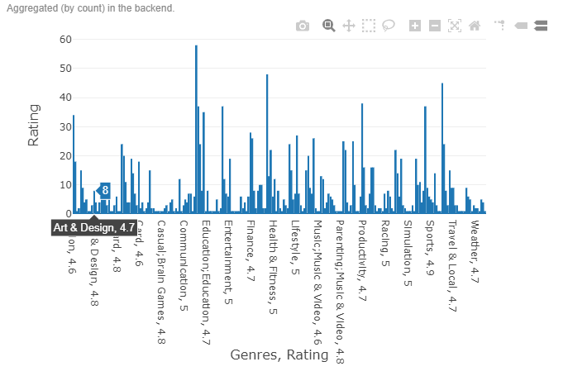
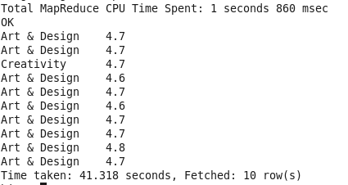
Query-3 Output

Slide 20
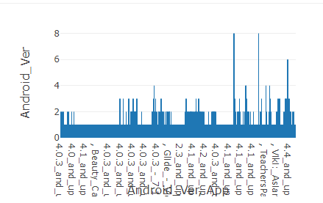
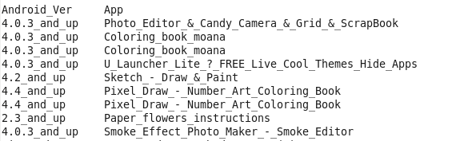
Query-4 Output

Slide 21


