Slide 1

KL DEEMED TO BE UNIVERSITY · B.TECH CSE
Community Library
Management System
A Java-Based Library Management Project
MEMBERS
Sneha
Santhoshi
Roll No: 2620080080
Roll No: 2620080081
Notes:
Introduce the project: a menu-driven Java application that manages books in a community library. Mention the team members and that the following slides map the project to the six course outcomes.

Slide 2






Project report at a glance
THE DOCUMENT
Abstract
Objectives
Advantages
A computerized system to add, view, search, issue and return books and register members.
Digital book and member records, quick search, availability check, simple issue and return.
Less manual work, faster searching, accurate availability and an easy menu-driven interface.
Scope
Implementation
Future work
A basic menu-driven Java app: show books, issue and return. A base for members and a database.
Java with arrays, loops, conditions and Scanner, running a do-while menu until Exit.
Database, login, fines, GUI, online reservation, due dates and notifications.
Notes:
Summarise the report: what the system does, what it aims for, its benefits and scope, how it is implemented in Java and where it can grow.

Slide 3


Understanding the problem statement
PROBLEM
What the library must manage
Problems with manual records
Book details
Author details
Difficulty in locating book records
Member information
Book availability
Errors while updating book availability
Issued books
Returned books
Loss or duplication of records
Proposed solution
Time-consuming issue and return
A computerized system to add books, register members, search, issue and return books, with availability updated automatically.
Difficulty in tracking library resources
Notes:
Manual registers make library work slow and error-prone. The system must keep book, author and member information and track availability, issues and returns.

Slide 4




CO1 · Computational foundation
COURSE OUTCOME 1
Algorithm and flowchart
JAVA
Menu loop: read choice, decide, update, repeat.
Scanner sc = new Scanner(System.in);
String[] books = {"Java", "Python",
"C Programming"};
boolean[] issued = {false, false, false};
int choice;
choice = sc.nextInt();
Variables and data types
int choice, String[] books, boolean[] issued.
OUTPUT
Operators
--- Community Library ---
1. Show Books
2. Issue Book
3. Return Book
4. Exit
Enter choice: 1
!, ==, !=, <, ++, ?: and the n - 1 index step.
Input and output
Scanner reads choices; println prints the menu.
Notes:
Computational thinking: the program is planned as input, process, output. Variables, primitive types, operators and Scanner are the building blocks.

Slide 5




CO2 · Decisions and control flow
COURSE OUTCOME 2
if / else-if chain
JAVA
Routes each menu choice to its operation.
do {
choice = sc.nextInt();
if (choice == 1) { /* show books */ }
else if (choice == 2) {
if (!issued[n - 1]) {
issued[n - 1] = true;
System.out.println("Book issued successfully.");
} else {
System.out.println("Book is already issued.");
}
} else if (choice == 3) { /* return book */ }
} while (choice != 4);
Nested if
Checks !issued before issuing a book.
do-while loop
Menu repeats until choice is 4 (Exit).
Ternary ?:
OUTPUT
Enter choice: 2
Enter book number: 1
Book issued successfully.
Prints Issued or Available per book.
Notes:
if / else-if chains route each menu choice. A nested if checks whether the book is already issued. do-while keeps the menu running until the user chooses Exit.

Slide 6

CO3 · Methods and arrays
COURSE OUTCOME 3
books[]
Java
Python
C Programming
books[i] and issued[i] describe one book
Loop up to books.length visits every title
User number n maps to index n - 1
main() runs the menu; Scanner methods read input
issued[]
false
false
false
[0]
[1]
[2]
JAVA
for (int i = 0; i < books.length; i++) {
System.out.println((i + 1) + ". " + books[i] +
(issued[i] ? " - Issued" : " - Available"));
}
Why arrays here
Fixed-size arrays keep the first version simple. Collections replace them in CO6 when the catalogue must grow.
OUTPUT
1. Java - Available
2. Python - Available
3. C Programming - Available
Notes:
Two parallel arrays hold the titles and their issued status; index i in both refers to the same book. A for loop traverses the arrays using length. Methods used: main, nextInt, println, close.

Slide 7



CO4 · Constructors
COURSE OUTCOME 4
Class and object
OBJECT-ORIENTED VERSION
Book is the blueprint; new Book("Java") makes one.
class Book {
private String title;
private boolean issued;
Book(String title) { // constructor
this.title = title;
this.issued = false;
}
boolean isIssued() { return issued; }
String getTitle() { return title; }
}
Book b = new Book("Java");
System.out.println(b.getTitle() +
(b.isIssued() ? " - Issued" : " - Available"));
Constructor
Runs on new; sets the title and issued = false.
this keyword
Separates the field from the parameter.
Encapsulation
EXPECTED OUTPUT
Private fields, public methods to read or change.
Java - Available
Notes:
The report describes the design with classes, objects, constructors and encapsulation. This slide shows how a Book class with a constructor would model one library item. The base program in the report uses arrays; this is the object-oriented step.

Slide 8


CO5 · Strings, algorithms and file I/O
COURSE OUTCOME 5
Strings
Library algorithms
File I/O
Titles stored in String[] books
'+' joins number, title, status
equalsIgnoreCase() for search
Linear search through books[]
Arrays.sort(books) orders titles
Arrays.toString(books) prints all
PrintWriter saves issued status
Scanner(File) loads it back
try-with-resources closes file
SEARCH BY TITLE
SAVE TO FILE
String query = "python";
for (int i = 0; i < books.length; i++) {
if (books[i].equalsIgnoreCase(query)) {
System.out.println("Found: " + books[i]);
}
}
try (PrintWriter pw =
new PrintWriter("lib.txt")) {
for (boolean s : issued)
pw.println(s);
}
lib.txt CONTAINS
EXPECTED OUTPUT
false
false
false
Found: Python
Notes:
Strings hold titles and are joined into output lines. A linear search with equalsIgnoreCase finds a book by title. File I/O saves the issued status so records survive a restart. Outputs shown are the expected results.

Slide 9


CO6 · Functional programming with Streams
COURSE OUTCOME 6
Lambda expressions
JAVA STREAMS
b -> !issued.get(b) tests one book.
List<String> books = List.of("Java",
"Python", "C Programming");
Map<String, Boolean> issued = new HashMap<>();
books.forEach(b -> issued.put(b, false));
issued.put("Python", true);
books.stream()
.filter(b -> !issued.get(b))
.map(String::toUpperCase)
.forEach(System.out::println);
Stream pipeline
filter, map, forEach in one chain.
Method references
String::toUpperCase, System.out::println.
EXPECTED OUTPUT (PYTHON IS ISSUED)
JAVA
C PROGRAMMING
Collections as data
List holds titles; Map holds status.
Notes:
Lambdas and streams are used as practical APIs on collections. Here a HashMap stores the issued flag for each title and a stream pipeline lists the available books. Output shown is the expected result.

Slide 10
Collections framework map
JAVA COLLECTIONS
Iterable
Collection
Separate hierarchy (key to value)
List
Set
Queue
Map
ArrayList
HashSet
ArrayDeque
HashMap
LinkedList
TreeSet
PriorityQueue
TreeMap
In CLMS: ArrayList<Book> catalogue · HashMap<id, Book> quick lookup · HashSet of member IDs · Queue of reservations
Notes:
Iterable and Collection sit at the top. List, Set and Queue extend Collection. Map is a separate hierarchy. The bottom strip shows where each would be used in the library system.

Slide 11
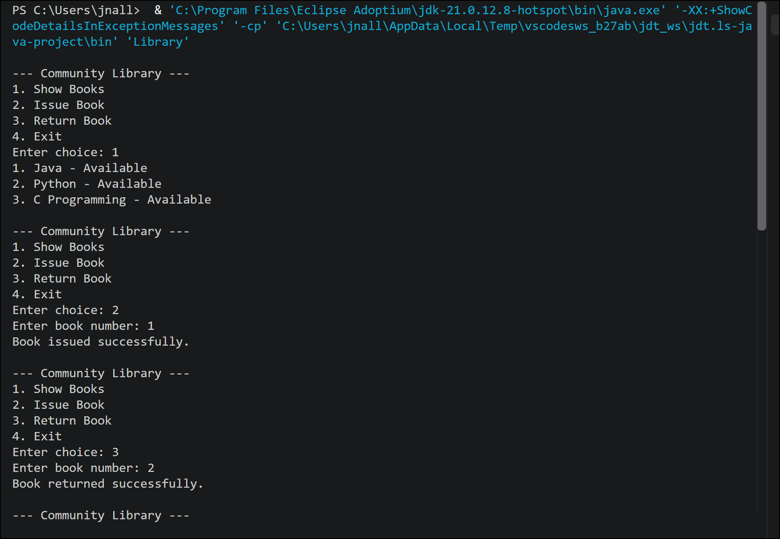

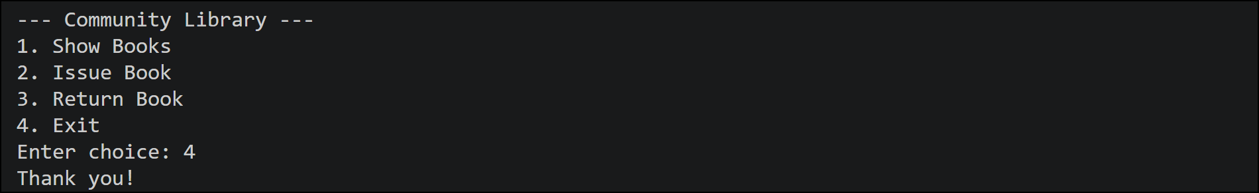

Program output
SAMPLE PROGRAM EXECUTION
1 · Show Books
All three titles are Available.
2 · Issue Book
Book 1 prints: Book issued successfully.
3 · Return Book
Book 2 prints: Book returned successfully.
4 · Exit
Loop ends and prints: Thank you!
Notes:
These are the actual screens from the sample program execution in the report: show books, issue book 1, return book 2, then exit with Thank you.

Slide 12





Conclusion and future work
WRAP-UP
Future work
Conclusion
Replaces register-based tracking with a menu-driven Java program.
Issue and return update book availability automatically.
Arrays, conditions, loops and Scanner form a base ready for classes, collections and files.
Simple, reliable and easy to extend into a full digital library.
Database integration
User authentication
Fine management
GUI (JavaFX / Swing)
Online reservation
Due-date notifications
Notes:
The project converts a manual library process into a structured Java application. The future-work items turn it into a complete digital library platform.

Slide 13
Thank You
Community Library Management System
Sneha · Santhoshi
Questions are welcome
Notes:
Thank the audience and invite questions.

