Slide 1
Attendance automation using image recognition
1. Santhoshkumar - 20BCE1184
2. Arvind Narayanan - 20BCE1447
3. Mahir - 20BCE1524
4. Ganesh V - 20BCE1692
5. Harini S - 20BCE1832

Slide 2
Introduction
Attendance automation with image recognition integrates advanced computer vision technologies to revolutionize traditional attendance tracking methods. Utilizing algorithms, the system analyzes images or video feeds to identify and register individuals present in a given space.
This innovative approach minimizes manual efforts and human errors associated with traditional methods, offering seamless and accurate attendance management. Applied across educational institutions and workplaces, it enhances efficiency, reduces administrative burden, and provides real-time insights.
The technology showcases the potential to transform various sectors, offering a reliable, automated solution for tracking attendance while promoting a more streamlined and digitally advanced environment.

Slide 3
Algorithm
3. Preprocess Images:
- Define functions for resizing and preprocessing images for both face detection and recognition.
4. Recognition Functions:
- Define functions for recognizing faces using the loaded models.
- Use the YOLOv5 model to detect faces and landmarks.
- Use the InsightFace model to extract features from the detected faces.
1. Import Libraries:
- Import the necessary libraries, including PyTorch, OpenCV, and other dependencies.
2. Load Models:
- Load the YOLOv5 face detection model (`yolov5m-face.pt`).
- Load the InsightFace recognition model (`resnet100_backbone.pth`).

Slide 4
Algorithm
7. CSV Operations:
- Maintain a CSV file (`recognized_faces.csv`) to store recognized faces along with the date and time of recognition.
8. Recognize from Images:
- Define a function to recognize faces from a folder of images.
- Iterate through the images, detect faces, and perform recognition.
5. Read Features:
- Define a function to read precomputed face features from a file.
6. Recognition Process:
- Perform face recognition on a given image.
- Calculate the similarity scores between the query face and the stored faces.
- If the score is above a certain threshold, consider the face recognized.

Slide 5
Algorithm
10. Save Video:
- Save the processed video with recognized faces to a file (`face-recognition2.mp4`).
11. Run the Main Function:
- Execute the `main` function to start the face recognition system.
12. Clean-up:
- Release video resources and close all OpenCV windows when the process is terminated.
9. Main Loop:
- In the `main` function:
- Capture video from a camera or use test images from a folder.
- Detect faces, landmarks, and recognize them in real-time.
- Display the results using OpenCV.
- Calculate and display the frames per second (FPS).

Slide 6
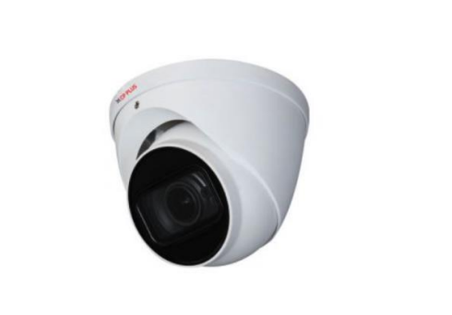
Specific Camera - CP-USC-DA50ZL6C-DS
SPECIFICATIONS:
1/2.7" 5MP CMOS Image Sensor (6.858 centimeters)
Max. 20fps@5MP
WDR(100dB), Day/Night(ICR), 2D-DNR, AWB, AGC, BLC,HLC
2.7-12mm Motorized lens
Max. IR length 60m, IP67, Smart IR, Built-in mic
Starlight Technology
OSD Menu, control over coaxial cable, 2D-DNR
HD and SD output switchable
Price: Rs. 1,900

Slide 7
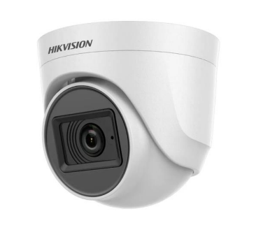
Specific Camera - DS-2CE76H0T-ITPFS
SPECIFICATIONS:
5 MP, 2560 × 1944 resolution
Digital WDR
2.8 mm, 3.6 mm, 6 mm fixed focal lens
Smart IR, up to 20 m IR distance
Audio over coaxial cable, built-in mic
4 in 1 video output (switchable TVI/AHD/CVI/CVBS
Price: Rs. 1,847

Slide 8
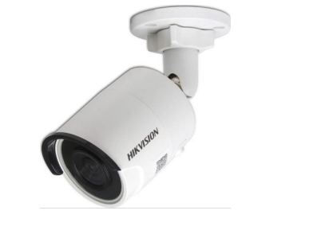
Specific Camera - DS-2CD2083G0-I
SPECIFICATIONS:
2.54cm (1/2.5inch) Progressive Scan CMOS
8MP, 3840 × 2160 @15 fps
2.8/4/6/8 mm fixed lens
Color: 0.01 lux @(F1.2, AGC ON), 0.028 lux @(F2.0, AGC ON), 0 lux with IR
H.265+, H.265, H.264+, H.264
120dB WDR
BLC/3D DNR/ROI
IP67 Built-in micro SD/SDHC/SDXC card slot, up to 128 GB
Price: Rs. 5,600

Slide 9
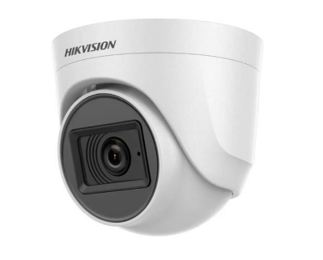
Specific Camera - 2CE76U1T-ITPF
SPECIFICATIONS:
8.29 MP high performance CMOS
3840 × 2160 resolution
2.8 mm, 3.6 mm, 6 mm fixed lens
EXIR 2.0, smart IR, up to 30 m IR distance
4 in 1 video output (switchable TVI/AHD/CVI/CVBS)
Up the coax (HIKVISION-C)
Price: Rs. 2,714

Slide 10
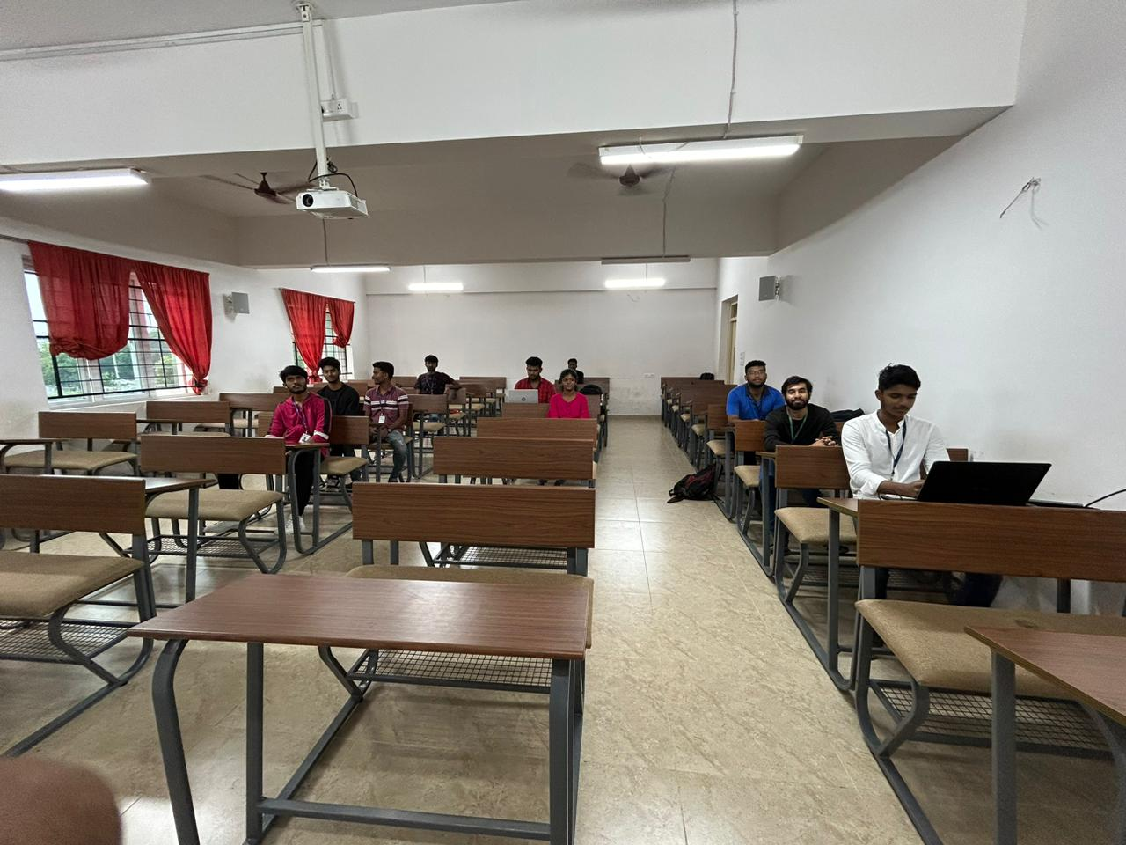
Result
Image Recognition

Slide 11
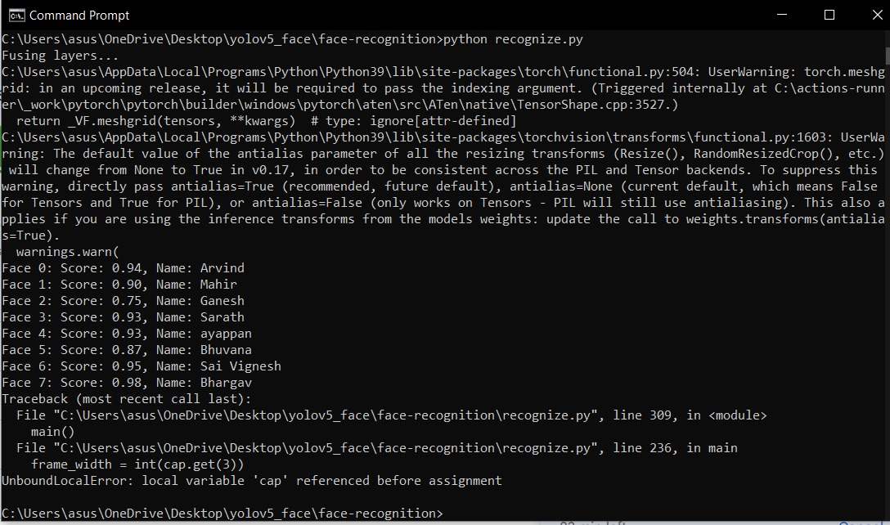
Result

Slide 12
Result
Fig 1. Group picture is provided as the input to the face recognition software
Fig 2. Shows the result that is obtained
Inference
Some of the faces are not being recognized since they are very far away
Most of faces are giving above 90% accuracy

Slide 13
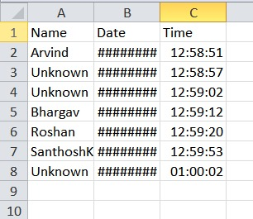
Result
Live Recogniziton
https://drive.google.com/file/d/1xsliffqDswu_kQAwsnYj2bJrhkdHBFQP/view?usp=shari

Slide 14
Result
Drive Link. Shows the live demo of the software recognizing faces
Fig 3. Shows the result that is obtained in an excel sheet
Inference
Some of the faces are not registered, hence given as unknown
Rest of the faces are easily being recognized
The time and date are being noted down

Slide 15
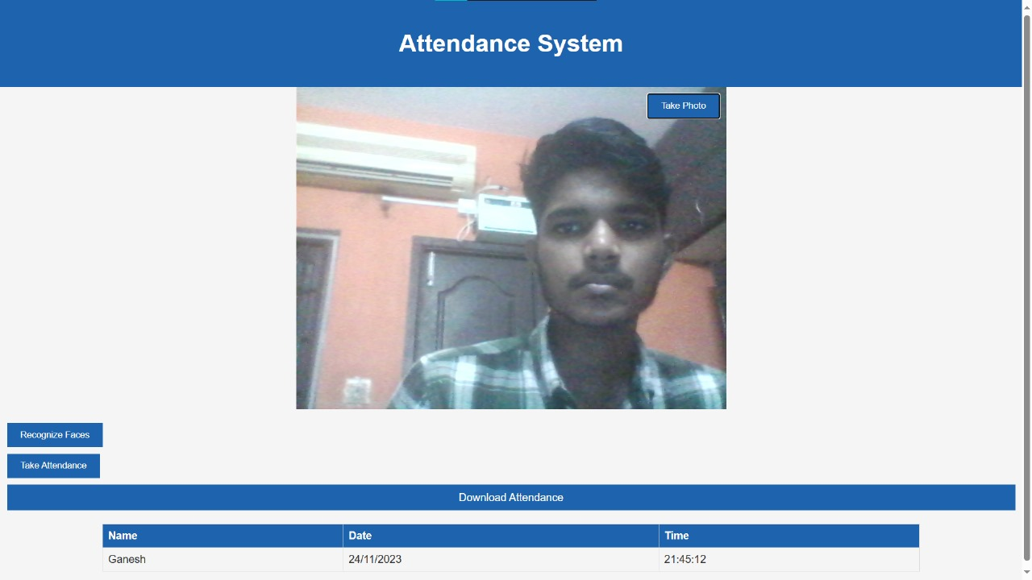
Result
Website

Slide 16
Result
Fig 4. Website to take attendance
Inference
Attendance can be taken from this website
The faces are being recognized and given below
The time and date are being noted down

