Slide 1
11-868 Course Survey

Slide 2
Homework 1 – Difficulty

Slide 3
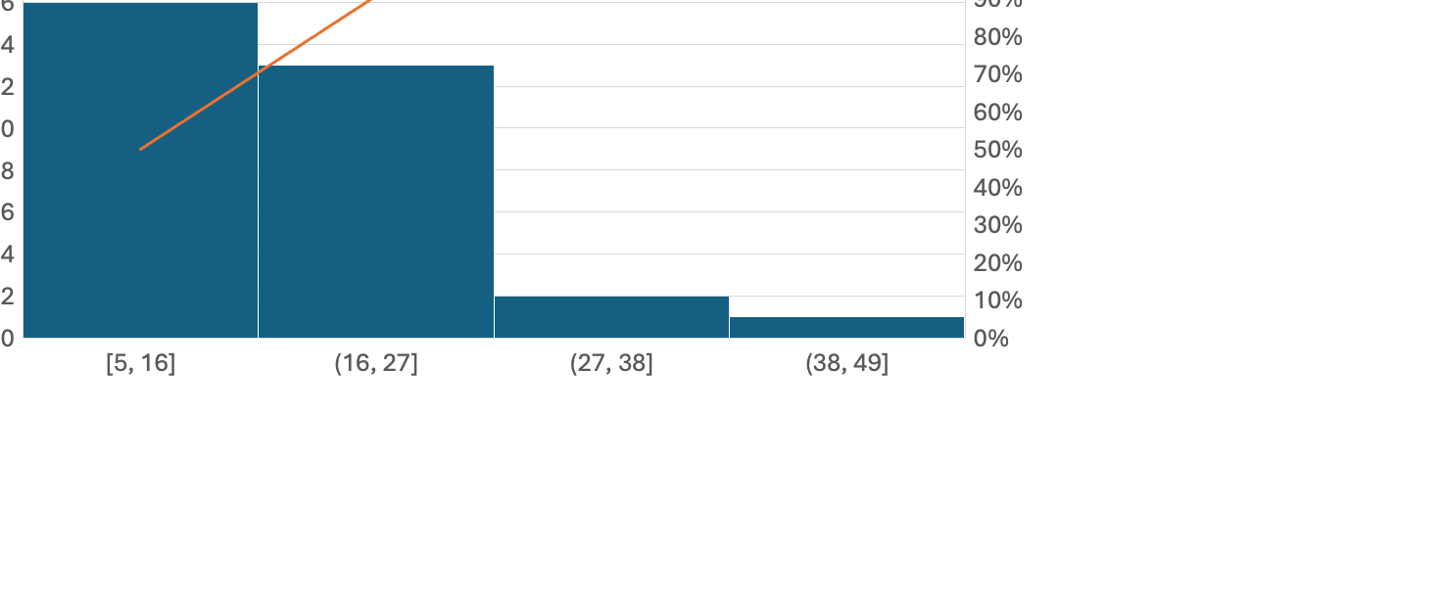
Homework 1 – Used Time

Slide 4
Homework 1 – Acquisition
(1 - 5, from learning nothing to learning a lot)

Slide 5
Homework 2 – Difficulty

Slide 6
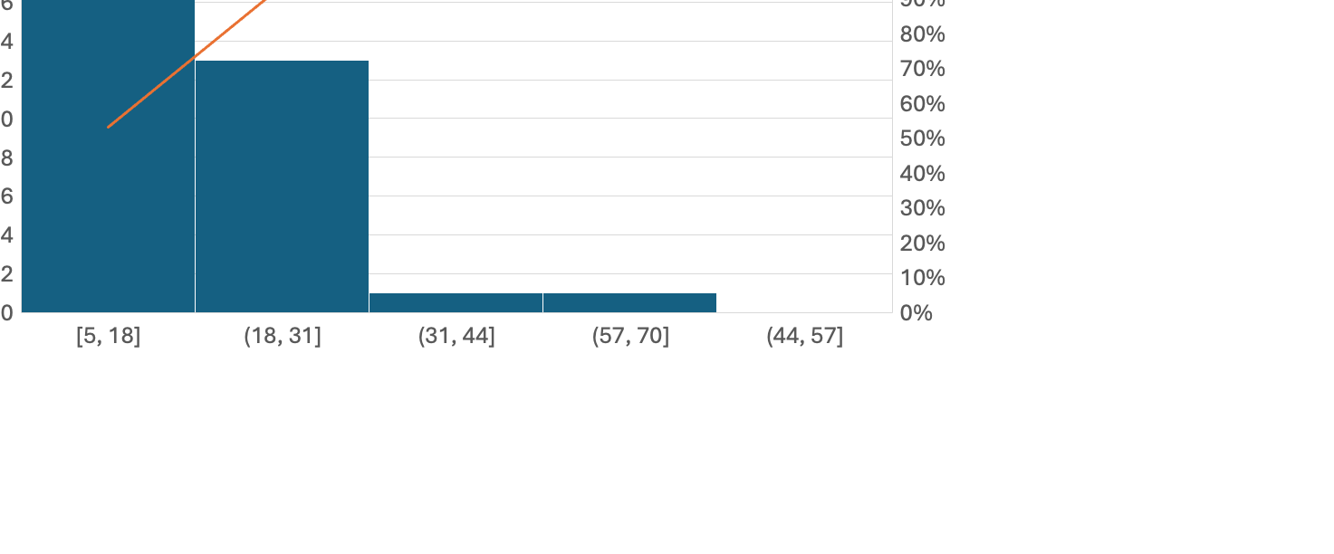
Homework 2 – Used Time

Slide 7
Homework 2 – Acquisition
(1 - 5, from learning nothing to learning a lot)

Slide 8
Homework 3 – Difficulty

Slide 9
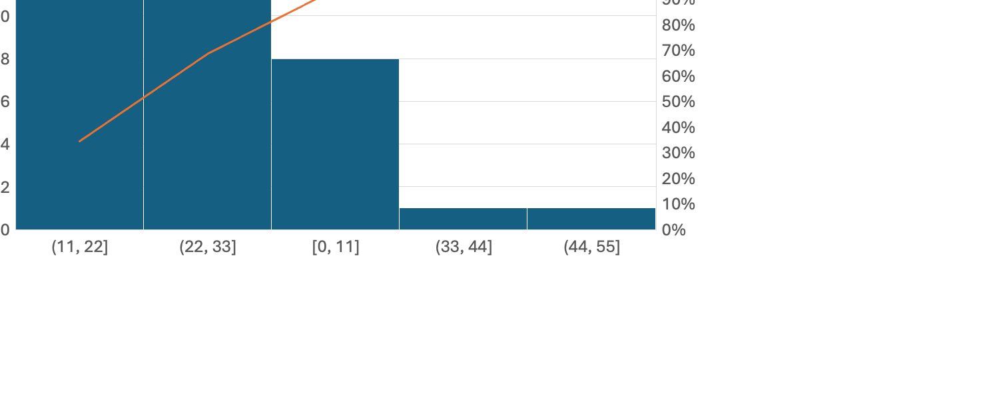
Homework 3 – Used Time

Slide 10
Homework 3 – Acquisition
(1 - 5, from learning nothing to learning a lot)

Slide 11
Homework 4 – Difficulty

Slide 12
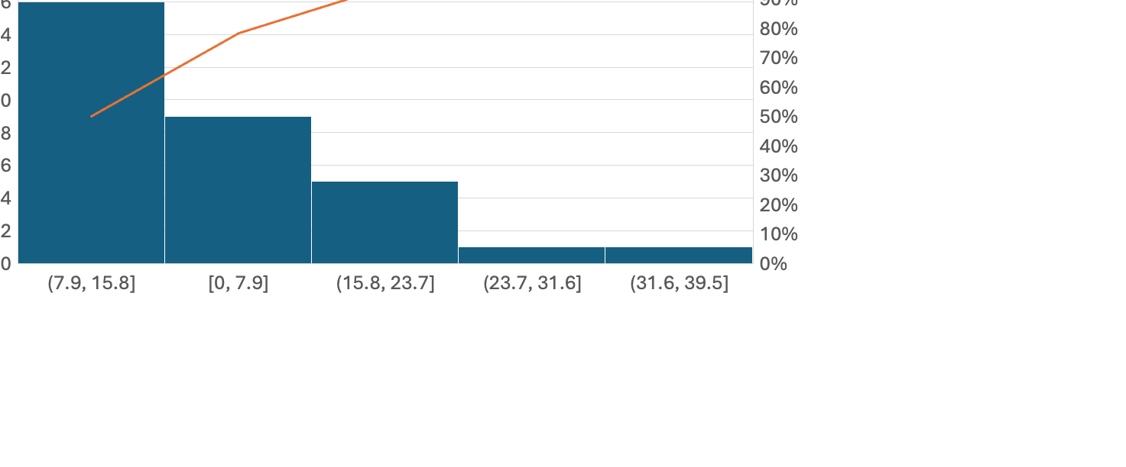
Homework 4 – Used Time

Slide 13
Homework 4 – Acquisition
(1 - 5, from learning nothing to learning a lot)

Slide 14
Rating of Assignment

Slide 15
Effectiveness of Homework Solution Session

Slide 16
Rating of Lecture

Slide 17
Rating of Presentation

Slide 18
Rating of Group Project

Slide 19
Do we need Separate Recitation Session?

Slide 20
Comments
I think that it would be nice to go over more case studies. I really enjoyed the lectures where we went over LightSeq 2 and the intuition behind how they identified bottlenecks and the different ways they solved them. It would be interesting to explore such papers for different architectures (CNNs, LSTMs, diffusion models, VAE's etc.)
More details about CUDA
I think we could dive deep into current LLM inference/training systems and cover the system design decisions in detail/implement portions. Also think that instead of having many assignments that are too broad, having a few focused CUDA assignments would be better.
We want to learn to use more packages, instead of writing things from scratch
Multi-GPU training, possibly.
how to use llm to train finetune and dive into some state-of-art models
More topics, like Flash Attention, KV Cache, etc. could be included in the lectures rather than group presentations.
It's fine to have all these contents as this semester, but the main concern is about the quality of students' presentations, which have a very large variance here. It might be more helpful if the instructors can take more lectures, and leave only a few for students.
I think we should touch more on algorithm-system co-design for new model architecture like Mamba.

