Slide 1
WEBIFY
A COST-EFFECTIVE SYSTEM FOR CONTROLLING OF DEVICES

Slide 2
OBJECTIVE:
The main idea of the project was help us to communicate with the electronic devices around us by means of controlling them, through an wireless communication technique from anywhere,at anytime.

Slide 3
ABSTRACT:
Now a day, the Internet becomes a public, independent facility accessible to hundreds of millions of people all over the world. Internet not only help us communicate with the peoples but also help us to communicate with the devices around us by means of controlling them, which is the core idea behind IoT (Internet of Things).
The idea used is Port forwarding and Local tunnelling which provides the capability to the IoT device to connect online without any Internet drivers connected directly with the device. This simple alternative will save several thousands of amounts for large enterprises that are investing in IoT because the core of IoT (connection through internet) becomes simplified

Slide 4
PROBLEM DEFINITION:
Webify is an IOT (Internet of Things) project that aim to create an alternative cost-effective solution to connect IOT devices to the cloud.
The idea used is local tunnelling which provides the capability to the IOT device to connect online without any Internet drivers connected directly with the device.
This simple alternative will save several thousands of moneys for large enterprises that are investing in IOT because the core of IOT (connection through internet) becomes simplified.Existing IOT models use cloud systems like Google cloud platform, Amazon Web Services Microsoft Asure, IBM Watson, Losant for their IOT connection.

Slide 5
These are not much reliable and providing our devices to the cloud is not reliable and may lead to a monocratic data dependent society.
Thus, local tunnelling our devices and maintaining a ledger for the connected devices will be more democratic and will be a better solution and also prevents us from relying on IaaS (Infrastructure as a Service) providers like AWS.
This solution is similar to torrents. Also, it is estimated that by 2020, about 30 billion IOT devices will be online and the IOT enterprise business will sum up to a net total of 7.1 trillion dollars. Therefore, this idea will have a bigger impact on the business economics if implemented

Slide 6
EXISTING SYSTEM AND DEMERITS:
The distance of controlling the electronic appliances is limited area because,the existing system is depends on limited area network like wifi,LAN and Bluetooth
Existing IOT models use cloud systems like Google cloud platform, Amazon Web Services Microsoft Asure, IBM Watson, Losant for their IOT connection
The IOT based system requires more cost
Implementation of IOT is complicated.
The accessing speed and usser interface is low

Slide 7
PROPOSED SYSTEM AND MERITS:
Simple and intuitive approach to achieve IOT through Local tunneling
The user interface for Controlling the Appliances is High
It is independant of wifi,LAN and bluetooth Connections
Distance restriction free of controlling the things
Cost Effective System
The commander can give the command from anywhere
The implementation is simplier than the existing system

Slide 8
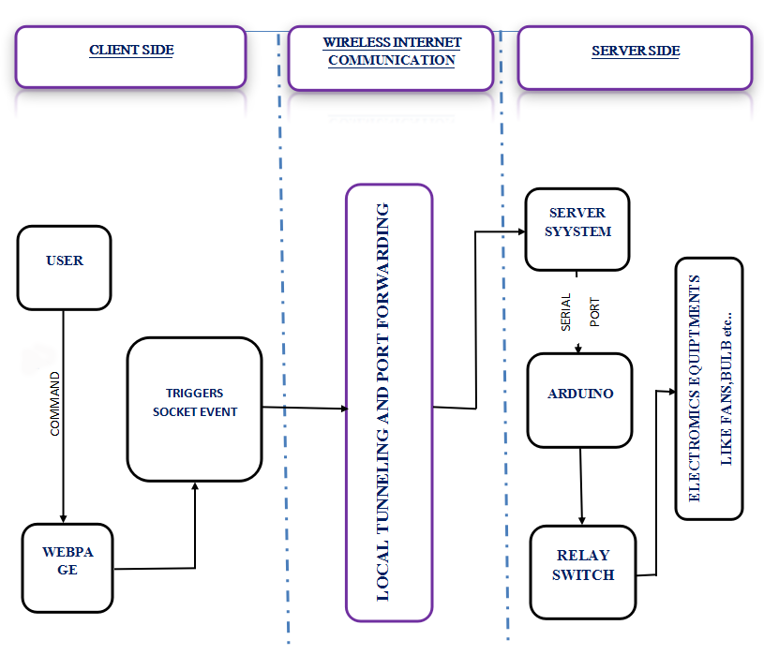
SYSTEM ARCHITECTURE:

Slide 9
MODULE DESCRIPTION:
Internet of Things(IOT)
Software and Hardware Technologies
Web Technologies

Slide 10
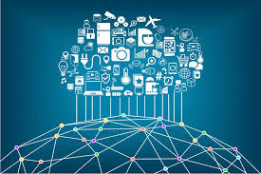
INTERNET OF THINGS(IOT):
The Internet of things (IoT) is the network of physical devices, vehicles, home appliances and other items embedded with electronics, software, sensors, actuators, and network connectivity which enables these objects to connect and exchange data.

Slide 11
Each thing is uniquely identifiable through its embedded computing system but is able to inter-operate within the existing Internet infrastructure.Experts estimate that the IoT will consist of about 30 billion objects by 2020. It is also estimated that the global market value of IoT will reach $7.1 trillion by 2020.
The IoT allows objects to be sensed or controlled remotely across existing network infrastructure, creating opportunities for more direct integration of the physical world into computer-based systems, and resulting in improved efficiency, accuracy and economic benefit in addition to reduced human intervention. When IoT is augmented with sensors and actuators, the technology becomes an instance of the more general class of cyber-physical systems, which also encompasses technologies such as smart grids, virtual power plants, smart homes, intelligent transportation and smart cities

Slide 12
"Things", in the IoT sense, can refer to a wide variety of devices such as heart monitoring implants, biochip transponders on farm animals, cameras streaming live feeds of wild animals in coastal waters, automobiles with built-in sensors, DNA analysis devices for environmental/food/pathogen monitoring, or field operation devices that assist firefighters in search and rescue operations. Legal scholars suggest regarding "things" as an "inextricable mixture of hardware, software, data and service".
These devices collect useful data with the help of various existing technologies and then autonomously flow the data between other devices.
The term "the Internet of things" was coined by Kevin Ashton of Procter & Gamble, later MIT's Auto-ID Center, in 1999.

Slide 13

SOFTWARE AND HARDWARE
TECHNOLOGIES:
Node.JS:
Node.js® is a JavaScript runtime built on Chrome's V8 JavaScript engine. Node.js uses an event-driven, non-blocking I/O model that makes it lightweight and efficient. Node.js' package ecosystem, npm, is the largest ecosystem of open source libraries in the world.

Slide 14
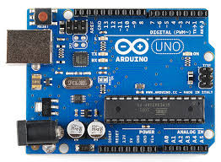
ARDUINO:
Arduino is an open source computer hardware and software company, project, and user community that designs and manufactures single-board microcontrollers and microcontroller kits for building digital devices and interactive objects that can sense and control objects in the physical world.

Slide 15
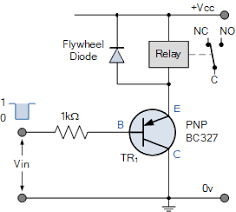
RELAY SWITCH:
A relay is an electrically operated switch. Many relays use an electromagnet to mechanically operate a switch, but other operating principles are also used, such as solid-state relays. Relays are used where it is necessary to control a circuit by a separate low-power signal, or where several circuits must be controlled by one signal.

Slide 16
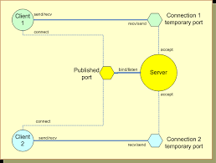
Socket Connection:
A network socket is an internal endpoint for sending or receiving data at a single node in a computer network. Concretely, it is a representation of this endpoint in networking software (protocol stack), such as an entry in a table (listing communication protocol, destination, status, etc.), and is a form of system resource.

Slide 17
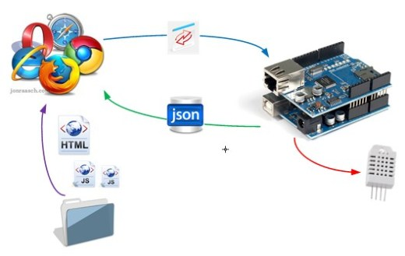
Software Firmata:
Firmata is a generic protocol for communicating with microcontrollers from software on a host computer. It is intended to work with any host computer software package. There are implementations for multiple microcontrollers and host software packages.

Slide 18

WEB TECHNOLOGIES:
HTML:
Hypertext Markup Language (HTML)
is the standard markup language for creating
web pages and web applications.
With Cascading Style Sheets (CSS) and
JavaScript it forms a triad of cornerstone
technologies for the World Wide Web.
Web browsers receive HTML documents from a web server or from local storage and render them into multimedia web pages. HTML describes the structure of a web page semantically and originally included cues for the appearance of the document.

Slide 19

CSS:
Cascading Style Sheets (CSS) is a style
sheet language used for describing the
presentation of a document written in a
markup language.
Along with HTML and JavaScript, CSS is a cornerstone technology used by most websites to create visually engaging webpages, user interfaces for web applications, and user interfaces for many mobile applications.

Slide 20

Local Tunnnelling:
In computer networks, a tunnelling
protocol allows a network end user
to access network service that the
network does not provide directly.
One important use of a tunnelling
protocol is to allow a foreign protocol
to run over a network that does not support that particular
protocol.
Another important use is to provide services that are impractical or unsafe to be offered using only the underlying network services. Because tunnelling involves repackaging the traffic data into a different form, perhaps with encryption as standard, a third use is to hide the nature of the traffic that is run through the tunnels.

Slide 21
Tunnelling and IOT Blocks:
The tunnelling technology is the most promising but unexposed technology that deserves some huge attention especially in the field of IoT. Tunnelling makes several initialization steps in the IoT platform unnecessary.
The promise of this technology is that the internet will not influence IoT and so physical devices won’t be hacked and they are secure. At the same time, they are robust enough as they are backed up by existing protocols.
This technology also has the potential to create private IoT blocks in the internet that can communicate with each other and they could share relevant data between themselves.

Slide 22
This would automate several tasks within the IoT block.IoT blocks are a kind of yet to come idea that will glue up several physical objects inside a specific area and monitored by a man power or an AI.
This kind of blocking up of the physical devices provide the necessary security and also the limit that any device could access data from.
Tunnelling makes this process of IoT Blocking possible by creating a tunnel for all the devices inside the block. Tunnels could possibly share certain amount of data.
The level of data abstraction that every tunnel shows depends upon the need for data. Thus, tunnels could make the entire IoT world private and separated from the vision of hackers.

Slide 23
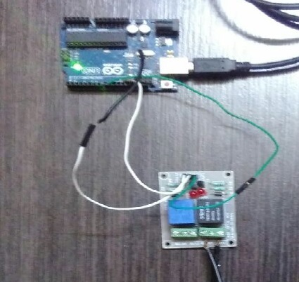
SCREENSHOTS:
Figure 1: Connection between the Relay switch and Arduino

Slide 24
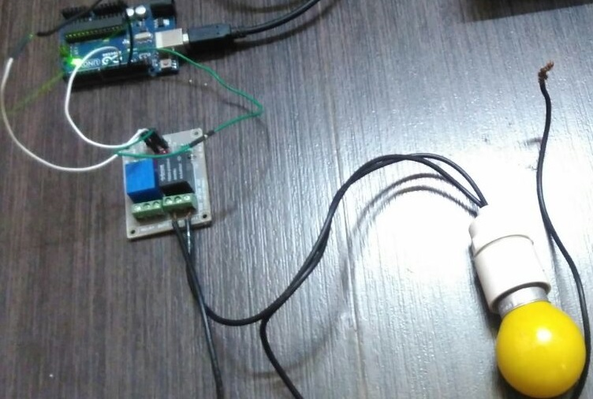
Figure 2: Connection with an Appliance

Slide 25
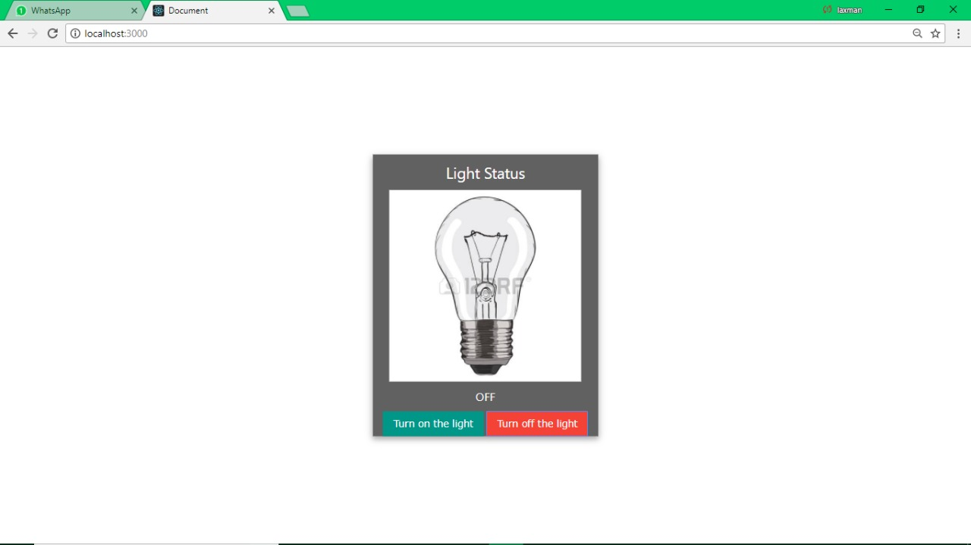
Figure 4:Web Application that indicates light is in off state

Slide 26
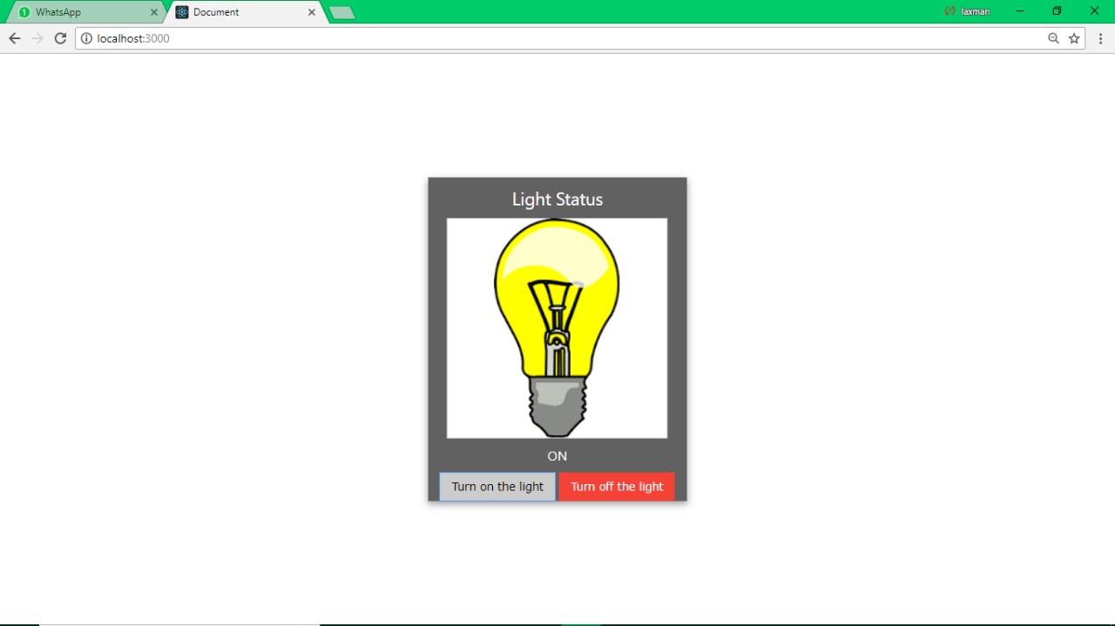
Figure 5:Receive user command and whens to On State

Slide 27
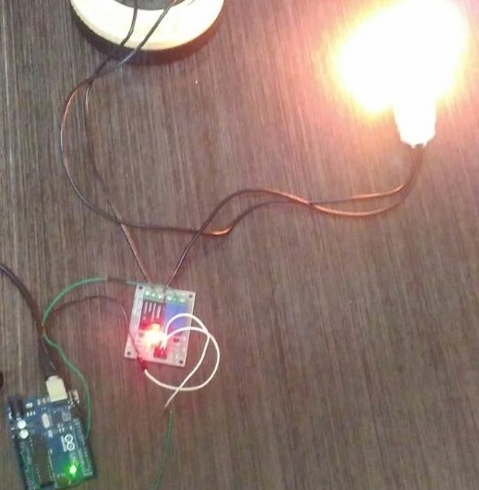
Figure 6:Output of
controlling the appliances

Slide 28
CONCLUSION:
In the future, this technology may be even used in the brain computer interaction technologies to control physical devices with just thoughts! So, the tunnelling technology has to be developed even further and exposed further to unlock its complete potentials.
Current tunnelling technologies are just in alpha or beta stage developments and not much commercially supported because of the limited exposure.
On the business and household side, this technology could be exposed to automate several tasks and control the physical devices from online over any distance, without any cloud dependency.

Slide 29
The final thought is that all data presently available should be open sourced and all future data also should not be dumped into a particular server. This will lead to a democratic online society for the future.
REFERENCES:
[1] Mung Chiang, Tao Zhang,’’ Fog and IoT: An Overview of Research Opportunities” IEEE Internet of Things Journal ( Volume: 3, Issue: 6, Dec. 2016 ) Page(s): 854 – 864.
[2] Yuchen Yang, Longfei Wu, Guisheng Y,”A Survey on Security and Privacy Issues in Internet-of-Things’’in IEEE Internet of Things Journal ( Volume: 4, Issue: 5, Oct. 2017 ),Page(s): 1250 – 1258

Slide 30
[3] Jie Lin, Wei Yu, Nan Zhang,’’ A Survey on Internet of Things: Architecture, Enabling Technologies, Security and Privacy, and Applications’’, IEEE Internet of Things Journal (Volume: 4, Issue: 5, Oct. 2017), Page(s): 1125 – 1142
[4] Ruinian Li; Tianyi Song; Nicholas Capurso; Jiguo Yu; Jason Couture; Xiuzhen Cheng,’’ IoT Applications on Secure Smart Shopping System” IEEE Internet of Things Journal (Volume: 4, Issue: 6, Dec. 2017) Publication Year: 2017, Page(s):1945-1954
[5] Shanzhi Chen; Hui Xu; Dake Liu; Bo Hu; Hucheng Wang,’’ A Vision of IoT: Applications, Challenges, and Opportunities with China Perspective” IEEE Internet of Things Journal, vol. 1, no. 4, august 2014 Publication Year: 2014, Page(s):349-359

Slide 31
THANK YOU

