Slide 1

PBR VISVODAYA INSTITUTE OF TECHNOLOGY AND SCIENCE
DEPARTMENT OF AIML
Batch No: 2239C4
P. Santhosh
2273A39127
D. Ganesh
2273A39079
Project Guide
N. Jaswanth
2273A39099
Dr. M. Praveen Kumar
V. Naveen
2273A39L01

Slide 2
PROJECT TITLE
MACHINE LEARNING BASED INTRUSION DETECTION SYSTEM IN CLOUD ENVIRONMENT
01 / 10

Slide 3
Contents
Abstract
Objectives
Introduction
Existing System
Existing System Drawbacks
Proposed System
Merits of Proposed System
System Requirements
02 / 10

Slide 4
Objective
To identify the limitations of existing cloud-based intrusion detection systems that use large feature sets and high computational resources.
To design a cloud-based intrusion detection system using feature engineering to select only the most relevant features.
To implement a Random Forest–based intrusion detection model for distinguishing normal and abnormal network activities.
To develop an efficient and reliable IDS that reduces computational overhead while handling cloud network traffic.
03 / 10

Slide 5
Literature Survey
Several researchers applied machine learning techniques to detect network intrusions in cloud environments and classify traffic as normal or malicious.
Deep learning approaches such as CNN, RNN, and neural networks have been used to improve intrusion detection accuracy and identify complex attack patterns.
Optimization techniques like Particle Swarm Optimization and Bat Algorithm are used for feature selection and parameter tuning in intrusion detection systems
However, many existing IDS models still face issues such as high computational complexity, large feature sets, and difficulty detecting new attacks in cloud environments.
04 / 10

Slide 6
Existing System
Existing cloud-based intrusion detection systems rely on traditional security tools such as firewalls, signature-based IDS, and machine learning models that use large feature sets.
These systems face challenges in handling large volumes of cloud traffic and have difficulty detecting unknown or new attack patterns.
Many existing IDS approaches use deep learning or multiple classifiers, which require high computational resources.
Due to large feature sets, existing systems often suffer from overfitting, high false alarms, and increased execution time.
05 / 10

Slide 7
Existing System Drawbacks
Existing cloud-based intrusion detection systems rely on traditional security tools such as firewalls, signature-based IDS, and machine learning models that use large feature sets.
High-dimensional data leads to longer training and detection time, making IDS inefficient for large-scale cloud environments.
Cloud environments generate large volumes of continuous network traffic, which existing IDS struggle to process in a timely manner.
Traditional IDS fail to detect unknown attacks, while some machine learning models suffer from overfitting, leading to false alarms and poor generalization.
06/ 10

Slide 8
Proposed System
The proposed system introduces a cloud-based intrusion detection approach that combines feature engineering with a Random Forest (RF) classifier to detect abnormal network activities.
The system performs data preprocessing and reduces the number of features by selecting only the most relevant ones for intrusion detection.
Feature reduction helps simplify the model and reduce computational complexity during training and detection.
By using a reduced and optimized feature set, the proposed IDS becomes more efficient and reliable for handling cloud network traffic.
07 / 10

Slide 9
Merits Of Proposed System
The proposed system efficiently analyzes cloud network traffic by using optimized features, making intrusion detection more reliable in dynamic cloud environments.
The use of a Random Forest classifier improves robustness and reduces the risk of overfitting compared to single-model approaches.
Feature selection reduces data complexity, leading to lower processing time and memory usage.
The system provides faster intrusion detection with reduced computational overhead, making it suitable for cloud-based environments.
08 / 10

Slide 10
System Requirements
Hardware Requirements
Software Requirements
RAM - 8GB (min.)
OS - Windows 10 and above
Minimum 50GB free disk space
Backend - Python (Django)
Any modern multi-core processor (Intel / AMD equivalent)
Frontend - HTML, CSS, JS
Database - MySQL
09 / 10

Slide 11
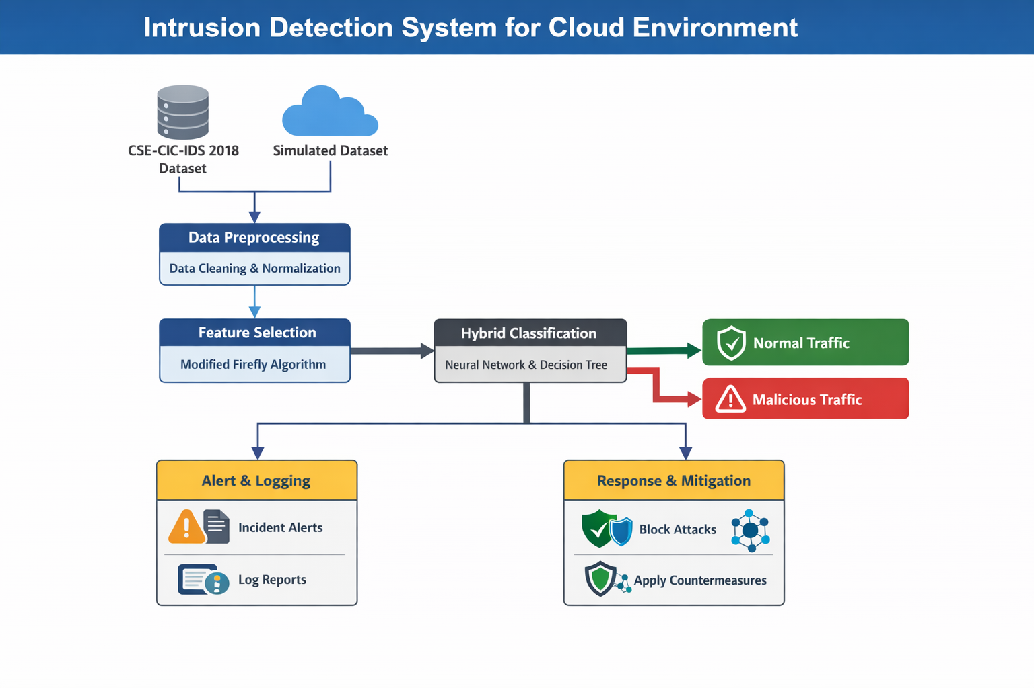
Model (or) Architecture Design
10/10

Slide 12
Thank You

