Slide 1
Pixel_Vault – Image Based Encryption Tool (secure data hiding in images using steganography )
CAPSTONE PROJECT
Presented By:
Student Name : J.Santhoshram
College Name & Department : Hindustan University & CSE

Slide 2
OUTLINE
Problem Statement
Technology used
Wow factor
End users
Result
Conclusion
Git-hub Link
Future scope

Slide 3
Problem Statement
In today's digital world, traditional encryption methods can be easily detected and blocked. This project presents a unique way to hide secret messages inside images using Least Significant Bit (LSB) Steganography. With this method, communication remains hidden, secure, and untraceable, making it a useful tool for secure messaging.

Slide 4
Technology used
Programming Language: Python
Libraries & Tools: - Tkinter (for the graphical interface), - PIL (for image processing), - hashlib (for password security)

Slide 5
Wow factors
Password-Protected Encryption & Decryption – Adds an extra layer of security
Hidden Communication – Data remains undetectable in images
Easy-to-Use Interface – Simple GUI for all users
No Image Quality Loss – Maintains the original image’s look while embedding secret messages

Slide 6
End users
Individuals who want to send confidential messages securely
Cybersecurity enthusiasts exploring data hiding techniques
Researchers & Students studying steganography
Organizations that require covert data transmission

Slide 7
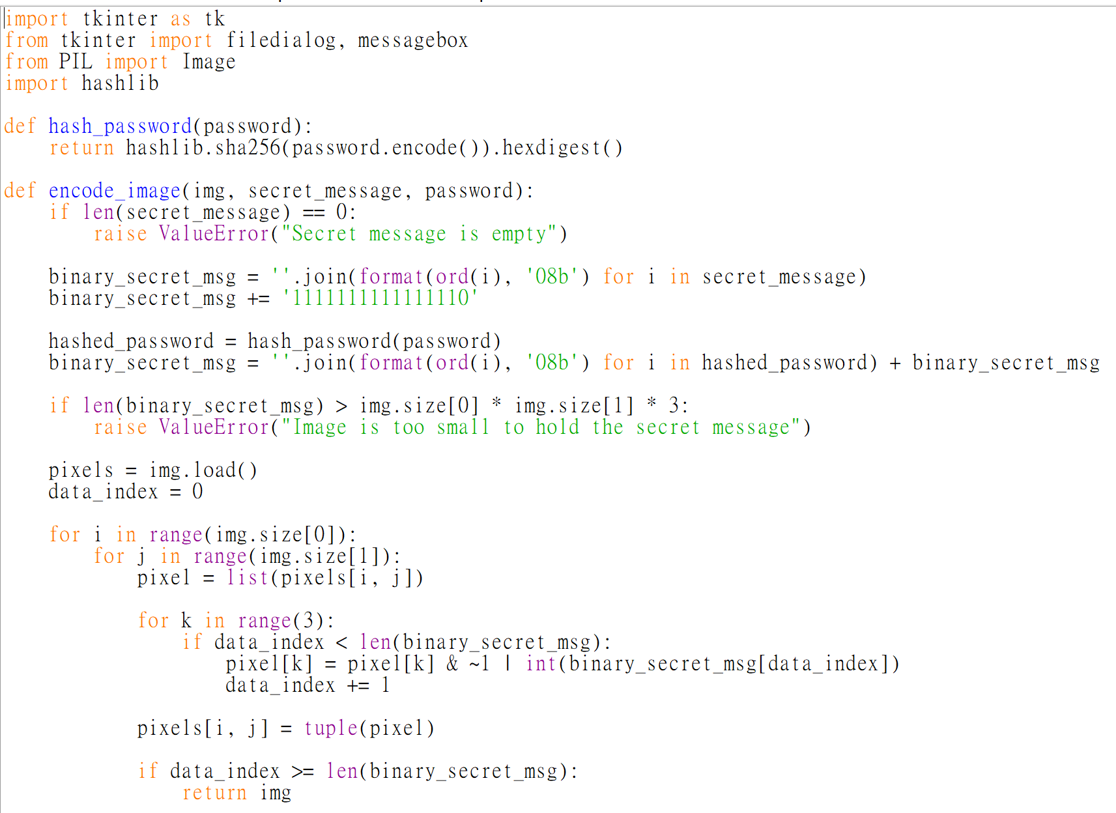
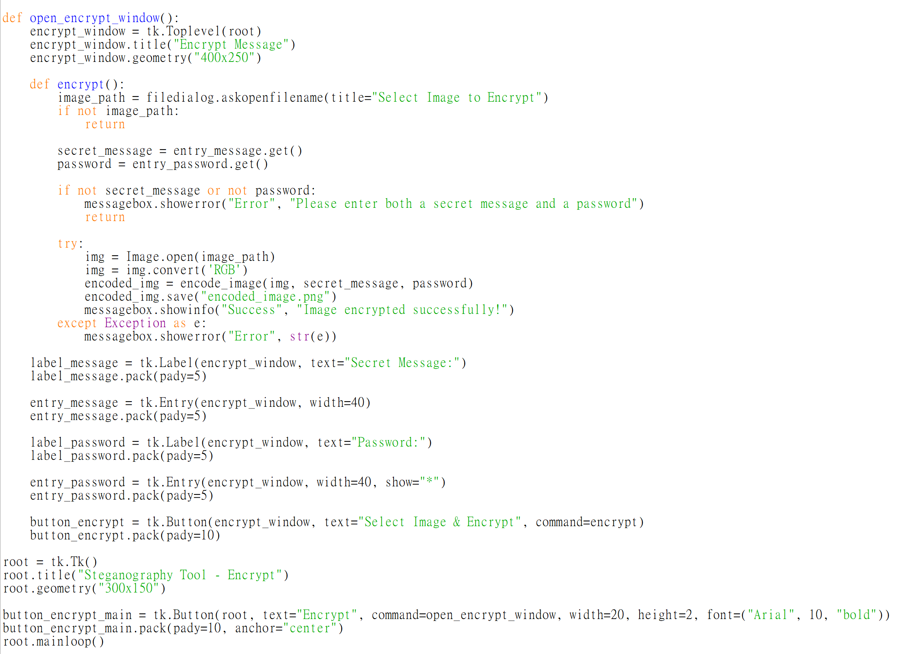
Results
Encryption Code:

Slide 8
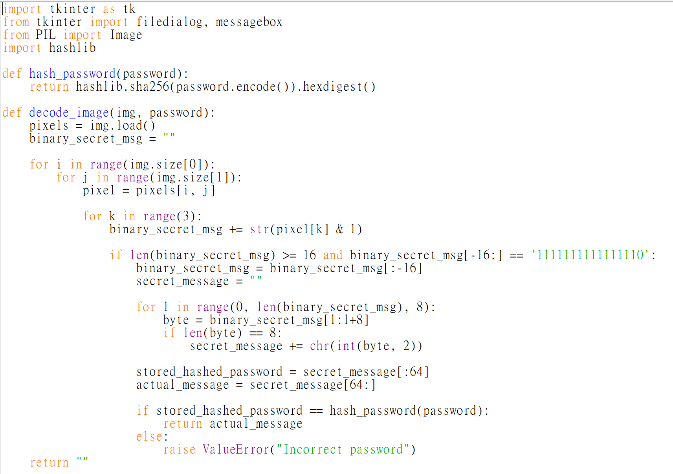
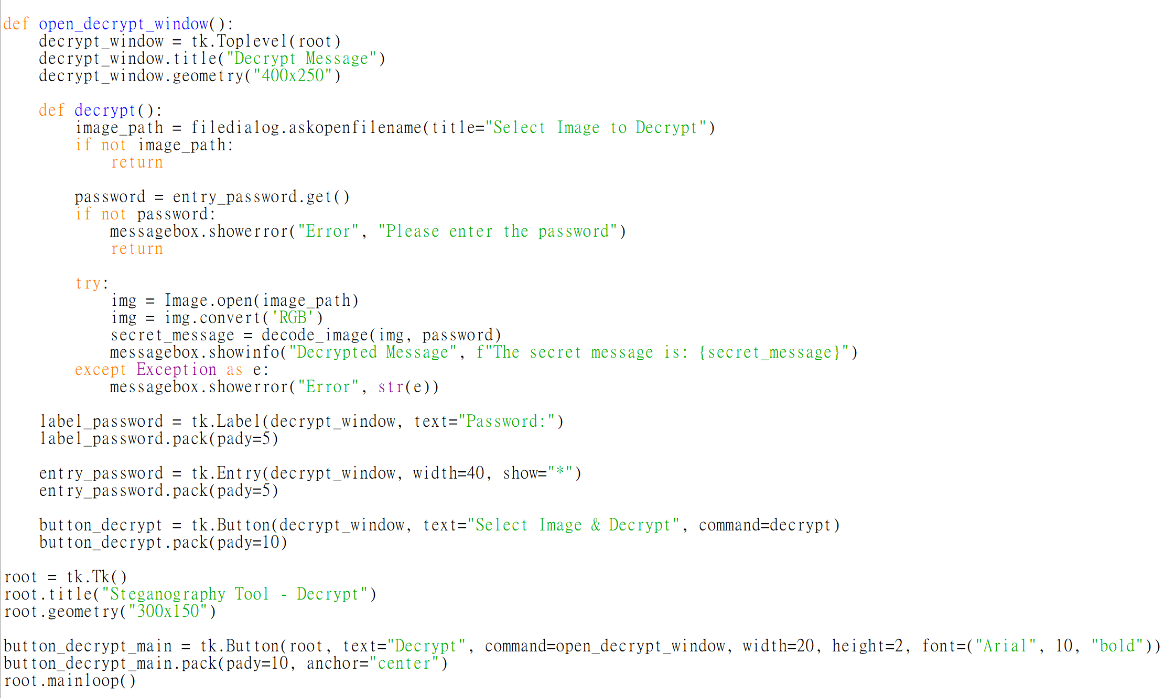
Results
Decryption Code:

Slide 9
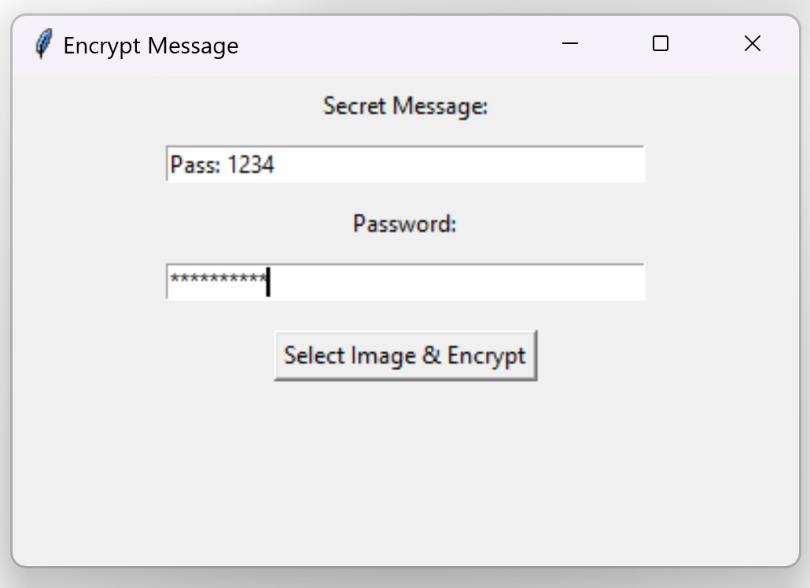
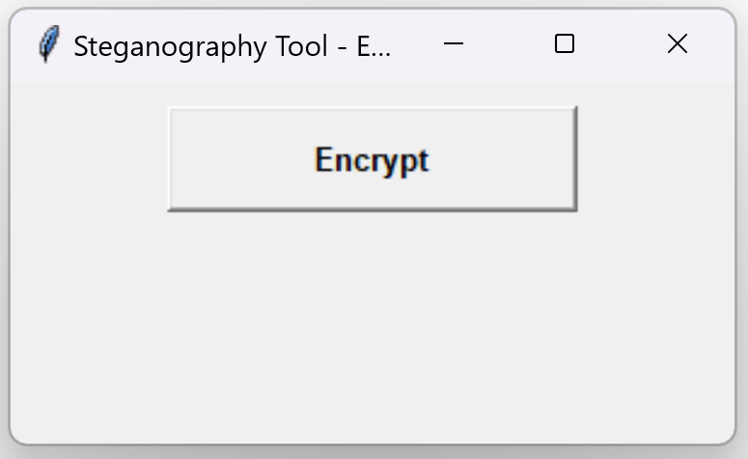
Results
Output:
→

Slide 10
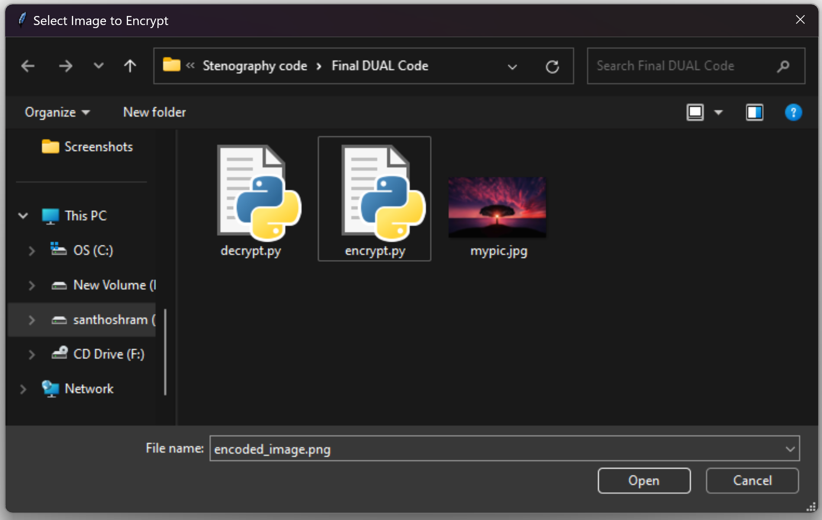
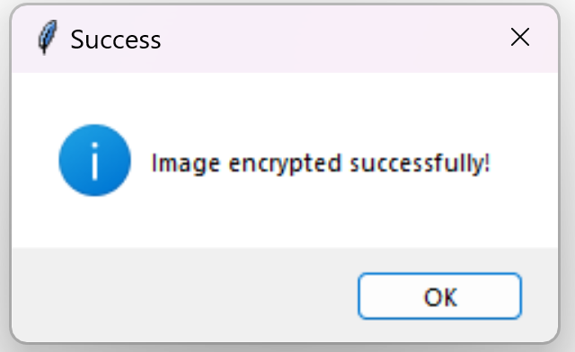
Results
Output:
→

Slide 11
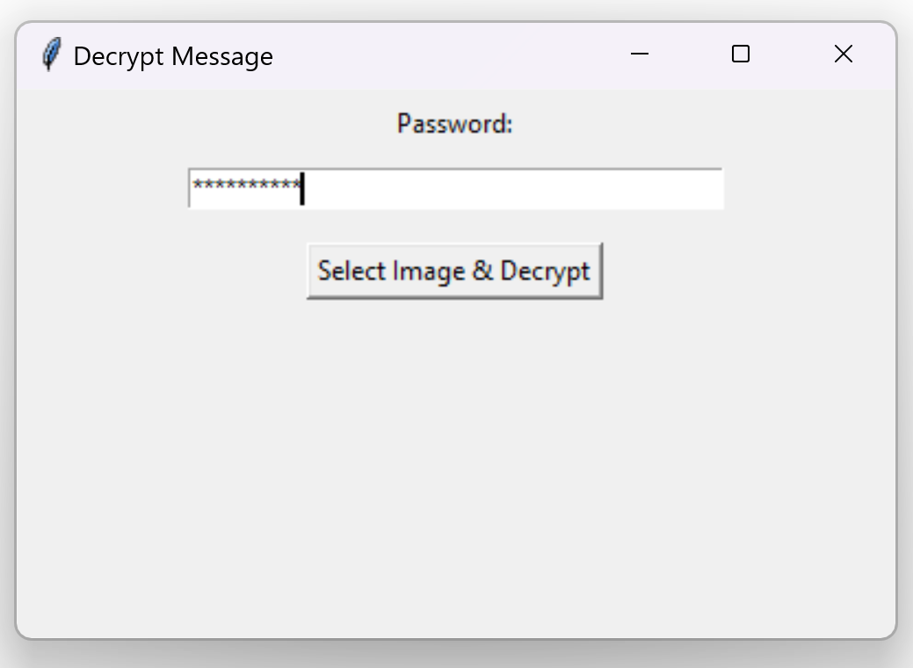
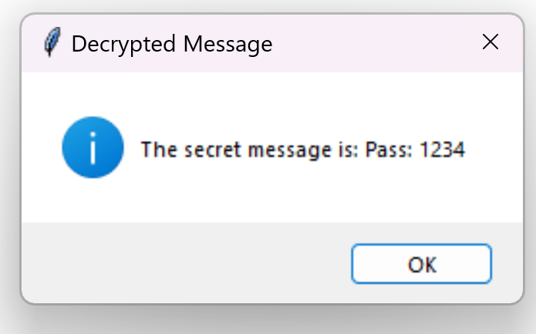
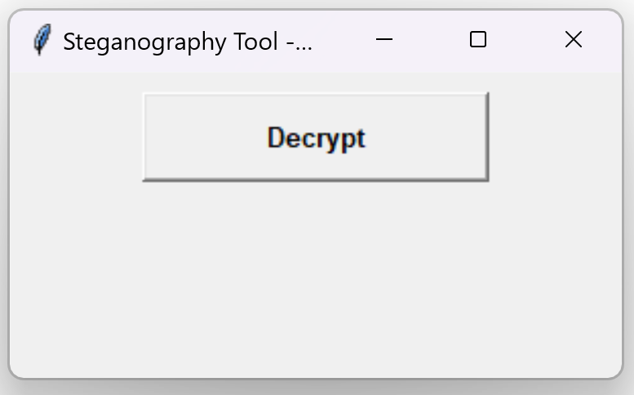
Results
Output:
→
→

Slide 12
Conclusion
This project successfully implements a simple yet powerful steganography tool that enables covert and password-protected communication through images. With an intuitive interface and strong security, it offers a reliable way to transmit sensitive data without raising suspicion.

Slide 13
GitHub Link
https://github.com/Santhoshram043/PixelVault-Image-Based-Encryption-Tool.git

Slide 14
Future scope(optional)
Mobile App Integration – Bringing steganography to smartphones
Advanced Encryption Algorithms – Further improving security
Support for More Image Formats – Expanding usability
Cloud-Based Secure Steganography – Enabling remote data hiding

Slide 15
THANK YOU

