Slide 1
Identify Covid-19 or not using SMLT

Slide 2
Abstract:
The Coronavirus disease 2019 (COVID-19) pandemic, which originated in Wuhan China, has had disastrous effects on the global community and has overburdened advanced healthcare systems throughout the world, WHO is continuously monitoring and responding to this pandemic. The current rapid and exponential rise in the number of patients has necessitated efficient and quick prediction of the possible outcome of an infected patient for appropriate treatment using AI techniques. The aim is to predict machine learning based techniques for covid-19 recovery chances possible or not prediction results in best accuracy. The analysis of dataset is done by supervised machine learning technique(SMLT) to capture several information’s like, variable identification, uni-variate analysis, bi-variate and multi-variate analysis, missing value treatments and analyze the data validation, data cleaning/preparing and data visualization will be done on the entire given dataset. To propose a machine learning-based method to accurately predict recovery chances by prediction results in the form of whether the covid-19 patient precondition.

Slide 3
Existing System
In December 2019, a pandemic named COVID-19 broke out in Wuhan, China, and in a few weeks, it spread to more than 200 countries worldwide. Every country infected with the disease started taking necessary measures to stop the spread and provide the best possible medical facilities to infected patients and take precautionary measures to control the spread. As the infection spread was exponential, there arose a need to model infection spread patterns to estimate the patient volume computationally. Such patients’ estimation is the key to the necessary actions that local governments may take to counter the spread, control hospital load, and resource allocations. This article has used long short-term memory (LSTM) to predict the volume of COVID-19 patients in Pakistan. LSTM is a particular type of recurrent neural network (RNN) used for classification, prediction, and regression tasks. We have trained the RNN model on Covid-19 data (March 2020 to May 2020) of Pakistan and predict the Covid-19 Percentage of Positive Patients for June 2020. Finally, we have calculated the mean absolute percentage error (MAPE) to find the model’s prediction effectiveness on different LSTM units, batch size, and epochs. Predicted patients are also compared with a prediction model for the same duration, and results revealed that the predicted patients’ count of the proposed model is much closer to the actual patient count.

Slide 4
Disadvantages
The existing method is only patient count and it does not classify whether covid or not the patient is recovered or not.
Accuracy , Recall F1 score metrics are not calculated and machine learning algorithms are not applied.

Slide 5
Proposed system
Exploratory Data Analysis of covid prediction
Multiple datasets from different sources would be combined to form a generalized dataset, and then different machine learning algorithms would be applied to extract patterns and to obtain results with maximum accuracy.
Data Wrangling
In this section of the report will load in the data, check for cleanliness, and then trim and clean given dataset for analysis. Make sure that the document steps carefully and justify for cleaning decisions.

Slide 6
Advantages
These reports are to the investigation of applicability of machine learning techniques for covid disease prediction in operational conditions.
Finally, it highlights some observations on future research issues, challenges, and needs.

Slide 7
Environmental Requirements
1. Software Requirements:
Operating System : Windows
Tool : Anaconda with Jupyter Notebook
2. Hardware requirements:
Processor : Pentium IV/III
Hard disk : minimum 80 GB
RAM : minimum 2 GB

Slide 8
INTRODUCTION:
Domain overview
Data science is an interdisciplinary field that uses scientific methods, processes, algorithms and systems to extract knowledge and insights from structured and unstructured data, and apply knowledge and actionable insights from data across a broad range of application domains.
The term "datascience " has been traced back to 1974, when Peter Naur proposed it as an alternative name for computer science. In 1996, the International Federation of Classification Societies became the first conference to specifically feature data science as a topic. However, the definition was still in flux.

Slide 9
MACHINE LEARNING::
Machine learning is to predict the future from past data. Machine learning (ML) is a type of artificial intelligence (AI) that provides computers with the ability to learn without being explicitly programmed. Machine learning focuses on the development of Computer Programs that can change when exposed to new data and the basics of Machine Learning, implementation of a simple machine learning algorithm using python. Process of training and prediction involves use of specialized algorithms. It feed the training data to an algorithm, and the algorithm uses this training data to give predictions on a new test data. Machine learning can be roughly separated in to three categories. There are supervised learning, unsupervised learning and reinforcement learning. Supervised learning program is both given the input data and the corresponding labeling to learn data has to be labeled by a human being beforehand. Unsupervised learning is no labels. It provided to the learning algorithm. This algorithm has to figure out the clustering of the input data. Finally, Reinforcement learning dynamically interacts with its environment and it receives positive or negative feedback to improve its performance.

Slide 10
PREPARING THE DATASET :
This dataset contains 11000 records of features extracted from Covid Patients, which were then classified into 2 classes:
Positive
Negative

Slide 11
Literature Survey:
Title: World-wide COVID-19 Outbreak Data Analysis and Prediction
Author: Fairoza Amira Binti Hamzaha , Cher Han Laub , Hafeez Nazric , Dominic Vincent Ligotd , Guanhua Leee , Cheng Liang Tanf , Mohammad Khursani Bin Mohd Shaibg , Ummi Hasanah Binti Zaidonh
Year:2020
COVID-19 outbreak was first reported in Wuhan, China and has spread to more than 50 countries. WHO declared COVID-19 as a Public Health Emergency of International Concern (PHEIC) on 30 January 2020. Naturally, a rising infectious disease involves fast spreading, endangering the health of large numbers of people, and thus requires immediate actions to prevent the disease at the community level. Therefore, CoronaTracker was born as the online platform that provides latest and reliable news development, as well as statistics and analysis on COVID-19. This paper is done by the research team in the CoronaTracker community and aims to predict and forecast COVID19 cases, deaths, and recoveries through predictive modelling. The model helps to interpret patterns of public sentiment on disseminating related health information, and assess political and economic influence of the spread of the virus.

Slide 12
Title: MACHINE LEARNING APPLICATIONS FOR COVID-19: A STATE-OF-THE-ART REVIEW.
Author: FIRUZ KAMALOV1∗ , ASWANI CHERUKURI2 , HANA SULIEMAN3 , FADI THABTAH4 , AKBAR HOSSAIN5
Year:2021
The field of machine learning has made tremendous progress over the past decade. Improved deep learning algorithms coupled with increased computational capacity catalyzed the growth of the field into stratosphere. As a result, machine learning has been used in a diverse array of applications. Arguably the most crucial application of machine learning has been in the fight against COVID-19 pandemic. Researchers have aggressively - and often successfully - pursued a number of different avenues using machine learning to battle COVID-19. A range of machine learning applications have been developed to tackle various issues related to the virus. In this paper, we present the latest results and achievements of the machine learning community in the battle against the global pandemic. In contrast, with other existing surveys on the subject we provide a general overview that is nuanced enough to provide a substantial insight.

Slide 13
Title: Prediction, Cross Validation and Classification in the Presence COVID-19 of Indian States and Union Territories using Machine Learning Algorithms
Author: P. Arumugam, V. Kadhirveni, R. Lakshmi Priya, Manimannan G
Year:2021
The present study predicts, cross validate and classify the data of COVID-19 based on four machine learning algorithm with four major parameters namely confirmed cases, recoveries, deaths and active cases. The secondary sources of database were collected from Ministry of Health and Family Welfare Department (MHFWD), from Indian State and Union Territories up to March, 2021. Based on these background, the database classified and predicted various machine learning Algorithm, like SVM, kNN, Random Forest and Logistic Regression. Initially, the k-mean clustering analysis is used to perform and identified five meaningful clusters and is labeled as Very Low, Low, Moderate, High and Very High of four major parameters based on their average values. In addition the five clusters are cross validated using four machine learning algorithm and affected states were .visualized with help of prediction and probabilities

Slide 14
Objectives:
The goal is to develop a machine learning model for Covid Disease Prediction, to potentially replace the updatable supervised machine learning classification models by predicting results in the form of best accuracy by comparing supervised algorithm.

Slide 15
Project Goals:
Exploration data analysis of variable identification
Loading the given dataset
Import required libraries packages
Analyze the general properties
Find duplicate and missing values
Checking unique and count values
Exploration data analysis of bi-variate and multi-variate
Plot diagram of pairplot, heatmap, bar chart and Histogram
Comparing algorithm to predict the result
Based on the best accuracy

Slide 16
Scope of the Project:
Here the scope of the project is that integration of clinical decision support with computer-based patient records could reduce medical errors, enhance patient safety, decrease unwanted practice variation, and improve patient outcome. This suggestion is promising as data modeling and analysis tools, e.g., data mining, have the potential to generate a knowledge-rich environment which can help to significantly improve the quality of clinical decisions.

Slide 17
Feasibility study:
Data Wrangling
In this section of the report will load in the data, check for cleanliness, and then trim and clean given dataset for analysis.
Make sure that the document steps carefully and justify for cleaning decisions.

Slide 18
List of Modules:
Data Pre-processing
Data Analysis of Visualization
Comparing Algorithm with prediction in the form of best accuracy result
Deployment Using Flask

Slide 19
PYTHON:
Introduction:
Python is an interpreted high-level general-purpose programming language. Its design philosophy emphasizes code readability with its use of significant indentation. Its language constructs as well as its object-oriented approach aim to help programmers write clear, logical code for small and large-scale projects.

Slide 20
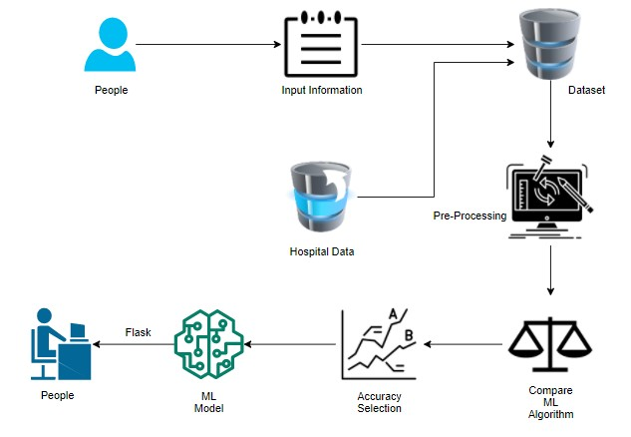
System Architecture :

Slide 21
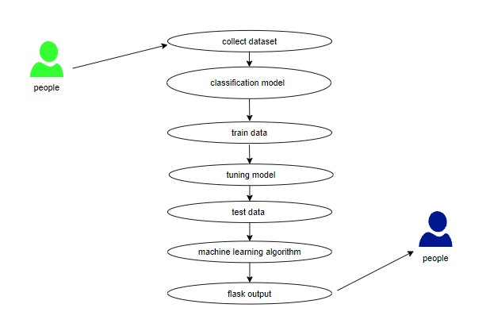
Use Case Diagram:

Slide 22
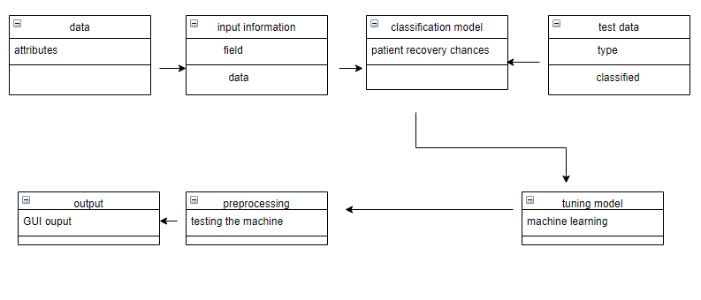
Class Diagram:

Slide 23
Module description:
Data Pre-processing
Validation techniques in machine learning are used to get the error rate of the Machine Learning (ML) model, which can be considered as close to the true error rate of the dataset. If the data volume is large enough to be representative of the population, you may not need the validation techniques. However, in real-world scenarios, to work with samples of data that may not be a true representative of the population of given dataset. To finding the missing value, duplicate value and description of data type whether it is float variable or integer. The sample of data used to provide an unbiased evaluation of a model fit on the training dataset while tuning model hyper parameters.

Slide 24
Data Validation/ Cleaning/Preparing Process:
Importing the library packages with loading given dataset. To analyzing the variable identification by data shape, data type and evaluating the missing values, duplicate values. A validation dataset is a sample of data held back from training your model that is used to give an estimate of model skill while tuning model's and procedures that you can use to make the best use of validation and test datasets when evaluating your models. Data cleaning / preparing by rename the given dataset and drop the column etc. to analyze the uni-variate, bi-variate and multi-variate process. The steps and techniques for data cleaning will vary from dataset to dataset. The primary goal of data cleaning is to detect and remove errors and anomalies to increase the value of data in analytics and decision making.

Slide 25
Exploration data analysis of visualization
Data visualization is an important skill in applied statistics and machine learning.
Statistics does indeed focus on quantitative descriptions and estimations of data.
Data visualization provides an important suite of tools for gaining a qualitative understanding.
This can be helpful when exploring and getting to know a dataset and can help with identifying patterns, corrupt data, outliers, and much more.

Slide 26
Comparing Algorithm with prediction in the form of best accuracy result:
It is important to compare the performance of multiple different machine learning algorithms consistently and it will discover to create a test harness to compare multiple different machine learning algorithms in Python with scikit-learn.
It can use this test harness as a template on your own machine learning problems and add more and different algorithms to compare.
Each model will have different performance characteristics. Using resampling methods like cross validation, you can get an estimate for how accurate each model may be on unseen data.

Slide 27
Algorithm Explanation:
In machine learning and statistics, classification is a supervised learning approach in which the computer program learns from the data input given to it and then uses this learning to classify new observation.
This data set may simply be bi-class (like identifying whether the person is male or female or that the mail is spam or non-spam) or it may be multi-class too.
Some examples of classification problems are: speech recognition, handwriting recognition, bio metric identification, document classification etc

Slide 28
Flask:
Flask is a micro web framework written in Python.
It is classified as a micro-framework because it does not require particular tools or libraries.
It has no database abstraction layer, form validation, or any other components where pre-existing third-party libraries provide common functions.
However, Flask supports extensions that can add application features as if they were implemented in Flask itself.
Extensions exist for object-relational mappers, form validation, upload handling, various open authentication technologies and several common framework related tools.

Slide 29
Conclusion:
The analytical process started from data cleaning and processing, missing value, exploratory analysis and finally model building and evaluation. The best accuracy on public test set is higher accuracy score will be find out. This application can help to find the Prediction of Covid Disease.

Slide 30
Future Work:
Covid Disease prediction to connect with Cloud.
To optimize the work to implement in Artificial Intelligence environment.

