Slide 1

SAMSUNG PRISM
Generative AI
Hackathon
3rd Edition 2026 – 27
Theme ID - 4
Team Name - GS CodeStorm
College Name -VIT University ,Vellore
Member Name & Email - Santhosh S . santhoshsanthoshkavi18@gmail.com
Submission Github link - https://github.com/Santhoshsubramani22/Samsung-Prism-Generative-AI-Hackathon-Santhosh-4
Notes:
Opening slide for the 3rd edition of the PRISM Generative AI Hackathon. Replace the SAMSUNG PRISM pill with the official PRISM logo image if you have the asset. Confirm the academic year label (2026-27) before circulating.

Slide 2
Theme
The Problem
Traditional RAG systems generally follow:
Query → Retrieve → Generate → End
This creates problems during real conversations:
1. No conversation continuity
Each query can be treated independently, causing the system to lose previous context.
2. Repeated retrieval
Follow-up questions may trigger retrieval from scratch instead of reusing the existing conversation state.

Slide 3
Theme
3. Late constraints are difficult
Users frequently modify their request after receiving an answer.
Example:
“What are the main modules?”
Then:
“Tell me only about the booking module.”
The system must understand that the second request is a refinement, not an unrelated question.

Slide 4
Theme
4. Multi-intent queries
A single question can contain multiple information needs.
“Who is Mayuri M Shine and what are the main modules?”
These should be understood as separate intents.
5. Irrelevant retrieved context
Retrieving many chunks does not guarantee that all retrieved information is useful or supports the final answer.
6. Delayed response experience
Traditional request-response generation makes the user wait for the complete answer.

Slide 5
Existing Solutions & Gaps
Why Traditional RAG Is Not Enough
Traditional RAG | Our Streaming Live RAG
Processes queries independently | Maintains conversation state
Retrieve → Generate | Understand → Retrieve → Stream → Refine
Follow-up may restart retrieval | Follow-up uses previous state
Late constraints are difficult | Supports constraint refinement
Single-query oriented | Multi-intent aware
Large retrieved context | Evidence filtering
Complete response generation | Incremental streaming
New answer each time | Versioned answer refinement
Key idea
Traditional RAG answers questions. Our system manages an evolving conversation.

Slide 6
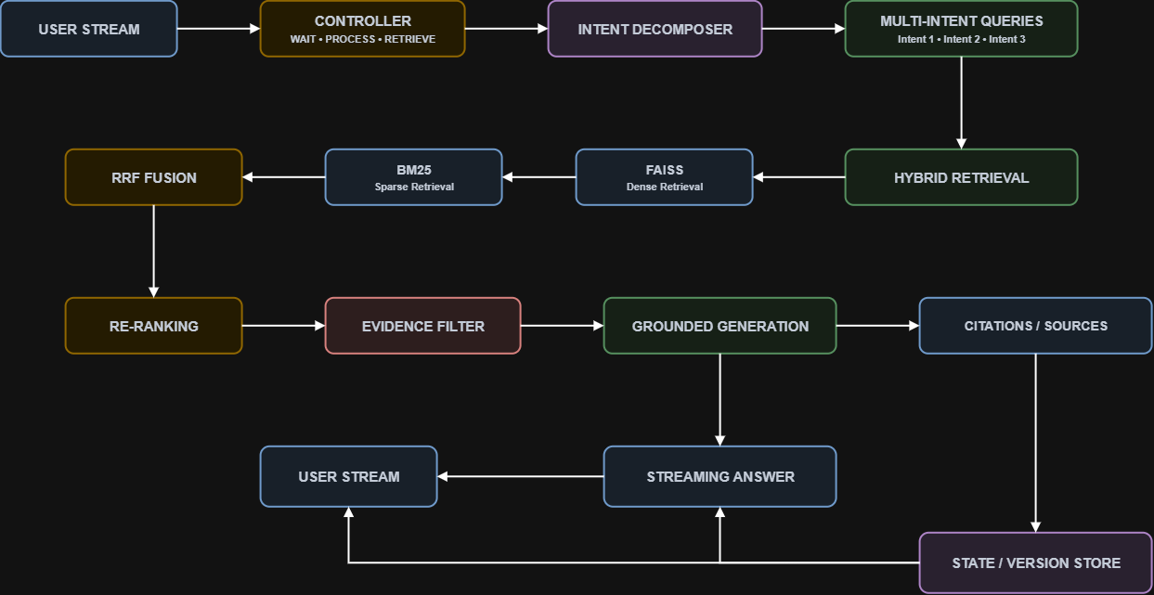
Our Solutions & Architecture Diagram
Streaming Live RAG
Our system introduces a state-preserving RAG workflow that continuously understands and refines the user's request.

Slide 7
Demo & Product Walkthrough
Live Product Walkthrough
1. WAIT — Conversational Input
User: “Hello”
Controller identifies a conversational message.
No unnecessary document retrieval.
System responds immediately.
2. RETRIEVE — Document Question
User: “Who is Mayuri M Shine?”
Intent identified as a retrieval request.
Relevant SRS evidence is retrieved.
Evidence is filtered.
Grounded answer is generated and streamed.

Slide 8
Demo & Product Walkthrough
3. MULTI-INTENT
User: “Who is Mayuri M Shine and what are the main modules?”
Query is decomposed into separate intents.
Relevant evidence is retrieved for each intent.
Information is combined into one response.

Slide 9
Demo & Product Walkthrough
State-Preserving Refinement
Initial Question
“What are the main modules of the Hotel Management System?”
⬇️
Answer Version 1
Customer Management
Room Management
Booking
Billing
.

Slide 10
Demo & Product Walkthrough
User adds a late constraint
“Tell me only about the booking module.”
⬇️
State-Preserving Refinement
Previous conversation state is retained.
New constraint is detected.
Retrieval is focused on the booking module.
Irrelevant context is filtered.
A refined Answer Version 2 is streamed

Slide 11
Demo & Product Walkthrough
Key Innovation
The system does not restart the conversation. It refines the existing answer.
Visual flow
USER QUERY
↓
CONTROLLER
↓
RETRIEVE
↓
ANSWER v1
↓
NEW CONSTRAINT
↓
STATE PRESERVED
↓
TARGETED RETRIEVAL
↓
ANSWER v2

Slide 12
Tools and tech stack used
Category | Technology | Purpose
Programming | Python | Core application and RAG pipeline
Web Framework | Flask | Backend, API and application routing
Frontend | HTML, CSS, JavaScript | Interactive chat interface
Generative AI | Google Gemini API | Grounded answer generation
Vector Retrieval | FAISS | Semantic similarity search
Keyword Retrieval | BM25 | Exact keyword-based retrieval
Retrieval Fusion | RRF | Combines FAISS + BM25 results
Reranking | Reranker | Improves relevance of retrieved chunks
Evidence | Evidence Filtering | Removes less relevant context
Streaming | Server-Sent Events (SSE) | Live incremental response streaming
Testing | Pytest | Automated testing

Slide 13
Impact & Use case
Our Streaming Live RAG system improves document-based conversational AI by:
Reducing repeated processing through conversation-state preservation.
Handling evolving user requirements using state-preserving refinement.
Improving retrieval relevance through FAISS + BM25 + RRF.
Reducing irrelevant context using reranking and evidence filtering.
Supporting complex questions through multi-intent decomposition.
Improving user experience through live response streaming.
Maintaining answer evolution using answer versions and conversation state.

Slide 14
Impact & Use case
Use Cases
🏢 Enterprise Knowledge Management
Employees can ask questions about internal policies, SRS documents, manuals, and organizational knowledge, then refine the answer without restarting the conversation.
🎧 Customer Support
Customers can begin with a broad question and progressively add constraints.
Example:
“What services are available?”
→ “Tell me only about premium services.”

Slide 15
Impact & Use case
📚 Education & Learning
Students can ask for an explanation and then refine it.
Example:
“Explain this topic.”
→ “Explain only the important points in simple terms.”
💻 Technical Documentation
Developers can ask about a system and then focus on a particular module, API, or component.
Example:
“What are the modules?”
→ “Explain only the authentication module.”

Slide 16
Impact & Use case
🔬 Research & Document Analysis
Researchers can ask broad questions over large document collections and progressively narrow the information they need.
Traditional RAG
Retrieve → Generate → Restart
↓
Streaming Live RAG
Understand → Retrieve → Stream → Remember → Refine

Slide 17
Innovation highlights, results and limitations
🚀 Innovation Highlights
State-Preserving RAG – Maintains conversation state instead of restarting retrieval for every query.
Live Streaming Answers – Uses SSE to stream generated responses progressively.
Late-Constraint Refinement – New constraints refine the previous answer without losing earlier context.
Multi-Intent Decomposition – Splits complex questions into separate intents for targeted retrieval.
Hybrid Retrieval – Combines FAISS semantic search + BM25 keyword search + RRF fusion.
Evidence-Aware Generation – Filters and verifies retrieved evidence before generating the answer.
Answer Versioning – Tracks Answer v1, v2, etc., showing how responses evolve after refinement.
Dynamic Controller – Routes each user message into WAIT, PROCESS, RETRIEVE, or REFINE states.

Slide 18
Innovation highlights, results and limitations
📊 Results / Evaluation
The prototype is designed to evaluate:
Recall@K & Precision@K – Retrieval quality
MRR – Ranking quality
Relevance Score – Retrieved evidence relevance
Groundedness / Evidence Accuracy – Whether answers are supported by retrieved content
TTFR – Time to first response/token
Retrieval & Generation Latency – Pipeline performance
Constraint Detection Accuracy – Correct identification of late constraints
Evidence Reuse / New Evidence – Measures whether refinement efficiently reuses previous context

Slide 19
Innovation highlights, results and limitations
Evaluation comparison:
Dense Retrieval → BM25 → Hybrid RRF → Hybrid + Reranking + Evidence Filtering
No fabricated benchmark values are claimed; quantitative results can be added after running the benchmark on the final corpus.
⚠️ Limitations
Gemini API availability and response latency can affect live streaming.
Current session state uses in-memory storage, not a distributed production store.
Complex tables, layouts, and poorly formatted documents may reduce retrieval quality.
Claim-level verification can be further strengthened.
Large-scale multi-user deployment requires persistent/distributed state management.
More diverse datasets and larger benchmarks are required for comprehensive evaluation.

Slide 20
What’s next
🔮 Future Enhancements
Persistent Distributed State
Integrate Redis/database-backed session memory for reliable multi-user conversations.
Advanced Document Processing
Improve extraction from PDFs, tables, scanned documents, and complex layouts.
Adaptive Retrieval
Dynamically adjust retrieval depth based on query complexity and conversation state.
Advanced Reranking
Add stronger cross-encoder/LLM-based reranking to improve evidence selection.

Slide 21
What’s next
Claim-Level Verification
Verify individual answer claims against retrieved evidence before presenting them.
Scalable Live Streaming
Optimize SSE/WebSocket streaming for concurrent users and low-latency responses.
Continuous Evaluation
Expand the benchmark dataset and continuously measure retrieval, grounding, refinement, and latency metrics.
🎯 Long-Term Vision
Understand → Retrieve → Stream → Remember → Refine
Transform RAG from a one-shot question-answering system into a continuous, state-aware knowledge assistant that improves its answers as the conversation evolves.

Slide 22
Brownie points slide( differentiation)
How Our Solution Stands Out
Traditional RAG | Streaming Live RAG – Our Approach
One-shot Retrieve → Generate | Understand → Retrieve → Stream → Remember → Refine
Conversation context may be lost | State is preserved across turns
New constraint can trigger a complete restart | Late constraints refine the existing answer
Single-intent processing | Multi-intent decomposition
Usually one retrieval strategy | FAISS + BM25 + RRF hybrid retrieval
Retrieved chunks directly passed to generation | Reranking + evidence filtering before generation
Final answer appears after generation | Progressive live response using SSE
No explicit answer evolution | Answer versioning: v1 → v2 → v3
Limited visibility into evidence | Evidence-aware and grounded responses

Slide 23
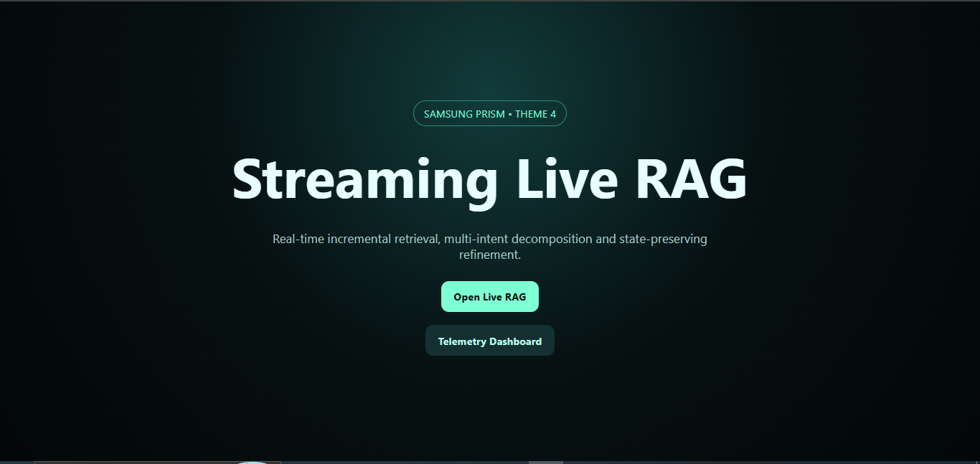
Screenshot

Slide 24
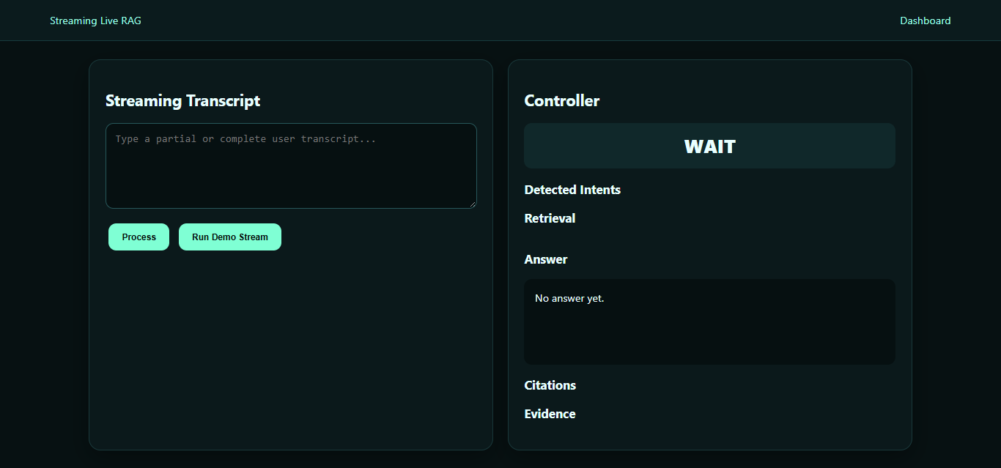
Screenshot

Slide 25
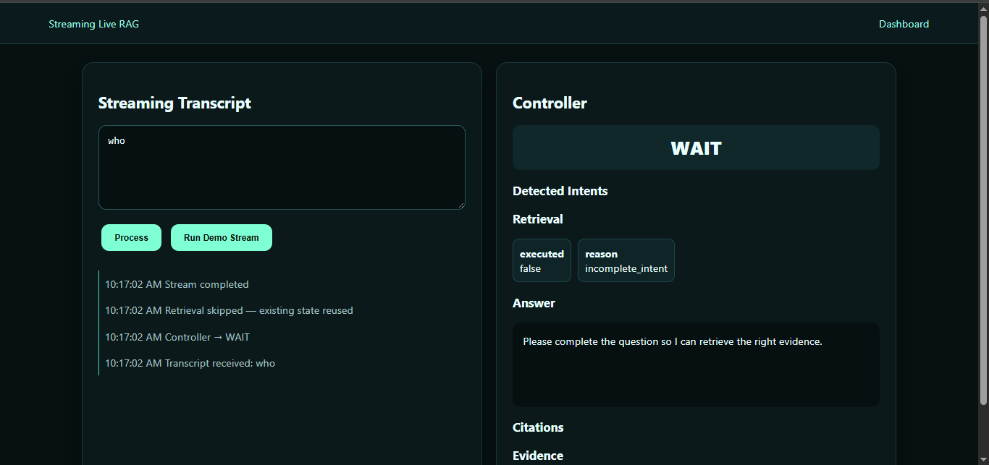
Screenshot

Slide 26
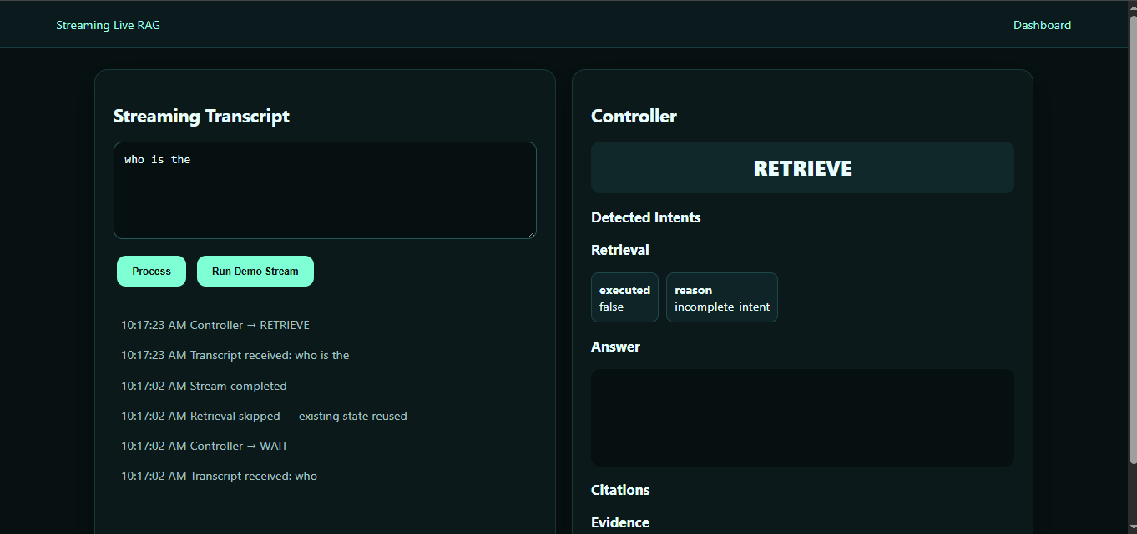
Screenshot

Slide 27
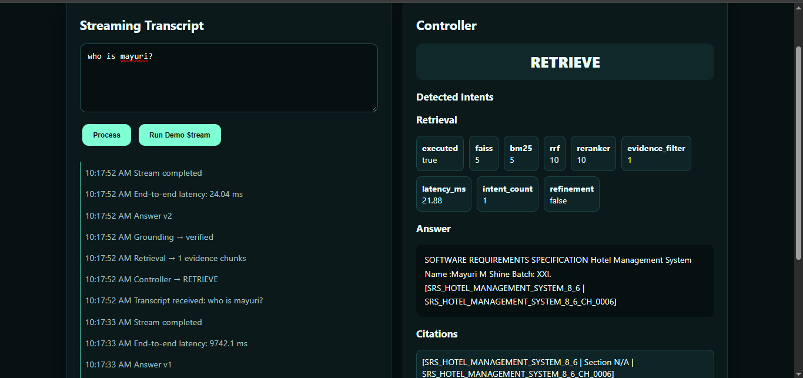
Screenshot

Slide 28
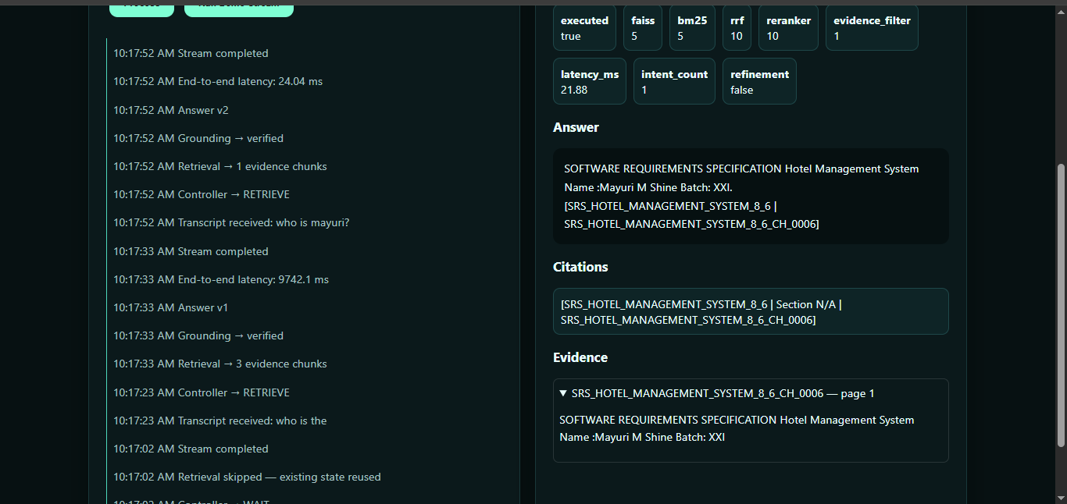
Screenshot

Slide 29
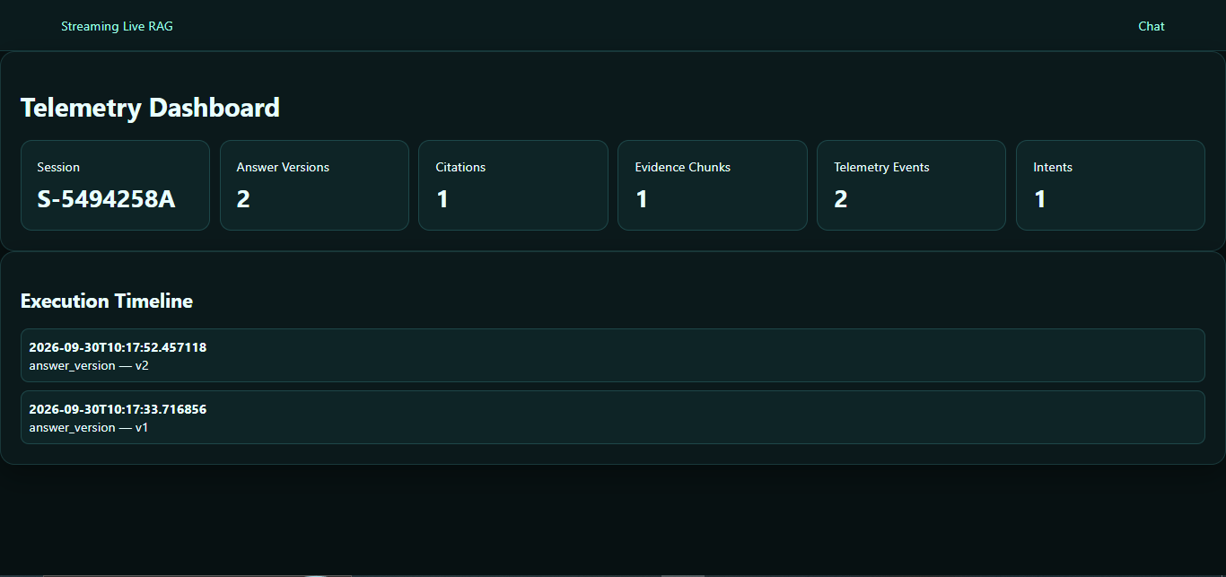
Screenshot

Slide 30
Checklist- Updated on Public GitHub
Working prototype code — public or shared GitHub repo (Y/N)- Yes
README with reproducible setup instructions (Y/N) - Yes
Demo video, max 5 minutes (YouTube or Drive link) - Yes
Presentation file (PPT or PDF) (Y/N) – Yes
Video link https://drive.google.com/file/d/1wRqeWR_73OF0UlTsOlgp88pMK-UJ6dD7/view?usp=drivesdk
Github link - https://github.com/Santhoshsubramani22/Samsung-Prism-Generative-AI-Hackathon-Santhosh-4

Slide 31
Thank you
Organised by the Language AI Team and the PRISM Team, Samsung R&D Institute India
Notes:
Closing slide. Add the Google Form URL and a contact email before sharing. Edition 2 organising team for reference: Language AI - Sourabh Tiwari, Gaurav, Sanjeeth Pothireddy, Gorang Maniar; PRISM - Binny Lakra, Prakhar Chandrakar, Vishu Kumar; Kick-off and mentors - Giridhar Jakki, Deepraj Prabhakar Patkar (Language AI), Srimanu Prasad Nagaraju, Ashish Kumar (Tech Strategy).

