Slide 1
Cognisec AI: Network Behaviour Fingerprinting
An Experimental Comparison of Supervised XGBoost and Variational Autoencoders for Unseen Attack Detection
Candidate: Santhoskrishna | Academic Research Project Defense | October 2026
Dataset: Authentic CICIDS2017 Benchmark Flow Records (757,646 Total Flows)
Core Paradigms: Discriminative Boundary Learning (XGBoost) vs. Benign-Only Manifold Learning (PyTorch VAE)
Cognisec AI Research Defense | Slide 1 of 19

Slide 2
Motivation & The Unseen Attack Problem
Supervised intrusion detection models achieve >99% accuracy on familiar signatures.
Closed-world assumption: models fail catastrophically when encountering novel attack mechanics.
Academic literature flaw: random train/test splits cause severe signature contamination across partitions.
Research Question: How do supervised and unsupervised models behave under a strictly isolated held-out attack family protocol?
Cognisec AI Research Defense | Slide 2 of 19

Slide 3
Research Objectives
1. Formulate a reproducible, leakage-controlled data pipeline on authentic CICIDS2017 flow records.
2. Eliminate socket-identity leakage (source/destination IPs, ports, and timestamps purged).
3. Rigorously benchmark Supervised XGBoost against a Tabular PyTorch VAE on Known Attacks (Exp A) and Held-Out Families (Exp B).
4. Quantify operational trade-offs: inference throughput, false-positive constraints, paired statistical significance, and complementarity.
Cognisec AI Research Defense | Slide 3 of 19

Slide 4
CICIDS2017 Benchmark Dataset Provenance
Created by Sharafaldin, Lashkari, & Ghorbani (2018) at Canadian Institute for Cybersecurity (UNB).
Captured over 5 consecutive days (July 3-7, 2017) across an attack-and-victim testbed network.
Contains 8 authentic PCAP-derived flow CSV files generated by CICFlowMeter.
Preserves 12 distinct attack families: DoS (Hulk, GoldenEye, Slowloris), DDoS, PortScan, Brute Force, Web Attacks, Botnet, Infiltration.
Cognisec AI Research Defense | Slide 4 of 19

Slide 5
Data Preprocessing & Leakage Controls
Socket Identity Purge: Source/Dest IPs, Ports, Protocols, and Timestamps removed to prevent network topology memorization.
Feature Selection: Retained exactly 70 clean, finite behavioral statistical flow features.
Non-Finite Value Handling: Inf flow rates capped at upper medians; missing values (0.01%) imputed via training set medians.
Strict Partition Isolation: Scaler statistics and imputation fitted exclusively on training data (persisted in flow_preprocessor.joblib).
Cognisec AI Research Defense | Slide 5 of 19

Slide 6
Experimental Design & Protocol
Experiment A (Known Attacks): 125,088 flows (40,000 Benign + 85,088 Known Attacks: DoS, PortScan, Brute Force).
Experiment B (Held-Out Attacks): 172,209 flows (40,000 Benign control + 132,209 Held-Out Attacks: DDoS, Web Attack, Bot, Infiltration).
Shared Benign Baseline: Exactly 40,000 identical benign flows serve as control across both experiments.
Reconciliation Audit: 257,297 unique physical test records yield 297,297 total benchmark evaluation decisions.
Cognisec AI Research Defense | Slide 6 of 19

Slide 7
Supervised XGBoost: Configuration
Algorithm: Extreme Gradient Boosted Trees (XGBClassifier) with histogram-based tree construction (tree_method='hist').
Hyperparameters: 200 estimators, max_depth=6, learning_rate=0.10, subsample=0.80, colsample_bytree=0.80.
Loss Function: Binary logistic log-loss with 15-round early stopping on validation partition.
Decision Boundary: Probability threshold calibrated at 0.52 via validation grid search to maximize F1-score.
Cognisec AI Research Defense | Slide 7 of 19

Slide 8
Tabular PyTorch VAE: Architecture
Input Dimension: 70 continuous behavioral features.
Encoder: Dense layers (70 -> 64 -> 32) with BatchNorm1d and LeakyReLU(0.2) activations.
Latent Space: 16-dimensional Gaussian bottleneck parameterized by mean vector (mu) and log-variance (log_var).
Reparameterization Trick: z = mu + sigma * epsilon, where epsilon ~ N(0, I_16).
Decoder: Symmetric reconstruction network (16 -> 32 -> 64 -> 70).
Loss Formulation: beta-ELBO loss with MSE reconstruction and analytic KL divergence (beta = 0.005).
Cognisec AI Research Defense | Slide 8 of 19

Slide 9
VAE Benign Training & Anomaly Threshold
Benign-Only Formulation: Trained strictly on legitimate network flows without ever observing attack vectors.
Anomaly Metric: Per-flow Mean Squared Reconstruction Error (MSE) across all 70 normalized features.
False-Alarm Ceiling: In operational SOCs, false alarm fatigue is catastrophic (cannot tolerate >1% false positives).
Calibrated Threshold: Set at 99.0th percentile of benign validation flows (tau = 0.330610), strictly bounding baseline FPR at 1.0%.
Cognisec AI Research Defense | Slide 9 of 19

Slide 10
Evaluation Metrics & Statistical Rigor
Metric Focus: Precision-Recall AUC (PR-AUC), Detection Recall, and False Positive Rate (accuracy is misleading under imbalance).
Strictly Paired Evaluations: Both models evaluate the exact same flow instances (N=125,088 in Exp A; N=172,209 in Exp B).
Inferential Testing: McNemar's paired chi-squared test on discordant classifications (df=1, p < 0.001).
Paired Non-Parametric Bootstrap: 1,000 iterations to derive bias-corrected 95% confidence intervals for metric deltas.
Cognisec AI Research Defense | Slide 10 of 19

Slide 11
Experiment A: Known Attack Benchmark Results
Supervised XGBoost: Recall 99.99%, Precision 99.95%, PR-AUC 0.99998, FPR 0.0975% (TN 39961, FP 39, FN 8, TP 85080).
Tabular PyTorch VAE: Recall 25.89%, Precision 98.34%, PR-AUC 0.94319, FPR 0.9300% (TN 39628, FP 372, FN 63058, TP 22030).
Statistical Delta: Delta F1 = +0.5898 (95% CI: [0.5859, 0.5934], p < 0.001, McNemar chi2 = 63,305.09).
Conclusion: Supervised boosting is overwhelmingly superior when attack signatures are previously represented in training.
Cognisec AI Research Defense | Slide 11 of 19

Slide 12
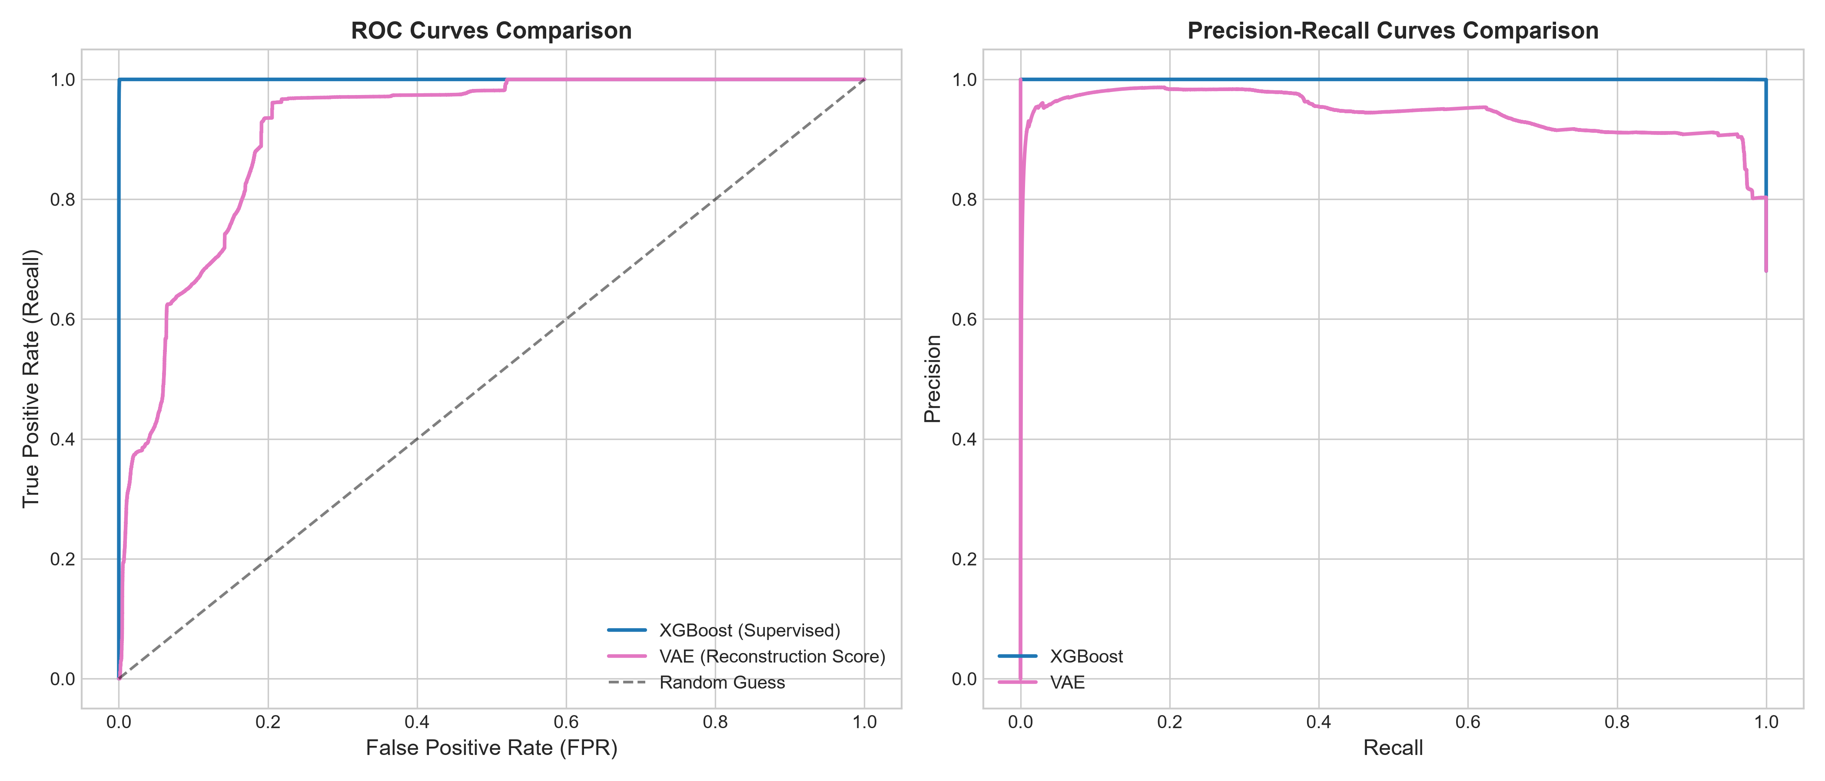
Experiment B: Held-Out Attack Benchmark Results
Supervised XGBoost: Recall 62.50%, Precision 99.95%, PR-AUC 0.99240, FPR 0.0975% (FN 49574, TP 82635).
Tabular PyTorch VAE: Recall 16.60%, Precision 98.33%, PR-AUC 0.98017, FPR 0.9300% (FN 110268, TP 21941).
Statistical Delta: Delta Recall = +0.4591 (95% CI: [0.4562, 0.4619], p < 0.001, McNemar chi2 = 60,128.40).
Critical Insight: Aggregate recall on held-out data is heavily dominated by volumetric DDoS flows (128,027 / 132,209 = 96.8%).
Cognisec AI Research Defense | Slide 12 of 19

Slide 13
Per-Family Disaggregation: The Infiltration Finding
DDoS (128,027 flows): XGBoost recall 63.01% (volumetric similarity to training DoS) vs. VAE 17.12%.
Web Attacks (2,180 flows): XGBoost recall 90.23% vs. VAE 0.00%.
Botnet Ares (1,966 flows): XGBoost recall 0.00% vs. VAE 0.56%.
Infiltration (36 flows): XGBoost achieved ZERO percent recall (0/36 detected)!
VAE Infiltration Recall: Successfully detected 47.22% (17/36 flows) without any prior training on attack patterns!
Core Takeaway: VAE detects subtle privilege escalation where supervised models are completely blind.
Cognisec AI Research Defense | Slide 13 of 19

Slide 14
Model Complementarity & Threshold Sensitivity
Mutual Detection Breakdown (132,209 Held-Out Attacks):
- Both Detected: 21,521 flows (16.28%)
- XGBoost Only: 61,114 flows (46.23%, overwhelmingly DDoS)
- VAE Only: 420 flows (0.32%, including stealth Infiltration)
- Both Missed: 49,154 flows (37.18%)
Threshold Trade-off (Exp C): Relaxing VAE false-alarm budget from 1% to 10% increases recall from 16.6% to 93.7%.
Cognisec AI Research Defense | Slide 14 of 19

Slide 15
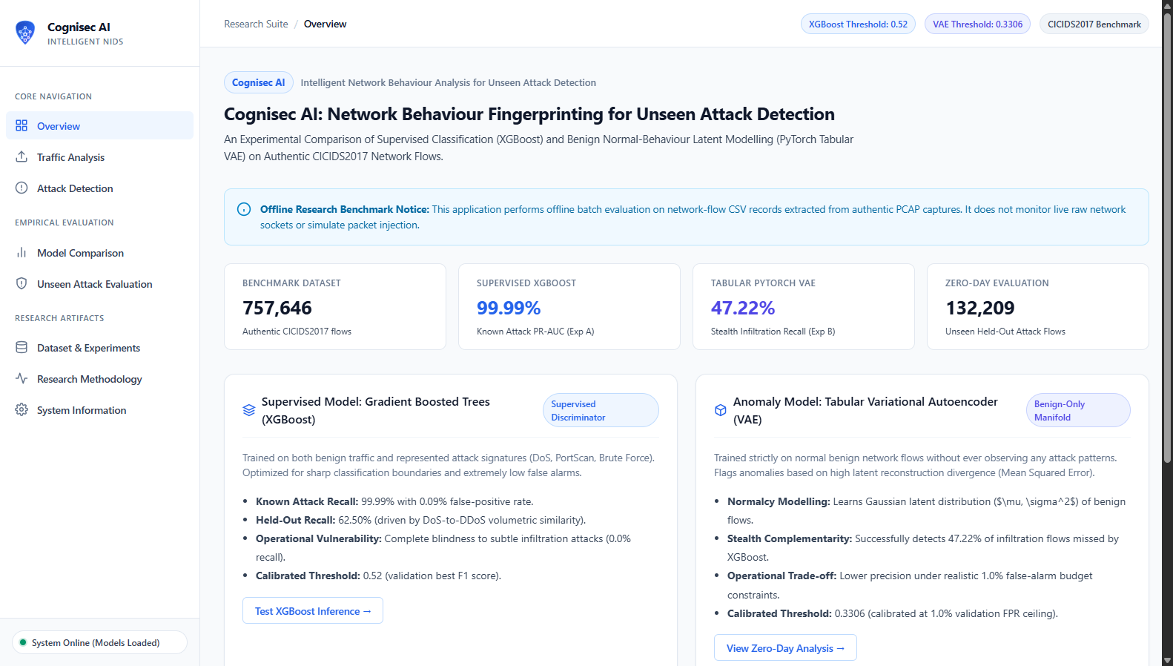
Cognisec AI Application Architecture
Decoupled Stack: Python Flask REST backend with modular HTML5, CSS3, and ES6 JavaScript frontend.
Inference Pipeline: Pre-flight schema validation -> robust imputation -> model inference -> structured JSON response.
Offline Flow Batch Analysis: Accurately scoped to CSV flow records extracted from PCAP (no false live-capture claims).
Sub-millisecond Throughput: XGBoost averages 0.49 microseconds/flow; VAE averages 5.22 microseconds/flow.
Cognisec AI Research Defense | Slide 15 of 19

Slide 16
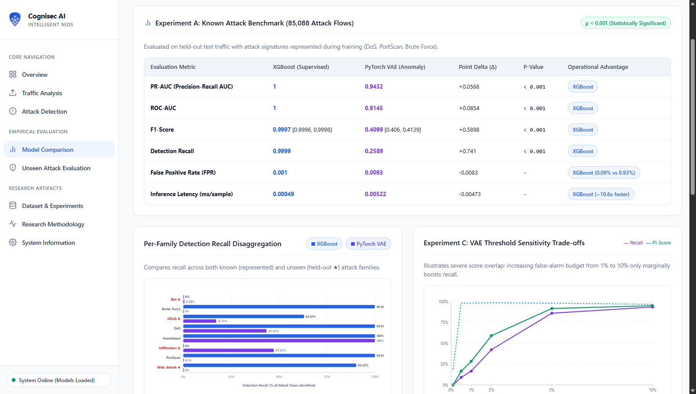
Live Application Demonstration & Verification
Fully verified across 18 automated regression unit and integration tests (tests/ passing 18/18).
Interactive Traffic Analysis view performing automatic schema alignment on authentic CICIDS2017 flow batches.
Dual Model Inspection: Side-by-side display of XGBoost probabilities and VAE reconstruction anomaly scores.
Interactive Research Dashboards rendering empirical ROC/PR curves and threshold sensitivity curves.
Cognisec AI Research Defense | Slide 16 of 19

Slide 17
Research Limitations & Threats to Validity
1. Benchmark Limitations: CICIDS2017 reflects 2017 testbed conditions; does not contain TLS 1.3 encrypted malware.
2. Held-Out Proxy: An experimentally held-out family within a testbed is not identical to a novel real-world zero-day exploit.
3. Small Sample Size: Infiltration comprises only 36 flows; high percentage recall carries wider variance.
4. Offline Flow Formulation: Requires upstream flow summarization; not evaluated as a streaming kernel packet monitor.
Cognisec AI Research Defense | Slide 17 of 19

Slide 18
Conclusions & Future Work
1. Supervised XGBoost remains essential for high-throughput frontline detection of known attack vectors.
2. PyTorch VAE provides vital orthogonal security value for detecting stealthy zero-day attacks that evade discriminative boundaries.
3. Optimal Architecture: A hybrid multi-tiered NIDS routing standard traffic through XGBoost and escalating low-confidence flows to a VAE.
4. Future Work: Real-time eBPF kernel flow extraction, streaming online VAE adaptation, and multi-tier ensemble fusion.
Cognisec AI Research Defense | Slide 18 of 19

Slide 19
References
Sharafaldin, I., Lashkari, A. H., & Ghorbani, A. A. (2018). 'Toward Generating a New Intrusion Detection Dataset and Intrusion Traffic Characterization.' ICISSP, 108-116. DOI: 10.5220/0006639801080116.
Chen, T., & Guestrin, C. (2016). 'XGBoost: A Scalable Tree Boosting System.' ACM SIGKDD, 785-794.
Kingma, D. P., & Welling, M. (2013). 'Auto-Encoding Variational Bayes.' arXiv:1312.6114.
Official CICIDS2017 Repository: https://www.unb.ca/cic/datasets/ids-2017.html
Cognisec AI Research Defense | Slide 19 of 19

