Slide 1

Wine Quality Classification and Prediction
This presentation examines the methods employed for wine quality classification and prediction through machine learning techniques. It focuses on data analysis, model selection, and performance evaluation, aiming to improve the assessment of wine quality. By leveraging advanced algorithms and data-driven insights, we can enhance our understanding of what factors contribute to high-quality wines.
AKKARABOINA DHAKSHAYANI SAI SANTHOSNI-322129512002

Slide 2

Introduction to Wine Quality
Importance of Wine Quality
Wine quality is crucial for consumer satisfaction and brand reputation.
Factors Affecting Quality
Influenced by grape variety, fermentation process, and environmental conditions.
Objective of the Study
To classify and predict wine quality using data-driven techniques.

Slide 3

Data Collection and Preparation Overview
Data Cleaning
Missing values and outliers are addressed to ensure quality data before analysis.
Dataset Overview
This study utilizes the Wine Quality dataset which contains chemical properties and quality ratings of
red and white wines.
Feature Selection
Key features impacting wine quality, such as pH, alcohol content, and residual sugar, are identified.

Slide 4
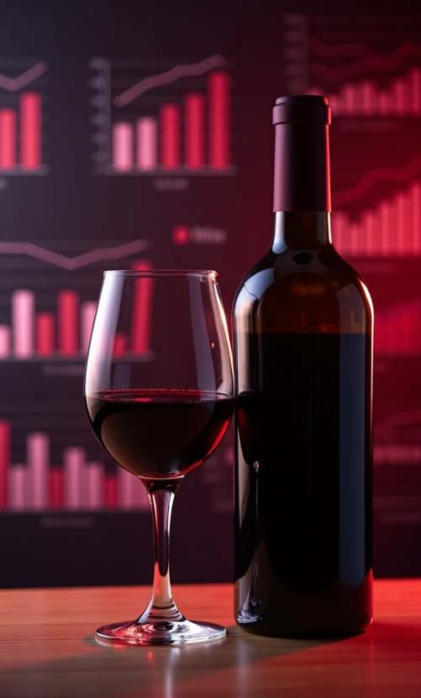
Exploratory Data Analysis (EDA)
Statistical Summary
The initial analysis includes descriptive statistics to summarize the dataset's main characteristics.
Visualization Techniques
Various visualization methods, such as histograms and box plots, help exhibit the relationships between different features and wine quality.
Correlation Analysis
Examining the correlation between features allows us to identify significant predictors affecting wine quality.

Slide 5

Evaluating Machine Learning Models for Wine Quality
Model Overview Choosing the Right Model Hyperparameter Tuning
Various machine learning algorithms evaluated for efficacy.
Factors influencing model selection include accuracy and interpretability.
Fine-tuning with techniques like Grid Search and Cross-Validation.

Slide 6
Model Evaluation Metrics
Confusion Matrix
Provides a detailed breakdown of true positives, false positives, true negatives,
Accuracy
and false negatives.
F1 Score
Measures the proportion of correctly predicted instances among the total instances.
Balances precision and recall, offering a comprehensive view of model performance.

Slide 7

Model Comparison Results
This PPT provides an overview of the comparative analysis of various models, identifying key performance metrics and their implications for real-world applications, particularly in winemaking.
Performance Summary Best Performing Model Implications for Winemakers
A comparative analysis of different models is presented, showcasing their accuracy, F scores, and confusion matrices.
The model that delivers optimal results in terms of accuracy and recall is identified.
Insights derived from the best model can guide winemakers in achieving desired quality levels.

Slide 8

Challenges and Limitations in Model Performance
Data Quality Issues Model Overfitting Scalability
Incomplete or inaccurate data can hinder model performance. Ensuring high-quality data is vital for effective wine classification and prediction.
Overfitting occurs when the model learns noise instead of the underlying patterns. Balancing model complexity with generalization is critical for robust predictions.
The ability to scale the model for real- time predictions may pose challenges, especially as the size of the dataset increases. Efficient algorithms are necessary for practical implementation.

Slide 9
Practical Applications
Consumer Insights
Retailers and consumers can use predicted quality ratings for informed purchasing decisions.
Wine Production
The classification model can be used to assess the quality of grapes and optimize the fermentation
process.
Quality Control
The model serves as a tool for quality control within wineries to maintain standards.

Slide 10



Future Directions in Machine Learning
Enhanced Data Sources Advanced Algorithms
Real-World Implementation
Future work may involve incorporating additional data sources, such as geographical information and consumer reviews, to improve prediction accuracy and robustness.
Exploring advanced machine learning techniques, including deep learning and ensemble methods, can lead to better classification outcomes and more reliable predictions.
Implementing the model in real- world scenarios will provide valuable feedback and continuous improvement opportunities, bridging the gap between theory and practice.

Slide 11

Conclusion on Wine Quality Prediction
Summary of Findings
The research confirms that machine learning techniques are effective in classifying and predicting wine quality, providing actionable insights for producers and consumers.
Impact on Industry
The application of these techniques has the potential to revolutionize the wine industry by enhancing quality assessment and decision-making processes.
Call for Further Research
Continued exploration and refinement of models, along with diverse data integration, are encouraged to advance wine quality prediction methodologies.

Slide 12
References
This section provides a comprehensive list of references used in the presentation, highlighting both cited works and additional reading suggestions for further exploration in machine learning and wine quality analysis.
Cited Works
Additional Reading
Key references utilized in this presentation, including academic
papers and datasets.
Suggestions for further reading materials related to wine science and data analysis techniques.

Slide 13
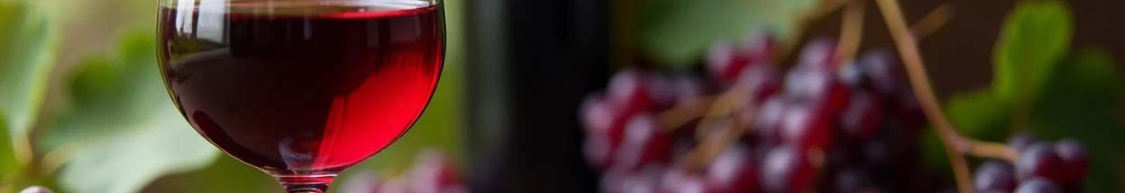
Questions and Discussion on Wine Quality
Clarify Concepts Address Concerns Explore Ideas
Discuss key concepts related to wine quality classification.
Open dialogue to address any concerns regarding wine quality predictions.

