Slide 1

Employee Management System

Slide 2
About Us:
Name: PAVAN SAI KUPPANNAGARI
Education Background: B. Tech
Linkedin: https://www.linkedin.com/pavansaikuppannagari
Name: BAGADI SANTHOSH KUMAR
Education Background: B.Tech
Linkedin: https://www.linkedin.com/santhoshbagadi

Slide 3
Objective:
Build a comprehensive SQL-based solution for managing employee data.
Provide a unified platform for tracking employee personal information, roles, departments, salaries, qualifications, leaves, and payroll.
Address HR and managerial needs for operational efficiency, data integrity, and secure information access.
Goals:
Streamline HR operations: hiring, payroll, leave management, and analytics.
Ensure accuracy by enforcing relational integrity through foreign keys and constraints.
Enable actionable business insights using advanced SQL queries for real-time decision-making.

Slide 4
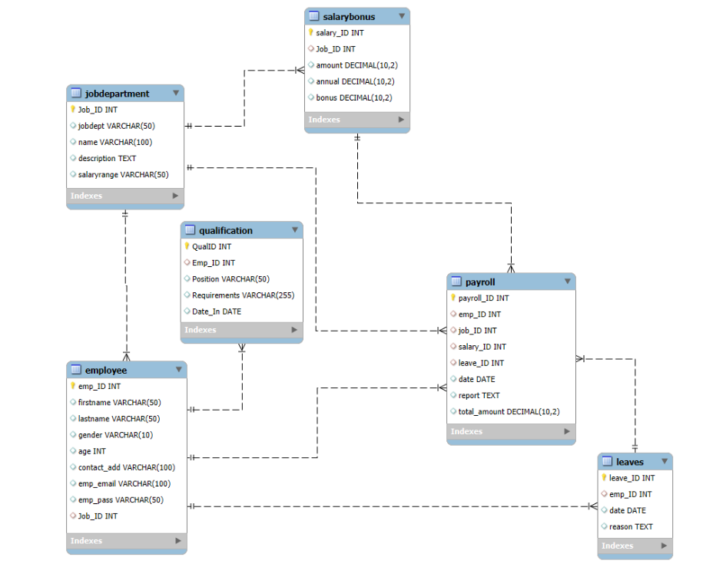
Schema Explanation:
jobdepartment: Holds job roles, department, and salary range.
employee: Contains employee personal and job details, linked by Job_ID.
salarybonus: Maps salary, bonus, and annual pay to job roles.
qualification: Tracks qualifications per employee for role compliance.
leaves: Records leave history and reasons for each employee.
payroll: Integrates employee, role, salary, and leave data for accurate payroll calculation.
All relationships are enforced with proper foreign keys and relevant cascade/update/delete actions.

Slide 5
Fact Table:
Payroll
  Why? Each row is a payroll event: it links to Employee, JobDepartment, SalaryBonus, Leaves, and quantifies total payment for a specific period.
  Fact column examples: total_amount, date (acts as a time dimension), bonuses.
Dimension Table:
Employee
  Attributes: emp_ID, name, contact, gender, email.
JobDepartment
  Attributes: Job_ID, jobdept (department), name (role), description, salaryrange.
SalaryBonus
  Attributes: salary_ID, Job_ID, amount, annual, bonus.
Leaves
  If you analyze leaves as events, they could also be modeled as a fact table. Usually, in BI, you summarize leaves (facts: count/type/duration).
Qualification
  Often treated as a "bridge" for many-to-many relationships (Employee↔Qualification)—could also be considered a dimension or a fact table if analyzing qualification events

Slide 6
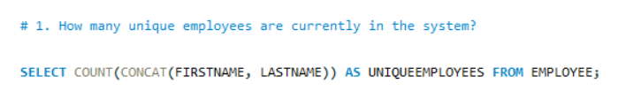

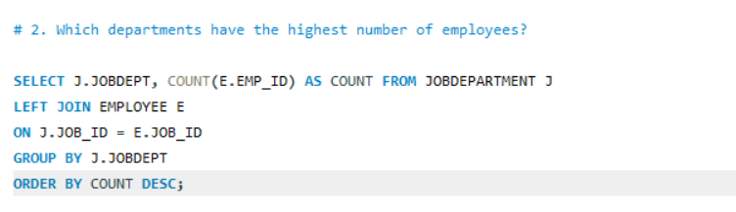
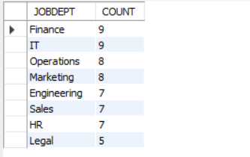
Employee Insights:
This query counts distinct employee IDs from the Employee table ensuring the count of unique employees.
Used COUNT to count employees if any exist.
Joins Employee with JobDepartment on Job_ID to relate employees to their departments.
Groups by department and counts employees in each.
Orders result descending to show highest employee counts first.

Slide 7
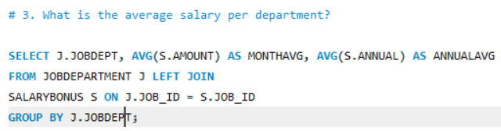
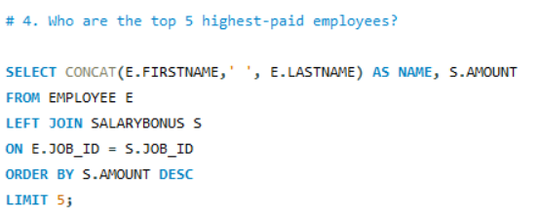
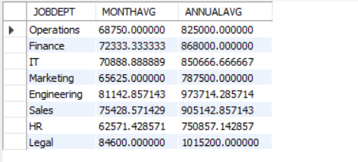
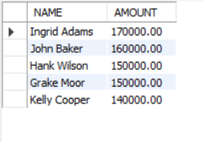
Employee Insights:
Joins JobDepartment, and SalaryBonus tables to connect jobid to salary amounts by job and department.
Calculates average salary in the SalaryBonus.amount field grouped by department.
Joins SalaryBonus, and JobDepartment to get each employee's salary and department.
Orders by salary descending to get highest payers.
Limits output to the top 5 employees.

Slide 8
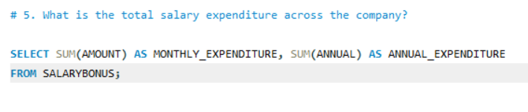
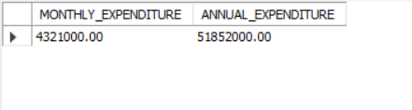
Employee Insights:
Calculates SalaryBonus to sum all employees' salaries for company-wide total expenditure.

Slide 9
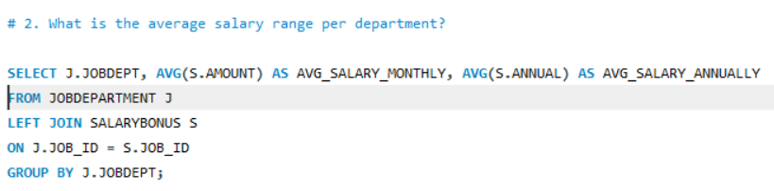
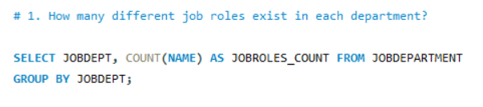
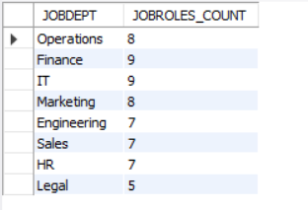
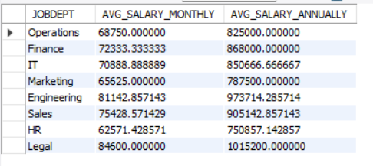
JOB ROLE AND DEPARTMENT ANALYSIS
Uses the JobDepartment table.
Counts distinct Job_ID grouped by departments to find the number of different job roles per department.
Joins JobDepartment and SalaryBonus.
Finds the AVG salary offered for each job dept.

Slide 10
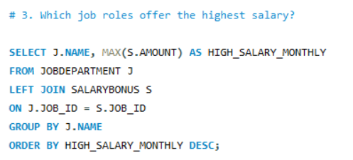
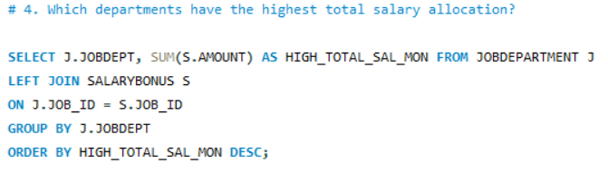
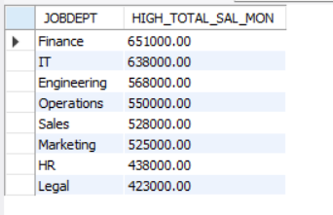
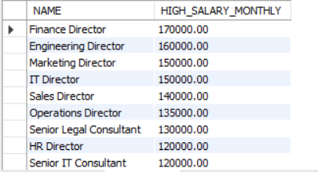
JOB ROLE AND DEPARTMENT ANALYSIS
Joins JobDepartment and SalaryBonus.
Finds the maximum salary offered for each job role.
Orders descending and limits to top 5 highest paying job roles.
Joins JobDepartment and SalaryBonus.
Aggregates total salary amounts by department, ordered to show those with highest total allocations.

Slide 11

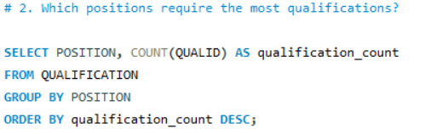
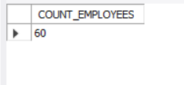
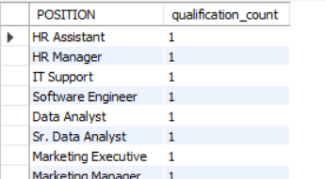
QUALIFICATION AND SKILLS ANALYSIS
Counts unique employees who have entries in the Qualification table, indicating at least one qualification
Groups the Qualification table by Position.
Counts the number of qualification records for each position.
Orders descending to show positions requiring the most qualifications.

Slide 12
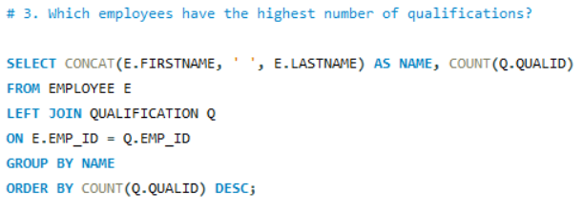
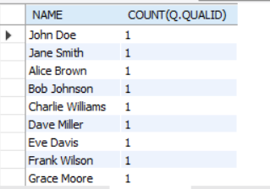
QUALIFICATION AND SKILLS ANALYSIS
Joins Qualification records by employee.
Counts qualifications per employee.
Orders by count descending to find employees with most qualifications.

Slide 13
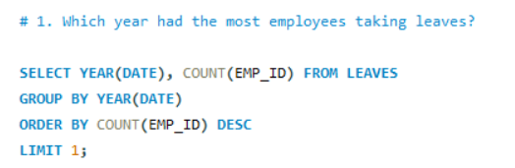
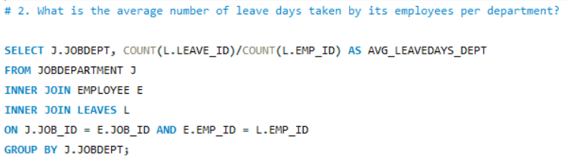
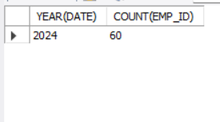
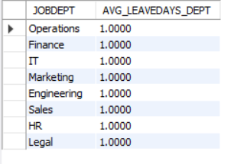
LEAVE AND ABSENCE PATTERNS
Extracts year from leave date.
Counts distinct employees who took leave per year.
Orders descending to find the year with most employees taking leaves.
Counts leave days per employee.
Joins with Employee and JobDepartment and Leaves to relate leaves to departments.
Calculates average leave days per department.

Slide 14
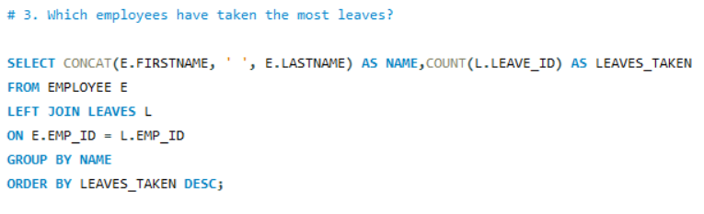

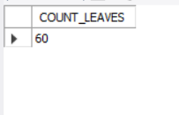
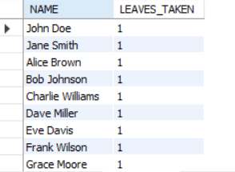
LEAVE AND ABSENCE PATTERNS
Simple count of all leave records to get total leave days in the company.
Joins Leaves and Employee tables.
Counts leaves per employee and orders descending.
Limits to top 5 employees who took most leaves.

Slide 15
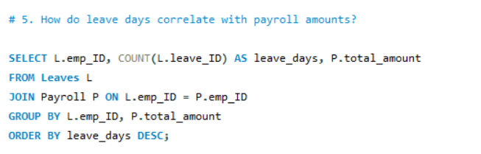
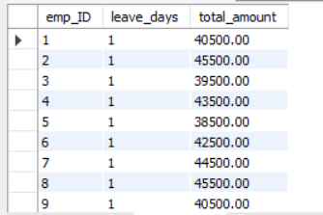
LEAVE AND ABSENCE PATTERNS
Joins leave records with payroll by employee.
Counts leave days and associates total payroll amounts.
Can be used to analyze correlation between leaves and pay.

Slide 16
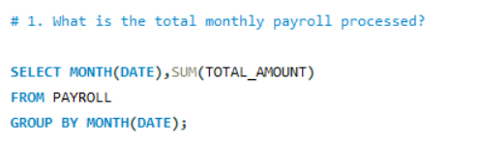

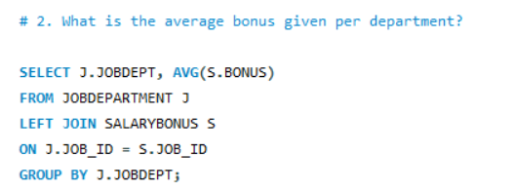
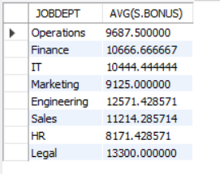
PAYROLL AND COMPENSATION ANALYSIS
Groups payroll records by month (YYYY-MM format).
Sums total payment amounts processed in each month.
Joins JobDepartment, and SalaryBonus.
Calculates average bonus by department.

Slide 17
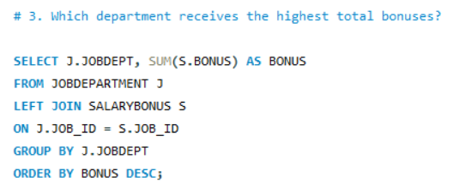
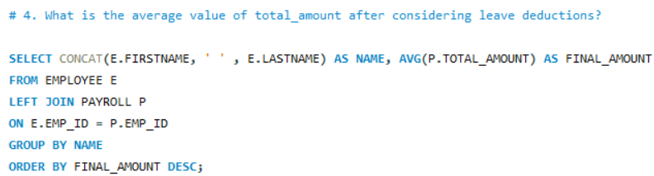
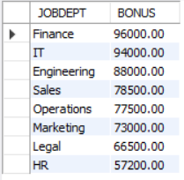
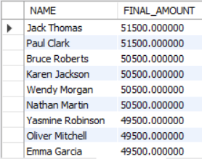
PAYROLL AND COMPENSATION ANALYSIS
Joins JobDepartment, and SalaryBonus. but sums bonus values.
Orders descending to identify department with highest total bonuses
Calculates average total payroll amount after deductions reflected in total_amount field.
Leaves deductions have been applied in Payroll.total_amount field as per design.

Slide 18
Final Business Insights
Key Observations:
Departments with higher qualification requirements tend to have fewer employees but higher compensation.
Bonuses and salary allocations vary widely between departments, highlighting areas for potential compensation optimization.
Leave patterns indicate departments where work-life balance improvements may be needed.
Data Driven Recommendations:
Enhance training in roles/positions with high qualification requirements to aid succession planning.
Review payroll allocation and bonus structures in high-expenditure departments.
Set benchmarks for leave and absenteeism across departments to ensure business continuity.

Slide 19
CONCLUSION:
The Employee Management System SQL project delivers a comprehensive and efficient solution for managing all facets of employee data within an organization. By implementing a well-structured relational database with six interlinked tables - spanning employees, job departments, qualifications, leaves, salaries, and payroll, the system ensures robust data integrity through primary keys, foreign keys, and cascading constraints. SQL-based analytical queries enable in-depth insights into workforce distribution, compensation, departmental trends, employee qualifications, absenteeism patterns, and payroll outcomes. These insights empower HR and management teams to make data-driven decisions regarding hiring, compensation planning, professional development, and employee engagement. The system’s design supports both operational needs and advanced business intelligence by mapping well to fact and dimension modeling principles. Overall, this project demonstrates the power of SQL in creating scalable, reliable, and analytics-ready HR systems that form the backbone of effective organizational management and strategic planning.

Slide 20
Personal Experience
Gained hands-on experience designing normalized relational databases.
Learned advanced SQL: joins, aggregations, subqueries for comprehensive reporting.
Developed confidence in managing complex data requirements and business logic.
Challenges Faced:
Defining proper foreign key constraints to maintain referential integrity and handle cascading updates/deletes.
Writing advanced queries involving multiple joins for cross-module analytics.
Ensuring data consistency across modules and avoiding duplicate or orphaned records.
Addressed issues with date formatting and data preparation for analytics.

Slide 21

THANK YOU

