Slide 1
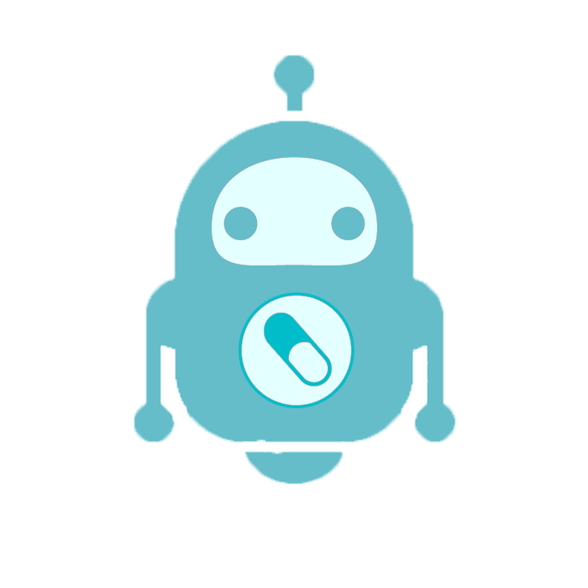
MedBot Medicine Tablet Dosage providing Robot
Presented By:
S. Kariyawasam
160275C

Slide 2
Why there is a need for a robot to help giving medicine?
1

Slide 3

Imagine
You are a busy person and forgets to take recommended medicine from a doctor
Your elder ones are careless about there medication
You are getting confused about how much tablet that you or your elder ones have to take in at what time.
Then this is exactly what you want to keep withing your reach.

Slide 4
What this robot is capable of?
2

Slide 5

This Robot is capable of,
(1) Choosing right medicine at right time
.
(2) Choosing the dosage of a single type tablet
(3)
Allow user to input at what time and how much dosage they want

Slide 6
How User can interact with the device?
3

Slide 7
Mobile App
App is to be developed with MIT App developer that will be with a user friendly interface. That will allow user to input data about,
1) Dosage
2) Time that output take place
3) Has a Bluetooth connectivity with the robot

Slide 8
Instructions for use
User can edit the four tablet dosage which is how much tablets they want at what time through the mobile app.
Smart phone apk file gives user the ability to change the the data any time and there is a alarm system to ensure that the user taken the dosage within one hour the output tablets have given.

Slide 9
Technology that is using in the device
4

Slide 10
Arduino Uno
DC Motors
Motor Controllers
BlueTooth Module
Power 5V
Smart Phone App
etc.

Slide 11
Improvements that can be made with the device
5

Slide 12

Let’s review some concepts
AI
We can add artifitial intelligents to give states and data about improvements user had made with the medicine.
Security
We can add a facial recognition system to prevent security threts or to check whether the right person is taking the right medicine
Multi User
With facial recognition system we can deliver medicine dosage according to the person basis not only in time basis.

Slide 13
Thanks!
Any questions?
You can find me at
skwin95@gmail.com

