Slide 1
Git and Github

Slide 2
What is Git and Github
Git is a tool used for source code management.
It is a free and open-source version control system used to handle small to very large projects efficiently.
Git is used to tracking changes in the source code, enabling multiple developers to work together on non-linear development
Github is a hosting service for git repositories

Slide 3
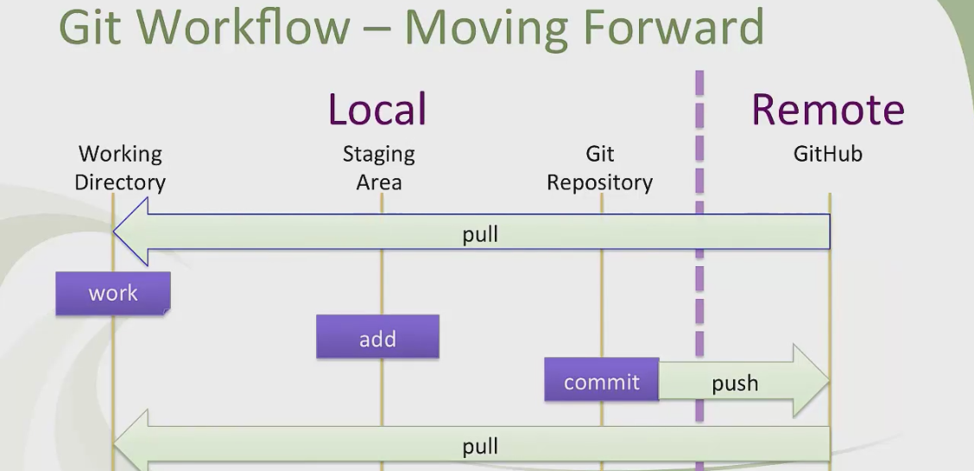
Git architecture
Working dir ➔ Staging ➔ Local repository {Git) ➔ Remote repository / GitHub
Working dir ➔workspace ➔Untracked files
Staging ➔Tracked files
Git : Local repository ➔ committed files
GITHub : Remote repository ➔Remote files

Slide 4
Launch Git
To Launch Git
Go to your project folder➔ Right click ➔ Git Bash Here
to view your file (this is your project files in local system)
dir
ls

Slide 5
Git commands
Configuration commands that is applicable for all repositories( all projects)
git config --global user.email “myemail@gmail.com” : one time command
git config --global user.name "your_name" : one time command required to specify your name
To query
git config –list : to list all the configrations
git config user.name : to see the name in config
git config user.email : to see the email in config

Slide 6
Git commands
Initialize a Repository
git init : To initialze the repository / creates empty repository
git status : Get the status
git add -A : adds all files to the staging area
git add . : adds all files to the staging area
git add pom.xml: adds specified files to the repository
git commit -m "this is first commit": To commit the changes to the repository
git commit -a -m “adding modified files” : Adds and commit in single command
Log History
git log: Shows commit history , displays the details of each commit ex: unique commit code, name, email, files, comment
git log –oneline : displays the commit history in one line

Slide 7
Git commands
To compare the difference between the files
git diff :
compare between
working dir and staging
staging and local repo
local repo and remote repo
To see the diff in file content bet working dir and staging area ( comparing before commit)
git diff file1.txt
To see the diff in file content bet working dir and last commit
git diff Head index.txt
To see the diff in file content bet staged copy and last commit
git diff --staged head index.txt

Slide 8
Git commands
Remove file
git rm file1.txt : removes file1.txt from working directory and staging
git rm -r . : removes all files from working directory and staging
git rm –cached file2.txt : Remove files from only staging
rm file3.txt : Remove files from working directory only
Undo commits at repo level
git reset index.txt
git <mode> <commit id>
git reset --mixed 3e9df31
git reset --soft 92f8c16
git reset --hard 92f8c16

Slide 9
Git commands
To create new branch
git branch branchname
To view available branches
git branch
To switch from one branch to another
git checkout branchname
Creating and switching to a branch
git checkout -b branchname
To delete a branch
git branch -d feature

Slide 10
To merge the file from feature(branch)
git merge feature :
git rebase master

Slide 11
Clone the repo /push into the repo
Create a folder where you want to clone the project
Go to git bash
git clone “https://github.com/Santi2020/testrepo.git”
Pull
Go to the folder
Git bash
git pull origin main

Slide 12
Remote origin
git remote add origin https://github.com/Santi2020/testrepo.git
Push to remote repository
git push -u origin main

Slide 13
UI options in Eclipse and Intellij
CLONE a project
Right click on project explorer →
import→
projects from git→
next →
clone URL→
provide remote repo URL →
next→
select the branch →
select directory →
import as general project →
provide a project name →
finish

Slide 14
UI options in Eclipse and Intellij
PUSH the changes
Right click on the file →
Team →
Add to index →
(file added to staging)
Right click on the file →
Team →
commit →
which open a window to provide commit message →
click commit (for local repo)
➔ commit and push (for remote repo) → provide username and password credentials
PULL the changes
Right click on the file → Team →Pull

