Slide 1
Java

Slide 2
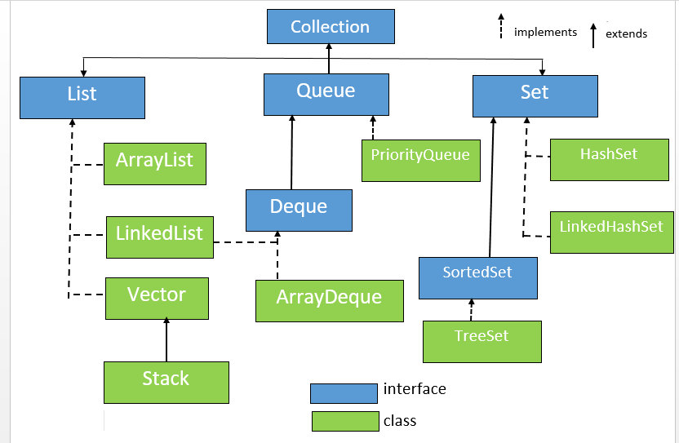
Collection

Slide 3
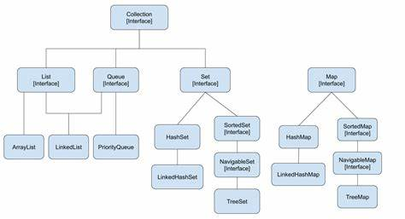
Collection and Map

Slide 4
Collection Methods(Parent interface) add() remove()
Arraylist
Insertion oreder is maintained
Allows dyplicate

