Slide 1
UNIX
Unix is the most powerful and popular multi-user and multi-tasking Operating System.

Slide 2
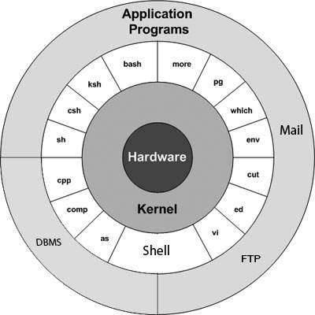
Unix Architecture The Unix architecture has 3 layers. These layers are as shown below:

Slide 3
Unix Archchitecture
The main concept that unites all the versions of Unix is the following four basics −
Kernel − The kernel is the heart of the operating system. It interacts with the hardware and most of the tasks like memory management, task scheduling and file management.
Shell − The shell is the utility that processes your requests. When you type in a command at your terminal, the shell interprets the command and calls the program that you want. The shell uses standard syntax for all commands. C Shell, Bourne Shell and Korn Shell are the most famous shells which are available with most of the Unix variants.
Commands and Utilities − There are various commands and utilities which you can make use of in your day to day activities. cp, mv, cat and grep, etc. are few examples of commands and utilities. There are over 250 standard commands plus numerous others provided through 3rd party software. All the commands come along with various options.

Slide 4
Advantages of UNIX operating system
Portable:
As UNIX is made from using C language so it is a highly portable OS. You can use this OS on any PC or MAC computers.
Supports multiple users:
In UNIX every user needs a username password to use the OS. Every file is protected from unauthorized use. Multiple users can log in to the system and use the OS as they need.
Multitasking:
You can open many programs in the UNIX OS and all the programs work in parallel using multiprocessor technology.
Many variants available:
There are many types of UNIX variants are available for UNIX OS. If you are not comfortable using Linux then you can use Ubuntu, Redhat or macOS.
Safe and secure:
UNIX provides a safe and secure platform in which multiple users can interact with the servers online without any security issues. The interaction with the UNIX servers is fast and without any bugs. UNIX uses UID and GID for controlling permissions for users and files are accessed by users through these permissions
Used in a large organization:
UNIX is used in universities, research laboratories, colleges and large government organizations.

Slide 5
Unix commands
who - Displays how many users have connected to the linux system
whoami - whoami - Displays the username of the current user.
hostname : Print the host name of the system
hostname -i : print IP address of the computer
chmod: change the mode of the file
date : displays the date
ps : displays the processes running on your system
sh: to run a shell script
kill <pid> : to kill a process
History : displays the history of all the commands executed

Slide 6
Unix commands
cd – change directory
cd .. : move to prev folder
cd ~ : Move to users home directory from anywhere.
pwd – present working directory /confirm current directory
mkdir – make new directory
mkdir –p maindir/subdir/subdirr
rmdir – remove directories in Unix

Slide 7
Listing Directories and Files
ls : used to list all the files and directory
ls –a : list all files and directories including hidden files
ls ? : (? Single character)
ls *.java : (* Multiple characters) list all files with .java extension
ls [a-d] : [ ] Range of values

Slide 8
Unix commands
cat cities.txt : displays the contents of the file
more cities.txt : Display content page by page in both directions
head –n 10 cities.txt : to display n lines from top of the file
tail –n 10 cities.txt : to display n lines from bottom of the file.
touch a.txt b.txt : to create files

Slide 9
Unix commands
cp : Copy contents from a file to another file(source to destination)
cp : copies files
cp cities.txt cities1.txt
mv : Renaming a file(changing name of the file)
Renaming a directory
Moves files from one directory to another directory
mv : moves or renames files
mv cities1 cities_new_name.txt
mv cities_new_name.txt /mydir
mv mydir mydirectory

Slide 10
rm : Delete/remove a file or directory (only if directory is empty).
rm filename
rm -r world : Remove the directory if it is empty

Slide 11
WC :Wordcount
wc newFile.txt
wc -l newFile.txt → line count
wc -w newFile.txt →word count
wc -c newFile.txt → character count
Sort → sorts the file. displays the output after sorting does not affect the original file
Sort file1.txt->
Sort -r file1.txt -> descending order sorting

Slide 12
Input, Output & Error Re-Direction
Standard input (0) →keyboard ➔ <
Standard output (1) →terminal ➔ > >>
Standard error (2) →error ➔ 2> 2>>
sort <cities.txt
date1111 2>> error.txt
Input and output redirection
sort 0< cities.txt 2>> error.txt

Slide 13
Unix commands
Piping : pass the output of one cmd as input to another cmd
ls | sort
ls | head -3 | sort -r
Grep : command is used for searching the required pattern in a file
grep "Hubli" cities.txt
grep -i “delhi" *.txt : ignore case
grep -n "delhi" cities.txt : displays line numbers
grep -c "delhi" cities.txt : counts num of times found
grep -v "delhi" cities.txt : gets all lines except the search pattern
grep -l "delhi" *cities* : lists all files that contain search pattern
Multiple commands using pipe and redirection
grep -i a a.txt | sort >> newcities.txt

Slide 14
sh: to run a shell script
sh myscript.sh → runs the script in background
sh myscript.sh & → runs the script in foreground
Userful tips
ls –help : to get help on the command
history : list of previous commands
Uparrow : to scroll previous executed command

Slide 15
Thank you

