Slide 1

CSCI E-96 Data Mining, Discovery and Exploration Steaming Analytics
Steve Elston
Copyright 2021, 2022, 2023, 2024, 2025, Stephen F Elston. All rights reserved.

Slide 2
Streaming Analytics
Are analytics always computed in batch?
No!
Data often arrives in streams
IOT/Sensor data – many applications
Capital markets data
E-commerce click streams and purchases
Emails, social media posts, etc.
Logistics information
Agricultural data
Internet packet streams for cybersecurity
Etc.
Analytics must be updated as data samples arrives
We call these online analytic algorithms

Slide 3
Streaming Analytics
Are analytics always computed in batch?
No!
Data often arrives in streams
IOT/Sensor data – many applications, e.g. anomaly detection
Capital markets data
E-commerce click streams and purchases
Network and data center monitoring
Logistics information
Agricultural data
Internet packet streams for cybersecurity
Etc.
Analytics must be updated as data samples arrives
We call these online analytic algorithms

Slide 4
Streaming Analytics
Do we always apply online analytics to real-time data?
No!
We can use these algorithms for analytics on beyond core memory size
Data is processed in ‘chunks’
Example, read files one or a few lines at a time
Example, use a series of limited data base queries
Analytics updated for each chuck

Slide 5
Streaming Analytics
What are the key points to learn in this lesson?
Measures must be taken to reduce the massive volume of infinite stream data
Real-valued stream data can be sampled and filtered to reduce volume
Hash methods can be used to filter discrete event streams
Sketches (hashes) are used to perform streaming analytics within computation and memory requirements

Slide 6

Streaming Analytics
Useful book on massive scale streaming analytics
Algorithms for Massive Datasets, Medjedovic, Tahirovic, and Dedovic, Manning, 2022

Slide 7
Streaming Analytics
Difficulties with streaming analytics
Example – small scale
US Geological Survey maintains about 13,500 stream gauges
Average of 4 types of sensors per station
Each measurement is 4 bytes - 16 bytes total per sample
Each gauge collects data sample every 15 mins
Data uploaded every 4 hours – 6 sets of measurements per day – 1,536 bytes
Total of 5.4 M bytes per day for network
2 G bytes per year for archive
But, network bandwidth is limited
Sensors often connected by point-to-point wireless connections

Slide 8
Streaming Analytics
Difficulties with streaming analytics
Data volumes can be massive
2nd Example – Large scale
Power company with real-time energy monitoring of 10⁷ customer drops
4 bytes every 10 ms per drop
34,560 bytes per drop per day
346 M bytes total per day
126 T bytes per year
Network bandwidth is limited

Slide 9
Streaming Analytics
Difficulties with streaming analytics
Streams are infinite with unlimited data volume
Results must be updated as new values arrive
How to treat older values?
How much should older values weight in the analytic results?
How much storage capacity is required for the history?
We can filter massive streams
Reduce volume of stream data for processing
Use filtered values to update analytics
Idea: compute and store only summary statistics?
Massive reduction in volume

Slide 10
Streaming Pipelines

Slide 11
Streaming Analytics
Components of stream analytics
Multiple input streams – potentially different data types
Network bandwidth often limited
Real-time stream processor
Real-time stream analytics output
Limited working storage for real-time processing
Ad-Hoc query capability – typically limited
Long-term archival storage
Ad-Hoc
Queries
Processor
. . . 1, 5, 2, 7, 0, 9, 3
. . . a, r, v, t, y, h, b
. . . 0, 0, 1, 0, 1, 1, 0
time
Streams Entering.
Each is stream is composed of elements/tuples
Standing
Queries
Output
Limited
Working
Storage
Archival
Storage

Slide 12
Processing of Stream Data
Push most processing to the periphery of network
Network bandwidth is major limitation for large networks
Consider IoT application with 100,000 sensors
At 1 sec sampling interval reporting rate is 360 M samples (messages) per hour
Statistic aggregated to 10 min reporting rate is 600 K samples (messages) per hour
Many peripheral devices have considerable processing power
We can take advantage of the idle capacity
Greatly reduce load on networks and central processing

Slide 13




Volume Reduction and Streaming Analytics
Reducing stream data volume is key to providing real-time analytics
Streams can be filtered and sampled near the source
Further filtering, sampling and sketching performed as preprocessing for analytics
Data Source
Filter/sample
Filter/sample/sketch
Stream analytic
Filter/sample/sketch
Stream analytic
Data Source
Filter/sample
$$⋮$$
$$⋮$$
$$⋮$$
$$⋮$$
Bandwidth limited network
Filter/sample/sketch
Stream analytic
Data Source
Filter/sample
Archival storage
Classical supervised and unsupervised ML
Server/Cloud
Minimum (filtered) data and analytics archived
Filtered streams and sketches used as input to classical ML

Slide 14
Case Study 1

Slide 15
Case Study 1: Telecom Fraud Detection
Goal: terminate calls from fraudulent accounts in real-time
Features
Call history
Phone characteristics
Payment history
Account types; individual, family, small business, corporate….
Etc.
Fraud detection algorithm
Train in batch
Terminate fraudulent calls in real time in < 1 sec - no billing record ‘residue’

Slide 16
Case Study 1: Telecom Fraud Detection
Model training
Ground truth is not known for 90-120 days
Must use delayed training data
Fraud patterns change quickly
Criminals constantly looking for greatest vulnerability
User behavior drifts with time

Slide 17
Case Study 1: Telecom Fraud Detection
Scaling
Training performed in batch – not time critical
Data size often larger than core memory
Realtime fraud detection
Move processing to edge – intercept communication between switch and billing system
Update blocked account/number list

Slide 18
Basic Sampling and Filtering

Slide 19
Memory Requirements
Memory requirements for stream analytics
Cannot store all history of streams in main memory!
At large scale infinite streams will fill any disk array!
We need a better approach!
Some ideas:
Delta coding: Only update when there is substantial change
Moving window: Compute statistic for each window position
Decay window: compute statistic down-weighting older event values
Reservoir sampling: compute statistic from a random sample of the stream
Bloom filter: uses hash to represent occurrence of events
Probabilistic sketch algorithms: use hashes to approximate counts, cardinality, quantiles, etc.

Slide 20
Delta Coding
Delta coding only transmits and processes values with significant differences
Example: consider a large network of sensors (IoT)
Values at most sensors do not change most of the time
Example: Temperature has not changed significantly
Example: Nothing moving in or out of image
Example: Current in transmission line has not changed
Etc.
Delta coding restricts transmission, processing and storage to significant changes (deltas)
A threshold determines significance of change
Threshold values are solution specific

Slide 21
Delta Coding
Delta coding moves filtering and initial processing to periphery of network
Example: Measuring flow in pipe network
100,000 flow sensors sampling every 1-sec with +/-3% standard error
Example: Set threshold and only report if change more than +/-3% of moving average
Can reduce network traffic and processing by orders of magnitude
Example: Security camera watching gate
Image transmission expensive at raw 50-60 frames per second
Threshold on object greater than some number of pixels moving in frame
Reduces transmission, processing and storage by many orders of magnitude

Slide 22
Moving Window Analytics
Compute and store summary statistics from moving window
Need to update the analytic as new values received
Must maintain samples in a window
Move window by a stride, number of samples
On update
Add new observations to the end of window
Remove old observations from beginning of window
Compute and store new estimate of statistic
Algorithm requires recomputing statistics using all observations in the window in main memory
May not scale well

Slide 23
Moving Window Analytics
Compute and store summary statistics from moving window
... t₀ t₁ t₂ t₃ t₃ t₄ t₅ t₆ t₇ t₈ t₉ t₁₀ t₁₁ t₁₂ t₁₃ t₁₄ t₁₅ …
Streaming data values
Window sample the stream
Compute statistic from samples
Move window by a Stride
Repeat steps 1-3 indefinitely
Span of time window = 8
Stride = 4
Statistic value
Statistic value

Slide 24
Exponential Decay Analytics
Exponential decay
Moving window updates the analytic as new values received
Is there an alternative to moving windows?
Yes, exponential decay methods
Past values are exponentially down-weighted in time
Estimates of a statistic are updated with new observations
Computationally efficient
Memory efficient: do not need to store past observations!

Slide 25
Exponential Decay Analytics
Family of exponential smoothing algorithms
Family of algorithms known as the Holt-Winters methods
First order exponential smoother
Smooths random (white) noise
Acts as a low-pass filter
Second order model
Known as double exponential smoothing
Includes a trend term
Third order model
Known as triple exponential smoothing
Accounts for seasonal (periodic) component

Slide 26
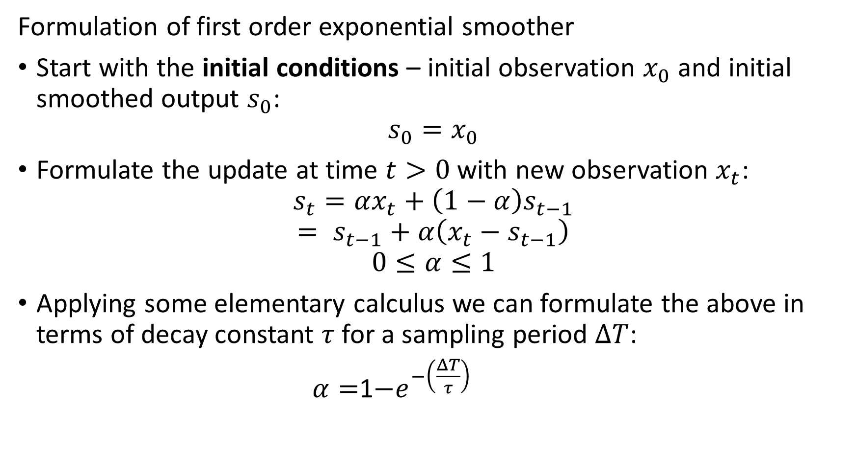
Exponential Decay Analytics
Formulation of first order exponential smoother
Start with the initial conditions – initial observation $x_{0}$ and initial smoothed output $s_{0}$:
$$s_{0}=x_{0}$$
Formulate the update at time $t>0$ with new observation $x_{t}$:
$$s_{t}=αx_{t}+\left(1−α\right)s_{t−1}$$
$$= s_{t−1}+α\left(x_{t}−s_{t−1}\right)$$
$$0≤α≤1$$
Applying some elementary calculus we can formulate the above in terms of decay constant $τ$ for a sampling period $ΔT$:
$α=$1$−e^{−\left(\frac{ΔT}{τ}\right)}$

Slide 27
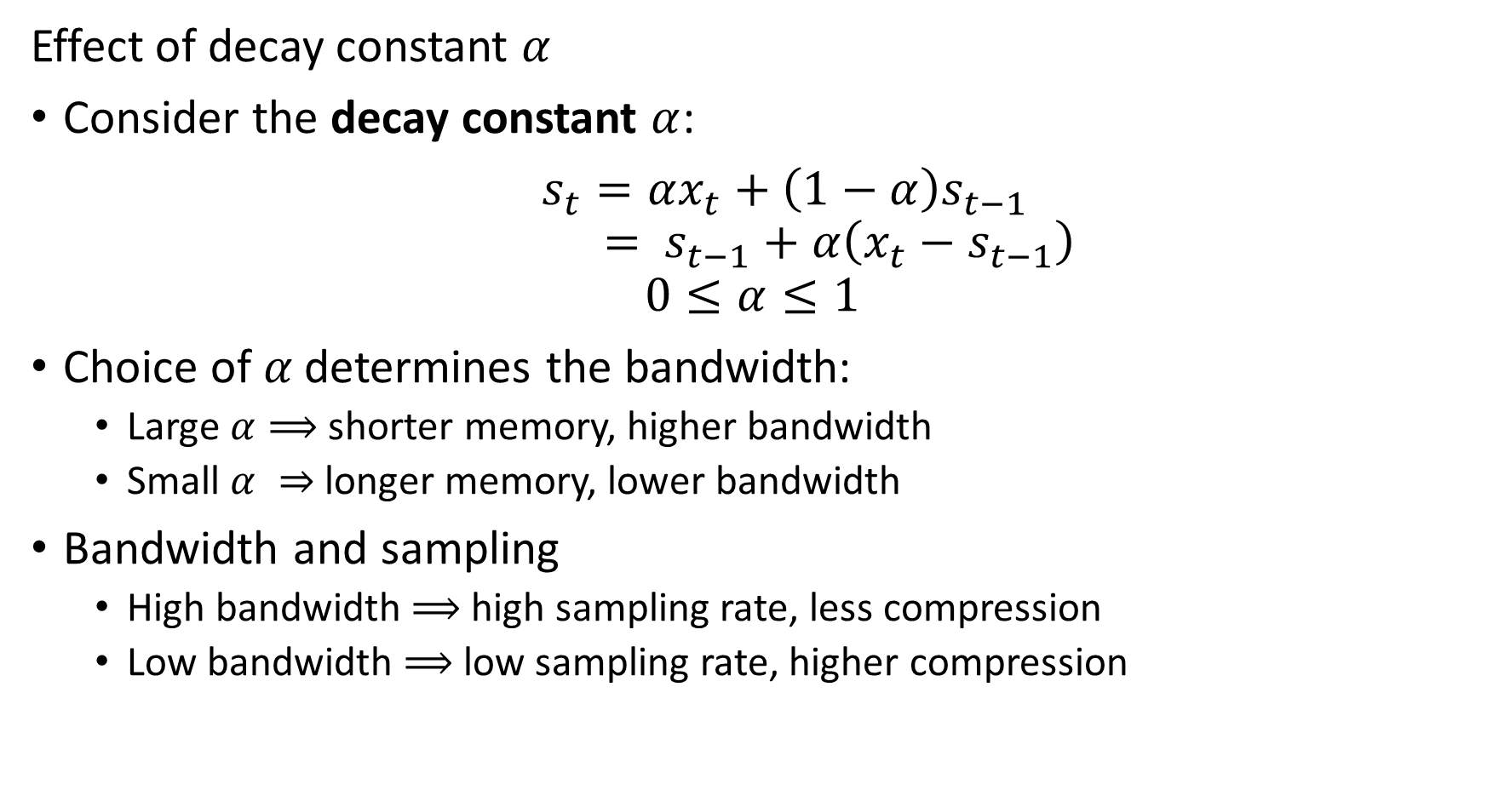
Exponential Decay Analytics
Effect of decay constant $α$
Consider the decay constant $α$:
$s_{t}=αx_{t}+\left(1−α\right)s_{t−1}$
$$= s_{t−1}+α\left(x_{t}−s_{t−1}\right)$$
$$0≤α≤1$$
Choice of$α$ determines the bandwidth:
Large $α⟹$ shorter memory, higher bandwidth
Small $α ⇒$ longer memory, lower bandwidth
Bandwidth and sampling
High bandwidth $⟹$ high sampling rate, less compression
Low bandwidth $⟹$ low sampling rate, higher compression

Slide 28
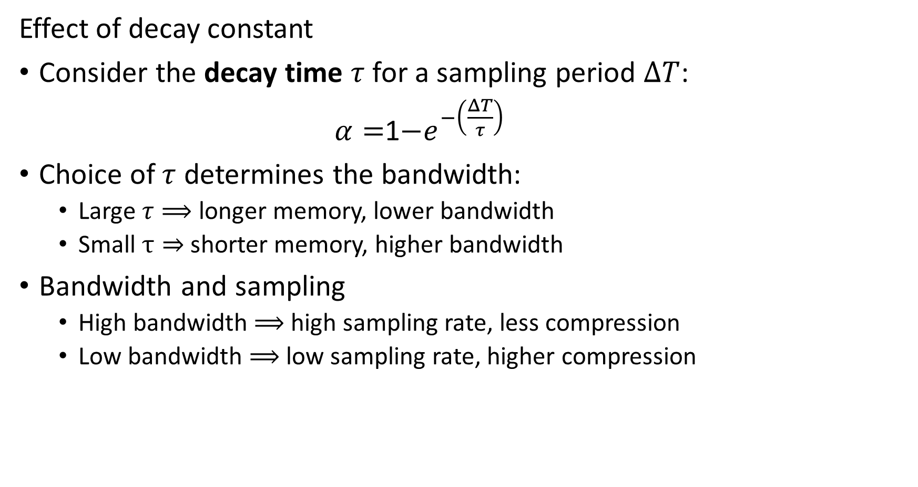
Exponential Decay Analytics
Effect of decay constant
Consider the decay time $τ$ for a sampling period $ΔT$:
$α=$1$−e^{−\left(\frac{ΔT}{τ}\right)}$
Choice of $τ$ determines the bandwidth:
Large $τ⟹$ longer memory, lower bandwidth
Small $τ⇒$ shorter memory, higher bandwidth
Bandwidth and sampling
High bandwidth $⟹$ high sampling rate, less compression
Low bandwidth $⟹$ low sampling rate, higher compression

Slide 29
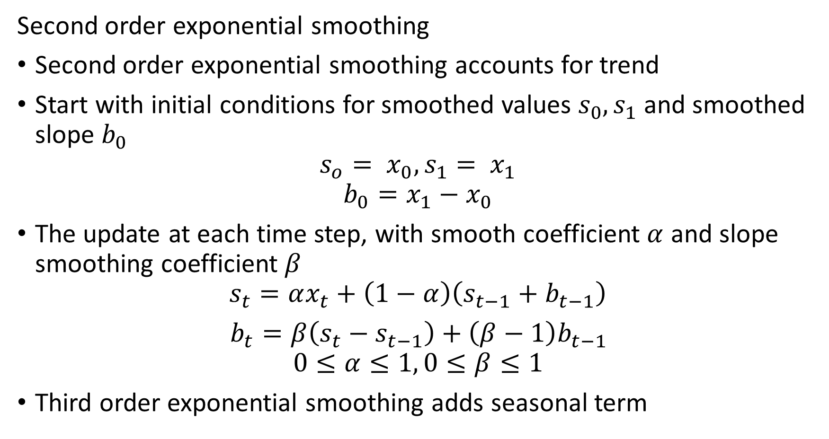
Exponential Decay Analytics
Second order exponential smoothing
Second order exponential smoothing accounts for trend
Start with initial conditions for smoothed values $s_{0},s_{1}$ and smoothed slope $b_{0}$
$$s_{o}= x_{0},s_{1}= x_{1}$$
$$b_{0}=x_{1}−x_{0}$$
The update at each time step, with smooth coefficient $α$ and slope smoothing coefficient $β$
$$s_{t}=αx_{t}+\left(1−α\right)\left(s_{t−1}+b_{t−1}\right)$$
$b_{t}=β\left(s_{t}−s_{t−1}\right)+\left(β−1\right)b_{t−1}$
$$0≤α≤1, 0≤β≤1$$
Third order exponential smoothing adds seasonal term

Slide 30
Reservoir Sampling

Slide 31
Reservoir Sampling
How can we randomly sample from infinite streams to compute an analytic?
Why do we need random samples or probabilistic sampling algorithms?
Moving window samples only hold information for a finite time
Loose history
Exponential smoothing methods only works for certain statistics
We cannot derive closed form recursions for many statistics, e.g. median
Idea, use a random sample of the observations
A random sample is representative of the full stream
Must updated random sample as new observations arrive
The stream has infinite length
Note: Reservoir sampling is implemented in the Apache DataSketches package

Slide 32
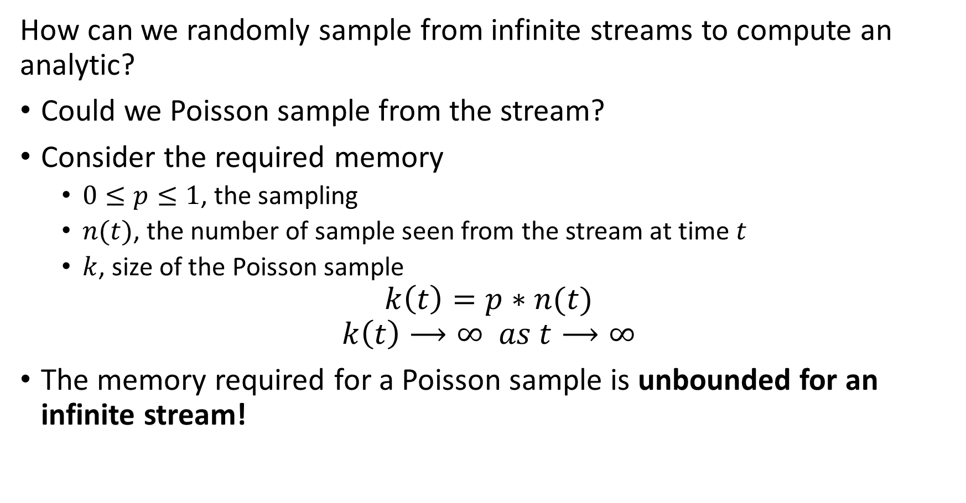
Reservoir Sampling
How can we randomly sample from infinite streams to compute an analytic?
Could we Poisson sample from the stream?
Consider the required memory
$0≤p≤1$, the sampling
$n(t)$, the number of sample seen from the stream at time $t$
$k$, size of the Poisson sample
$$k\left(t\right)=p∗n(t)$$
$$k\left(t\right)⟶∞ as t⟶∞$$
The memory required for a Poisson sample is unbounded for an infinite stream!

Slide 33
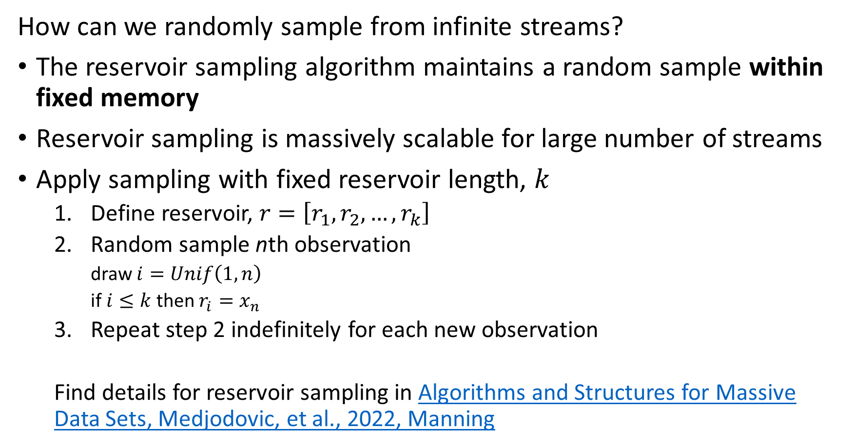
Reservoir Sampling
How can we randomly sample from infinite streams?
The reservoir sampling algorithm maintains a random sample within fixed memory
Reservoir sampling is massively scalable for large number of streams
Apply sampling with fixed reservoir length, $k$
Define reservoir, $r=\left[r_{1},r_{2},…,r_{k}\right]$
Random sample nth observation
draw $i=Unif\left(1,n\right)$
if $i≤k$ then $r_{i}=x_{n}$
Repeat step 2 indefinitely for each new observation
Find details for reservoir sampling in Algorithms and Structures for Massive Data Sets, Medjodovic, et al., 2022, Manning

Slide 34
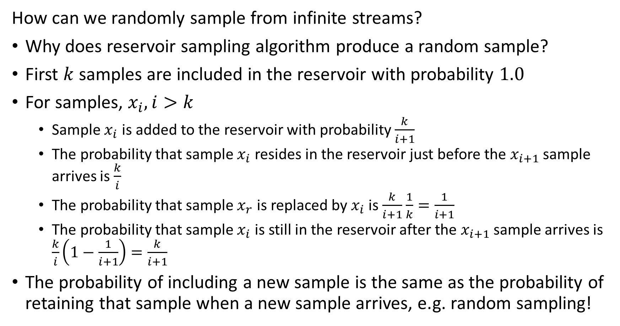
Reservoir Sampling
How can we randomly sample from infinite streams?
Why does reservoir sampling algorithm produce a random sample?
First $k$ samples are included in the reservoir with probability $1.0$
For samples, $x_{i}, i>k$
Sample $x_{i}$ is added to the reservoir with probability $\frac{k}{i+1}$
The probability that sample $x_{i}$ resides in the reservoir just before the $x_{i+1}$ sample arrives is $\frac{k}{i}$
The probability that sample $x_{r}$ is replaced by $x_{i}$ is $\frac{k}{i+1}$ $\frac{1}{k}=\frac{1}{i+1}$
The probability that sample $x_{i}$ is still in the reservoir after the $x_{i+1}$ sample arrives is $\frac{k}{i}\left(1−\frac{1}{i+1}\right)=\frac{k}{i+1}$
The probability of including a new sample is the same as the probability of retaining that sample when a new sample arrives, e.g. random sampling!

Slide 35
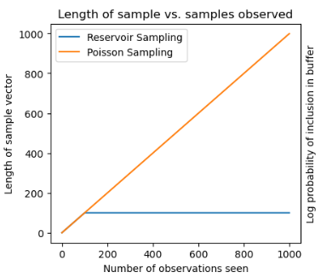
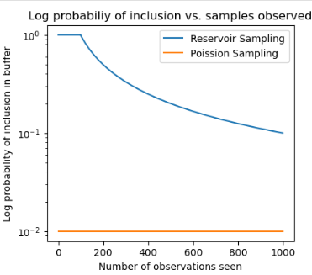
Reservoir Sampling
Compare reservoir sampling to Poisson sampling
A Poisson sample grows linearly, whereas the reservoir sample is constant
The probability of a sample residing in a Poisson sample is constant, whereas the probability declines for reservoir sampling

Slide 36
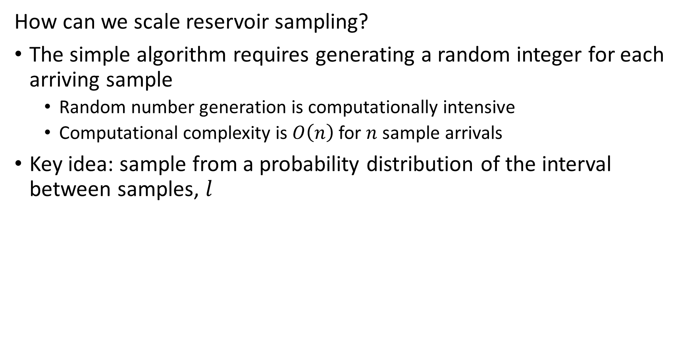
Reservoir Sampling
How can we scale reservoir sampling?
The simple algorithm requires generating a random integer for each arriving sample
Random number generation is computationally intensive
Computational complexity is $O\left(n\right)$ for $n$ sample arrivals
Key idea: sample from a probability distribution of the interval between samples, $l$

Slide 37
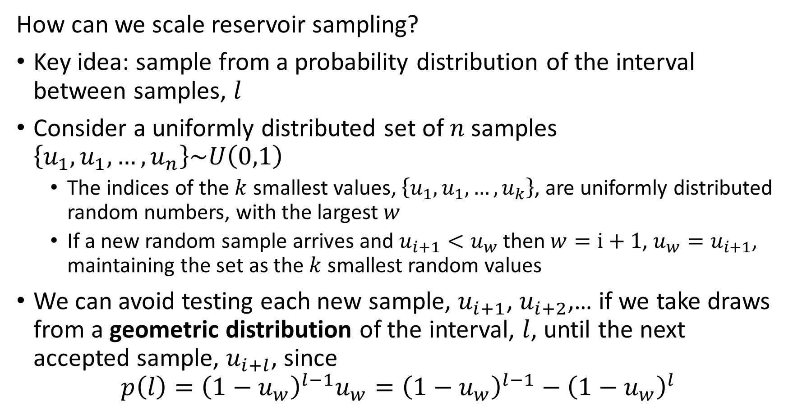
Reservoir Sampling
How can we scale reservoir sampling?
Key idea: sample from a probability distribution of the interval between samples, $l$
Consider a uniformly distributed set of $n$samples $\left\{u_{1},u_{1},…,u_{n}\right\}\sim U\left(0,1\right)$
The indices of the $k$ smallest values, $\left\{u_{1},u_{1},…,u_{k}\right\}$, are uniformly distributed random numbers, with the largest $w$
If a new random sample arrives and $u_{i+1}<u_{w}$ then $w=i+1$, $u_{w}=u_{i+1}$, maintaining the set as the $k$ smallest random values
We can avoid testing each new sample, $u_{i+1}$, $u_{i+2}$,… if we take draws from a geometric distribution of the interval, $l$, until the next accepted sample, $u_{i+l}$, since
$$p\left(l\right)={\left(1−u_{w}\right)}^{l−1}u_{w}={\left(1−u_{w}\right)}^{l−1}−{\left(1−u_{w}\right)}^{l}$$

Slide 38
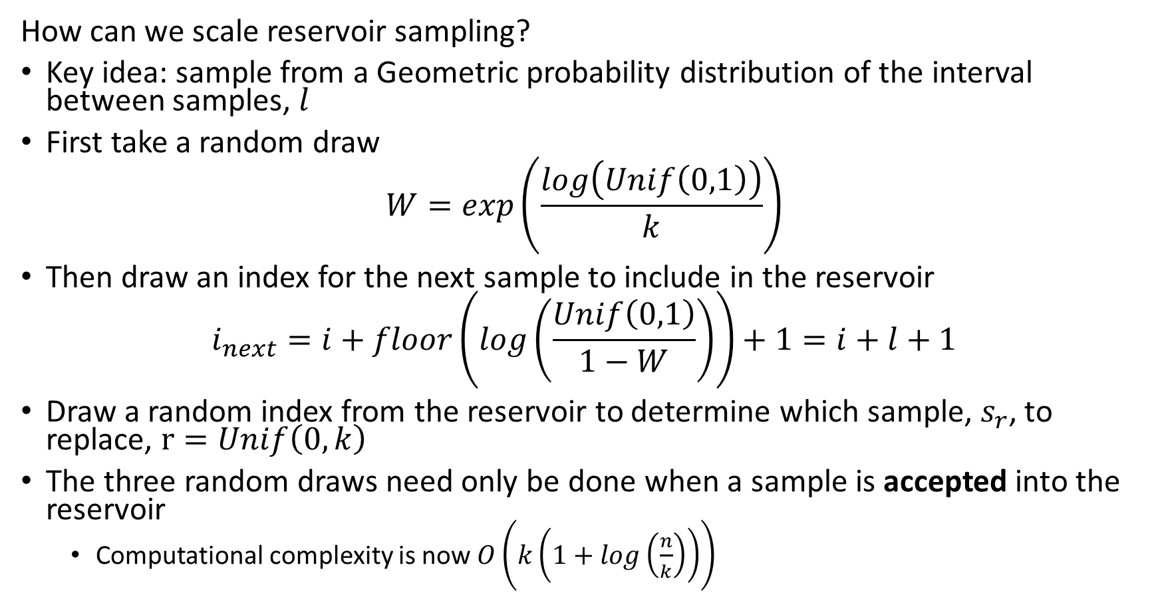
Reservoir Sampling
How can we scale reservoir sampling?
Key idea: sample from a Geometric probability distribution of the interval between samples, $l$
First take a random draw
$$W=exp\left(\frac{log\left(Unif\left(0,1\right)\right)}{k}\right)$$
Then draw an index for the next sample to include in the reservoir
$$i_{next}=i+floor\left(log\left(\frac{Unif\left(0,1\right)}{1−W}\right)\right)+1=i+l+1$$
Draw a random index from the reservoir to determine which sample, $s_{r}$, to replace, $r=Unif\left(0,k\right)$
The three random draws need only be done when a sample is accepted into the reservoir
Computational complexity is now $O\left(k\left(1+log\left(\frac{n}{k}\right)\right)\right)$

Slide 39
Reservoir Sampling
How can we scale reservoir sampling?
Take an initial random draw
Compute index of next sample to expect
Add sample to random location in reservoir buffer
Update random value
W = math.exp(math.log(random.random())/k)
## Loop over the remianing samples in the stream
while i < n:
i = i + math.floor(math.log(random.random())/math.log(1 - W))
if i < n:
indx = random.randint(1, k) -1
reservoir_buffer[indx] = stream[i]
W = W * math.exp(math.log(random.random())/k)

Slide 40
Evaluating Stream Filtering
How can we evaluate the effect of filtering and decimation of time series?
Evaluated the differences between original series and the filtered/decimated series
What does the difference series look like
How does the magnitude of the errors compare to original values?
Are the errors fairly uniformly distributed?
Error metrics
RMSE
MAE
Max deviation
Etc.

Slide 41
Discrete Streaming Events

Slide 42
Discrete Event Data
Discrete streaming data is common
Clicks on a web site
Counts of Key-value lookups
Counts of IP address pairs in internet traffic
Sensors count events
Vehicles passing
People entering a building
Wildlife sightings
…
And many more…

Slide 43
Volume Reduction and Streaming Analytics
Event stream algorithms are both filters and analytics
Streams can be filtered and sampled near the source
Further filtering, sampling and sketching performed as preprocessing for analytics
Data Source
Filter/sample
Filter/sample/sketch
Stream analytic
Filter/sample/sketch
Stream analytic
Data Source
Filter/sample
$$⋮$$
$$⋮$$
$$⋮$$
$$⋮$$
Bandwidth limited network
Filter/sample/sketch
Stream analytic
Data Source
Filter/sample
Archival storage
Classical supervised and unsupervised ML
Server/Cloud
Minimum (filtered) data and analytics archived
Filtered streams and sketches used as input to classical ML

Slide 44
Discrete Event Data
What types of operations can we do with discrete event data?
Filter events to only process those of interest
Count events in a time window or in a reservoir sample
Unique types of events occurring in time window, or cardinality
Can concatenate operations, for example:
Filter events by type
Count events
Find cardinality of filtered stream
Query specific events
Etc.

Slide 45
Discrete Event Data
What limits discrete event data analytics?
Consider volume of events:
Storing all events is prohibitive
Want to push processing as far to periphery as possible
Use computationally and memory efficient approximate algorithms
Accept some error in exchange for orders of magnitude improvement in memory and computation
For large volume streams, approximations generally converge toward exact values
Many algorithms have been developed
Bloom filter and quotient filter for event history
Count-min-sketch algorithm for event counts
Flajolet-Martin and hyper-log-log algorithms for cardinality
Etc.
These algorithms can be applied in batch

Slide 46
Filtering Discrete Events

Slide 47
Filtering Event Data
Often need to exclude events
Messages from IP addresses not on an authorized list
Is the originating phone one of our accounts?
Is this a sensor reading we need to process?
Has an event already occurred previously?
Etc.
The majority of traffic is often filtered in stream processing

Slide 48
Filtering Event Data
Filtering streaming data
How can we filter a stream of events?
Hash table look-up?
B-tree structure?
Above works at small scale
Need to store hash for each allowed value or state
Must maintain lookup in main memory for speed
A Bloom filter is a highly space-efficient approximate lookup
No false negative event
Some probability of false positive – hash collision
Note: The Bloom filter and quotient filter algorithms are implemented in the PyProbables package

Slide 49

Filtering Event Data
0
0
0
0
How does a Bloom filter work?
Start with bit array or bitmap of length $m$
Use $k$ hash functions that output a bit location
0
0
0
0
0
0
0
0
0
0
0
0
…
0
0
0
0

Slide 50

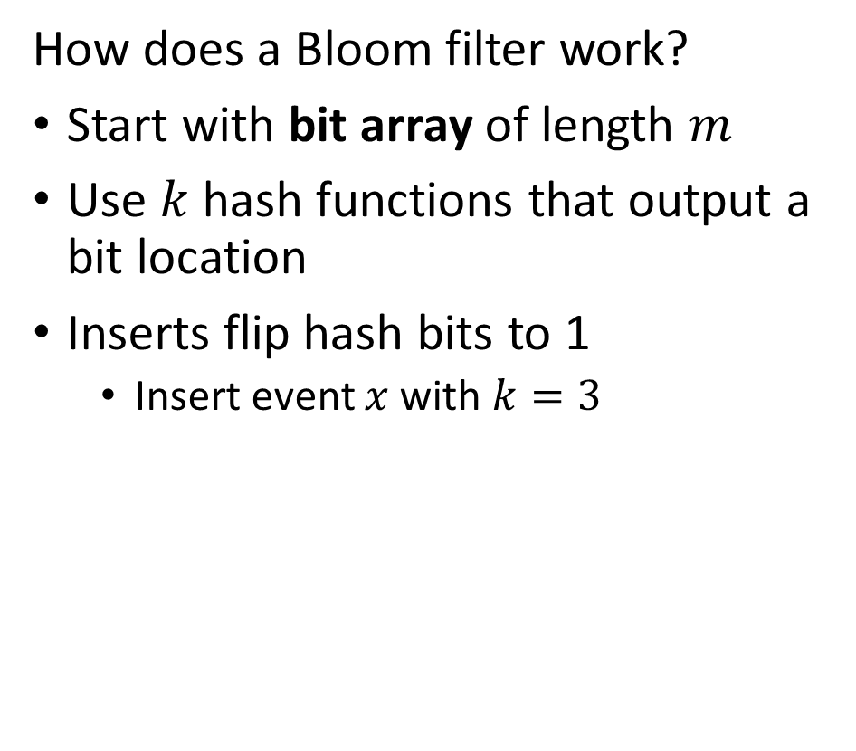


Filtering Event Data
0
1
$$f^{\left(1\right)}\left(x\right)$$
0
0
How does a Bloom filter work?
Start with bit array of length $m$
Use $k$ hash functions that output a bit location
Inserts flip hash bits to 1
Insert event $x$ with $k=3$
0
$$f^{\left(2\right)}\left(x\right)$$
0
0
$$f^{\left(3\right)}\left(x\right)$$
1
0
0
0
0
0
0
0
1
…
0
0
0
0

Slide 51


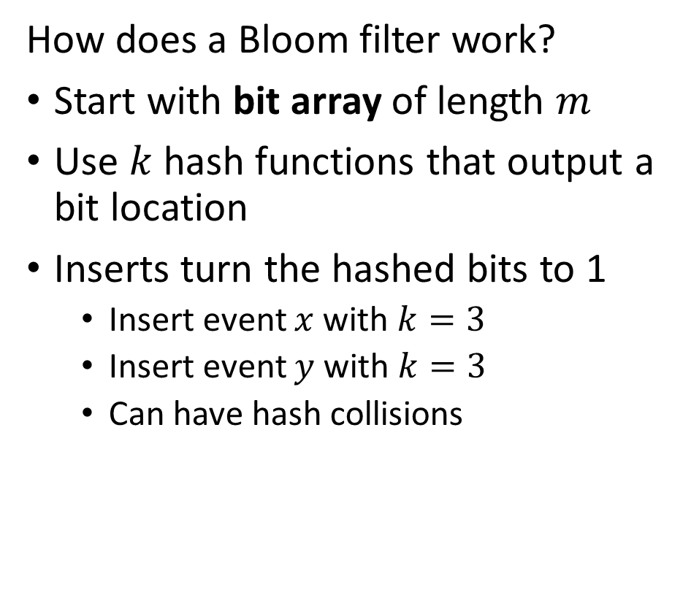

Filtering Event Data
0
1
$$f^{\left(1\right)}\left(x\right)$$
0
0
How does a Bloom filter work?
Start with bit array of length $m$
Use $k$ hash functions that output a bit location
Inserts turn the hashed bits to 1
Insert event $x$ with $k=3$
Insert event $y$ with $k=3$
Can have hash collisions
0
$$f^{\left(2\right)}\left(x\right)$$
0
0
$$f^{\left(3\right)}\left(x\right)$$
1
0
1
0
$$f^{\left(1\right)}\left(y\right)$$
1
0
$$f^{\left(2\right)}\left(y\right)$$
0
0
$$f^{\left(3\right)}\left(y\right)$$
1
…
0
0
0
0

Slide 52

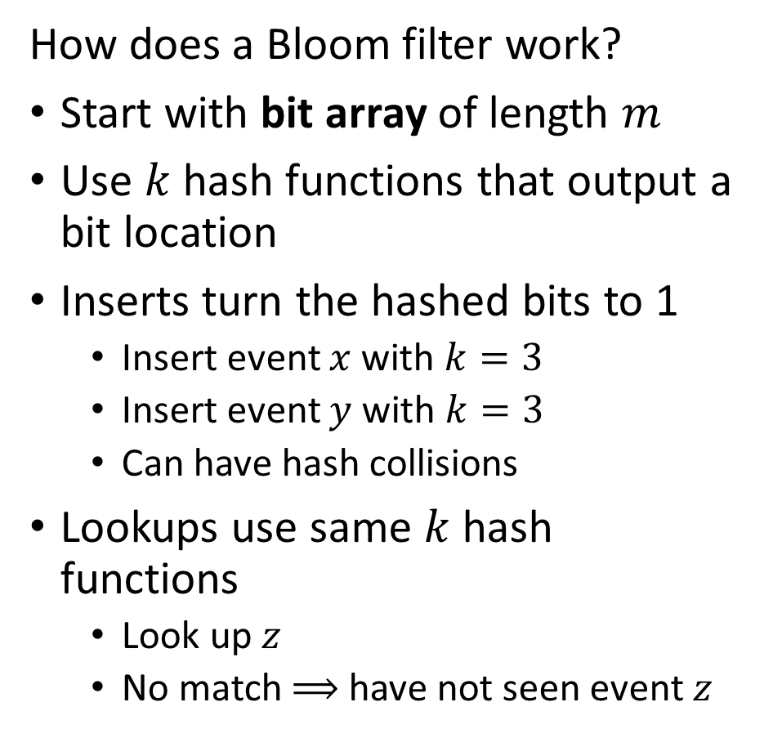


Filtering Event Data
0
1
$$f^{\left(1\right)}\left(z\right)$$
0
0
How does a Bloom filter work?
Start with bit array of length $m$
Use $k$ hash functions that output a bit location
Inserts turn the hashed bits to 1
Insert event $x$ with $k=3$
Insert event $y$ with $k=3$
Can have hash collisions
Lookups use same $k$ hash functions
Look up $z$
No match $⟹$ have not seen event $z$
0
$$f^{\left(2\right)}\left(z\right)$$
0
0
$$f^{\left(3\right)}\left(z\right)$$
1
0
1
0
1
0
0
0
1
…
0
0
0
0

Slide 53
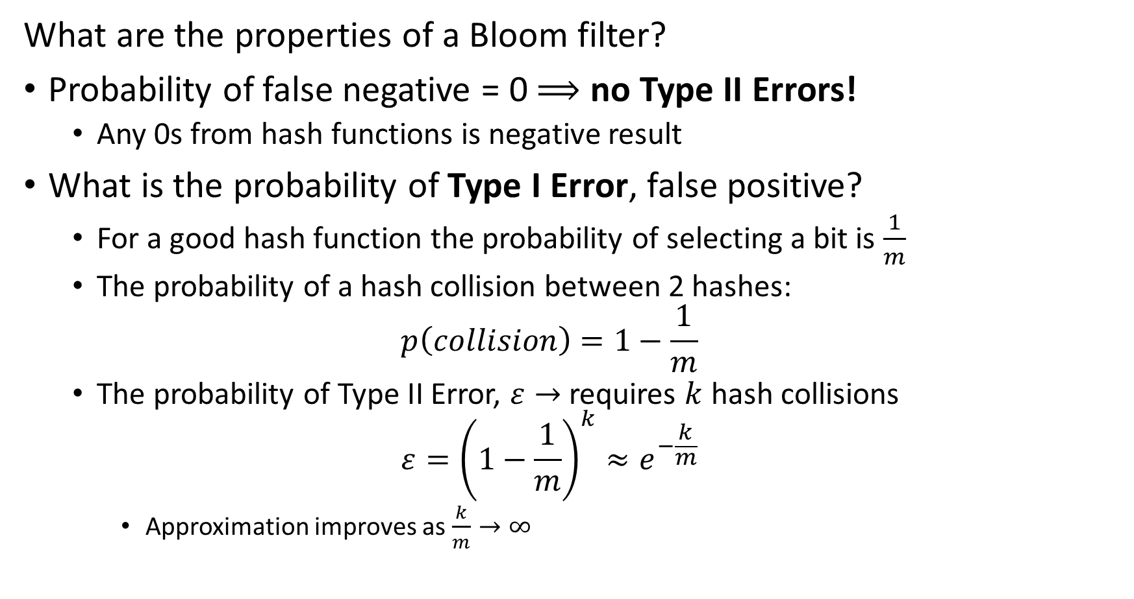
Filtering Event Data
What are the properties of a Bloom filter?
Probability of false negative = 0 $⟹$ no Type II Errors!
Any 0s from hash functions is negative result
What is the probability of Type I Error, false positive?
For a good hash function the probability of selecting a bit is $\frac{1}{m}$
The probability of a hash collision between 2 hashes:
$$p\left(collision\right)=1−\frac{1}{m}$$
The probability of Type II Error, $ε→$ requires $k$ hash collisions
$$ε={\left(1−\frac{1}{m}\right)}^{k}≈e^{−\frac{k}{m}}$$
Approximation improves as $\frac{k}{m}→∞$

Slide 54
Filtering Event Data
Alternatives to Bloom filter
Variation capable of deletes:
Each bit location has a counter
When event type is deleted, a count is decremented from each hash location
Quotient filter uses sophisticated hashing scheme
Memory efficient
Generally lower false positive rate
Manages counts in buckets
Better use of memory and computation compared to Bloom filter
Find details for quotient filter in Algorithms and Structures for Massive Data Sets, Medjodovic, et al., 2022, Manning

Slide 55



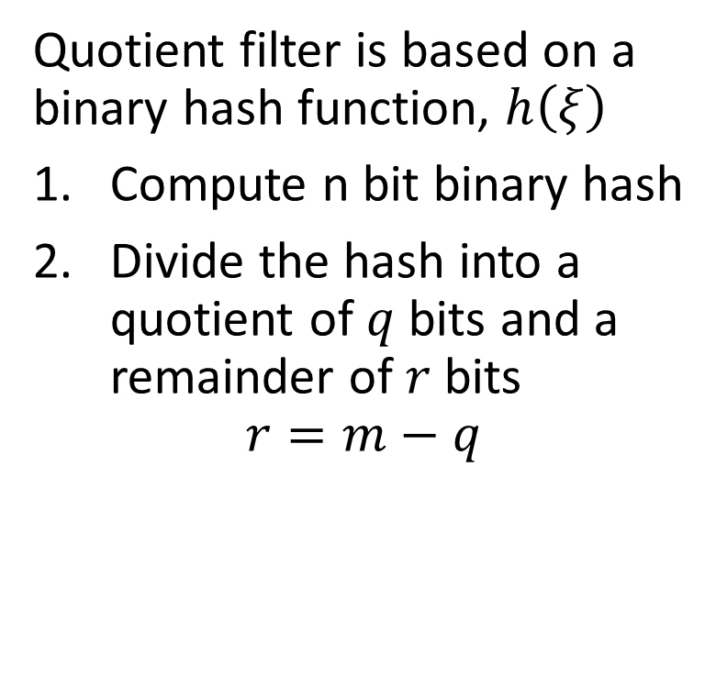















Filtering Event Data
Quotient filter is memory and computationally efficient
Quotient filter is based on a binary hash function, $h\left(ξ\right)$
Compute n bit binary hash
Divide the hash into a quotient of $q$ bits and a remainder of $r$ bits
$$r=m−q$$
Quotient
Remainder
$$h\left(w\right)=10001001010⇒$$
$$10001$$
$$001010$$
$$h\left(u\right)=10011000111⇒$$
$$10011$$
$$000111$$
$$h\left(v\right)=10011111111⇒$$
$$10011$$
$$111111$$
$$h\left(q\right)=10101101101⇒$$
$$10101$$
$$101101$$
$$h\left(x\right)=10110000111⇒$$
$$10110$$
$$000111$$
$$h\left(y\right)=00111111110⇒$$
$$00111$$
$$111110$$

Slide 56




Filtering Event Data
Quotient filter is memory and computationally efficient
The quotient defines a hash bucket
The remainder is the value
Notice the hash collision
Quotient
Remainder
$$h\left(w\right)=10001001010⇒$$
$$10001$$
$$001010$$
$$h\left(u\right)=10011000111⇒$$
$$10011$$
$$000111$$
$$h\left(v\right)=10011111111⇒$$
$$10011$$
$$111111$$
$$h\left(q\right)=10101101101⇒$$
$$10101$$
$$101101$$
$$h\left(x\right)=10110000111⇒$$
$$10110$$
$$000111$$
$$h\left(y\right)=00111111110⇒$$
$$00111$$
$$111110$$

Slide 57
Filtering Event Data
Quotient filter is memory and computationally efficient
Two key concepts used to manage hash collisions in quotient filters
A run is a consecutive sequence of slots occupied with remainders with the same quotient
A cluster is a continuous sequence of one or more runs
Performance of quotient filter relies on the empirical evidence for the prevalence of short clusters
Linear probing is used to find open slots
Remainders with the same quotient are stored consecutively
Remainders with same quotient are stored in sort order to improve search efficiency

Slide 58






























Filtering Event Data
Quotient filter is memory and computationally efficient
Quotient filters use three bits to manage linear probing to resolve hash collisions
Run Continued bit is set when the slot is occupied but not the first element of the run
Is Occupied bit is set when the slot is occupied by some other hash from another location
Is Shifted bit is set to indicate the value in the slot is from another bucket
Bucket Occupied
Run Continued
Is Shifted
Quotient
Remainder
$$0$$
$$0$$
$$0$$
$$10001$$
$$001010$$
$$0$$
$$0$$
$$0$$
$$10011$$
$$000111$$
$$1$$
$$0$$
$$1$$
$$10$$
$$111111$$
$$0$$
$$0$$
$$0$$
$$10101$$
$$101101$$
$$0$$
$$0$$
$$0$$
$$10110$$
$$000111$$
$$0$$
$$0$$
$$0$$
$$00111$$
$$111110$$

Slide 59
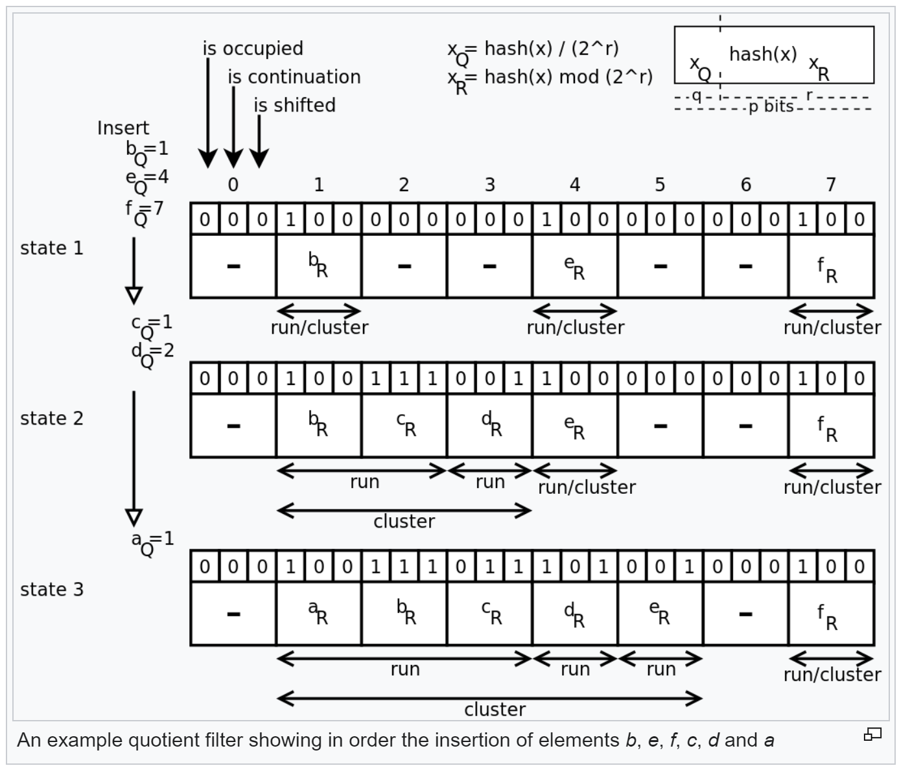
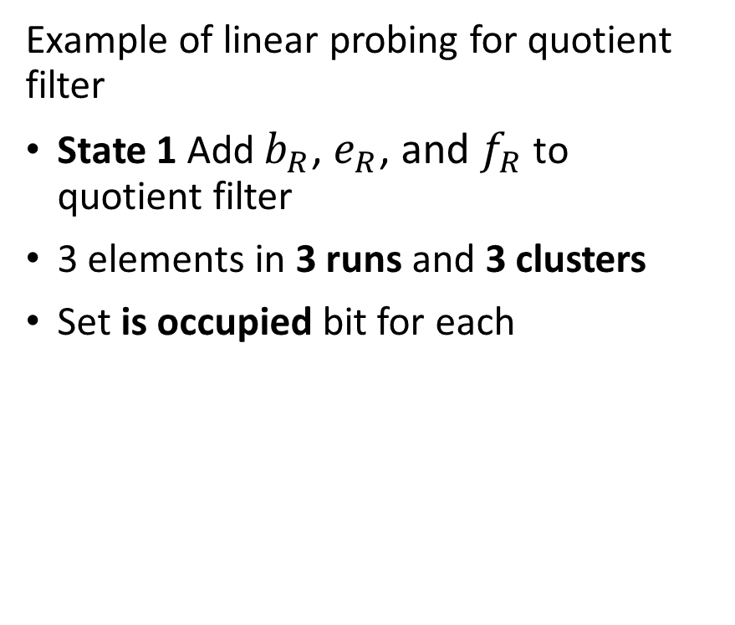
Filtering Event Data
Quotient filter is memory and computationally efficient
Example of linear probing for quotient filter
State 1 Add $b_{R}$, $e_{R}$, and $f_{R}$ to quotient filter
3 elements in 3 runs and 3 clusters
Set is occupied bit for each
Illustration from Wikipedia quotient filter article

Slide 60
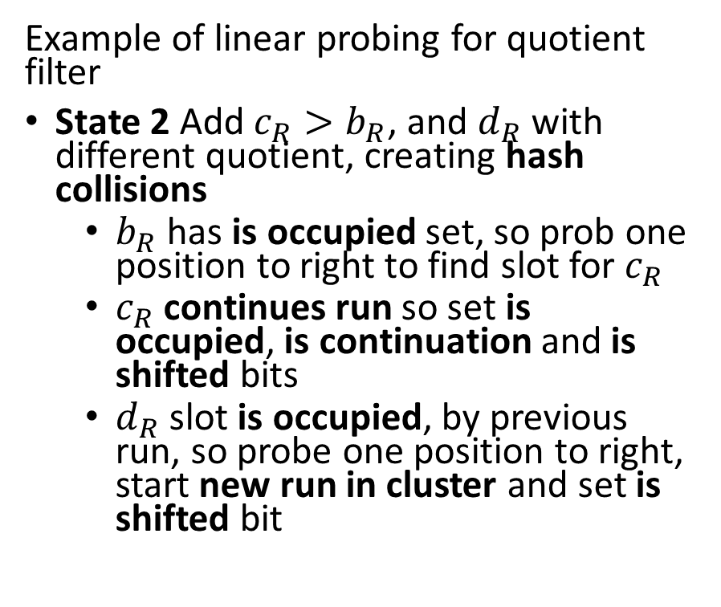
Filtering Event Data
Quotient filter is memory and computationally efficient
Example of linear probing for quotient filter
State 2 Add $c_{R}>b_{R}$, and $d_{R}$ with different quotient, creating hash collisions
$b_{R}$ has is occupied set, so prob one position to right to find slot for $c_{R}$
$c_{R}$ continues run so set is occupied, is continuation and is shifted bits
$d_{R}$ slot is occupied, by previous run, so probe one position to right, start new run in cluster and set is shifted bit
Illustration from Wikipedia quotient filter article

Slide 61
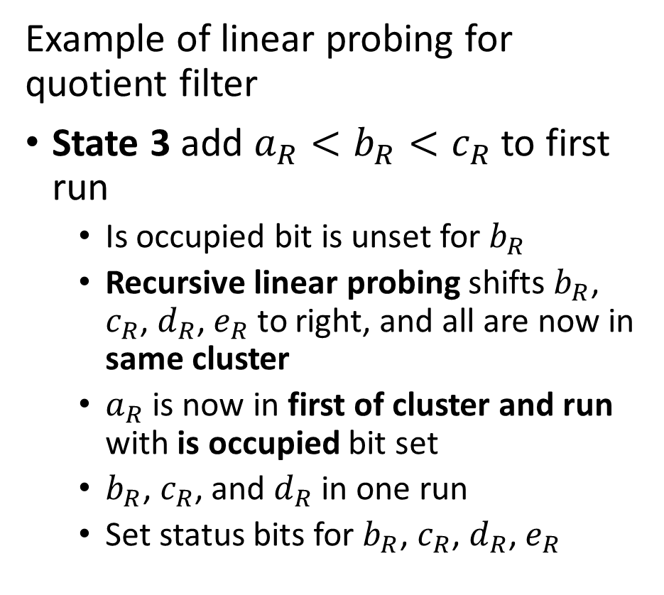
Filtering Event Data
Quotient filter is memory and computationally efficient
Example of linear probing for quotient filter
State 3 add $a_{R}<b_{R}<c_{R}$ to first run
Is occupied bit is unset for $b_{R}$
Recursive linear probing shifts $b_{R}$, $c_{R}$, $d_{R}$, $e_{R}$ to right, and all are now in same cluster
$a_{R}$ is now in first of cluster and run with is occupied bit set
$b_{R}$, $c_{R}$, and $d_{R}$ in one run
Set status bits for $b_{R}$, $c_{R}$, $d_{R}$, $e_{R}$
Illustration from Wikipedia quotient filter article

Slide 62
Filtering Event Data
Merging and resizing the quotient filter
Quotient filters can be merged by adding remainders of one filter to the bins defined by the quotients of another filter
Merging filters allows simple aggregation
Quotients must have same number of bits, or can resize, so quotients match
Need to ensure table is large enough to prevent quotient (hash) collisions.
Merging filters is useful for aggregation over multiple time periods
Can easily double the size of a quotient filter
Most significant bit of reminder becomes least significant bit of quotient
Adding a bit to the quotient doubles the size of the filter

Slide 63
Counting Discrete Events

Slide 64
Counting Events
Many applications of large-scale event counting
Events can be counted offline or online
Counting events by scanning massive databases offline
Counting events in streams in time windows – our focus here
Applications
Count vehicles in highway sensors
Count trade volume in capital markets
Counts of packets to find suspicious activity in networks
Counts of transactions to find fraudulent activity
Counts from wearable technology
……

Slide 65
Counting Events
Count-min-sketch algorithm efficiently counts events
A full count table needs an entry for every possible event identifier
Size is unbounded
Unmanageable for large event set
We need a better approach!
A sketch is a minimal (approximate) representation of a data structure
Create a sketch of the counts using hash functions
Count is approximated by the sketch
Data structure is of fixed compact size!

Slide 66




Counting Events
Count-min-sketch employs a compact 2-dimensional data structure
Depth, d, hash functions, typically 10s
Width, w, buckets, typically 1000s
Compact data structure size leads to hash collisions
Width, w, buckets
1 | 2 | 3 | 4 | 5 | 6 | 7 | 8
0 | 0 | 0 | 0 | 0 | 0 | 0 | 0
0 | 0 | 0 | 0 | 0 | 0 | 0 | 0
0 | 0 | 0 | 0 | 0 | 0 | 0 | 0
0 | 0 | 0 | 0 | 0 | 0 | 0 | 0
$$h_{1}\left(\right)$$
Depth, d, hash functions
$$h_{2}\left(\right)$$
$$h_{3}\left(\right)$$
$$h_{4}\left(\right)$$

Slide 67
Counting Events
Count-min-sketch algorithm efficiently counts events
A sketch is a minimal (approximate) representation of a data structure
The count-min-sketch algorithm uses probabilistic sampling
Counts of events are added to the hash buckets in the sketch data structure
If no hash collisions, event counts in buckets for event identifier are exact
With inevitable hash collisions use minimum count in the hash buckets for the event identifier
Never get an under-count
Get over-count with some probability

Slide 68




Counting Events
Count-min-sketch employs a 2-dimensional data structure
Example, count events u, v, w, x, y
Event is tuple, (identifier, occurrences)
Event (u,1), add 1 to buckets indexed by hash functions for key u
1 | 2 | 3 | 4 | 5 | 6 | 7 | 8
0 | 0 | 1 | 0 | 0 | 0 | 0 | 0
0 | 0 | 0 | 0 | 0 | 0 | 1 | 0
1 | 0 | 0 | 0 | 0 | 0 | 0 | 0
0 | 0 | 0 | 0 | 1 | 0 | 0 | 0
$$h_{1}\left(u\right)=3$$
$$h_{2}\left(u\right)=7$$
$$h_{3}\left(u\right)=1$$
$$h_{4}\left(u\right)=5$$

Slide 69




Counting Events
Count-min-sketch employs a 2-dimensional data structure
Example, count events u, v, w, x, y
Event is tuple, (identifier, occurrences)
Event (v,2), add 2 to buckets indexed by hash functions, hash collision
1 | 2 | 3 | 4 | 5 | 6 | 7 | 8
2 | 0 | 1 | 0 | 0 | 0 | 0 | 0
0 | 0 | 0 | 0 | 0 | 2 | 1 | 0
1 | 0 | 0 | 2 | 0 | 0 | 0 | 0
0 | 0 | 0 | 0 | 3 | 0 | 0 | 0
$$h_{1}\left(v\right)=1$$
$$h_{2}\left(v\right)=6$$
$$h_{3}\left(v\right)=4$$
$$h_{4}\left(v\right)=5$$

Slide 70




Counting Events
Count-min-sketch employs a 2-dimensional data structure
Example, count events u, v, w, x, y
Event is tuple, (identifier, occurrences)
Event (w,1), add 1 to buckets, hash collision
1 | 2 | 3 | 4 | 5 | 6 | 7 | 8
3 | 0 | 1 | 0 | 0 | 0 | 0 | 0
0 | 0 | 0 | 0 | 1 | 2 | 1 | 0
1 | 0 | 1 | 2 | 0 | 0 | 0 | 0
0 | 0 | 0 | 0 | 3 | 1 | 0 | 0
$$h_{1}\left(w\right)=1$$
$$h_{2}\left(w\right)=5$$
$$h_{3}\left(w\right)=3$$
$$h_{4}\left(w\right)=6$$

Slide 71




Counting Events
Count-min-sketch employs a 2-dimensional data structure
Example, count events u, v, w, x, y
Event is tuple, (identifier, occurrences)
Event (x,3), add 3 to buckets, multiple hash collisions
1 | 2 | 3 | 4 | 5 | 6 | 7 | 8
3 | 0 | 4 | 0 | 0 | 0 | 0 | 0
0 | 0 | 0 | 3 | 1 | 2 | 1 | 0
3 | 0 | 1 | 2 | 0 | 0 | 0 | 0
0 | 3 | 0 | 0 | 3 | 1 | 0 | 0
$$h_{1}\left(x\right)=3$$
$$h_{2}\left(x\right)=4$$
$$h_{3}\left(x\right)=1$$
$$h_{4}\left(x\right)=2$$

Slide 72




Counting Events
Count-min-sketch employs a 2-dimensional data structure
Example, count events u, v, w, x, y
Event is tuple, (identifier, occurrences)
Event (y,2), add 2 to buckets, hash collision
1 | 2 | 3 | 4 | 5 | 6 | 7 | 8
3 | 2 | 4 | 0 | 0 | 0 | 0 | 0
0 | 0 | 0 | 5 | 1 | 2 | 1 | 0
3 | 0 | 1 | 2 | 2 | 0 | 0 | 0
0 | 3 | 0 | 0 | 3 | 1 | 0 | 2
$$h_{1}\left(y\right)=2$$
$$h_{2}\left(y\right)=4$$
$$h_{3}\left(y\right)=5$$
$$h_{4}\left(y\right)=8$$

Slide 73




Counting Events
Best estimate of count is minimum of counts in buckets of sketch data structure
Count-min-sketch algorithm finds upper bound on count
Actual count may be less than estimate, never greater
u | v | w | x | y
4 | 3 | 3 | 4 | 2
1 | 2 | 1 | 5 | 5
3 | 2 | 1 | 3 | 2
3 | 3 | 3 | 3 | 3
1 | 2 | 1 | 3 | 2
1 | 2 | 1 | 3 | 2
$$h_{1}$$
$$h_{2}$$
$$h_{3}$$
$$h_{4}$$
Min count
Actual count

Slide 74
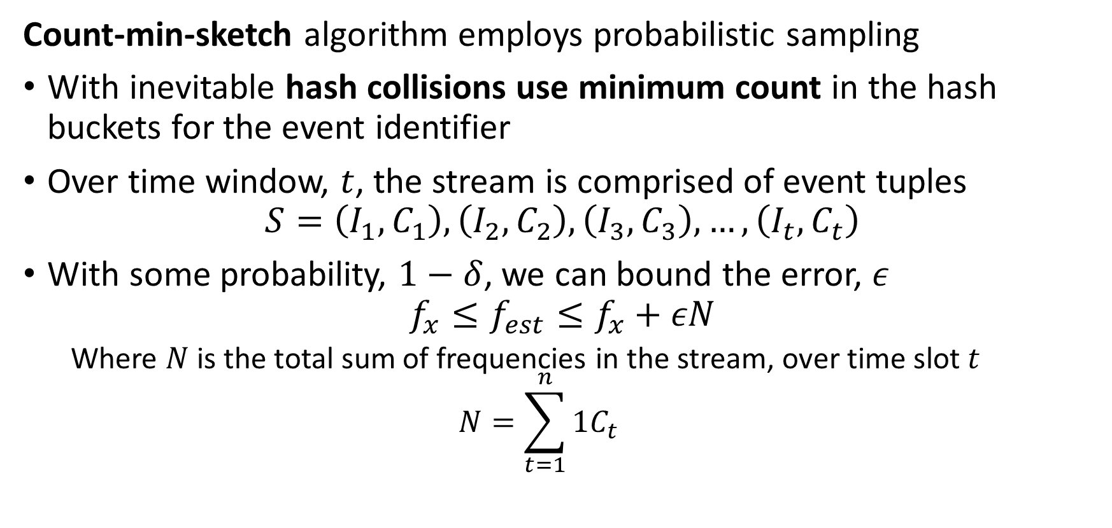
Counting Events
Count-min-sketch algorithm employs probabilistic sampling
With inevitable hash collisions use minimum count in the hash buckets for the event identifier
Over time window, $t$, the stream is comprised of event tuples
$$S=\left(I_{1},C_{1}\right),\left(I_{2},C_{2}\right),\left(I_{3},C_{3}\right),…,\left(I_{t},C_{t}\right)$$
With some probability, $1−δ$, we can bound the error, $ε$
$$f_{x}≤f_{est}≤f_{x}+εN$$
Where $N$ is the total sum of frequencies in the stream, over time slot $t$
$$N=\sum_{t=1}^{n}{1C_{t}}$$

Slide 75
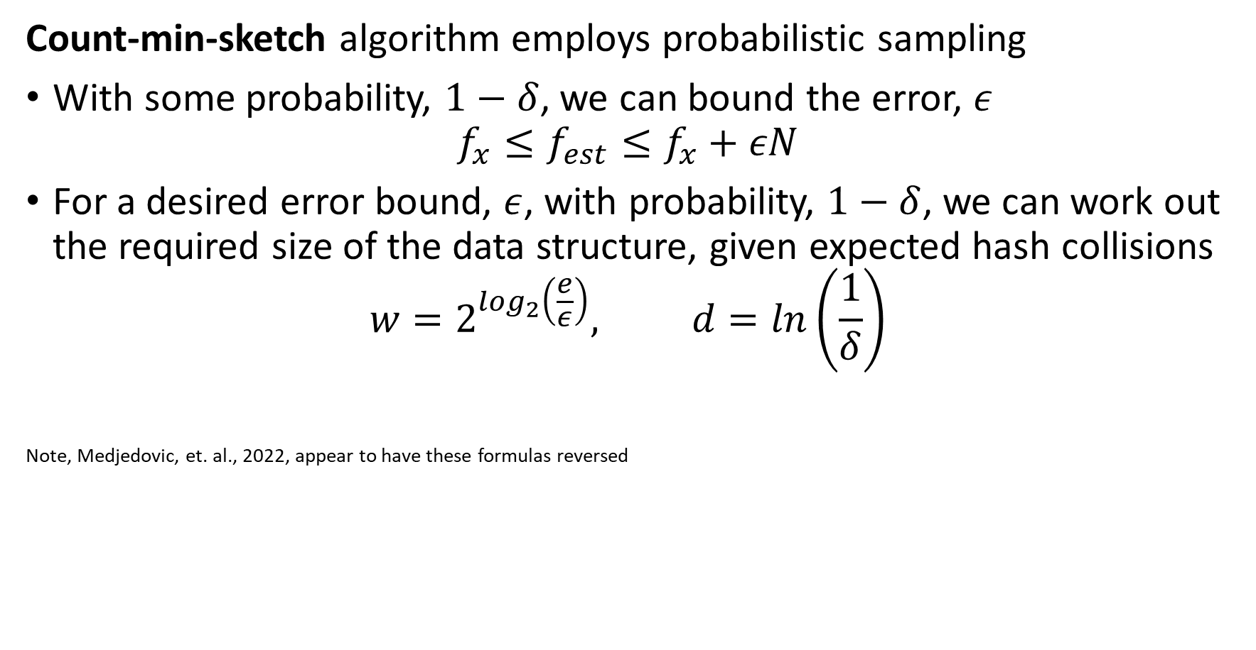
Counting Events
Count-min-sketch algorithm employs probabilistic sampling
With some probability, $1−δ$, we can bound the error, $ε$
$$f_{x}≤f_{est}≤f_{x}+εN$$
For a desired error bound, $ε$, with probability, $1−δ$, we can work out the required size of the data structure, given expected hash collisions
$$w=2^{\log_{2}\left(\frac{e}{ε}\right)}, d=ln\left(\frac{1}{δ}\right)$$
Note, Medjedovic, et. al., 2022, appear to have these formulas reversed

Slide 76
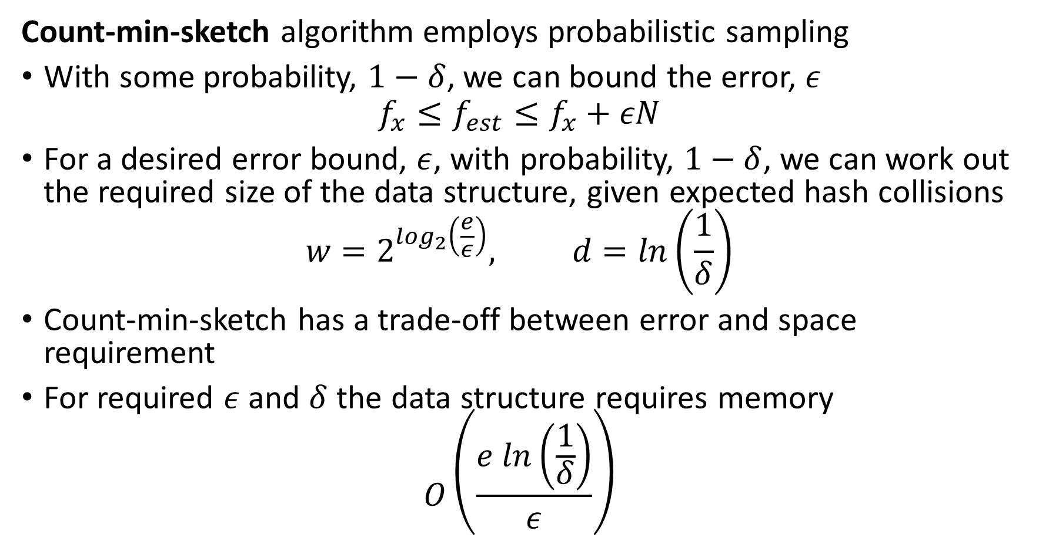
Counting Events
Count-min-sketch algorithm employs probabilistic sampling
With some probability, $1−δ$, we can bound the error, $ε$
$$f_{x}≤f_{est}≤f_{x}+εN$$
For a desired error bound, $ε$, with probability, $1−δ$, we can work out the required size of the data structure, given expected hash collisions
$$w=2^{\log_{2}\left(\frac{e}{ε}\right)}, d=ln\left(\frac{1}{δ}\right)$$
Count-min-sketch has a trade-off between error and space requirement
For required $ε$ and $δ$ the data structure requires memory
$$O\left(\frac{e ln\left(\frac{1}{δ}\right)}{ε}\right)$$

Slide 77
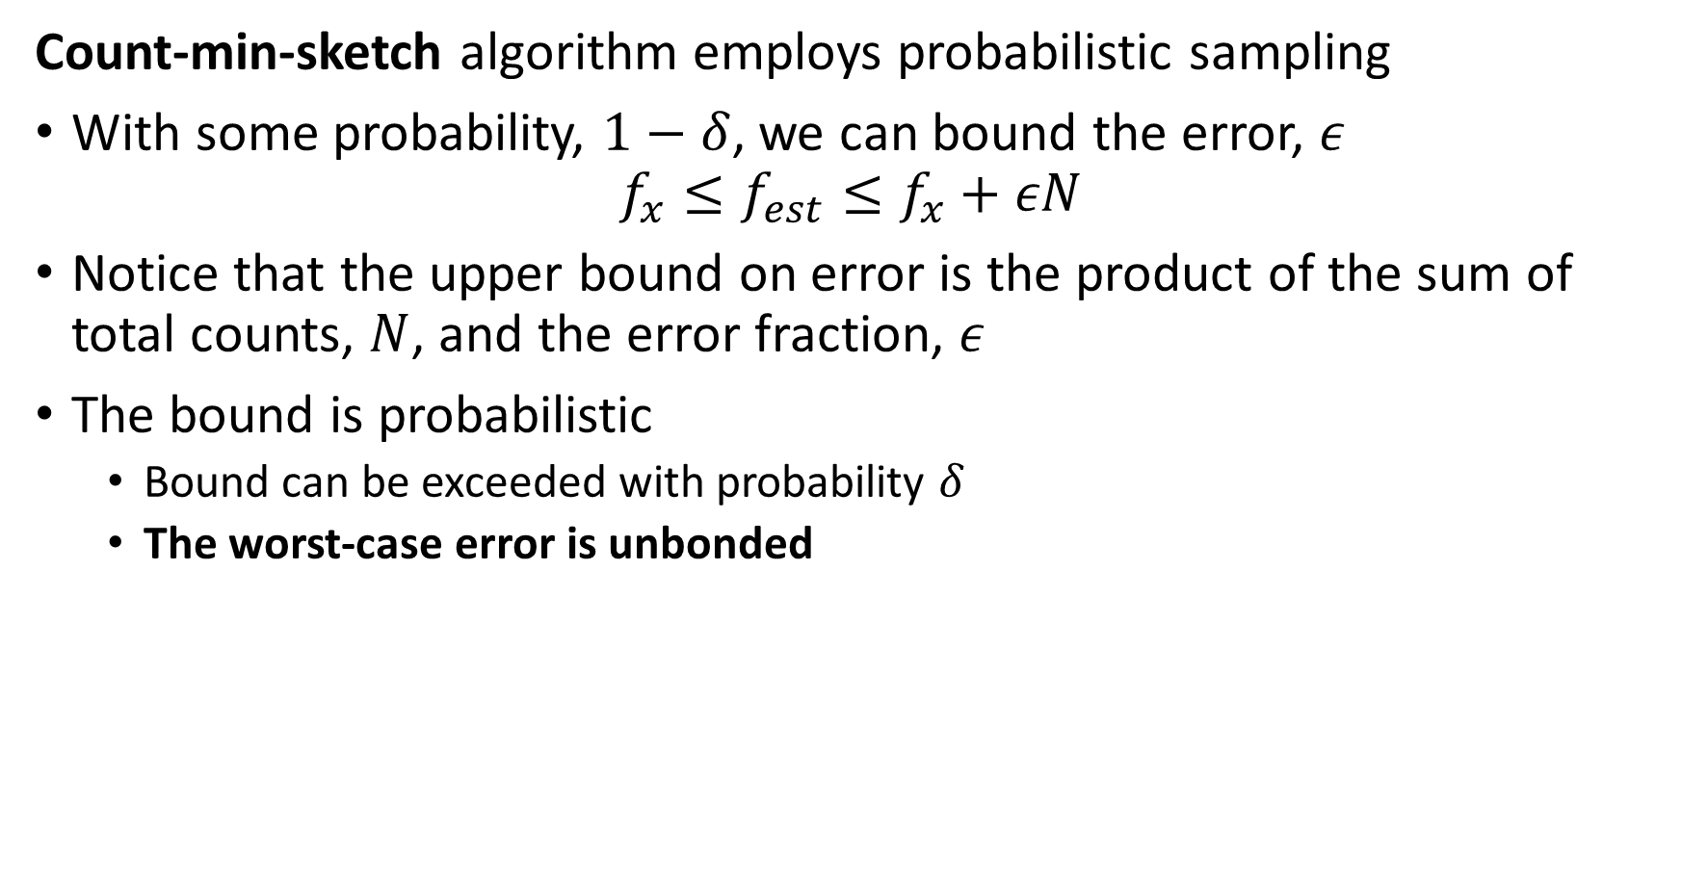
Counting Events
Count-min-sketch algorithm employs probabilistic sampling
With some probability, $1−δ$, we can bound the error, $ε$
$$f_{x}≤f_{est}≤f_{x}+εN$$
Notice that the upper bound on error is the product of the sum of total counts, $N$, and the error fraction, $ε$
The bound is probabilistic
Bound can be exceeded with probability $δ$
The worst-case error is unbonded

Slide 78
Counting Events
We can merge the sketches
Mergeability is a key property of sketches
Examples of merging count min sketches:
Merge multiple sketches to represent longer time periods
Merge sketches from several independent streams
Mergeable sketches allows parallel processing
Process each stream independently
Process multiple sub-queries from a database

Slide 79










Counting Events
We can merge the sketches
Mergeability is a key property of sketches
Sketches of same dimensions merged by summing elementwise
u | v | w | x | y
2 | 2 | 1 | 1 | 0
1 | 1 | 1 | 2 | 2
1 | 0 | 1 | 1 | 1
1 | 2 | 2 | 2 | 1
u | v | w | x | y
2 | 1 | 2 | 3 | 2
0 | 1 | 0 | 3 | 3
2 | 2 | 0 | 2 | 1
2 | 1 | 1 | 1 | 2
u | v | w | x | y
4 | 3 | 3 | 4 | 2
1 | 2 | 1 | 5 | 5
3 | 2 | 1 | 3 | 2
3 | 3 | 3 | 3 | 3
1 | 2 | 1 | 3 | 2
1 | 2 | 1 | 3 | 2
$$h_{1}$$
$$h_{1}$$
$$h_{2}$$
$$+$$
$$=$$
$$h_{2}$$
$$h_{3}$$
$$h_{3}$$
$$h_{4}$$
$$h_{4}$$
Min count
Actual count

Slide 80
Counting Events
Count-min-sketch is implemented in several Python packages
The PyProbables package implements both count-min-sketch and the heavy-hitters algorithms
The Apache DataSketches package implements count-min-sketch and frequent item sketch (aka heavy hitters)

Slide 81
Counting Events - Cardinality

Slide 82
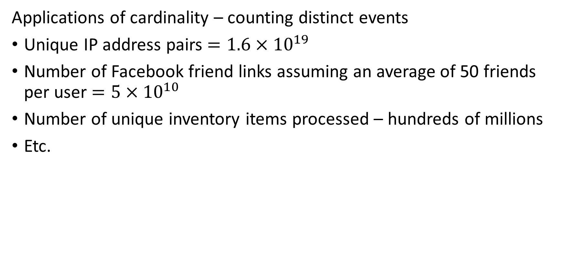
Counting Distinct Events – Cardinality
Applications of cardinality – counting distinct events
Unique IP address pairs $=1.6×{10}^{19}$
Number of Facebook friend links assuming an average of 50 friends per user $=5×{10}^{10}$
Number of unique inventory items processed – hundreds of millions
Etc.

Slide 83
Counting Distinct Events – Cardinality
How to determine cardinality?
Maintain table of unique identifiers?
Table can grow without bounds
Need billions of entries for many applications
Not scalable!
We need a better approach!
Accept approximate results using a sketch, or hash summary, of full data

Slide 84
Counting Distinct Events - Cardinality
Approximate counting algorithms used for streaming data
Sketch algorithms built on probability analysis of bit map hashes
Flajolet-Martin algorithm proposed 1985
Improvement: LogLog algorithm, Durand and Flajolet, 2003
Improvement: HyperLogLog algorithm more accurate, 2007
Refinment: HyperLogLog++, Heule, et. al., 2013
For a review of many variations discrete events for large-scale streams see Chapter 5 of Algorithms and Structures for Massive Data Sets, Medjodovic, et al., 2022, Manning

Slide 85
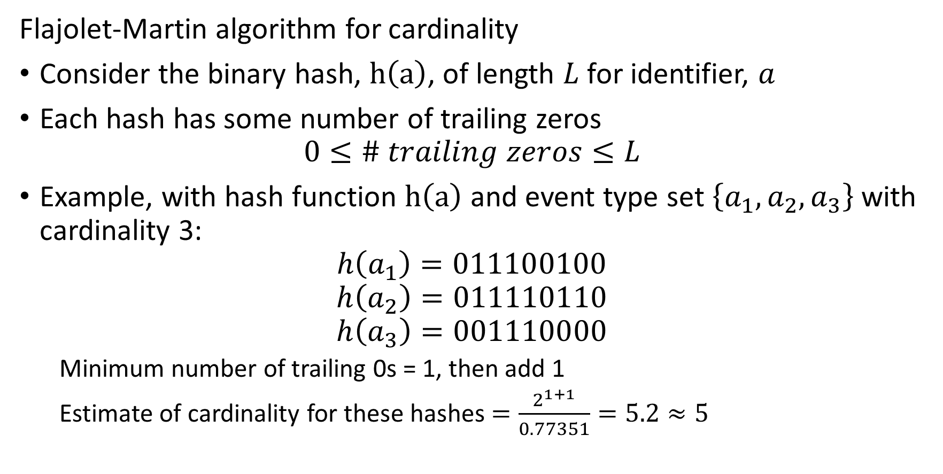
Counting Distinct Events – Cardinality
Flajolet-Martin algorithm for cardinality
Consider the binary hash, $h\left(a\right)$, of length $L$ for identifier, $a$
Each hash has some number of trailing zeros
$$0≤\# trailing zeros≤L$$
Example, with hash function $h\left(a\right)$ and event type set $\left\{a_{1},a_{2},a_{3}\right\}$ with cardinality 3:
$$h\left(a_{1}\right)=011100100$$
$$h\left(a_{2}\right)=011110110$$
$$h\left(a_{3}\right)=001110000$$
Minimum number of trailing 0s = 1, then add 1
Estimate of cardinality for these hashes $=\frac{2^{1+1}}{0.77351}=5.2≈5$

Slide 86
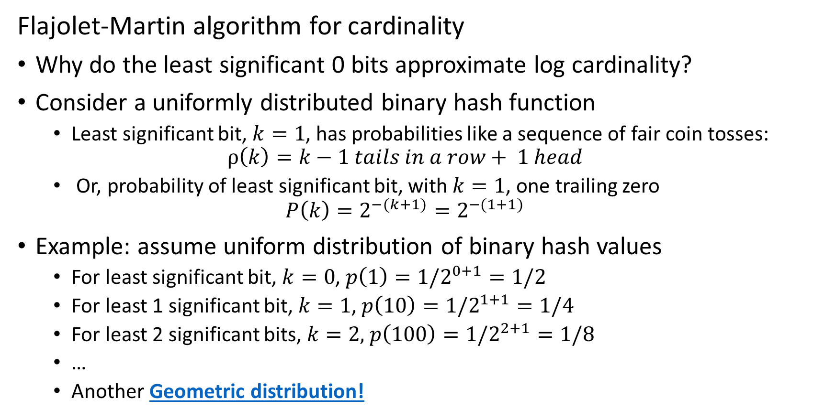
Counting Distinct Events – Cardinality
Flajolet-Martin algorithm for cardinality
Why do the least significant 0 bits approximate log cardinality?
Consider a uniformly distributed binary hash function
Least significant bit, $k=1$, has probabilities like a sequence of fair coin tosses:
$$ρ\left(k\right)=k−1 tails in a row+ 1 head$$
Or, probability of least significant bit, with $k=1$, one trailing zero
$$P\left(k\right)=2^{−(k+1)}=2^{−(1+1)}$$
Example: assume uniform distribution of binary hash values
For least significant bit, $k=0$, $p\left(1\right)=1/2^{0+1}=1/2$
For least 1 significant bit, $k=1$, $p\left(10\right)=1/2^{1+1}=1/4$
For least 2 significant bits, $k=2,$ $p\left(100\right)=1/2^{2+1}=1/8$
…
Another Geometric distribution!

Slide 87
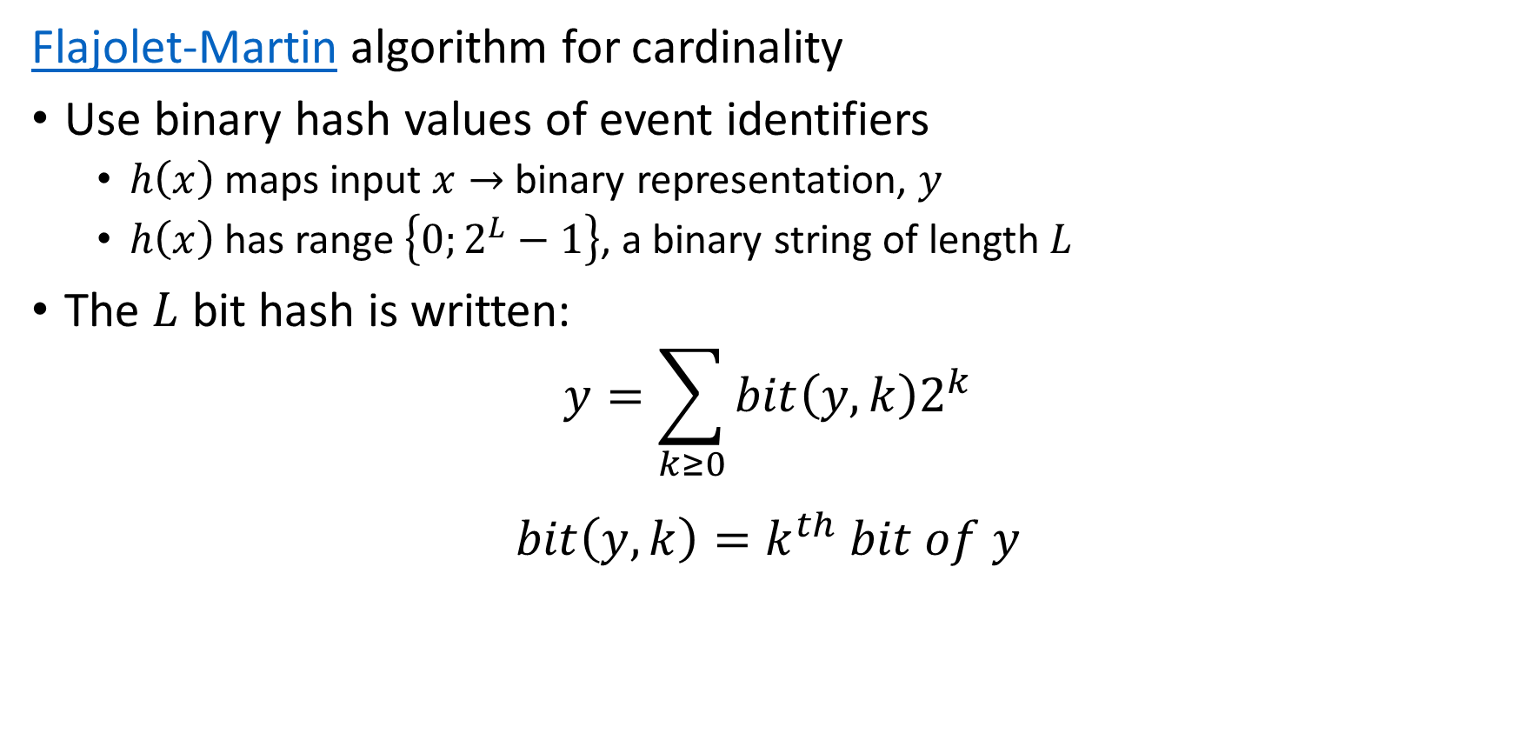
Counting Distinct Events – Cardinality
Flajolet-Martin algorithm for cardinality
Use binary hash values of event identifiers
$h\left(x\right)$ maps input $x→$ binary representation, $y$
$h\left(x\right)$ has range $\left\{0;2^{L}−1\right\}$, a binary string of length $L$
The $L$ bit hash is written:
$$y=\sum_{k≥0}^{ }{bit\left(y,k\right)2^{k}}$$
$$bit\left(y,k\right)=k^{th} bit of y$$

Slide 88
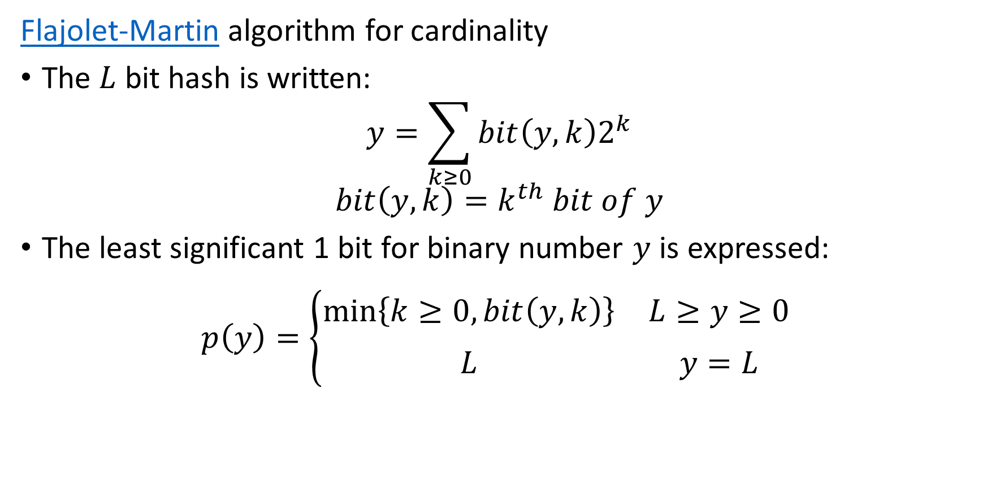
Counting Distinct Events – Cardinality
Flajolet-Martin algorithm for cardinality
The $L$ bit hash is written:
$$y=\sum_{k≥0}^{ }{bit\left(y,k\right)2^{k}}$$
$$bit\left(y,k\right)=k^{th} bit of y$$
The least significant 1 bit for binary number $y$ is expressed:
$$p\left(y\right)=\left\{\begin{matrix}\min_{ }\left\{k≥0, bit\left(y,k\right)\right\} & L≥y≥0 \\ L & y=L\end{matrix}\begin{matrix} \\ \end{matrix}\right.$$

Slide 89

Counting Distinct Events – Cardinality
Flajolet-Martin algorithm for cardinality
The least significant 1 bit for binary number $y$ is expressed:
$$p\left(y\right)=\left\{\begin{matrix}\min_{ }\left\{k≥0, bit\left(y,k\right)\right\} & L>y>0 \\ L & y=L\end{matrix}\begin{matrix} \\ \end{matrix}\right.$$
Assuming a uniform distribution of bits
$$p\left(2^{k}\right)=2^{−\left(k+1\right)}=probability of k trialing 0s$$

Slide 90
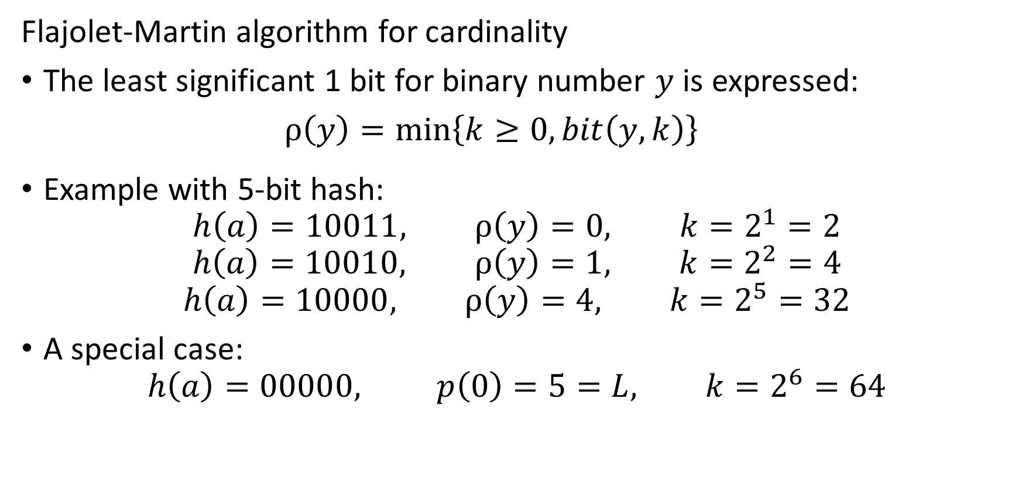
Counting Distinct Events – Cardinality
Flajolet-Martin algorithm for cardinality
The least significant 1 bit for binary number $y$ is expressed:
$ρ\left(y\right)=\min_{ }\left\{k≥0, bit\left(y,k\right)\right\}$
Example with 5-bit hash:
$$h\left(a\right)=10011, ρ\left(y\right)=0, k=2^{1}=2$$
$$h\left(a\right)=10010, ρ\left(y\right)=1, k=2^{2}=4$$
$$h\left(a\right)=10000, ρ\left(y\right)=4, k=2^{5}=32$$
A special case:
$$h\left(a\right)=00000, p\left(0\right)=5=L, k=2^{6}=64$$

Slide 91
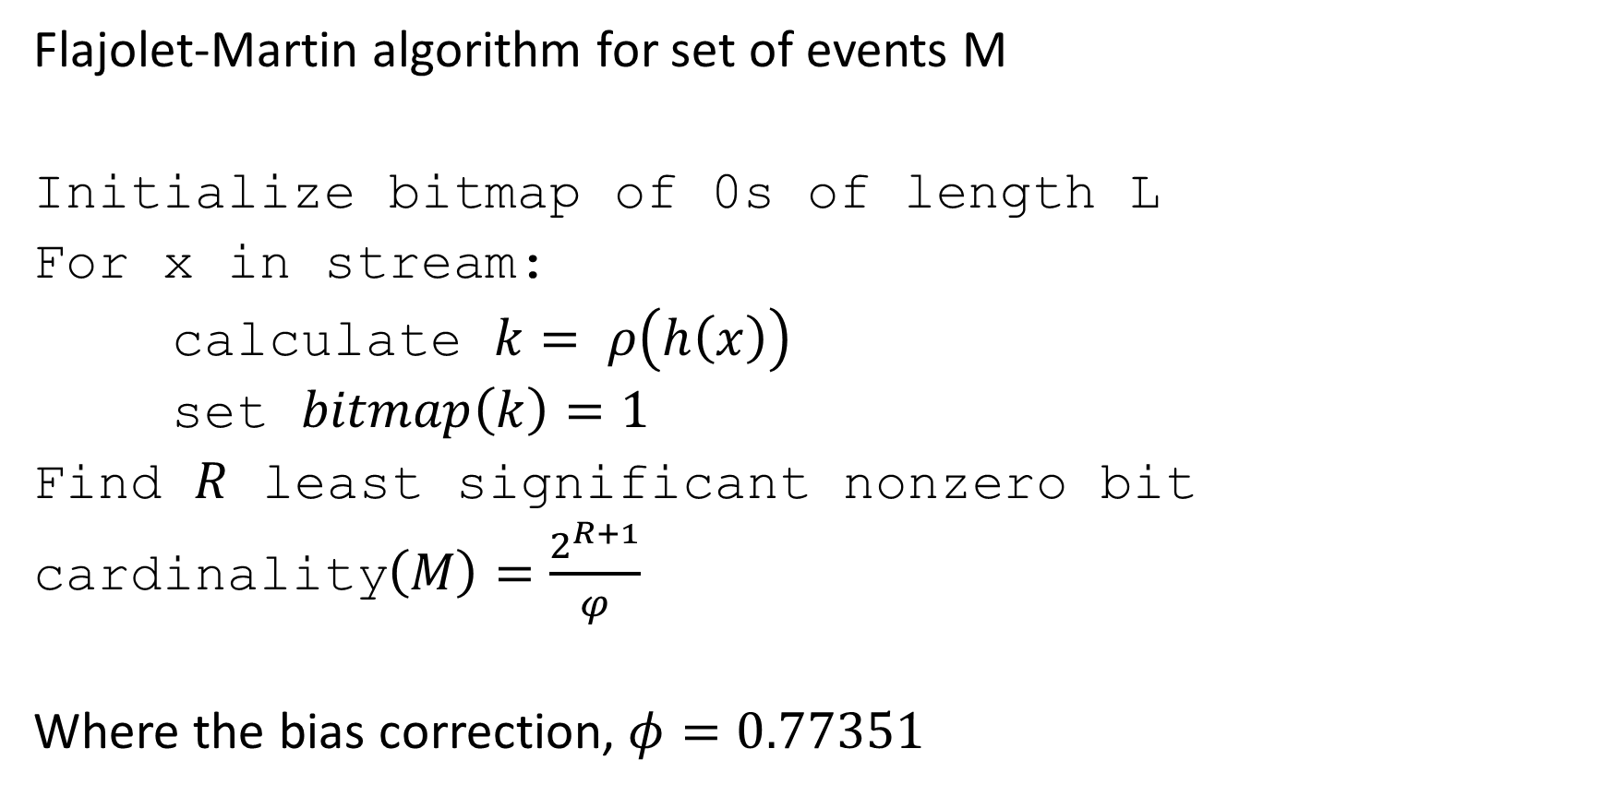
Counting Distinct Events – Cardinality
Flajolet-Martin algorithm for set of events M
Initialize bitmap of 0s of length L
For x in stream:
calculate $k= ρ\left(h\left(x\right)\right)$
set $bitmap\left(k\right)=1$
Find $R$ least significant nonzero bit
cardinality$\left(M\right)=\frac{2^{R+1}}{φ}$
Where the bias correction, $φ=0.77351$

Slide 92
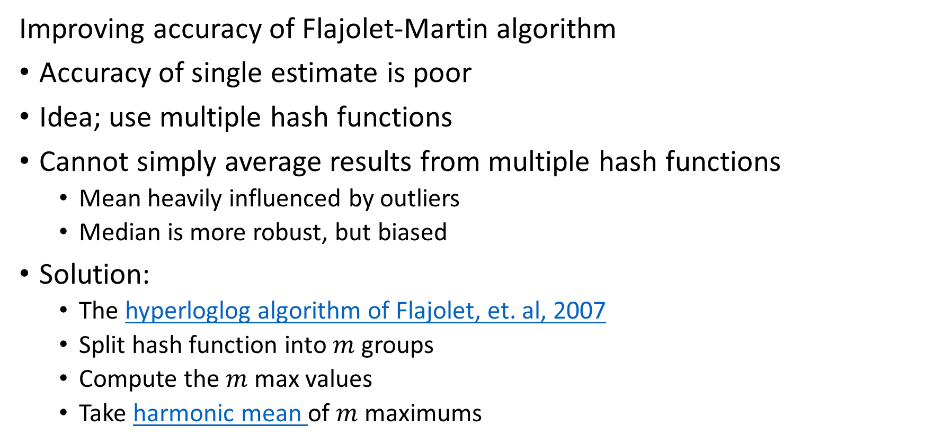
Counting Distinct Events – Cardinality
Improving accuracy of Flajolet-Martin algorithm
Accuracy of single estimate is poor
Idea; use multiple hash functions
Cannot simply average results from multiple hash functions
Mean heavily influenced by outliers
Median is more robust, but biased
Solution:
The hyperloglog algorithm of Flajolet, et. al, 2007
Split hash function into $m$ groups
Compute the $m$ max values
Take harmonic mean of $m$ maximums

Slide 93
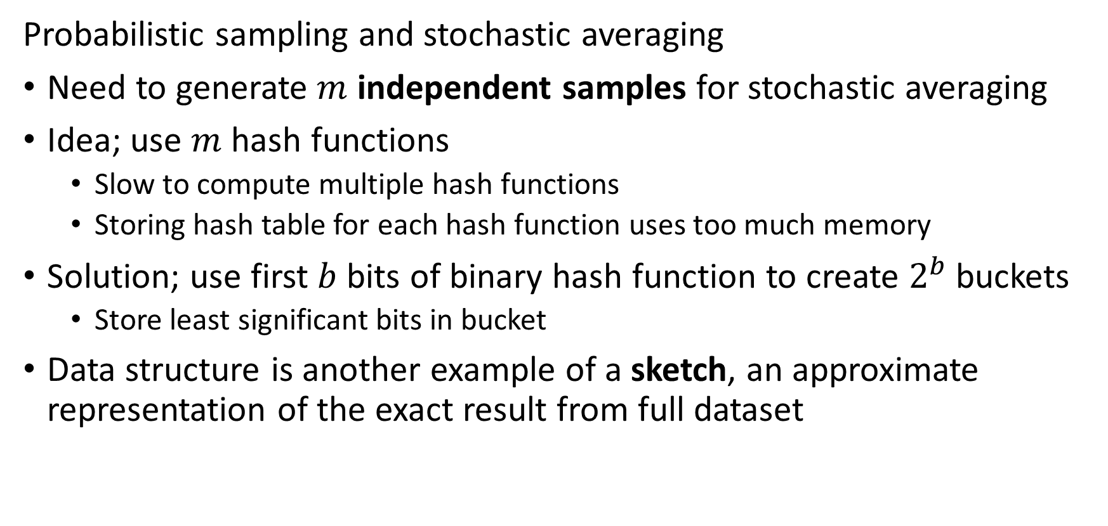
Counting Distinct Events – Cardinality
Probabilistic sampling and stochastic averaging
Need to generate $m$ independent samples for stochastic averaging
Idea; use $m$ hash functions
Slow to compute multiple hash functions
Storing hash table for each hash function uses too much memory
Solution; use first $b$ bits of binary hash function to create $2^{b}$ buckets
Store least significant bits in bucket
Data structure is another example of a sketch, an approximate representation of the exact result from full dataset

Slide 94



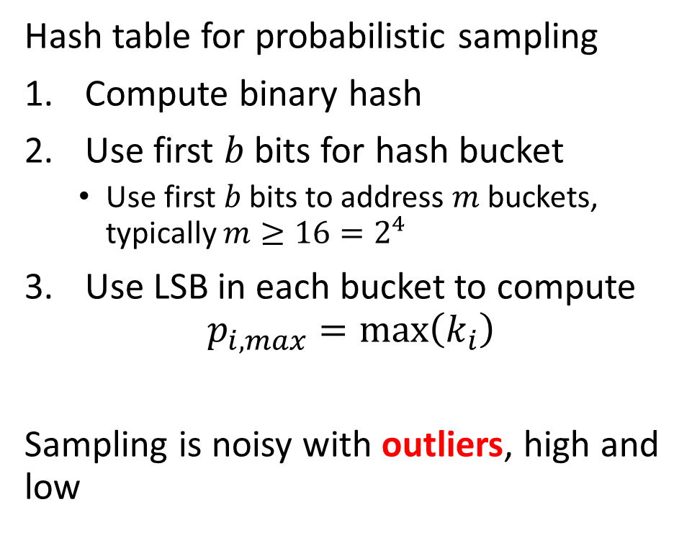












Filtering Event Data
Probabilistic sampling and stochastic averaging
Hash table for probabilistic sampling
Compute binary hash
Use first $b$ bits for hash bucket
Use first 𝑏 bits to address 𝑚 buckets, typically $m≥16=2^{4}$
Use LSB in each bucket to compute
$$p_{i,max}=max\left(k_{i}\right)$$
Sampling is noisy with outliers, high and low
Bucket
LSB
$$h\left(w\right)=10010100⇒$$
$100$1
$$0100$$
$$h\left(u\right)=10100110⇒$$
$101$0
$$0110$$
$$h\left(v\right)=11011111⇒$$
$$1101$$
$$1111$$
$$h\left(x\right)=00000000⇒$$
$000$0
$$0000$$
$$h\left(y\right)=00111100⇒$$
$001$1
$$1100$$

Slide 95
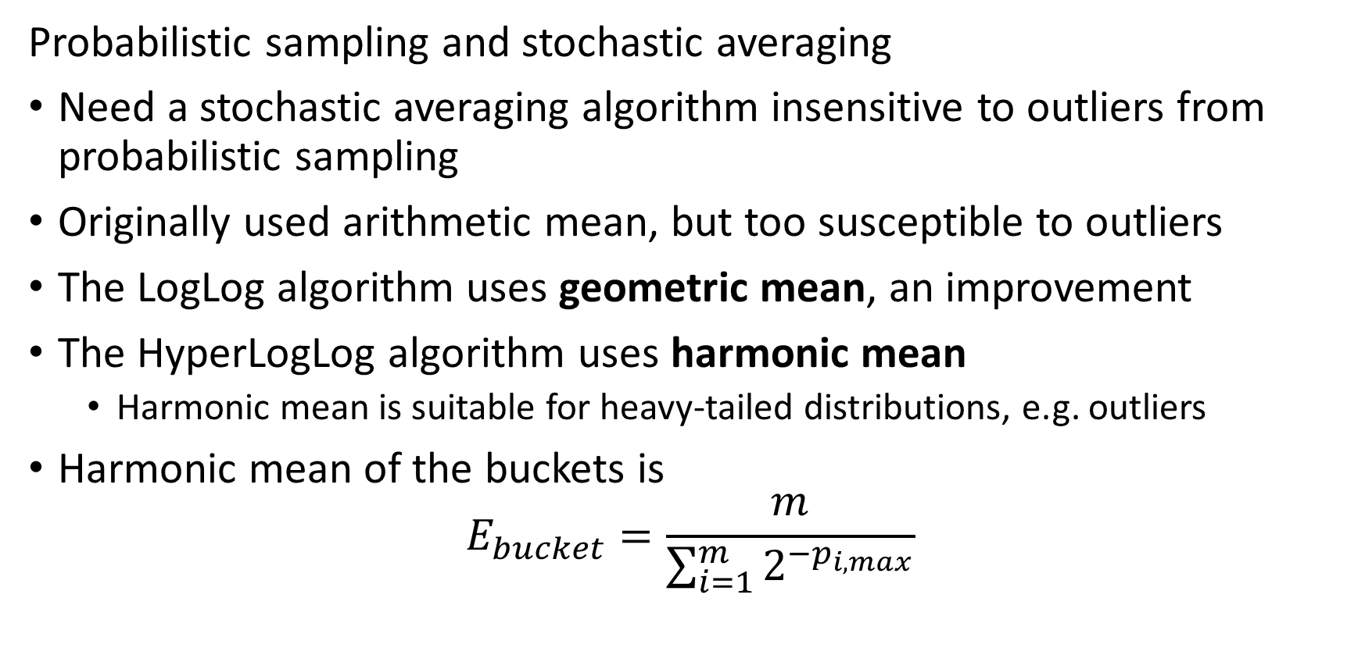
Counting Distinct Events – Cardinality
Probabilistic sampling and stochastic averaging
Need a stochastic averaging algorithm insensitive to outliers from probabilistic sampling
Originally used arithmetic mean, but too susceptible to outliers
The LogLog algorithm uses geometric mean, an improvement
The HyperLogLog algorithm uses harmonic mean
Harmonic mean is suitable for heavy-tailed distributions, e.g. outliers
Harmonic mean of the buckets is
$$E_{bucket}=\frac{m}{\sum_{i=1}^{m}{2^{−p_{i,max}}}}$$

Slide 96
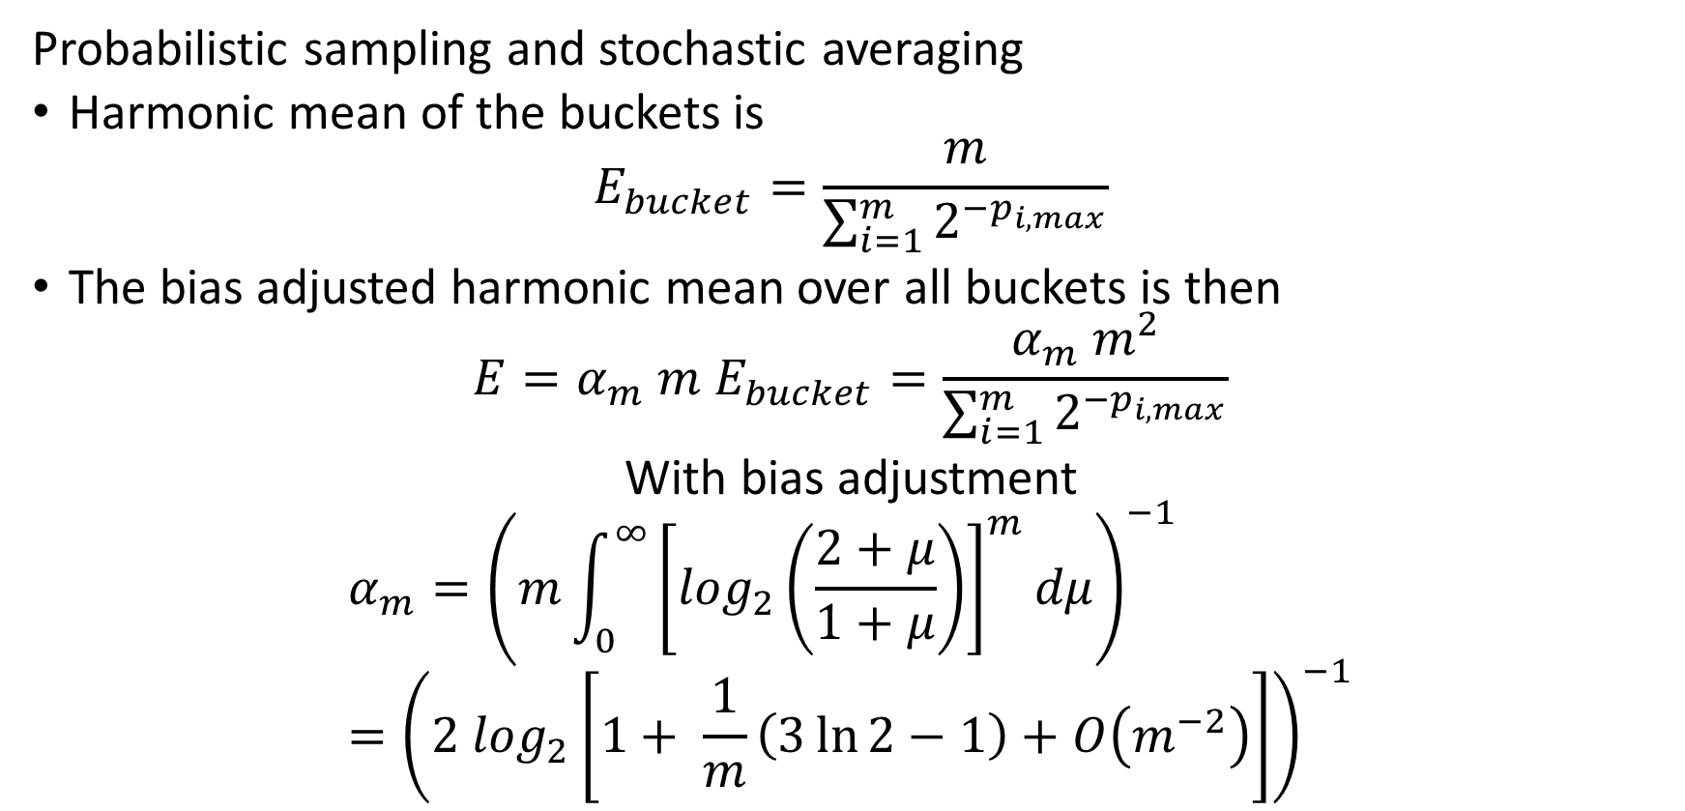
Counting Distinct Events – Cardinality
Probabilistic sampling and stochastic averaging
Harmonic mean of the buckets is
$$E_{bucket}=\frac{m}{\sum_{i=1}^{m}{2^{−p_{i,max}}}}$$
The bias adjusted harmonic mean over all buckets is then
$${E=α_{m} m E}_{bucket}=\frac{α_{m} m^{2}}{\sum_{i=1}^{m}{2^{−p_{i,max}}}}$$
With bias adjustment
$$α_{m}={\left(m\int_{0}^{∞}{{\left[\log_{2}\left(\frac{2+μ}{1+μ}\right)\right]}^{m}dμ}\right)}^{−1}={\left(2 \log_{2}\left[1+ \frac{1}{m}\left(3\ln{2}−1\right)+O\left(m^{−2}\right)\right]\right)}^{−1}$$

Slide 97
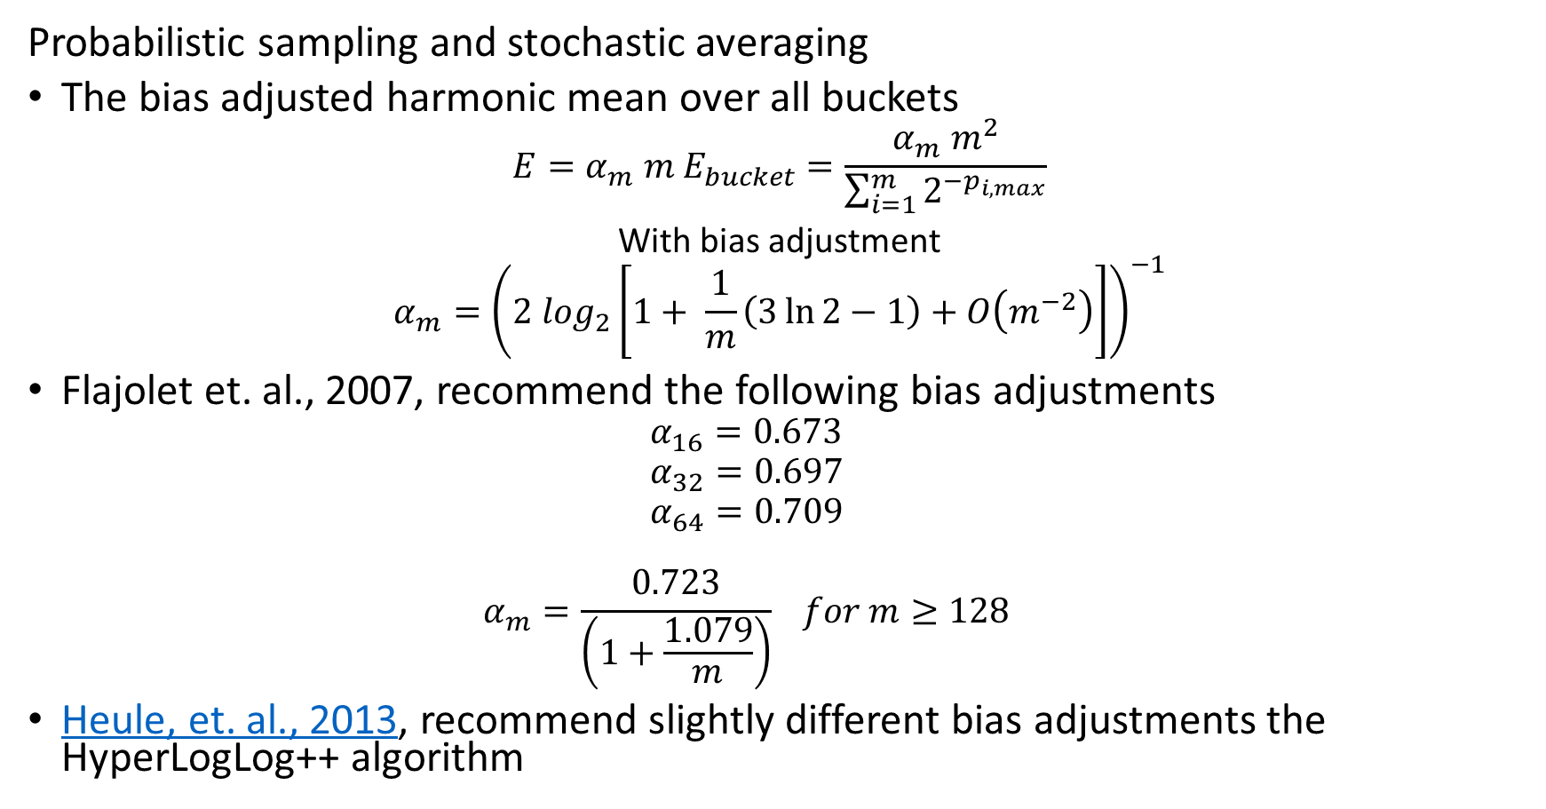
Counting Distinct Events – Cardinality
Probabilistic sampling and stochastic averaging
The bias adjusted harmonic mean over all buckets
$${E=α_{m} m E}_{bucket}=\frac{α_{m} m^{2}}{\sum_{i=1}^{m}{2^{−p_{i,max}}}}$$
With bias adjustment
$$α_{m}={\left(2 \log_{2}\left[1+ \frac{1}{m}\left(3\ln{2}−1\right)+O\left(m^{−2}\right)\right]\right)}^{−1}$$
Flajolet et. al., 2007, recommend the following bias adjustments
$$α_{16}=0.673$$
$$α_{32}=0.697$$
$$α_{64}=0.709$$
$$α_{m}=\frac{0.723}{\left(1+\frac{1.079}{m}\right)} for m≥128$$
Heule, et. al., 2013, recommend slightly different bias adjustments the HyperLogLog++ algorithm

Slide 98
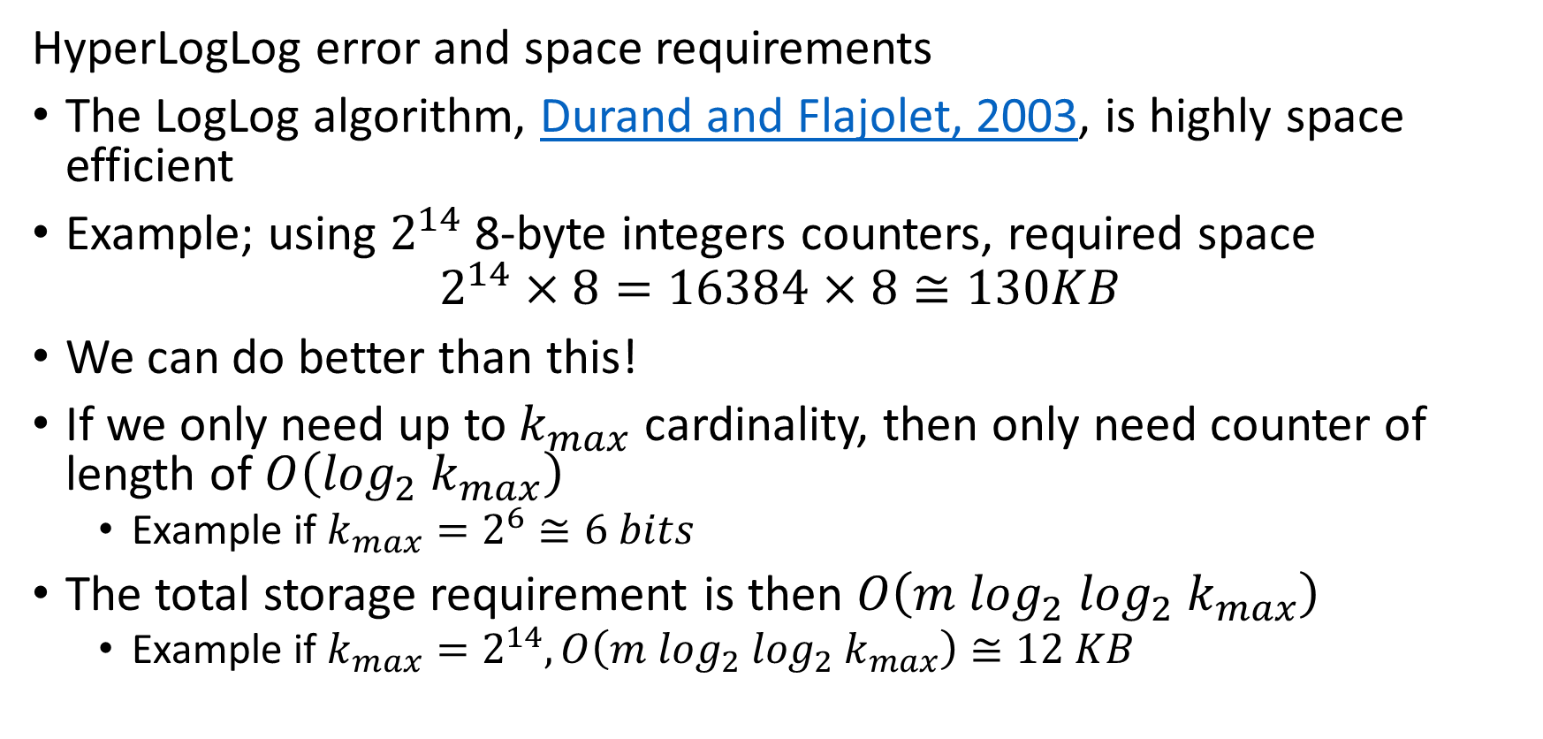
Counting Distinct Events – Cardinality
HyperLogLog error and space requirements
The LogLog algorithm, Durand and Flajolet, 2003, is highly space efficient
Example; using $2^{14}$ 8-byte integers counters, required space
$$2^{14}×8=16384×8≅130KB$$
We can do better than this!
If we only need up to $k_{max}$ cardinality, then only need counter of length of $O\left(\log_{2}{ k}_{max}\right)$
Example if $k_{max}=2^{6}≅6 bits$
The total storage requirement is then $O\left(m {\log_{2} log}_{2}{ k}_{max}\right)$
Example if $k_{max}=2^{14}, O\left(m {\log_{2} log}_{2}{ k}_{max}\right)≅12 KB$

Slide 99
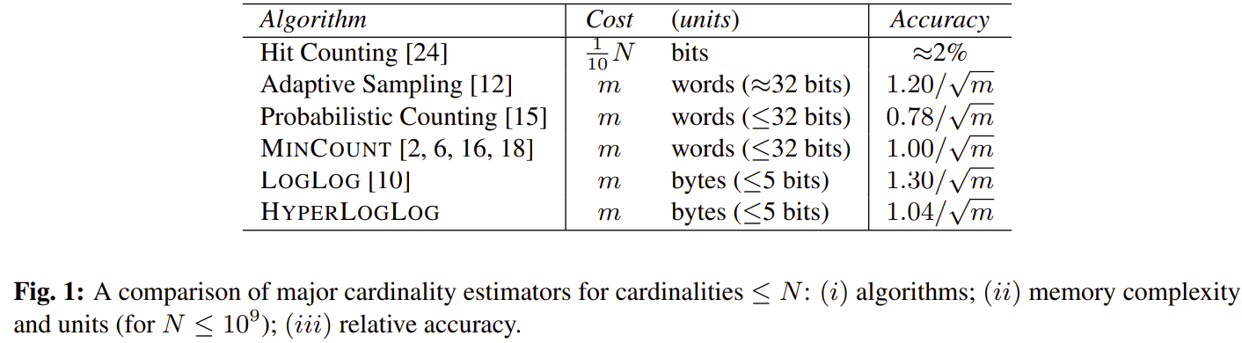
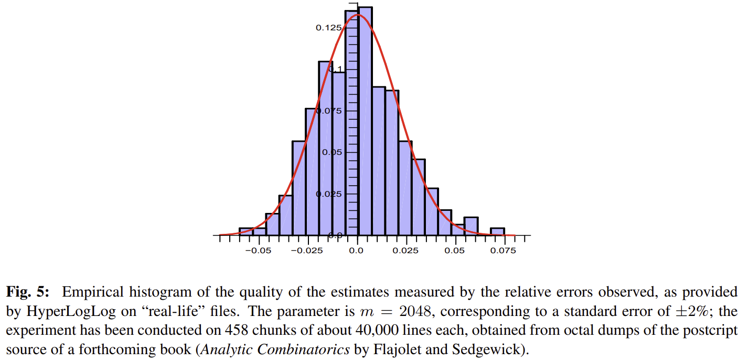
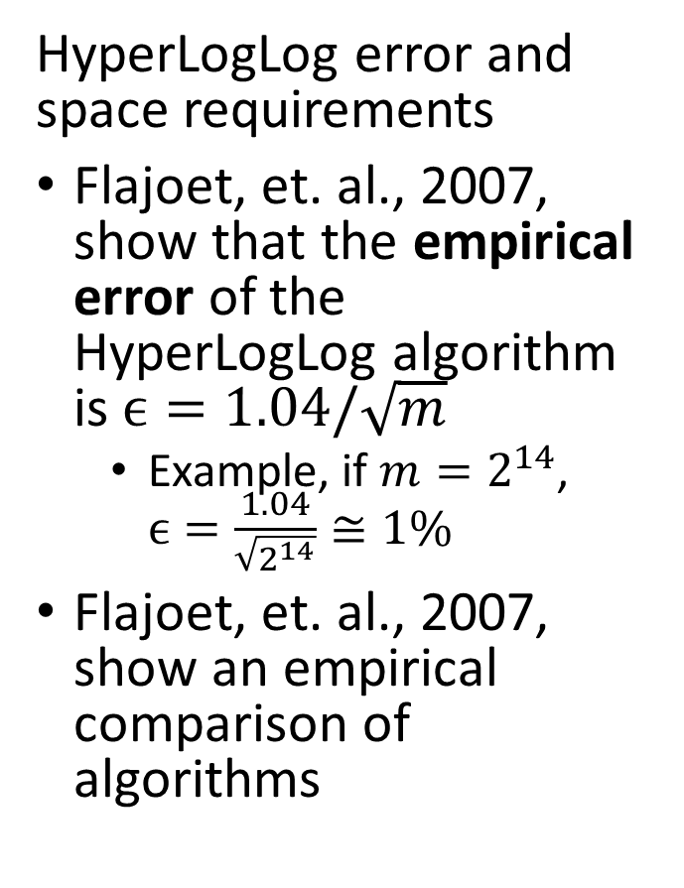
Counting Distinct Events – Cardinality
HyperLogLog error and space requirements
Flajoet, et. al., 2007, show that the empirical error of the HyperLogLog algorithm is $ϵ=1.04/\sqrt{m}$
Example, if $m=2^{14}$, $ϵ=\frac{1.04}{\sqrt{2^{14}}}≅1\%$
Flajoet, et. al., 2007, show an empirical comparison of algorithms

Slide 100
Counting Distinct Events – Cardinality
Aggregating HyperLogLog counters
HyperLogLog counters can be readily merged
Example; counters by minute merged (aggregated) to counters by hour
Example; counters by day merged to weekly or monthly
Example; counters for different streams merged into single estimate
But we cannot just sum the total unique events over multiple periods!
Example; A user who is active several days of the month is only counted once aggregated over a month
A simple sum will count the user multiple times
Must merge by union and then sum

Slide 101
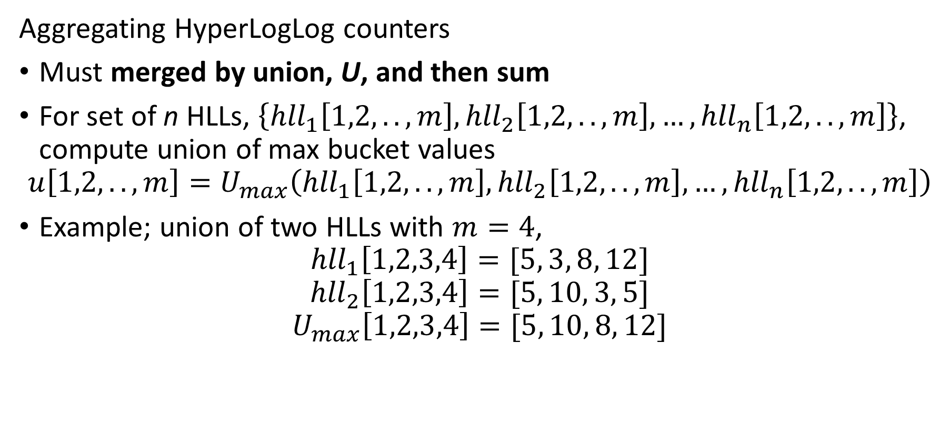
Counting Distinct Events – Cardinality
Aggregating HyperLogLog counters
Must merged by union, U, and then sum
For set of n HLLs, $\left\{{hll}_{1}\left[1,2,..,m\right],{hll}_{2}\left[1,2,..,m\right],…,{hll}_{n}\left[1,2,..,m\right]\right\}$, compute union of max bucket values
$$u\left[1,2,..,m\right]=U_{max}\left({hll}_{1}\left[1,2,..,m\right],{hll}_{2}\left[1,2,..,m\right],…,{hll}_{n}\left[1,2,..,m\right]\right)$$
Example; union of two HLLs with $m=4$,
$${hll}_{1}\left[1,2,3,4\right]=[5, 3, 8, 12]$$
$${hll}_{2}\left[1,2,3,4\right]=[5, 10, 3, 5]$$
$$U_{max}\left[1,2,3,4\right]=[5, 10, 8, 12]$$

Slide 102
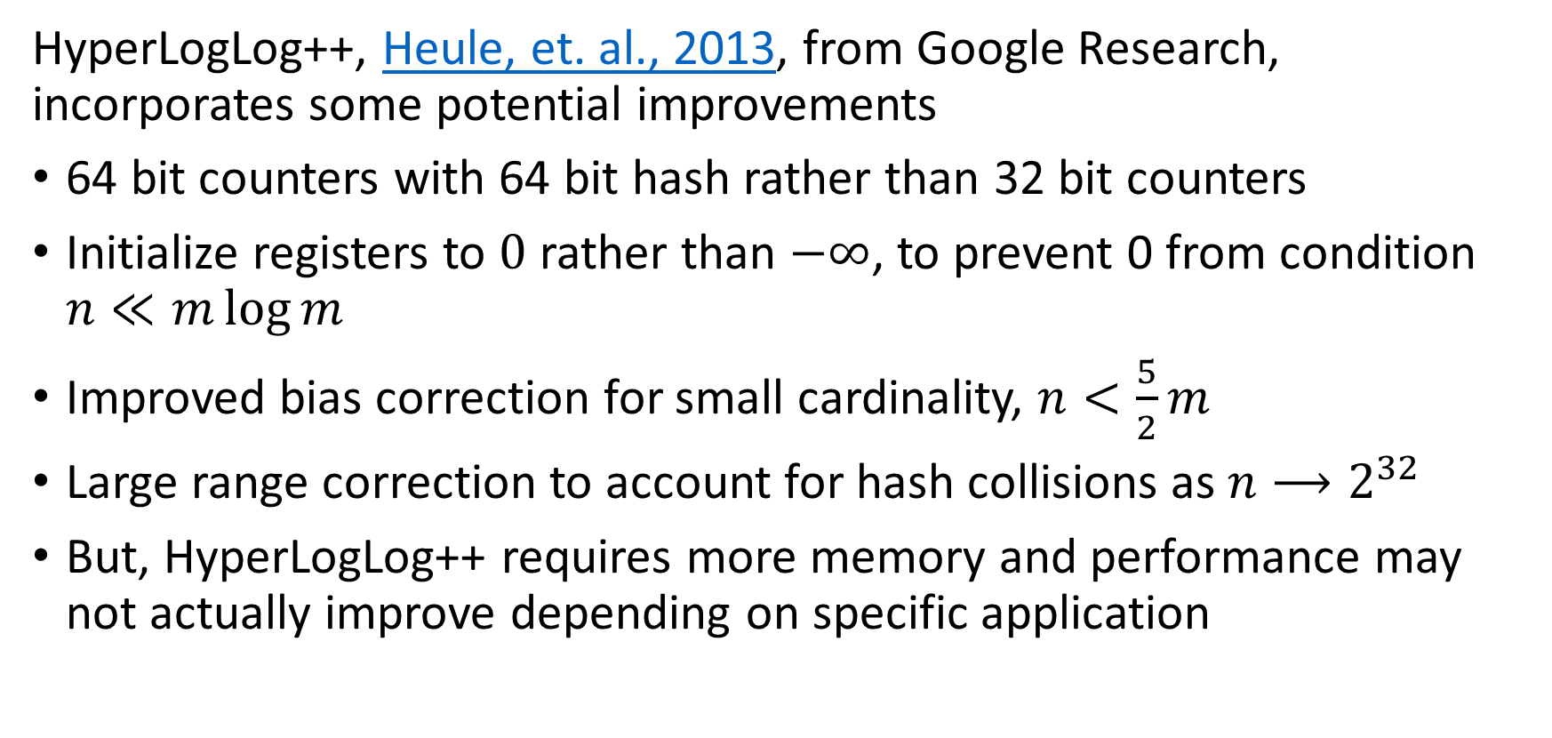
Counting Distinct Events – Cardinality
HyperLogLog++, Heule, et. al., 2013, from Google Research, incorporates some potential improvements
64 bit counters with 64 bit hash rather than 32 bit counters
Initialize registers to $0$ rather than $−∞$, to prevent 0 from condition $n≪m\log{m}$
Improved bias correction for small cardinality, $n<\frac{5}{2}m$
Large range correction to account for hash collisions as $n⟶2^{32}$
But, HyperLogLog++ requires more memory and performance may not actually improve depending on specific application

Slide 103
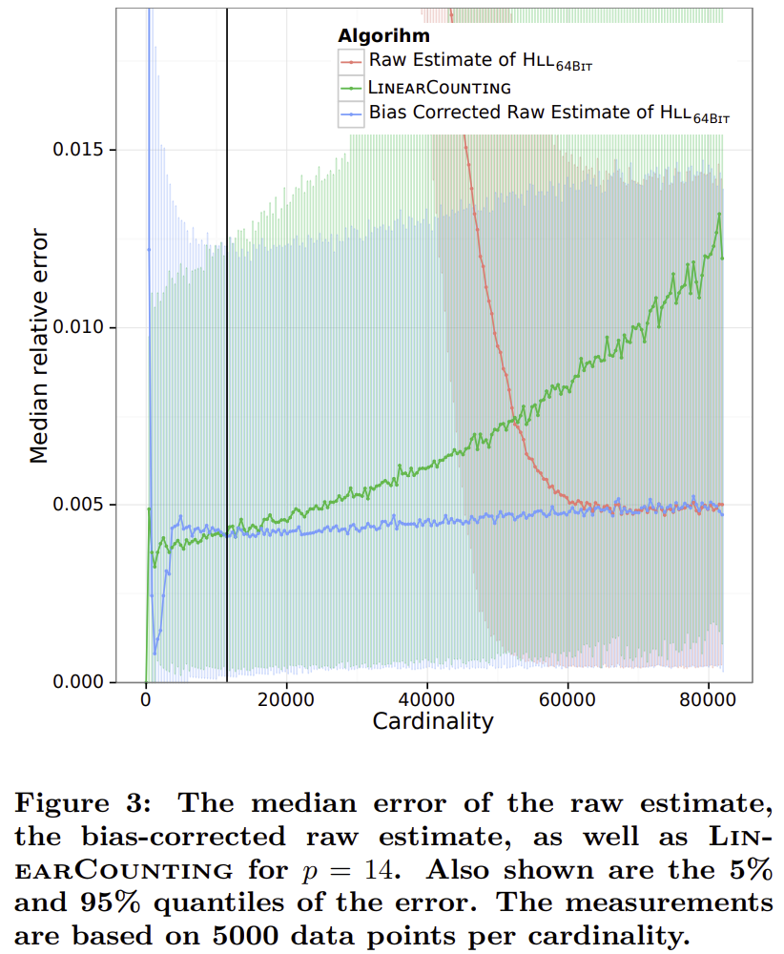
Counting Distinct Events – Cardinality
HyperLogLog++, Heule, et. al., 2013, from Google Research, incorporates some potential improvements
Comparison between algorithms shows HyperLogLog and HyperLogLog++ performance converge
Simple linear counting is best for small cardinality

Slide 104
Counting Distinct Events – Cardinality
A number of Python packages and platforms support cardinality estimation
The HyperLogLog algorithm can be found is several packages
The HLL package has a fast, C++ backended, implementation
The Apache DataSketches package implements several widely used cardinality estimation algorithms, including HyperLogLog
HyperLogLog++ is available in Google BigQuery

Slide 105
Estimating Quantiles in Streams

Slide 106
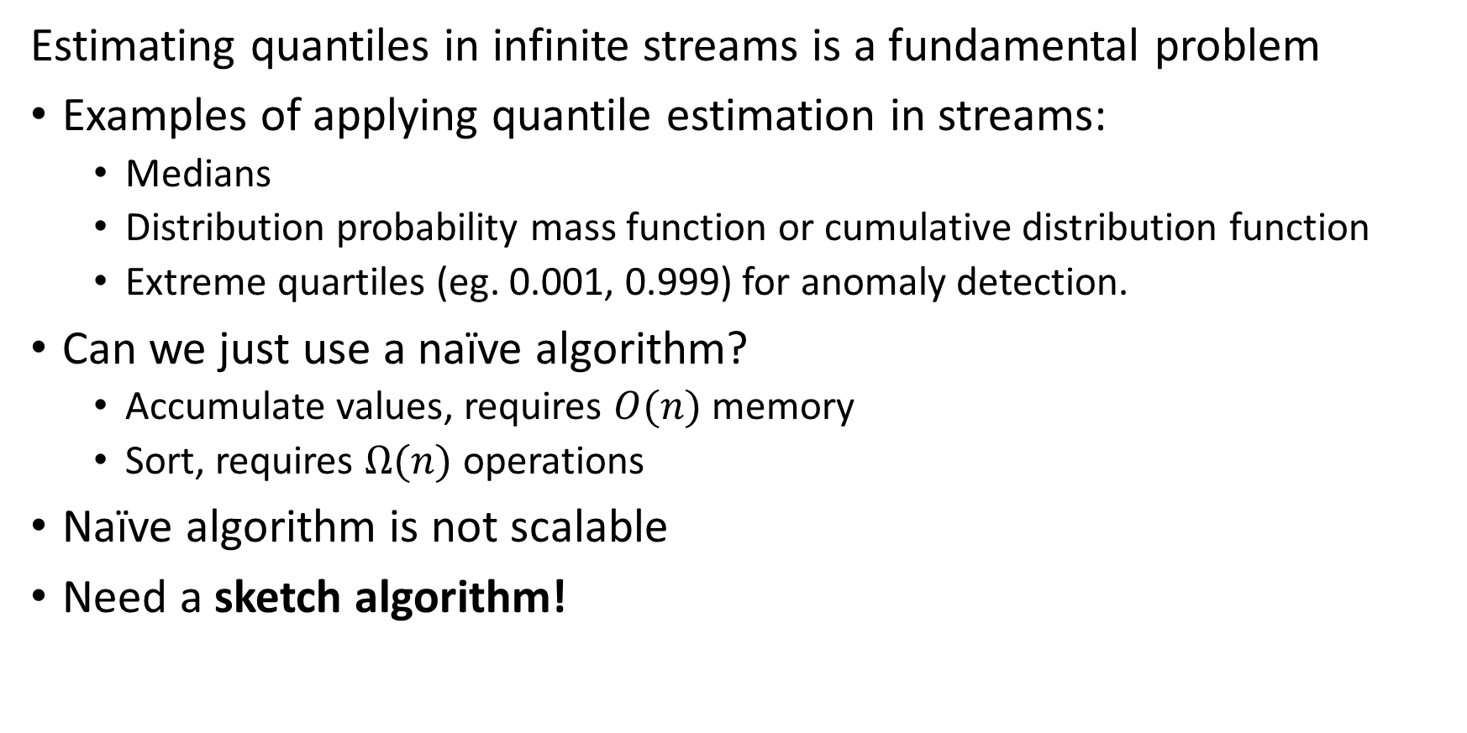
Estimating Quantiles in Streams
Estimating quantiles in infinite streams is a fundamental problem
Examples of applying quantile estimation in streams:
Medians
Distribution probability mass function or cumulative distribution function
Extreme quartiles (eg. 0.001, 0.999) for anomaly detection.
Can we just use a naïve algorithm?
Accumulate values, requires $O(n)$ memory
Sort, requires $Ω(n)$ operations
Naïve algorithm is not scalable
Need a sketch algorithm!

Slide 107
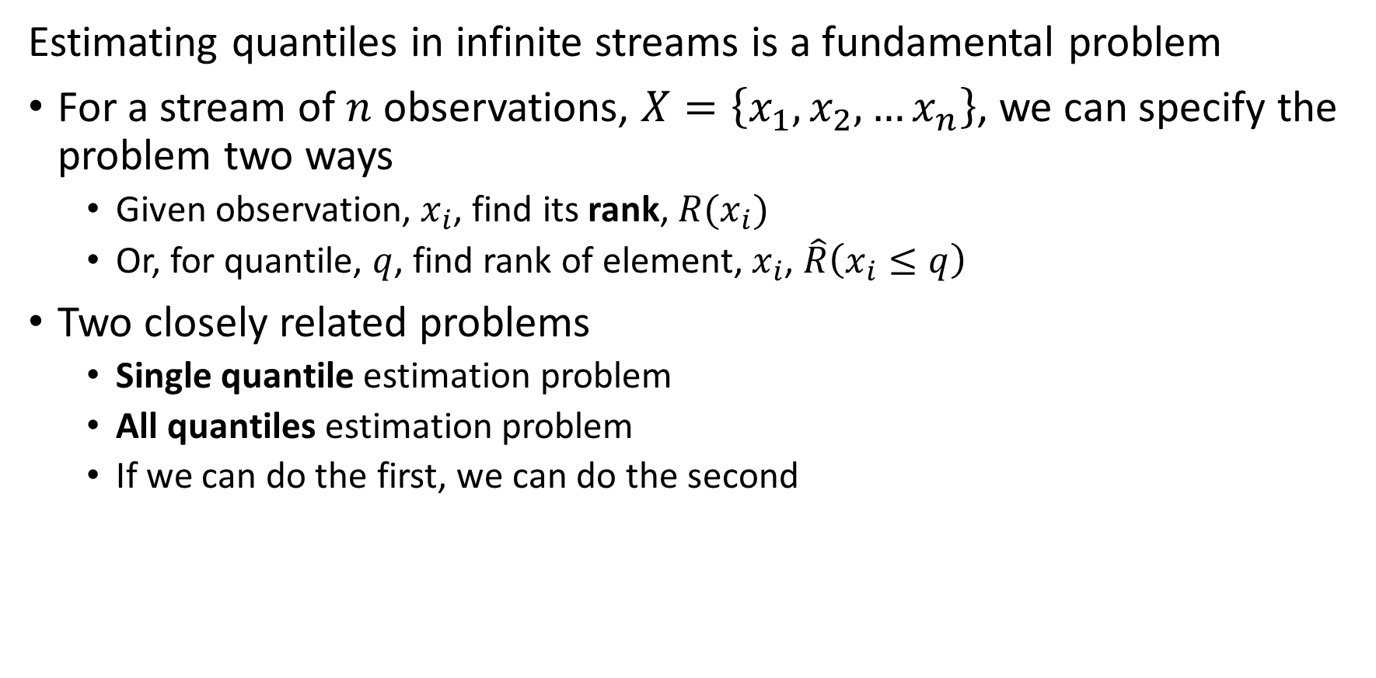
Estimating Quantiles in Streams
Estimating quantiles in infinite streams is a fundamental problem
For a stream of $n$ observations, $X=\left\{x_{1},x_{2},…x_{n}\right\}$, we can specify the problem two ways
Given observation, $x_{i}$, find its rank, $R(x_{i})$
Or, for quantile, $q$, find rank of element, $x_{i}$, $\hat{R}\left(x_{i}≤q\right)$
Two closely related problems
Single quantile estimation problem
All quantiles estimation problem
If we can do the first, we can do the second

Slide 108
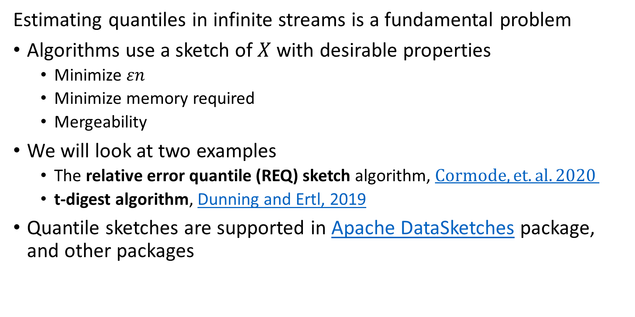
Estimating Quantiles in Streams
Estimating quantiles in infinite streams is a fundamental problem
Algorithms use a sketch of $X$ with desirable properties
Minimize $εn$
Minimize memory required
Mergeability
We will look at two examples
The relative error quantile (REQ) sketch algorithm, $Cormode, et. al. 2020$
t-digest algorithm, Dunning and Ertl, 2019
Quantile sketches are supported in Apache DataSketches package, and other packages

Slide 109
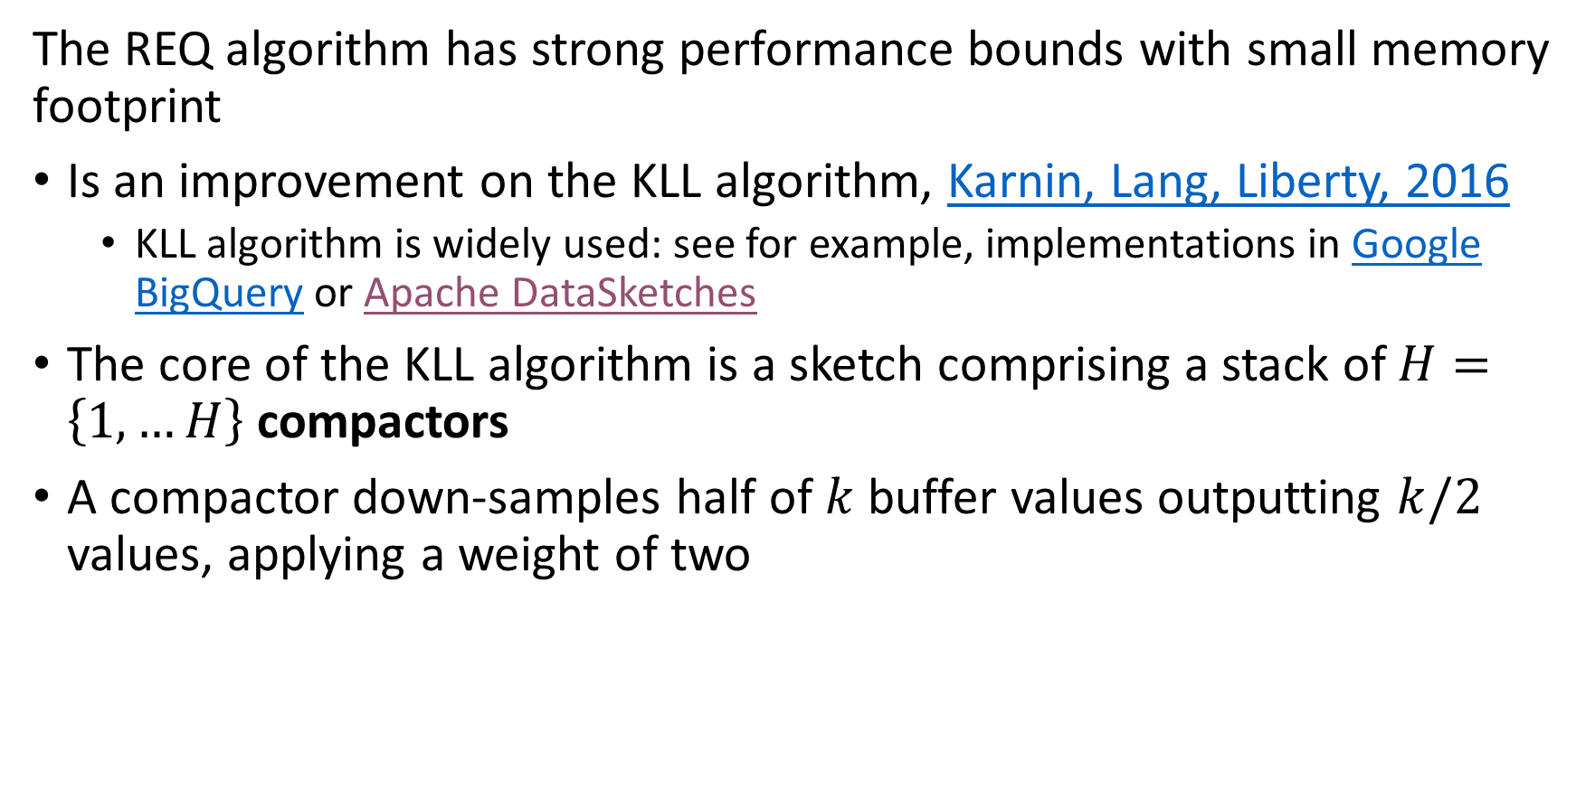
Relative Error Quantile in Sketch
The REQ algorithm has strong performance bounds with small memory footprint
Is an improvement on the KLL algorithm, Karnin, Lang, Liberty, 2016
KLL algorithm is widely used: see for example, implementations in Google BigQuery or Apache DataSketches
The core of the KLL algorithm is a sketch comprising a stack of $H=\left\{1,…H\right\}$ compactors
A compactor down-samples half of $k$ buffer values outputting $k/2$ values, applying a weight of two

Slide 110





Relative Error Quantile in Sketch
After three compactors, $k/6$ samples, with weight $6w$
After one compactor, $k/2$ samples, with weight $2w$
After two compactors, $k/4$ samples, with weight $4w$
A compactor down-samples half of the input buffer values, applying a weight of two
The compactors randomly sample either even or odd values from a buffer of size $k$

Slide 111



Relative Error Quantile in Sketch
Smallest possible compactor with $2$ values
After one compactor, $k/2$ samples, with weight $2w$
After two compactors, $k/4$ samples, with weight $4w$
Stack of $H$ compactors down-samples input buffer values

Slide 112
T-Digest Algorithm
The t-digest is an effective heuristic algorithm
The t-digest uses a unique sampling strategy that improves quantile estimates at extremes, e.g. distribution tails
Accuracy improved by interpolation between samples
Effective for anomaly detection and similar situations
There are numerous implementations of the t-digest algorithm
Apache DataSketches
Fastdigest package
Tdigest package
Also see implementations in many languages in Ted Dunning’s reference implementation GitHub repository

Slide 113

T-Digest Algorithm
The t-digest is an effective heuristic algorithm
The t-digest algorithm computes representative cluster centroids $∈R^{1}$
Samples $X=\left\{x_{1},x_{2},…x_{n}\right\}∈R^{1}$ are partitioned into $m$ clusters
$$X=\left\{π_{1}|π_{2}|…{|π}_{m}\right\}$$
Where, $π_{i}=\left\{x_{left}…x_{right}\right\}$
Each cluster, $π_{i}$, contains as many samples as possible, subject to a size bound

Slide 114

T-Digest Algorithm
The t-digest is an effective heuristic algorithm
Each cluster, $π_{i}$, contains as many samples as possible, subject to a size bound
For clusters of size $\left|C_{j}\right|>0$, centroid is the mean of the partition
$$\overline{C_{j}}=\sum_{x_{i}∈π_{j}}{\frac{x_{i}}{n}}$$
Clusters centers are ordered $\overline{C_{1}}<\overline{C_{2}}…\overline{C_{m}}$
Partitions may be strongly ordered; ${i<j, x}_{i}<x_{j} { x}_{i}∈π_{i},x_{j}∈π_{j}$
Or weakly ordered; ${i<j+Δ, offset Δ>1, x}_{i}<x_{j} { x}_{i}∈π_{i},x_{j}∈π_{j}$
Weekly ordered clusters have overlapping partitions

Slide 115

T-Digest Algorithm
The t-digest is an effective heuristic algorithm
Clusters centers are ordered $\overline{C_{1}}<\overline{C_{2}}…\overline{C_{m}}$
For cluster $C_{i}$ the left and right weights are:
$$W_{left}\left(C_{i}\right)=\sum_{j<i}{C_{j}}$$
$$W_{right}\left(C_{i}\right)=\sum_{j>i}{C_{j}}$$

Slide 116

T-Digest Algorithm
Choice of sampling interval is key to the t-digest algorithm
Quantile estimation algorithms face a persistent problem with extreme quantiles
Example, for anomaly detection we want to compute values at $q=0.001, 0.999$ or even more extreme
Sketches with uniform sampling have insufficinet extreme samples to accurately estimate tail behavior
The t-digest algorithm uses a non-uniform sampling function to overcome this problem
Sampling extreme values is favored

Slide 117

T-Digest Algorithm
Choice of sampling interval is key to the t-digest algorithm
The t-digest algorithm uses a scale function to perform nonuniform sampling
Example of scale function with compression parameter $δ$
$$k_{1}\left(q\right)=\frac{δ}{2π}\sin^{−1}\left(2q−1\right)$$
Where: $−\frac{δ}{4}{≤k}_{1}(q)≤\frac{δ}{4}$
For $δ≪n$, $δ\sim m$, the number of clusters

Slide 118


T-Digest Algorithm
Choice of sampling interval is key to the t-digest algorithm
Example of scale function with compression parameter $δ$
$$k_{1}=\frac{δ}{2π}\sin^{−1}\left(2q−1\right)$$
Vertical lines show cluster centroids for $δ=10$
Sampling denser at extreme values of $q$

Slide 119
T-Digest Algorithm
Choice of sampling interval is key to the t-digest algorithm
Example of scale function with compression parameter $δ$
$$k_{1}=\frac{δ}{2π}\sin^{−1}\left(2q−1\right)$$
Vertical lines show cluster centroids for $δ=10$
Sampling denser at extreme values of $q$

Slide 120

T-Digest Algorithm
Using a scale function improves interpolation of tail quantiles
Uniform bin-width random sampling results in limited samples for interpolation at extreme quantiles
Variable sized bins results non-uniform number of samples and greatly improved interpolation for extreme quantiles

Slide 121

T-Digest Algorithm
Choice of sampling interval is key to the t-digest algorithm
Cluster size for a t-digest algorithm is bounded to ensure mergeability
$${\left|C_{k}\right|}_{ }=k\left(q_{left}\right)−k\left(q_{right}\right)≤1$$
Where
$$q_{left}=\frac{W_{left}\left(C_{k}\right)}{n}$$
$$q_{right}=q_{left}+\frac{{\left|C_{k}\right|}_{ }}{n}$$
The implication is that the number of clusters must be sufficient to honor the bond

Slide 122
Case Study 2

Slide 123
Case Study 2: Capital Markets Risk
Goal: provide market and credit risk reports to management and regulators
Global bank with large holdings
Trading on a 24/7 basis – global markets never sleep!
Hold illiquid (rarely traded) assets
Regulators require snap shot reports every 4 hours and within 2 hours on demand
Existing batch system required 12+ hours to update reports

Slide 124
Case Study 2: Capital Markets Risk
Model training
1000s of risk factors to calibrate
Asset type
Industry exposure
Ratings
FX exposure
Interest rate exposure
….
Market conditions change rapidly
Must down weight older data
Impute valuations for illiquid assets

Slide 125
Case Study 2: Capital Markets Risk
Scaling
Initial calibration is computed in batch
Not time critical
Running model in production
Batch too slow
Stream data and update asset holdings (positions)
Incrementally update risk factors
Upon demand perform aggregation to generate required reports – fast
Distribute streaming compute load by asset type on cluster
Trades, prices and other data only go to node where required
Archive all raw data per regulatory required retention policy

Slide 126
Summary
Key points for this lesson
Streaming data often arrives at a massive scale
Down sample streams with real-number values
Moving averages
Delta coding
Exponential weighting
Reservoir sampling
….
Use probabilistic hash algorithms for discrete event streams
Uniqueness – have we seen this event type before?
Counts – how many of these events in time interval?
Cardinality – how many event types?
…

