Slide 1

CSCI E-108 Data Mining, Exploration and Discovery Association Rules and Frequent Item Sets
Steve Elston
Copyright 2021, 2022, 2023, 2024, 2025, Stephen F Elston. All rights reserved.

Slide 2
Association Rules and Frequent Item Sets
Association rules are used to find sets of items that occur frequently
Originally, association rules applied to market basket analysis
Retailers search database of transaction to find items commonly purchased together
Many applications of association rules
Identify sets of items customers are likely to buy in the same transaction
Find unusual commonality in text documents; e.g. plagiarism
Match similar names or entities
Identify symptoms from drug interactions
Identify transaction patterns that imply fraud
Match IP addresses to DoS messages
Identify patterns of environmental pollutants and disease
And many more….

Slide 3
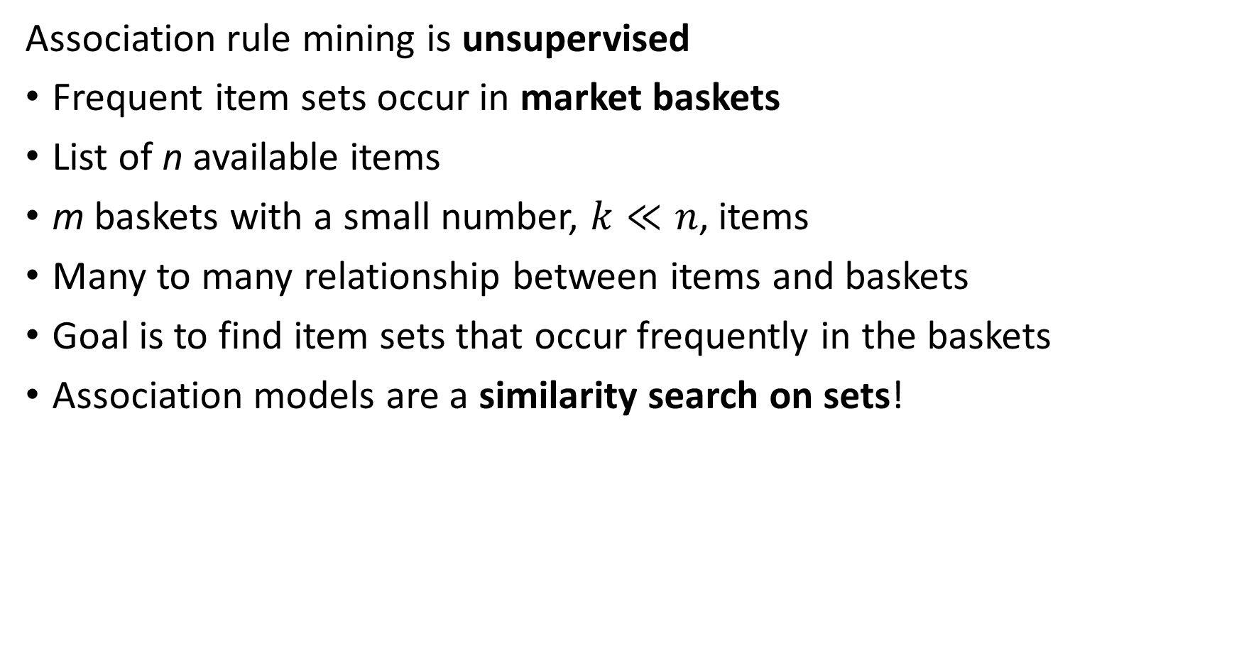
The Market Basket Model
Association rule mining is unsupervised
Frequent item sets occur in market baskets
List of n available items
m baskets with a small number, $k≪n$, items
Many to many relationship between items and baskets
Goal is to find item sets that occur frequently in the baskets
Association models are a similarity search on sets!

Slide 4
Association Rules vs Similarity
How are association rules different from similarity search
Similarity search seeks baskets with large fraction of common items
Generally large number of items
Seek high, but not absolute, similarity between baskets
Example; content-based recommenders
Association rules seek the absolute number of baskets containing specific item sets
Large number of baskets
Large number of items
Small average number of items in baskets
Seek exact match of sets

Slide 5

The Market Basket Model
Start with item set, $I=\left\{bread, butter, eggs, milk, bacon\right\}$
Database of baskets
Identify frequent item sets
Notice the growth in data structure size!
Memory is a major limitation!
Item Set | Frequency
{bread, butter} | 2
{bread, eggs} | 1
{bread, milk} | 2
{bread, bacon} | 1
{butter, eggs} | 1
{butter, milk} | 2
{butter, bacon} | 2
{eggs, milk} | 1
{eggs, bacon} | 4
{milk, bacon} | 1
Basket ID | Item Set
1 | {bread, butter, milk}
2 | {butter, eggs, bacon}
3 | {bread, butter, milk}
4 | {butter, eggs, bacon}
5 | {bread, eggs, bacon}
6 | {eggs, milk, bacon}

Slide 6
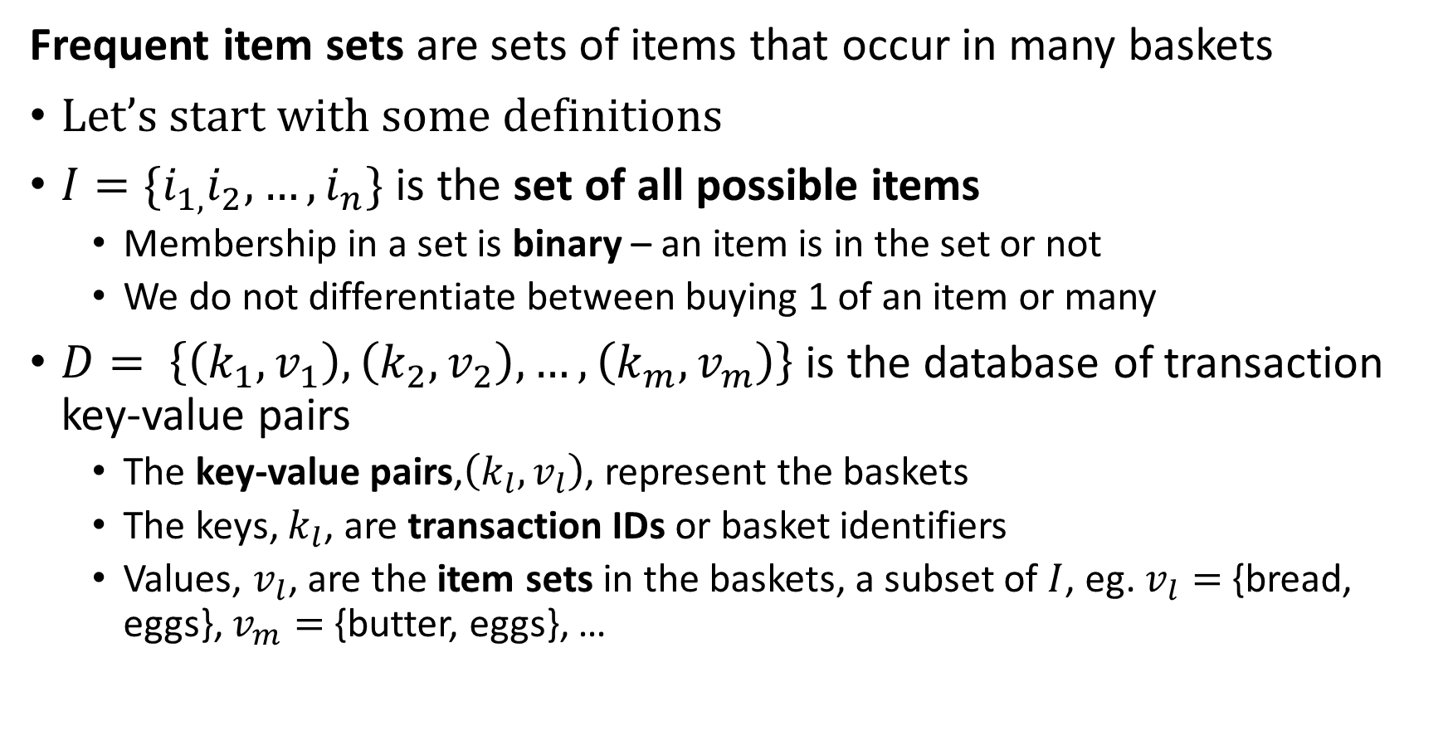
Frequent Item Sets and Association Rules
Frequent item sets are sets of items that occur in many baskets
Let’s start with some definitions
$I=\{i_{1,}i_{2},…,i_{n}\}$ is the set of all possible items
Membership in a set is binary – an item is in the set or not
We do not differentiate between buying 1 of an item or many
$D= \left\{\left(k_{1},v_{1}\right),\left(k_{2},v_{2}\right),…,\left(k_{m},v_{m}\right)\right\}$ is the database of transaction key-value pairs
The key-value pairs,$\left(k_{l},v_{l}\right)$, represent the baskets
The keys, $k_{l}$, are transaction IDs or basket identifiers
Values, $v_{l}$, are the item sets in the baskets, a subset of $I$, eg. $v_{l}=$ {bread, eggs}, $v_{m}=$ {butter, eggs}, …

Slide 7
Frequent Item Sets and Association Rules
Frequent item sets are sets of items that occur in many baskets
Let’s start with some definitions
Many to many relationship between baskets and items
A bipartite graph!
We have seen this before in other similarity searches

Slide 8
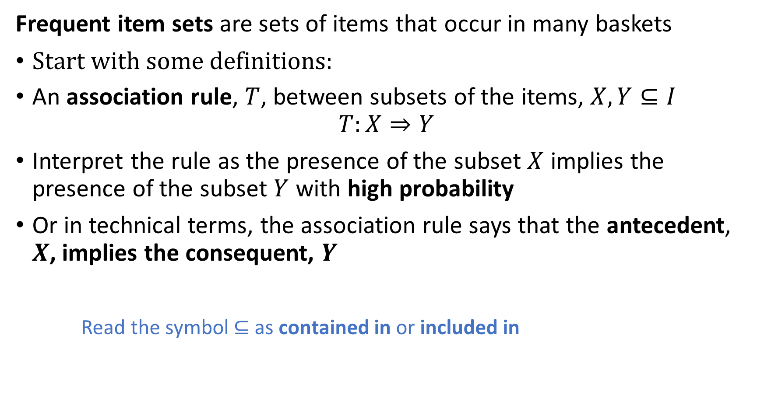
Frequent Item Sets and Association Rules
Frequent item sets are sets of items that occur in many baskets
Start with some definitions:
An association rule, $T$, between subsets of the items, $X,Y⊆I$
$$T:X⇒Y$$
Interpret the rule as the presence of the subset $X$ implies the presence of the subset $Y$ with high probability
Or in technical terms, the association rule says that the antecedent, $X$, implies the consequent, $Y$
Read the symbol $⊆$ as contained in or included in

Slide 9
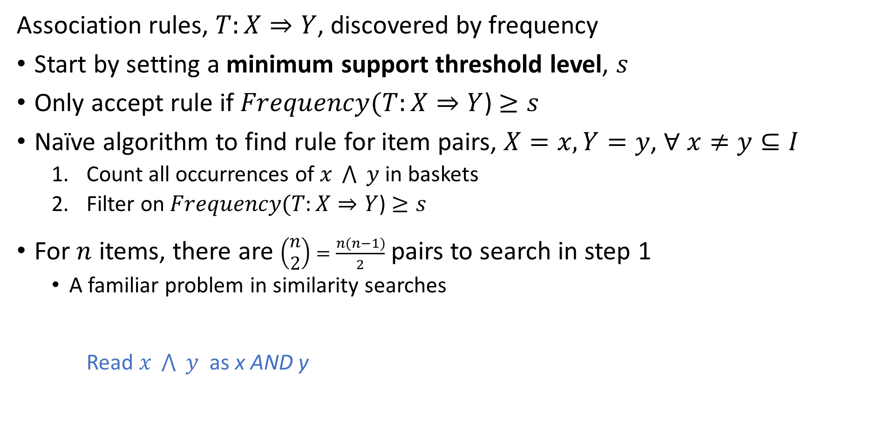
Computing Association Frequency
Association rules, $T:X⇒Y$, discovered by frequency
Start by setting a minimum support threshold level, $s$
Only accept rule if $Frequency(T:X⇒Y$) $≥s$
Naïve algorithm to find rule for item pairs, $X=x, Y=y$, $∀ x≠y⊆I$
Count all occurrences of $x \bigwedge{ }y$ in baskets
Filter on $Frequency(T:X⇒Y$) $≥s$
For $n$ items, there are $\left(\begin{matrix}n \\ 2\end{matrix}\right)=\frac{n(n−1)}{2}$ pairs to search in step 1
A familiar problem in similarity searches
Read $x \bigwedge{ }y$ as x AND y

Slide 10
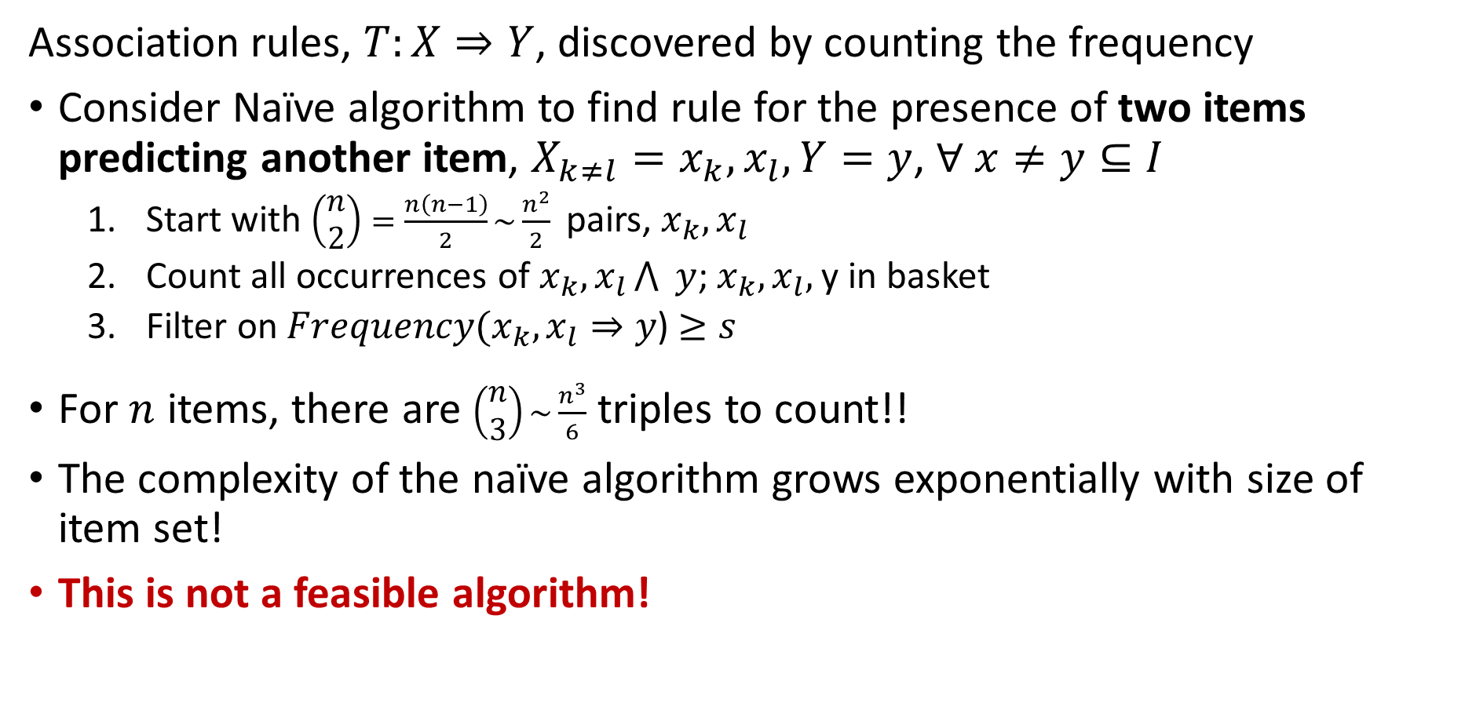
Computing Association Frequency
Association rules, $T:X⇒Y$, discovered by counting the frequency
Consider Naïve algorithm to find rule for the presence of two items predicting another item, $X_{k≠l}=x_{k},x_{l}, Y=y$, $∀ x≠y⊆I$
Start with ${\left(\begin{matrix}n \\ 2\end{matrix}\right)=\frac{n\left(n−1\right)}{2}\sim \frac{n^{2}}{2}}^{ }$ pairs, $x_{k},x_{l}$
Count all occurrences of $x_{k},x_{l}\bigwedge{ }y$; $x_{k},x_{l},$y in basket
Filter on $Frequency(x_{k},x_{l}⇒y$) $≥s$
For $n$ items, there are $\left(\begin{matrix}n \\ 3\end{matrix}\right)\sim \frac{n^{3}}{6}$ triples to count!!
The complexity of the naïve algorithm grows exponentially with size of item set!
This is not a feasible algorithm!

Slide 11
Apriori Algorithm

Slide 12
Apriori Algorithm
Apriori algorithm is based on the properties of sets
Apriori algorithm proposed by Agrawal and Srikant (1994)
Algorithm relies on the downward closure lemma of sets:
All subsets of a frequent set must also be at least as frequent
Downward closure property also know as the monotonicity property of sets
The downward closure lemma ensures that we only need only consider frequent subsets when searching for frequent item sets

Slide 13
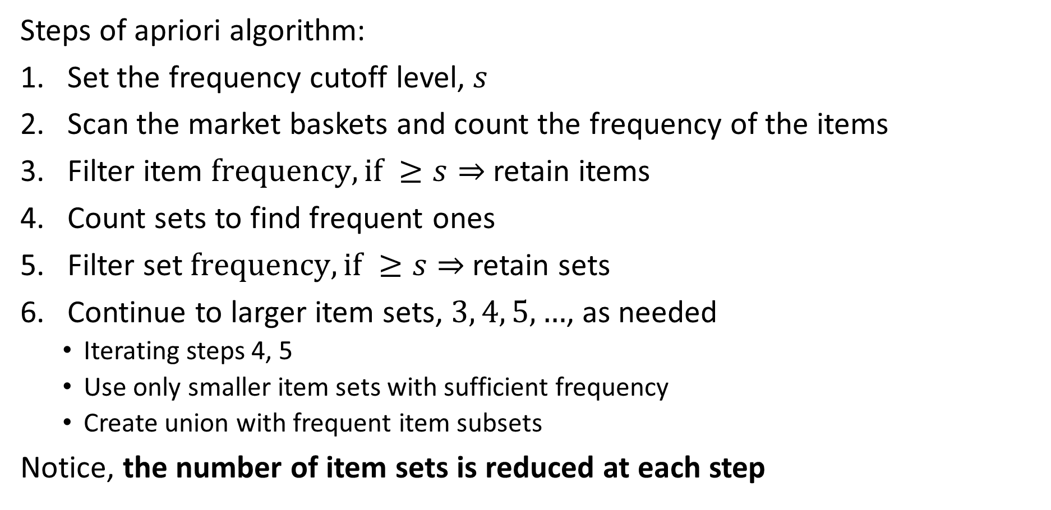
Apriori Algorithm
Steps of apriori algorithm:
Set the frequency cutoff level, $s$
Scan the market baskets and count the frequency of the items
Filter item $frequency, if ≥s⇒$ retain items
Count sets to find frequent ones
Filter set $frequency, if ≥s⇒$ retain sets
Continue to larger item sets, $3, 4, 5,…$, as needed
Iterating steps 4, 5
Use only smaller item sets with sufficient frequency
Create union with frequent item subsets
Notice, the number of item sets is reduced at each step

Slide 14
Apriori Algorithm
Apriori algorithm example; s = 3
Start with small database
First pass find frequent items
TID | Item Set
1 | {a,b}
2 | {b,c,d}
3 | {a,c,d,e}
4 | {a,d,e}
5 | {a,c,d}
6 | {a,b,c}
7 | {a,b,c,d}
item | Frequency
a | 6
b | 3
c | 5
d | 5
e | 2
item | Frequency
a | 6
b | 3
c | 5
d | 5
Compute Frequency
Filter on Frequency

Slide 15
Apriori Algorithm
Apriori algorithm example; s = 3
Second pass find frequent item pairs for frequent items; don’t consider sets containing e
Filter on frequency
TID | Item Set
1 | {a,b}
2 | {b,c,d}
3 | {a,c,d,e}
4 | {a,d,e}
5 | {a,c,d}
6 | {a,b,c}
7 | {a,b,c,d}
Item Set | Frequency
{a,b} | 3
{a,c} | 4
{a,d} | 4
{b,c} | 3
{b,d} | 2
{c,d} | 4
Item Set | Frequency
{a,b} | 3
{a,c} | 4
{a,d} | 4
{b,c} | 3
{c,d} | 4
Compute Pair Frequency
Filter on Frequency
item | Frequency
a | 6
b | 3
c | 5
d | 5

Slide 16
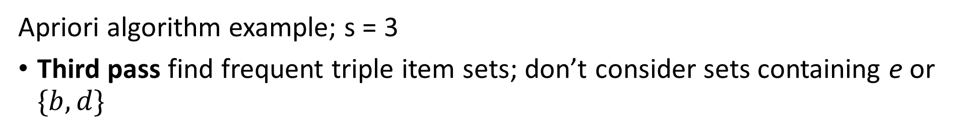
Apriori Algorithm
Apriori algorithm example; s = 3
Third pass find frequent triple item sets; don’t consider sets containing e or $\{b,d\}$
Item Set | Frequency
{a,b} | 3
{a,c} | 4
{a,d} | 4
{b,c} | 3
{c,d} | 4
TID | Item Set
1 | {a,b}
2 | {b,c,d}
3 | {a,c,d,e}
4 | {a,d,e}
5 | {a,c,d}
6 | {a,b,c}
7 | {a,b,c,d}
Item Set | Frequency
{a,b,c} | 2
{a,b,d} | 1
{a,c,d} | 3
{b,c,d} | 2
Compute Item Set Frequncy
Item Set | Frequency
{a,c,d} | 3
item | Frequncy
a | 6
b | 3
c | 5
d | 5
Filter on Frequncy

Slide 17
Apriori Algorithm
Antecedent | Consequent | Frequency
{a} | {b} | 3
{a} | {c} | 4
{a} | {d} | 4
{b} | {c} | 3
{c} | {d} | 4
{b} | {a} | 3
{c} | {a} | 4
{d} | {a} | 4
{c} | {b} | 3
{c} | {d} | 4
{a,c} | {d} | 3
{a,d} | {c} | 3
{c,d} | {a} | 3
{a} | {c,d} | 3
{c} | {a,d} | 3
{d} | {a,c} | 3
Apriori algorithm example; s = 3
Start with all frequent item sets
Find all possible rule combinations from frequent item sets
Rule maps antecedent to its consequent
Item Set | Frequency
{a,b} | 3
{a,c} | 4
{a,d} | 4
{b,c} | 3
{c,d} | 4
{a,c,d} | 3
Derive rules

Slide 18
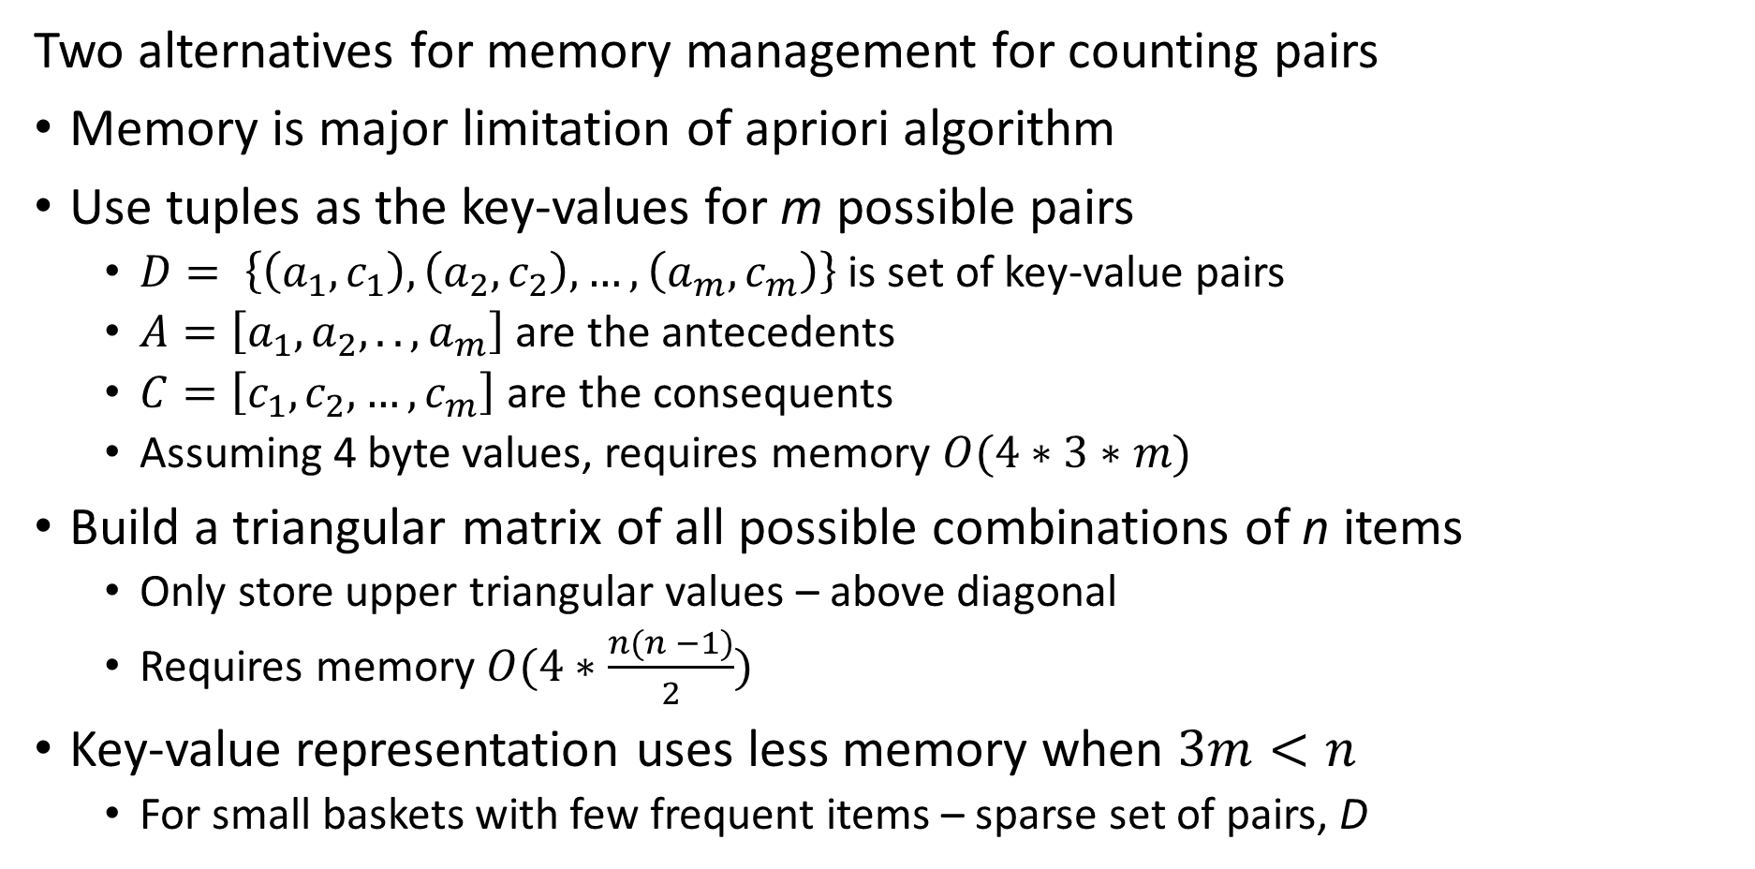
Memory Management for Apriori Algorithm
Two alternatives for memory management for counting pairs
Memory is major limitation of apriori algorithm
Use tuples as the key-values for m possible pairs
$D= \left\{\left(a_{1},c_{1}\right),\left(a_{2},c_{2}\right),…,\left(a_{m},c_{m}\right)\right\}$ is set of key-value pairs
$A=\left[a_{1},a_{2},..,a_{m}\right]$ are the antecedents
$C=\left[c_{1},c_{2},…,c_{m}\right]$ are the consequents
Assuming 4 byte values, requires memory $O(4∗3∗m)$
Build a triangular matrix of all possible combinations of n items
Only store upper triangular values – above diagonal
Requires memory $O(4∗\frac{{n(n}^{ }−1)}{2})$
Key-value representation uses less memory when $3m<n$
For small baskets with few frequent items – sparse set of pairs, D

Slide 19
Summary of Apriori Algorithm
Advantages and disadvantages of apriori algorithm
Advantages
Reduces the set size for unions at each step
Simple table-oriented implementation
Easy to parallelize; e.g. MapReduce
Disadvantages
Computationally intensive since all unions of subsets must be counted – potentially massive candidate sets
Count for all pairs must fit in main memory
Multiple passes over data required

Slide 20
Evaluation of Association Rules

Slide 21
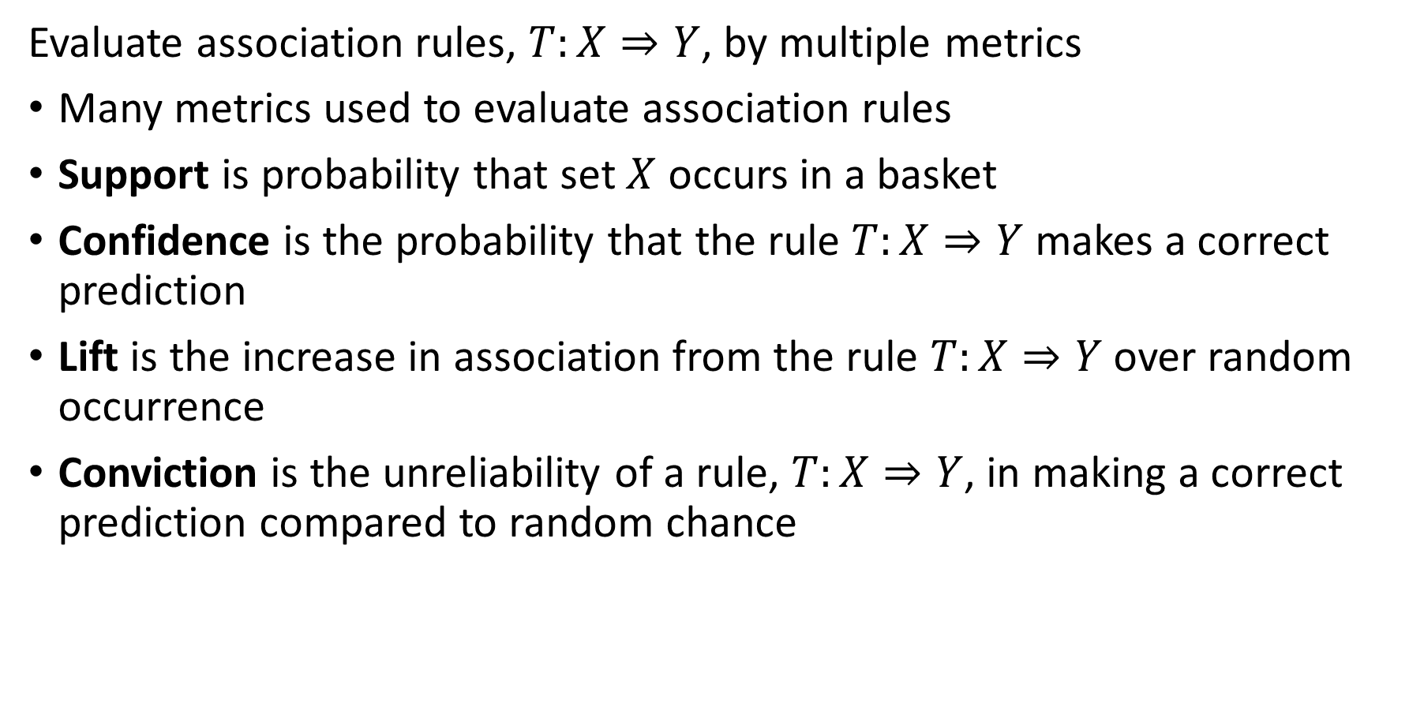
Evaluation of Association Rules
Evaluate association rules, $T:X⇒Y$, by multiple metrics
Many metrics used to evaluate association rules
Support is probability that set $X$ occurs in a basket
Confidence is the probability that the rule $T:X⇒Y$ makes a correct prediction
Lift is the increase in association from the rule $T:X⇒Y$ over random occurrence
Conviction is the unreliability of a rule, $T:X⇒Y$, in making a correct prediction compared to random chance

Slide 22
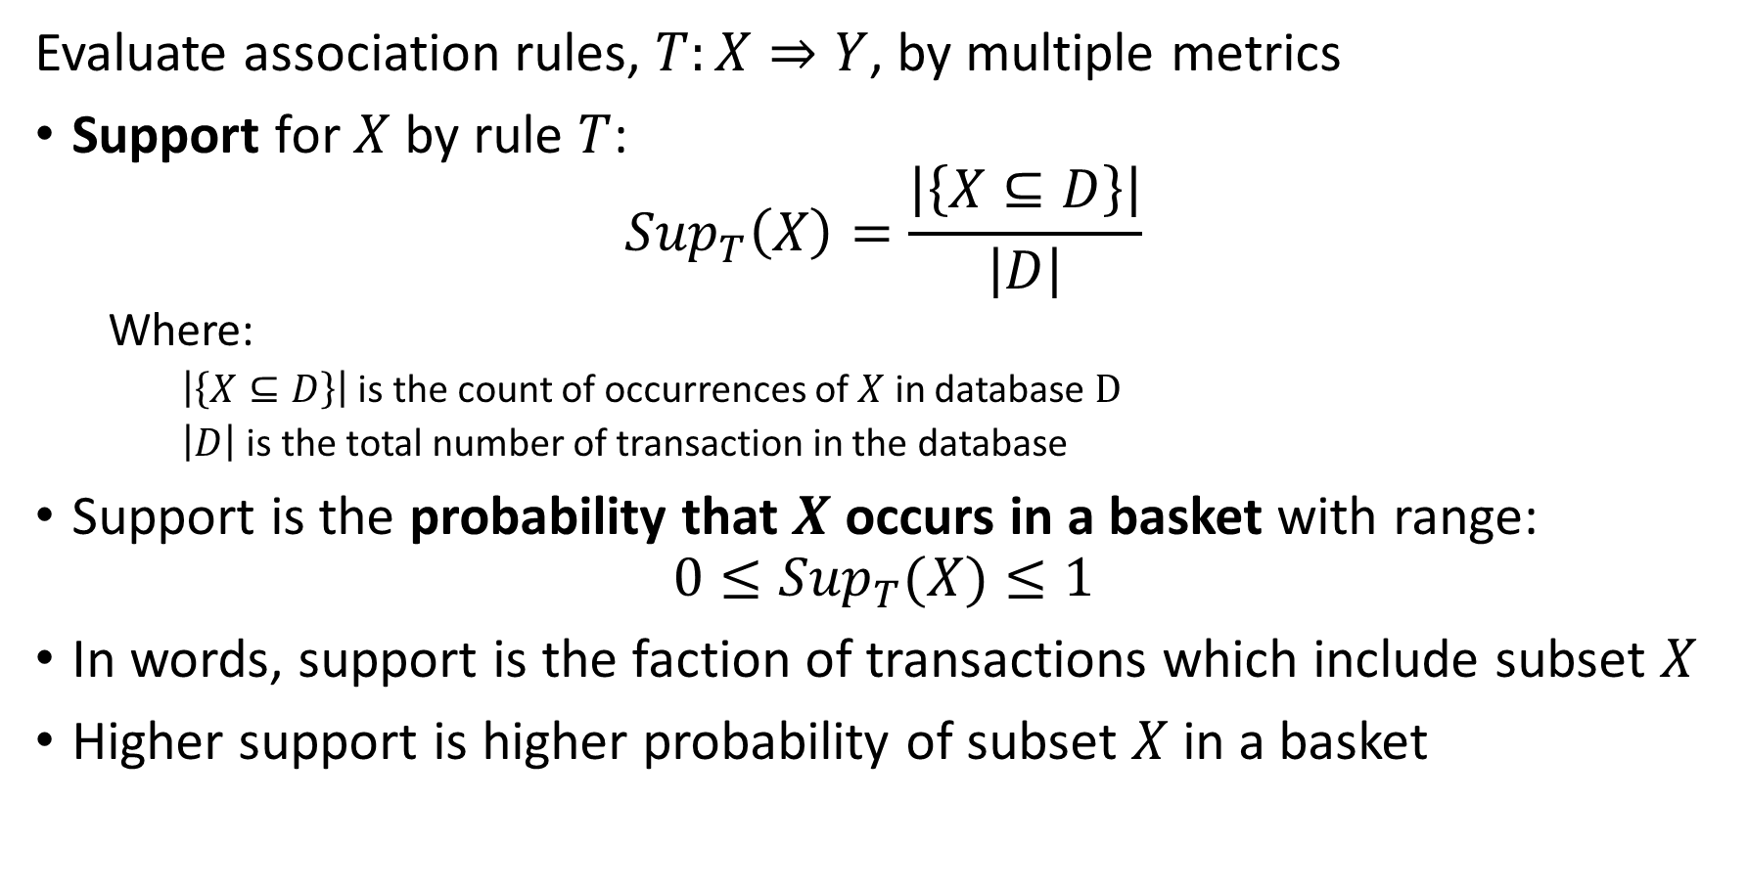
Evaluation of Association Rules
Evaluate association rules, $T:X⇒Y$, by multiple metrics
Support for $X$ by rule $T$:
$${Sup}_{T}\left(X\right)=\frac{\left|\left\{X⊆D\right\}\right|}{\left|D\right|}$$
Where:
$\left|\left\{X⊆D\right\}\right|$ is the count of occurrences of $X$ in database $D$
$\left|D\right|$ is the total number of transaction in the database
Support is the probability that $X$ occurs in a basket with range:
$$0≤{Sup}_{T}(X)≤1$$
In words, support is the faction of transactions which include subset $X$
Higher support is higher probability of subset $X$ in a basket

Slide 23
Evaluation of Association Rules
Example: Compute Support for association rules
item | Frequency
a | 6
b | 3
c | 5
d | 5
Item Set | Support
{a} | 6/7=0.86
{b} | 3/7=0.43
{c} | 5/7=0.71
{d} | 5/7=0.71
{a,b} | 3/7=0.43
{a,c} | 4/7=0.57
{a,d} | 4/7=0.57
{b,c} | 3/7=0.43
{c,d} | 4/7=0.57
{a,c,d} | 3/7=0.43
Item Set | Frequency
{a,b} | 3
{a,c} | 4
{a,d} | 4
{b,c} | 3
{c,d} | 4
{a,c,d} | 3

Slide 24
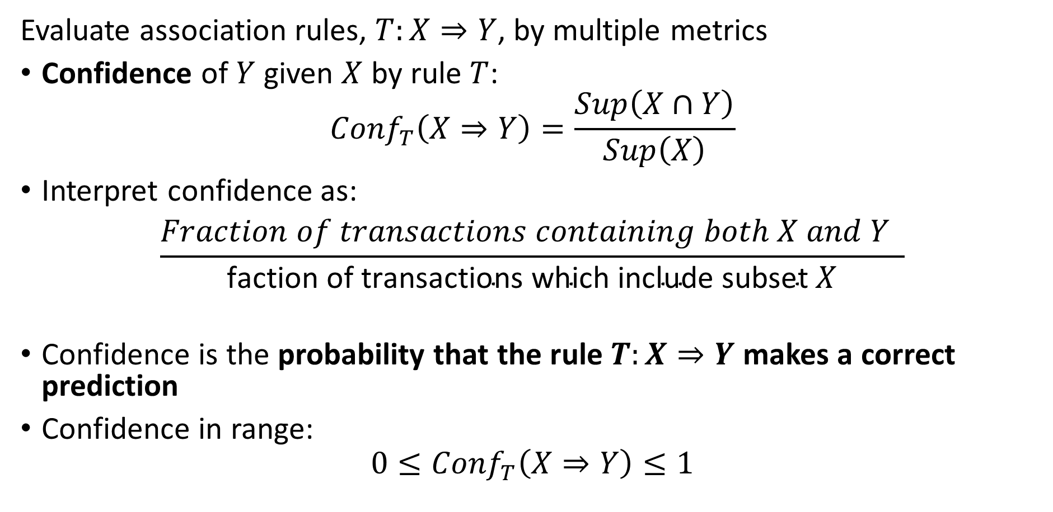
Evaluation of Association Rules
Evaluate association rules, $T:X⇒Y$, by multiple metrics
Confidence of $Y$ given $X$ by rule $T$:
$${Conf}_{T}\left(X⇒Y\right)=\frac{Sup\left(X∩Y\right)}{Sup\left(X\right)}$$
Interpret confidence as:
$$\frac{Fraction of transactions containing both X and Y }{\text{faction} \text{of} \text{transactions} \text{which} \text{include} \text{subset} X}$$
Confidence is the probability that the rule $T:X⇒Y$ makes a correct prediction
Confidence in range:
$$0≤{Conf}_{T}\left(X⇒Y\right)≤1$$

Slide 25
Evaluation of Association Rules
Example: Compute Confidence for association rules
Partial list not showing all rule permutations
Antecedent | Consequent | Confidence
{a} | {b} | 0.43/0.86=0.5
{b} | {a} | 0.43/.43=1.0
{a} | {c} | 0.57/.86=0.66
{c} | {a} | 0.57/.71=0.80
{a} | {d} | 0.57/0.86=0.66
{d} | {a} | 0.57/.71=0.80
{b} | {c} | 0.43/0.43=1.0
{c} | {b} | 0.43/0.71=0.61
{c} | {d} | 0.57/0.71=0.80
{d} | {c} | 0.57/0.71=0.80
{a,c} | {d} | 0.43/0.57=0.76
{a,d} | {c} | 0.43/0.57=0.76
{c,d} | {a} | 0.43/0.57=0.76
Item Set | Support
{a} | 6/7=0.86
{b} | 3/7=0.43
{c} | 5/7=0.71
{d} | 5/7=0.71
{a,b} | 3/7=0.43
{a,c} | 4/7=0.57
{a,d} | 4/7=0.57
{b,c} | 3/7=0.43
{c,d} | 4/7=0.57
{a,c,d} | 3/7=0.43

Slide 26
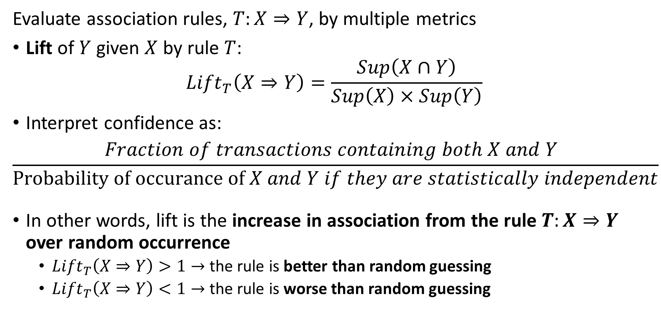
Evaluation of Association Rules
Evaluate association rules, $T:X⇒Y$, by multiple metrics
Lift of $Y$ given $X$ by rule $T$:
$${Lift}_{T}\left(X⇒Y\right)=\frac{Sup\left(X∩Y\right)}{Sup\left(X\right)×Sup\left(Y\right)}$$
Interpret confidence as:
$$\frac{Fraction of transactions containing both X and Y }{\text{Probability} \text{of} \text{occurance} \text{of} X and Y if they are statistically independent}$$
In other words, lift is the increase in association from the rule $T:X⇒Y$ over random occurrence
${Lift}_{T}\left(X⇒Y\right)>1→$ the rule is better than random guessing
${Lift}_{T}\left(X⇒Y\right)<1→$ the rule is worse than random guessing

Slide 27
Evaluation of Association Rules
Example: Compute Lift for association rules
Item Set | Support | Lift
{a} | 6/7=0.86 | NA
{b} | 3/7=0.43 | NA
{c} | 5/7=0.71 | NA
{d} | 5/7=0.71 | NA
{a,b} | 3/7=0.43 | 0.43/(0.86*0.43)=1.16
{a,c} | 4/7=0.57 | 0.57/(0.86*0.71)=0.93
{a,d} | 4/7=0.57 | 0.57/(0.86*0.71)=0.93
{b,c} | 3/7=0.43 | 0.43/(0.43*0.71)=1.41
{c,d} | 4/7=0.57 | 0.57/(0.71*0.71)=1.13
{a,c,d} | 3/7=0.43 | 0.43/(0.86*0.71*0.71)=0.99

Slide 28
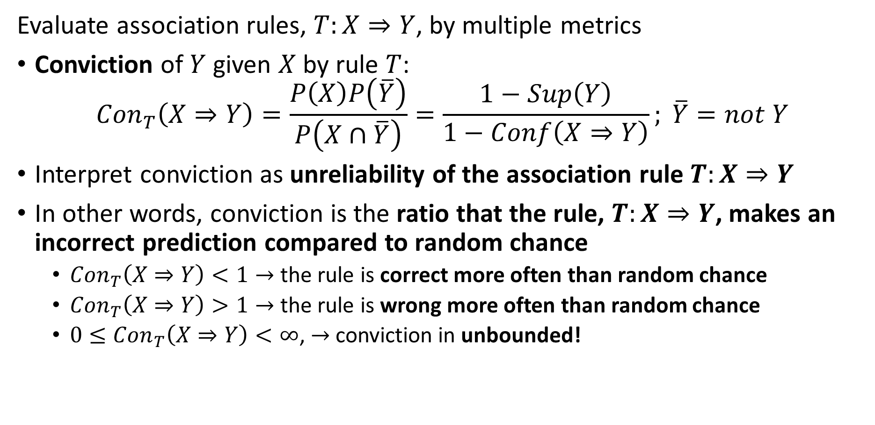
Evaluation of Association Rules
Evaluate association rules, $T:X⇒Y$, by multiple metrics
Conviction of $Y$ given $X$ by rule $T$:
$${Con}_{T}\left(X⇒Y\right)=\frac{P\left(X\right)P\left(\overline{Y}\right)}{P\left(X∩\overline{Y}\right)}=\frac{1−Sup\left(Y\right)}{1−Conf\left(X⇒Y\right)}; \overline{Y}=not Y$$
Interpret conviction as unreliability of the association rule $T:X⇒Y$
In other words, conviction is the ratio that the rule, $T:X⇒Y$, makes an incorrect prediction compared to random chance
${Con}_{T}\left(X⇒Y\right)<1→$ the rule is correct more often than random chance
${Con}_{T}\left(X⇒Y\right)>1→$ the rule is wrong more often than random chance
${0≤Con}_{T}\left(X⇒Y\right)<∞$, $→$ conviction in unbounded!

Slide 29
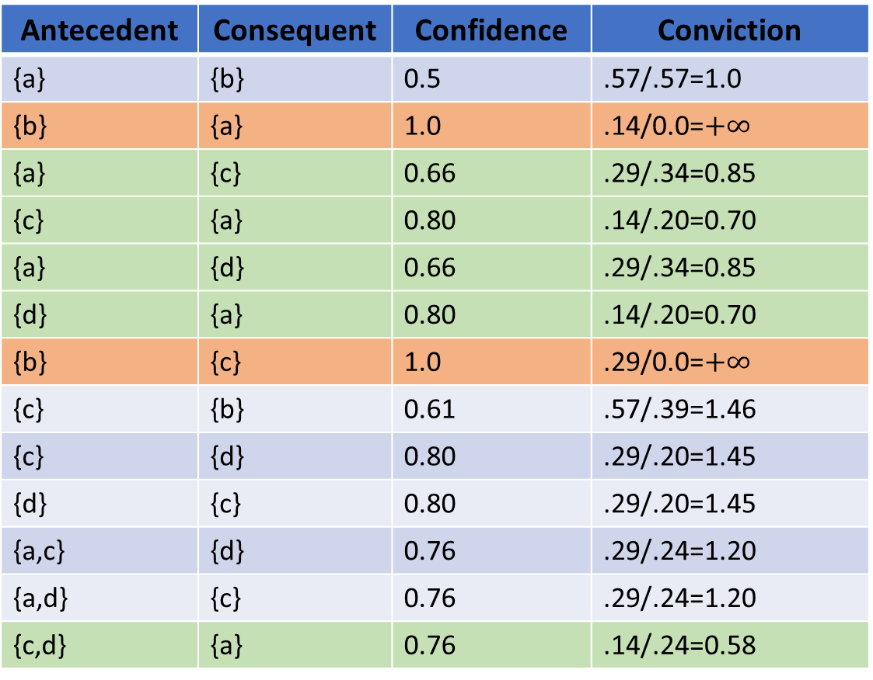
Evaluation of Association Rules
Example: Compute Conviction for association rules
Antecedent | Consequent | Confidence | Conviction
{a} | {b} | 0.5 | .57/.57=1.0
{b} | {a} | 1.0 | .14/0.0=$+∞$
{a} | {c} | 0.66 | .29/.34=0.85
{c} | {a} | 0.80 | .14/.20=0.70
{a} | {d} | 0.66 | .29/.34=0.85
{d} | {a} | 0.80 | .14/.20=0.70
{b} | {c} | 1.0 | .29/0.0=$+∞$
{c} | {b} | 0.61 | .57/.39=1.46
{c} | {d} | 0.80 | .29/.20=1.45
{d} | {c} | 0.80 | .29/.20=1.45
{a,c} | {d} | 0.76 | .29/.24=1.20
{a,d} | {c} | 0.76 | .29/.24=1.20
{c,d} | {a} | 0.76 | .14/.24=0.58
Item Set | Support
{a} | 6/7=0.86
{b} | 3/7=0.43
{c} | 5/7=0.71
{d} | 5/7=0.71
{a,b} | 3/7=0.43
{a,c} | 4/7=0.57
{a,d} | 4/7=0.57
{b,c} | 3/7=0.43
{c,d} | 4/7=0.57
{a,c,d} | 3/7=0.43

Slide 30
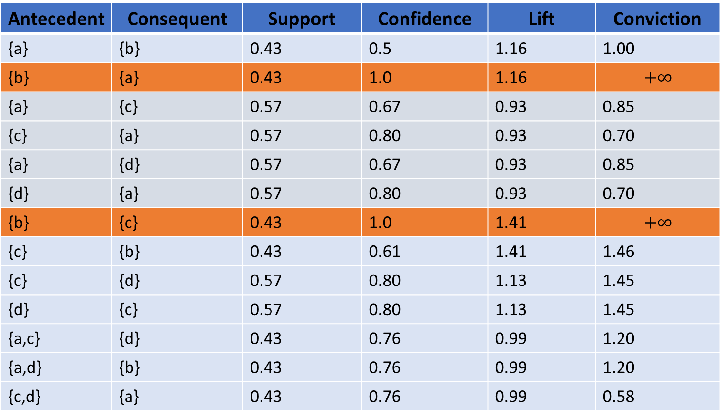
Evaluation of Association Rules
Antecedent | Consequent | Support | Confidence | Lift | Conviction
{a} | {b} | 0.43 | 0.5 | 1.16 | 1.00
{b} | {a} | 0.43 | 1.0 | 1.16 | $$+∞$$
{a} | {c} | 0.57 | 0.67 | 0.93 | 0.85
{c} | {a} | 0.57 | 0.80 | 0.93 | 0.70
{a} | {d} | 0.57 | 0.67 | 0.93 | 0.85
{d} | {a} | 0.57 | 0.80 | 0.93 | 0.70
{b} | {c} | 0.43 | 1.0 | 1.41 | $$+∞$$
{c} | {b} | 0.43 | 0.61 | 1.41 | 1.46
{c} | {d} | 0.57 | 0.80 | 1.13 | 1.45
{d} | {c} | 0.57 | 0.80 | 1.13 | 1.45
{a,c} | {d} | 0.43 | 0.76 | 0.99 | 1.20
{a,d} | {b} | 0.43 | 0.76 | 0.99 | 1.20
{c,d} | {a} | 0.43 | 0.76 | 0.99 | 0.58
Example: Summary for association rules
No rule with lift >1 and conviction < 1
This is an anomaly for cases with confidence = 1.0!

Slide 31
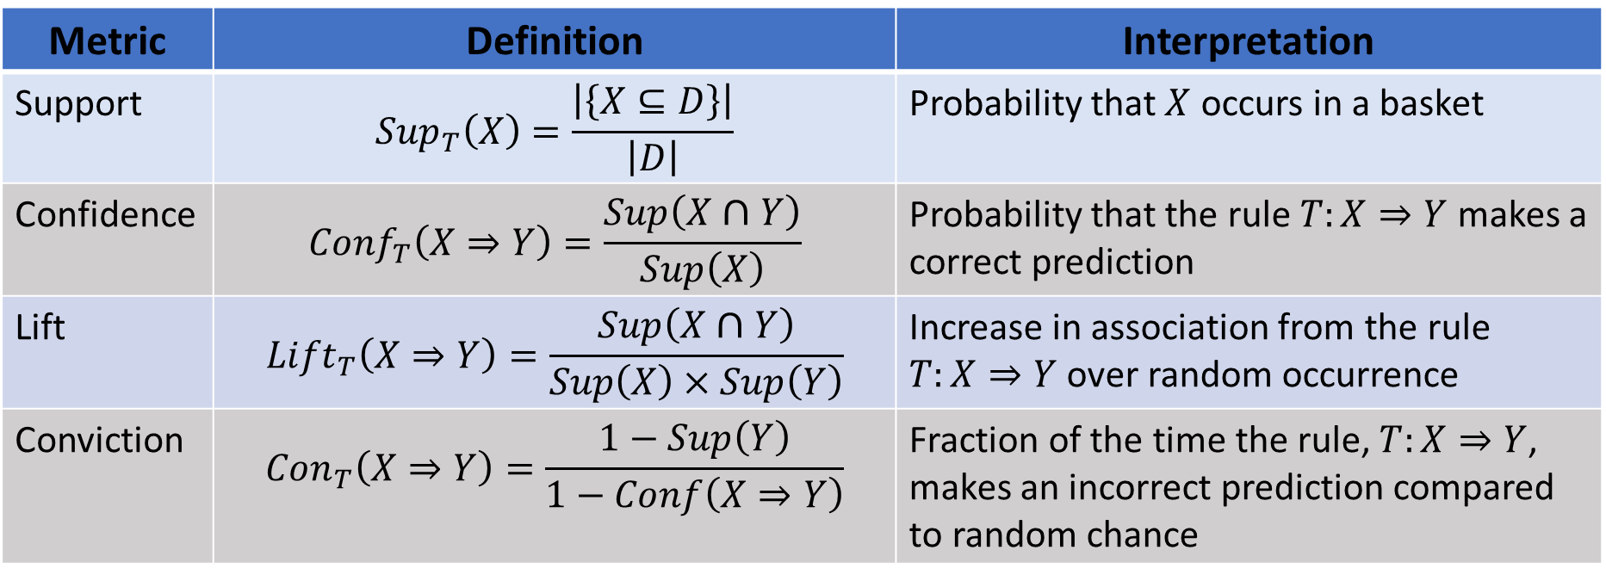
Evaluation of Association Rules
Metric | Definition | Interpretation
Support | $${Sup}_{T}\left(X\right)=\frac{\left|\left\{X⊆D\right\}\right|}{\left|D\right|}$$ | Probability that $X$ occurs in a basket
Confidence | $${Conf}_{T}\left(X⇒Y\right)=\frac{Sup\left(X∩Y\right)}{Sup\left(X\right)}$$ | Probability that the rule $T:X⇒Y$ makes a correct prediction
Lift | $${Lift}_{T}\left(X⇒Y\right)=\frac{Sup\left(X∩Y\right)}{Sup\left(X\right)×Sup\left(Y\right)}$$ | Increase in association from the rule $T:X⇒Y$ over random occurrence
Conviction | $${Con}_{T}\left(X⇒Y\right)=\frac{1−Sup\left(Y\right)}{1−Conf\left(X⇒Y\right)}$$ | Fraction of the time the rule, $T:X⇒Y$, makes an incorrect prediction compared to random chance

Slide 32
Improving the Apriori Algorithm

Slide 33
Improving on Apriori Algorithm
How can we improve the apriori algorithm?
Many proposals
Make clever use of hash tables
Exploit aspects of the downward closure property of sets and subsets
Success depends on frequency of item sets
For example, the Park, Chen, Yu (PCY) algorithm proposed in 1995
Modification to basic apriori algorithm
Uses hash table or sketch to filter frequent item sets
Similar to a Bloom filter

Slide 34

The PCY Algorithm
Start with item set, $I=\left\{bread, butter, eggs, milk, bacon\right\}$
Database of baskets
On first pass use simple hash of first letter of identifier
Hash first basket and add counts to buckets
Notice hash collisions
Basket ID | Item Set
1 | {bread, butter, milk}
2 | {butter, eggs, bacon}
3 | {bread, butter, milk}
4 | {butter, eggs, bacon}
5 | {bread, eggs, bacon}
6 | {eggs, milk, bacon}
Hash | Frequency
bb | 1
bm | 2

Slide 35

The PCY Algorithm
Start with item set, $I=\left\{bread, butter, eggs, milk, bacon\right\}$
Continue first pass
Hash second basket and add counts to buckets
More has collisions!
Basket ID | Item Set
1 | {bread, butter, milk}
2 | {butter, eggs, bacon}
3 | {bread, butter, milk}
4 | {butter, eggs, bacon}
5 | {bread, eggs, bacon}
6 | {eggs, milk, bacon}
Hash | Frequency
bb | 2
bm | 2
be | 2

Slide 36

The PCY Algorithm
Start with item set, $I=\left\{bread, butter, eggs, milk, bacon\right\}$
Hash all other baskets in order and add counts to buckets
Basket ID | Item Set
1 | {bread, butter, milk}
2 | {butter, eggs, bacon}
3 | {bread, butter, milk}
4 | {butter, eggs, bacon}
5 | {bread, eggs, bacon}
6 | {eggs, milk, bacon}
Hash | Frequency
bb | 5
bm | 5
be | 6
em | 1

Slide 37

The PCY Algorithm
Start with item set, $I=\left\{bread, butter, eggs, milk, bacon\right\}$
Filter after first pass
For count $>s=5$, only one hash bucket remains
Only pairs in hash bucket need to be considered
$$\left\{butter,eggs\right\},\left\{bread, eggs\right\}, \{bacon, eggs\}$$
Basket ID | Item Set
1 | {bread, butter, milk}
2 | {butter, eggs, bacon}
3 | {bread, butter, milk}
4 | {butter, eggs, bacon}
5 | {bread, eggs, bacon}
6 | {eggs, milk, bacon}
Hash | Frequency
bb | 5
bm | 5
be | 6
em | 1

Slide 38
The PYC Algorithm
Hash filters reduce memory use
Like a Bloom filter, the are no false negatives, only false positives
For sparse item sets, PYC algorithm significantly reduces memory use compared to aprioir
Only count pairs with positive hash in table
Reduce pairs considered by downward closure property of sets
Can create new hash tables with triples for other passes
More sophisticated implementations use multiple hash tables
Reduce false positive rate
Trade-off between memory use and computational complexity

Slide 39
FP-Growth Algorithm

Slide 40
FP Growth Algorithm
Frequent pattern (FP) growth algorithm
The FP growth algorithm proposed by Han et.al. (2004) as a possible improvement over apriori
Advantages of FP growth
Computationally efficient
Potentially significant reduction in memory use
Compression in representation from downward closure property of sets
FP growth grows a tree (graph) of item sets
Counts of occurrence are maintained in the tree
Pointers across branches used to sum frequency of items

Slide 41
FP Growth Algorithm
FP growth algorithm example – grow tree case by case
Start with small database
Sort sets by item frequency
TID | Item Set
1 | {a,b}
2 | {b,c,d}
3 | {a,c,d,e}
4 | {a,d,e}
5 | {a,c,d}
6 | {a,b,c}
7 | {a,b,c,d}
item | Frequency
a | 6
c | 5
d | 5
b | 4
e | 2
Sort

Slide 42
FP Growth Algorithm
FP growth algorithm example – grow tree case by case
Build tree branch for 1st item set
Start with set containing most frequent item, a, ordered by frequency
Null
a:1
TID | Item Set
1 | {a,b}
2 | {b,c,d}
3 | {a,c,d,e}
4 | {a,d,e}
5 | {a,c,d}
6 | {a,b,c}
7 | {a,b,c,d}
c:1
d:1
Items and counts in sets
e:1

Slide 43
FP Growth Algorithm
FP growth algorithm example – grow tree case by case
Increment count of items in next set containing first set
Null
a:2
TID | Item Set
1 | {a,b}
2 | {b,c,d}
3 | {a,c,d,e}
4 | {a,d,e}
5 | {a,c,d}
6 | {a,b,c}
7 | {a,b,c,d}
c:2
d:2
Increment counts for members of set
e:1

Slide 44
FP Growth Algorithm
FP growth algorithm example – grow tree case by case
Create branch for next item set containing most frequent item, a
Increment counts
Null
a:3
TID | Item Set
1 | {a,b}
2 | {b,c,d}
3 | {a,c,d,e}
4 | {a,d,e}
5 | {a,c,d}
6 | {a,b,c}
7 | {a,b,c,d}
c:2
d:2
d:1
e:1
e:1

Slide 45
FP Growth Algorithm
FP growth algorithm example – grow tree case by case
Add pointers between common items in branches
Null
a:3
TID | Item Set
1 | {a,b}
2 | {b,c,d}
3 | {a,c,d,e}
4 | {a,d,e}
5 | {a,c,d}
6 | {a,b,c}
7 | {a,b,c,d}
c:2
d:2
d:1
e:1
e:1

Slide 46
FP Growth Algorithm
FP growth algorithm example – grow tree case by case
Add branch for next set in sort order
Null
a:4
TID | Item Set
1 | {a,b}
2 | {b,c,d}
3 | {a,c,d,e}
4 | {a,d,e}
5 | {a,c,d}
6 | {a,b,c}
7 | {a,b,c,d}
c:2
d:1
b:1
d:2
e:1
e:1

Slide 47
FP Growth Algorithm
FP growth algorithm example – grow tree case by case
Add branch for next set in sort order
Increment counts
Pointers between common items
Null
a:5
TID | Item Set
1 | {a,b}
2 | {b,c,d}
3 | {a,c,d,e}
4 | {a,d,e}
5 | {a,c,d}
6 | {a,b,c}
7 | {a,b,c,d}
c:2
b:2
d:2
d:1
e:1
c:1
e:1

Slide 48
FP Growth Algorithm
FP growth algorithm example – grow tree case by case
Add branch for next set in sort order
Increment counts
Pointers between common items
Null
a:6
TID | Item Set
1 | {a,b}
2 | {b,c,d}
3 | {a,c,d,e}
4 | {a,d,e}
5 | {a,c,d}
6 | {a,b,c}
7 | {a,b,c,d}
c:2
d:1
b:3
d:2
e:1
c:2
e:1
d:1

Slide 49
FP Growth Algorithm
FP growth algorithm example – grow tree case by case
Finally, add the last branch!
Pointers between common items
Null
a:6
c:1
TID | Item Set
1 | {a,b}
2 | {b,c,d}
3 | {a,c,d,e}
4 | {a,d,e}
5 | {a,c,d}
6 | {a,b,c}
7 | {a,b,c,d}
c:2
d:1
d:1
b:3
d:2
b:1
e:1
c:2
e:1
d:1

Slide 50
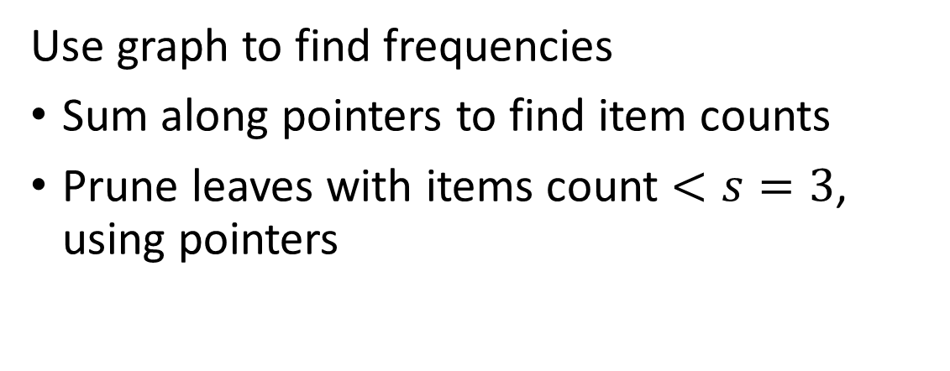
FP Growth Algorithm
Use graph to find frequencies
Sum along pointers to find item counts
Prune leaves with items count $<s=3$, using pointers
Null
a:6
c:1
c:2
d:1
d:1
b:3
d:2
b:1
e:1
c:2
e:1
d:1

Slide 51
FP Growth Algorithm
Use graph to find frequencies
Sum from leaves to root to find item set frequency
Item Set | Frequency
{d,c} | 4
{d,a} | 4
{c,a} | 4
{c,b} | 3
{b,a} | 3
{d,c,a} | 3
{d,c,b} | 2
{c,b,a} | 2
{d,c,b,a} | 1
Null
a:6
c:1
c:2
d:1
d:1
b:3
d:2
b:1
c:2
d:1

Slide 52
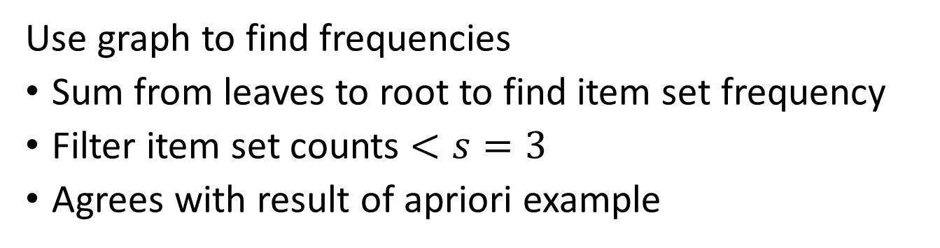
FP Growth Algorithm
Use graph to find frequencies
Sum from leaves to root to find item set frequency
Filter item set counts $<s=3$
Agrees with result of apriori example
Item Set | Frequency
{d,c} | 4
{d,a} | 3
{c,a} | 4
{c,b} | 3
{b,a} | 3
{d,c,a} | 3
{d,c,b} | 2
{c,b,a} | 2
{d,c,b,a} | 1
Null
a:6
c:1
c:2
d:1
d:1
b:3
d:2
b:1
c:2
d:1
d:1

Slide 53
FP Growth Algorithm
Compression with FP growth algorithm
Compression arises from monotonicity property of sets
Example: Sets {a,c}, {a,c,d} require no additional memory given set {a,c,d,e}
Example: Set {a,b} and {a,b,c} requires no additional memory given set {a,b,c,d)
Notice that this representation places the most frequent item sets near root of tree
Sets {a,c,d,e}, {a,c,d} and {a,c}
Null
Sets {a,b,c,d}, {a,b,c} and {a,b}
a:6
c:1
c:2
d:1
d:1
b:3
d:2
b:1
c:2
e:1
e:1
d:1

Slide 54
FP Growth Algorithm
Frequent pattern (FP) growth algorithm
Recall that computing the pair frequencies is the memory consuming step of the apriori algorithm
FP growth algorithm can provide considerable compression
The downward closure says that frequent large item sets are comprised of smaller frequent item sets
Smaller item sets are highly likely to occur on the same branch
If this pattern is consistent there is considerable compression over tables
But, FP growth is still relatively slow
Building tree is computationally intensive
May use excessive memory if there is little redundancy on the branches

Slide 55
FP Growth Algorithm
Why build the tree in inverse sort order?
Graph built in inverse sort order
- Uses less memory by downward closure property
Graph built in random order - More complex graph, uses more memory
Null
Null
a:6
c:1
a:6
b:1
c:2
b:3
c:1
c:1
d:1
b:3
d:1
d:1
d:1
d:2
d:1
c:2
d:1
b:1
e:1
e:1
c:2
e:1
d:1
e:1
d:1

Slide 56
Python Support
Association rule mining is supported in a number Python packages
MLxtend package appears to have conflicts with latest Pandas
PAMI is a dedicated association rule mining package
Includes standard database mining
Extends to time-dependent, sequential and geo-referenced spatial-dependent patterns!
Includes algorithms optimized for genetics research
Find GitHub repository here – includes extensve collection of tutorials
Frequent Pattern Minning package in Spark is considered highly scalable

Slide 57
Summary of Association Rules
Association rules are used to find sets of items that occur frequently
Originally, association rules applied to market basket analysis
Now used in many domains
Systematic search algorithm is computationally infeasible
Memory is the major limitation
Many algorithms have been developed to limit memory use
Practical algorithms rely on downward closure property of sets
Apriori algorithm was first practical method
Search limited by filtering
PCY improves on apriori using hashing methods
FP growth algorithm is a tree (graph) based method
Memory efficient by downward closure property of sets

Slide 58
How are the topics in this course connected?
7. Recommender Algorithms
11. Association Models
Task Specific Algorithms
4. Graph and Social Network Analysis
8. Web/Document Search
3. Streaming Algorithms
9. Clustering Algorithms
Core Algorithms
10. Dimensionality Reduction
6. Similarity Search and NN Algorithms
2. Large Scale Computing
5. Distance and Similarity Metrics
1. Large-Scale Statistics
Foundations

