Slide 1

CSCI E-96 Data Mining, Exploration and Discovery Introduction to Clustering Models Part 2
Steve Elston
Copyright 2020,2021, 2022, 2023, 2024, 2025, Stephen F Elston. All rights reserved.

Slide 2
Algorithms for Non-Euclidean Spaces
Euclidean spaces are optimal only for Normally distributed variables
Common examples of variables in non-Euclidean spaces
Categorical variables including NLP problems
Binary variables
Ordinal variables
Algorithms for non-Euclidian spaces
Tree-graph-based Agglomerative clustering
Graph-based affinity clustering – slow and not discussed further here
NN graph-based density algorithms
NN graph-based spectral clustering

Slide 3
Graph-Based Clustering Models

Slide 4
Graph Based Clustering Models
Many cluster models use a graph-based associations
A graph is constructed for the distance or similarity relationships
Observations (samples) are nodes
Edges connect samples
Edge weights are distance or similarity
Relationships on the graph are used to separate data into clusters
Several commonly used classes of clustering algorithms are graph-based
Hierarchical
Affinity clustering
Density clustering
Spectral clustering

Slide 5
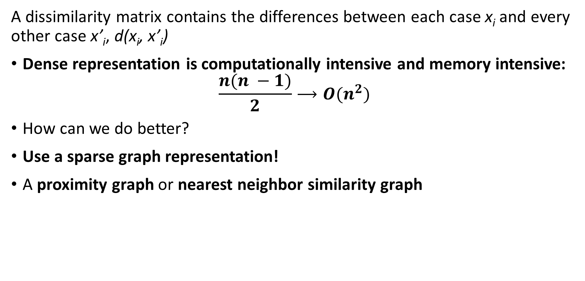
Scaling distance and similarity measures
A dissimilarity matrix contains the differences between each case x_{i} and every other case x’_{i}, d(x_{i}, x’_{i})
Dense representation is computationally intensive and memory intensive:
$$\frac{{n(n}^{ }−1)}{2}⟶O(n^{2})$$
How can we do better?
Use a sparse graph representation!
A proximity graph or nearest neighbor similarity graph

Slide 6
Scaling distance and similarity measures
A dissimilarity matrix contains the differences between each case x_{i} and every other case x’_{i}, d(x_{i}, x’_{i})
Sparse graph representation reduces computation and memory use
The sparser the graph the greater the approximation
In many practical situations only need metric for closest neighbors
Construct graph of nearest neighbors
Only compute and store metric for edges between nearest neighbors
Approximation ignores other associations
Ways to define nearest neighbor
Neighbors within distance r
Nearest k neighbors

Slide 7
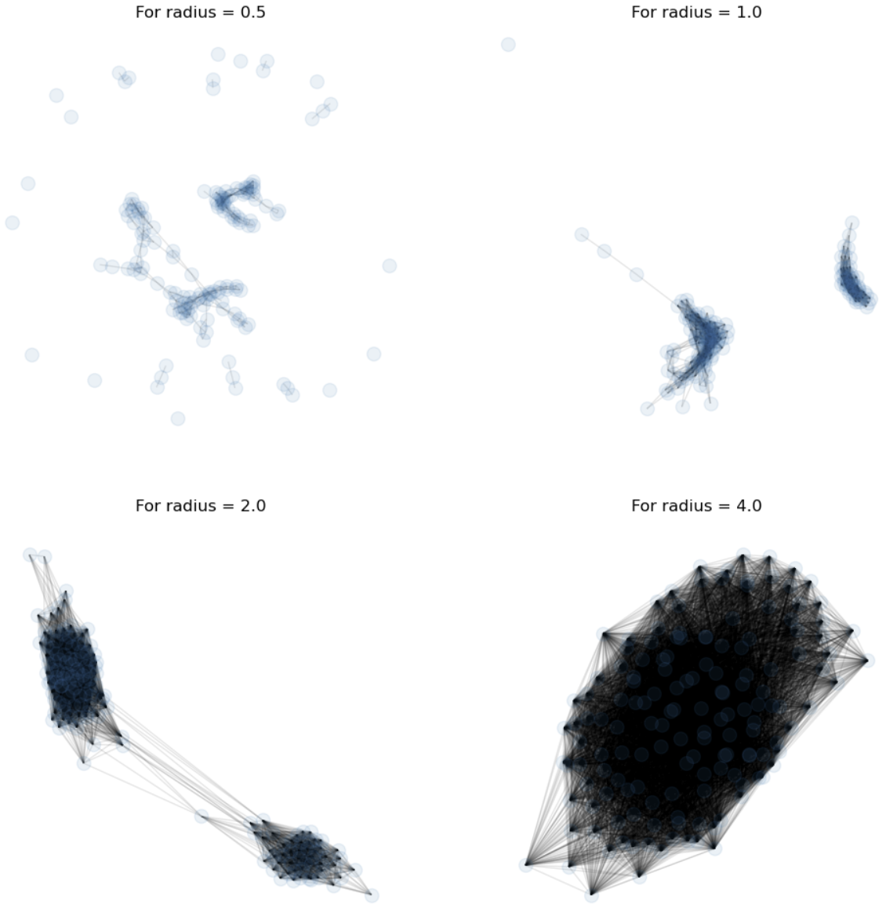
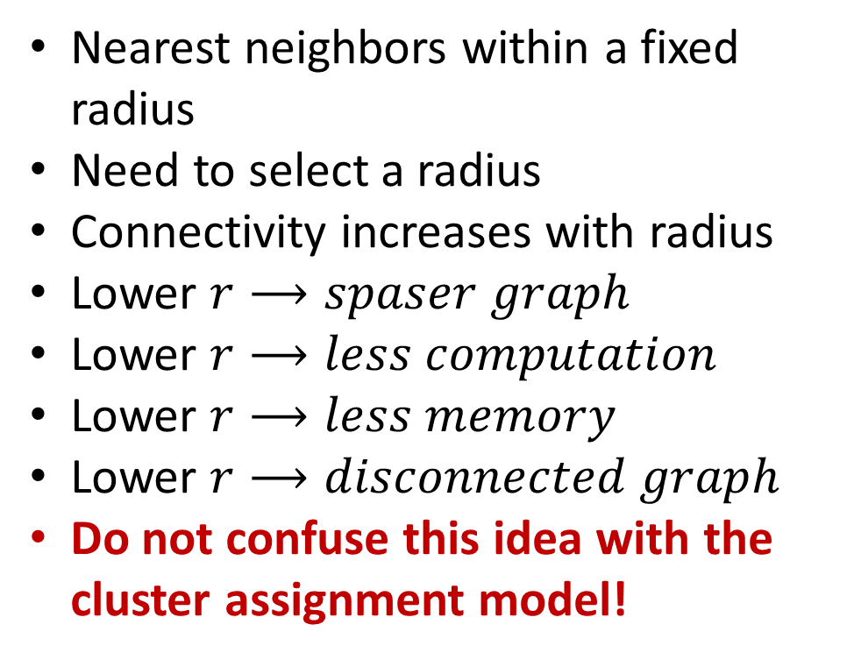
Scaling distance and similarity measures
Sparse graph representation reduces computation and memory use
Nearest neighbors within a fixed radius
Need to select a radius
Connectivity increases with radius
Lower $r⟶spaser graph$
Lower $r⟶less computation$
Lower $r⟶less memory$
Lower $r⟶disconnected graph$
Do not confuse this idea with the cluster assignment model!

Slide 8
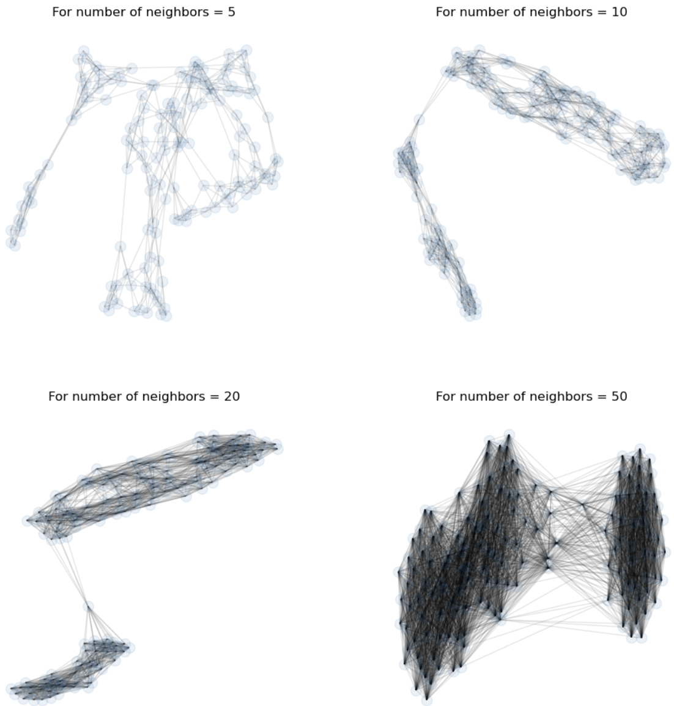
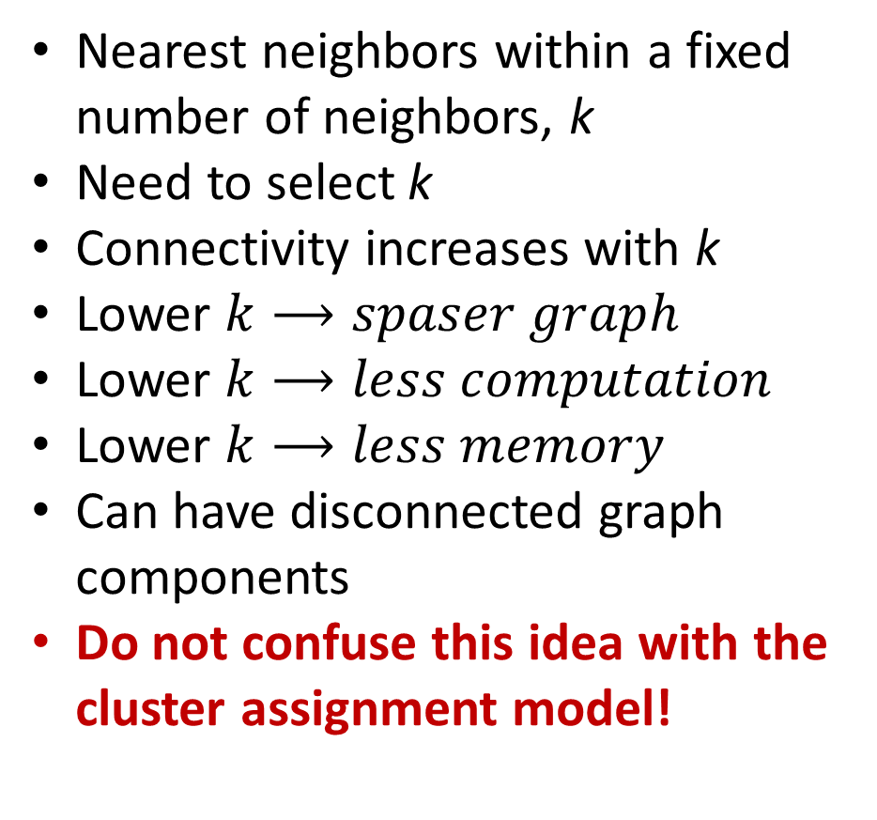
Scaling distance and similarity measures
Sparse graph representation reduces computation and memory use
Nearest neighbors within a fixed number of neighbors, k
Need to select k
Connectivity increases with k
Lower $k⟶spaser graph$
Lower $k⟶less computation$
Lower $k⟶less memory$
Can have disconnected graph components
Do not confuse this idea with the cluster assignment model!

Slide 9
Spectral Clustering Models

Slide 10
Spectral Clustering
Spectral clustering algorithm finds the minimum cuts by three steps
Construct association matrix for the graph of the samples
Fully connected graph or, sparse K-nearest-neighbor graph
KD-tree, ball-tree or other NN algorithm
The edges are undirected and weighted
Weights are similarity between the samples
Generally, use symmetric nearest neighbors
The graph Laplacian matrix is constructed from the associaton matrix
Full matrix for fully connected graph
Sparse matrix for nearest-neighbor graph – faster algorithm!
Partition graph Laplacian by minimum weight cuts
A min-cut algorithm

Slide 11
Spectral Clustering
Steps of spectral clustering algorithm
Start with samples
Construct graph
3-nearest-neighbors in this case
Use undirected edges
Edge weights are similarity
Association matrix constructed from graph
Weighted by similarity between points
Compute graph Laplacian
Perform clustering by partioning graph on eigenvectors of graph Laplacian

Slide 12
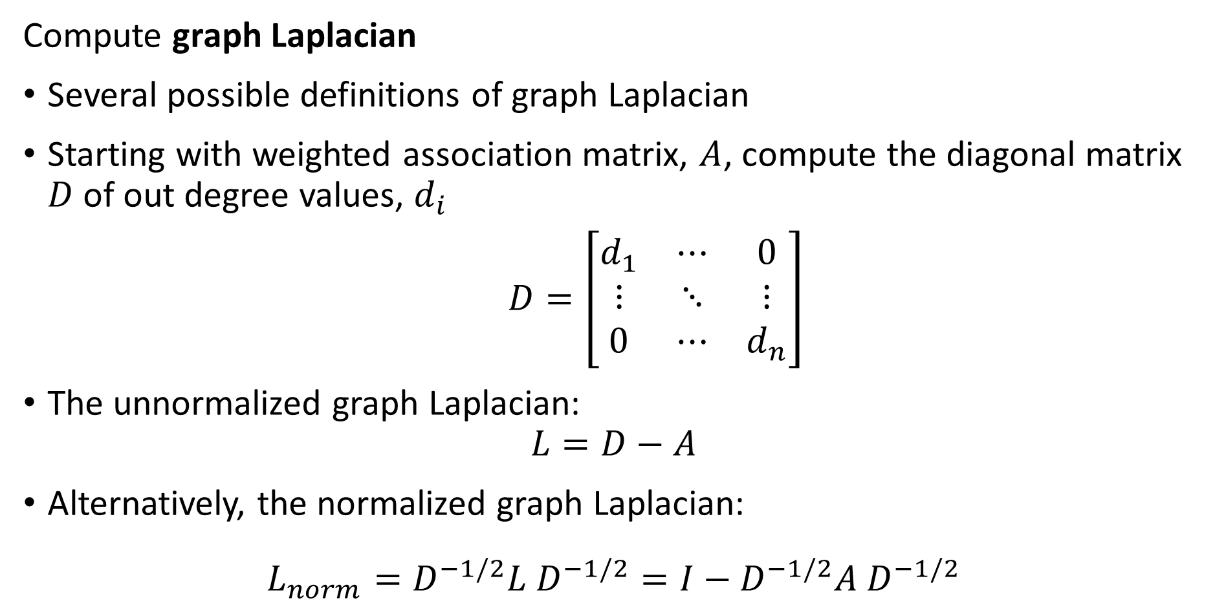
Spectral Clustering
Compute graph Laplacian
Several possible definitions of graph Laplacian
Starting with weighted association matrix, $A$, compute the diagonal matrix $D$ of out degree values, $d_{i}$
$D=\left[\begin{matrix}d_{1} & ⋯ & 0 \\ ⋮ & ⋱ & ⋮ \\ 0 & ⋯ & d_{n}\end{matrix}\right]$
The unnormalized graph Laplacian:
$$L=D−A$$
Alternatively, the normalized graph Laplacian:
$$L_{norm}=D^{−1/2}{L D}^{−1/2}=I−D^{−1/2}{A D}^{−1/2}$$

Slide 13
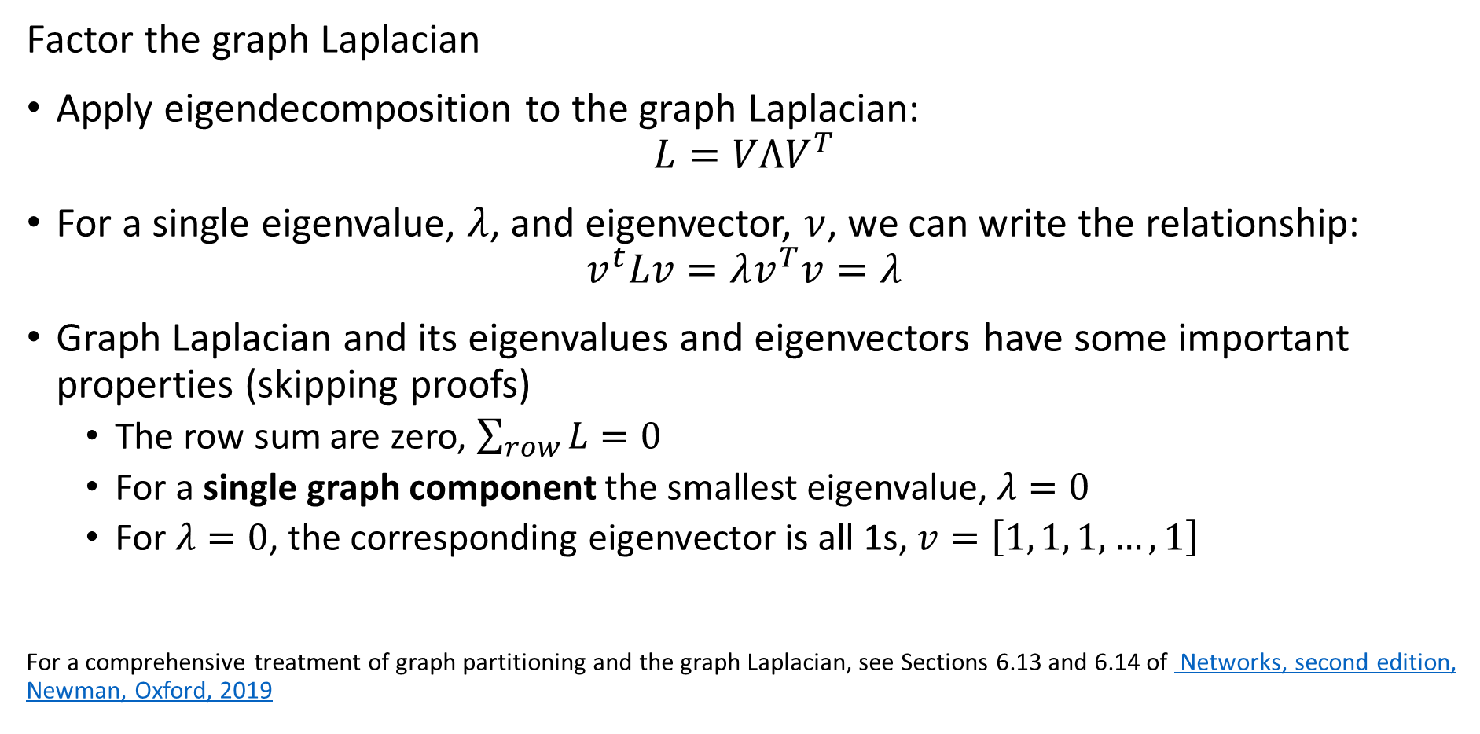
Spectral Clustering
Factor the graph Laplacian
Apply eigendecomposition to the graph Laplacian:
$$L=VΛV^{T}$$
For a single eigenvalue, $λ$, and eigenvector, $ν$, we can write the relationship:
$$v^{t}Lv=λv^{T}v=λ$$
Graph Laplacian and its eigenvalues and eigenvectors have some important properties (skipping proofs)
The row sum are zero, $\sum_{row}{L}=0$
For a single graph component the smallest eigenvalue, $λ=0$
For $λ=0$, the corresponding eigenvector is all 1s, $v=\left[1, 1, 1, …, 1\right]$
For a comprehensive treatment of graph partitioning and the graph Laplacian, see Sections 6.13 and 6.14 of Networks, second edition, Newman, Oxford, 2019

Slide 14
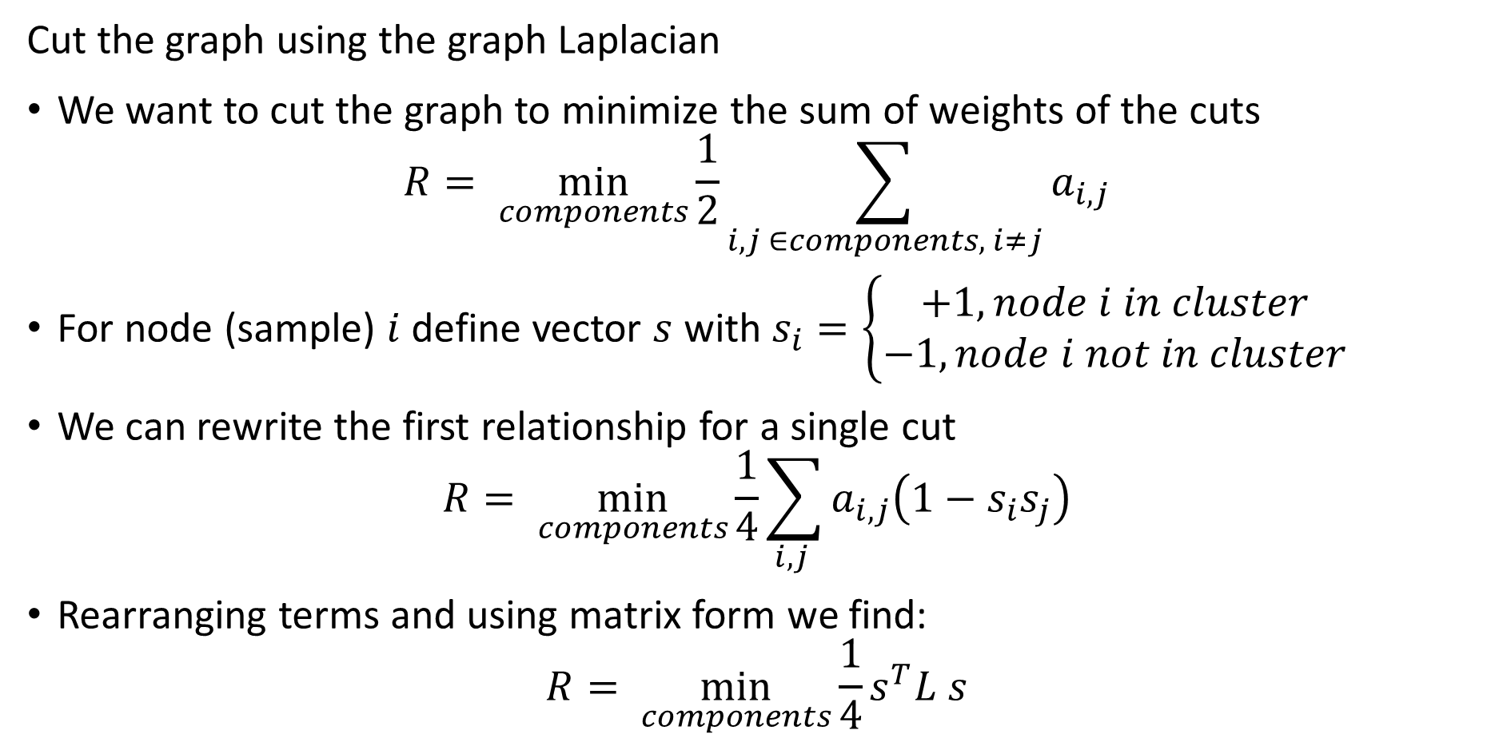
Spectral Clustering
Cut the graph using the graph Laplacian
We want to cut the graph to minimize the sum of weights of the cuts
$$R= \min_{components}{\frac{1}{2}\sum_{i,j ∈components, i≠j}{a_{i,j}}}$$
For node (sample) $i$ define vector $s$ with $s_{i}=\left\{\begin{aligned}+1, node i in cluster \\ −1, node i not in cluster\end{aligned}\right.$
We can rewrite the first relationship for a single cut
$$R= \min_{components}{\frac{1}{4}\sum_{i,j }{a_{i,j}\left(1−s_{i}s_{j}\right)}}$$
Rearranging terms and using matrix form we find:
$$R= \min_{components}{\frac{1}{4}s^{T}L s}$$

Slide 15
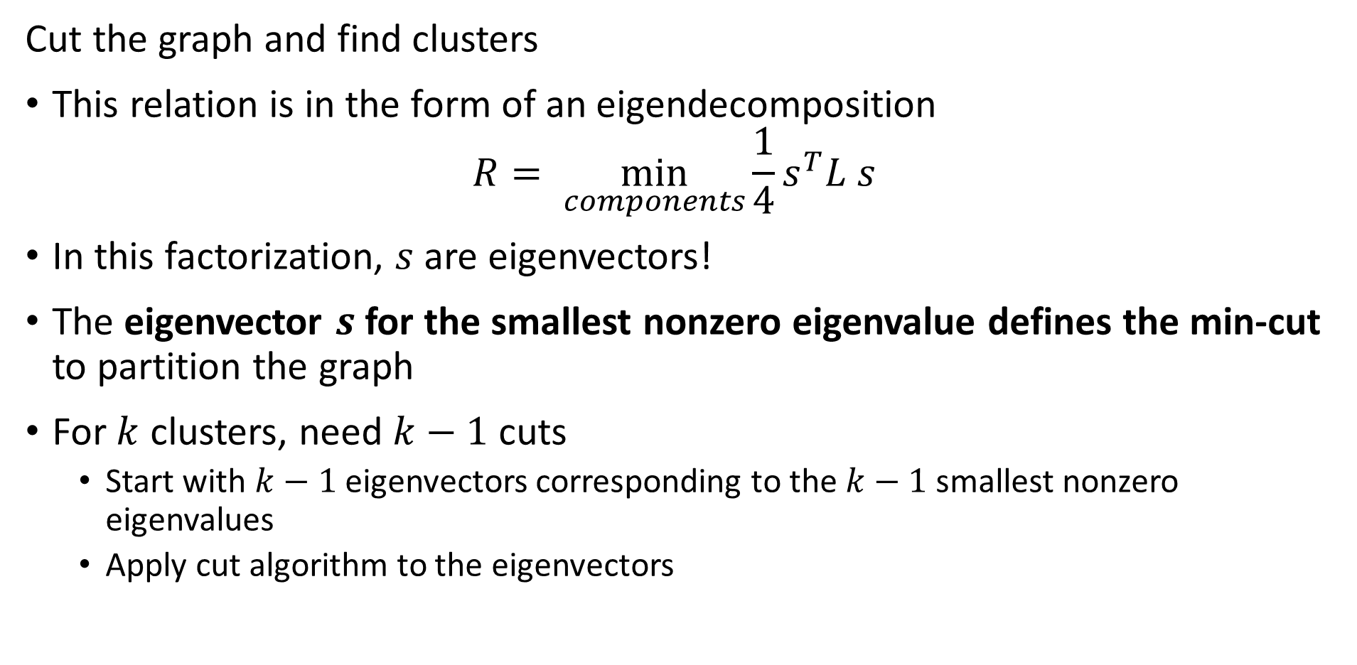
Spectral Clustering
Cut the graph and find clusters
This relation is in the form of an eigendecomposition
$$R= \min_{components}{\frac{1}{4}s^{T}L s}$$
In this factorization, $s$ are eigenvectors!
The eigenvector $s$ for the smallest nonzero eigenvalue defines the min-cut to partition the graph
For $k$ clusters, need $k−1$ cuts
Start with $k−1$ eigenvectors corresponding to the $k−1$ smallest nonzero eigenvalues
Apply cut algorithm to the eigenvectors

Slide 16
Spectral Clustering
Spectral clustering is a graph-based state of the art clustering method
Spectral clustering follows these steps:
Construct the association matrix
Compute the graph Laplacian from the association matrix
Factor the graph Laplacian
Partition the graph by k-1 eigenvectors
In summary, spectral clustering constructs clusters on the orthogonal projections of the Laplacian matrix
For a rigorous introduction to spectral clustering see this tutorial article by von Luxburg

Slide 17
Density-Based Clustering Models

Slide 18
Density Clustering
Using sample density is another way to form clusters
High density points form clusters
How can we find high density points?
Find points with large number of near neighbors
Form clusters around these high-density points
Naive algorithms have high complexity
Scalable algorithms are largely heuristic
Many algorithms proposed, including
DBSCAN
OPTICS
HDBSCAN

Slide 19
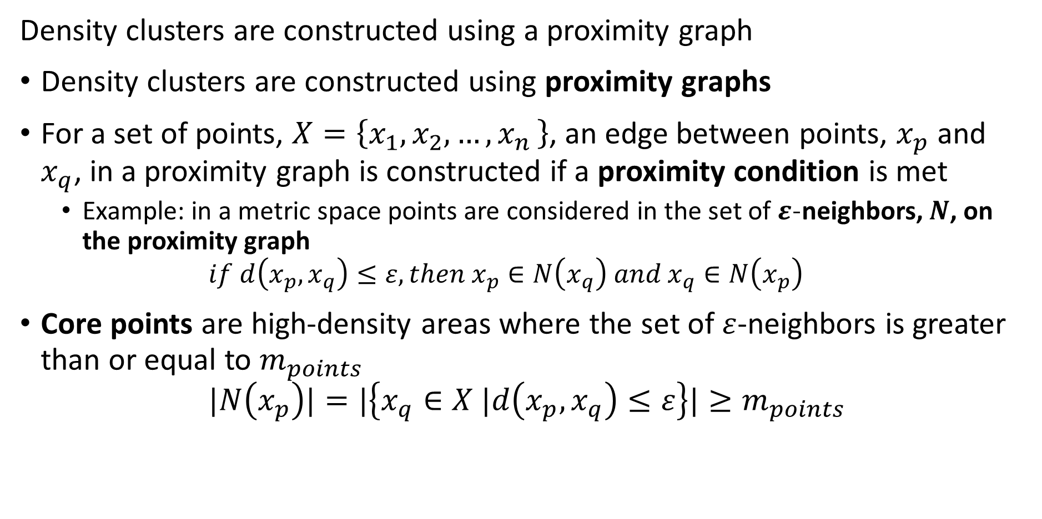
Density Clustering
Density clusters are constructed using a proximity graph
Density clusters are constructed using proximity graphs
For a set of points, $X=\left\{x_{1},x_{2},{…,x}_{n}\right\}$, an edge between points, $x_{p}$ and $x_{q}$, in a proximity graph is constructed if a proximity condition is met
Example: in a metric space points are considered in the set of $ε$-neighbors, $N$, on the proximity graph
$$if d\left(x_{p},x_{q}\right)≤ε, then x_{p}∈N\left(x_{q}\right) and x_{q}∈N\left(x_{p}\right)$$
Core points are high-density areas where the set of $ε$-neighbors is greater than or equal to $m_{points}$
$$|N\left(x_{p}\right)|=|\left\{x_{q}∈X |d\left(x_{p},x_{q}\right)≤ε\right\}|≥m_{points}$$

Slide 20
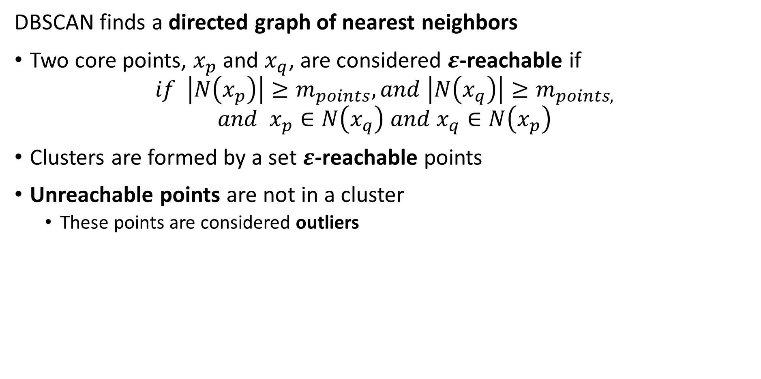
Density Clustering
DBSCAN finds a directed graph of nearest neighbors
Two core points, $x_{p}$ and $x_{q}$, are considered $ε$-reachable if
$$if \left|N\left(x_{p}\right)\right|≥m_{points}, and \left|N\left(x_{q}\right)\right|≥m_{points,}$$
$${and x}_{p}∈N\left(x_{q}\right) and x_{q}∈N\left(x_{p}\right)$$
Clusters are formed by a set $ε$-reachable points
Unreachable points are not in a cluster
These points are considered outliers

Slide 21
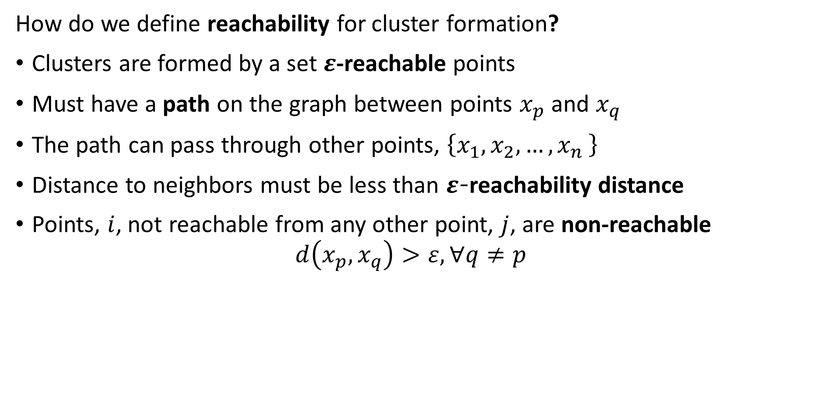
Density Clustering
How do we define reachability for cluster formation?
Clusters are formed by a set $ε$-reachable points
Must have a path on the graph between points $x_{p}$ and $x_{q}$
The path can pass through other points, $\left\{x_{1},x_{2},{…,x}_{n}\right\}$
Distance to neighbors must be less than $ε$-reachability distance
Points, $i$, not reachable from any other point, $j$, are non-reachable
$$d\left(x_{p},x_{q}\right)>ε, ∀q≠p$$

Slide 22
DBSCAN Algorithm

Slide 23
DBSCAN Algorithm
DBSCAN was the first (1996) large-scale density-based clustering algorithm
DBSCAN still in use today
Many variations created
DBSCAN scales to out of memory dataset size
DBSCAN minimizes the number of passes through the data base
Can scale DBSCAN with MapReduce

Slide 24
DBSCAN Algorithm
Properties of DBSCAN algorithm
DBSCAN has two hyperparameters
minPts is the minimum number of near neighbors required for core points
ε is the maximum distance between neighbors
DBSCAN makes passes thorough a database to create the graph
Scalable, average runtime O(n log(n))
Uses memory, O(n²)

Slide 25
DBSCAN Algorithm
Properties of DBSCAN algorithm
DBSCAN constructed with proximity graph with node types
Reachable, core – points in the dense core of the cluster
Reachable, noncore – reachable points in low-density regions
Non-reachable, outliers not in any cluster
Points are classified as Graph edge is bidirectional (undirected) if both points are core
Graph edges from core to reachable non-core point are unidirectional (directed)

Slide 26
DBSCAN Algorithm
What are the steps of DBSCAN?
Start with some samples or observations
For each point, find near neighbors within distance ε
A point is core if it has > minPts near neighbors (2 in this example)
If two point are core, connect with undirected edge
If point is non-core, connect with directed edge
If point further that ε from neighbors, point is non-reachable
Result is an NN graph

Slide 27
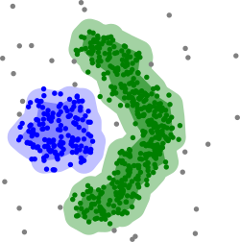
DBSCAN Algorithm
What are some properties of DBSCAN?
Can find non-convex clusters
Optimized for uniform sample density of clusters with fixed ε and minPts
Clusters depend on distance metric
Clusters robust to noise, since outliers are non-reachable
Credit: Wikipedia commons

Slide 28
DBSCAN Algorithm
What are some properties of DBSCAN?
Selecting maximum reachability distance to neighbors, ε, is difficult in high dimensions
Single, ε, used for all clusters
Fixed ε not optimal for non-constant density
Credit: Wikipedia commons

Slide 29
Density-Based Clustering with OPTICS

Slide 30
OPTICS Algorithm
How can we overcome the limitations of DBSCAN?
Hard to find good value of ε for DBSCAN in high dimensions with variable density
The OPTICS algorithm is an improvement on DBSCAN
OPTICS uses a heuristic to adaptively compute reachability distances
Core distance determines if a sample is core
Reachability distance determines if one sample is reachable from the other
Only one mandatory hyperparameter, min_pts

Slide 31
OPTICS Algorithm
OPTICS performs a sequential search
OPTICS compute reachability to points sequentially
The order of the search though observations matters
A difference from DBSCAN
Uses a sequential greedy algorithm with reachability of a point determining if edge is added to dendrogram
Creates a proximity graph
Points are saved in a queue and processed in order
Reachability dynamically calculated based on neighbors on graph
Reachability search determines nearest neighbors
Based on the reachability graph clusters are formed
Clusters formed by partitioning graph constrained by min_pts

Slide 32
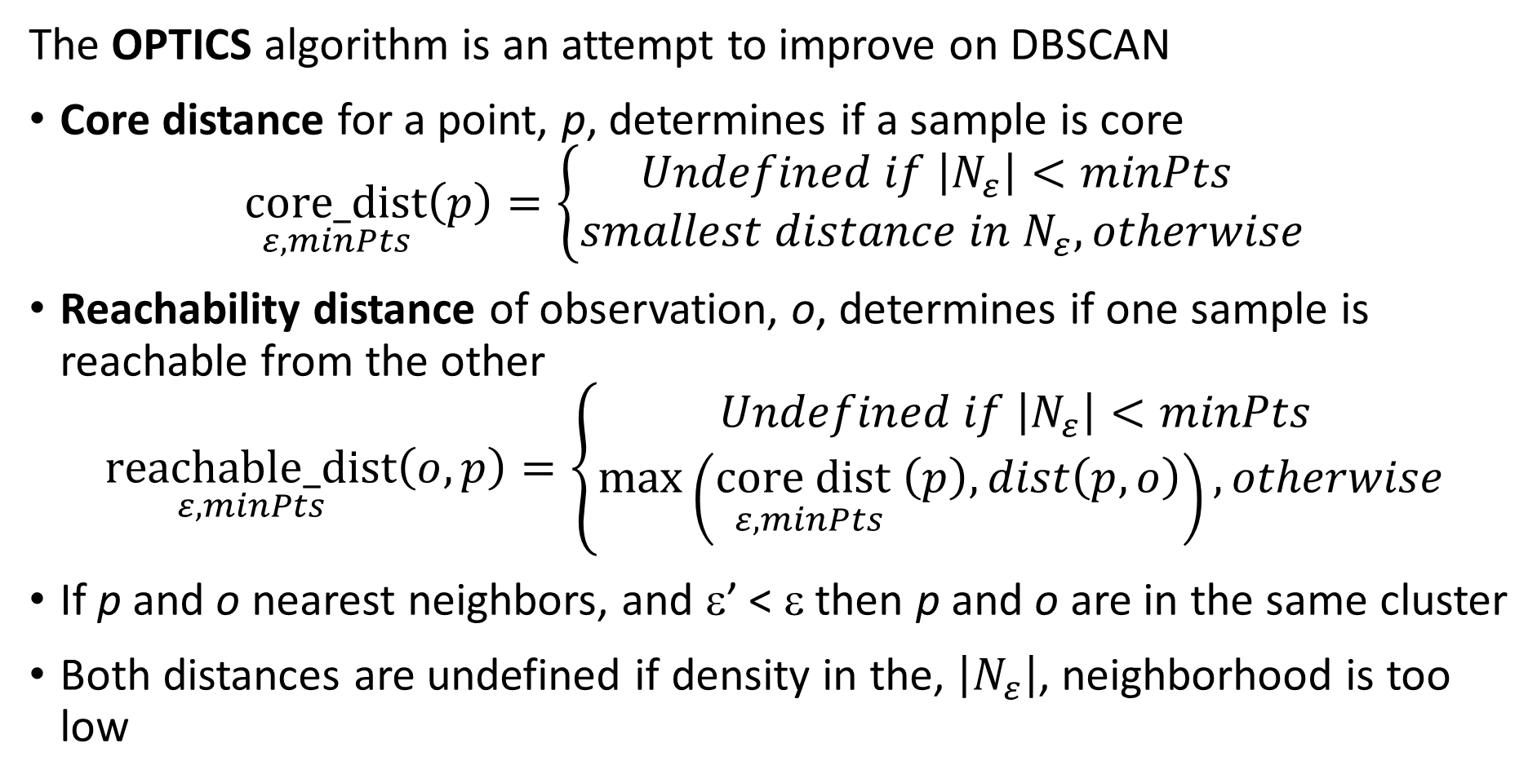
OPTICS Algorithm
The OPTICS algorithm is an attempt to improve on DBSCAN
Core distance for a point, p, determines if a sample is core
$$\underset{ε,minPts}{core_dist}\left(p\right)=\left\{\begin{aligned}Undefined if \left|N_{ε}\right|<minPts \\ smallest distance in N_{ε}, otherwise\end{aligned}\right.$$
Reachability distance of observation, o, determines if one sample is reachable from the other
$$\underset{ε,minPts}{reachable_dist}\left(o,p\right)=\left\{\begin{aligned}Undefined if \left|N_{ε}\right|<minPts \\ \max\left(\underset{ε,minPts}{{core dist}_{ }}\left(p\right),dist\left(p,o\right)\right), otherwise\end{aligned}\right.$$
If p and o nearest neighbors, and ε’ < ε then p and o are in the same cluster
Both distances are undefined if density in the, $\left|N_{ε}\right|$, neighborhood is too low

Slide 33
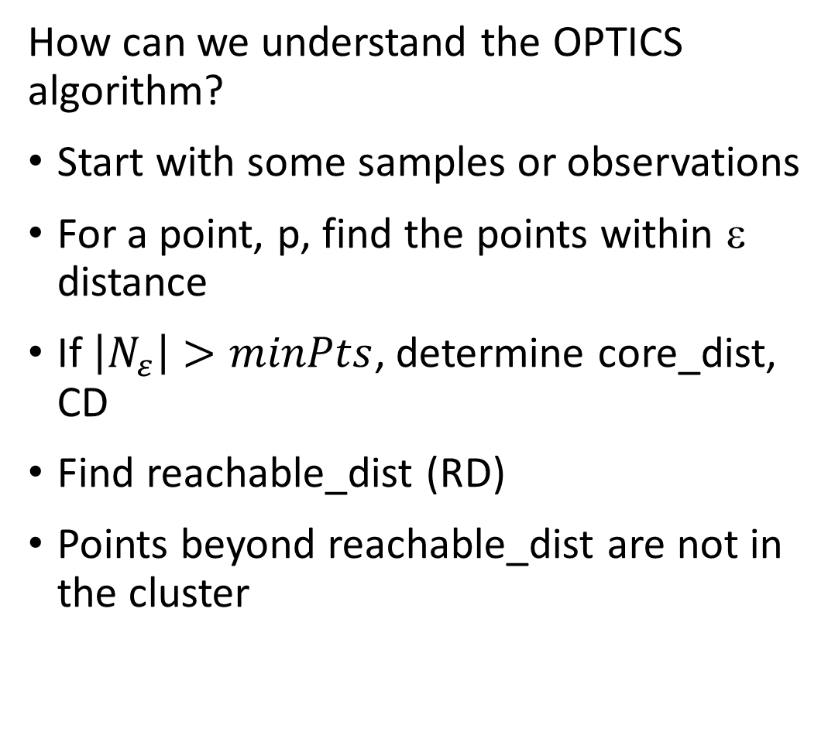
OPTICS Algorithms
How can we understand the OPTICS algorithm?
Start with some samples or observations
For a point, p, find the points within ε distance
If $\left|N_{ε}\right|>minPts$, determine core_dist, CD
Find reachable_dist (RD)
Points beyond reachable_dist are not in the cluster
ε
CD
RD

Slide 34
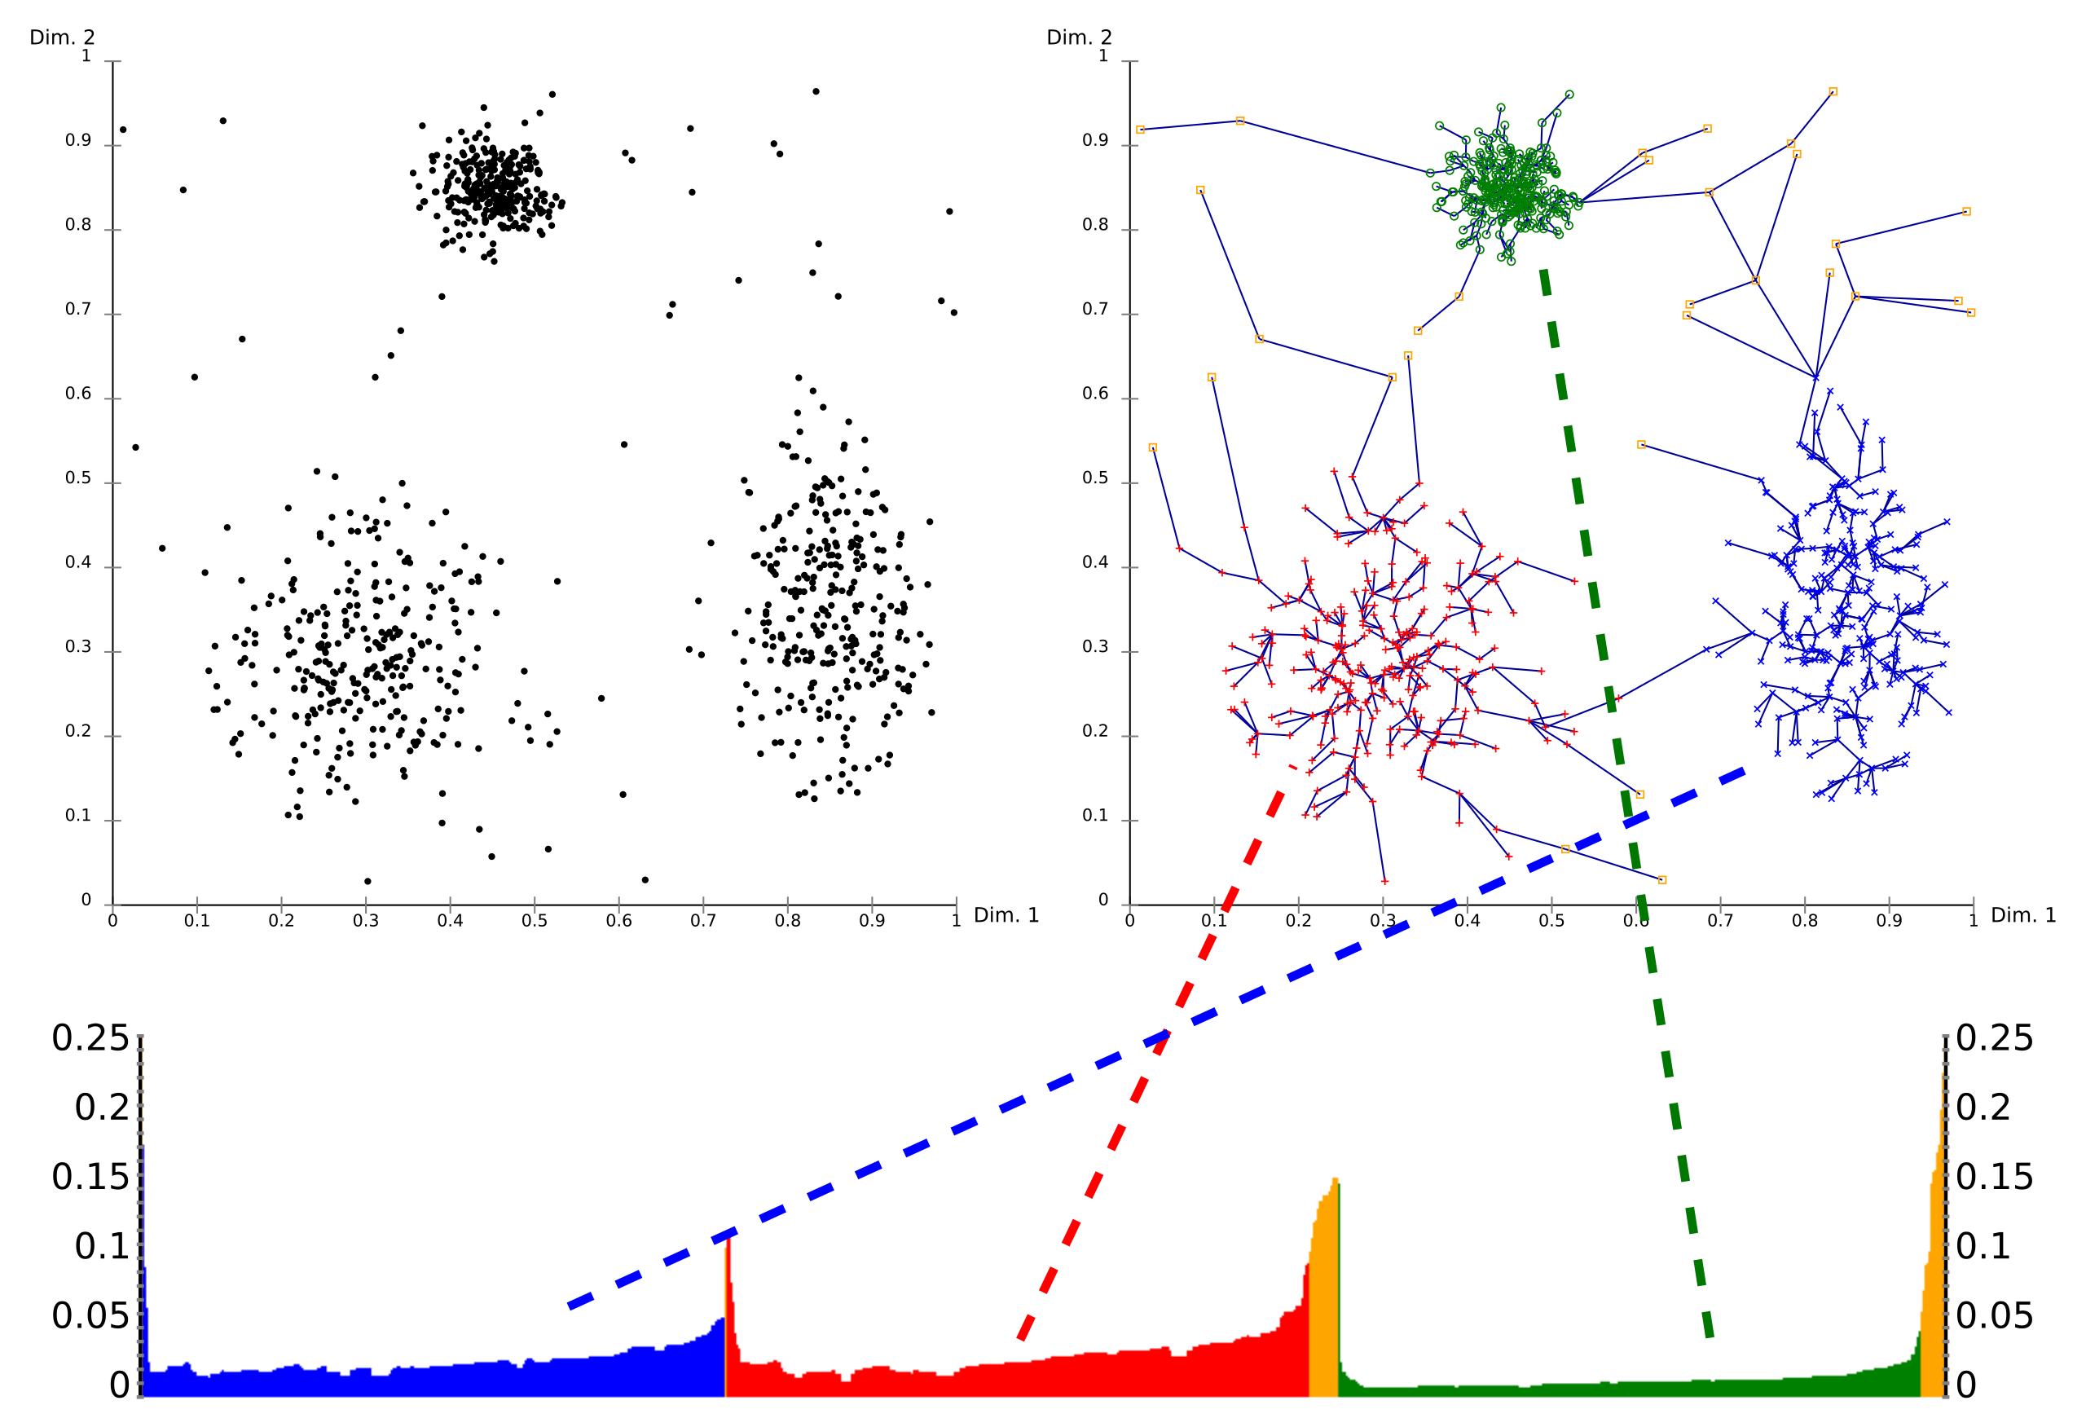
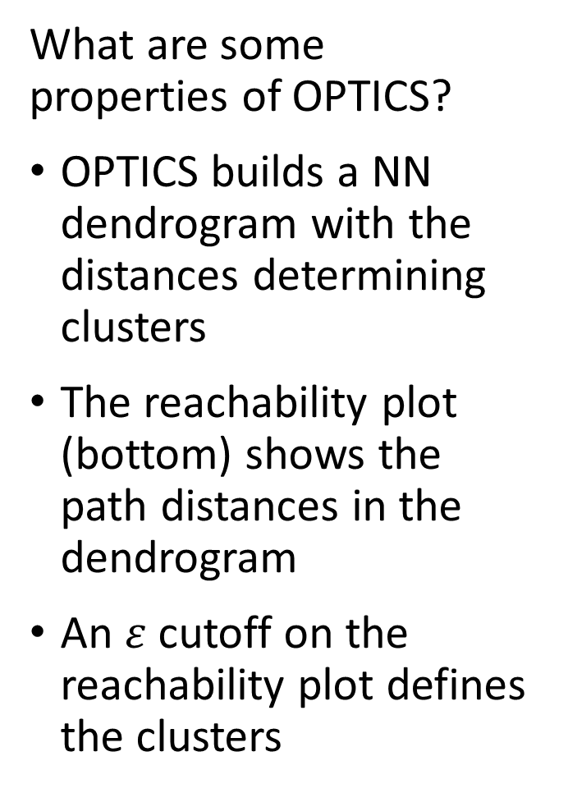
OPTICS Algorithm
What are some properties of OPTICS?
OPTICS builds a NN dendrogram with the distances determining clusters
The reachability plot (bottom) shows the path distances in the dendrogram
An $ε$ cutoff on the reachability plot defines the clusters
Credit: Wikipedia commons

Slide 35
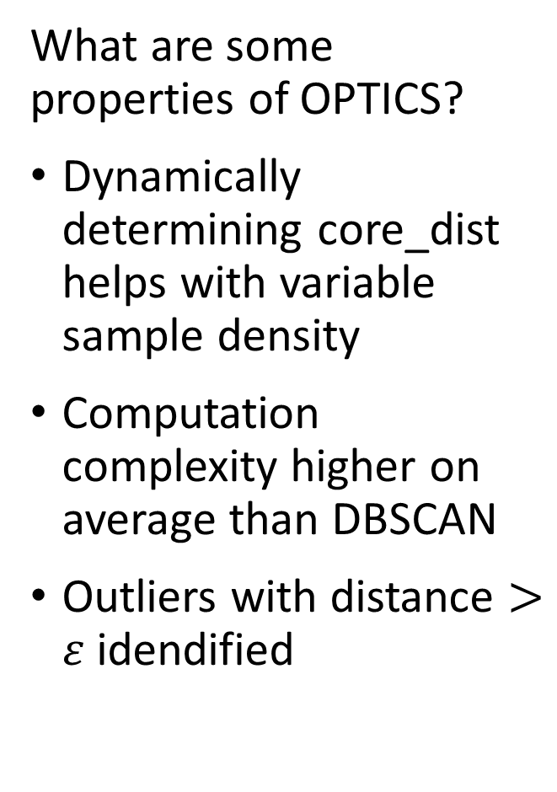
OPTICS Algorithm
What are some properties of OPTICS?
Dynamically determining core_dist helps with variable sample density
Computation complexity higher on average than DBSCAN
Outliers with distance $>ε$ idendified
Credit: Wikipedia commons

Slide 36
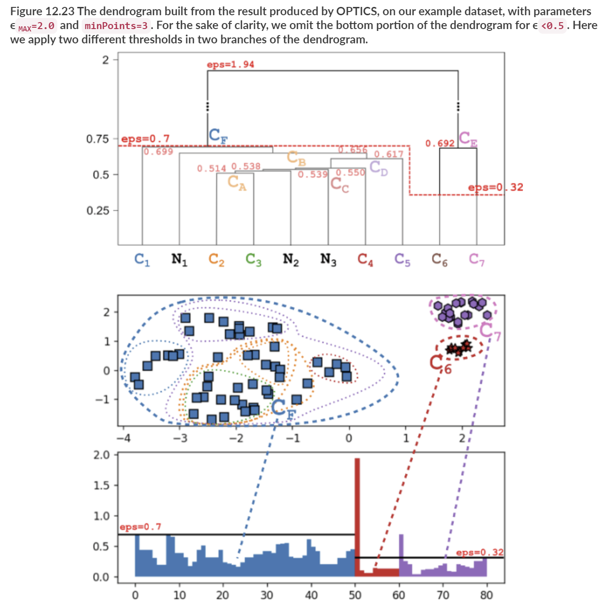
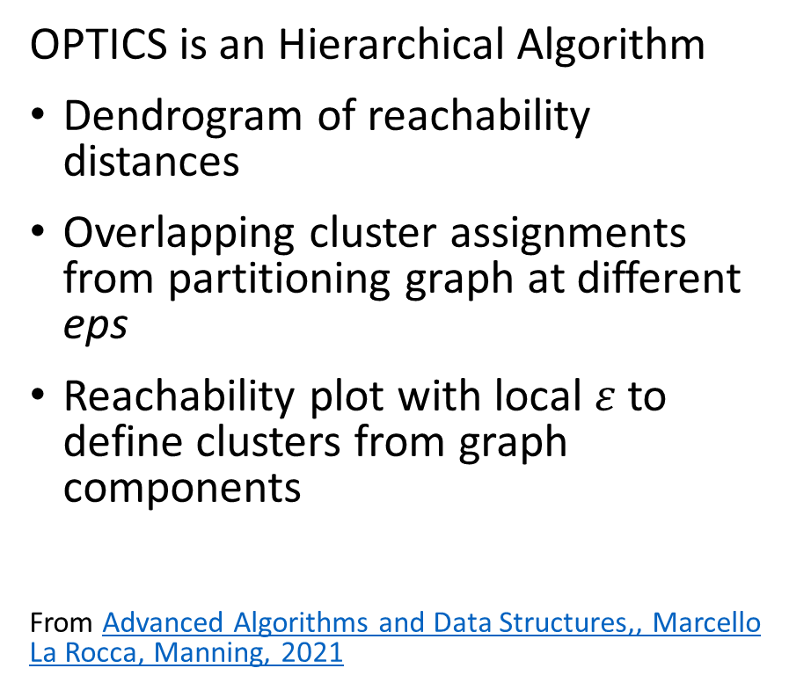
OPTICS Algorithm
OPTICS is an Hierarchical Algorithm
Dendrogram of reachability distances
Overlapping cluster assignments from partitioning graph at different eps
Reachability plot with local $ε$ to define clusters from graph components
From Advanced Algorithms and Data Structures,, Marcello La Rocca, Manning, 2021

Slide 37
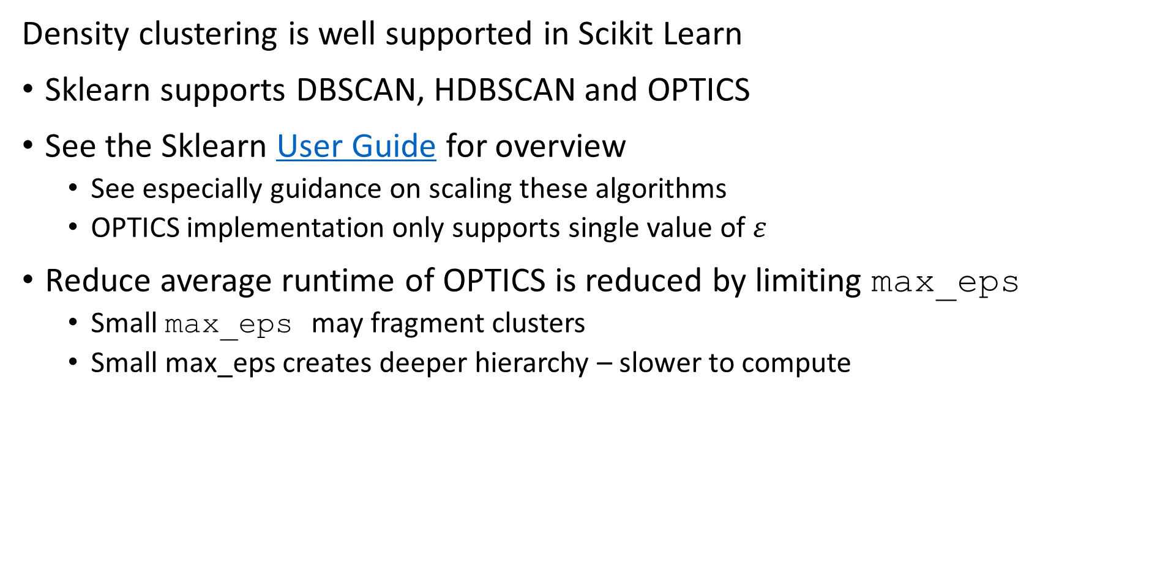
OPTICS Algorithm
Density clustering is well supported in Scikit Learn
Sklearn supports DBSCAN, HDBSCAN and OPTICS
See the Sklearn User Guide for overview
See especially guidance on scaling these algorithms
OPTICS implementation only supports single value of $ε$
Reduce average runtime of OPTICS is reduced by limiting max_eps
Small max_eps may fragment clusters
Small max_eps creates deeper hierarchy – slower to compute

Slide 38
Density-Based Clustering with Hierarchical DBSCAN - HDBSCAN

Slide 39
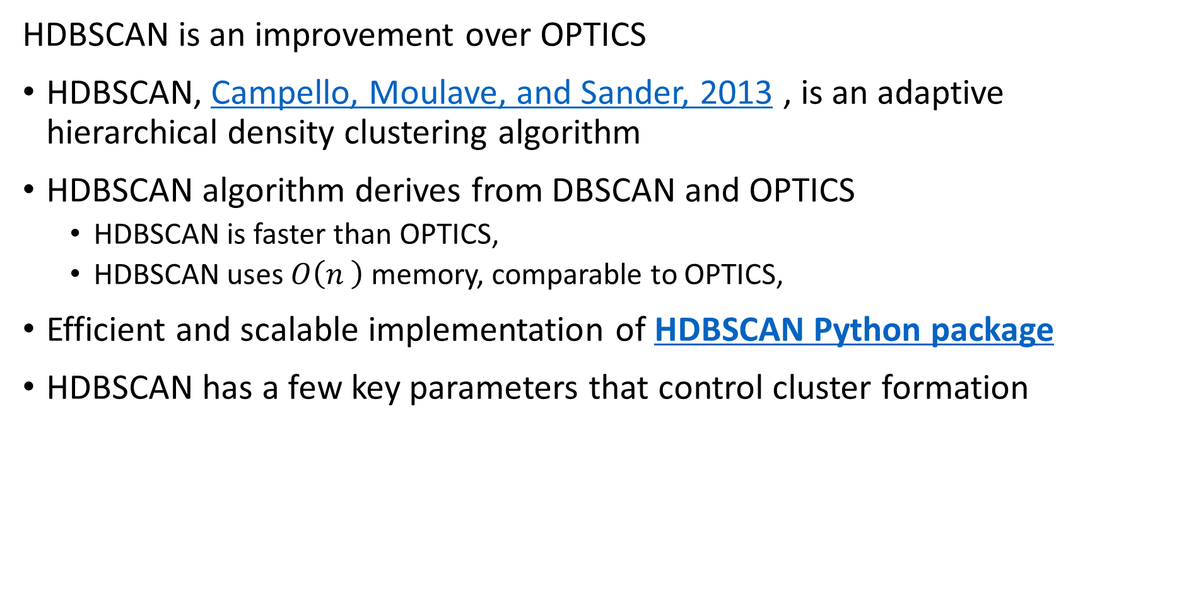
HDBSCAN Algorithm
HDBSCAN is an improvement over OPTICS
HDBSCAN, Campello, Moulave, and Sander, 2013 , is an adaptive hierarchical density clustering algorithm
HDBSCAN algorithm derives from DBSCAN and OPTICS
HDBSCAN is faster than OPTICS,
HDBSCAN uses $O\left(n^{ }\right)$ memory, comparable to OPTICS,
Efficient and scalable implementation of HDBSCAN Python package
HDBSCAN has a few key parameters that control cluster formation

Slide 40
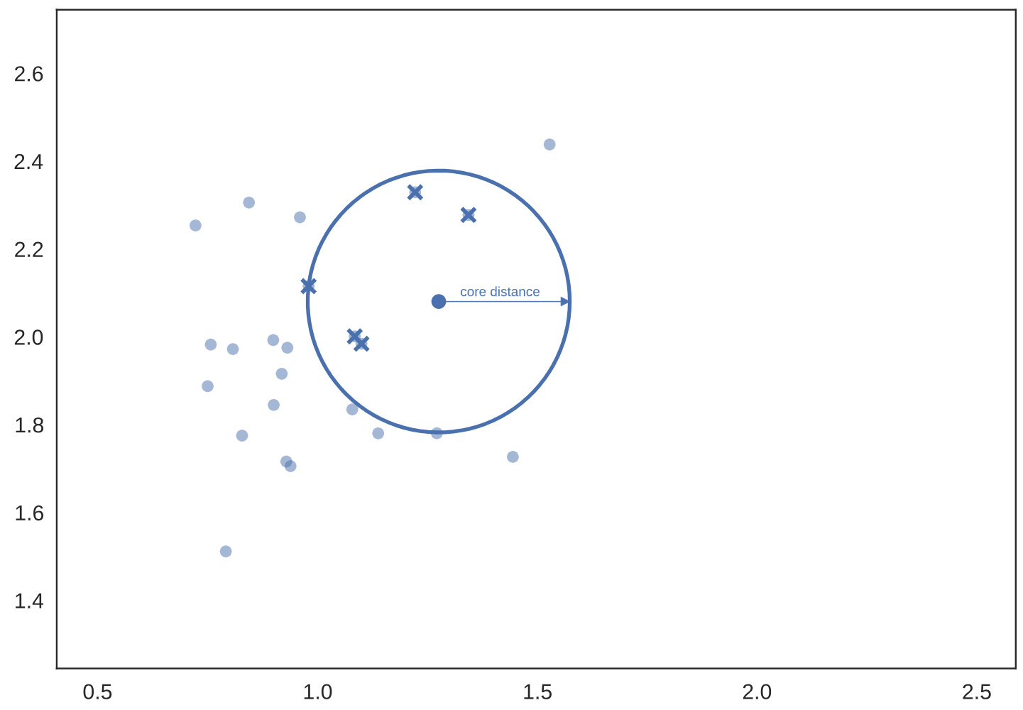
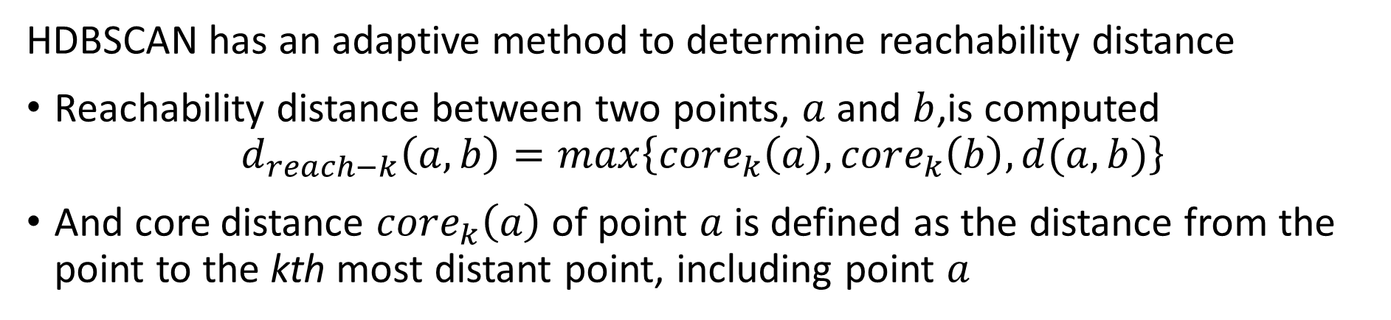
HDBSCAN Algorithm
HDBSCAN has an adaptive method to determine reachability distance
Reachability distance between two points, $a$ and $b$,is computed
$$d_{reach−k}\left(a,b\right)=max\left\{{core}_{k}\left(a\right),{core}_{k}\left(b\right),d(a,b)\right\}$$
And core distance ${core}_{k}\left(a\right)$ of point $a$ is defined as the distance from the point to the kth most distant point, including point $a$
Example: core distance of a point to k neighbors
Illustration from HDBSCAN documentation

Slide 41
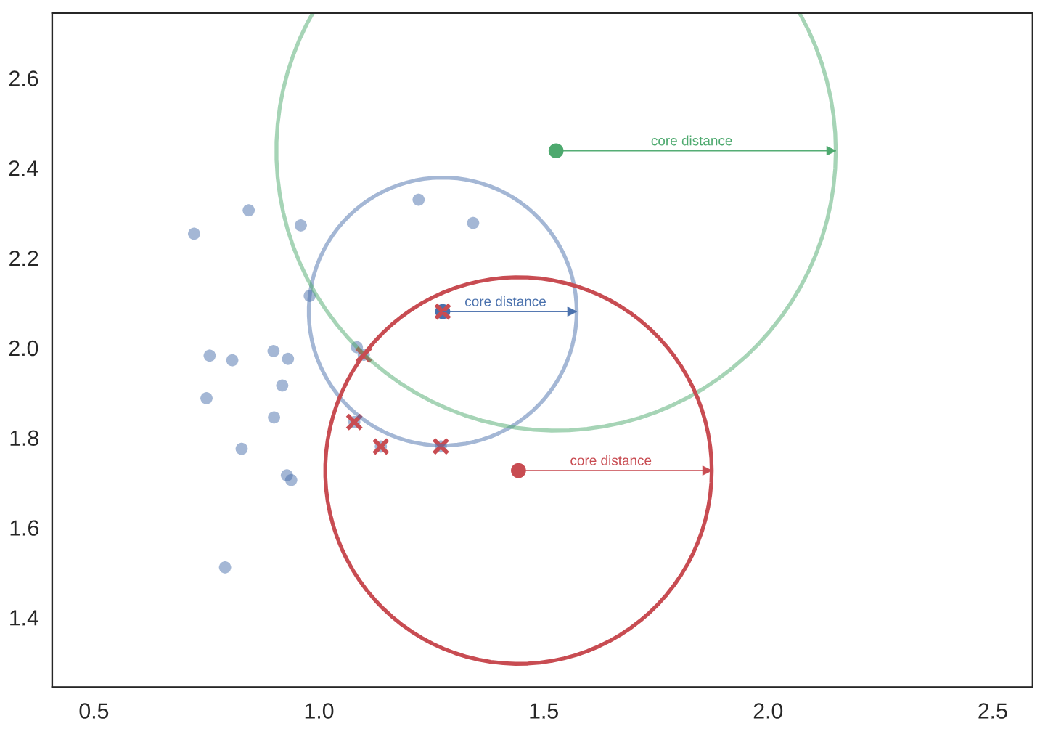
HDBSCAN Algorithm
HDBSCAN adaptively determines reachability distance
Example: In less dense regions the core distance increases
Using variable core distance makes HDBSCAN more adaptive
Illustration from HDBSCAN documentation

Slide 42
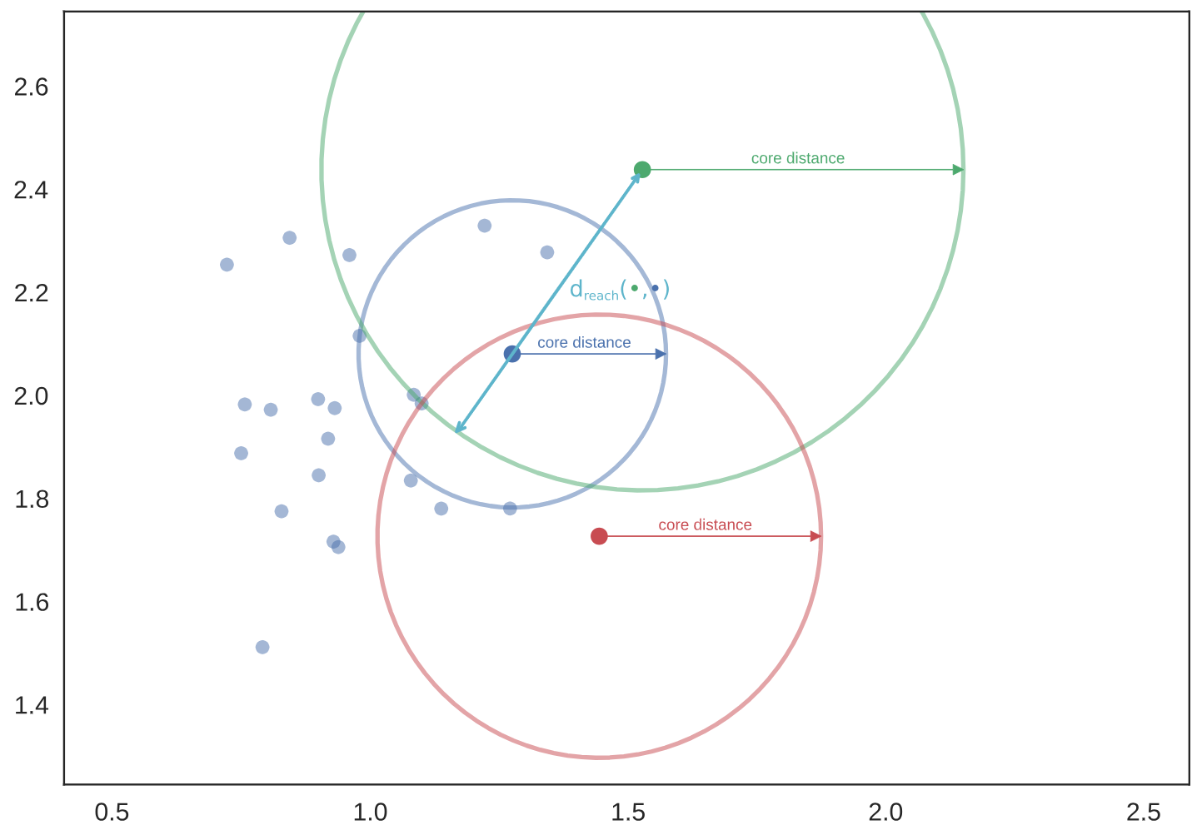
HDBSCAN Algorithm
HDBSCAN adaptively determines reachability distance
Example: reachability distance is distance is larger of core distances of the points
Reachability distance is dynamically determined
Illustration from HDBSCAN documentation

Slide 43
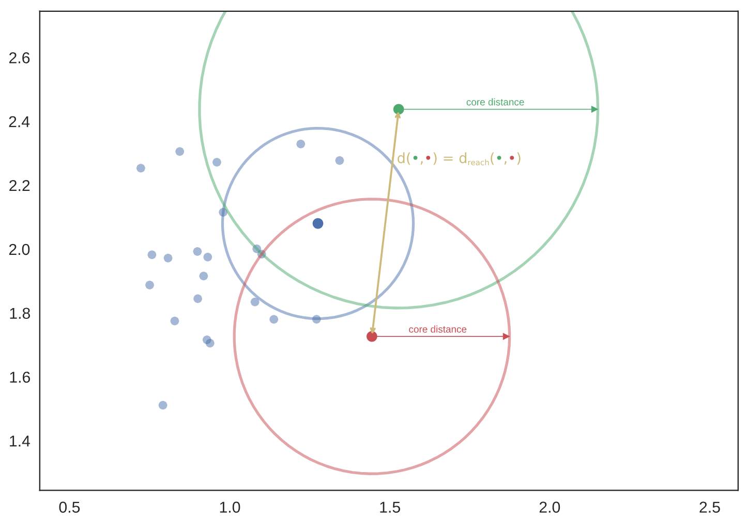
HDBSCAN Algorithm
HDBSCAN adaptively determines reachability distance
Example: reachability distance is distance between two points
Reachability distance is dynamically determined
Illustration from HDBSCAN documentation

Slide 44
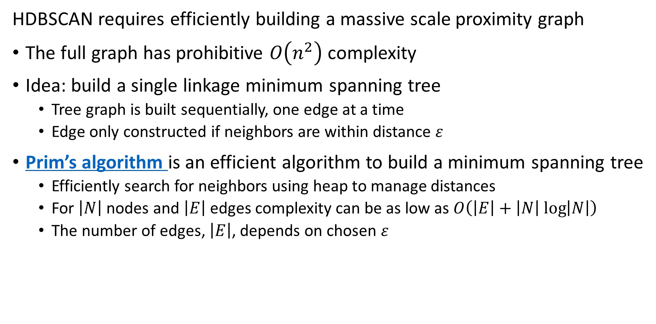
HDBSCAN Algorithm
HDBSCAN requires efficiently building a massive scale proximity graph
The full graph has prohibitive $O\left(n^{2}\right)$ complexity
Idea: build a single linkage minimum spanning tree
Tree graph is built sequentially, one edge at a time
Edge only constructed if neighbors are within distance $ε$
Prim’s algorithm is an efficient algorithm to build a minimum spanning tree
Efficiently search for neighbors using heap to manage distances
For $\left|N\right|$ nodes and $\left|E\right|$ edges complexity can be as low as $O\left(\left|E\right|+\left|N\right| log\left|N\right|\right)$
The number of edges, $\left|E\right|$, depends on chosen $ε$

Slide 45
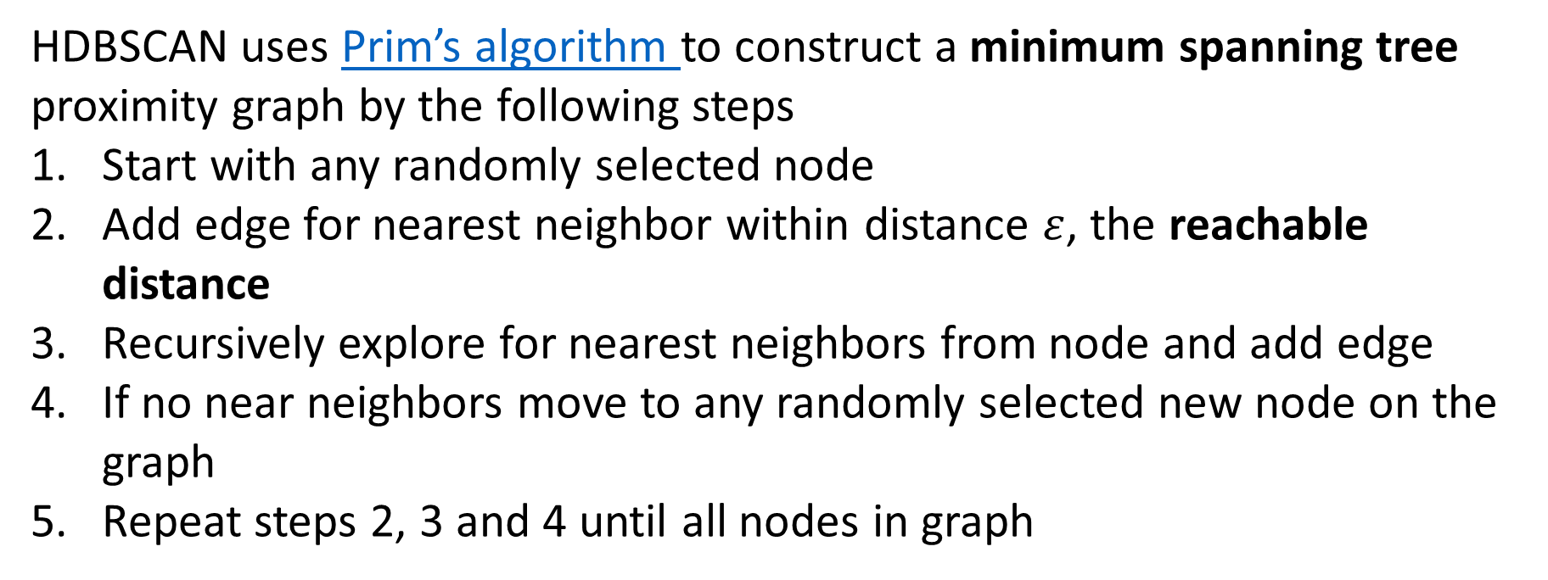
HDBSCAN Algorithm
HDBSCAN uses Prim’s algorithm to construct a minimum spanning tree proximity graph by the following steps
Start with any randomly selected node
Add edge for nearest neighbor within distance $ε$, the reachable distance
Recursively explore for nearest neighbors from node and add edge
If no near neighbors move to any randomly selected new node on the graph
Repeat steps 2, 3 and 4 until all nodes in graph

Slide 46
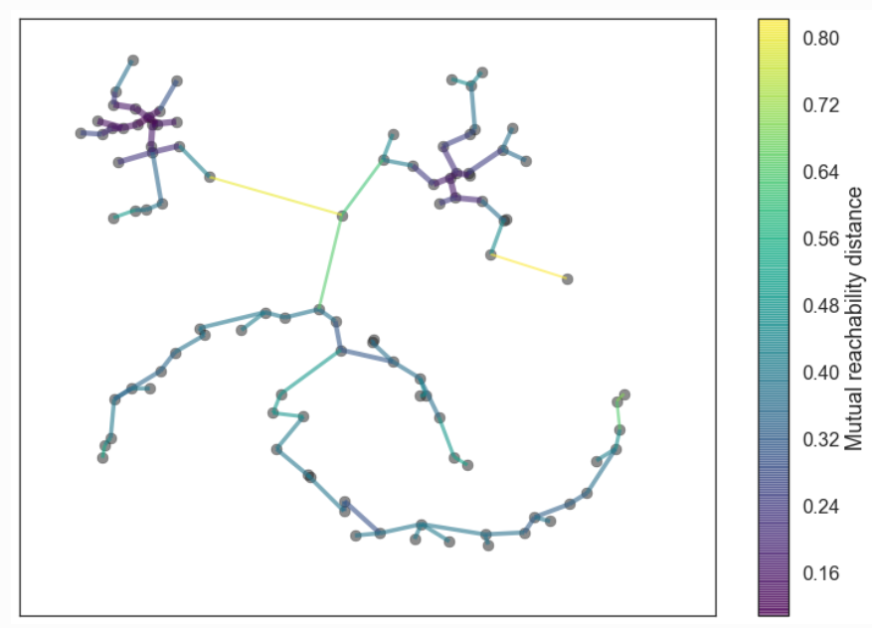
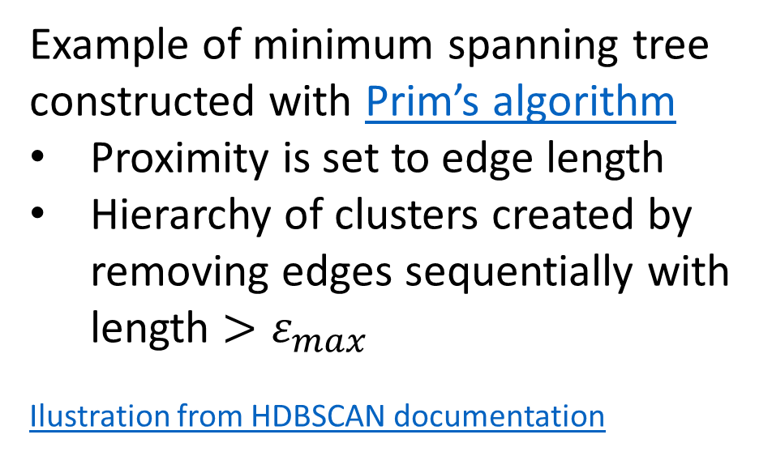
HDBSCAN Algorithm
Example of minimum spanning tree constructed with Prim’s algorithm
Proximity is set to edge length
Hierarchy of clusters created by removing edges sequentially with length $>ε_{max}$
Ilustration from HDBSCAN documentation

Slide 47
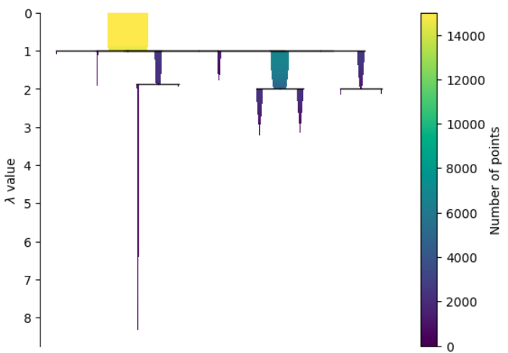
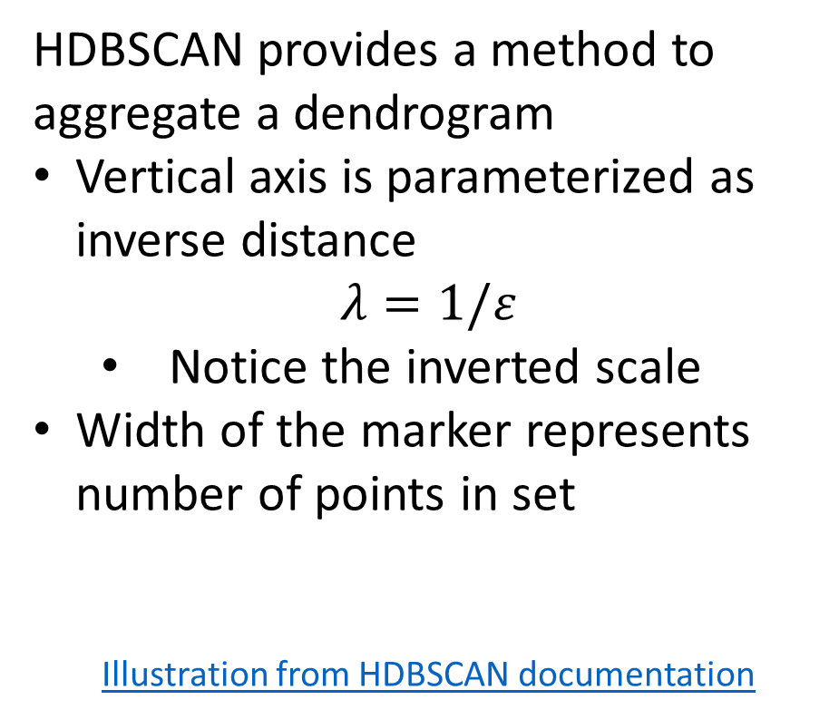
HDBSCAN Algorithm
HDBSCAN provides a method to aggregate a dendrogram
Vertical axis is parameterized as inverse distance
$$λ=1/ε$$
Notice the inverted scale
Width of the marker represents number of points in set
Illustration from HDBSCAN documentation

Slide 48
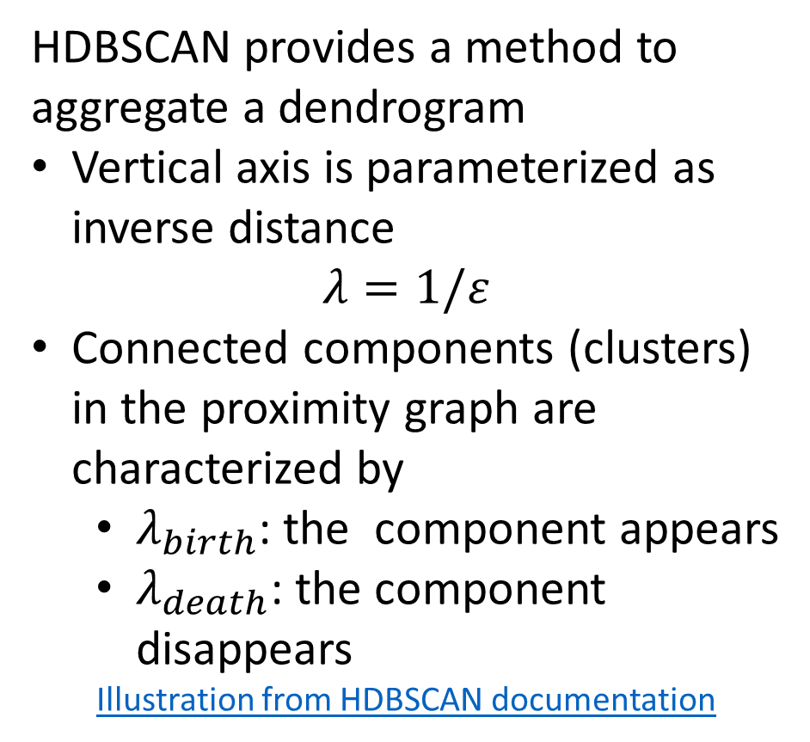
HDBSCAN Algorithm
HDBSCAN provides a method to aggregate a dendrogram
Vertical axis is parameterized as inverse distance
$$λ=1/ε$$
Connected components (clusters) in the proximity graph are characterized by
$λ_{birth}$: the component appears
$λ_{death}$: the component disappears
Illustration from HDBSCAN documentation

Slide 49
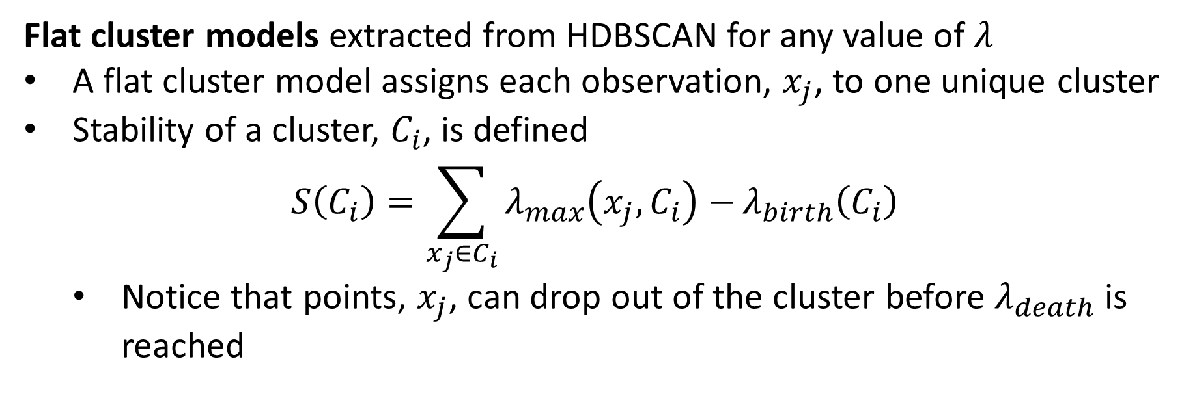
HDBSCAN Algorithm
Flat cluster models extracted from HDBSCAN for any value of $λ$
A flat cluster model assigns each observation, $x_{j}$, to one unique cluster
Stability of a cluster, $C_{i}$, is defined
$$S\left(C_{i}\right)=\sum_{x_{j}∈C_{i}}{λ_{max}\left(x_{j},C_{i}\right)−}λ_{birth}\left(C_{i}\right)$$
Notice that points, $x_{j}$, can drop out of the cluster before $λ_{death}$ is reached

Slide 50
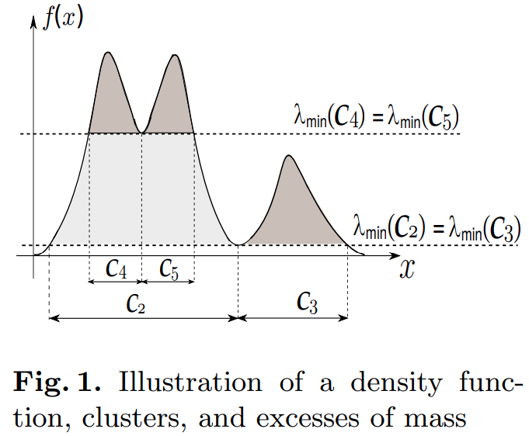
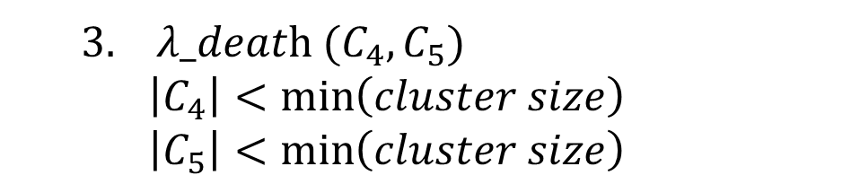
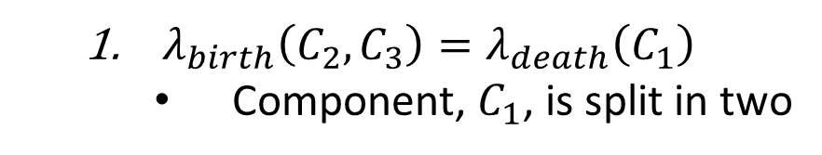
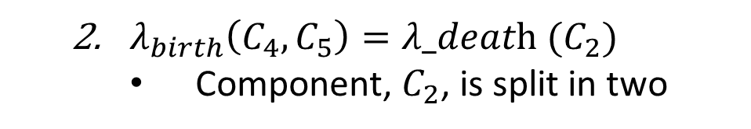
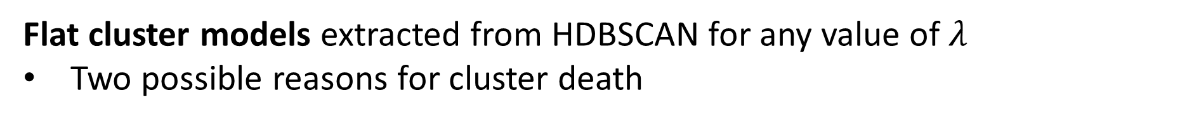
HDBSCAN Algorithm
Flat cluster models extracted from HDBSCAN for any value of $λ$
Two possible reasons for cluster death
$\text{λ}\text{_}\text{deat}\text{h}\text{ (}C_{4},C_{5}\text{)}$
$$\left|C_{4}\right|<\min\left(cluster size\right)$$
$$\left|C_{5}\right|<\min\left(cluster size\right)$$
$λ_{birth}\left(C_{4},C_{5}\right)=\text{λ}\text{_}\text{deat}\text{h}\text{ (}C_{2}\text{)}$
Component, $C_{2}$, is split in two
$λ_{birth}\left(C_{2},C_{3}\right)=λ_{death}\left(C_{1}\right)$
Component, $C_{1}$, is split in two
figure from Campello, Moulave, and Sander, 2013

Slide 51
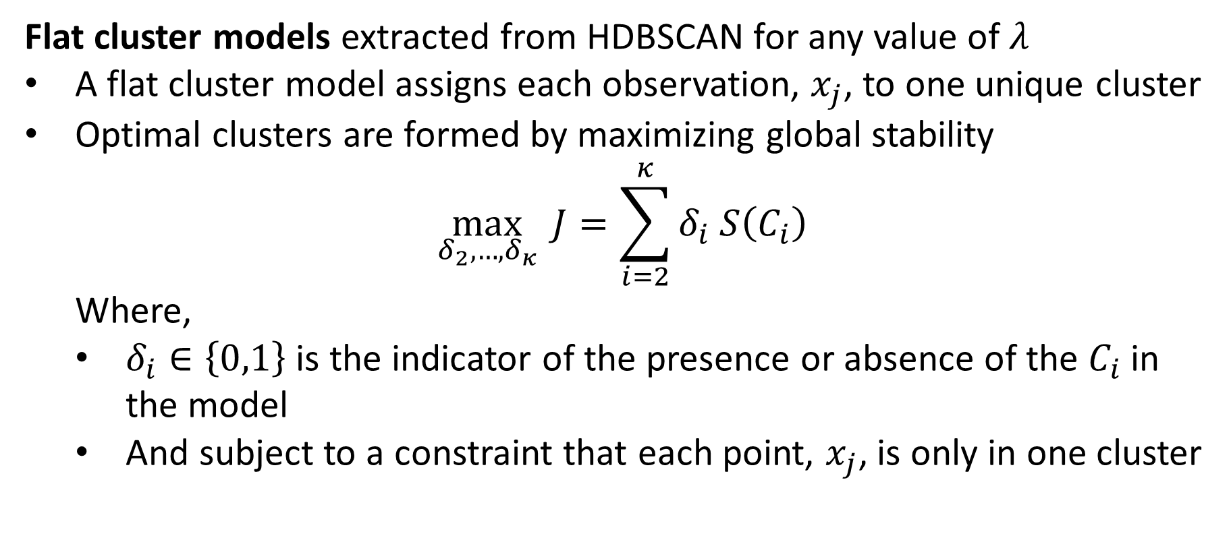
HDBSCAN Algorithm
Flat cluster models extracted from HDBSCAN for any value of $λ$
A flat cluster model assigns each observation, $x_{j}$, to one unique cluster
Optimal clusters are formed by maximizing global stability
$$\max_{δ_{2},…,δ_{κ}}{J=\sum_{i=2}^{κ}{δ_{i} S\left(C_{i}\right)}}$$
Where,
$δ_{i}∈\left\{0,1\right\}$ is the indicator of the presence or absence of the $C_{i}$ in the model
And subject to a constraint that each point, $x_{j}$, is only in one cluster

Slide 52
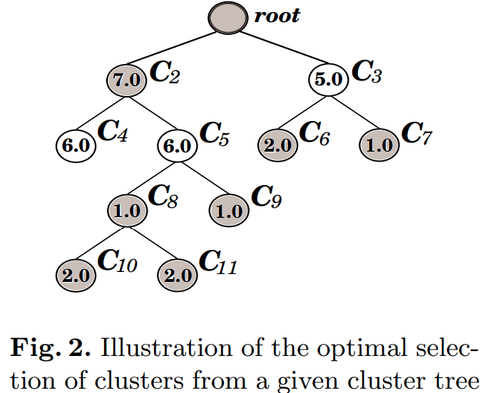
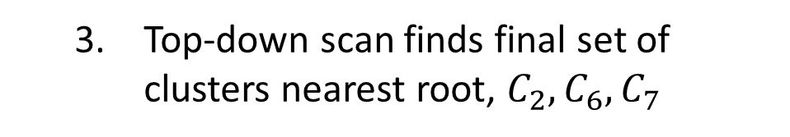
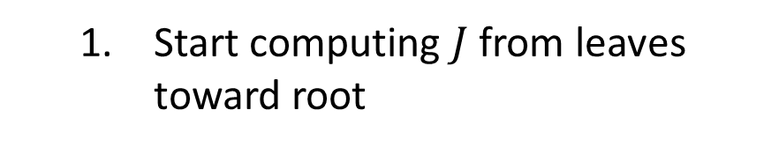
HDBSCAN Algorithm
Flat cluster models extracted from HDBSCAN for any value of $λ$
Top-down scan finds final set of clusters nearest root, $C_{2},C_{6},C_{7}$
In some cases, find larger 𝐽 by combining clusters
Start computing $J$ from leaves toward root
figure from Campello, Moulave, and Sander, 2013

Slide 53
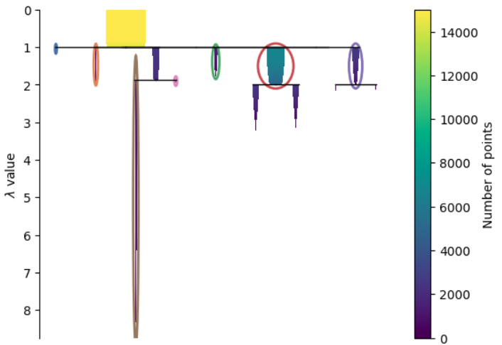
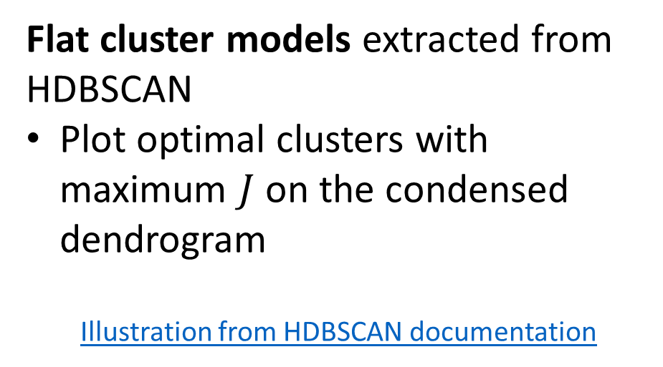
HDBSCAN Algorithm
Flat cluster models extracted from HDBSCAN
Plot optimal clusters with maximum $J$ on the condensed dendrogram
Illustration from HDBSCAN documentation

Slide 54
HDBSCAN Algorithm
HDBSCAN has key hyperparameters
min_cluster_size defines the smallest cluster that can be formed
Large min_cluster_size forms larger clusters which may loose details
Small min_cluster_size can result in small clusters or fragmentation
Small min_cluster_size creates deep hierarchy, slowing execution
The HDBSCAN package uses a very small default value min_cluster_size =5
min_samples defines the minimum local density required to form clusters
Large min_samples prevents cluster fragmentation, resulting in more un-clustered points
Small min_samples allows more detailed partitioning of space
The default in HDBSCAN is min_samples = min_cluster_size

Slide 55
HDBSCAN Algorithm
HDBSCAN has key hyperparameters
cluster_selection_epsilon determines the maximum distance at which clusters can be merged
cluster_selection_epsilon limits chaining behavior in cluster formation
Default value is cluster_selection_epsilon = 0, clusters are merged
metric – Don’t forget that many problems are non-Euclidean the default!
You can find more guidance on model hyperparameters in the HDBSCAN documentation
The full set of hyperparameters can be found in the API documentation

Slide 56
Clustering in High Dimensions and The Curse of Dimensionality!

Slide 57
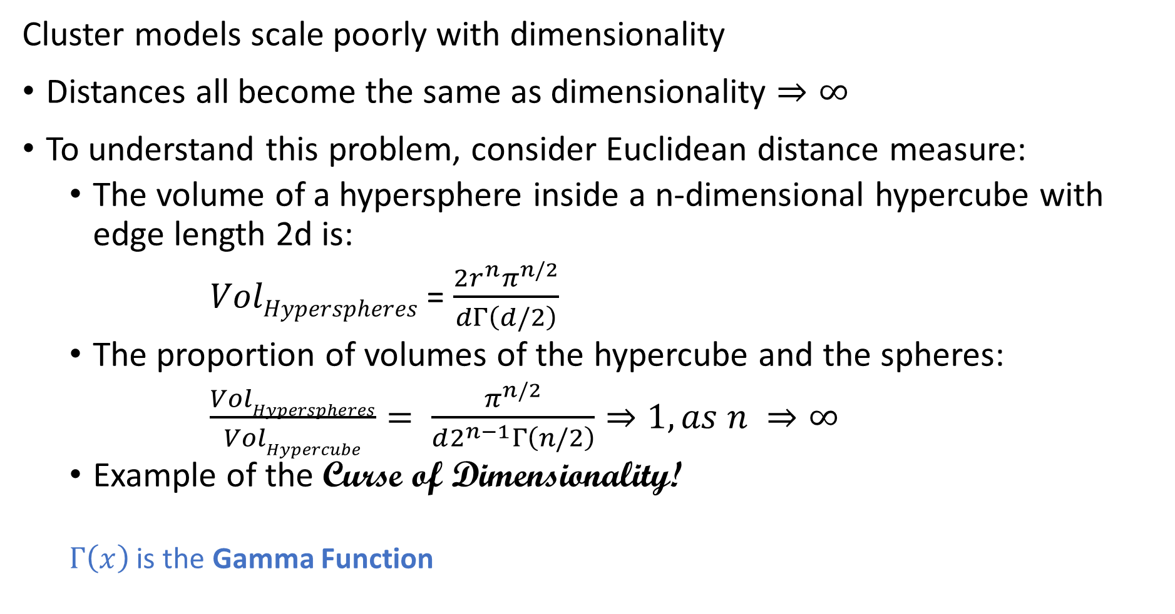
What Could Possibly Go Wrong? Curse of Dimensionality
Cluster models scale poorly with dimensionality
Distances all become the same as dimensionality $⇒∞$
To understand this problem, consider Euclidean distance measure:
The volume of a hypersphere inside a n-dimensional hypercube with edge length 2d is:
$VolHyperspheres$ = $\frac{2r^{n}π^{n/2}}{dΓ\left(d/2\right)}$
The proportion of volumes of the hypercube and the spheres:
$\frac{VolHyperspheres}{VolHypercube}= \frac{π^{n/2}}{d2^{n−1}Γ\left(n/2\right)}⇒1, as n ⇒∞$
Example of the Curse of Dimensionality!
$Γ\left(x\right)$ is the Gamma Function

Slide 58
What Could Possibly Go Wrong? Curse of Dimensionality
The curse of dimensionality means that all clusters are the same in high dimensions
Sampling density decreases exponentially
Distances converge to the same value in a high dimensional space
The choice of metric does not help
All distances are the same in high dimensions!
Implication is that high-dimensional cluster models are easy to overfit!!

Slide 59
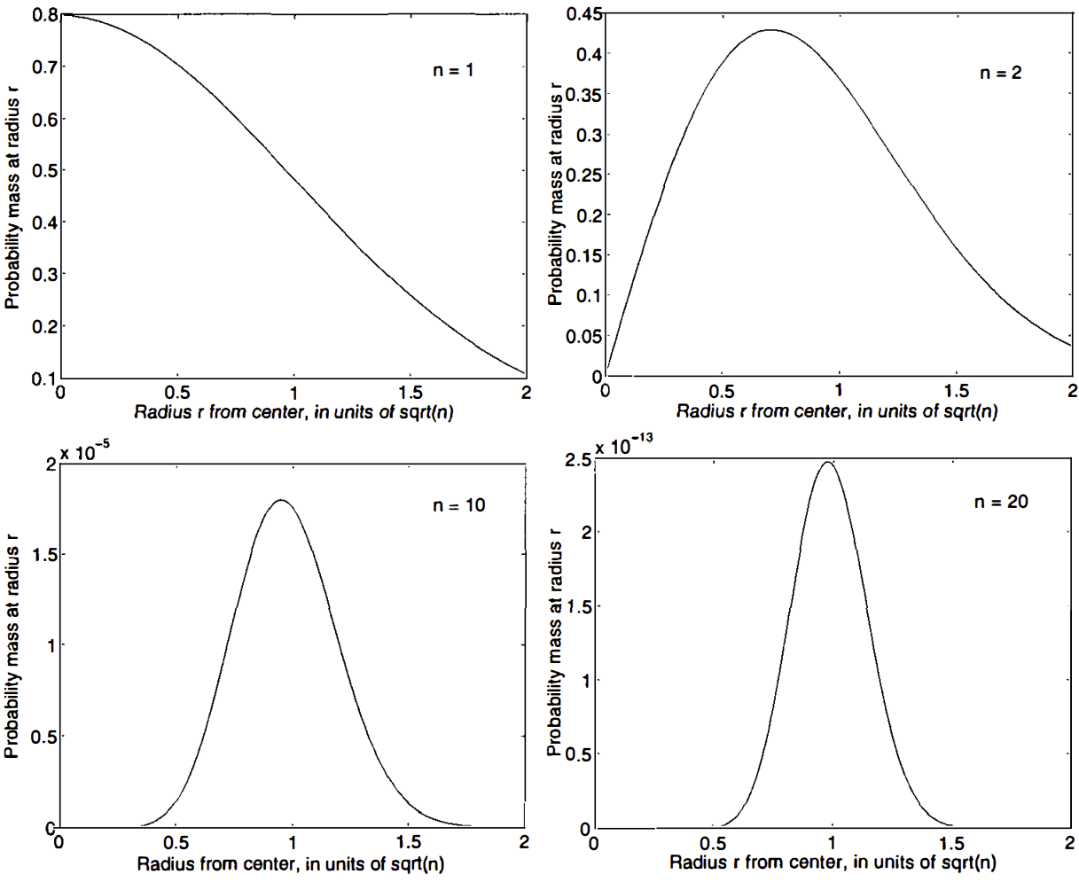
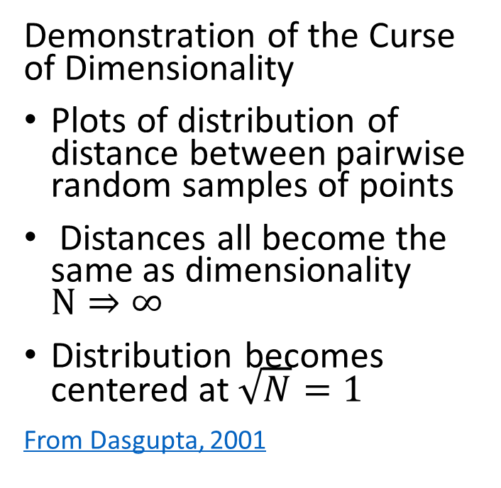
What Could Possibly Go Wrong? Curse of Dimensionality
Demonstration of the Curse of Dimensionality
Plots of distribution of distance between pairwise random samples of points
Distances all become the same as dimensionality $N⇒∞$
Distribution becomes centered at $\sqrt{N}=1$
From Dasgupta, 2001

Slide 60
What Could Possibly Go Wrong? Curse of Dimensionality
How can we extend clustering to higher dimensions?
Reducing dimensionality can help
Need to create a lower dimensional embedding
But how?
PCA is a linear Euclidian projection
Several families of alternatives
Subspace clustering
Random projection
Manifold learning
Our next lesson!

Slide 61
Summary

Slide 62
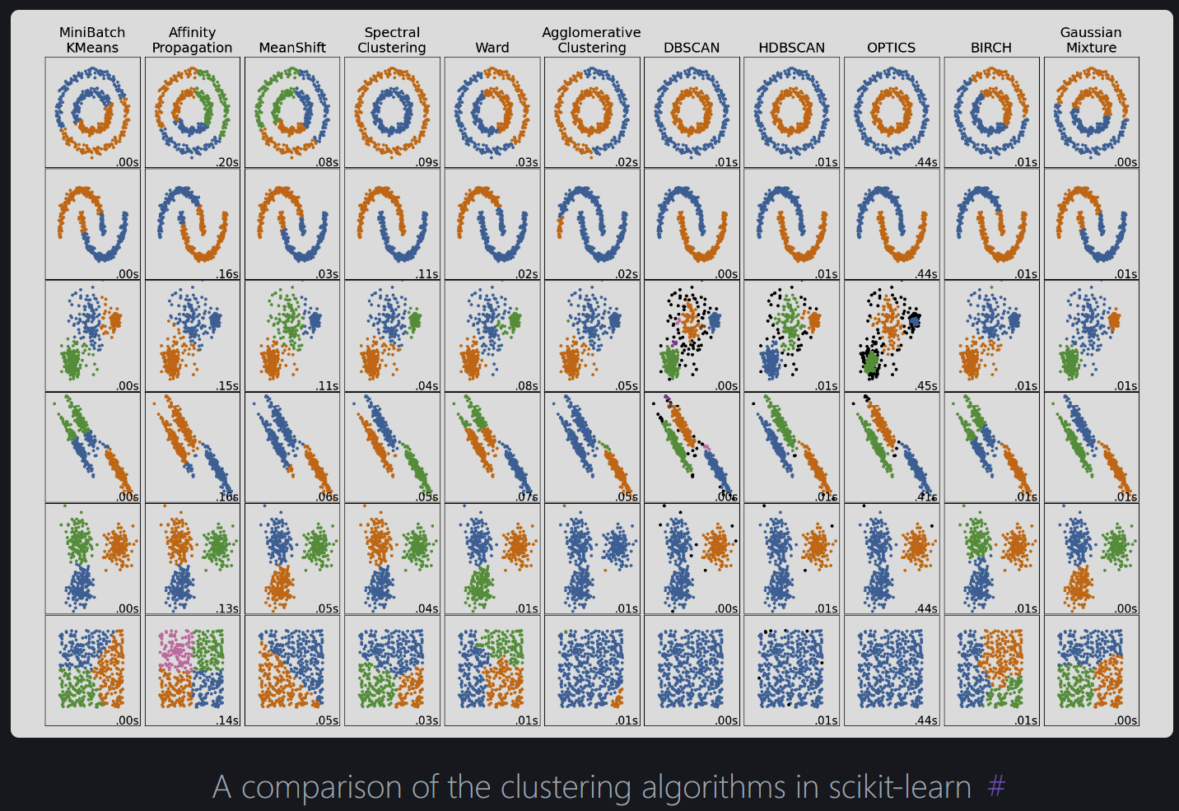
Summary
From Scikit-Learn Clustering User Guide

Slide 63

Summary
From Scikit-Learn Clustering User Guide

Slide 64
Summary
Unsupervised learning methods learn structure of data
Structure is learned by determining similarity between cases
Similarity based on measures of proximity, distance or dissimilarity
Clustering algorithms are core data mining methods
Data mining seeks to find interesting relationships in data
We have already encountered feature importance as a data mining method

Slide 65
Summary
Algorithms can use different distance or dissimilarity metrics
Structure based on distance metrics
Different algorithms use different metrics
Metric can matter more than choice of algorithm
Good clusters have two properties
Compactness: We what the clusters to be small with members close to each other
Separation: We want the clusters are well separated, a closeness property

Slide 66

Summary
Algorithm | Method | Cluster characteristic | Characteristics | Scalability
K-means | Maximizes cluster compactness | Convex | Need to find k Assumes equal variance | high, $O\left(n+d+k\right)$ Mini-batch high, O(n log(n))
Agglomerative hierarchical | Clusters into dendrogram | Convex Hierarchical | low, $O\left(n^{2}\right)$ | low, $O\left(n^{2}\right)$
Spectral | Minimum energy graph partition | Nonconvex | Scalable with sparse graph | low to medium - O(n) to O(n log(n))
DBSCAN | Density graph | Nonconvex | Uniform density – finds number of clusters | high, O(n log(n)), out of core
OPTICS | Density graph | Nonconvex Hierarchal | Variable density– finds number of clusters | High to medium, O(n log(n)) to O(n²), out of core
HDBSCAN | Density graph | Nonconvex Hierarchical | Scalable with sparse graph | High with correct hyperparameters

