Slide 1

CSCI E-96 Data Mining, Exploration and Discovery Introduction to Dimensionality Reduction
Steve Elston
Copyright 2020,2021, 2022, 2023, 2024, 2025, Stephen F Elston. All rights reserved.

Slide 2
Introduction to Dimensionality Reduction
Dimensionality reduction is widely used in data mining
Human understanding of high dimensional spaces is poor at best
For most people, perception of data relationships starts to diminish beyond 4 or 5 dimensions
Exploration of complex spaces can be aided by projection into lower dimensional space
Most algorithms exhibit improved convergence in lower dimensional spaces
High dimensional spaces can lead to over-fitting of data mining algorithms
For example, clustering in high dimensional spaces can lead fragmentation of the data
Dimensionality reduction can improve results

Slide 3
Introduction to Dimensionality Reduction
Why is dimensionality reduction possible?
Consider the information content of each feature
Information of a feature is only unique if it is independent of all other features
Dependent features have redundant information
Dependency implies effective dimensionality less than number of features
Dependent feature values lie on a low-dimensional manifold in a higher dimensional space
We want dimensionality reduction to be similarity (distance) preserving
Embedding must minimize bias and error with respect to original high-dimensional space

Slide 4
Introduction to Dimensionality Reduction
Why is dimensionality reduction possible?
Dependency of features almost always the case in the real world
Semantic dependence
Linear dependency
Nonlinear dependency
We have already looked at some embedding algorithms, a form of dimensionality reduction
Hash embeddings
Neural embeddings
Latent representations
Methods used for similarity search

Slide 5
Lesson Overview
Dimensionality reduction is widely used in data mining
Curse of Dimensionality!
Introduction to dimensionality reduction
Principal component analysis (PCA)
Singular value decomposition (SVD)
Manifold Learning
Spectral Embedding
Uniform Manifold Approximation and Projection (UMAP)

Slide 6
Curse of Dimensionality!

Slide 7
What Could Possibly Go Wrong? Curse of Dimensionality!
Cluster models scale poorly with dimensionality
Consider sampling required to maintain the same uniformly distributed sampling density in a hypercube:
An example of the Curse of Dimensionality!
Dimensions | Samples
1 | 10
2 | 100
3 | 1,000
5 | 10⁵
10 | 10¹⁰

Slide 8
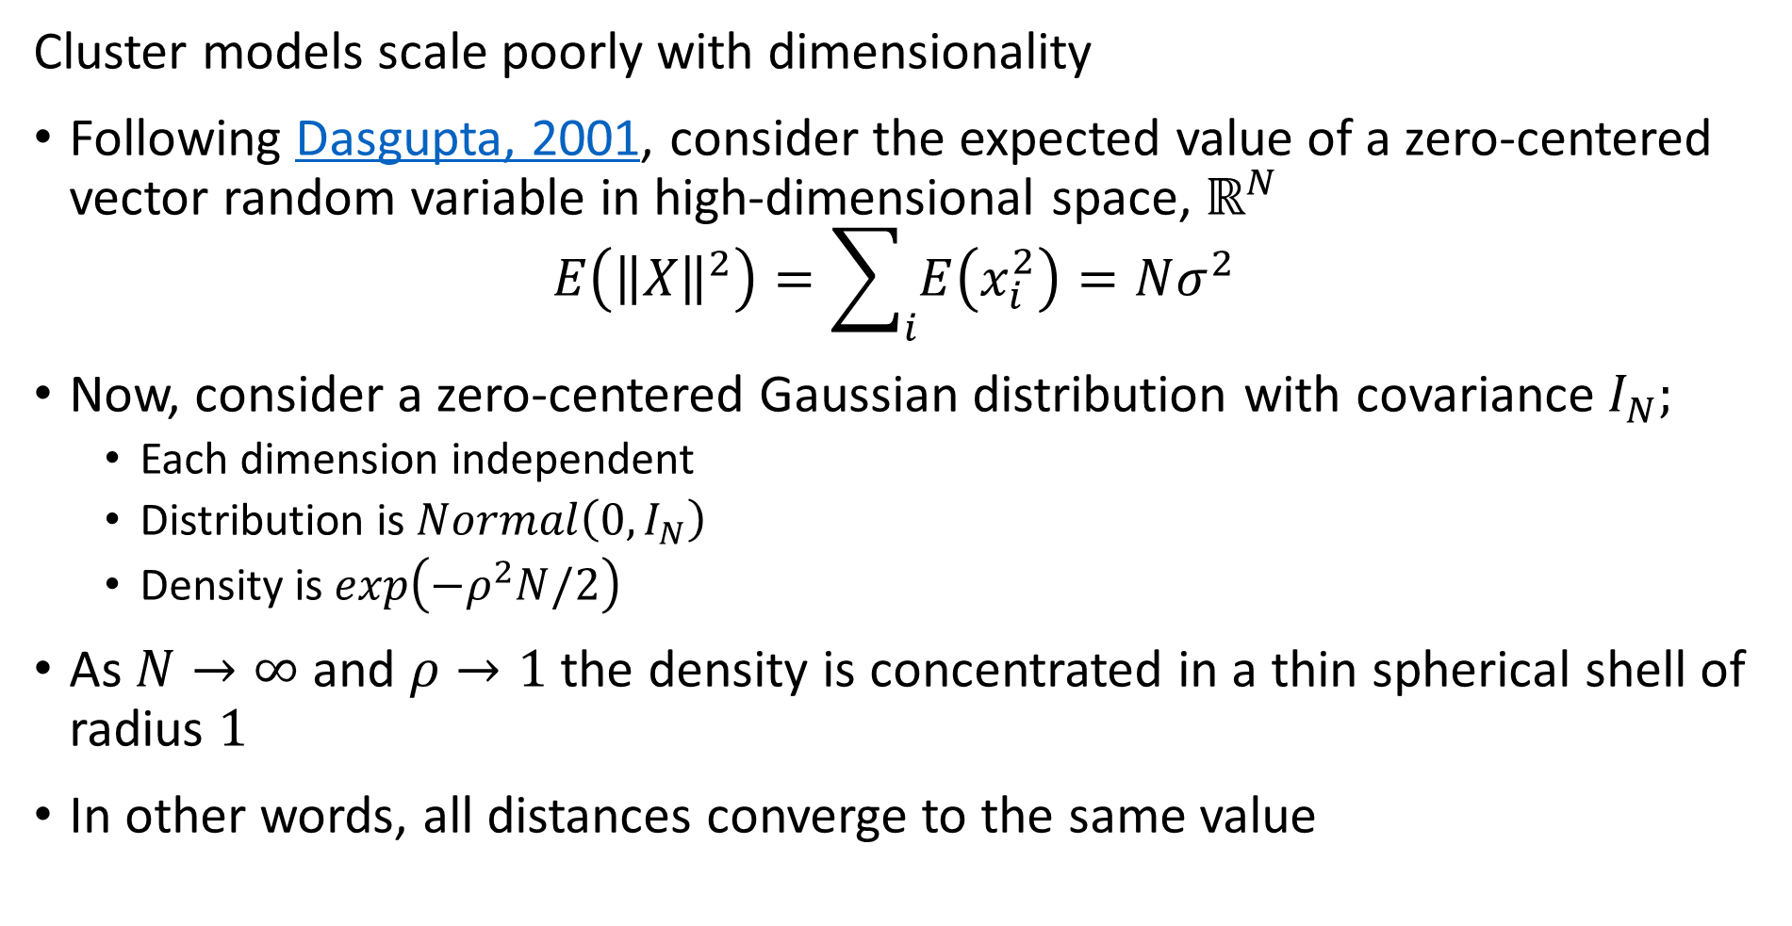
What Could Possibly Go Wrong? Curse of Dimensionality
Cluster models scale poorly with dimensionality
Following Dasgupta, 2001, consider the expected value of a zero-centered vector random variable in high-dimensional space, $ℝ^{N}$
$$E\left({\left\|X\right\|}^{2}\right)=\sum_{i}{E\left(x_{i}^{2}\right)=Nσ^{2}}$$
Now, consider a zero-centered Gaussian distribution with covariance $I_{N};$
Each dimension independent
Distribution is$Normal\left(0,I_{N}\right)$
Density is $exp\left(−ρ^{2}N/2\right)$
As $N→∞$ and $ρ→1$ the density is concentrated in a thin spherical shell of radius $1$
In other words, all distances converge to the same value

Slide 9
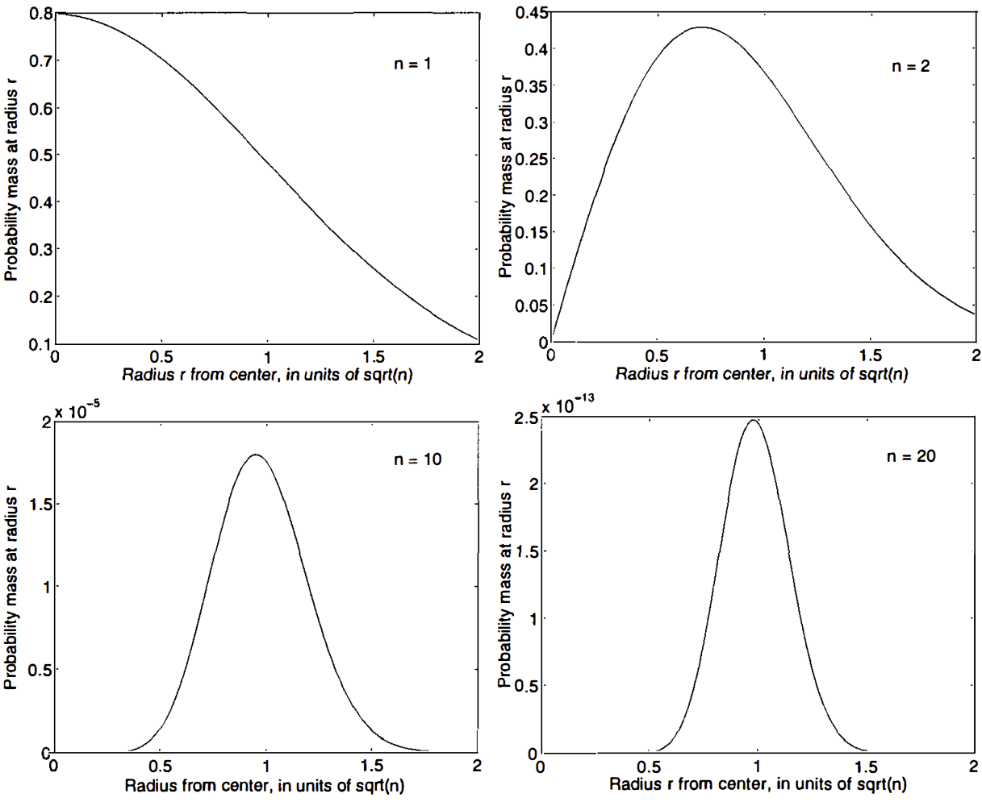
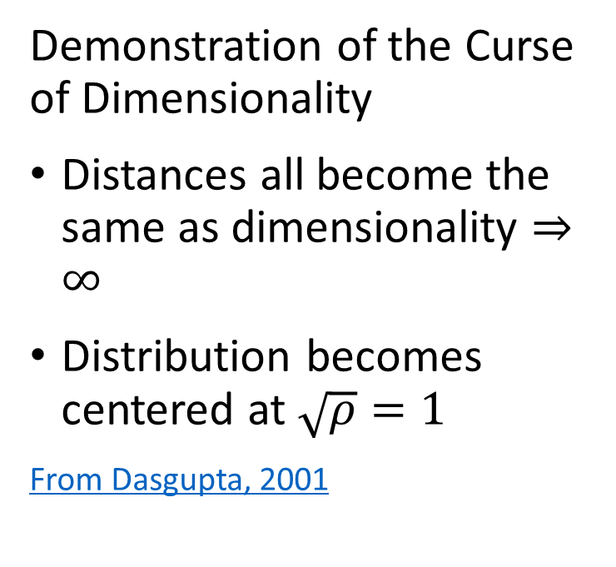
What Could Possibly Go Wrong? Curse of Dimensionality
Demonstration of the Curse of Dimensionality
Distances all become the same as dimensionality $⇒∞$
Distribution becomes centered at $\sqrt{ρ}=1$
From Dasgupta, 2001

Slide 10
What Could Possibly Go Wrong? Curse of Dimensionality
The curse of dimensionality means that all clusters are the same in high dimensions
Sampling density decreases exponentially
Distances converge to the same length in a high dimensional space
The choice of metric does not help
All distances are the same in high dimensions!
Implication is that high-dimensional cluster models are easy to overfit!!

Slide 11
What Could Possibly Go Wrong? Curse of Dimensionality
How can we extend clustering to higher dimensions?
Reducing dimensionality can help
Need to create a lower dimensional embedding
But how?
PCA and SVD are a linear projections
Manifold learning can be linear or nonlinear

Slide 12
Properties of Dimensionality Reduction

Slide 13
Properties of Dimensionality Reduction
What are the properties good dimensionality reduction algorithms?
Goal is to find a mapping to the lower dimensional manifold or embedding space
Embedding should minimize error with respect to the original data
Ideally, reconstruct original data by inverse transformation
Embedding should preserve distances
Distances or similarities should not be distorted by transformation
Embedding should have low bias
Embedding should not produce systematic bias

Slide 14
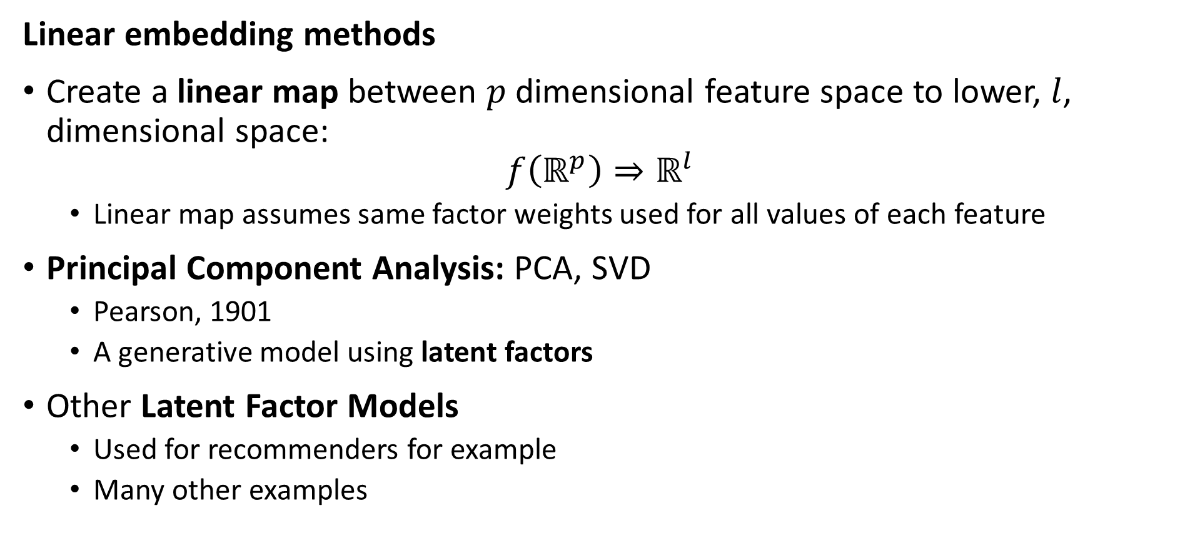
Properties of Dimensionality Reduction
Linear embedding methods
Create a linear map between $p$ dimensional feature space to lower, $l$, dimensional space:
$$f\left(ℝ^{p}\right)⇒ℝ^{l}$$
Linear map assumes same factor weights used for all values of each feature
Principal Component Analysis: PCA, SVD
Pearson, 1901
A generative model using latent factors
Other Latent Factor Models
Used for recommenders for example
Many other examples

Slide 15
Properties of Dimensionality Reduction
Nonlinear embedding methods
Manifold learning for visualization
Spectral embedding
UMAP
Etc……
Deep autoencoders, other NN-based embedding methods
Neural embedding discussed in earlier lesson
For a well written tutorial on using VAEs as image generative models see this post by the amazing Lily Wang of NVIDIA, 2018

Slide 16
Linear Embedding with PCA

Slide 17
Linear Dimensionality Reduction - PCA
PCA applies a linear projection from sample space to an orthogonal space
Start with the original features of the model matrix in the p-dimensional sample space
Compute a linear transformation to an orthogonal latent space
Principle (1st) axis with highest variance
Each axis is orthogonal to the others, explaining maximum remaining variance
First l projection axes define orthogonal lower dimensional space, l < p

Slide 18
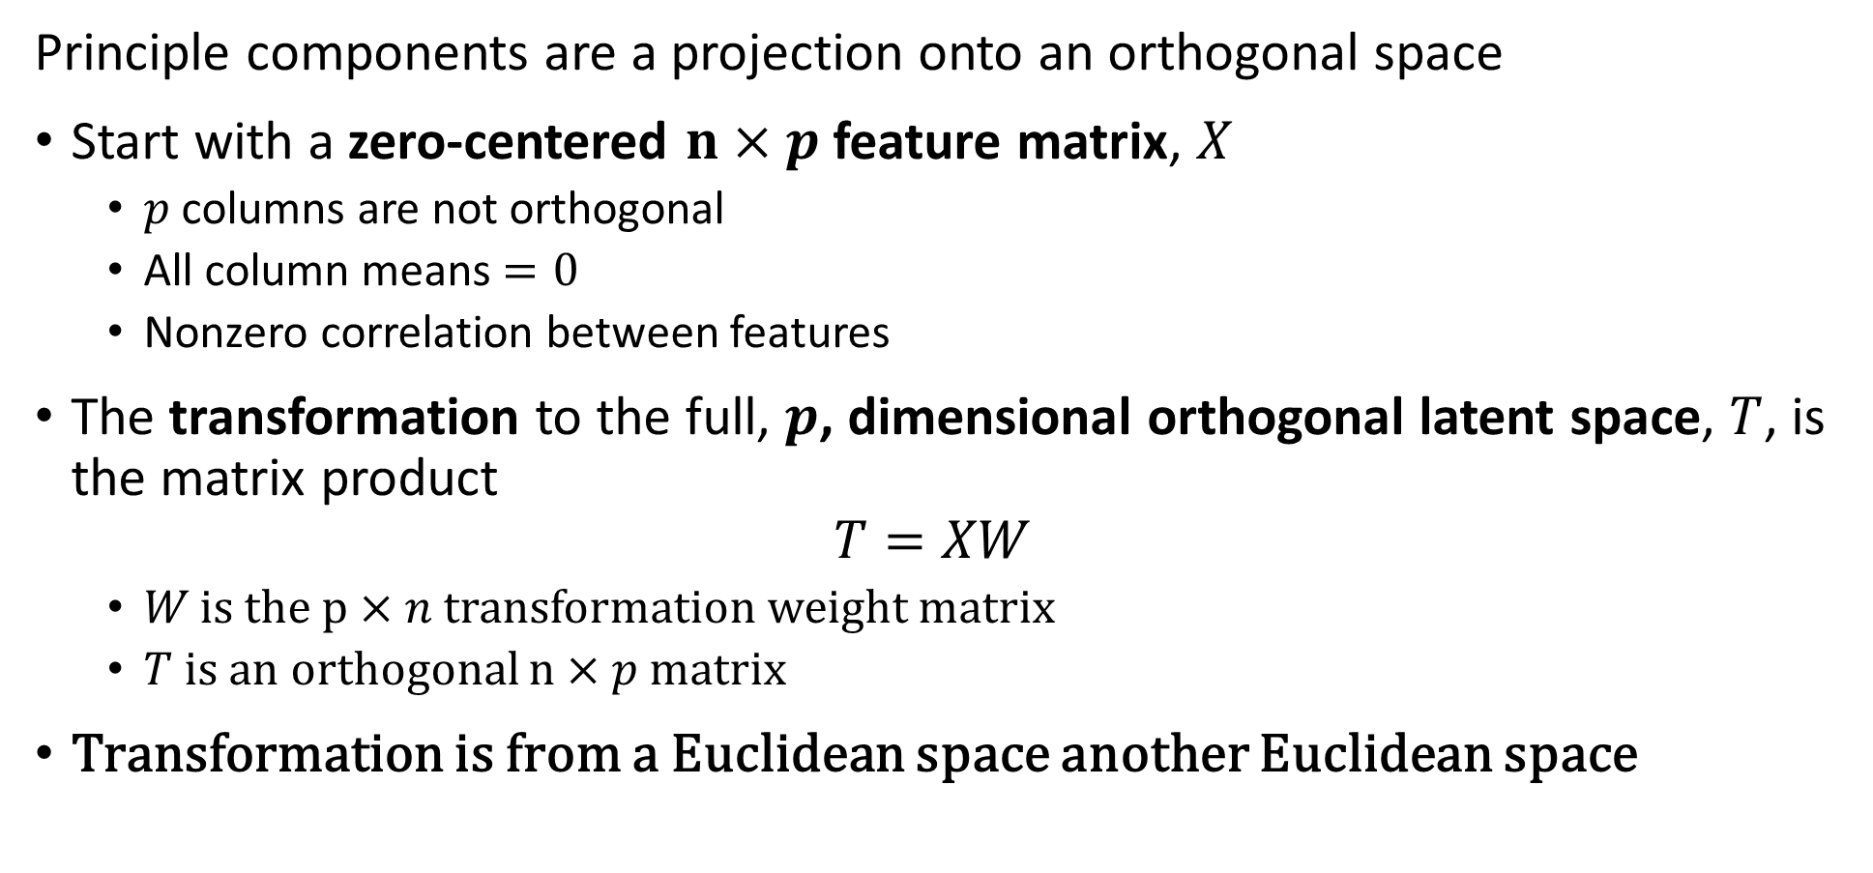
Principle Component Decomposition
Principle components are a projection onto an orthogonal space
Start with a zero-centered $n×p$ feature matrix, $X$
$p$ columns are not orthogonal
All column means $=0$
Nonzero correlation between features
The transformation to the full, $p$, dimensional orthogonal latent space, $T$, is the matrix product
$$T=XW$$
$W$is the $p×n$ transformation weight matrix
$T$ is an orthogonal $n×p$ matrix
Transformation is from a Euclidean space another Euclidean space

Slide 19
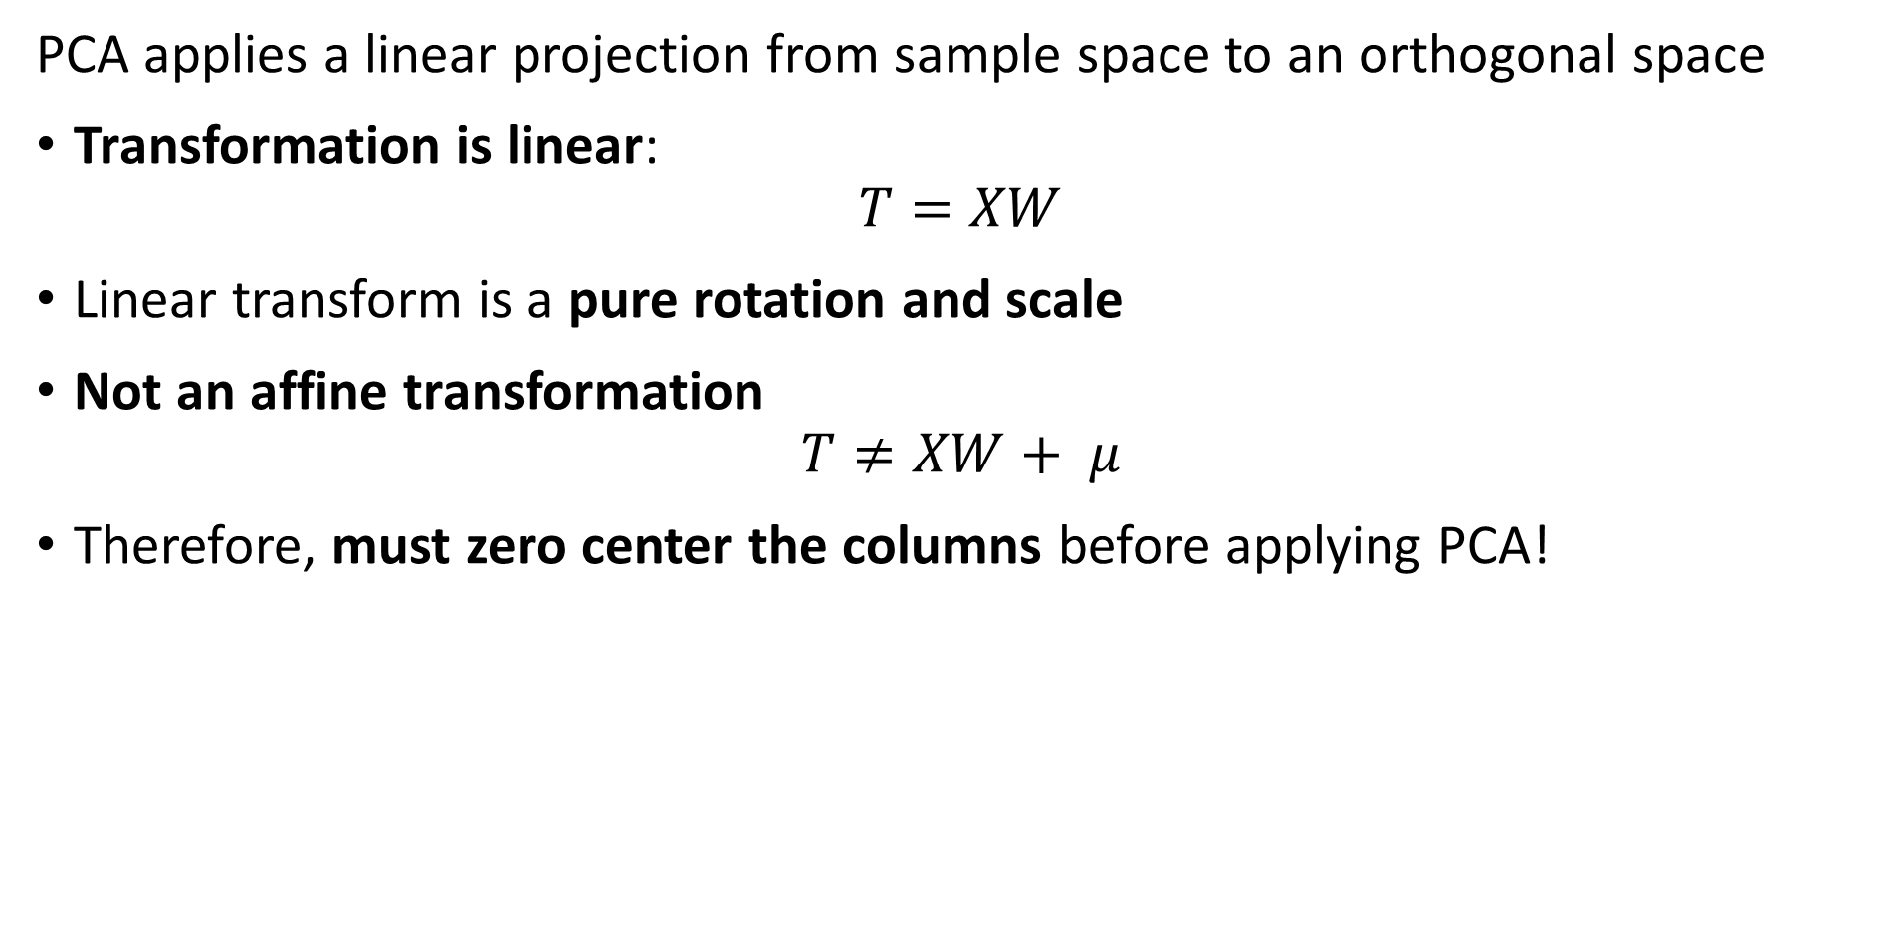
Linear Dimensionality Reduction - PCA
PCA applies a linear projection from sample space to an orthogonal space
Transformation is linear:
$$T=XW$$
Linear transform is a pure rotation and scale
Not an affine transformation
$$T≠XW+ μ$$
Therefore, must zero center the columns before applying PCA!

Slide 20
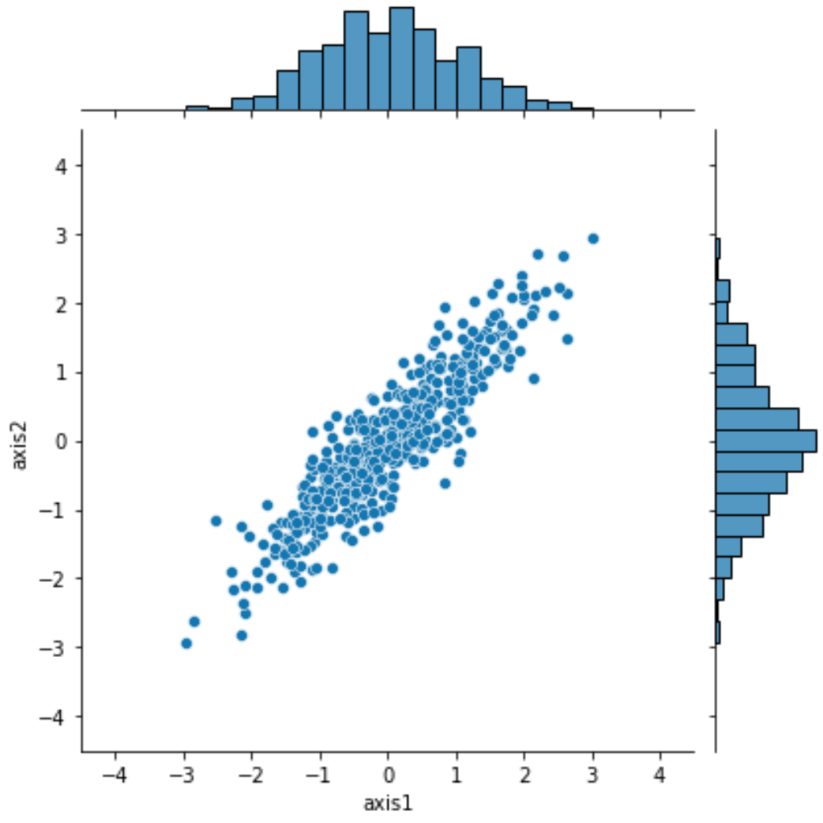
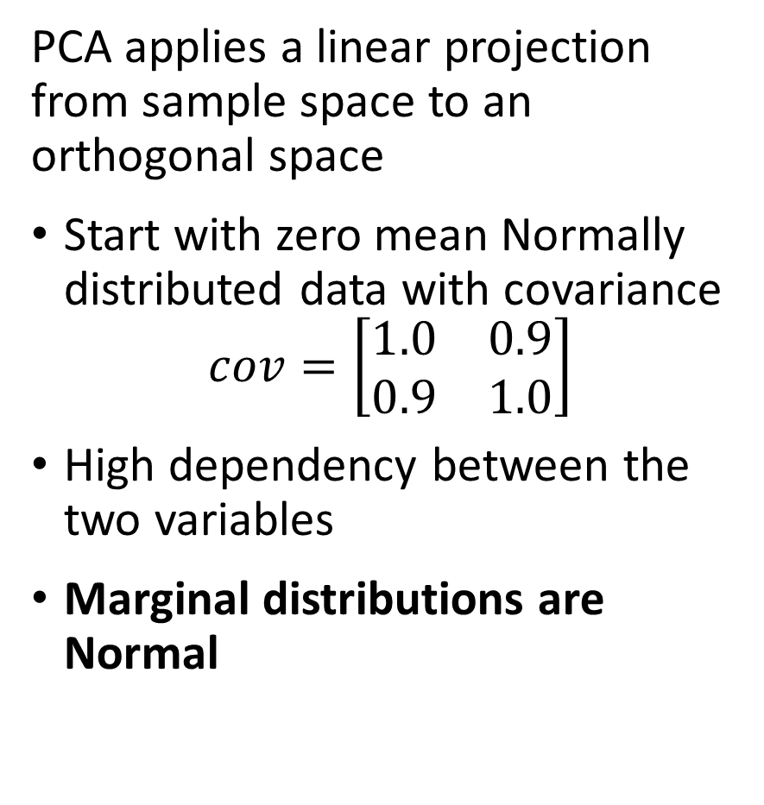
Linear Dimensionality Reduction - PCA
PCA applies a linear projection from sample space to an orthogonal space
Start with zero mean Normally distributed data with covariance
$$cov=\left[\begin{matrix}1.0 & 0.9 \\ 0.9 & 1.0\end{matrix}\right]$$
High dependency between the two variables
Marginal distributions are Normal

Slide 21
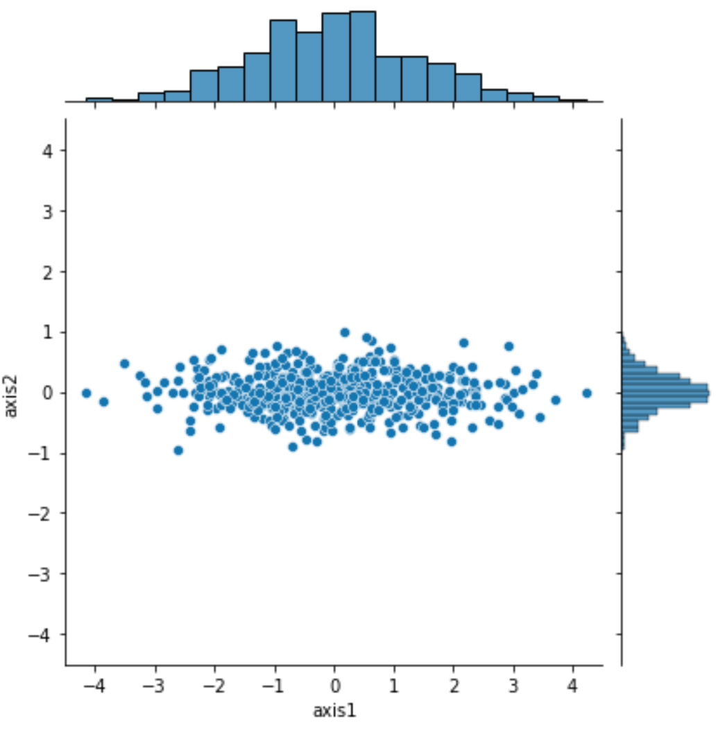
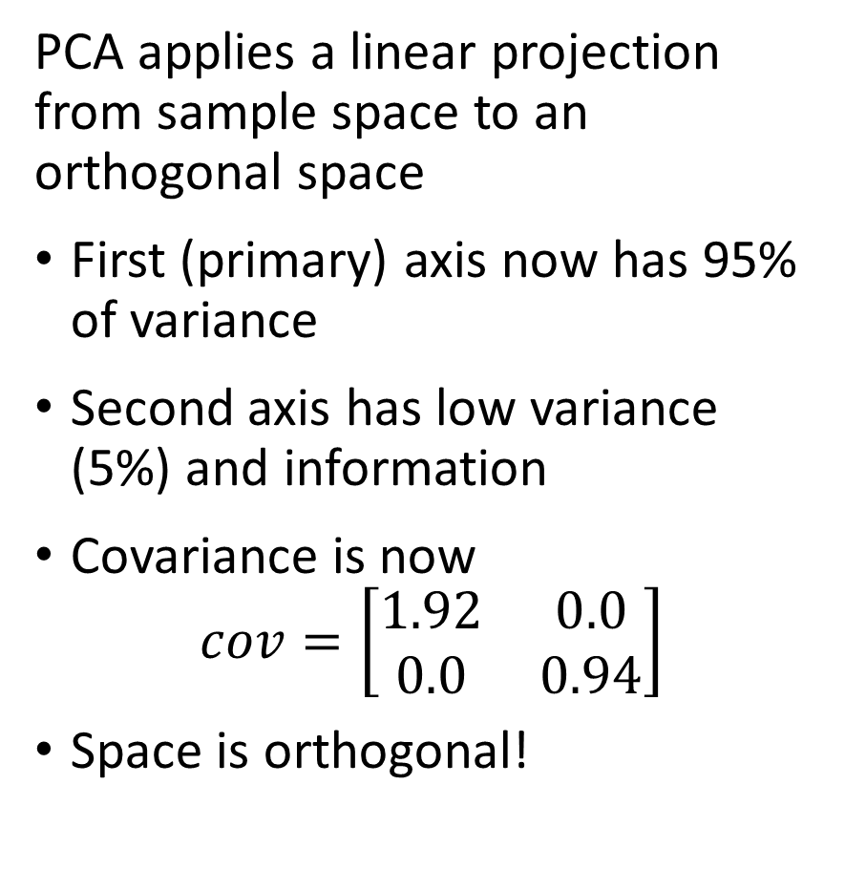
Linear Dimensionality Reduction - PCA
PCA applies a linear projection from sample space to an orthogonal space
First (primary) axis now has 95% of variance
Second axis has low variance (5%) and information
Covariance is now
$$cov=\left[\begin{matrix}1.92 & 0.0 \\ 0.0 & 0.94\end{matrix}\right]$$
Space is orthogonal!

Slide 22
Principal Component Dimensionality Reduction

Slide 23
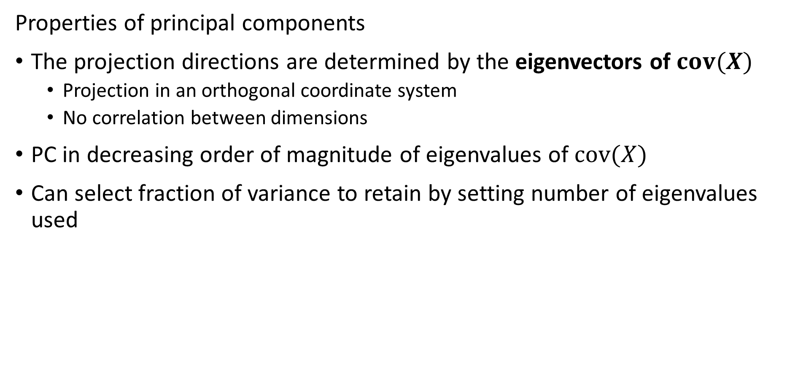
Principle Component Decomposition
Properties of principal components
The projection directions are determined by the eigenvectors of $cov(X)$
Projection in an orthogonal coordinate system
No correlation between dimensions
PC in decreasing order of magnitude of eigenvalues of $cov(X)$
Can select fraction of variance to retain by setting number of eigenvalues used

Slide 24
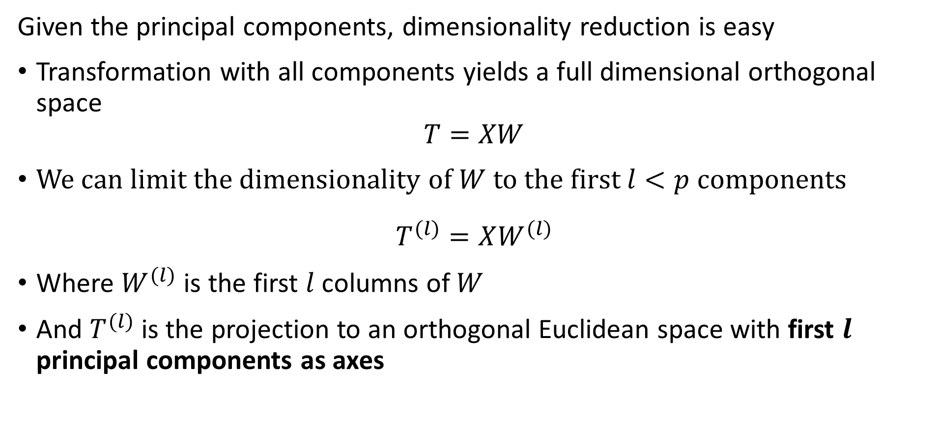
Principle Component Decomposition
Given the principal components, dimensionality reduction is easy
Transformation with all components yields a full dimensional orthogonal space
$$T=XW$$
We can limit the dimensionality of $W$ to the first $l<p$ components
$$T^{(l)}=XW^{(l)}$$
Where $W^{(l)}$ is the first $l$ columns of $W$
And $T^{(l)}$ is the projection to an orthogonal Euclidean space with first $l$ principal components as axes

Slide 25
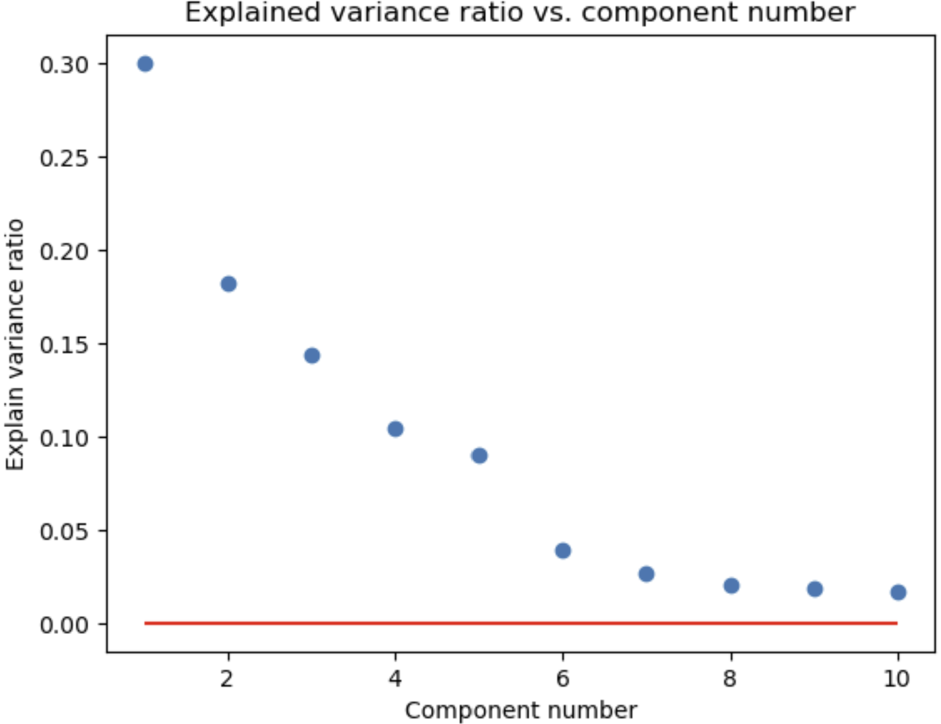
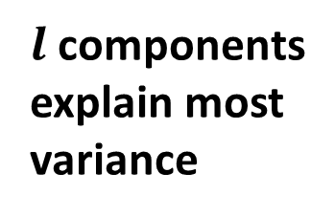
Principle Component Decomposition
How many components do you need?
Need to retain enough components to explain most of the variance
explained variance 1st component
explained variance 2nd component
$l$ components explain most variance
Apparent random variation – irreducible error

Slide 26
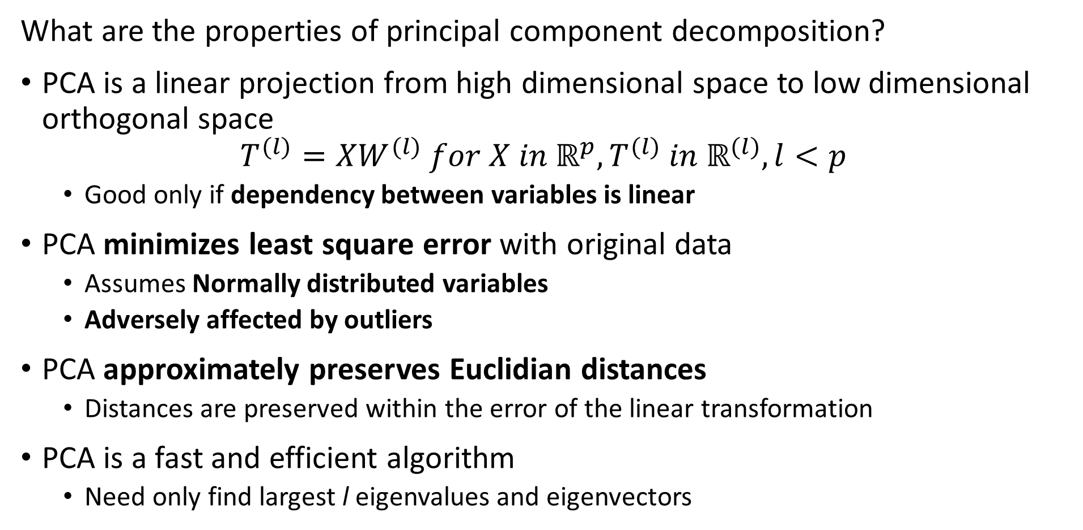
Principle Component Decomposition
What are the properties of principal component decomposition?
PCA is a linear projection from high dimensional space to low dimensional orthogonal space
$$T^{(l)}=XW^{(l)} for X in ℝ^{p},T^{(l)} in ℝ^{(l)}, l<p$$
Good only if dependency between variables is linear
PCA minimizes least square error with original data
Assumes Normally distributed variables
Adversely affected by outliers
PCA approximately preserves Euclidian distances
Distances are preserved within the error of the linear transformation
PCA is a fast and efficient algorithm
Need only find largest l eigenvalues and eigenvectors

Slide 27
Principle Component Decomposition
Data preparation for PCA
Treat outliers since PCA susceptible
Details are problem dependent
If outliers inherent in data, consider nonlinear method like spectral embedding
Demean the variables
PCA is a linear transformation
But not an affine transformation!
Transforming variables to unit variance can improve convergence
Particularly important in high dimensions

Slide 28
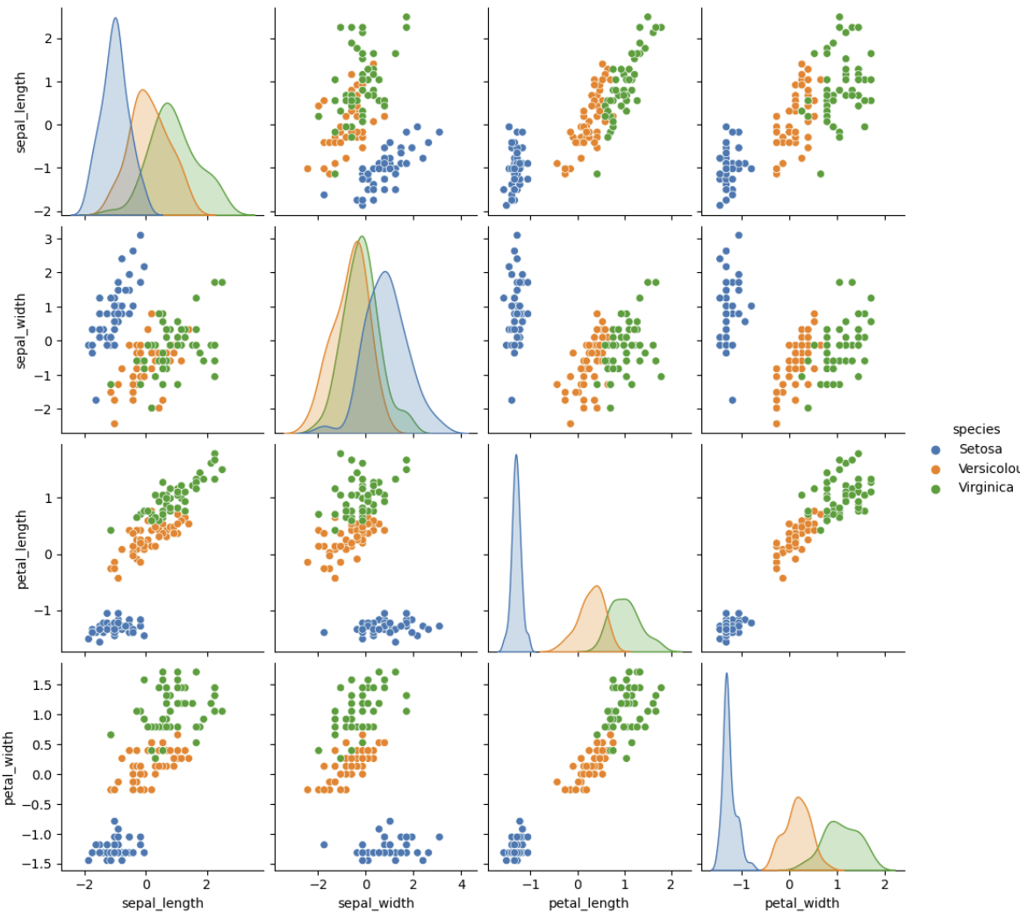
Principle Component Decomposition
Example, Iris dataset
3 spices of iris flowers
4 dimensions of measurements
1 species well separated
2 species overlap in all dimensions

Slide 29
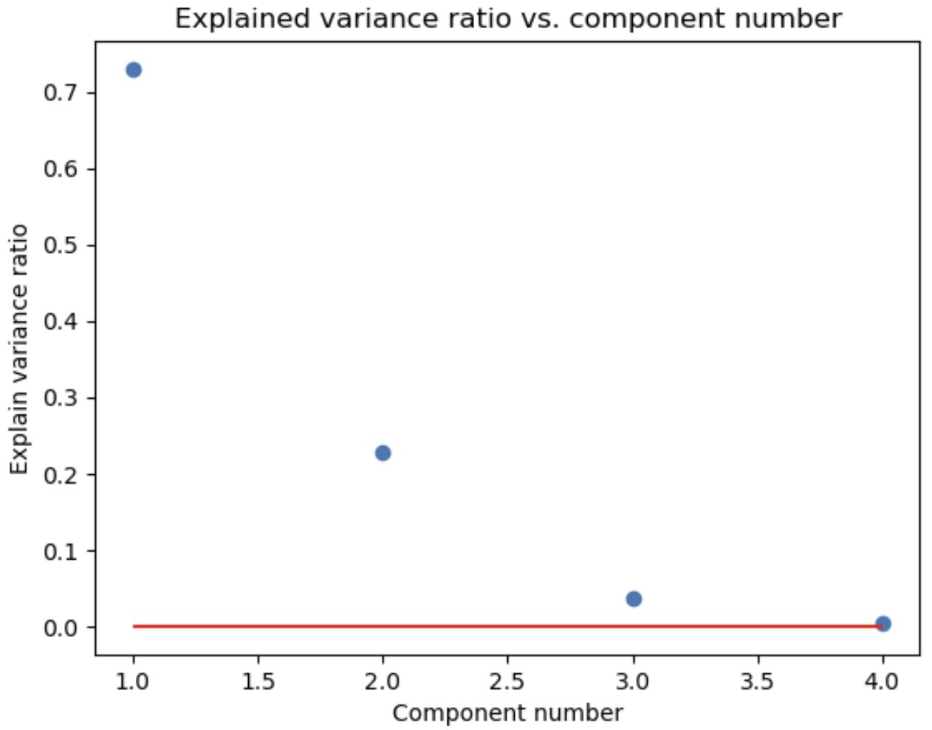
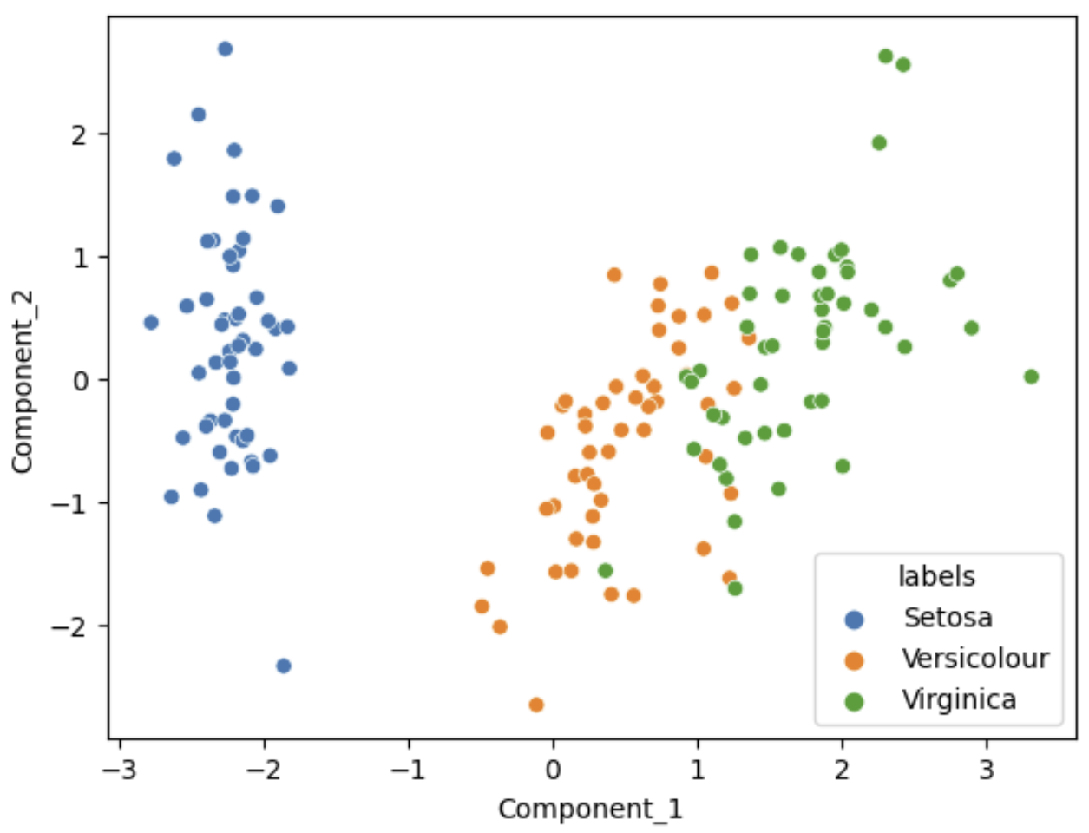
Principle Component Decomposition
Example, first 2 principal components explain about 95% of variance for Iris dataset
Variance ratio by PCA component
Scatterplot of first 2 PCA Components

Slide 30
Singular Value Decomposition

Slide 31
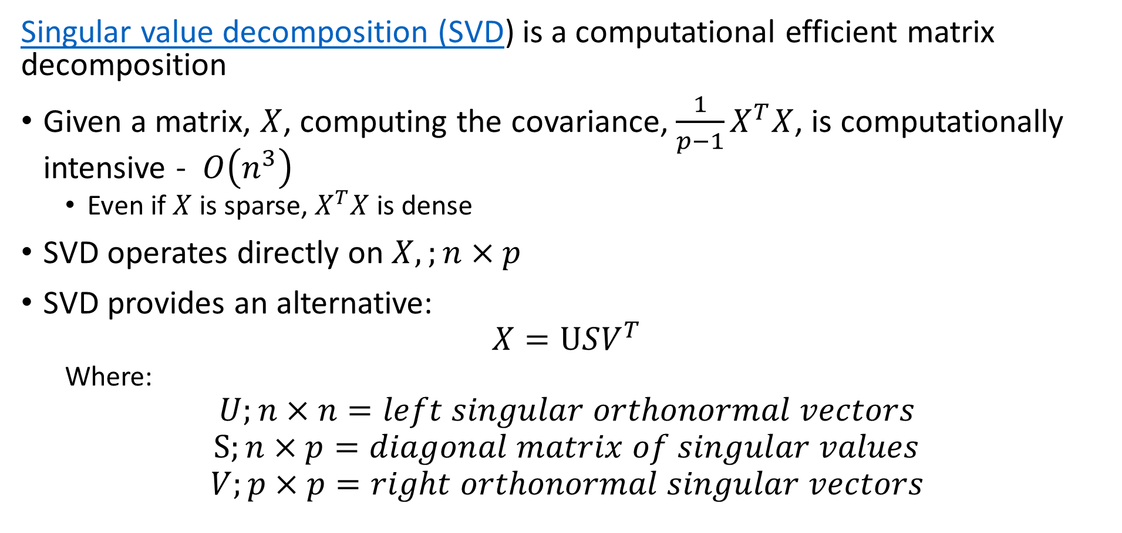
Singular Value Decomposition
Singular value decomposition (SVD) is a computational efficient matrix decomposition
Given a matrix, $X$, computing the covariance, ${\frac{1}{p−1}X}^{T}X$, is computationally intensive - $O\left(n^{3}\right)$
Even if $X$ is sparse, $X^{T}X$ is dense
SVD operates directly on $X,;n×p$
SVD provides an alternative:
$$X=USV^{T}$$
Where:
$$U;n×n=left singular orthonormal vectors$$
$$S;n×p=diagonal matrix of singular values$$
$$V;p×p=right orthonormal singular vectors$$

Slide 32
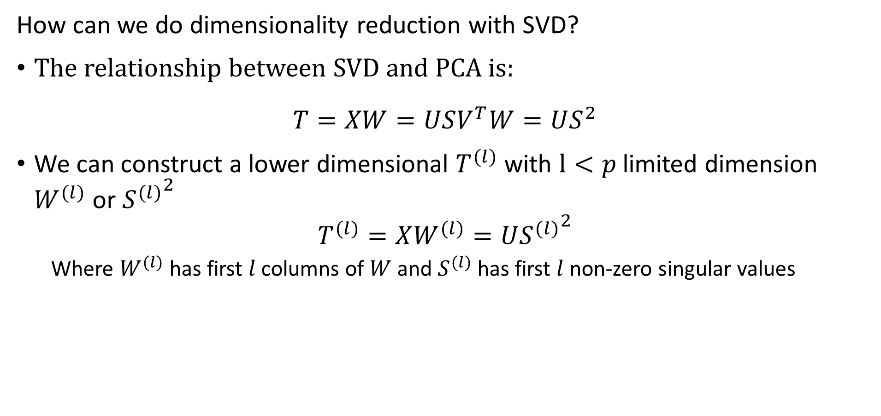
Singular Value Decomposition
How can we do dimensionality reduction with SVD?
The relationship between SVD and PCA is:
$$T=XW=USV^{T}W=US^{2}$$
We can construct a lower dimensional $T^{(l)}$ with $l<p$ limited dimension $W^{(l)}$ or ${S^{(l)}}^{2}$
$$T^{(l)}=XW^{(l)}=U{S^{(l)}}^{2}$$
Where $W^{(l)}$ has first $l$ columns of $W$ and $S^{(l)}$ has first $l$ non-zero singular values

Slide 33
Manifold Learning

Slide 34
Manifold Learning
How can we visualize data from higher dimensions?
Reducing dimensionality can help
Need to create a lower dimensional embedding
But how?
Manifold Learning projects a high-dimensional space onto a low-dimensional manifold
Many commonly used unsupervised methods
Spectral embedding
Uniform Manifold Approximation and Projection (UMAP)
t-distributed Stochastic Neighbor Embedding (t-SNE) – largely supplanted by UMAP
…..

Slide 35
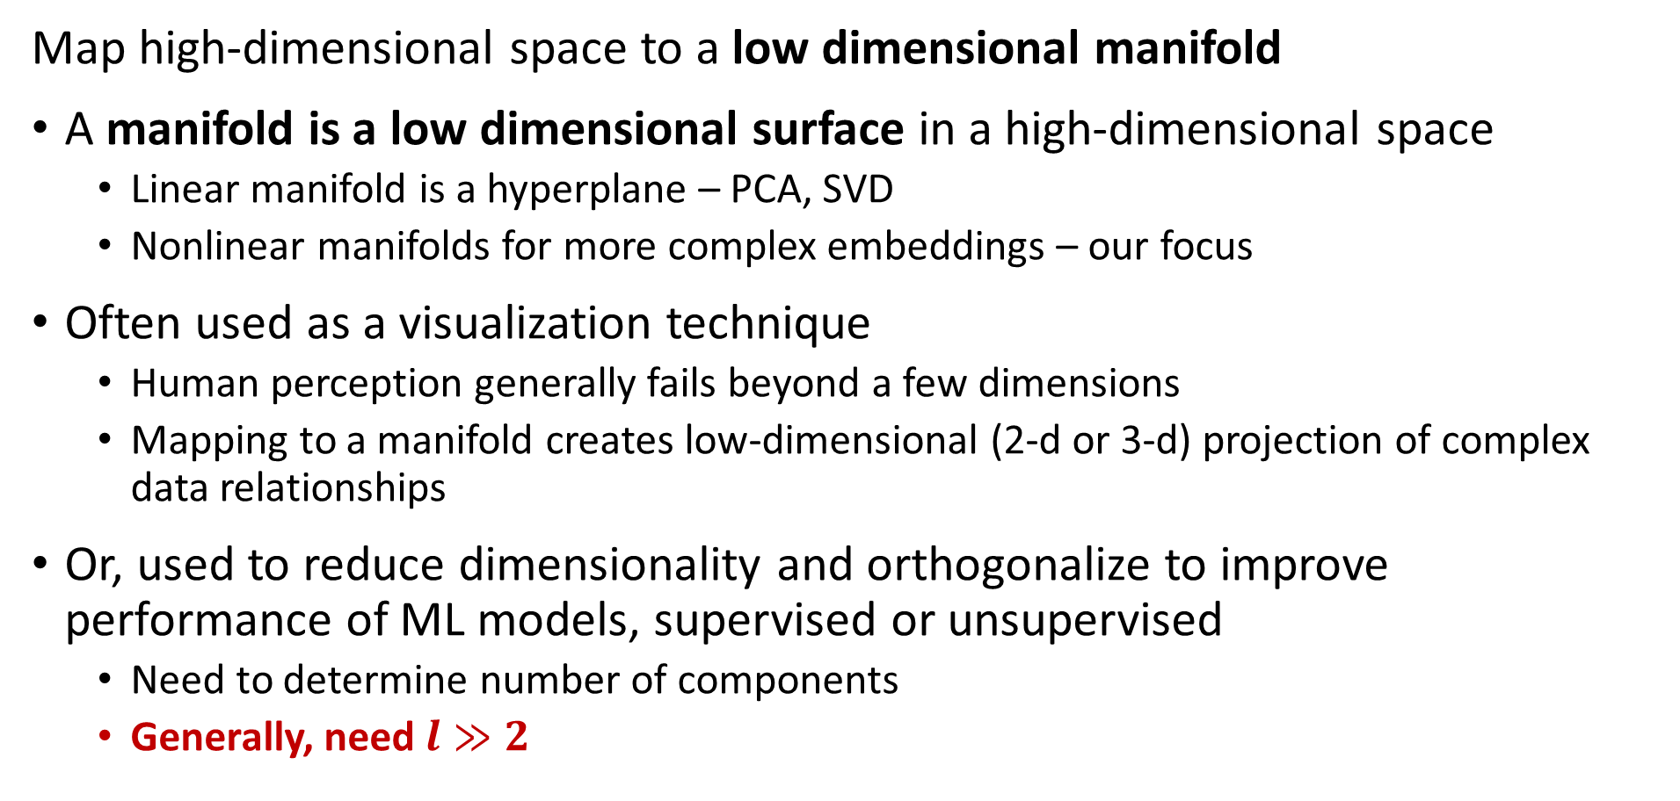
Manifold Learning
Map high-dimensional space to a low dimensional manifold
A manifold is a low dimensional surface in a high-dimensional space
Linear manifold is a hyperplane – PCA, SVD
Nonlinear manifolds for more complex embeddings – our focus
Often used as a visualization technique
Human perception generally fails beyond a few dimensions
Mapping to a manifold creates low-dimensional (2-d or 3-d) projection of complex data relationships
Or, used to reduce dimensionality and orthogonalize to improve performance of ML models, supervised or unsupervised
Need to determine number of components
Generally, need $l≫2$

Slide 36
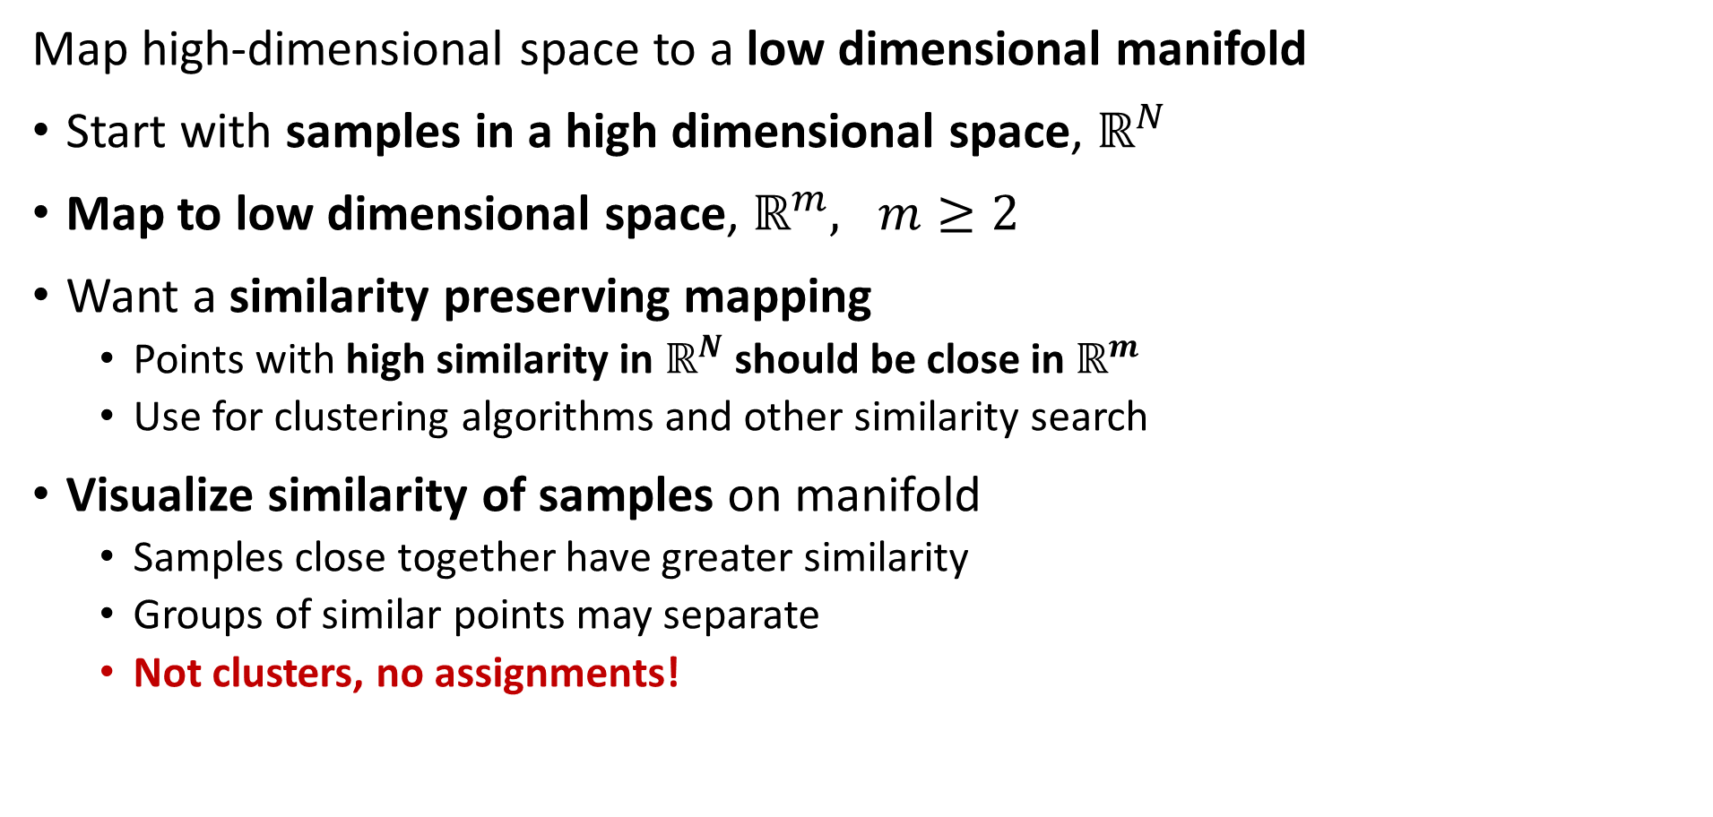
Manifold Learning
Map high-dimensional space to a low dimensional manifold
Start with samples in a high dimensional space, $ℝ^{N}$
Map to low dimensional space, $ℝ^{m}, m≥2$
Want a similarity preserving mapping
Points with high similarity in $ℝ^{N}$ should be close in $ℝ^{m}$
Use for clustering algorithms and other similarity search
Visualize similarity of samples on manifold
Samples close together have greater similarity
Groups of similar points may separate
Not clusters, no assignments!

Slide 37
Manifold Learning
Map high-dimensional space to a low dimensional manifold
Many algorithms have been developed
Scikit-Learn supports 8 algorithms + PCA
PCA finds projection of PCs is on a linear manifold or hyperplane
We will look at two nonlinear unsupervised algorithms in detail:
Spectral embedding
UMAP

Slide 38
Spectral Embedding

Slide 39
Spectral Embedding
Spectral embedding uses graph-based construction
Creates a low-dimensional map of high dimensional space
Closely related to spectral clustering algorithm
Uses eigendecomposition of graph Laplacian
Maps to nonlinear manifold from high-dimensional space
Preserves distances of most similar pairs on graph
Supported in Scikit-Learn

Slide 40
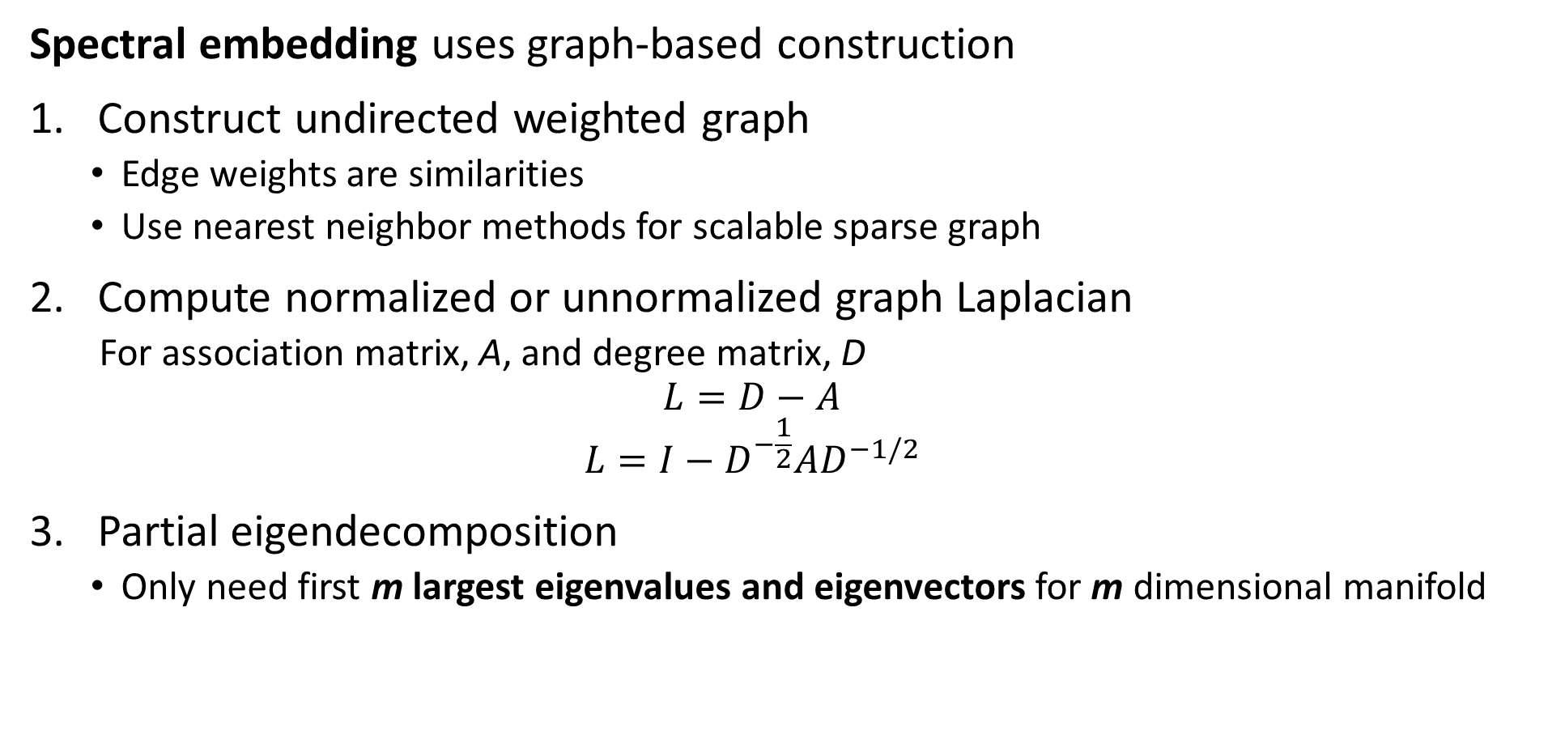
Spectral Embedding
Spectral embedding uses graph-based construction
Construct undirected weighted graph
Edge weights are similarities
Use nearest neighbor methods for scalable sparse graph
Compute normalized or unnormalized graph Laplacian
For association matrix, A, and degree matrix, D
$$L=D−A$$
$$L={I−D}^{−\frac{1}{2}}AD^{−1/2}$$
Partial eigendecomposition
Only need first m largest eigenvalues and eigenvectors for m dimensional manifold

Slide 41
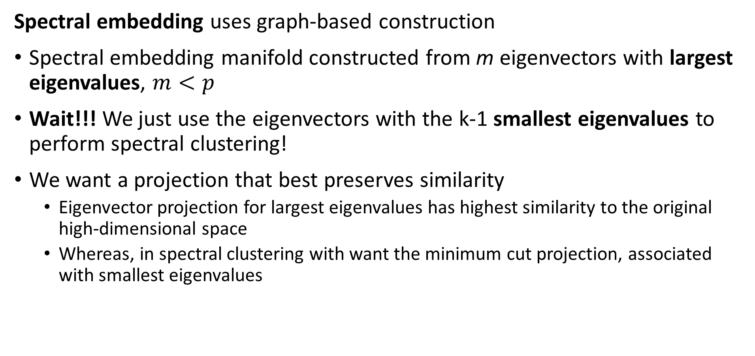
Spectral Embedding
Spectral embedding uses graph-based construction
Spectral embedding manifold constructed from m eigenvectors with largest eigenvalues, $m<p$
Wait!!! We just use the eigenvectors with the k-1 smallest eigenvalues to perform spectral clustering!
We want a projection that best preserves similarity
Eigenvector projection for largest eigenvalues has highest similarity to the original high-dimensional space
Whereas, in spectral clustering with want the minimum cut projection, associated with smallest eigenvalues

Slide 42
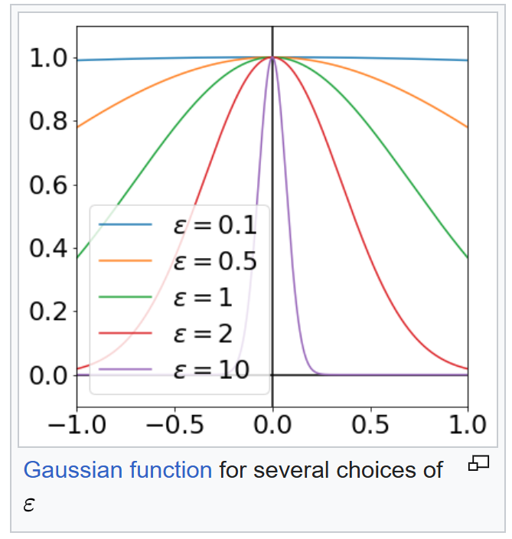
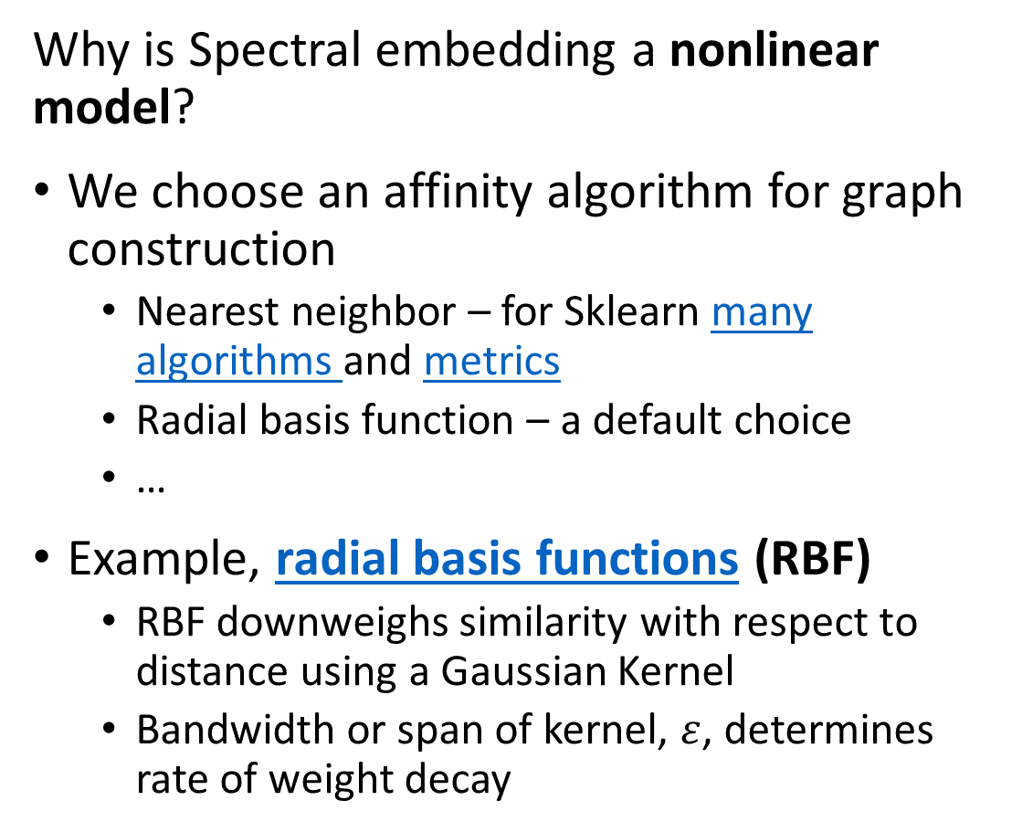
Spectral Embedding
Why is Spectral embedding a nonlinear model?
We choose an affinity algorithm for graph construction
Nearest neighbor – for Sklearn many algorithms and metrics
Radial basis function – a default choice
…
Example, radial basis functions (RBF)
RBF downweighs similarity with respect to distance using a Gaussian Kernel
Bandwidth or span of kernel, $ε$, determines rate of weight decay
Illustration from Wikipedia Commons

Slide 43
Uniform Manifold Approximation and Projection (UMAP)

Slide 44
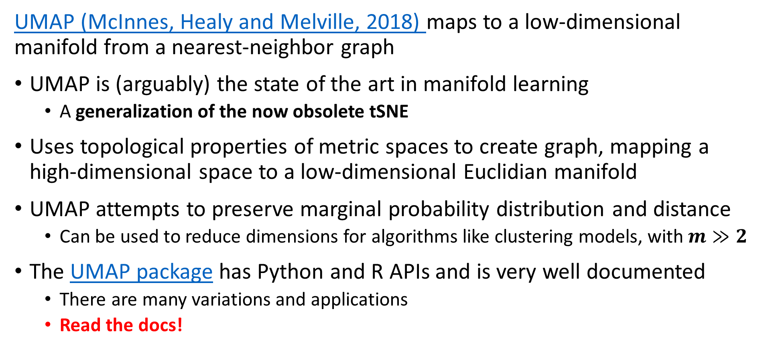
Uniform Manifold Approximation and Projection (UMAP)
UMAP (McInnes, Healy and Melville, 2018) maps to a low-dimensional manifold from a nearest-neighbor graph
UMAP is (arguably) the state of the art in manifold learning
A generalization of the now obsolete tSNE
Uses topological properties of metric spaces to create graph, mapping a high-dimensional space to a low-dimensional Euclidian manifold
UMAP attempts to preserve marginal probability distribution and distance
Can be used to reduce dimensions for algorithms like clustering models, with $m≫2$
The UMAP package has Python and R APIs and is very well documented
There are many variations and applications
Read the docs!

Slide 45
Uniform Manifold Approximation and Projection (UMAP)
Key properties of UMAP
UMAP attempts to preserve probability distribution and distance
Assumes the observations on a manifold are locally connected and uniformly distributed
High-dimensional manifold can use most any distance metric
Low-dimensional manifold is Euclidean
Algorithm relies on properties of Reimann manifolds
Reimann manifolds are locally smooth
Reimann manifolds have continuous first derivatives

Slide 46
Uniform Manifold Approximation and Projection (UMAP)
Key properties of UMAP
Low-dimensional Euclidean Reimann manifold has desirable properties
Human perception is good for visualizations in Euclidean space
Euclidean space has advantages for machine learning
Wide choice of possible algorithms
Can compute sum of squares
Clusters are elliptical or spherical

Slide 47
Uniform Manifold Approximation and Projection (UMAP)
How does the UMAP algorithm work?
Algorithm for mapping to low dimensional Euclidian space has 4 major steps:
Locally compute fuzzy weights
Build nearest-neighbor graph
Use spectral embedding to find good starting transformation
Minimize cross-entropy to optimize low-dimensional Euclidian manifold

Slide 48
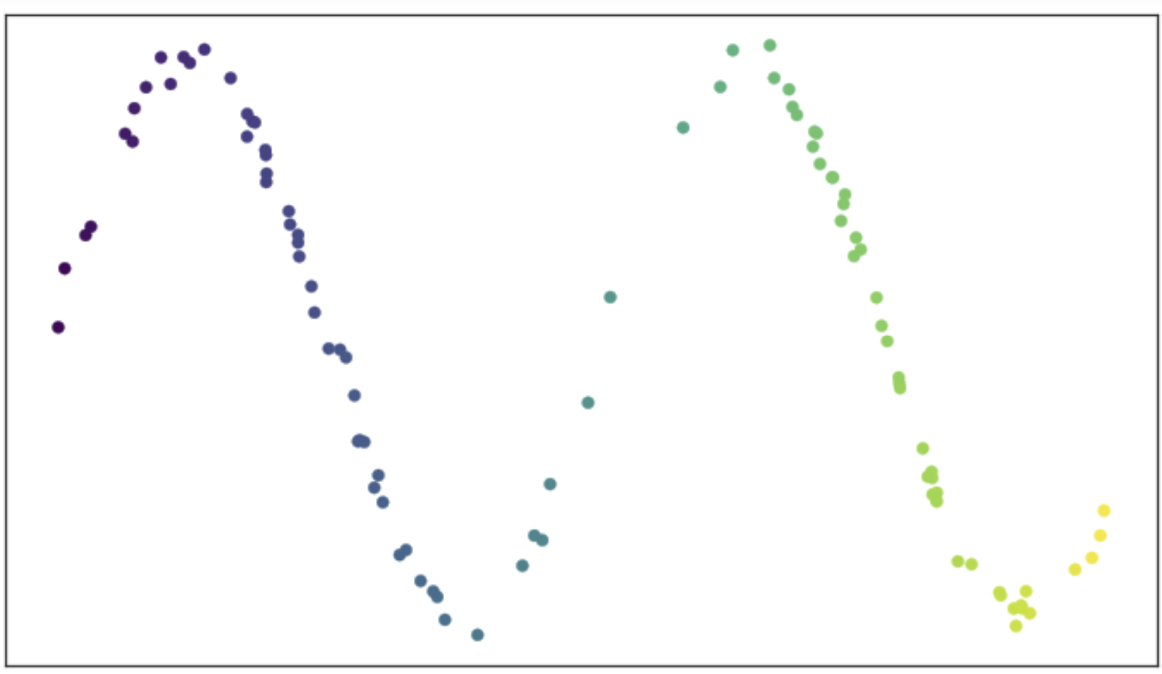
Uniform Manifold Approximation and Projection (UMAP)
How does the UMAP algorithm work?
Consider an example of data on a manifold
Is a two-dimensional space
Sample values are predominantly on a 1-dimensional smooth (Reimann) manifold
How do we construct the low-dimensional manifold?
From UMAP documentation, Leland McInnis, 2018

Slide 49
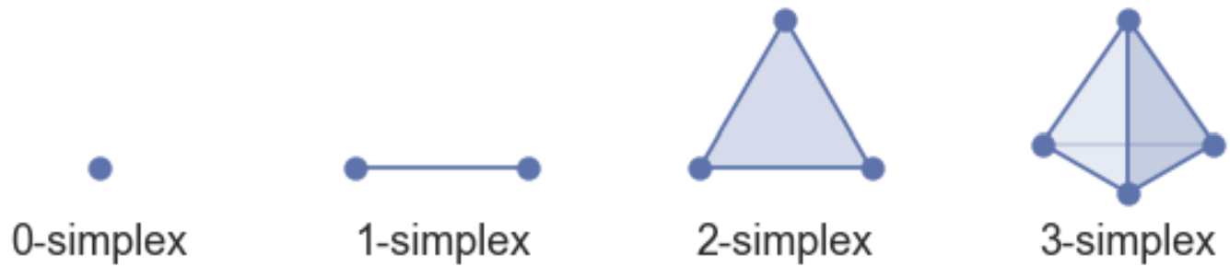
Uniform Manifold Approximation and Projection (UMAP)
How does the UMAP algorithm work?
Construct the manifold as a set of simplexes
K-simplex has k+1 fully connected nodes
Can construct high-dimensional shapes by joining simplices
Simplices joined on common faces
Represent complex manifold as simplicial complexes
From UMAP documentation, Leland McInnis, 2018

Slide 50
Uniform Manifold Approximation and Projection (UMAP)
How does the UMAP algorithm work?
Example of simplicial complex construction
Start with some observations, 0-simplicies
Construct a first 1-simplex, joining faces of 2 0-simplicies
Add 2 more 1-simplices, constructing a first 2-simplex
Construct a second 2-simplex, creating a simplicial complex along the common face
Construct a third 2-simplex, extending the simplicial complex along the common face

Slide 51
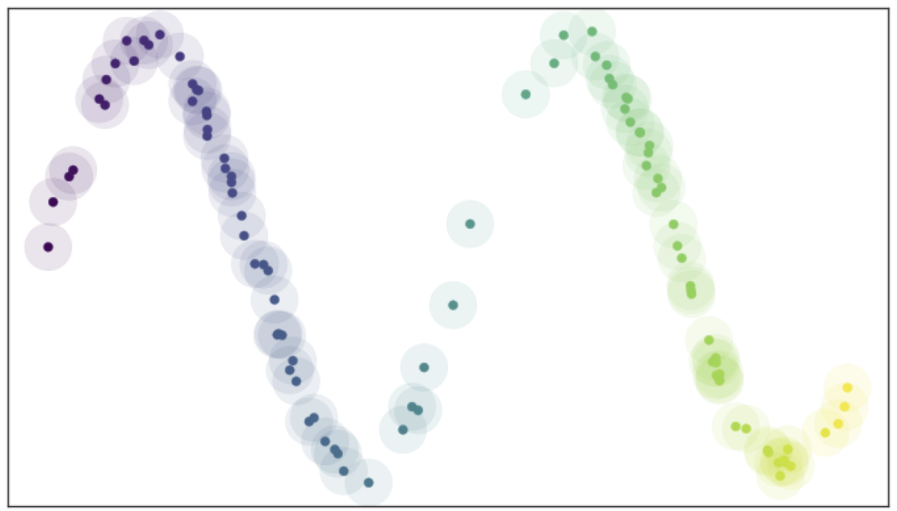
Uniform Manifold Approximation and Projection (UMAP)
How does the UMAP algorithm work?
Find manifold from connectivity of nearest neighbor graph
Place hyper-balls (circles in 2-d) of radius r on each point
Nearest neighbors within distance r
Ideal if vertices (observations) uniformly distributed
From UMAP documentation, Leland McInnis, 2018

Slide 52
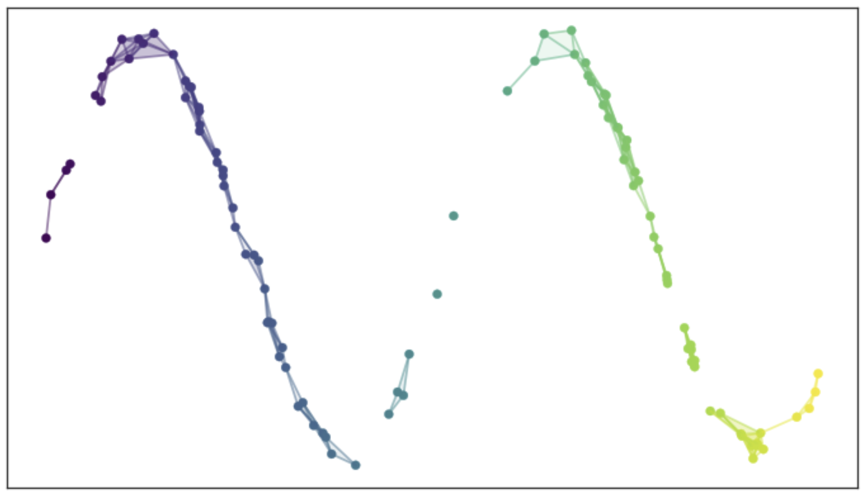
Uniform Manifold Approximation and Projection (UMAP)
How does the UMAP algorithm work?
Edges connect nearest neighbors within distance r
The resulting graph is not ideal!
Graph may have disconnected components
Too dense in some places
Discontinuous in other places
A poor representation of a smooth Reiman manifold
From UMAP documentation, Leland McInnis, 2018

Slide 53
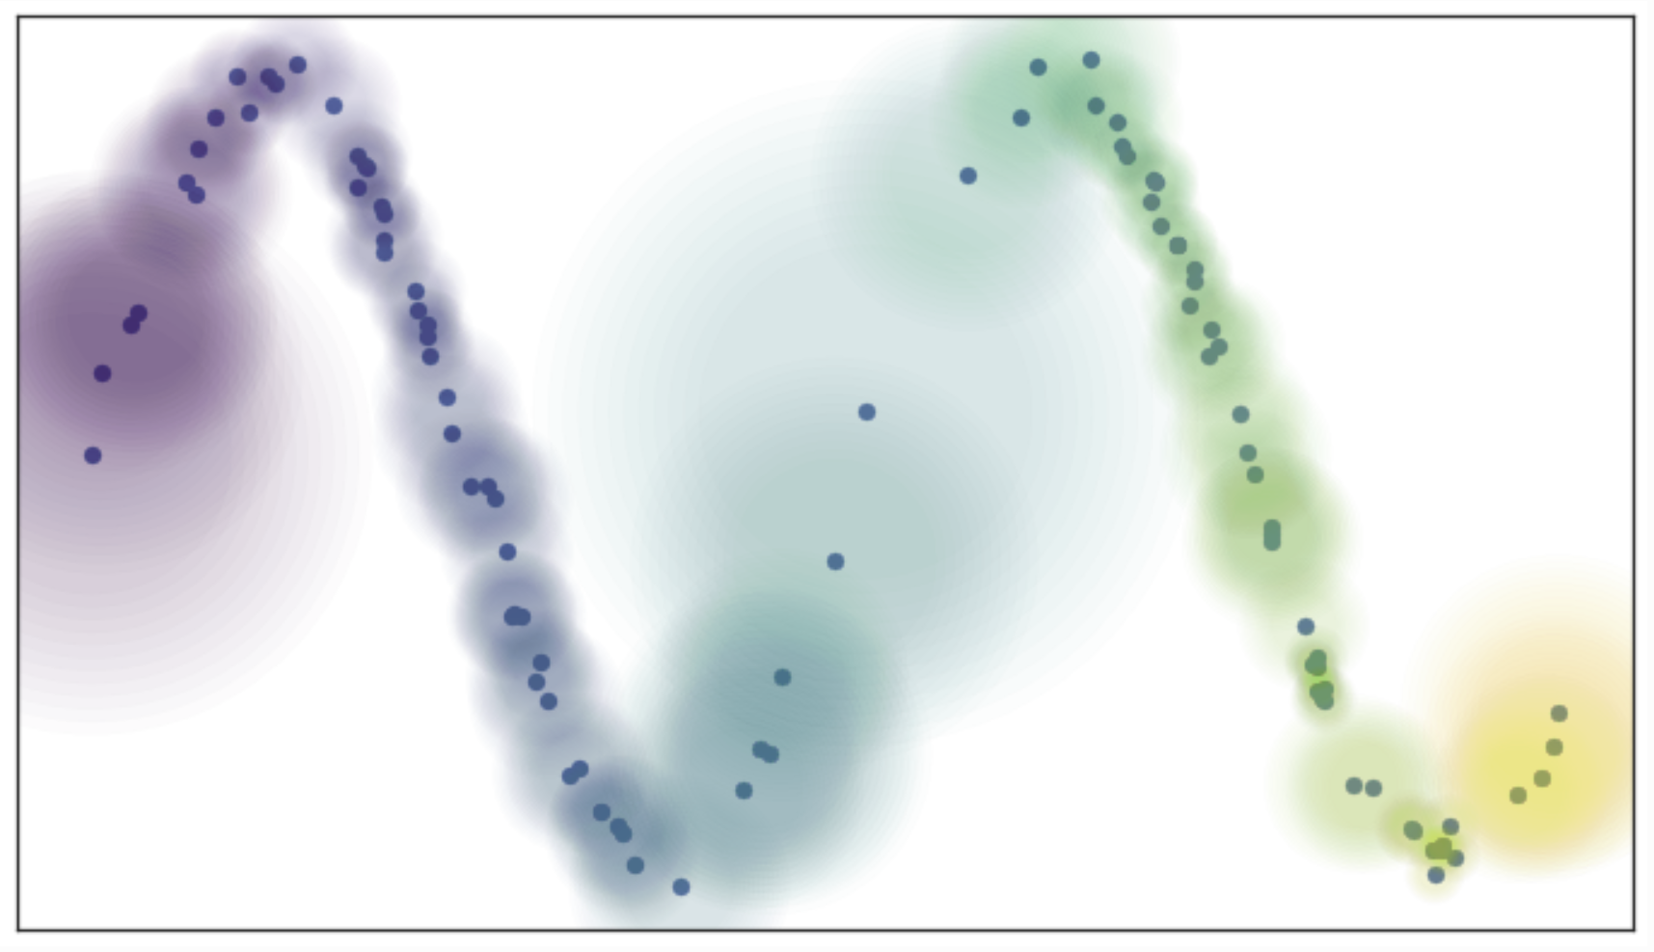
Uniform Manifold Approximation and Projection (UMAP)
How does the UMAP algorithm work?
Use ‘fuzzy balls’ to represent similarity
Example; probability (weight) of connection decays exponentially
Connect vertices on the manifold that are not uniformly distributed
From UMAP documentation, Leland McInnis, 2018

Slide 54
Uniform Manifold Approximation and Projection (UMAP)
How does the UMAP algorithm work?
Size of fuzzy ball determined by local density metric
Works since we assume a Reimann manifold, smooth and continuous first derivatives
From UMAP documentation, Leland McInnis, 2018

Slide 55
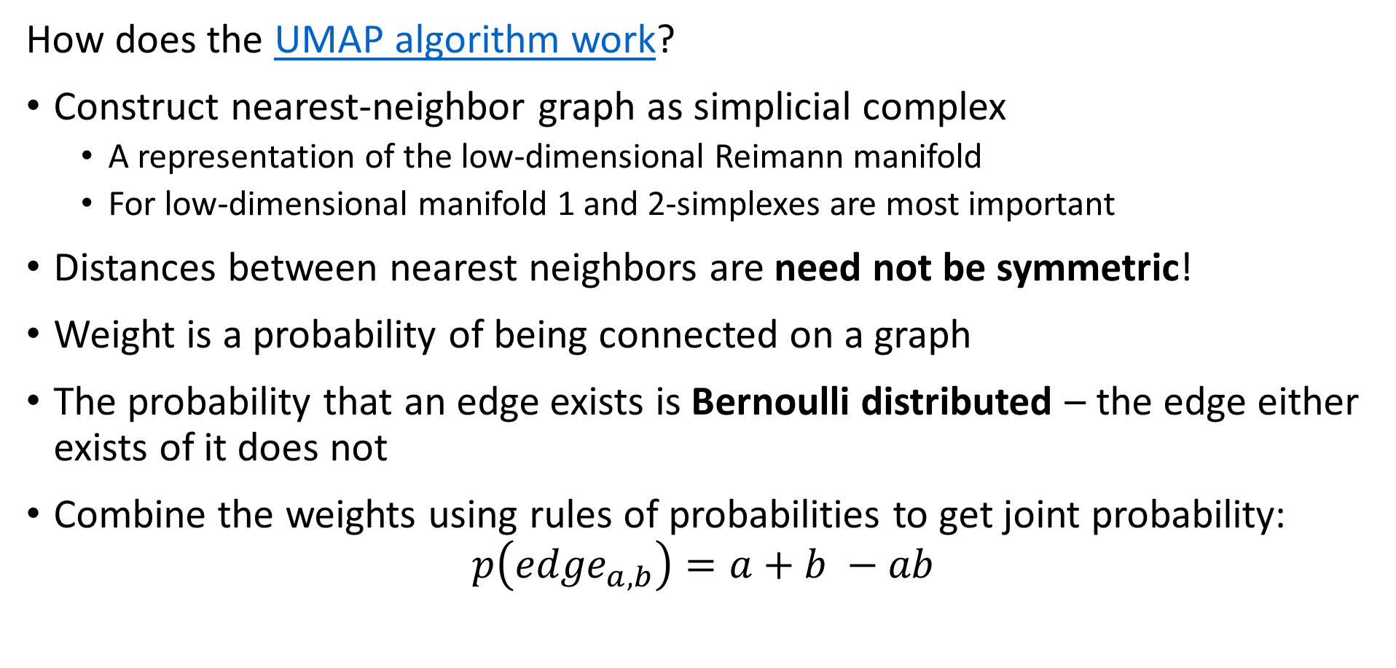
Uniform Manifold Approximation and Projection (UMAP)
How does the UMAP algorithm work?
Construct nearest-neighbor graph as simplicial complex
A representation of the low-dimensional Reimann manifold
For low-dimensional manifold 1 and 2-simplexes are most important
Distances between nearest neighbors are need not be symmetric!
Weight is a probability of being connected on a graph
The probability that an edge exists is Bernoulli distributed – the edge either exists of it does not
Combine the weights using rules of probabilities to get joint probability:
$$p\left({edge}_{a,b}\right)=a+b −ab$$

Slide 56
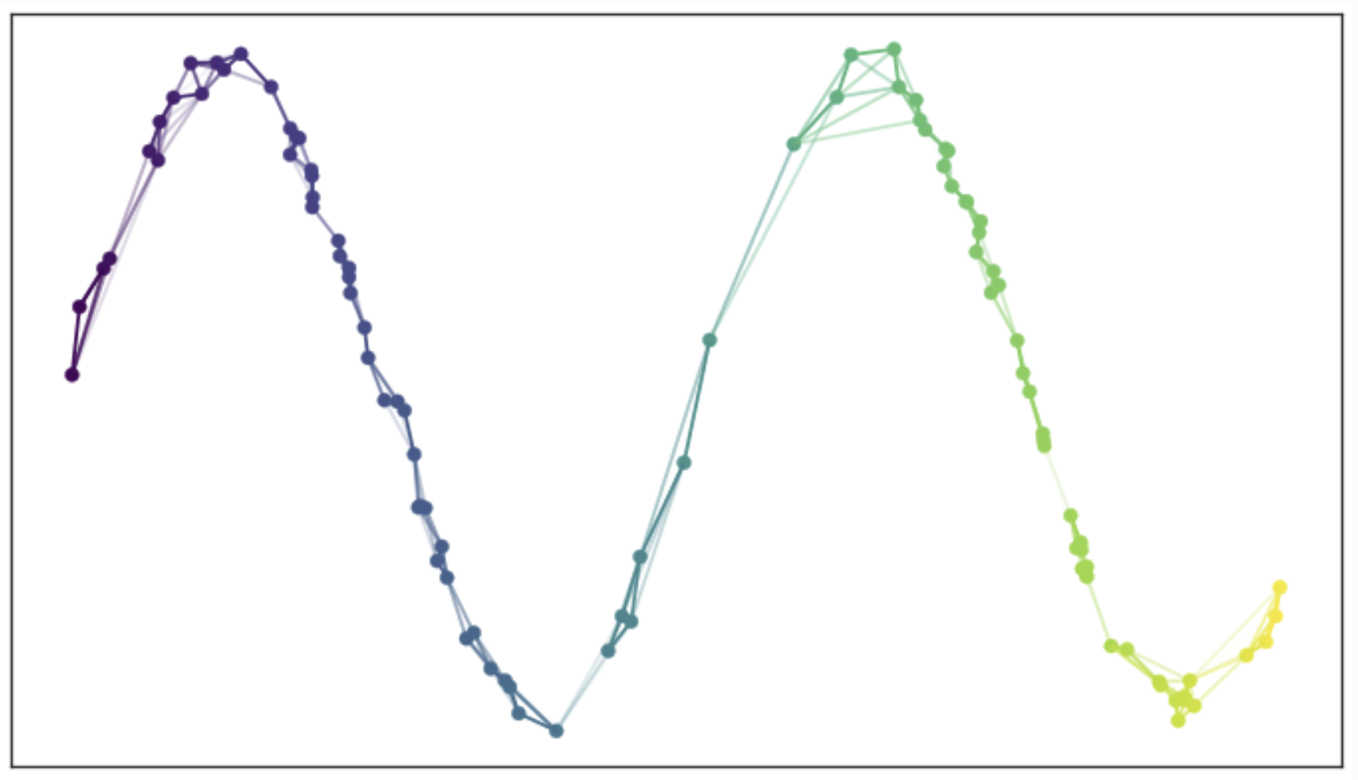
Uniform Manifold Approximation and Projection (UMAP)
How does the UMAP algorithm work?
Use the joint probabilities to define edges
Each observation is now connected to near neighbors in the simplicial complex
Graph is a map of the low-dimensional manifold
From UMAP documentation, Leland McInnis, 2018

Slide 57
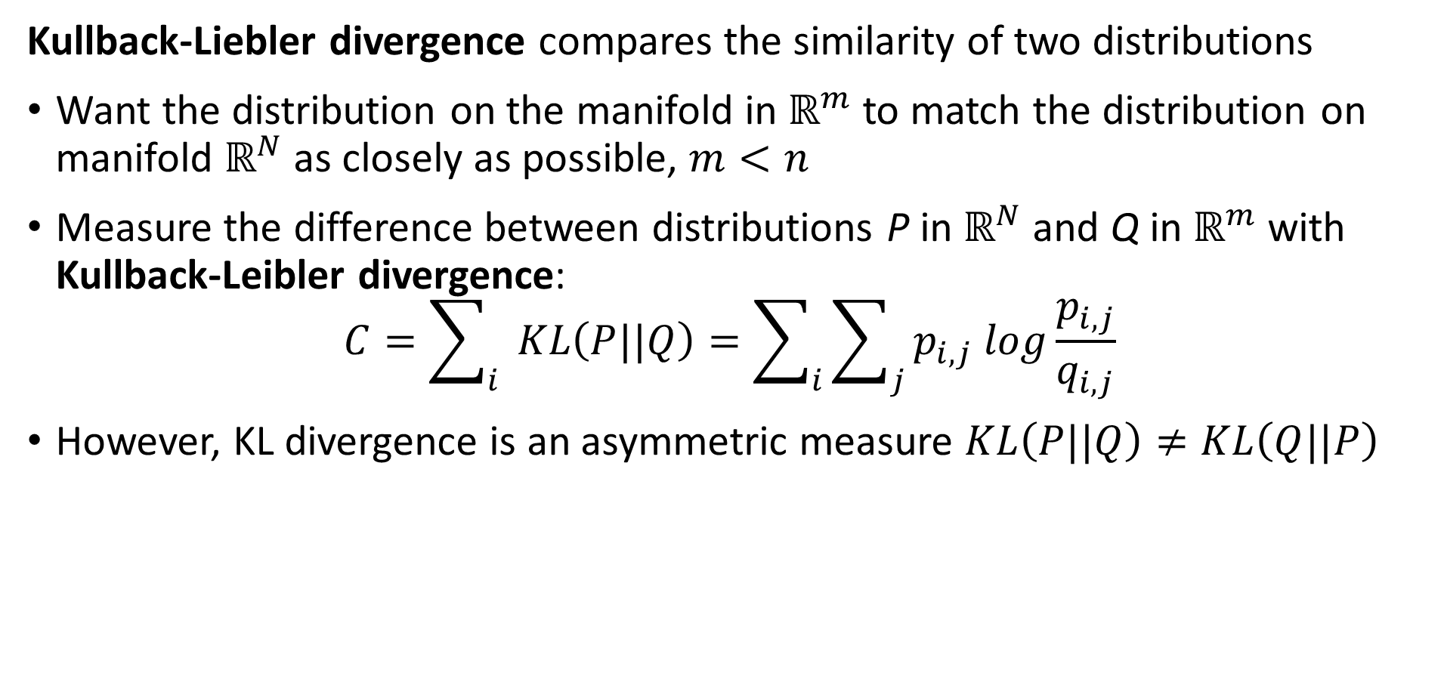
Uniform Manifold Approximation and Projection (UMAP)
Kullback-Liebler divergence compares the similarity of two distributions
Want the distribution on the manifold in $ℝ^{m}$ to match the distribution on manifold $ℝ^{N}$ as closely as possible, $m<n$
Measure the difference between distributions P in $ℝ^{N}$ and Q in $ℝ^{m}$ with Kullback-Leibler divergence:
$$C=\sum_{i}{ }KL\left(P||Q\right)=\sum_{i}{\sum_{j}{p_{i,j} log\frac{p_{i,j}}{q_{i,j}}}}$$
However, KL divergence is an asymmetric measure $KL\left(P||Q\right)≠KL\left(Q||P\right)$

Slide 58
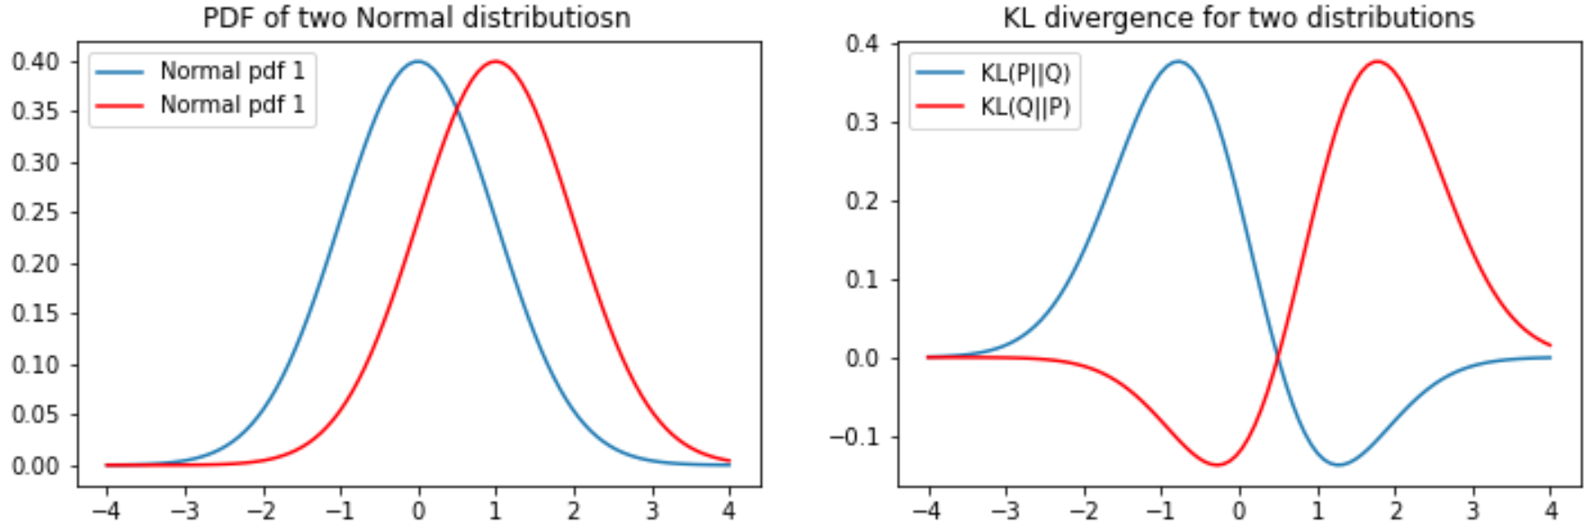
KL Divergence
The KL divergence is asymmetric
For two distributions the KL divergence depend on the order or arguments
Notice that the gradient becomes near zero on one side of the KL function

Slide 59
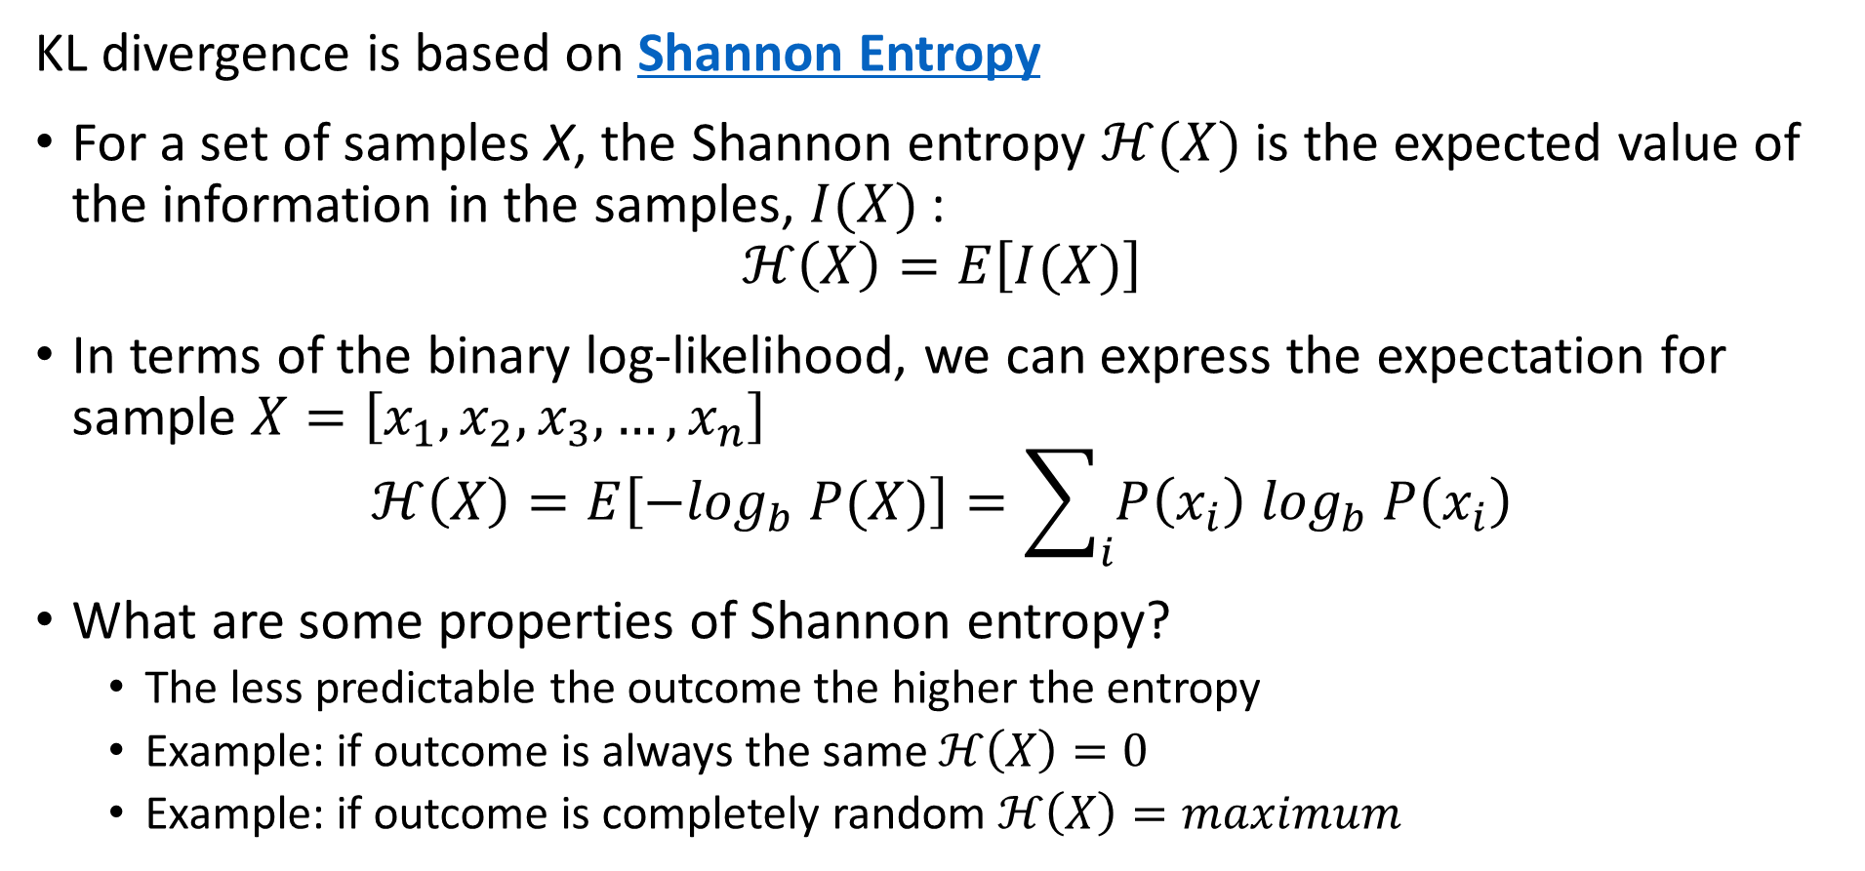
KL Divergence
KL divergence is based on Shannon Entropy
For a set of samples X, the Shannon entropy $ℋ(X)$ is the expected value of the information in the samples, $I(X)$:
$$ℋ\left(X\right)=E\left[I(X)\right]$$
In terms of the binary log-likelihood, we can express the expectation for sample $X=\left[x_{1},x_{2},x_{3},…,x_{n}\right]$
$$ℋ\left(X\right)=E\left[{−log}_{b} P(X)\right]=\sum_{i}{P\left(x_{i}\right) \log_{b} P\left(x_{i}\right)}$$
What are some properties of Shannon entropy?
The less predictable the outcome the higher the entropy
Example: if outcome is always the same $ℋ\left(X\right)=0$
Example: if outcome is completely random $ℋ\left(X\right)=maximum$

Slide 60
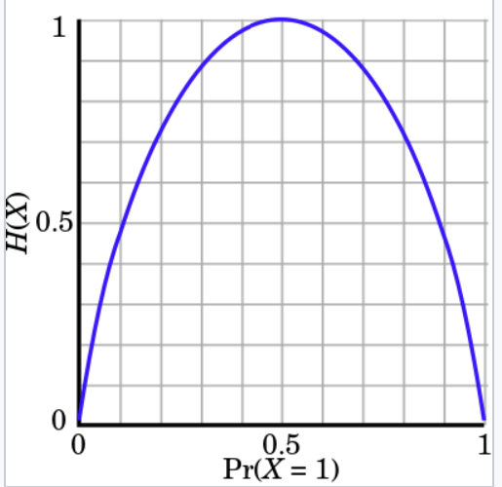
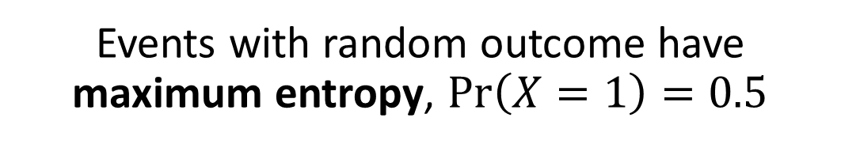
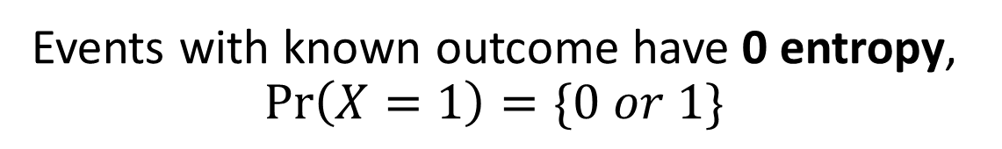
KL Divergence
Events with random outcome have maximum entropy, $\operatorname{Pr}\left(X=1\right)=0.5$
Understanding Shannon Entropy
Example: binomially distributed events
Events with known outcome have 0 entropy, $\operatorname{Pr}\left(X=1\right)=\{0 or 1\}$
Credit: Wikipedia commons

Slide 61
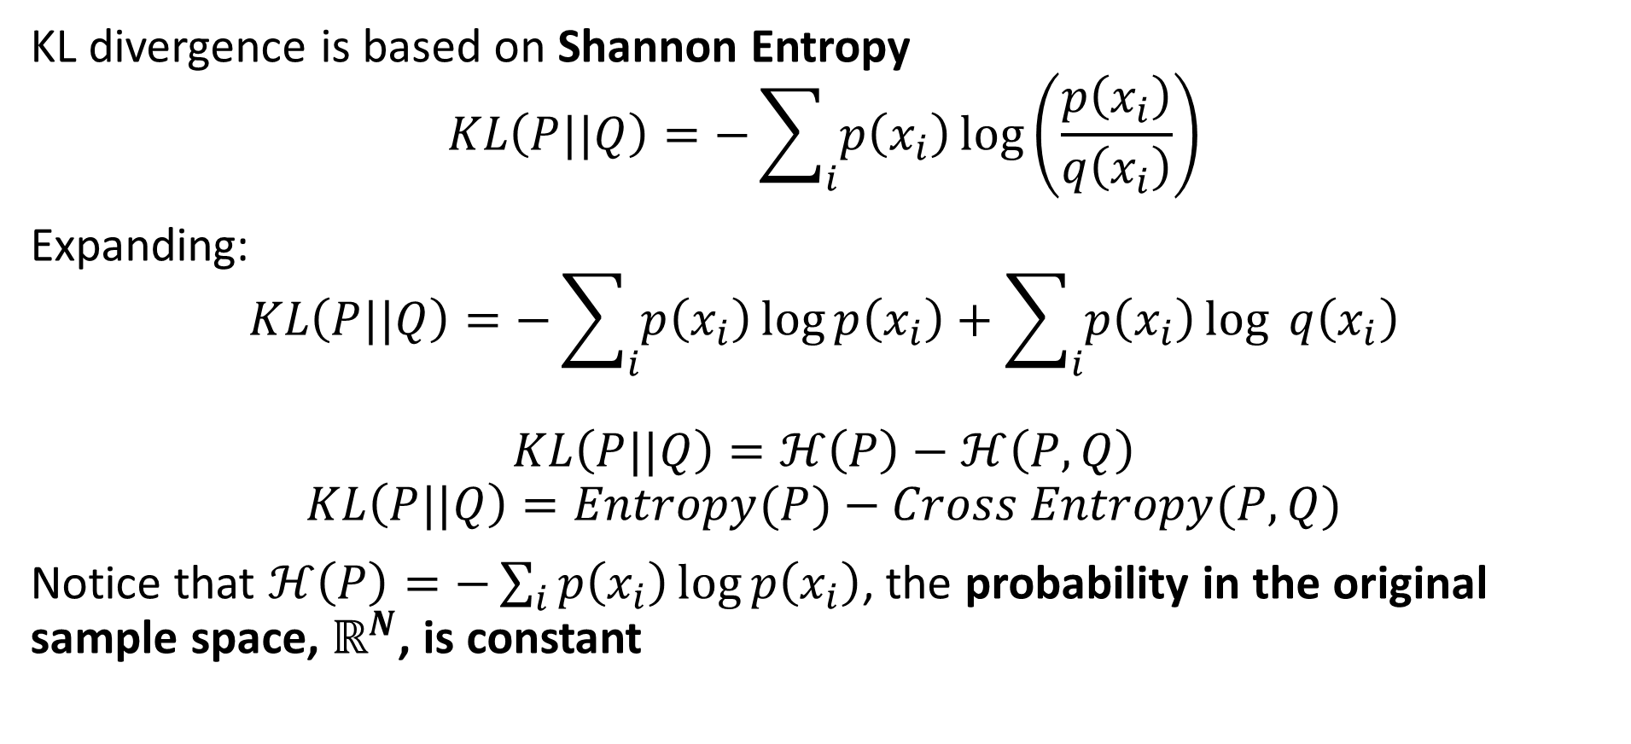
KL Divergence
KL divergence is based on Shannon Entropy
$$KL\left(P||Q\right)=−\sum_{i}{p\left(x_{i}\right)}\log\left(\frac{p\left(x_{i}\right)}{q\left(x_{i}\right)}\right)$$
Expanding:
$$KL\left(P||Q\right)=−\sum_{i}{p\left(x_{i}\right)}\log{p\left(x_{i}\right)}+\sum_{i}{p\left(x_{i}\right)}\log{q\left(x_{i}\right)}$$
$$KL\left(P||Q\right)=ℋ\left(P\right)−ℋ\left(P,Q\right)$$
$$KL\left(P||Q\right)=Entropy(P)−Cross Entropy(P,Q)$$
Notice that $ℋ\left(P\right)=−\sum_{i}{p\left(x_{i}\right)}\log{p\left(x_{i}\right)}$, the probability in the original sample space, $ℝ^{N}$, is constant

Slide 62
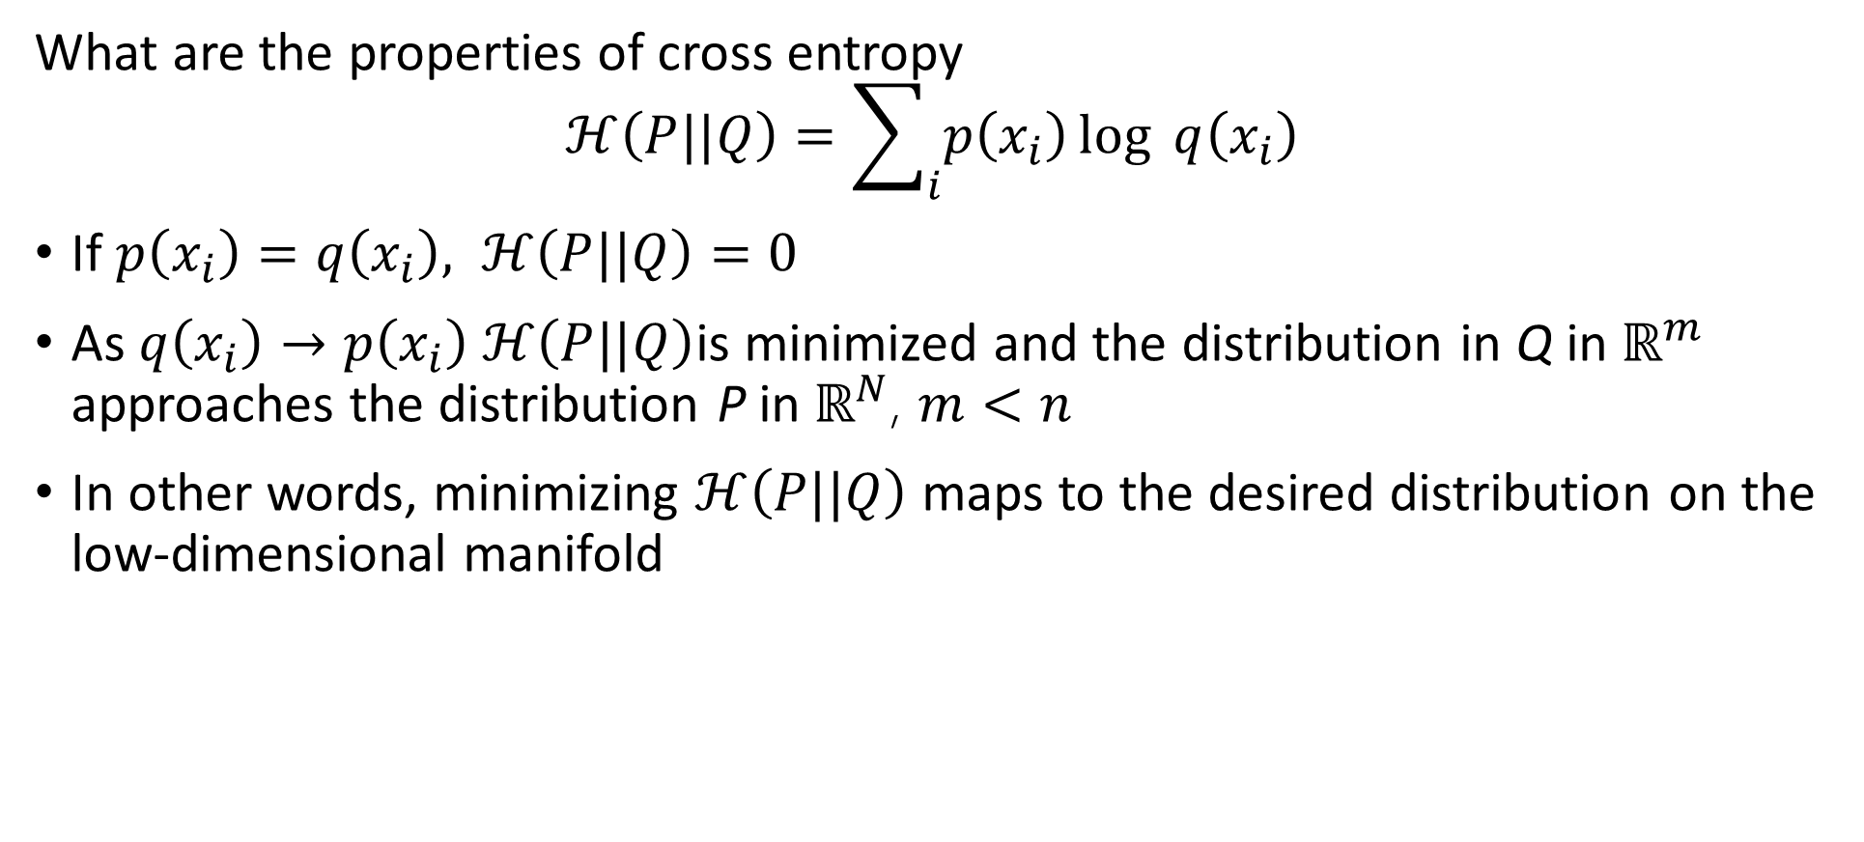
KL Divergence
What are the properties of cross entropy
$$ℋ\left(P||Q\right)=\sum_{i}{p\left(x_{i}\right)}\log{q\left(x_{i}\right)}$$
If $p\left(x_{i}\right)=q\left(x_{i}\right), ℋ\left(P||Q\right)=0$
As $q\left(x_{i}\right)→p\left(x_{i}\right) ℋ\left(P||Q\right)$is minimized and the distribution in Q in $ℝ^{m}$ approaches the distribution P in $ℝ^{N}$, $m<n$
In other words, minimizing $ℋ\left(P||Q\right)$ maps to the desired distribution on the low-dimensional manifold

Slide 63
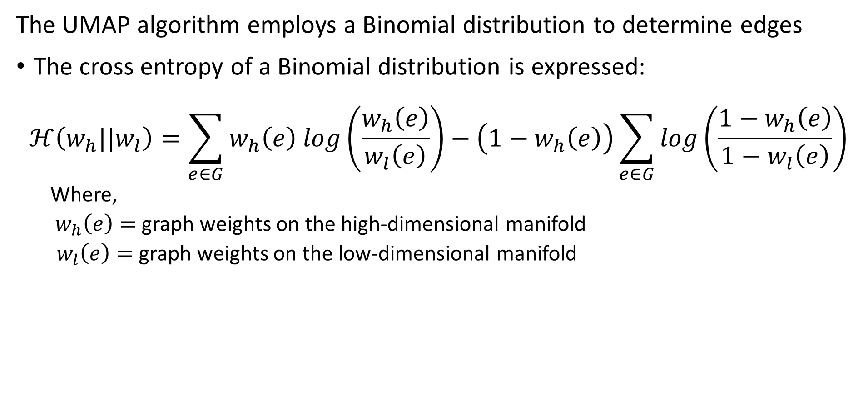
Uniform Manifold Approximation and Projection (UMAP)
The UMAP algorithm employs a Binomial distribution to determine edges
The cross entropy of a Binomial distribution is expressed:
$$ℋ\left(w_{h}||w_{l}\right)=\sum_{e∈G}^{ }{w_{h}\left(e\right) log\left(\frac{w_{h}\left(e\right)}{w_{l}\left(e\right)}\right)−\left(1−w_{h}\left(e\right)\right)\sum_{e∈G}^{ }{log\left(\frac{1−w_{h}\left(e\right)}{1−w_{l}\left(e\right)}\right)}}$$
Where,
$w_{h}\left(e\right)=$ graph weights on the high-dimensional manifold
$w_{l}\left(e\right)=$ graph weights on the low-dimensional manifold

Slide 64
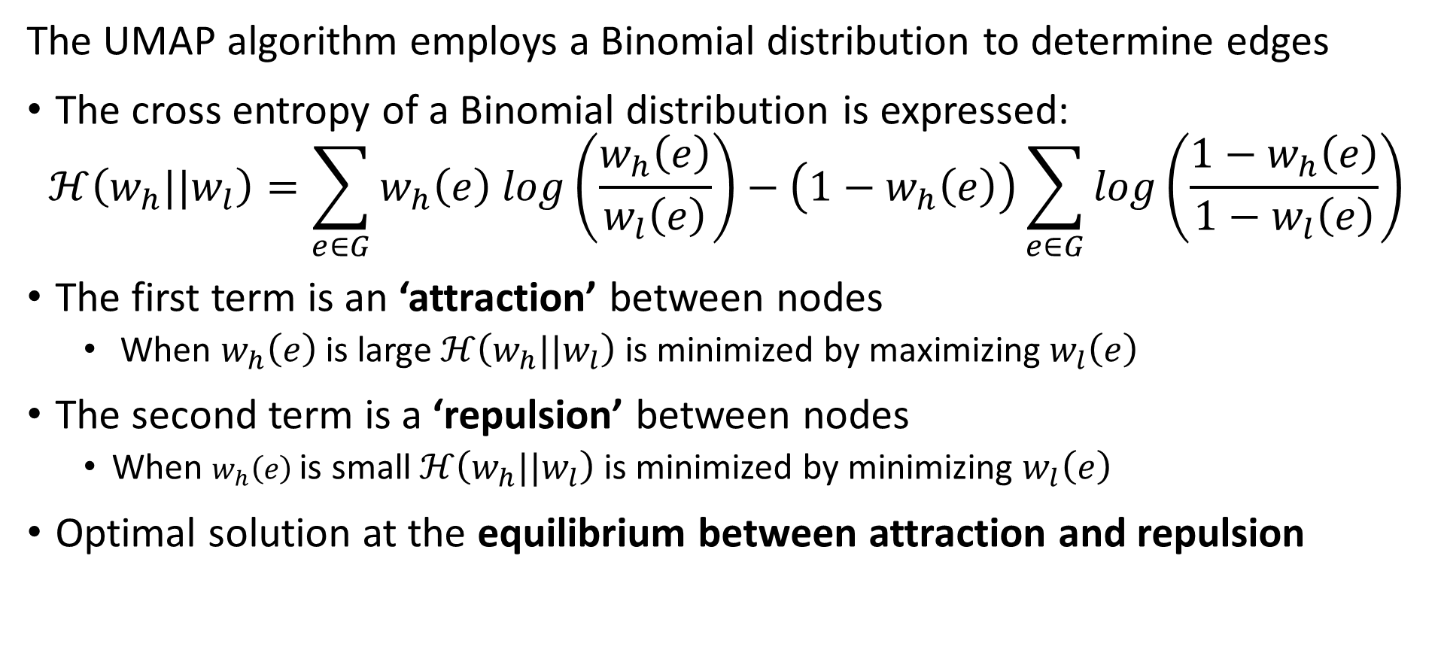
Uniform Manifold Approximation and Projection (UMAP)
The UMAP algorithm employs a Binomial distribution to determine edges
The cross entropy of a Binomial distribution is expressed:
$$ℋ\left(w_{h}||w_{l}\right)=\sum_{e∈G}^{ }{w_{h}\left(e\right) log\left(\frac{w_{h}\left(e\right)}{w_{l}\left(e\right)}\right)−\left(1−w_{h}\left(e\right)\right)\sum_{e∈G}^{ }{log\left(\frac{1−w_{h}\left(e\right)}{1−w_{l}\left(e\right)}\right)}}$$
The first term is an ‘attraction’ between nodes
When $w_{h}\left(e\right)$is large $ℋ\left(w_{h}||w_{l}\right)$ is minimized by maximizing $w_{l}\left(e\right)$
The second term is a ‘repulsion’ between nodes
When $w_{h}\left(e\right)$is small $ℋ\left(w_{h}||w_{l}\right)$ is minimized by minimizing $w_{l}\left(e\right)$
Optimal solution at the equilibrium between attraction and repulsion

Slide 65
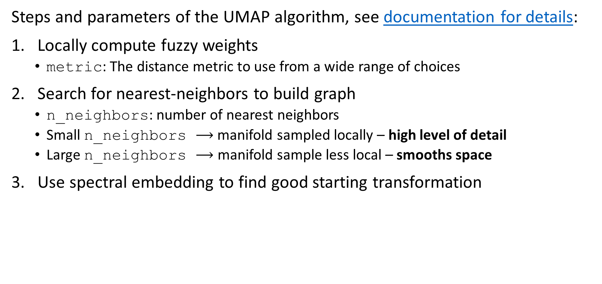
Uniform Manifold Approximation and Projection (UMAP)
Steps and parameters of the UMAP algorithm, see documentation for details:
Locally compute fuzzy weights
metric: The distance metric to use from a wide range of choices
Search for nearest-neighbors to build graph
n_neighbors: number of nearest neighbors
Small n_neighbors $⟶$ manifold sampled locally – high level of detail
Large n_neighbors $⟶$ manifold sample less local – smooths space
Use spectral embedding to find good starting transformation

Slide 66
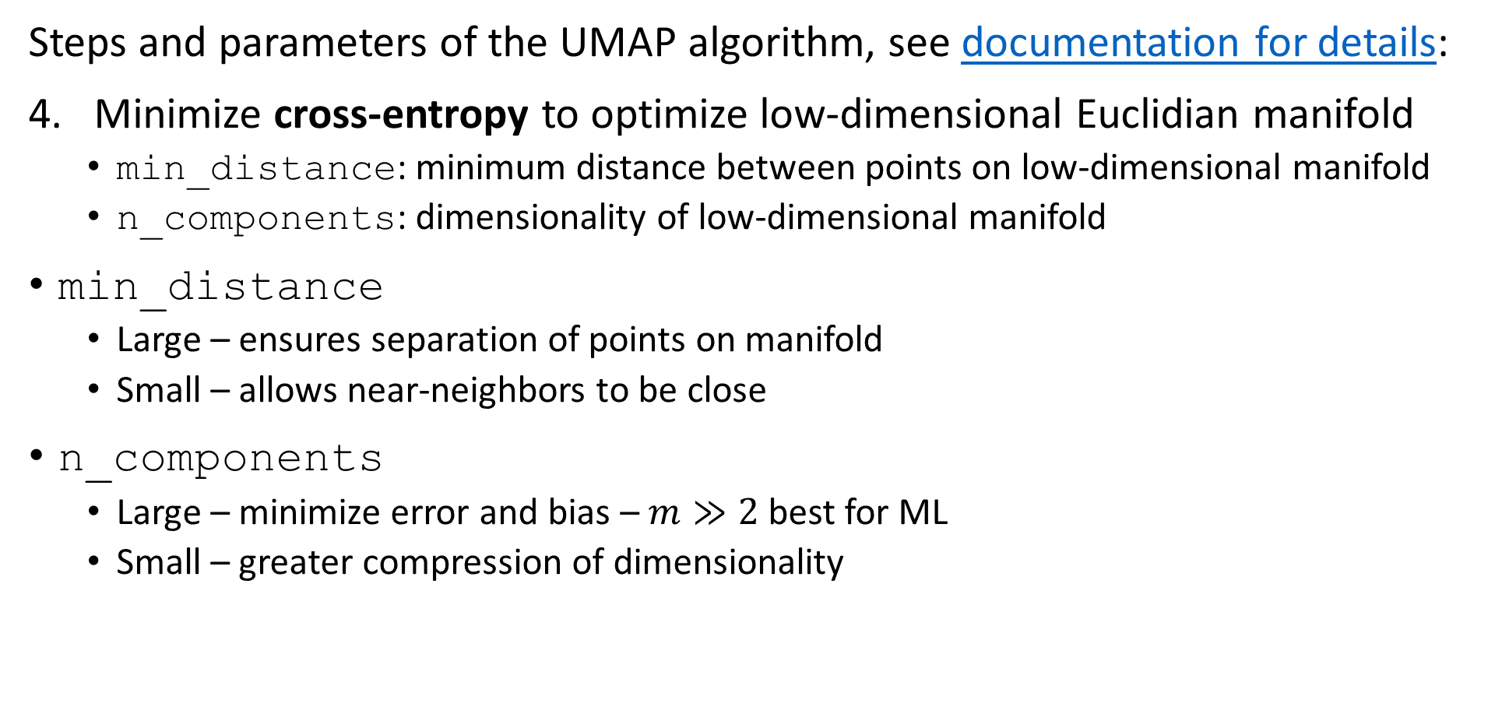
Uniform Manifold Approximation and Projection (UMAP)
Steps and parameters of the UMAP algorithm, see documentation for details:
Minimize cross-entropy to optimize low-dimensional Euclidian manifold
min_distance: minimum distance between points on low-dimensional manifold
n_components: dimensionality of low-dimensional manifold
min_distance
Large – ensures separation of points on manifold
Small – allows near-neighbors to be close
n_components
Large – minimize error and bias – $m≫2$ best for ML
Small – greater compression of dimensionality

Slide 67
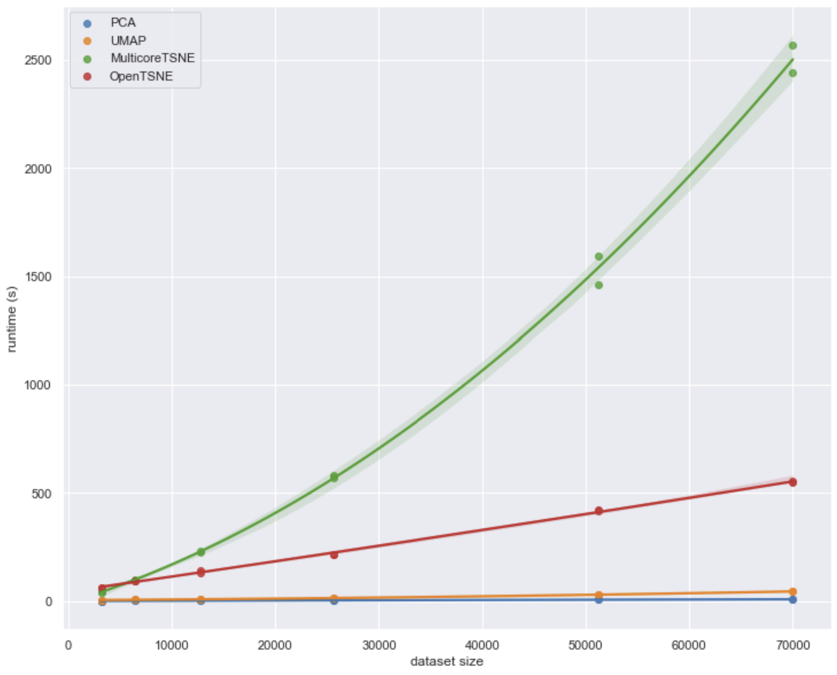
Uniform Manifold Approximation and Projection (UMAP)
How does UMAP performance compare?
From UMAP documentation, Leland McInnis, 2018

Slide 68
Summary
Dimensionality reduction is widely used in data mining
Review of high-dimensional spaces and the Curse of Dimensionality
PCA and SVD are efficient linear algorithms
Find linear projections to lower dimensional hyperplane
SVD applied directly to rectangular model matrix, no need to compute covariance matrix
Manifold learning for nonlinear dimensionality reduction and visualization in high dimensions
Project to low dimensional manifold
Can be distance preserving
UMAP is (arguably) the state-of-the-art manifold learning algorithm

