Slide 1

CSCI E-108 Data Mining, Discovery and Exploration Introduction and Pitfalls
Steve Elston
Copyright 2021, 2022, 2023 2024, 2025 Stephen F Elston. All rights reserved.

Slide 2
Overview of Today’s Lesson
What is data mining?
Data mining is the science of knowledge discovery
About this course
Data mining often uses massive data sets
Manage massive data with key-values pairs and hashing
Knowledge discovery requires inference
Inference for complex data must control false discovery rate

Slide 3
What is data mining?
Data mining is the science of actionable knowledge discovery from inferences on massive datasets
Known as knowledge discovery and data mining (KDD)
Data mining is an iterative process of exploration
Exploration is difficult
Many steps
Only some attempts work
Try lots of ideas, fail fast, keep the ones that work!
Keep this in mind when doing your graduate project!

Slide 4
What is data mining?
Data mining (KDD) is generally performed at large scale
Dataset size has grown nearly exponentially
More importantly, dataset and problem complexity has grown
Data mining is at the intersection of several subjects
Statistics: What of significance can we learn from the data?
Mathematics: How do we represent a model of the data as, say, a graph?
Algorithms: How do we efficiently find important relationships in massive datasets?
Technology: How do we manage and process massive datasets?

Slide 5
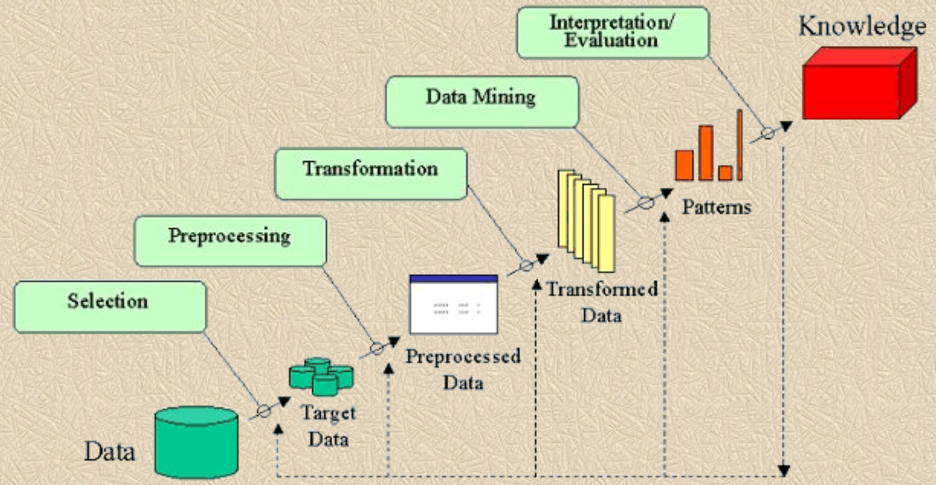
KDD process
What is the KDD process?
Is this old diagram representative? - e.g. Fayyad et.al. 1996

Slide 6
KDD process
What is the KDD process?
Is this diagram representative of today’s process?
Perhaps or perhaps not?
Must have a clear idea of goal!
Multiple complex data sources
Need to perform in-depth exploration of data and inferences at every step!!
KDD is an iterative process
The results of one step informs updates to previous steps
Process is a series of overlapping cycles

Slide 7
About This Course

Slide 8
About your Instructor: Steve Elston
Instructor for Harvard since 2017
Data science consultant with several decades of experience
Lead team that commercialized Bell Labs S, now open-source R
Company co-founder and held executive positions in several industries
Creator of multiple edX courses, author of books and articles
Inventor/coinventor on 5 issued patents
BS, physics and math (minor), University of New Mexico
MS and PhD, geophysics, Princeton University – John von Neuman Supercomputing Fellow
I love anything to do with natural history and the outdoors

Slide 9
Teaching Assistant: Tatyana Boland
MBA in Finance from Texas A&M
MLA from Harvard Extension School in Sustainability & Environmental Management
BA in Political Science from University of Washington
Program manager for cloud products at Nvidia
Worked previously at Oracle OCI as Principal Technical Program Manager in Physical Networking team
Loves playing the piano and playing and with my cats

Slide 10

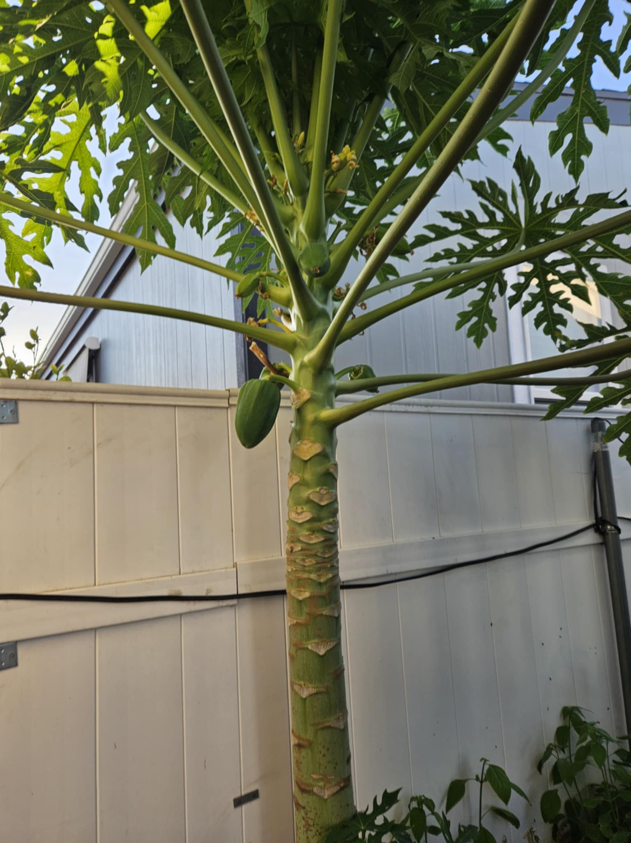
Teaching Assistant: Waree Protprommart
ALM Student in Data Science at HES
BS in Biology from Mount Saint Mary’s University
Disaster planning and information at the American Red Cross
Substitute teaching K-12 part-time for STEM subjects
Worked as a research technician at the California Institute of Technology
Interned at the UCLA School of Engineering, researching a 6-degree-of-freedom robotic arm hand signal detection.
Hobbies: Surfing, Hiking, Camping, Gardening, Zumba, Lying down and watching TV

Slide 11
What can you gain from this course?
Our overarching objective is giving you a deep understand of the algorithms forming the backbone of todays massive scale analytics
Lean how to work with highly scalable analytic KDD methods and algorithms
Good algorithms have long staying power
Understand algorithm performance analysis
Good algorithms are the essential to scaling
Good algorithm can scale analysis by orders of magnitude
Better algorithms beats throwing hardware at the problem
Deliberately minimize data engineering required for course
Wide and constantly changing landscape of Big Data platforms
Other Harvard DCE courses explore big data engineering

Slide 12
What is the focus of this course?
Data mining is exploratory and is often Unsupervised
Use algorithms with massive scalability
Key-value management and hashing algorithms
Scalable approximate algorithms analytic algorithms
Focus on unsupervised learning
Approximate similarity search algorithms are massively scalable
Ranking for recommenders, web search, RAG algorithms, etc.
Clustering models for exploration of complex data sets
Algorithms for infinite data – streaming data
Dimensionality reduction algorithms
Graphs models
How to apply efficient graph representations and algorithms?

Slide 13
What is the focus of this course?
Topics we (mostly) avoid in this course
Supervised machine learning
Data mining is focused on exploration and knowledge discovery, not prediction!
Some supervised machine learning is useful in data mining
Supervised machine learning covered in-depth in other DCE courses
Most deep learning
Promising deep NN data mining algorithms are emerging
In some cases, deep NN algorithm provide more accurate results
But, NN algorithms are generally much less scalable!
In practice, more and better data is usually more important!

Slide 14
How are the topics in this course connected?
7. Recommender Algorithms
11. Association Models
Taks Speific Algorithms
4. Graph and Social Network Analysis
8. Web/Document Search
3. Streaming Algorithms
9. Clustering Algorithms
Core Algorithms
10. Dimensionality Reduction
6. Similarity Search and NN Algorithms
2. Hashing and K-V pair management
5. Distance and Similarity Metrics
1. Large-Scale Statistics
Foundations

Slide 15
Schedule
Schedule for live class meetings
Wednesdays – Lectures focused on theoretical foundations – 6:00 to 8:00 pm US Eastern Time
Mondays – Section meeting to address your questions, review and background – starting at 6:00 pm US Eastern Time
All class meetings are recorded and available on-demand – See Class Recordings tab in Canvas

Slide 16
Schedule
Schedule for live class meetings
Mondays and Wednesdays – Lectures focused on theoretical foundations - 6:30-9:30 pm US Eastern Time
Most lessons less than 3 hours
Tuesdays and Thursdays – Section meeting to address questions, discuss code, background review – starting at 6:30 pm US Eastern Time
One-on-one meetings can be held by arrangement
All class meetings are recorded and available on-demand – See Class Recordings tab in Canvas

Slide 17
Pace of this course
Harvard Summer School session is only 7 weeks!
Expect an intense pace!
Course moves at twice the rate of a regular semester
Lesson and assignments cover all material of the regular 15-week semester
Assignment deadlines are important
One or two assignments due every week!
Do not fall behind!!
Expect 9 assignments plus online discussion questions
There is no time to ‘catch up’!

Slide 18
Undergraduate Credit Grading
Students enrolled for undergraduate credit are evaluated by the following weights:
10% Class Participation – Class participation in online discussions
90% Assignments – Hands-on assignments for most lessons
Expect 9 assignments

Slide 19
Graduate Credit Grading
Students enrolled for graduate credit are evaluated by the following weights:
10% Class Participation – Class participation in online discussions
65% Assignments – Hands-on assignments for most lessons
Expect 9 assignments
5% Project proposal – Proposal describing the problem you wish to address and methods you plan to apply. Based on your proposal, your instructor will approve your project as appropriate for the course.
20% Project – Independent data mining project report – More on this next class

Slide 20
Where can you find the course materials?
Read and understand the Syllabus!
Material specific to this course are in the Github repository
Slides
Notebooks for assignments
Data
Supplementary materials for review
Assignment due dates, submissions, and grading in Canvas
Class assignments
Graduate independent projects
Solutions and examples under Modules
Assignments are being revised!
Do not start assignments before they are posted in Canvas
Do a pull on the GitHub repository to get updated notebooks

Slide 21
Where can you find the course materials?
Recommended reading primarily from these texts:
Mining of Massive Datasets, 3rd Ed - .pdf download available
Networks, 2nd edition, Mark Newman Available through the Harvard Coop
Algorithms and data structures for massive datasets, Medjedovic, Dzejla, Tahirovic, Emin, Manning, 2022
Advanced algorithms and data structures, La Rocca, Marcello, Manning, 2021
Data Mining, Concepts and Techniques, 4th Edition, Jiawei Han, Jian Pei, Hanghang Tong, Morgan Kaufmann, 2022
Available as Library Reserves – See tab in Canvas

Slide 22
Communication
Ed Discussion is the primary means of communication for this course
Use Ed Discussion to get help with assignments and projects
It’s okay to post code for your question!
Post code and complete exception messages if you are dealing with code problem!
Graded online class discussions take place in Ed
Private communications regarding matters such as grades
Use private messages in Ed Discussion for fastest response
Or, Steve Elston: stephen_elston at g dot harvard dot edu, Tatyana Boland: tab840 at g dot Harvard dot edu, or Waree Porprommart: wap185 at g dot Harvard dot edu
Private one-on-one appointments on request
Do not use Canvas messages, unless you want a delayed response!

Slide 23
Late Assignment Policy
Timely release of assignment solutions is an important part of the learning process
Harvard Summer School moves at an intense pace!!
Late assignment policy:
Up to one day late - no penalty
Up to 3 days late - less 20%
More than 3 days late - no credit
Make sure you turn in work on time!

Slide 24
Using AI for this course
As AI (LLMs) is becoming a standard tool for professional data scientists, limited use is allowed for this course
Writing & Analysis: Your written reports, question responses and discussion post must be your own original work!
Code Generation: You may use AI to generate small, discrete portions of code.
You may do so for up to 4 instances of up to 20 lines each in an assignment or a report
Required: Include the exact prompt(s) used to generate the code in your submission.
Validation of Results: You are responsible for validating the correctness, efficiency, and security of any AI-generated code.
Attribution & Integrity: Cite AI use per the Harvard Academic Integrity Policy (e.g., "Code generated using [Tool Name] with prompt: ‘...’")
An exception message is a valid prompt
See course syllabus in Canvas for additional details

Slide 25
Late Assignment Policy
Timely release of assignment solutions is an important part of the learning process
Do not fall behind! With 9-10 assignments and a project, there is very little time to “catch-up”
Late assignment policy:
Up to one day late - no penalty
Up to 6 days late - less 20%
More than 6 days late - no credit
Make sure you turn in work on time!

Slide 26
Foundations of Large-Scale Data-Mining

Slide 27
Foundations for Large-Scale Data Mining
Mastering tools for working with and performing inference on massive and complex of data is a core goal for this course
Massive size requires efficient storage and retrieval
Manage data with key-value pairs
Hash keys for efficient storage and retrieval
We apply hashing and ‘sketches’ in future lessons
Complexity requires reliable inference methods
Large number of variables makes false positive inferences likely
Example, spurious correlations
Example, positive hypothesis test from random variation alone
Require methods to control false positive rates

Slide 28
Data Management with Key-Value Pairs

Slide 29
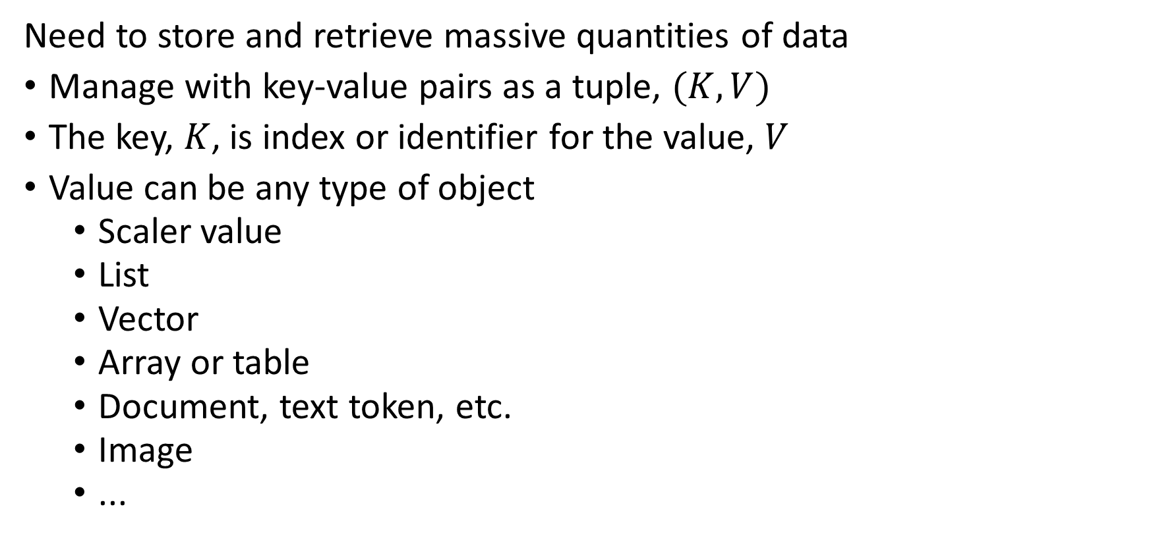
Introduction to key-value indexing
Need to store and retrieve massive quantities of data
Manage with key-value pairs as a tuple, $(K,V)$
The key, $K$, is index or identifier for the value, $V$
Value can be any type of object
Scaler value
List
Vector
Array or table
Document, text token, etc.
Image
...

Slide 30
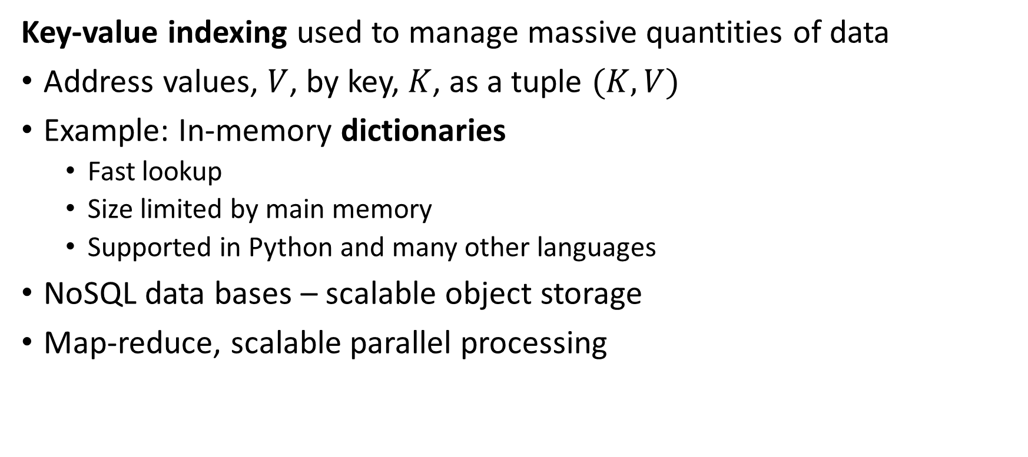
Introduction to key-value indexing
Key-value indexing used to manage massive quantities of data
Address values, $V$, by key, $K$, as a tuple $(K,V)$
Example: In-memory dictionaries
Fast lookup
Size limited by main memory
Supported in Python and many other languages
NoSQL data bases – scalable object storage
Map-reduce, scalable parallel processing

Slide 31
Introduction to key-value indexing
How can we do data management with key-value pairs?
Linear list
Sorted list
Linked list
Balanced trees (B-trees)
Hash tables

Slide 32
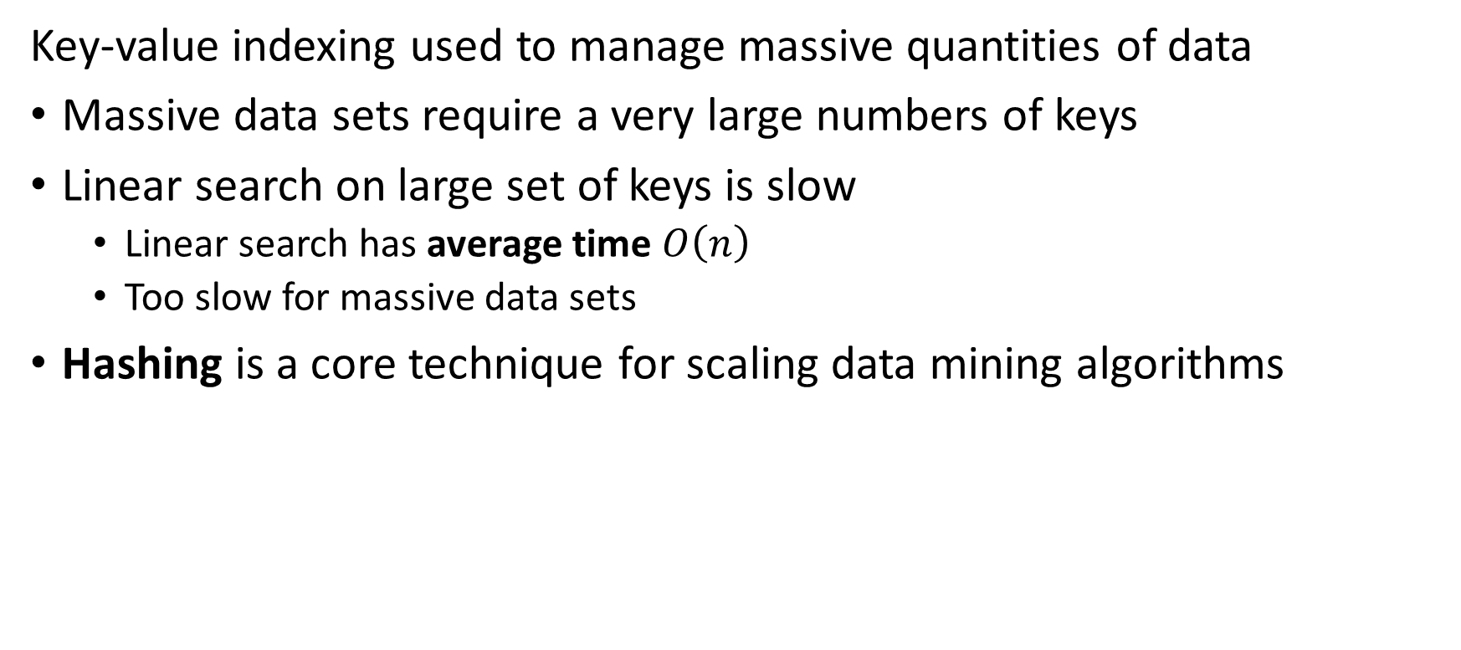
Introduction to key-value indexing
Key-value indexing used to manage massive quantities of data
Massive data sets require a very large numbers of keys
Linear search on large set of keys is slow
Linear search has average time $O\left(n\right)$
Too slow for massive data sets
Hashing is a core technique for scaling data mining algorithms

Slide 33
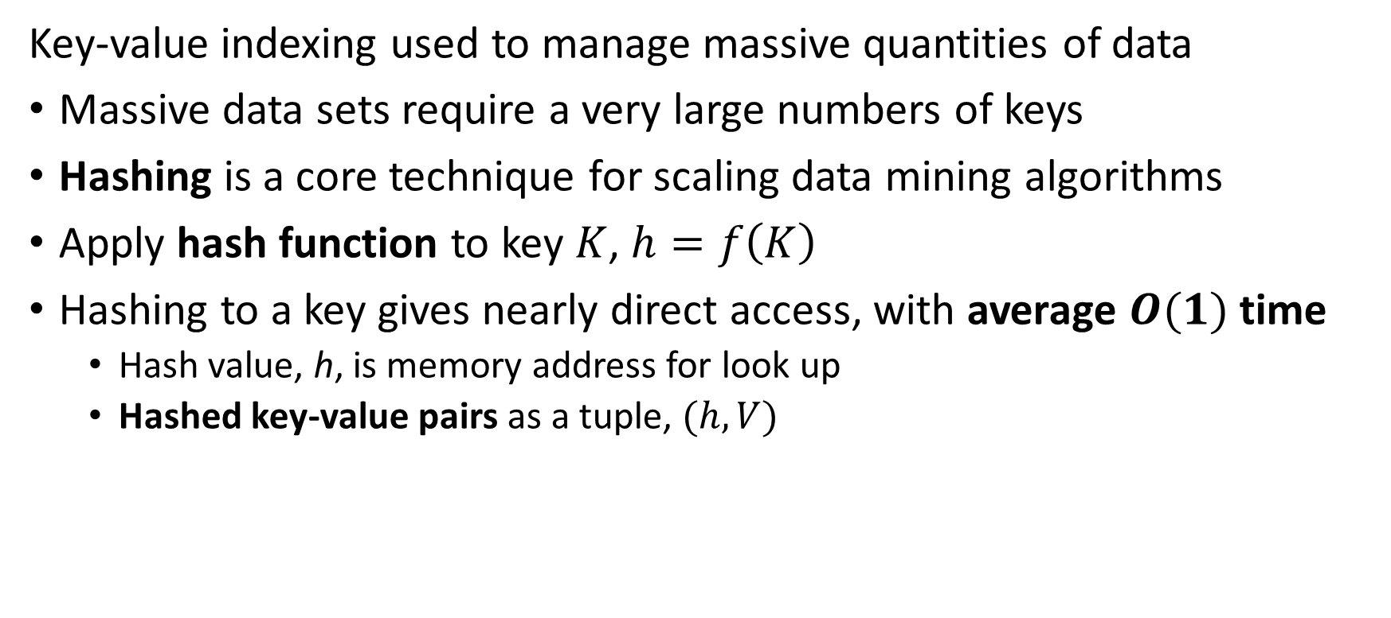
Introduction to key-value indexing
Key-value indexing used to manage massive quantities of data
Massive data sets require a very large numbers of keys
Hashing is a core technique for scaling data mining algorithms
Apply hash function to key $K$, $h=f\left(K\right)$
Hashing to a key gives nearly direct access, with average $O(1)$ time
Hash value, h, is memory address for look up
Hashed key-value pairs as a tuple, $(h,V)$

Slide 34
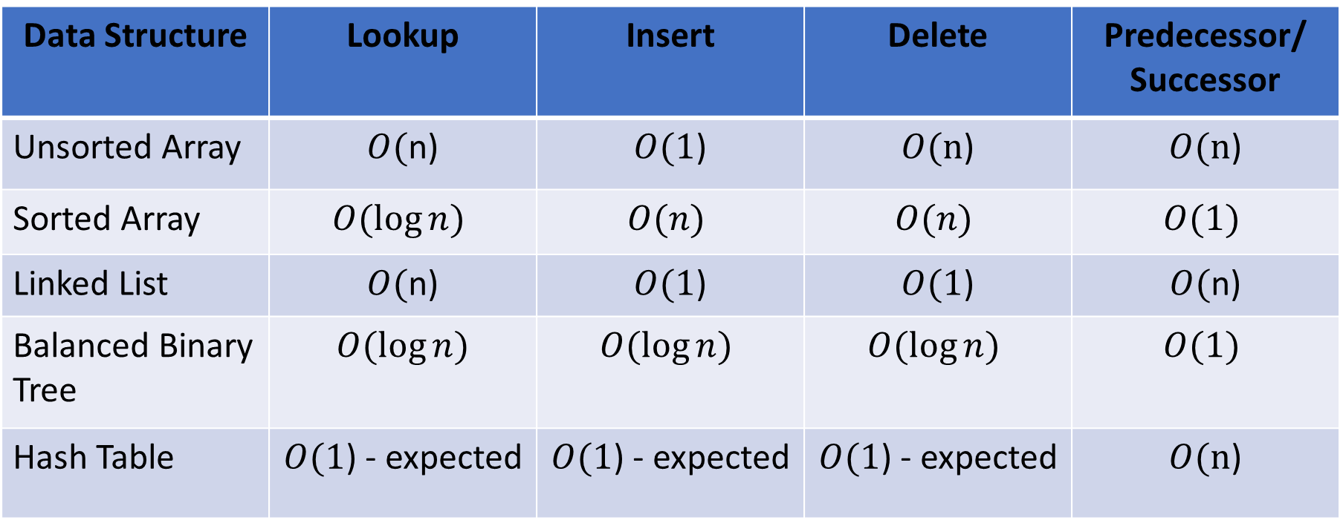
Introduction to key-value indexing
How can we compare data structure options for storage and retrieval of key-value pairs?
Data Structure | Lookup | Insert | Delete | Predecessor/ Successor
Unsorted Array | $O($n) | $O(1$) | $O(n$) | $O(n$)
Sorted Array | $$O(\log{n})$$ | $$O(n)$$ | $$O(n)$$ | $$O(1)$$
Linked List | $O($n) | $O(1$) | $O(1$) | $O($n)
Balanced Binary Tree | $$O(\log{n})$$ | $$O(\log{n})$$ | $$O(\log{n})$$ | $$O(1)$$
Hash Table | $O(1$) - expected | $O(1$) - expected | $O(1$) - expected | $O(n$)

Slide 35
Introduction to Hashing

Slide 36
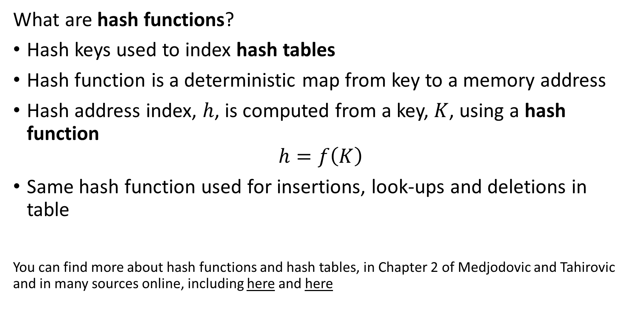
Introduction to Hashing
What are hash functions?
Hash keys used to index hash tables
Hash function is a deterministic map from key to a memory address
Hash address index, $h$, is computed from a key, $K$, using a hash function
$$h=f\left(K\right)$$
Same hash function used for insertions, look-ups and deletions in table
You can find more about hash functions and hash tables, in Chapter 2 of Medjodovic and Tahirovic and in many sources online, including here and here

Slide 37
Introduction to Hashing
Generally speaking, there are two major types of hash functions
Cryptographic hash functions are invertable encodings used to prevent unauthorized access.
Address hash functions compute a sequence of address values for access to buckets of data tables.
There is a body of theory underlying both types of hashes
For data mining we apply address hashes to manage massive datasets

Slide 38

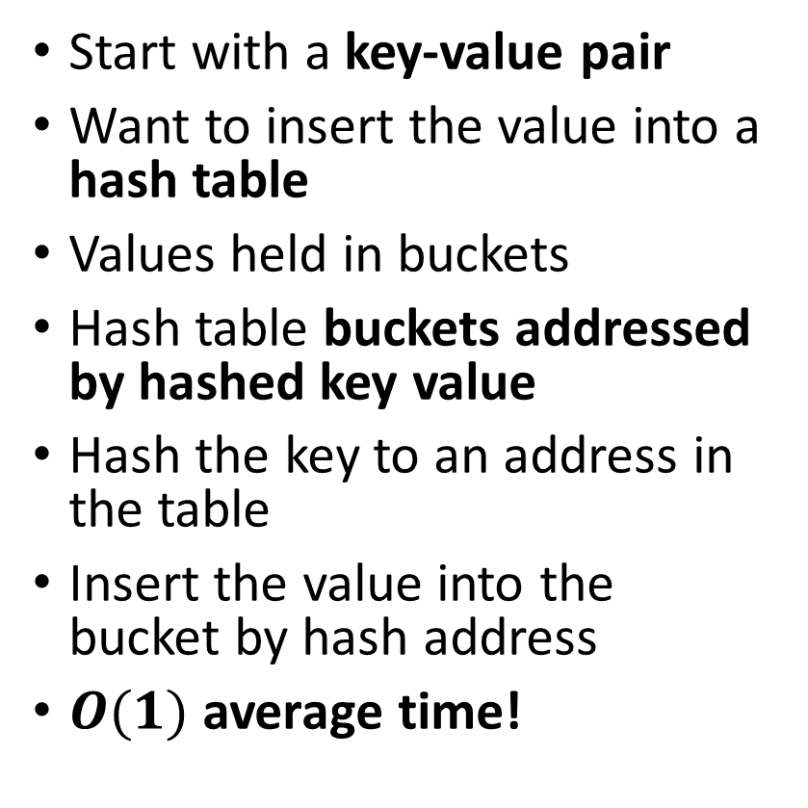
Introduction to Hashing
A hash table uses a hash of a key to index values
Start with a key-value pair
Want to insert the value into a hash table
Values held in buckets
Hash table buckets addressed by hashed key value
Hash the key to an address in the table
Insert the value into the bucket by hash address
$O(1)$ average time!
Hash table
Key-value pair
h₁
v₁
key_{i}
v_{i}
h₂
v₂
h₃
v₃
$$h_{i}=f(key)$$
h_{i}
v_{i}
h_{n}
v_{n}

Slide 39

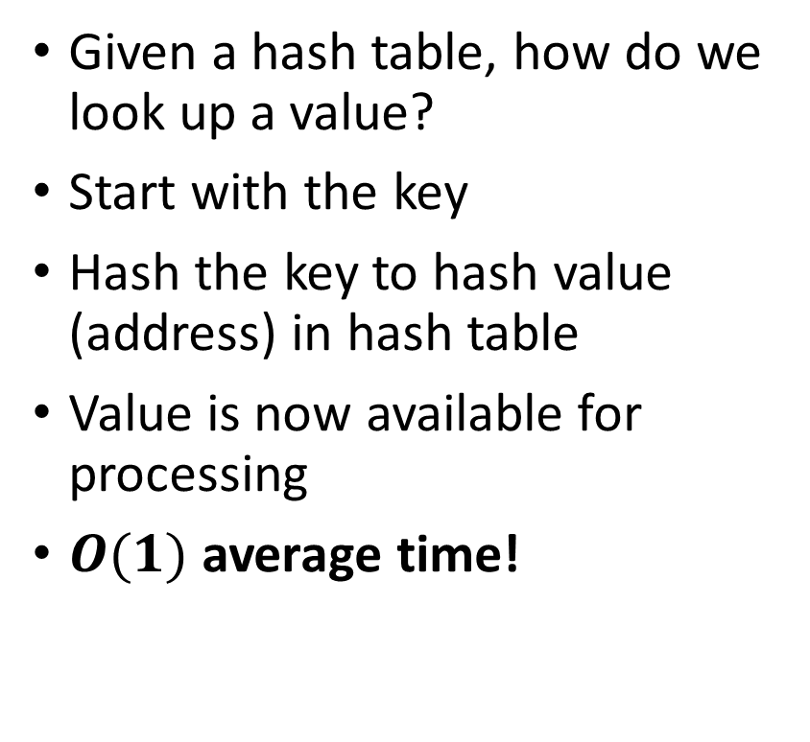
Introduction to Hashing
A hash table uses a hash of a key to index values
Hash table
Given a hash table, how do we look up a value?
Start with the key
Hash the key to hash value (address) in hash table
Value is now available for processing
$O(1)$ average time!
h₁
v₁
key_{i}
h₂
v₂
h₃
v₃
$$h_{i}=f(key)$$
h_{i}
v_{i}
v_{i}
h_{n}
v_{n}

Slide 40
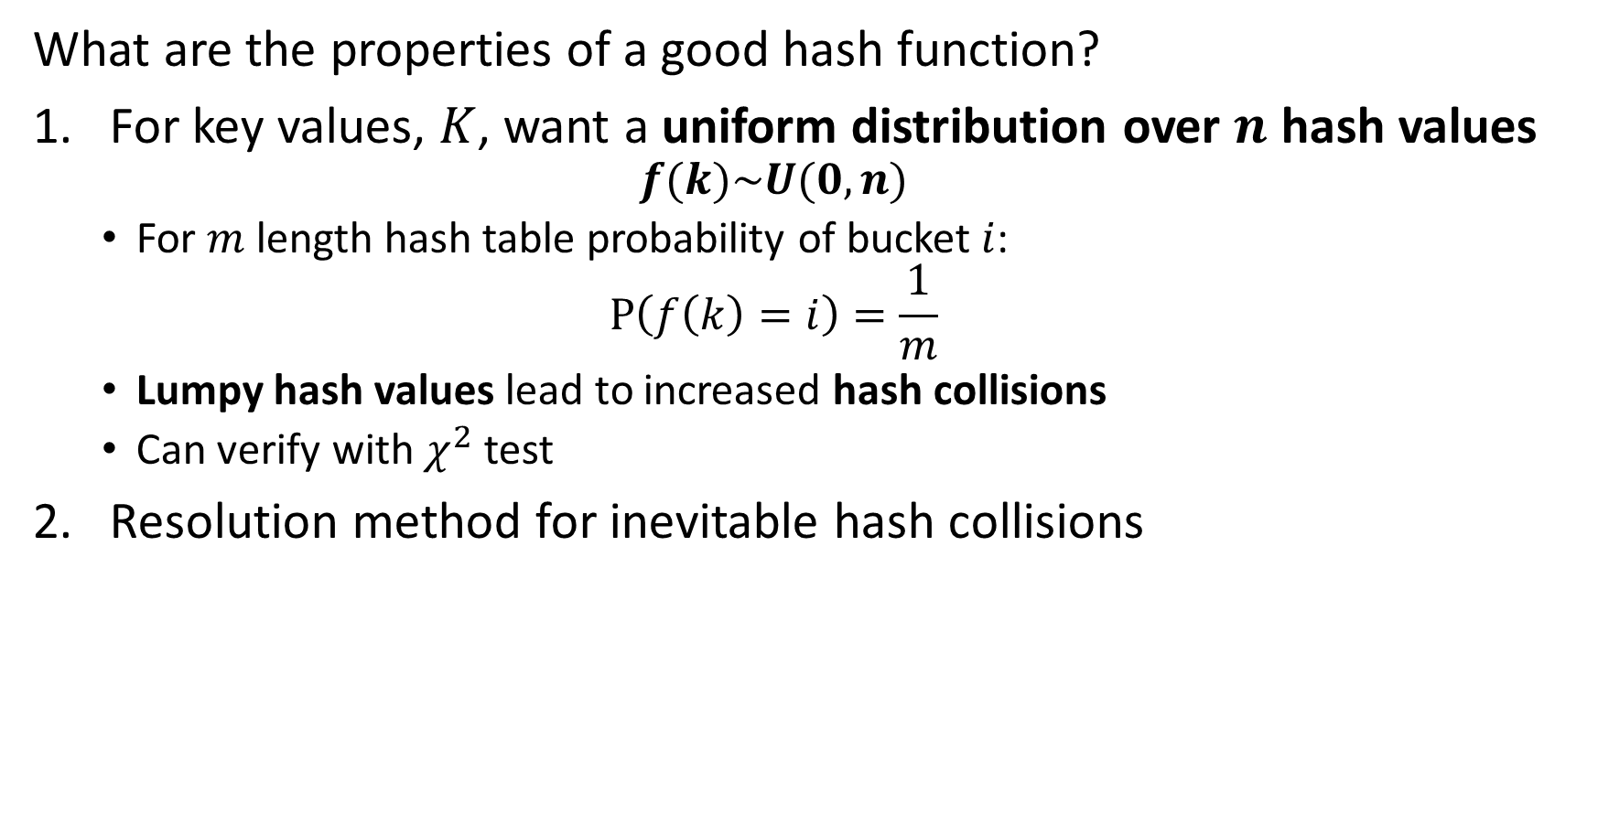
Introduction to Hashing
What are the properties of a good hash function?
For key values, $K$, want a uniform distribution over $n$ hash values
$$f(k)\sim U(0,n)$$
For $m$ length hash table probability of bucket $i$:
$$P\left(f\left(k\right)=i\right)=\frac{1}{m}$$
Lumpy hash values lead to increased hash collisions
Can verify with $χ^{2}$ test
Resolution method for inevitable hash collisions

Slide 41
Introduction to Hashing
What are the properties of a good hash function?
Appropriate for the table or required size
Hash functions produce limited range of hash values
Too large wastes space
Too small leads to collisions
Ideally make hash table resizable - Half or double as needed
Ability to merge hash tables
Enables parallel processing
Hash multiple data streams

Slide 42
Introduction to Hashing
Commonly used hash functions
A great many hash functions are used in practice
Simple hash functions operate on numeric keys
Binary or integer
Binary representation of strings, e.g. Unicode
Hash a binary or integer representation of a string

Slide 43
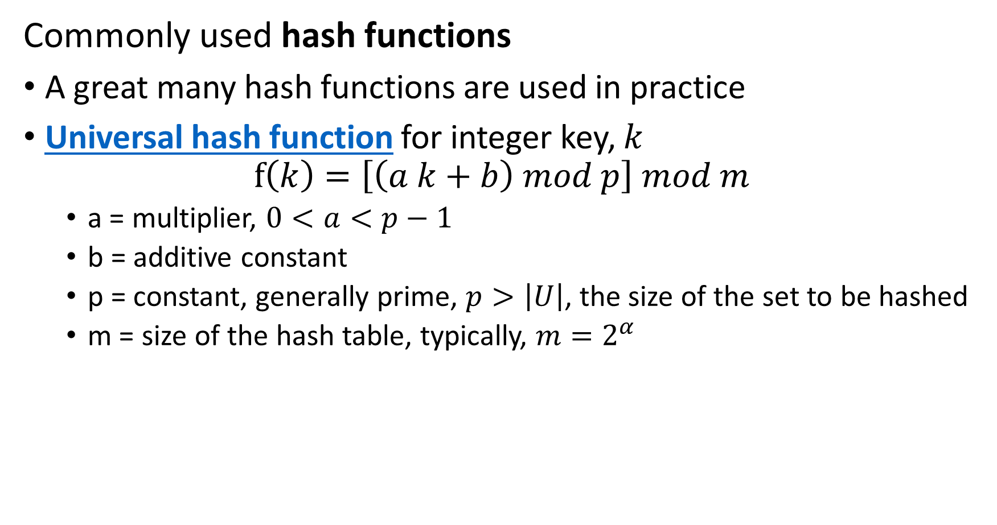
Introduction to Hashing
Commonly used hash functions
A great many hash functions are used in practice
Universal hash function for integer key, $k$
$$f\left(k\right)=\left[\left(a k+b\right) mod p\right] mod m$$
a = multiplier, $0<a<p−1$
b = additive constant
p = constant, generally prime, $p>\left|U\right|$, the size of the set to be hashed
m = size of the hash table, typically, $m=2^{α}$

Slide 44
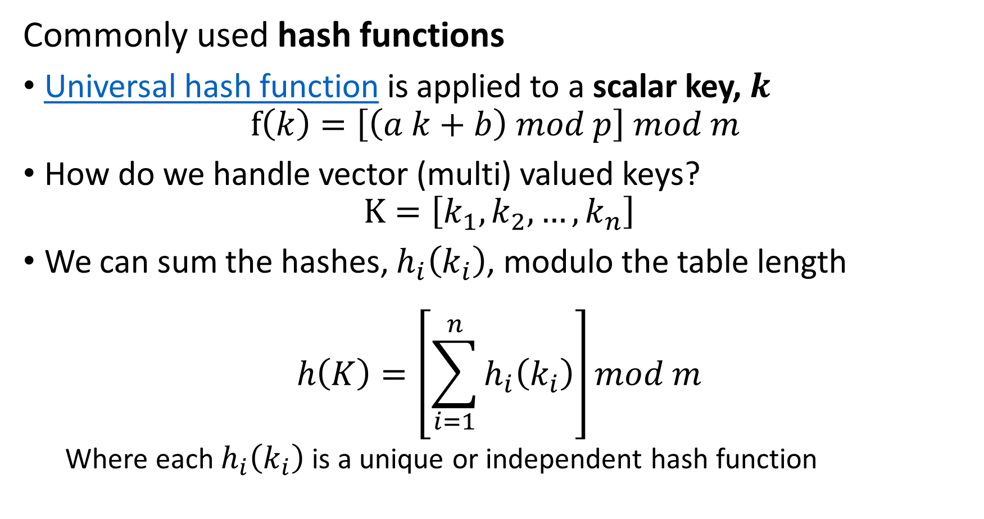
Introduction to Hashing
Commonly used hash functions
Universal hash function is applied to a scalar key, $k$
$$f\left(k\right)=\left[\left(a k+b\right) mod p\right] mod m$$
How do we handle vector (multi) valued keys?
$$K=\left[k_{1},k_{2},…,k_{n}\right]$$
We can sum the hashes, $h_{i}\left(k_{i}\right)$, modulo the table length
$$h\left(K\right)=\left[\sum_{i=1}^{n}{h_{i}\left(k_{i}\right)}\right]mod m$$
Where each $h_{i}\left(k_{i}\right)$ is a unique or independent hash function

Slide 45
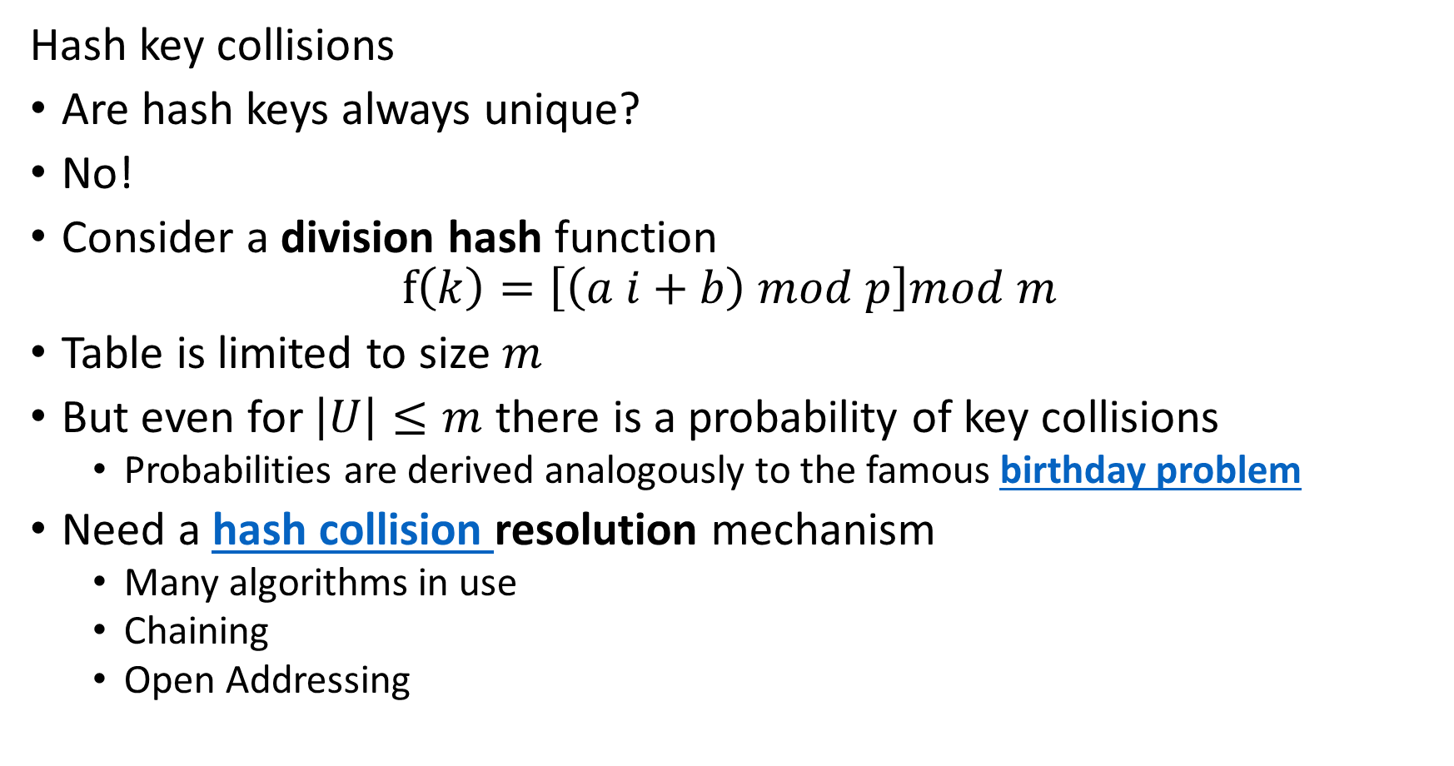
Introduction to Hashing
Hash key collisions
Are hash keys always unique?
No!
Consider a division hash function
$$f\left(k\right)=\left[\left(a i+b\right) mod p\right]mod m$$
Table is limited to size $m$
But even for $\left|U\right|≤m$ there is a probability of key collisions
Probabilities are derived analogously to the famous birthday problem
Need a hash collision resolution mechanism
Many algorithms in use
Chaining
Open Addressing

Slide 46
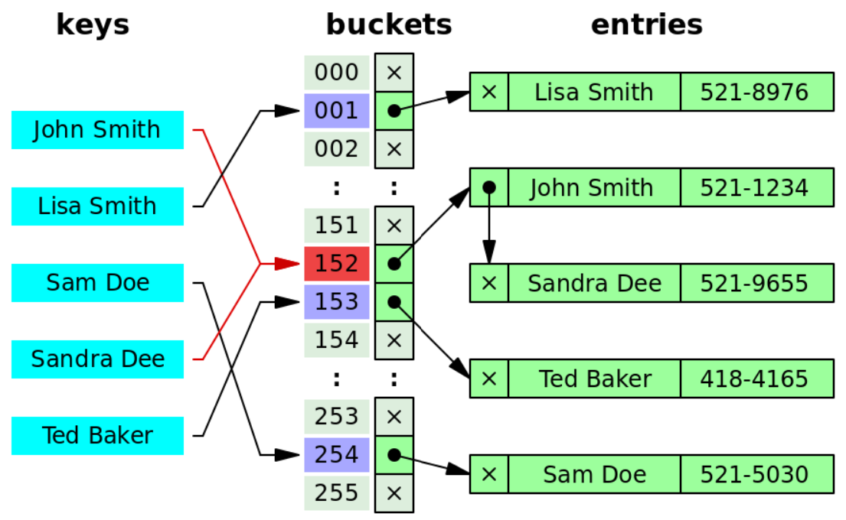
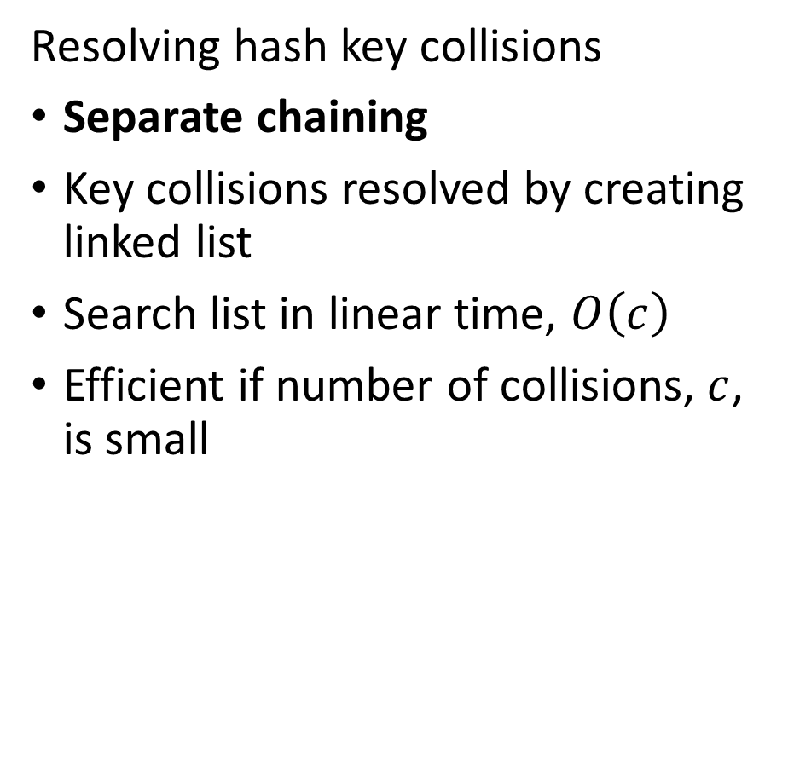
Introduction to Hashing
Resolving hash key collisions
Separate chaining
Key collisions resolved by creating linked list
Search list in linear time, $O\left(c\right)$
Efficient if number of collisions, $c$, is small
Credit: Wikipedia commons

Slide 47
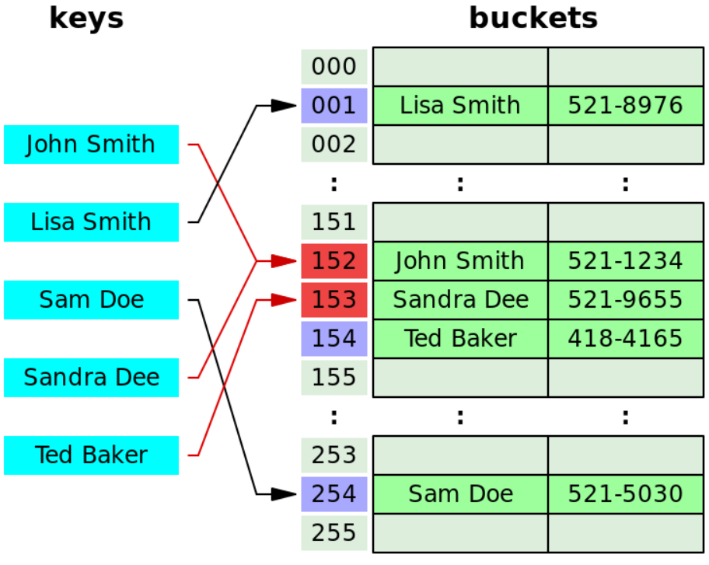
Introduction to Hashing
Resolving hash key collisions
Open addressing methods widely used
Key collisions resolved by probing for open bucket
Linear probing – search buckets in order – efficient and widely used
Quadratic probing – increases interval between buckets searched
Double hashing – search for open bucket with second hash
Searching colliding keys in less than linear time
Credit: Wikipedia commons

Slide 48
Review of Hypothesis Tests

Slide 49
Review: Statistical Inference
Statistical inference is widely used to determine if differences in populations are significant
Does a population mean have a specified value, e.g. 0?
Is there a significant difference between two means?
Test a paired-response difference from zero
e.g. before/after drug treatment on patient.
Is there a significant differences in counts between discrete variables?
Is variance significantly different between two variables?
Is correlation between two variables significant?
Test whether the slope of a line zero
Important for testing the importance of variables

Slide 50
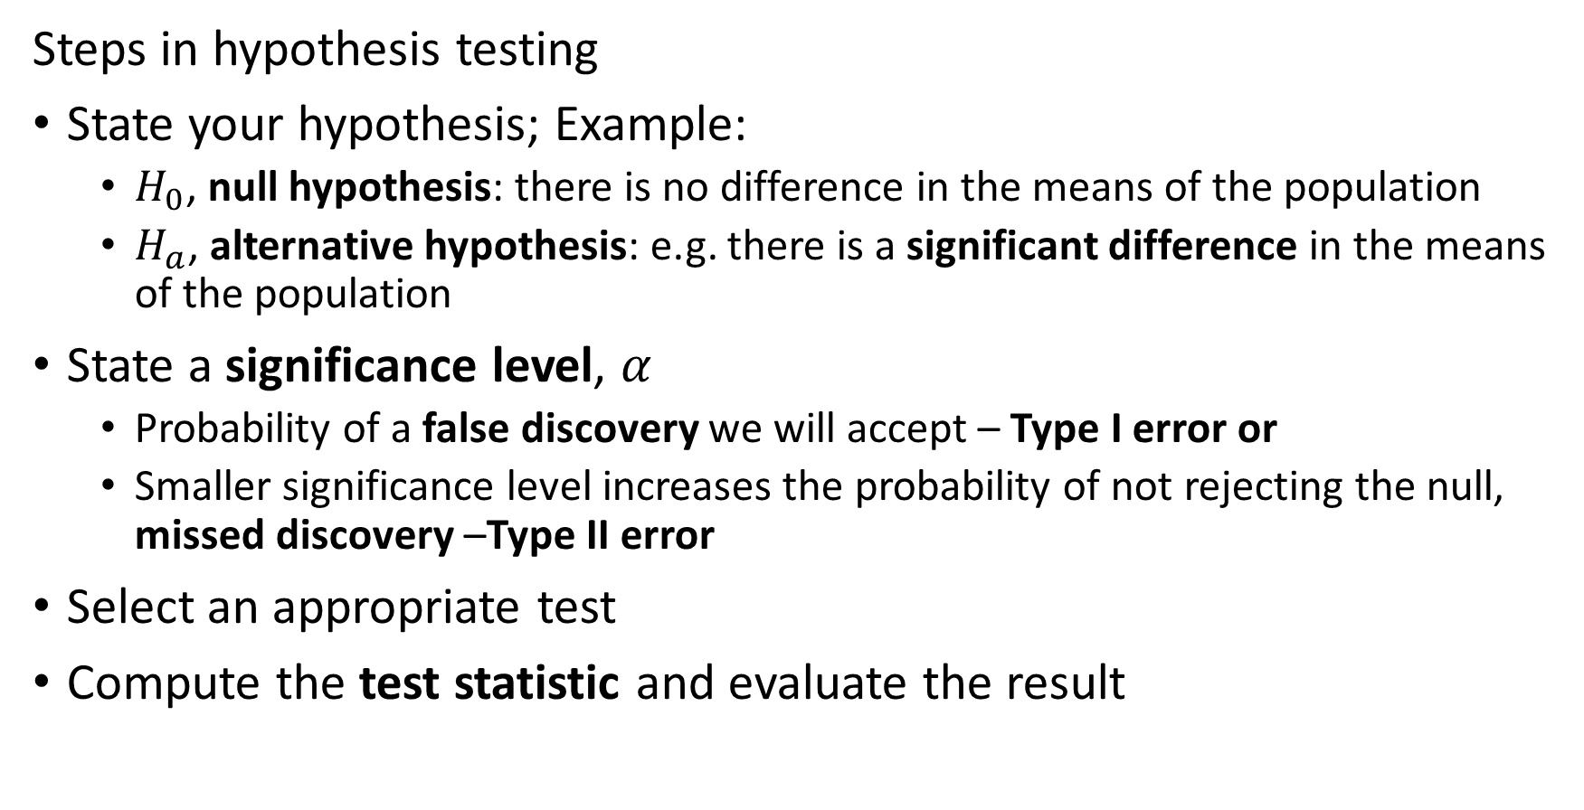
Review: Hypothesis Testing
Steps in hypothesis testing
State your hypothesis; Example:
$H_{0}$, null hypothesis: there is no difference in the means of the population
$H_{a}$, alternative hypothesis: e.g. there is a significant difference in the means of the population
State a significance level, $α$
Probability of a false discovery we will accept – Type I error or
Smaller significance level increases the probability of not rejecting the null, missed discovery –Type II error
Select an appropriate test
Compute the test statistic and evaluate the result

Slide 51
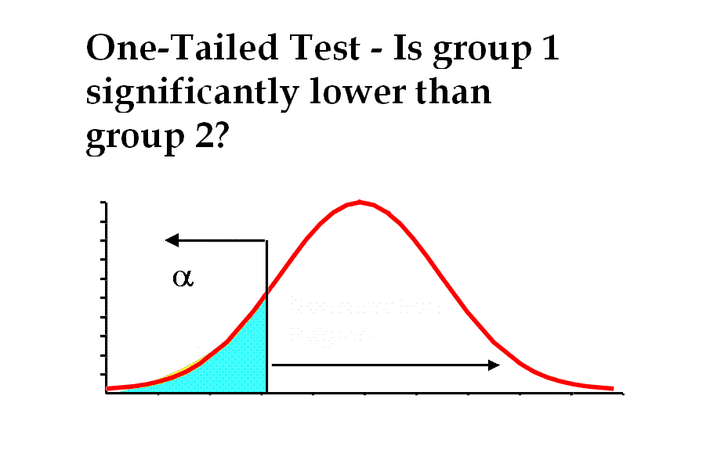
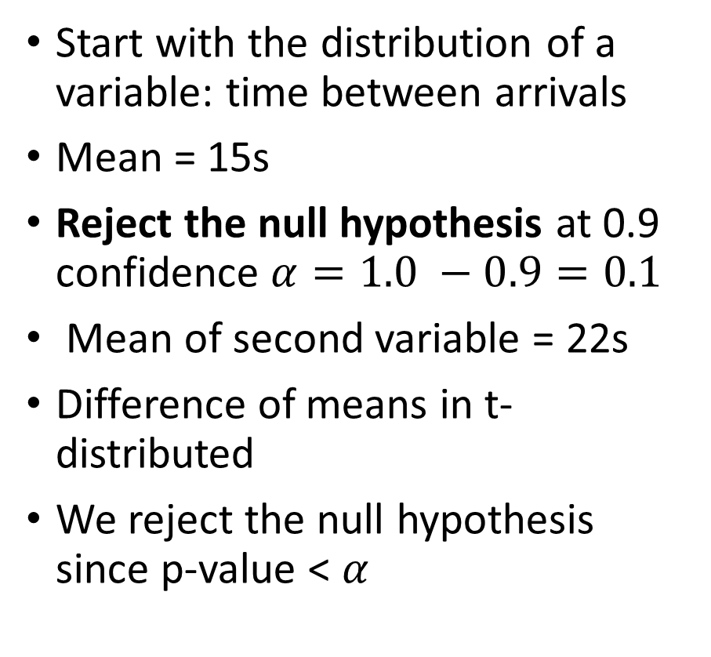

Review: Hypothesis Testing
How can we understand the p-value?
Start with the distribution of a variable: time between arrivals
Mean = 15s
Reject the null hypothesis at 0.9 confidence $α=1.0 −0.9=0.1$
Mean of second variable = 22s
Difference of means in t-distributed
We reject the null hypothesis since p-value < $α$
Rejection Region
Non-Rejection Region
$$0.9$$
15s
22s

Slide 52
Review: Hypothesis Testing
Evaluate an hypothesis test using the p-value
The p-value is the probability of obtaining the sample with results at least this extreme from random variation alone when the null hypothesis is true
Alternatively, p-value is the probability that the evidence this extreme or greater arrises simply from random variation (random sampling) of the null distribution

Slide 53
Review: Hypothesis Testing
Evaluate an hypothesis test using the p-value
The p-value is the probability of obtaining the sample with results at least this extreme from random variation alone when the null hypothesis is true
Lots of ways to misuse the p-value; some examples:
p-values are an order statistic; we can only reject the null hypothesis based on the p-value
p-value mining: test all relationships between variables to find the ‘significant’ ones
Assuming a smaller p-value is ‘more significant’: p-values only indicate the probability of a value being at least this extreme

Slide 54
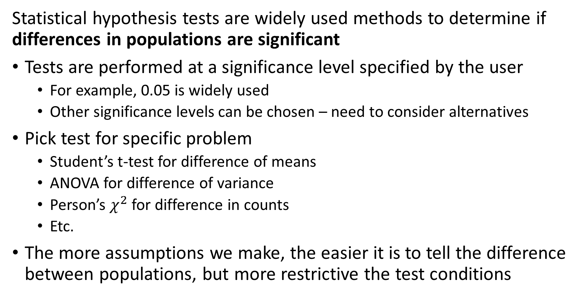
Review: Hypothesis Testing
Statistical hypothesis tests are widely used methods to determine if differences in populations are significant
Tests are performed at a significance level specified by the user
For example, 0.05 is widely used
Other significance levels can be chosen – need to consider alternatives
Pick test for specific problem
Student’s t-test for difference of means
ANOVA for difference of variance
Person’s $χ^{2}$ for difference in counts
Etc.
The more assumptions we make, the easier it is to tell the difference between populations, but more restrictive the test conditions

Slide 55
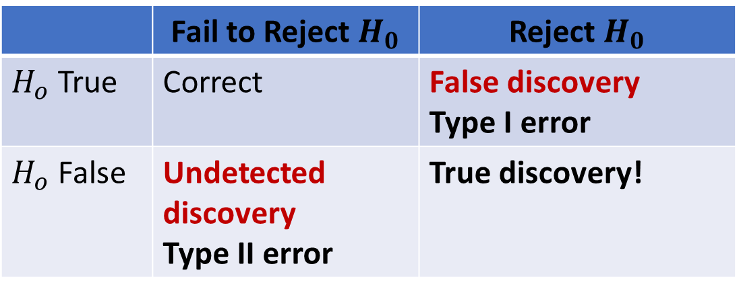
Review: Hypothesis Testing
Errors in hypothesis testing
Consider a truth table for the decision rule of any hypothesis test
Diagonal of table represent correct inferences
Type I error is a false discovery
Type II error is an undetected discovery
 | Fail to Reject $H_{0}$ | Reject $H_{0}$
$H_{o}$ True | Correct | False discovery Type I error
$H_{o}$ False | Undetected discovery Type II error | True discovery!

Slide 56
Pitfalls of Large-Scale Data Mining

Slide 57
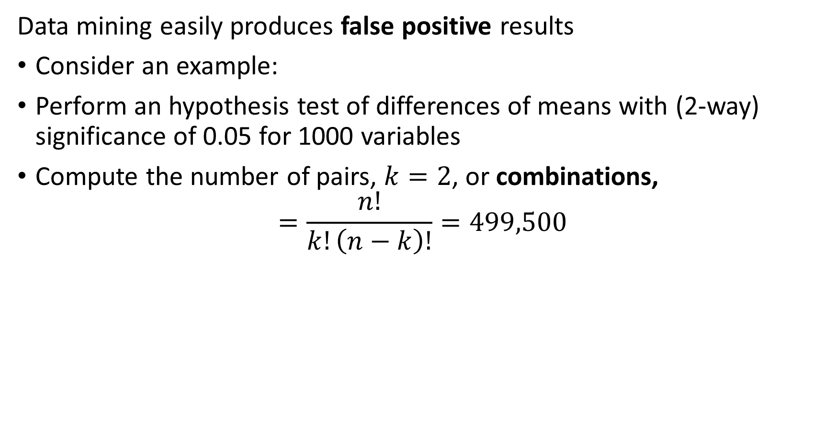
Pitfalls of Data Mining
Data mining easily produces false positive results
Consider an example:
Perform an hypothesis test of differences of means with (2-way) significance of 0.05 for 1000 variables
Compute the number of pairs, $k=2$, or combinations,
$$=\frac{n!}{k!\left(n−k\right)!}=499,500$$

Slide 58
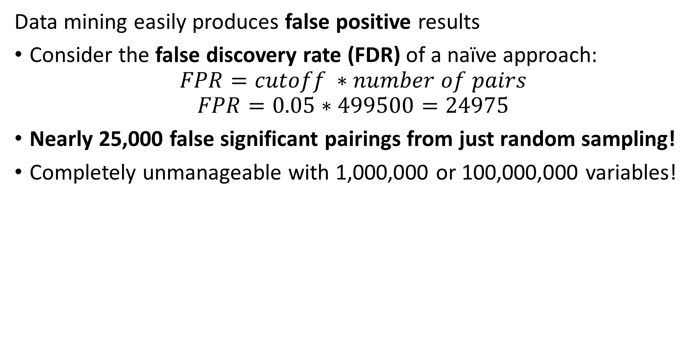
Pitfalls of Data Mining
Data mining easily produces false positive results
Consider the false discovery rate (FDR) of a naïve approach:
$$FPR=cutoff ∗number of pairs$$
$$FPR=0.05∗499500=24975$$
Nearly 25,000 false significant pairings from just random sampling!
Completely unmanageable with 1,000,000 or 100,000,000 variables!

Slide 59
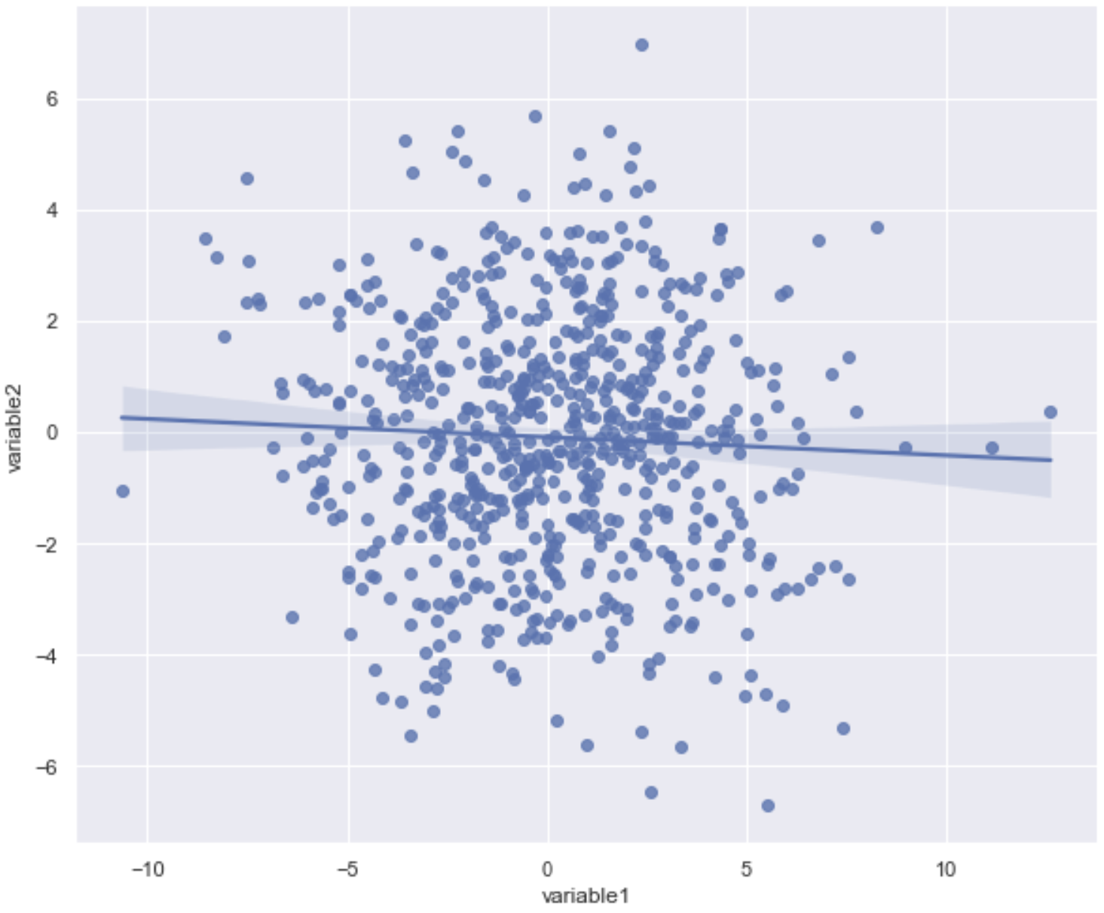
Pitfalls of Data Mining
Data dredging leads often leads to false positive results
Consider two iid Normal random variables
Variables are independent and uncorrelated

Slide 60
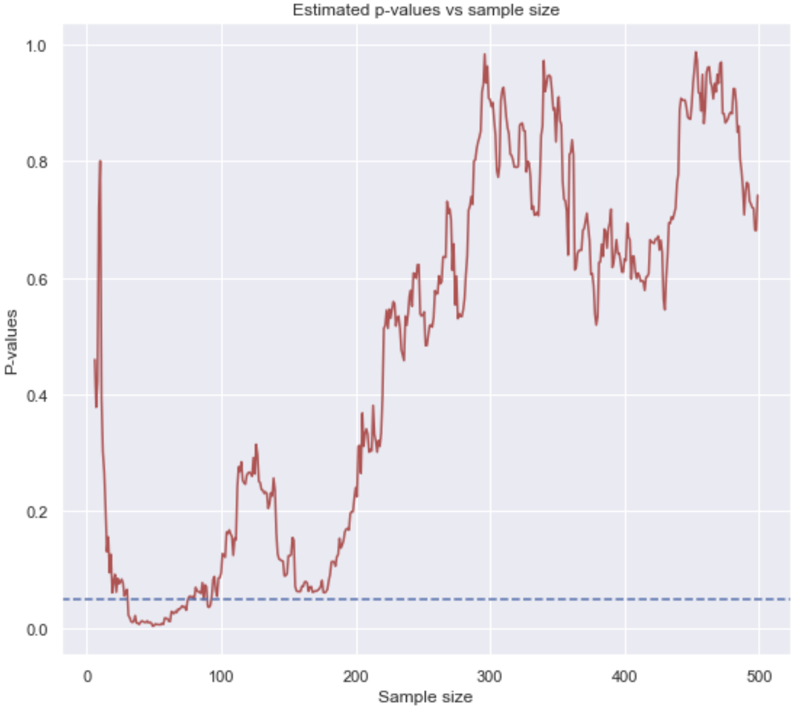
Pitfalls of Data Mining
Data dredging leads often leads to false positive results
Increase sample size one at a time
Compute regression line for sample
Compute p-value of slope coefficient
Results in false positive!
Full example and code in SupplementaryMaterials directory of GitHub repositor

Slide 61
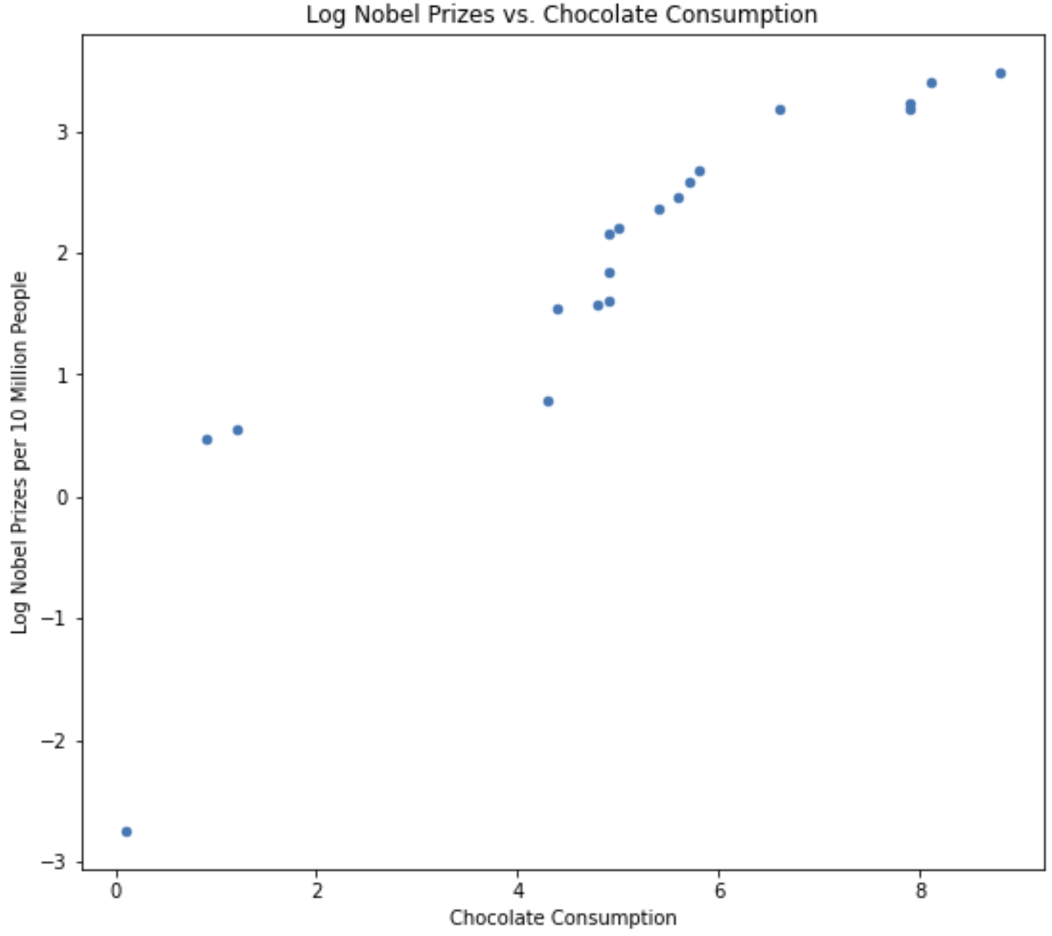
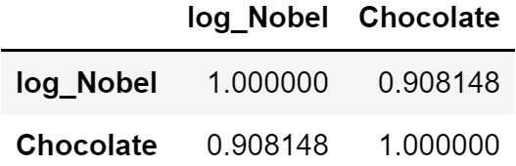
Pitfalls of Data Mining
Correlations alone can be misleading
Can eating chocolate help you win a Nobel prize?
Consider log chocolate consumption and log Nobel prizes for 18 countries
The high correlation between these variables looks promising!

Slide 62
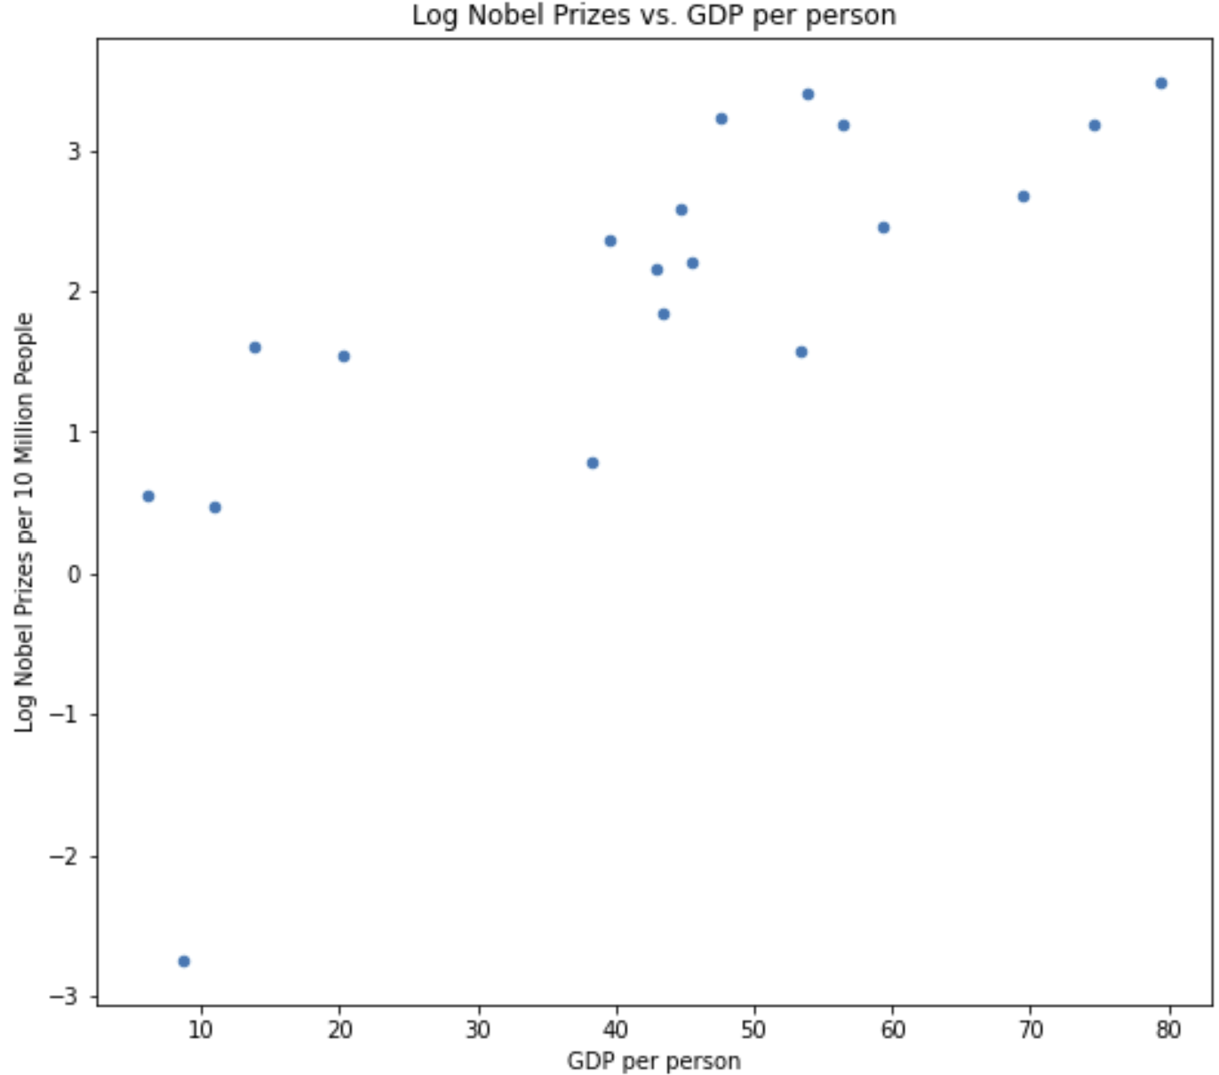
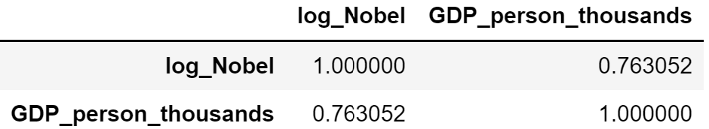
Pitfalls of Data Mining
Correlations alone can be misleading
Log of GDP is also a good predictor of winning Nobel prizes
And high correlation

Slide 63
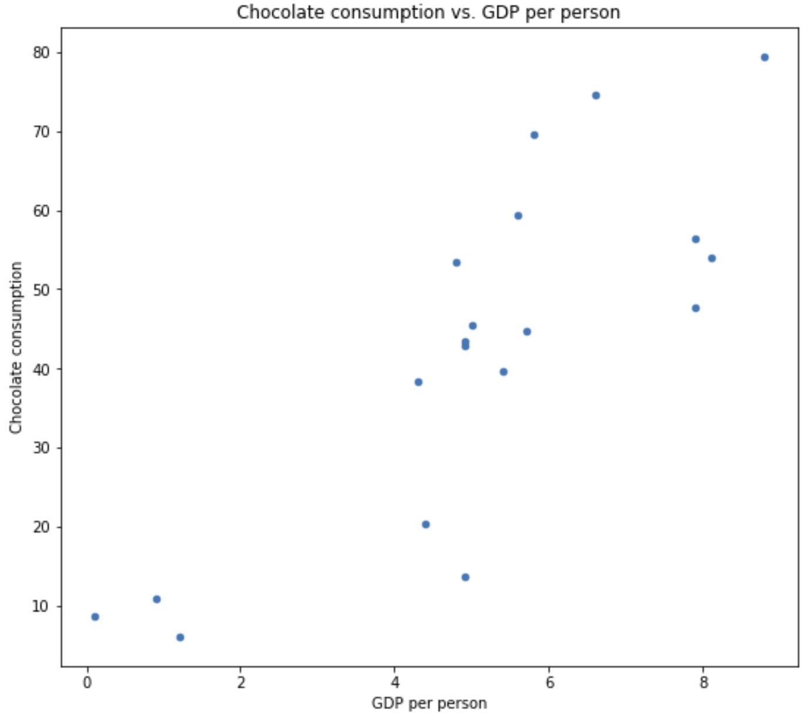
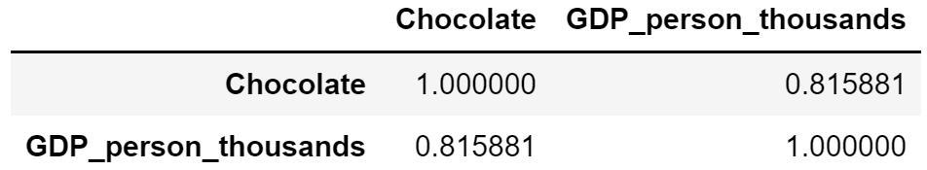
Pitfalls of Data Mining
Correlations alone can be misleading
Log of GDP is also a good predictor of chocolate consumption
With high correlation
This is an example of Simpson’s pardox
Full example and code in SupplementaryMaterials directory of GitHub repositor

Slide 64
Comparison at Large Scale

Slide 65
Large-Scale Comparison Methods
False discovery rate (FDR) control methods
FDR control methods limit the false positive rate (Type I errors)
Must limit Type II errors – missed-discoveries
Statistical methods
Bonferroni correction
Holm’s method
Benjamini-Hochberg FDR control
Notes:
The cu

Slide 66
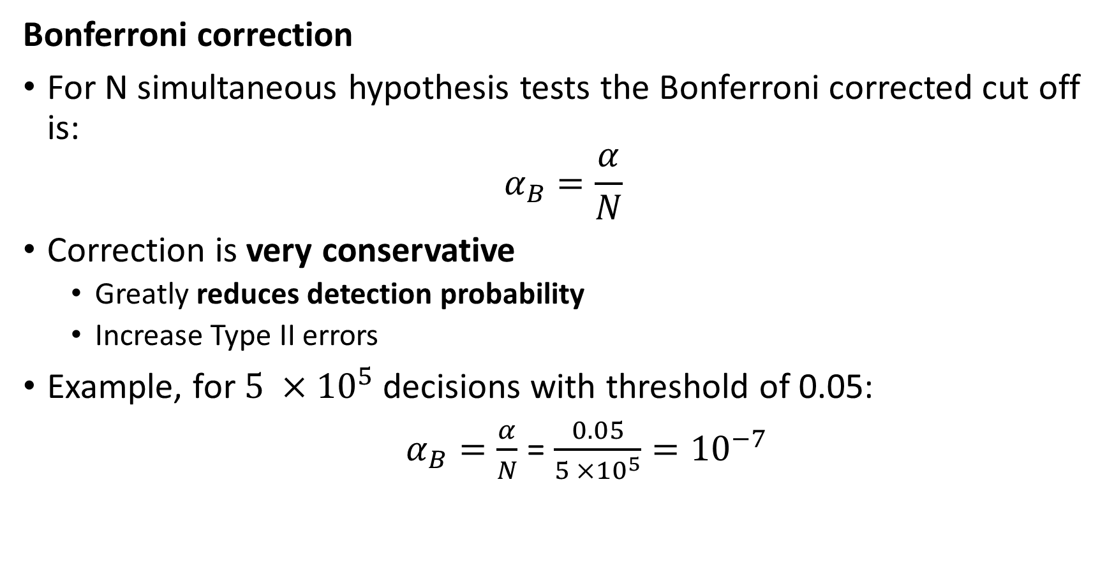
Large-Scale Comparison Methods
Bonferroni correction
For N simultaneous hypothesis tests the Bonferroni corrected cut off is:
$$α_{B}=\frac{α}{N}$$
Correction is very conservative
Greatly reduces detection probability
Increase Type II errors
Example, for $5 ×{10}^{5}$ decisions with threshold of 0.05:
$α_{B}=\frac{α}{N}$ = $\frac{0.05}{5 ×{10}^{5}}={10}^{−7}$
Notes:
The cu

Slide 67
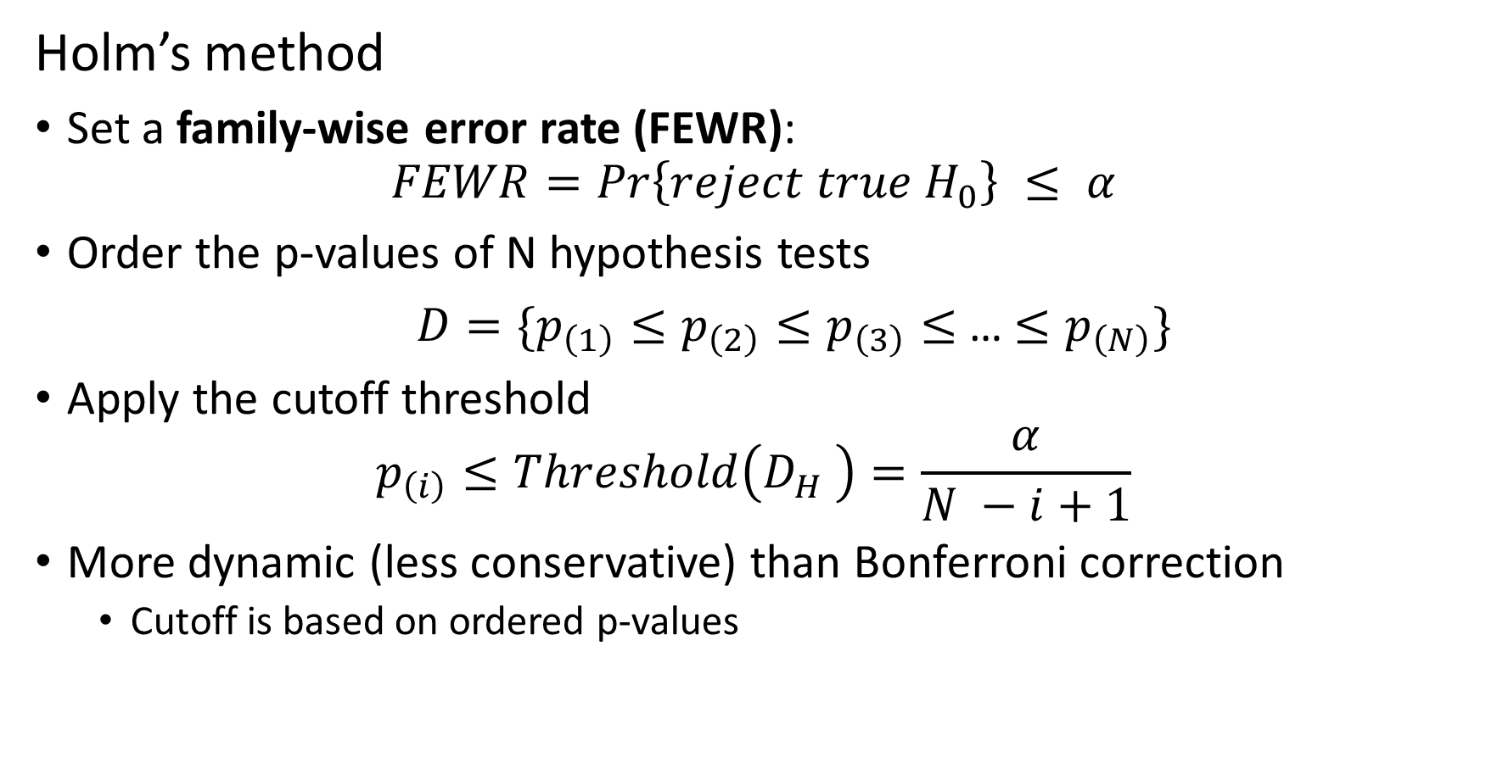
Large-Scale Comparison Methods
Holm’s method
Set a family-wise error rate (FEWR):
$$FEWR=Pr\left\{reject true H_{0}\right\} ≤ α$$
Order the p-values of N hypothesis tests
${D=\{p}_{\left(1\right)}≤p_{\left(2\right)}≤p_{\left(3\right)}≤$…${ ≤p}_{\left(N\right)}\}$
Apply the cutoff threshold
$$p_{\left(i\right)}≤Threshold\left({D_{H}}_{ }\right)=\frac{α}{N −i+1}$$
More dynamic (less conservative) than Bonferroni correction
Cutoff is based on ordered p-values
Notes:
The cu

Slide 68
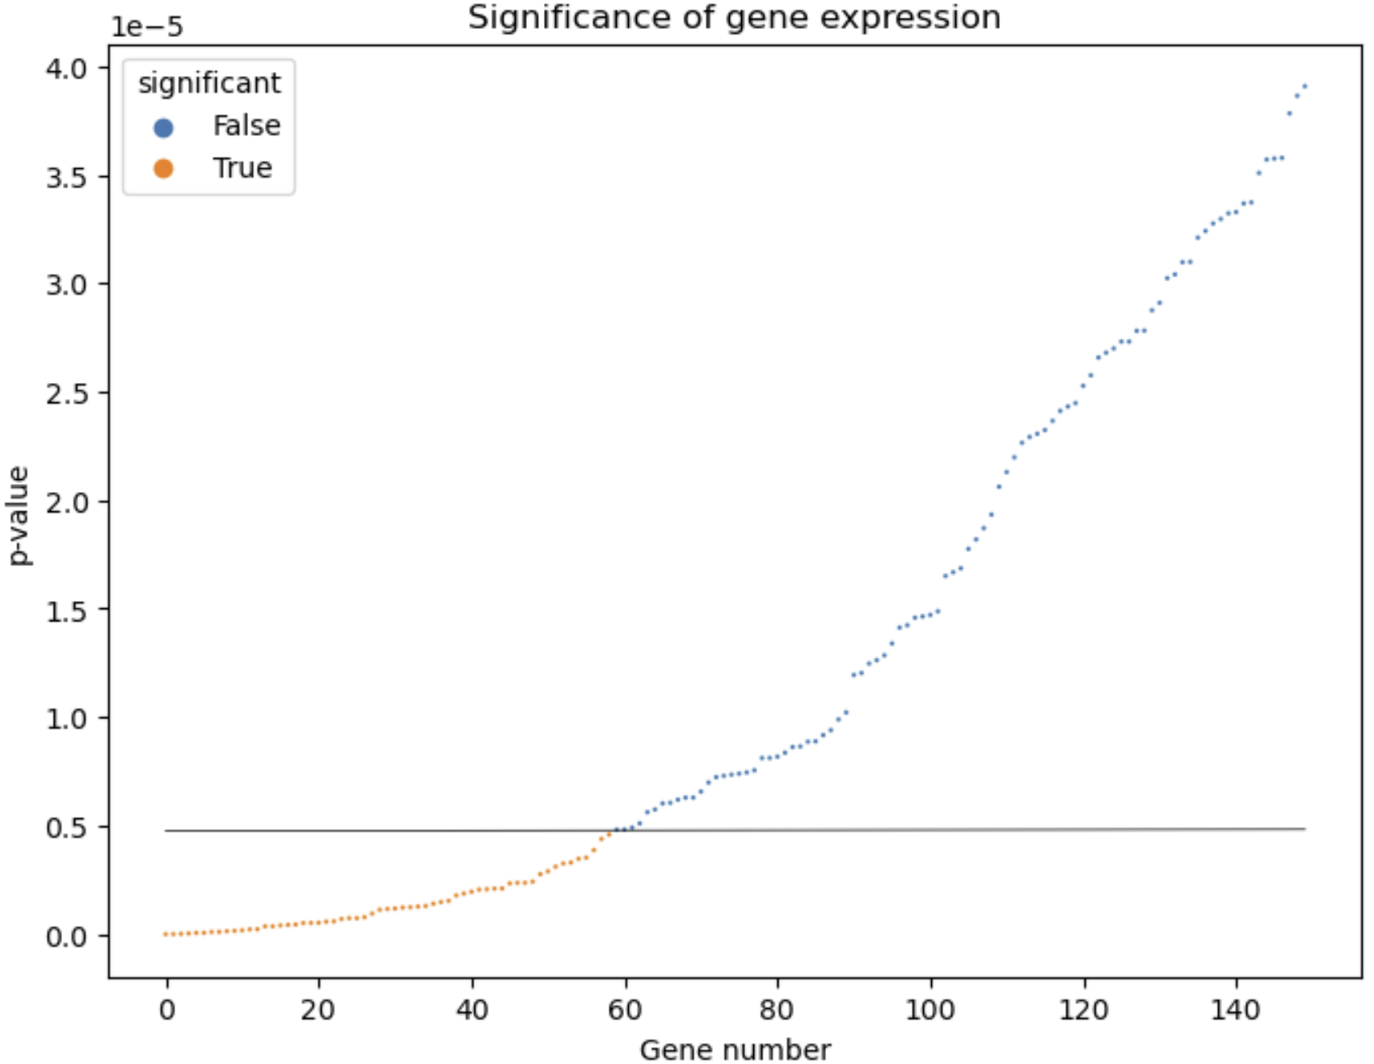
Large-Scale Comparison Methods
Holm’s method: Example
Notes:
The cu

Slide 69
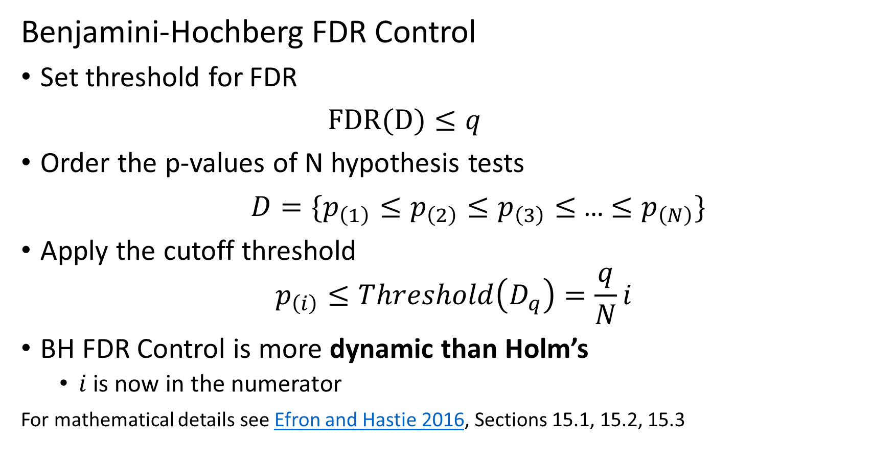
Large-Scale Comparison Methods
Benjamini-Hochberg FDR Control
Set threshold for FDR
$FDR(D)≤q$
Order the p-values of N hypothesis tests
${D=\{p}_{\left(1\right)}≤p_{\left(2\right)}≤p_{\left(3\right)}≤$…${ ≤p}_{\left(N\right)}\}$
Apply the cutoff threshold
$$p_{\left(i\right)}≤Threshold\left(D_{q}\right)=\frac{q}{N}i$$
BH FDR Control is more dynamic than Holm’s
$i$ is now in the numerator
For mathematical details see Efron and Hastie 2016, Sections 15.1, 15.2, 15.3
Notes:
The cu

Slide 70
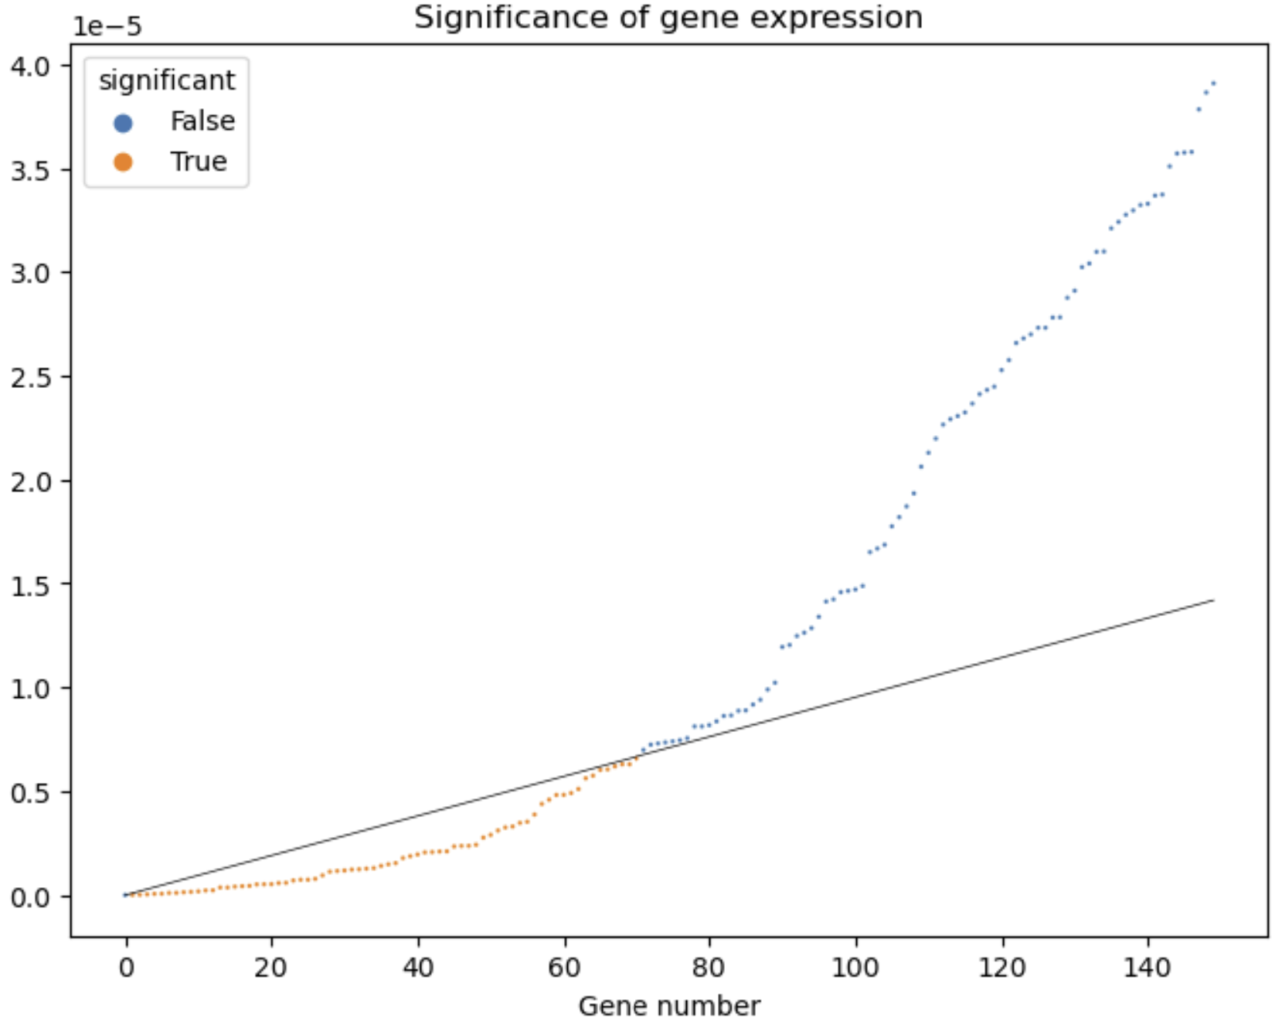
Large-Scale Comparison Methods
Benjamini-Hochberg FDR Control: Example
Notes:
The cu

Slide 71
Key Points
Data mining is the science of knowledge discovery using data
Data mining uses massive data sets!
Manage massive data with key-values pairs
Hashing keys can reduce storge and retrieval times
Knowledge discovery requires inference
Inference for complex data must control false discovery rate
Must limit Type II error with FDR controls

