Slide 1
OPERATING SYSTEMS PROJECT
Santiago Giraldo Velez
Hassanalizadeh Farshad
Wang YuYing
Hemadi Yasmin

Slide 2


GETTING STARTED
Install linux:

Slide 3
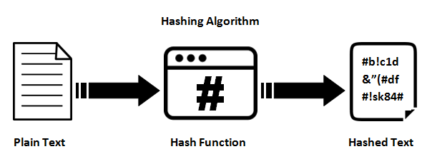
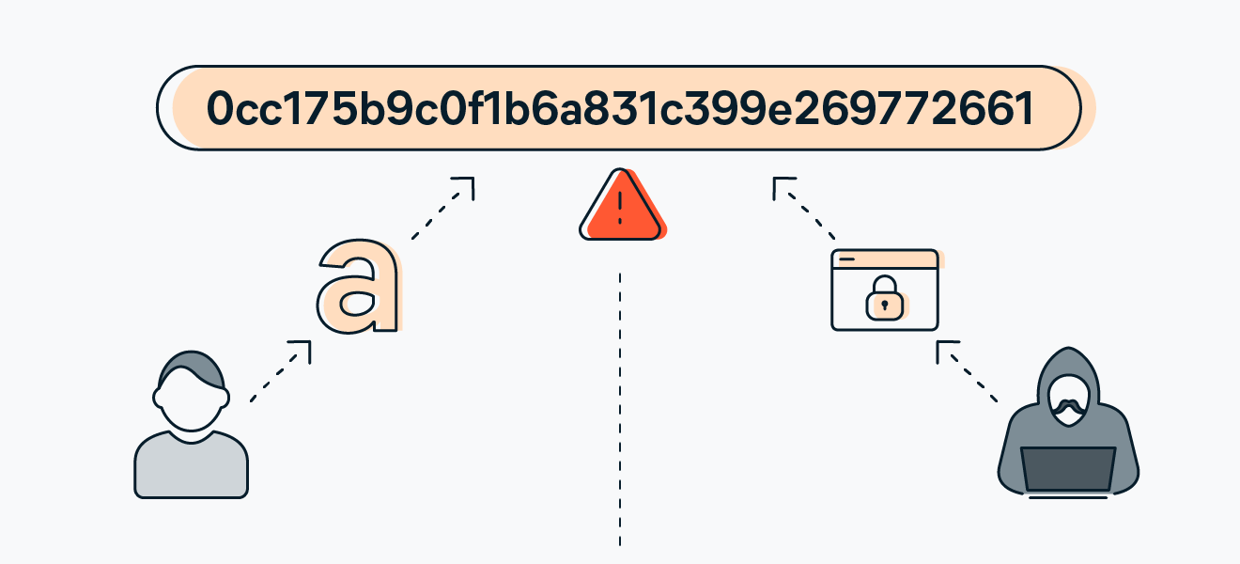
WHAT DOES MD5 MEAN…
Cryptographic hash function algorithm that accepts message as input of any length and modifies it into a fixed-length message

Slide 4

Some of the disadvantages of the algorithm are its vulnerabilities. MD5 is susceptible to collision attacks, where two different inputs produce the same hash. This poses a severe security risk, particularly in applications like digital signatures. Also, attackers can reverse-engineer the hash to find an input that matches a given MD5 hash, compromising data security. Finally, The speed at which MD5 can generate hashes makes it susceptible to brute force attacks.

Slide 5

QEMU, the project environment
Generic and open source machine emulator and virtualizer that is used as a machine emulator in this project. QEMU can run OS and programs made for one machine (e.g. an ARM board) on a different machine achieving very good performance.

Slide 6
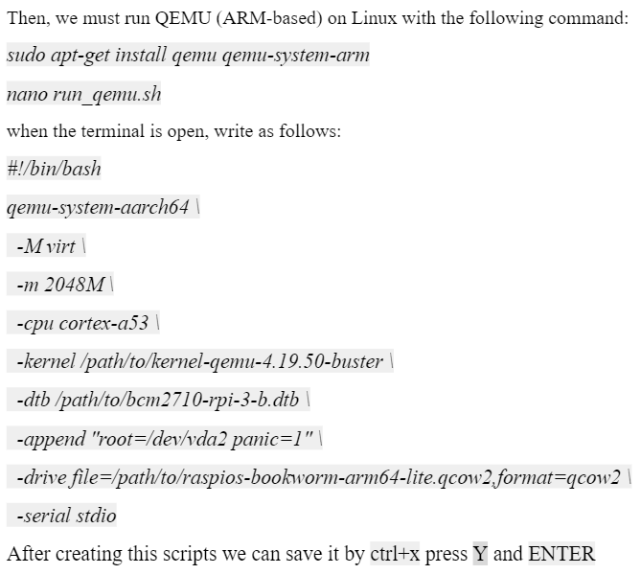
Preparing QEMU environment

Slide 7
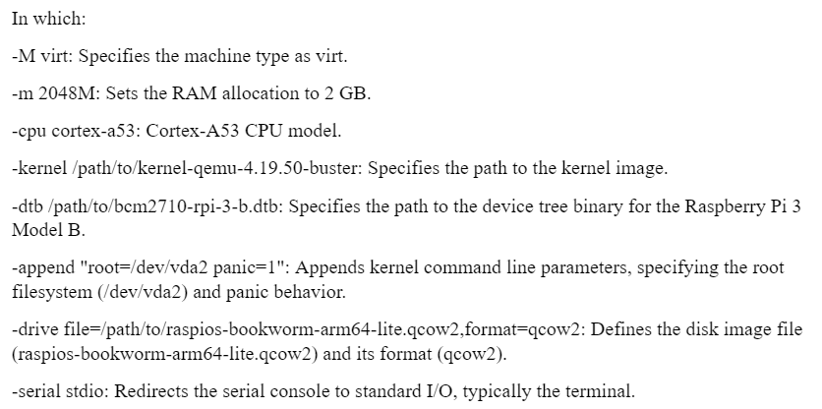

Slide 8
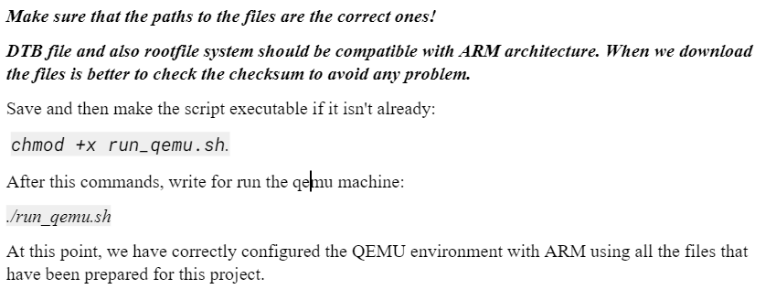

Slide 9
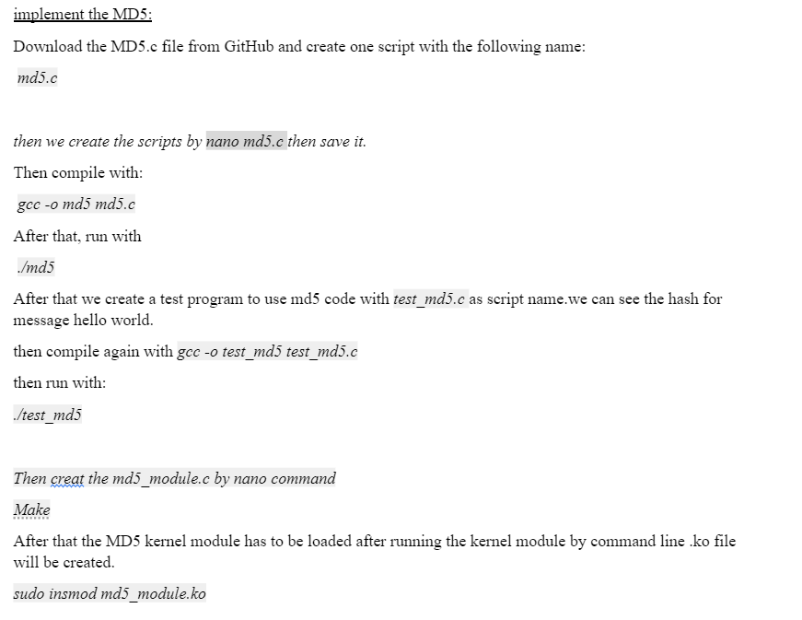

Slide 10
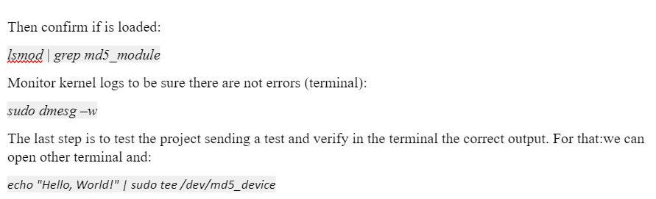

Slide 11
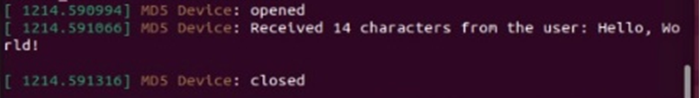
Expected result

Slide 12
DRIVER
In both general-purpose and embedded systems, encapsulating hardware knowledge is essential to provide a simple, uniform interface for higher-level abstraction. Linux achieves this by virtualizing most resources as files, allowing applications to use common system calls (open(), read(), write(), close(), etc.) for hardware interaction. This is facilitated by the Virtual File System (VFS), which abstracts the underlying file system and integrates with device drivers in kernel space. Device drivers, written in C, implement the low-level functions required by the VFS, thus hiding hardware specifics from applications.
Linux categorizes devices into three types:
Character devices: Accessed as sequential word streams, like conventional files (e.g., a crypto core).
Block devices: Accessed in byte-block multiples.
Network interfaces: Handle data packet transmission and reception through the networking subsystem.

Slide 13
Devices are identified by:
Major numbers: Indicating the device family.
Minor numbers: Differentiating instances within a device family.
Device numbers can be assigned statically or dynamically. Device files (nodes) serve as entry points for applications to interact with kernel space and peripherals. Modern kernels provide APIs to automate device node creation, requiring device registration in a class directory inside /sys.
In our MD5 project, a character device driver interfaces with an MD5 hardware core, allowing user-space applications to compute MD5 hashes using standard file operations. The driver abstracts the hardware complexity, ensuring efficient and user-friendly interactions with the MD5 core via the Linux VFS.

Slide 14
EXERCISE1
Develop a C program to perform a test for a driver implementing the MD5 hashing algorithm. The test program should validate the correctness of the MD5 hashing algorithm.
Test Function:
Write: This is the basic instruction, where a word is written and a hash is read back.

Slide 15
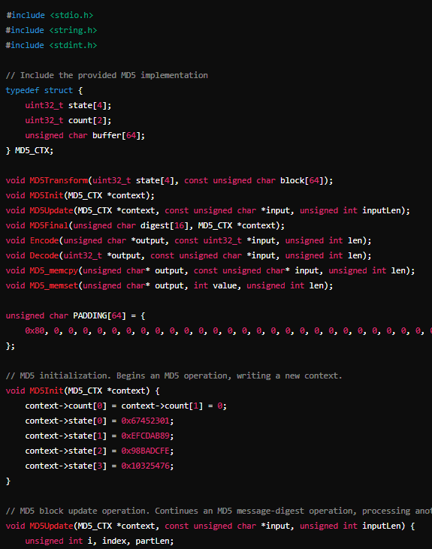
To validate the correctness of the MD5 hashing algorithm implemented in the provided code, we need to write a test program that computes the MD5 hash of a given input string and compares the result with the expected hash value.

Slide 16
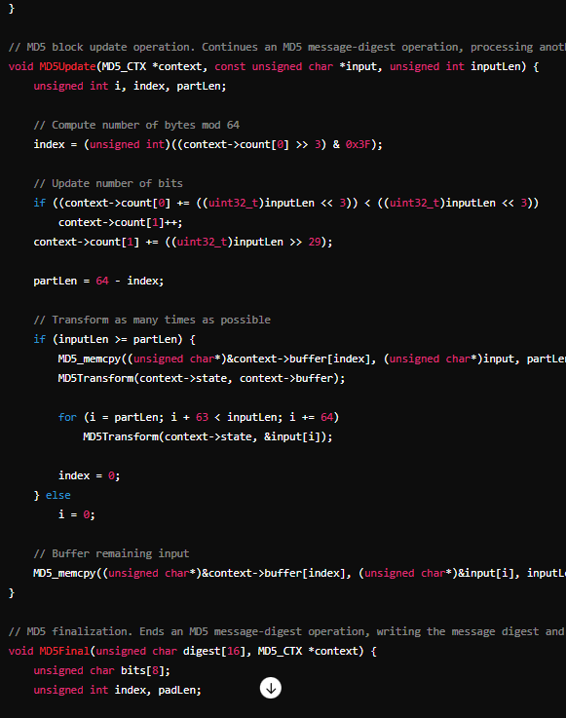
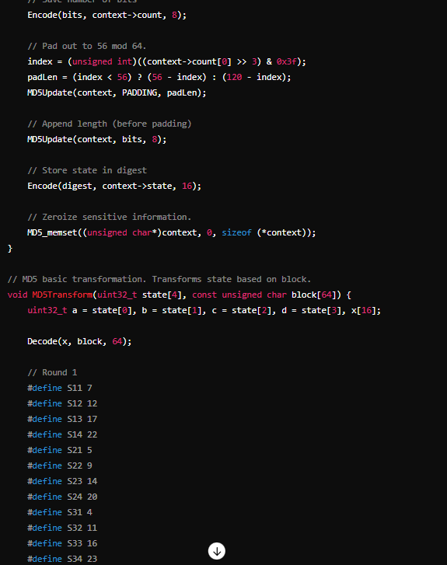

Slide 17
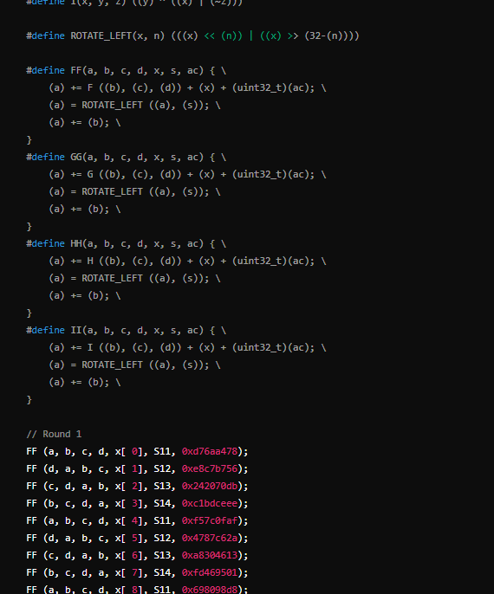
This test program hashes the string "hello" and compares the result with the known MD5 hash of "hello". If the implementation is correct, the output should match the expected hash, and the test should pass.

Slide 18
EXERCISE2
Create the 3 text files with different sentences and send these massages on the Kernel module and see that the MD5 device received these files?

Slide 19
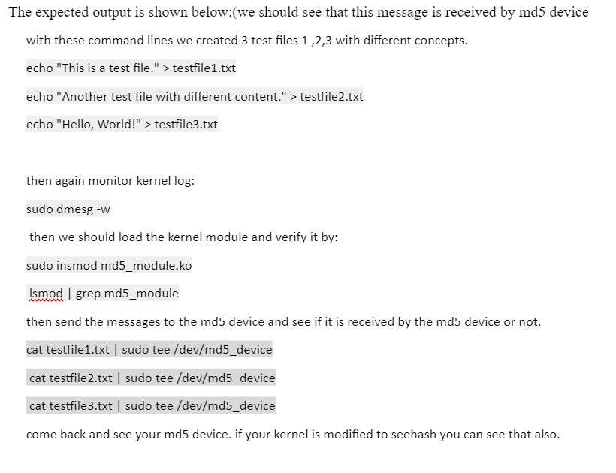
Solution:

