Slide 1


TRANSFER PRICING · AMSTERDAM
Your trusted
transfer pricing partner.
Capability deck — 2026
inRange Solutions B.V.
Amsterdam, Netherlands
Scan for full site

Slide 2
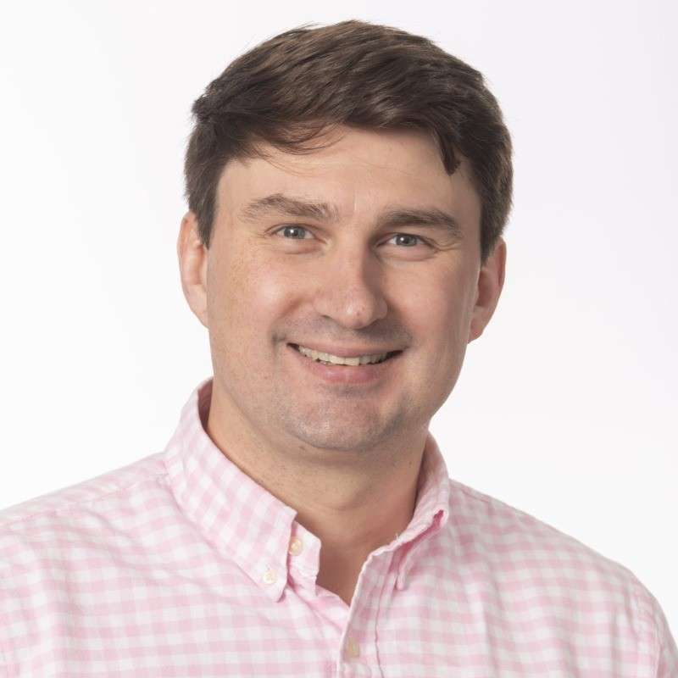
ABOUT US
Transfer pricing expertise,
combined with market-leading technology.
Our mission
At inRange, we combine Transfer Pricing expertise with market-leading technology and a passion for serving clients. Our experts have decades of experience gained at leading global consulting firms and multinational companies — and apply it to develop practical, sustainable solutions for your group.
[ Founder name ]
Founder · Managing Partner
15+ yrs · Amsterdam
What sets us apart
Senior-led — partner-calibre advice on every engagement.
AI-enabled delivery — documentation and research up to 60% faster.
Independent — TP-only focus, no cross-sell conflicts.
Materially better value than Big-Four engagements.
[ Short bio — prior firms, focus areas, typical engagements. Replace this placeholder before sending. ]
inRange · Your trusted transfer pricing partner
2 / 9

Slide 3
OUR SERVICES
Six ways we help.
A focused Transfer Pricing practice. Every engagement led by a senior specialist; every deliverable reviewed at partner level.
01
Planning → implementation
02
Master file · Local files · CbCR
03
Tax audits & controversy
Transfer Pricing Advice
TP Documentation
Audit Support
Expert guidance on all aspects of TP, ensuring your intercompany set-up is at arm's length.
Stay compliant worldwide — we prepare, update and review your Master file, Local files and CbCR.
Safeguard your business during TP examinations — early-stage support, strategic defence, favourable outcomes.
04
Peak-workload support
05
Financial & non-financial data
06
Intercompany contracts
Interim Placements
Economic Analyses
Legal Agreements
Experienced TP specialists embedded inside your team during peak workload periods.
Expert support analysing financial and non-financial data for Transfer Pricing purposes.
Prepare or refresh the legal agreements supporting your intercompany transactions.
inRange · Your trusted transfer pricing partner
3 / 9

Slide 4
HOW WE WORK
A predictable path from scope to sign-off.
Every engagement runs on the same four-stage cadence — led end-to-end by a senior specialist, with AI-enabled tooling handling the mechanical work so yours gets the considered thought.
01
02
03
04
WEEK 1
WEEKS 2–4
WEEKS 4–8
ONGOING
Scope
Analyse
Document
Support
Discovery call, review of your group structure and intercompany flows, agreement on deliverables and fee.
Functional analysis, economic analyses and benchmarking — AI-accelerated research, human judgement on method and comparables.
Master file, Local files and Country-by-Country Reporting, drafted to local-country regulatory requirements in every jurisdiction you operate.
Tax-audit defence, controversy support, refreshes on change — and interim placement when your own team needs an extra set of hands.
Fixed fee
Senior-led
OECD-aligned
AI-enabled
Locally compliant
Partner-reviewed
Audit defence
Interim specialists
inRange · Your trusted transfer pricing partner
4 / 9

Slide 5
HIGHLIGHTED PROJECT · 01
CASE STUDY
Amsterdam · Netherlands
01
THE CHALLENGE
Group-wide TP policy for a global fintech.
[ Placeholder — brief description of the client situation: group structure, core flows and the regulatory pressure that triggered the review. ]
02
OUR APPROACH
[ Placeholder — what we did: functional mapping, benchmarking, intercompany framework design covering licensing and intra-group services. ]
TP Policy Design
03
THE RESULTS
Payments · Fintech
[ Placeholder — quantifiable outcome: e.g., policy adopted across N jurisdictions, successful audit defence, documentation cycle X% faster. ]
inRange
inRange · Your trusted transfer pricing partner
5 / 9

Slide 6
HIGHLIGHTED PROJECT · 02
CASE STUDY
London · United Kingdom
01
THE CHALLENGE
HMRC audit defence for a mid-size FMCG.
[ Placeholder — context of the HMRC enquiry, period under review, intercompany flows in scope. ]
02
OUR APPROACH
[ Placeholder — early engagement with HMRC, position papers, economic analysis supporting the existing TP set-up. ]
Audit Defence
03
THE RESULTS
FMCG
[ Placeholder — quantifiable outcome: enquiry closed favourably, £X of proposed adjustment avoided, no penalty. ]
inRange
inRange · Your trusted transfer pricing partner
6 / 9

Slide 7
RECENT ENGAGEMENTS
Amsterdam-based, working internationally.
15 engagements · 12 cities · scoped out of Amsterdam, delivered wherever they are needed.
SAN JOSE
COPENHAGEN
STOCKHOLM
APA Support
Audit Defence
Master File Review
TOKYO
Local File
LONDON ×2
Audit Defence · Master File
AMSTERDAM · HQ
DUBAI
NEW YORK
3 engagements · TP Policy · Financial Transactions · TP Diagnostics
Valuation
Benchmarking
FRANKFURT
MEXICO CITY
Audit Support
HO CHI MINH CITY
Local File
SYDNEY
Profit Attribution
HQ
Engagement
Profit Attribution
inRange · Your trusted transfer pricing partner
7 / 9

Slide 8
CREDENTIALS
Industries we serve.
A focused practice, applied across the sectors where transfer pricing complexity is highest.
15+
15+
8
ENGAGEMENTS
JURISDICTIONS
INDUSTRIES
Across recent projects
From Amsterdam outward
Where we have depth
INDUSTRIES
Construction
Consumer & Retail
FMCG
Food Delivery
Industrial
Payments
SaaS & Technology
Travel
inRange · Your trusted transfer pricing partner
8 / 9

Slide 9
WE'D LOVE TO HEAR FROM YOU
Get your transfer
pricing done.
A short note is usually enough to start. Tell us what you're working on — a new structure, a documentation cycle, or a question from a tax authority — and we'll come back with a clear next step, typically within a working day.
ADDRESS
EMAIL
PHONE
inrange.nl
Saskia van Uijlenburgkade 104
Amsterdam, Netherlands
info@inrange.nl
+31 648 44 6063
Scan to visit
inRange · Your trusted transfer pricing partner
9 / 9

