Slide 1
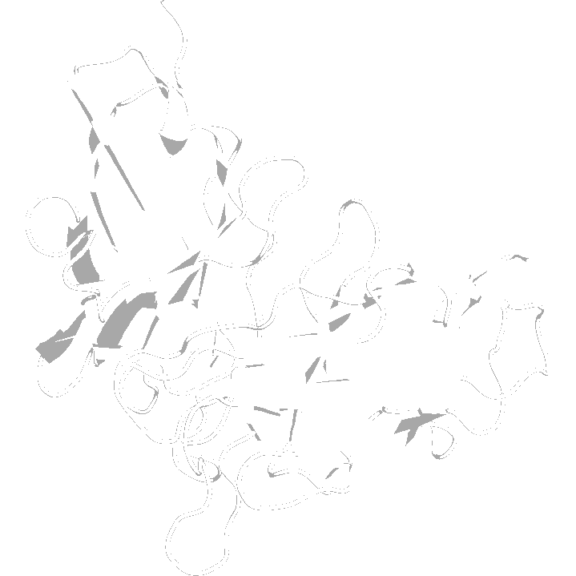
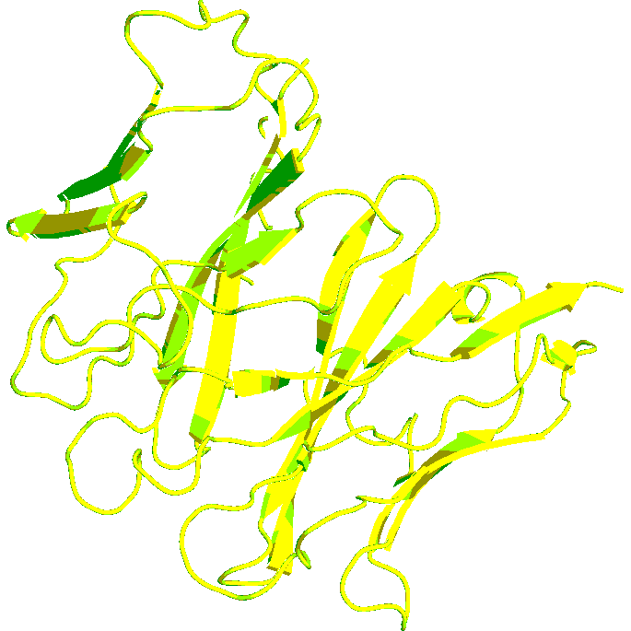
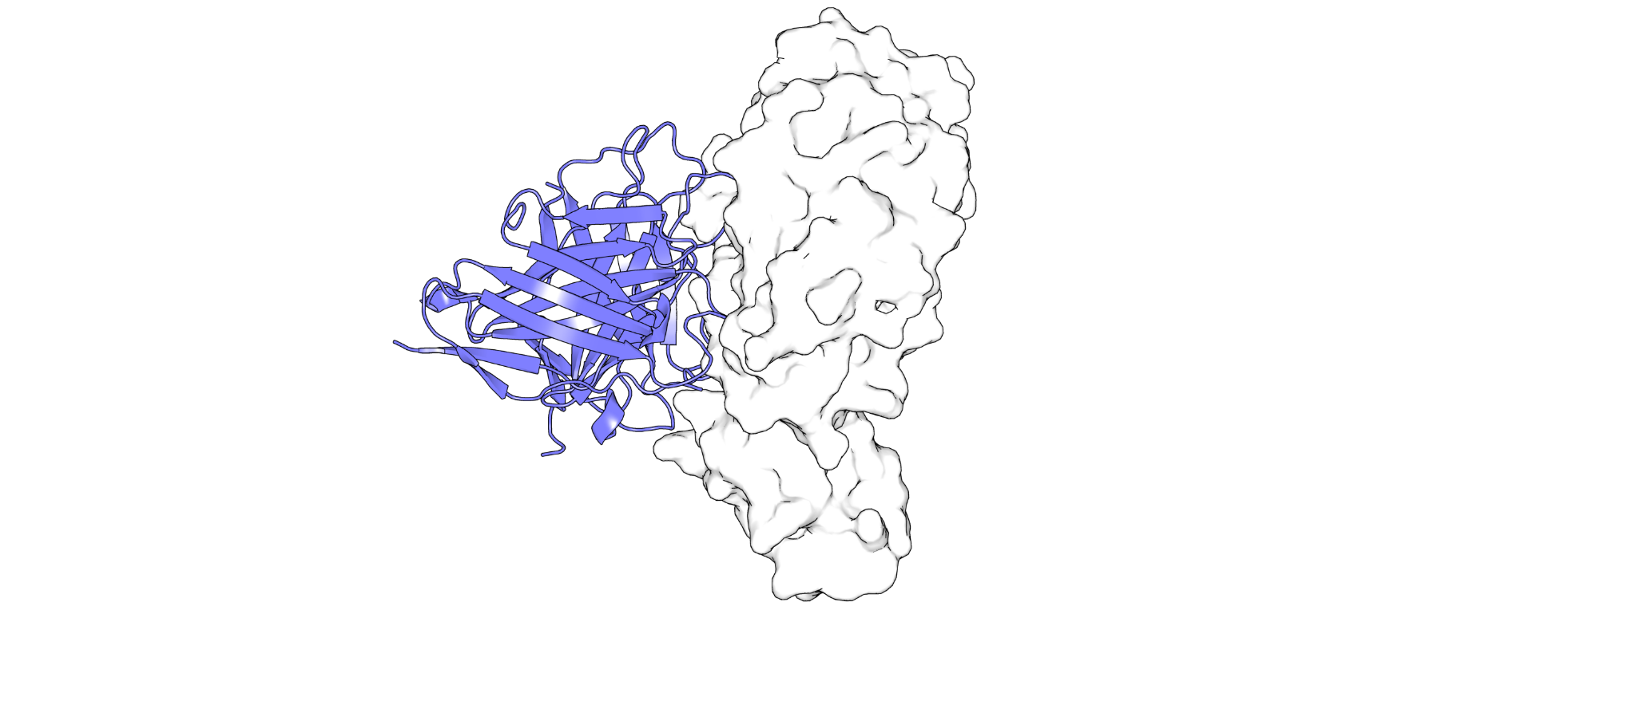
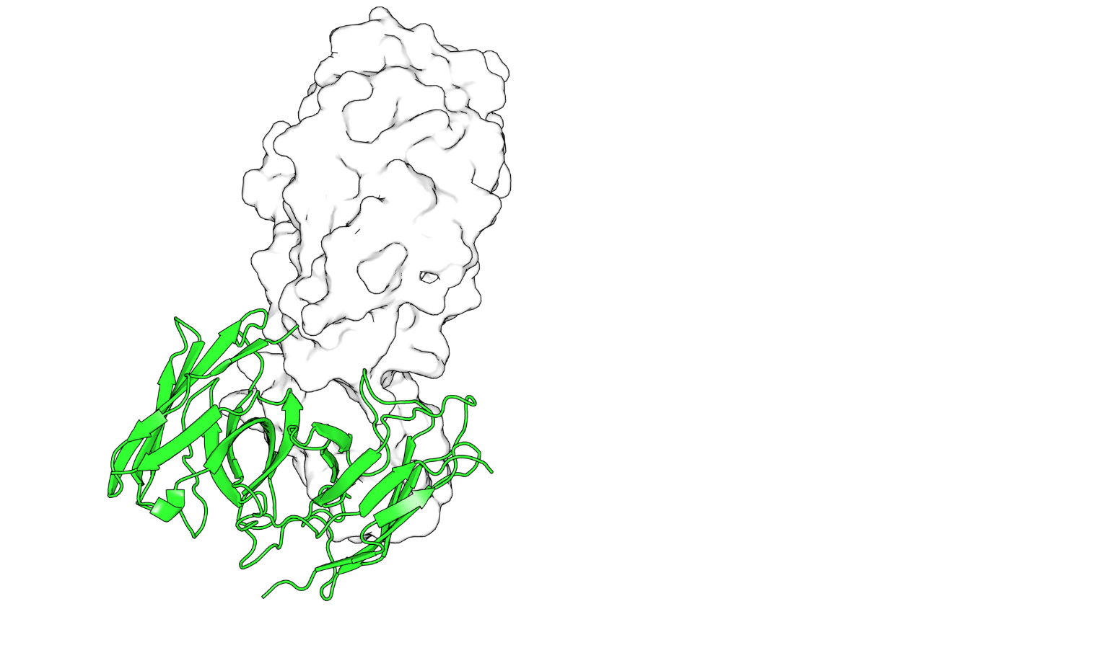


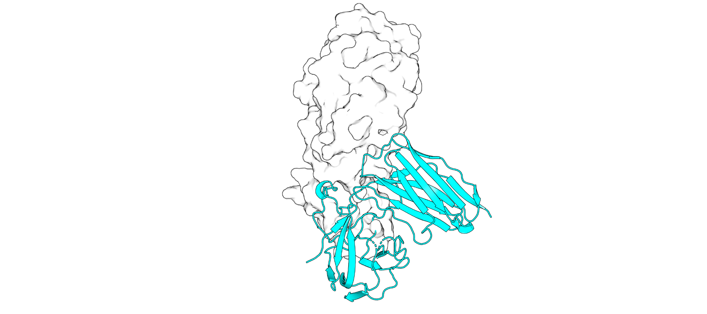
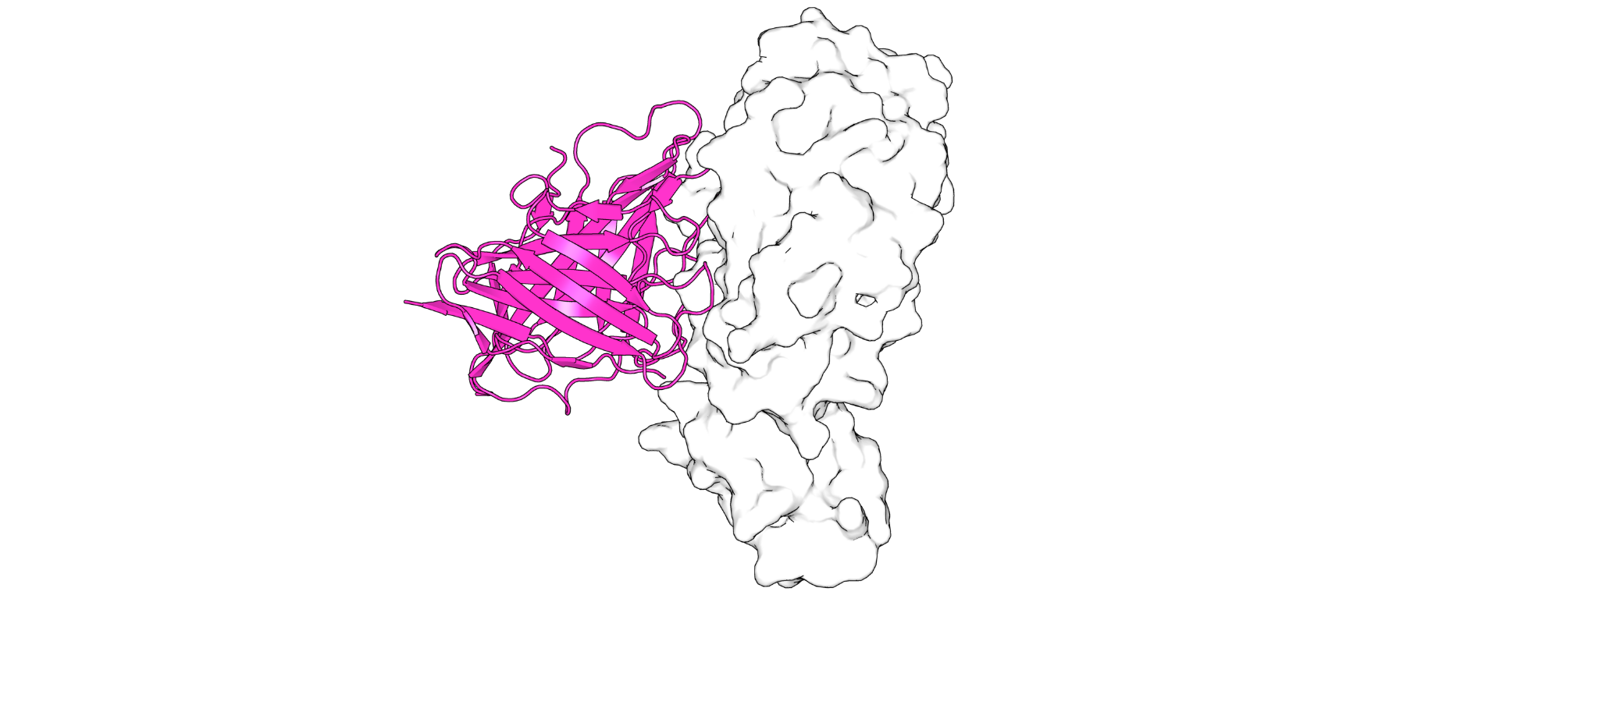
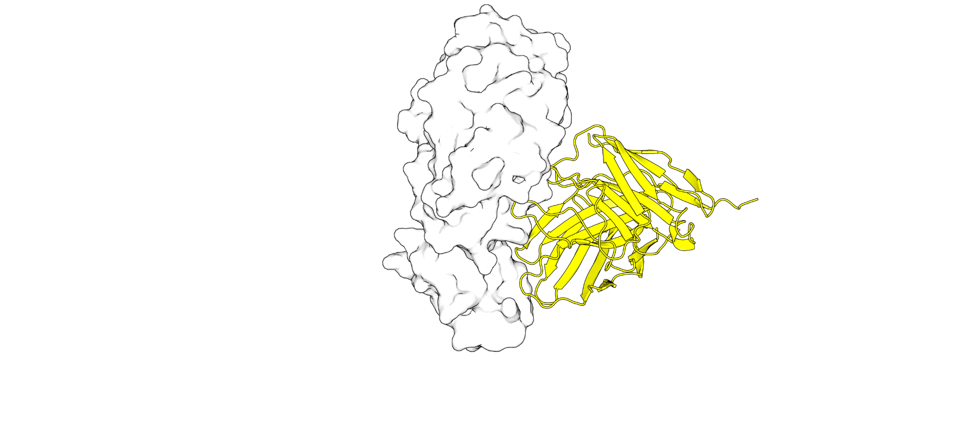
Data Preparation
Protein Data Bank + Thera-SAbDab
Sequence Alignment
(MUSCLE)
Reference
Antibodies
Frankies Pipelines
EVQLVK…
Sequence Diffusion
(EvoDiff)
Protein Folding
(AlphaFold3 /
ESM3)
Antigen Docking
(HADDOCK3)
Outputs
Binding Metrics
Summary
Report
Diffused Antibodies bound to Antigen

