Slide 1
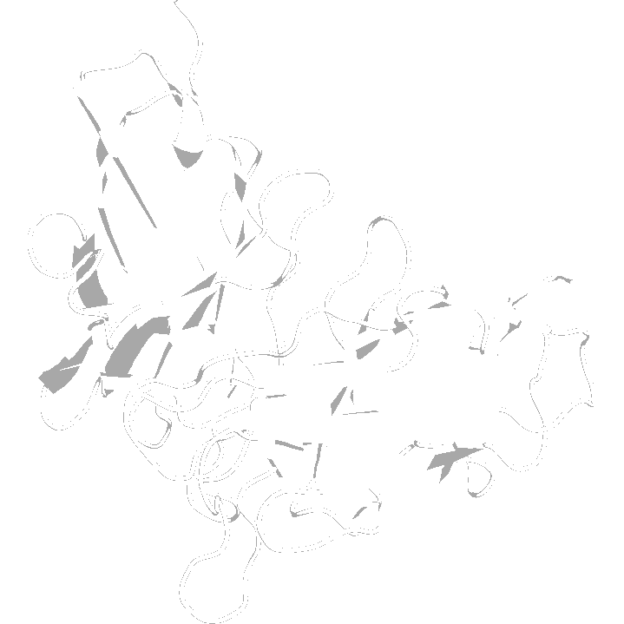
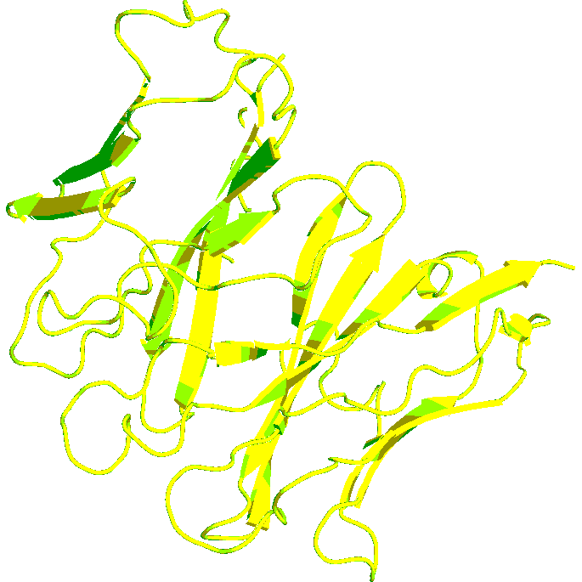
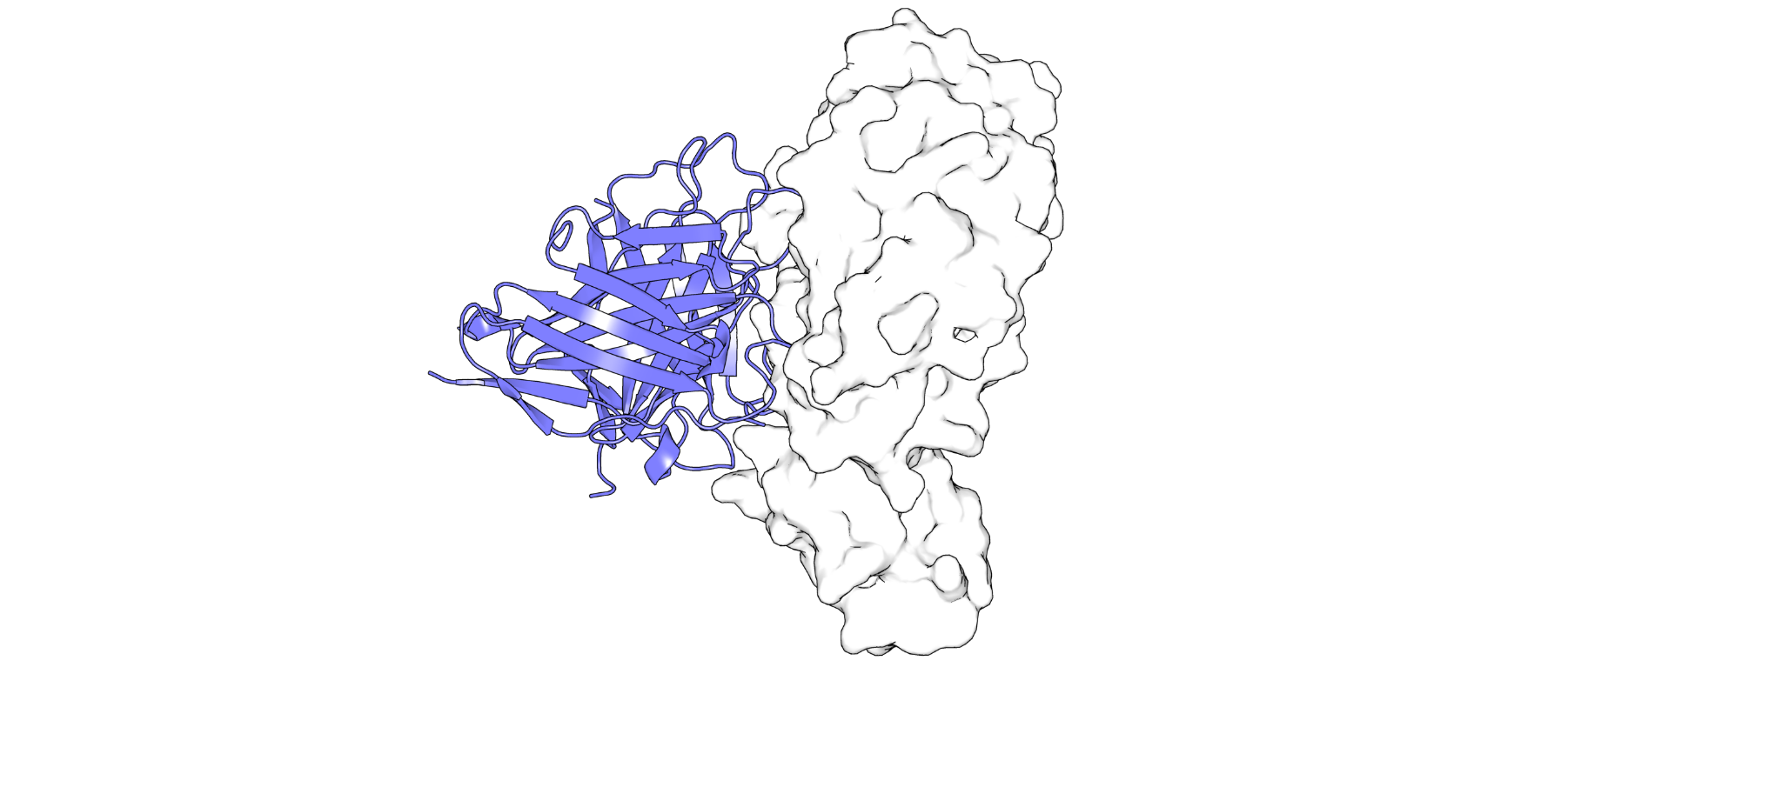
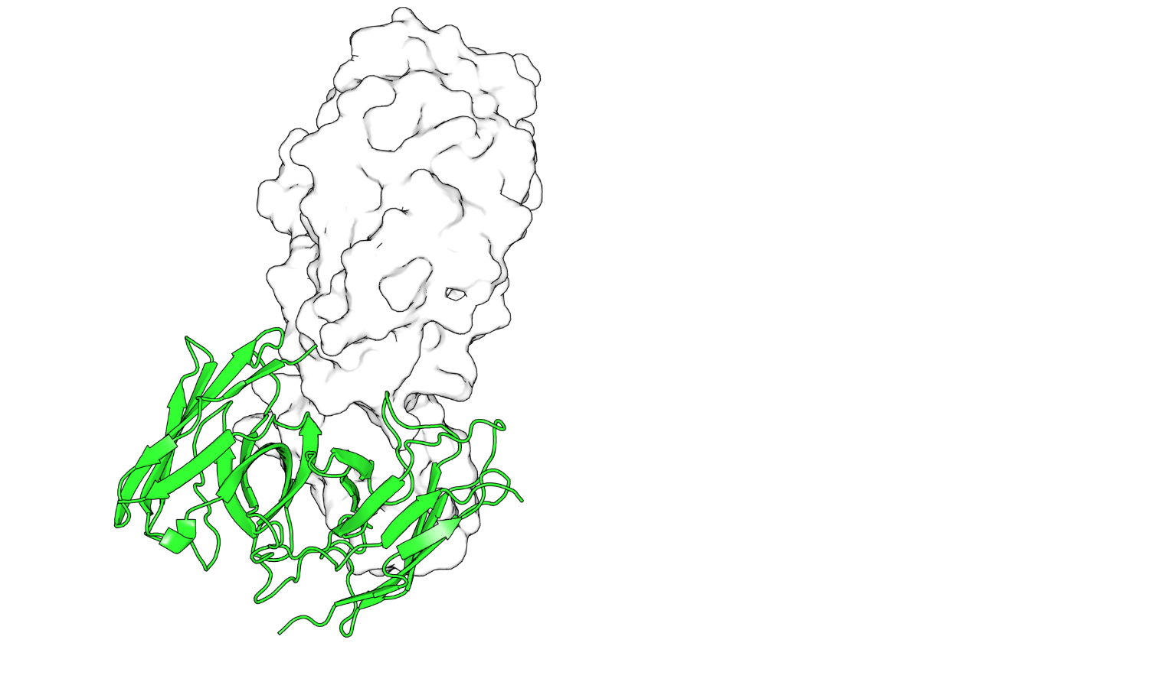


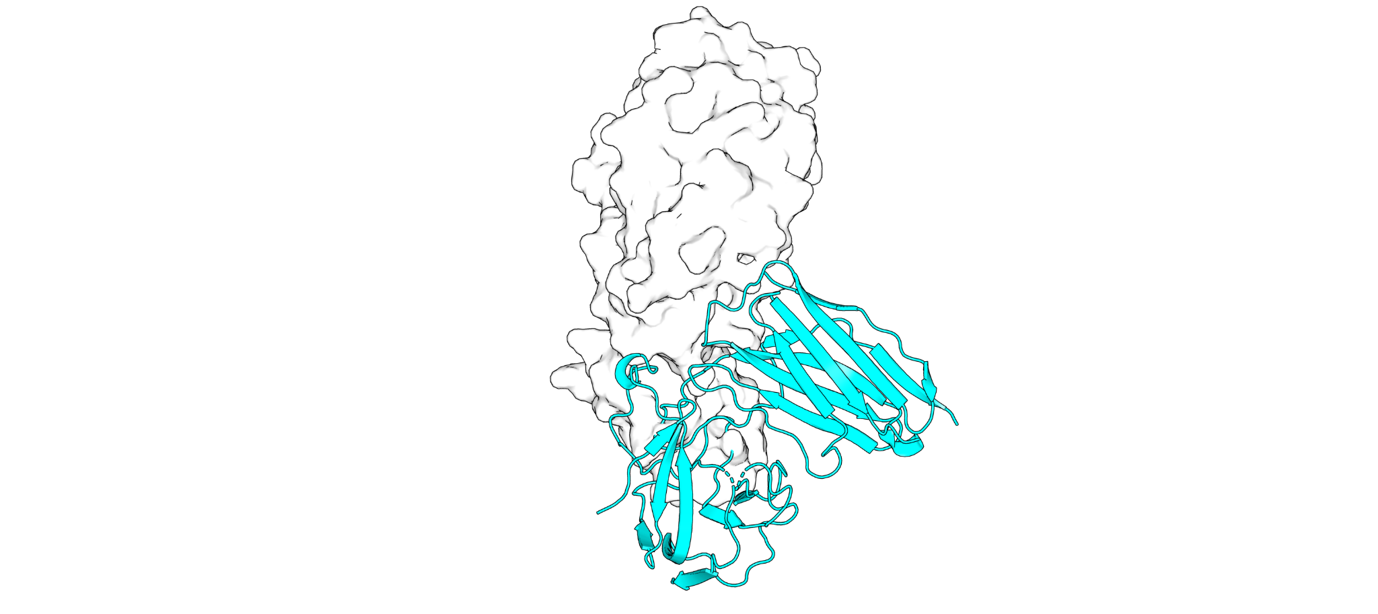
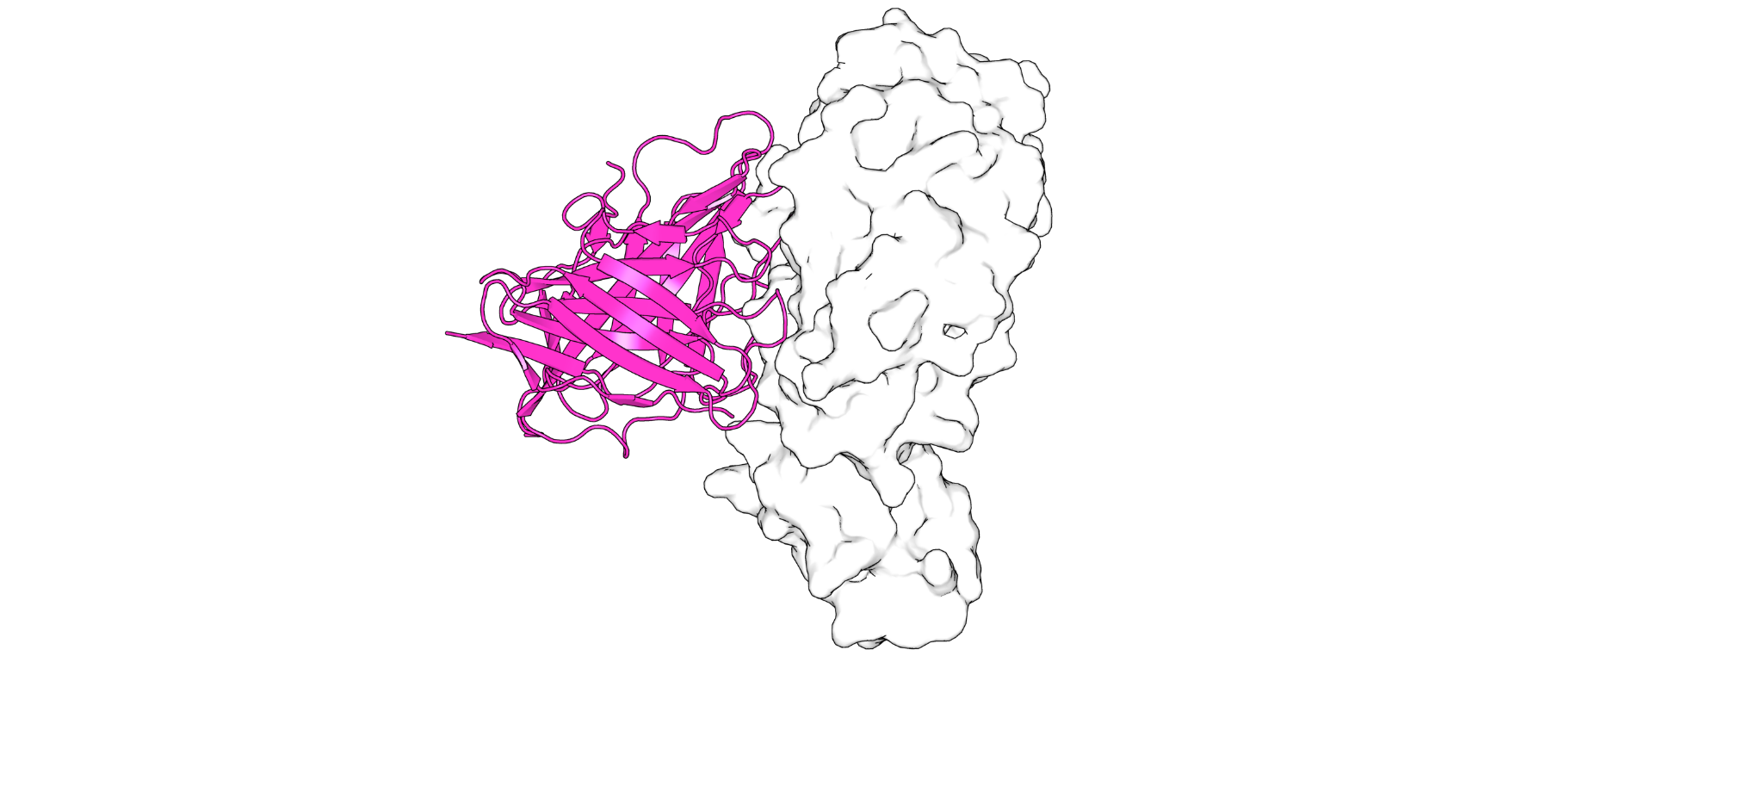
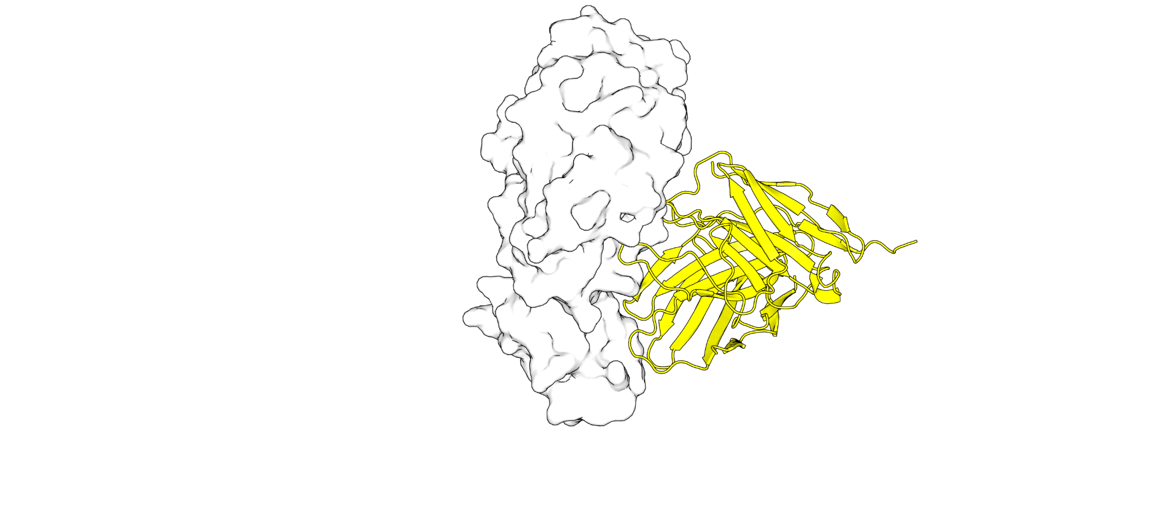
Data Preparation
Protein Data Bank + Thera-SAbDab
Sequence Alignment
(MUSCLE)
Reference
Antibodies
Frankies Pipelines
EVQLVK…
Sequence Diffusion
(EvoDiff)
Protein Folding
(AlphaFold3 /
ESM3)
Antigen Docking
(HADDOCK3)
Outputs
Binding Metrics
Summary
Report
Diffused Antibodies bound to Antigen

Slide 2
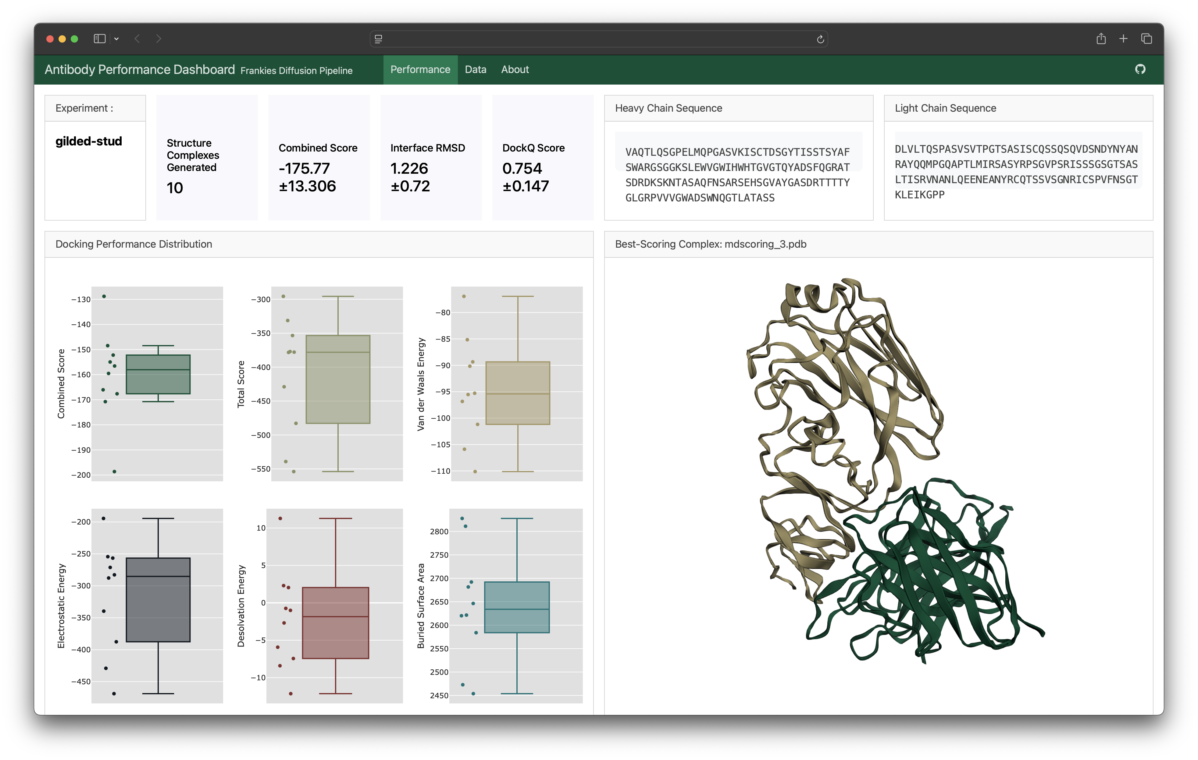



AI-Based Antibody Design Targeting Recent H5N1 Avian Influenza Strains
Data Preparation
Protein Data Bank + Thera-SAbDab
Sequence Alignment
(MUSCLE)
Reference
Antibodies
Frankies Pipelines
EVQLVK…
Sequence Diffusion
(EvoDiff)
Protein Folding
(AlphaFold3 /
ESM3)
Antigen Docking
(HADDOCK3)
Outputs
Conclusion: The Frankies AI-based antibody generation pipeline provides a reliable method to generate Fv structures that bind to desired antigen targets, such as recent H5N1 influenza strains.
Binding Metrics
Summary
Report
Diffused Antibodies bound to Antigen
Santolla and Ford, 2025

