Slide 1

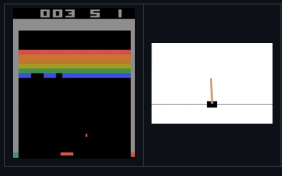
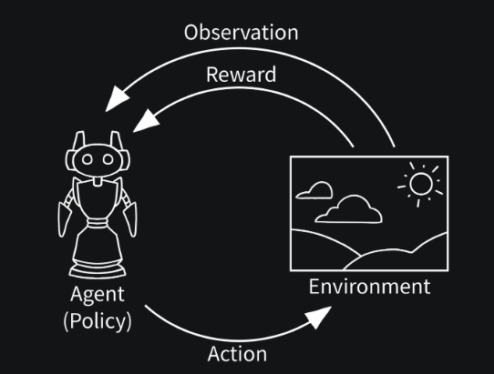
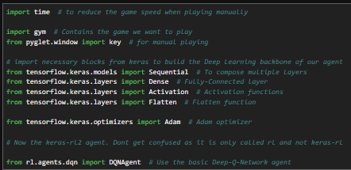
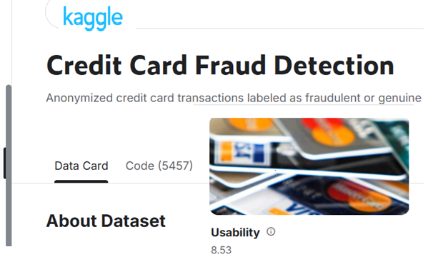
Reinforcement Learning with Tensorflow, Keras-RL and Gym
https://github.com/keras-rl/keras-rl
https://gymnasium.farama.org/introduction/basic_usage/
https://www.kaggle.com/datasets/mlg-ulb/creditcardfraud

Slide 2
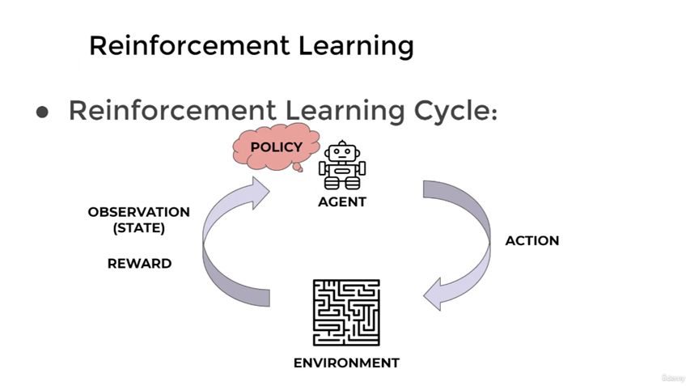

Slide 8
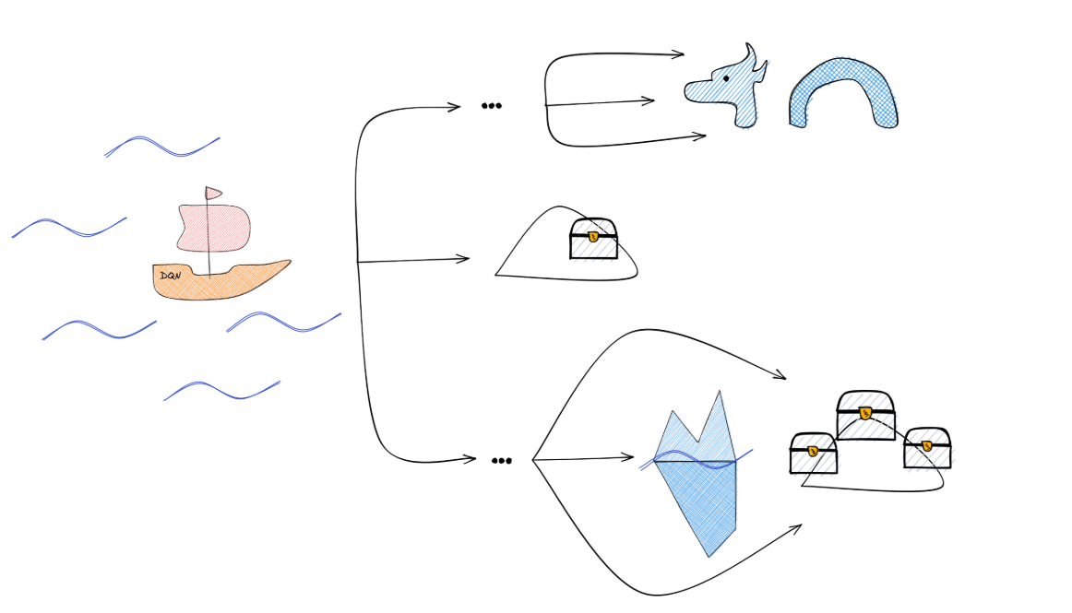

Slide 9
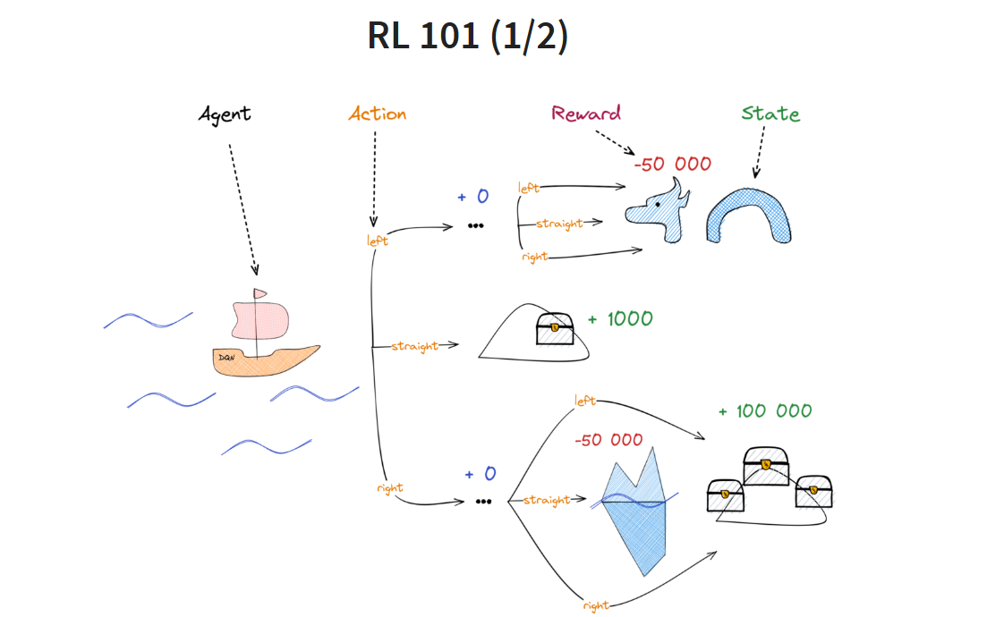

Slide 10
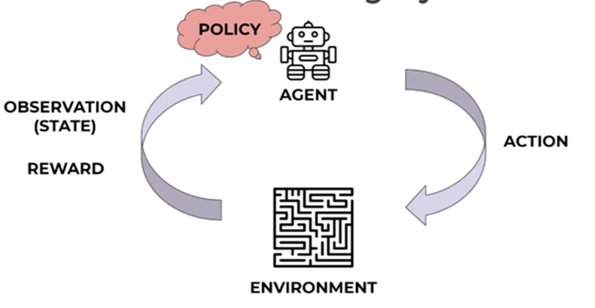

Slide 12
Agent
Perform an action (policy driven by)
It generates an observation("State") from the environment.
It gives a Reward (or penalty)
Update policy

Slide 13
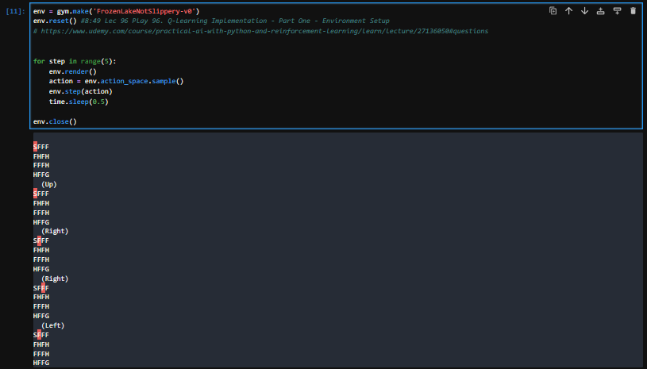
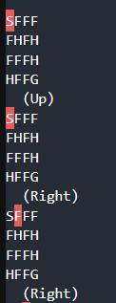
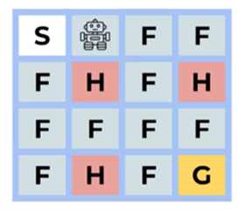

Slide 14
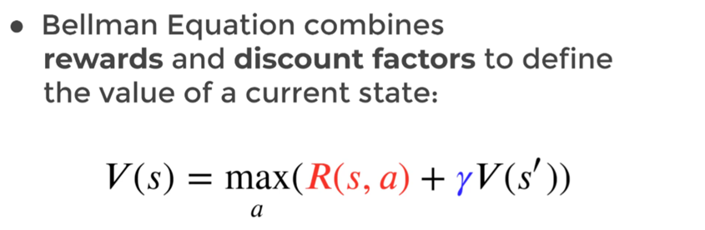
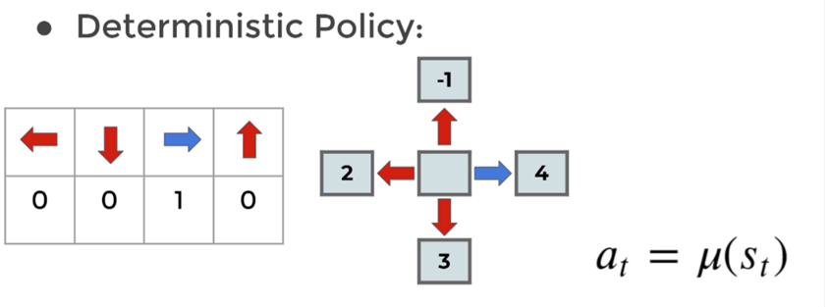

Slide 15
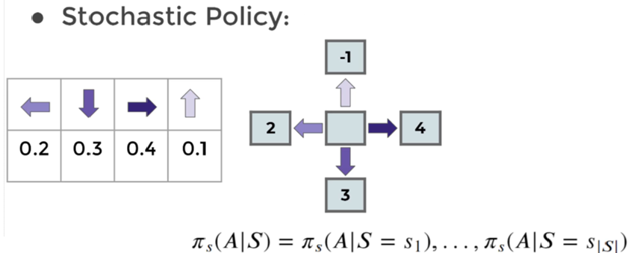

Slide 16
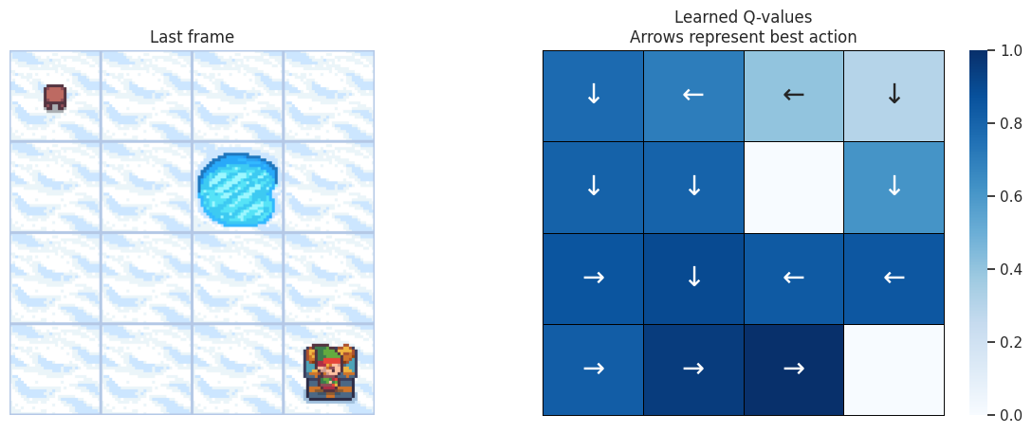
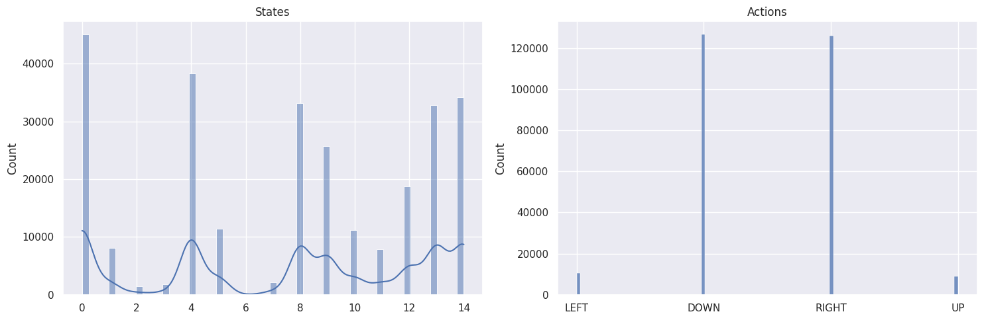
"Real" toy model.
https://gymnasium.farama.org/tutorials/training_agents/frozenlake_q_learning/

Slide 17
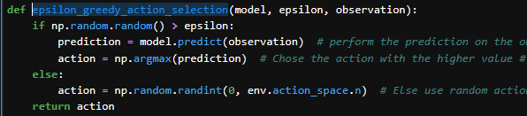
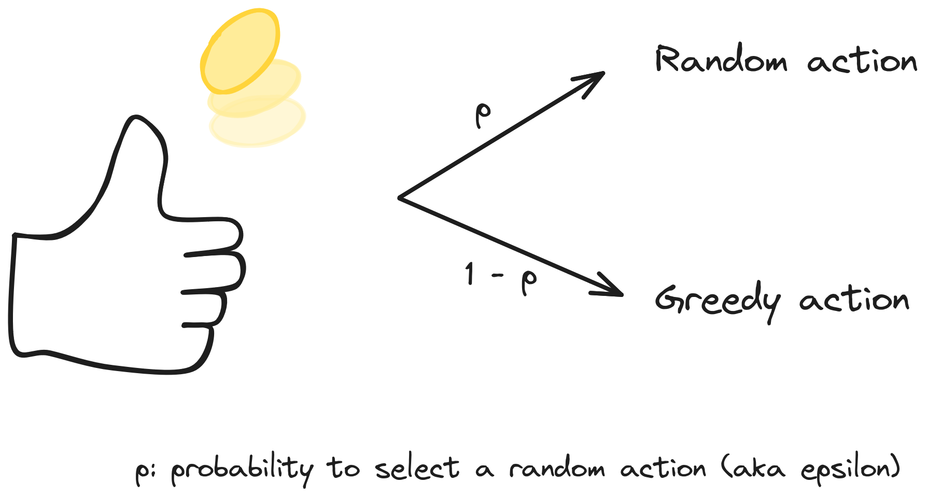
Epsilon greedy action selection
Exploration
Vs.
Exploitation

Slide 18
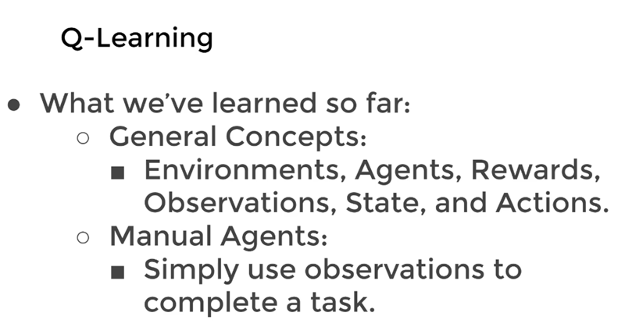

Slide 19
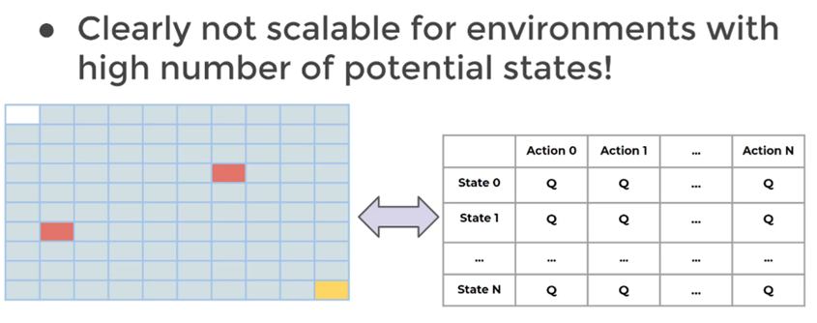

Slide 20
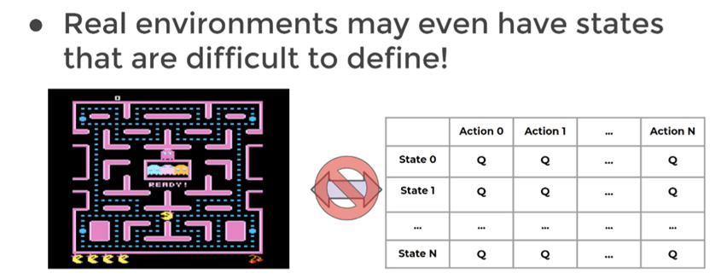

Slide 21
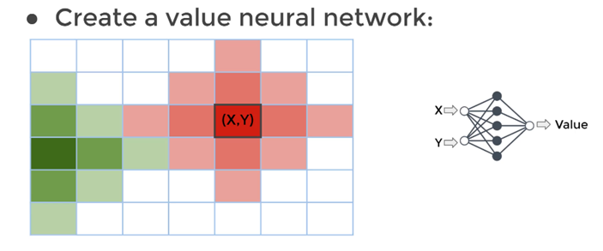
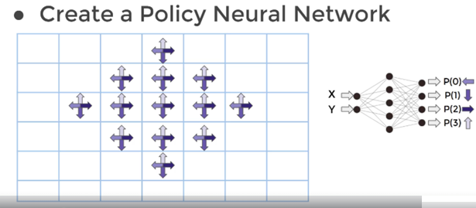

Slide 22
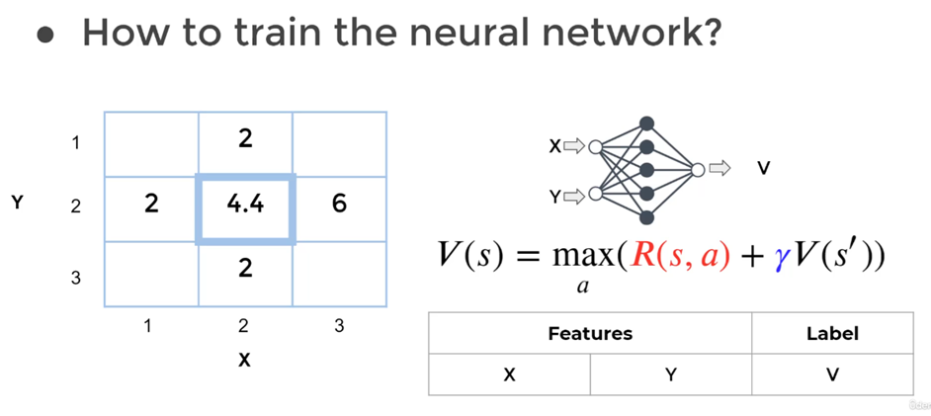

Slide 23
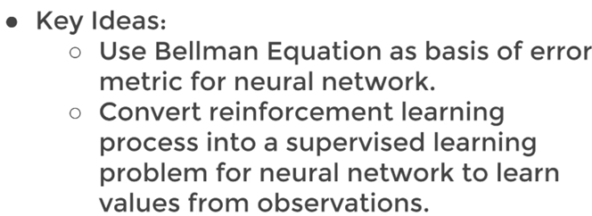

Slide 24
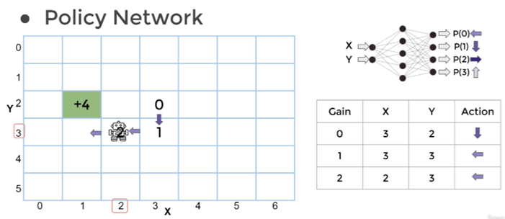

Slide 25
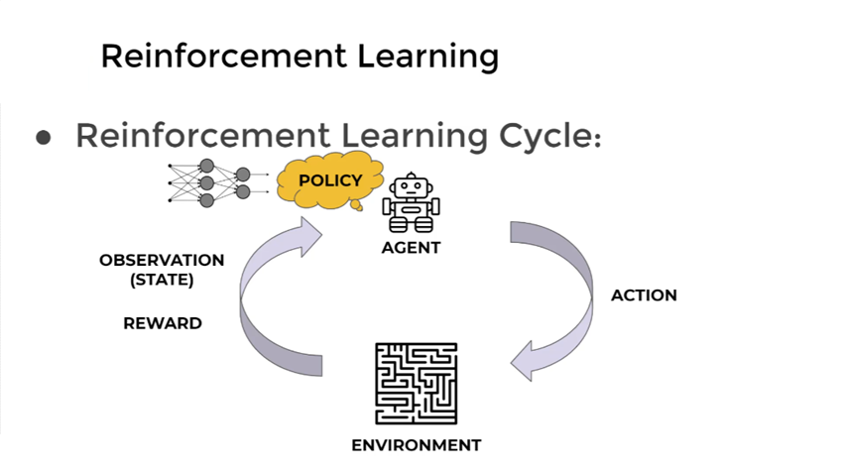

Slide 26
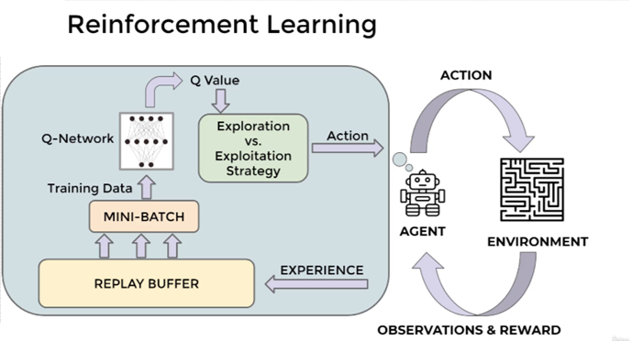

Slide 27
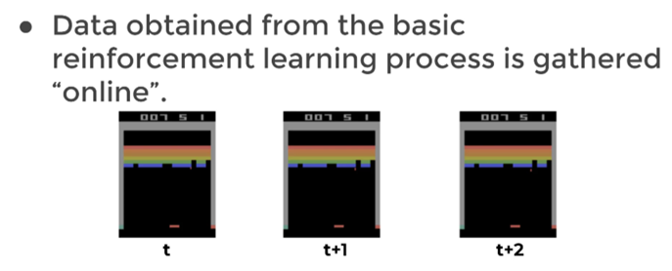
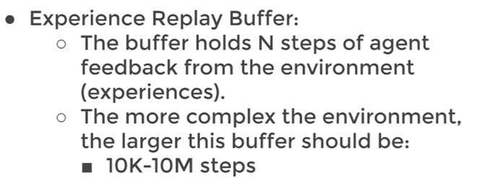
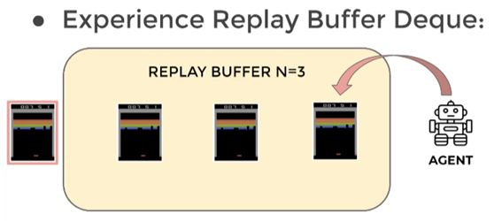
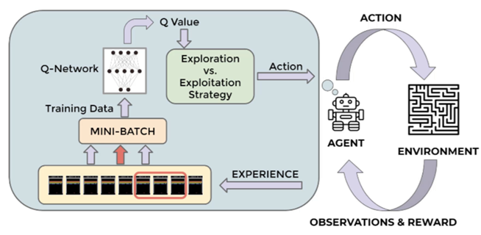
DQN Theory and Intuition
I
II
II
IV
III

Slide 28

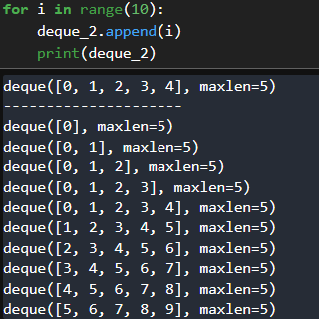
DQN Theory and Intuition
I
II
II
IV
III

Slide 29
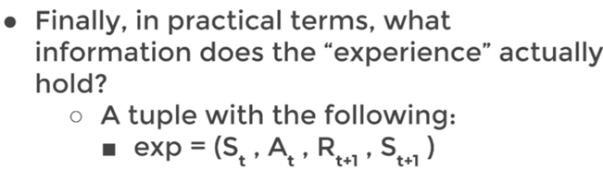
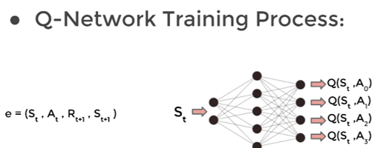
DQN Theory and Intuition

Slide 30
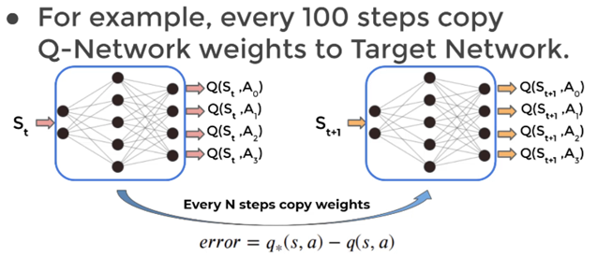
DQN Theory and Intuition

Slide 31
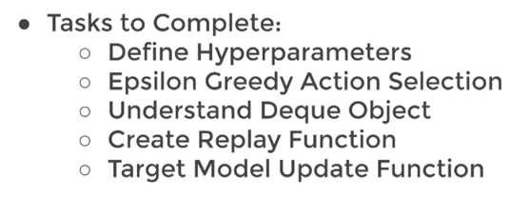
DQN Theory and Intuition

Slide 32
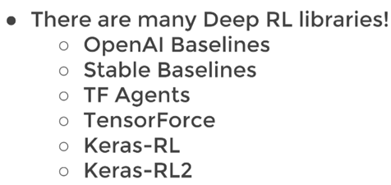
DQN Theory and Intuition

Slide 33
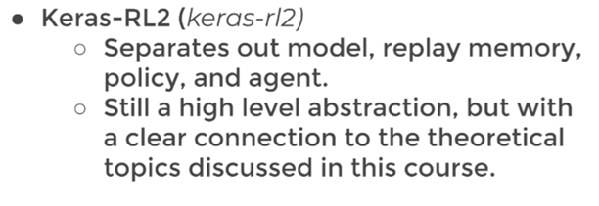
DQN Theory and Intuition

Slide 34
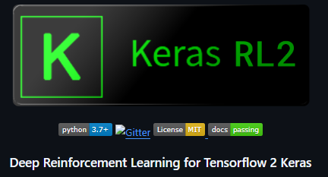


DQN: technical difficulties
Tensorflow 2.10.1
gym-0.26.2

Slide 35


Slide 36
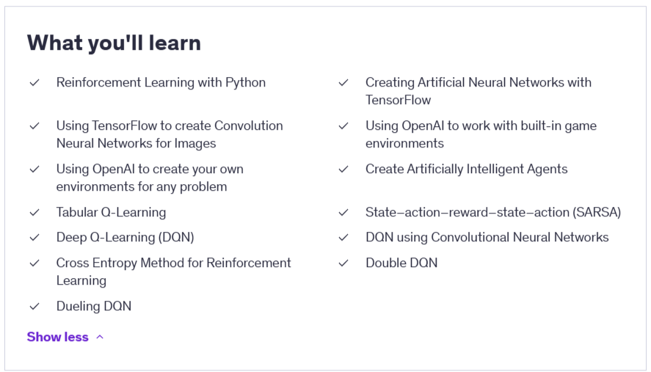

Slide 37

A simple problem

Slide 38
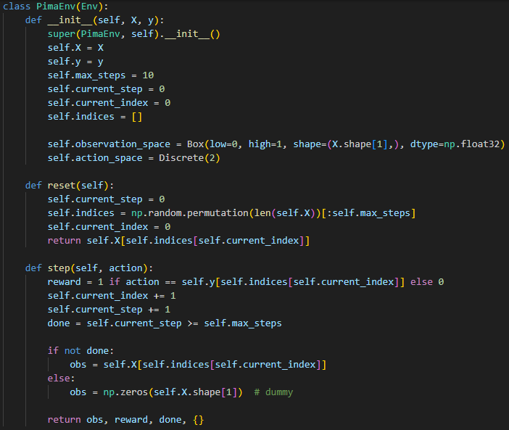
Example
Keras RL2
Tensorflow 2.10.1
gym-0.26.2
Customized Environment

Slide 39
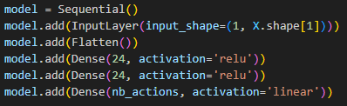
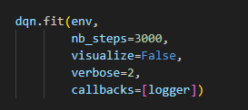
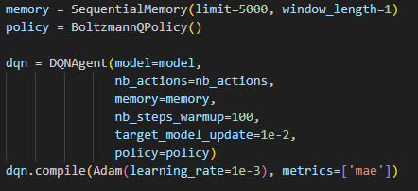
Example
Keras RL2
Tensorflow 2.10.1
gym-0.26.2

Slide 40
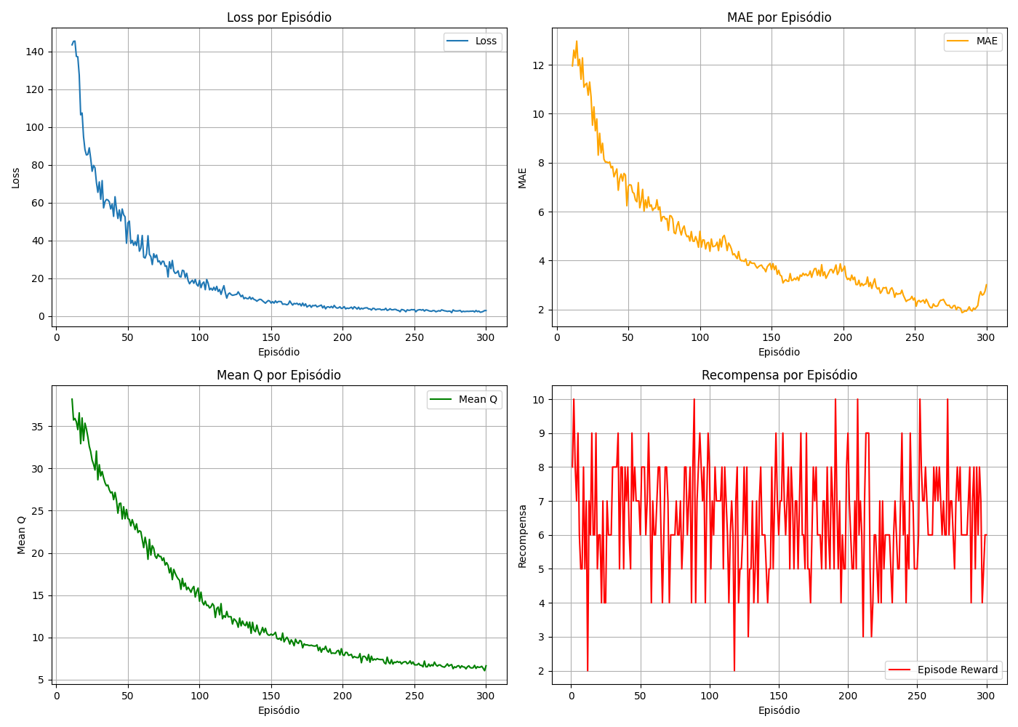
Example
Keras RL2
Tensorflow 2.10.1
gym-0.26.2

Slide 41
Conclusions
Reinforcement learning (RL) has a natural application for interaction-based learning; therefore, it can, in principle, be used for online real-time fraud detection.
On the other hand, from the literature, we know that RL does not present good scores in comparison with machine learning models (ML) such as boosted decision trees.
Due to that, an investigation about the usage of Quantum machine learning (QML) can improve the RL for this task (at least in the anomaly detection area).

Slide 42
Conclusions
Reinforcement learning (RL) has a natural application for interaction-based learning; therefore, it can, in principle, be used for online real-time fraud detection.
On the other hand, from the literature, we know that RL does not present good scores in comparison with machine learning models (ML) such as boosted decision trees.
Due to that, an investigation about the usage of Quantum machine learning (QML) can improve the RL for this task (at least in the anomaly detection area).
A first step was achieved, a first RL model were developed and roughly tested.

Slide 43

Conclusions
The next steps are:
  Fraud data set tests;
  Usage of other packages such as pytorch;
  Replication of some interesting paper applying RL to fraud detection and comparing with the state of the art of fraud detection ML methodology (classical);
  Start mixing the classical with Quantum elements of ML into Classical RL structure.

