Slide 1


Reinforcement Learning with Tensorflow, Keras-RL and Gym

Slide 2
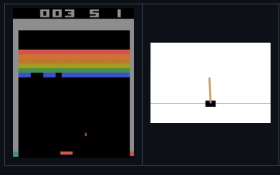
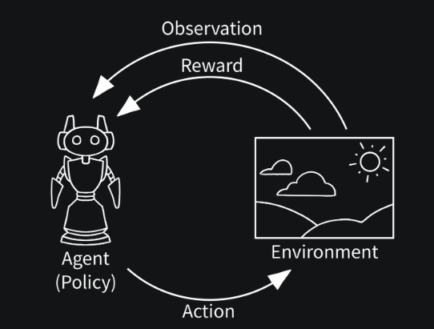
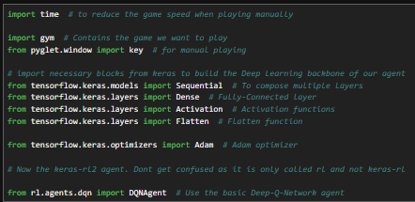
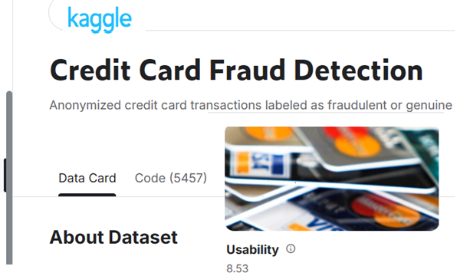
Reinforcement Learning with Tensorflow, Keras-RL and Gym

Slide 3
Reinforcement Learning with Tensorflow, Keras-RL and Gym
https://github.com/keras-rl/keras-rl
https://gymnasium.farama.org/introduction/basic_usage/
https://www.kaggle.com/datasets/mlg-ulb/creditcardfraud

Slide 4
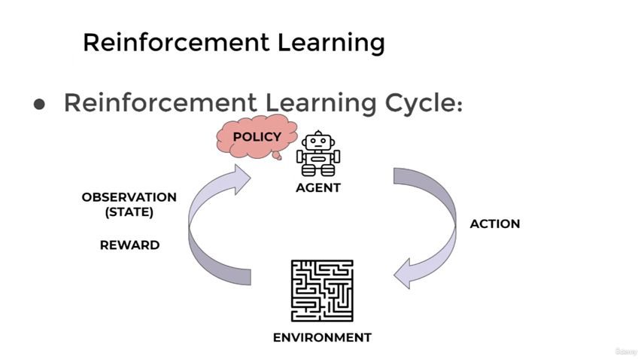

Slide 10
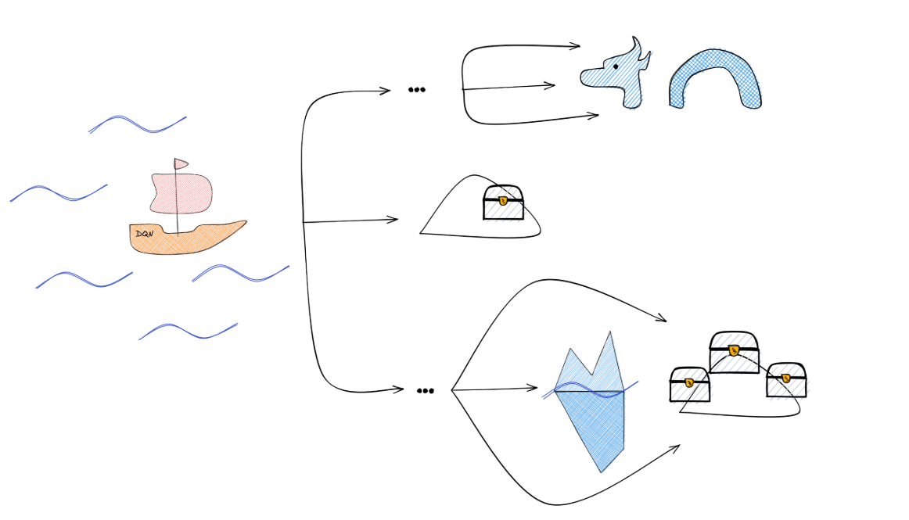
https://araffin.github.io/slides/dqn-tutorial/#/6/0/4

Slide 11
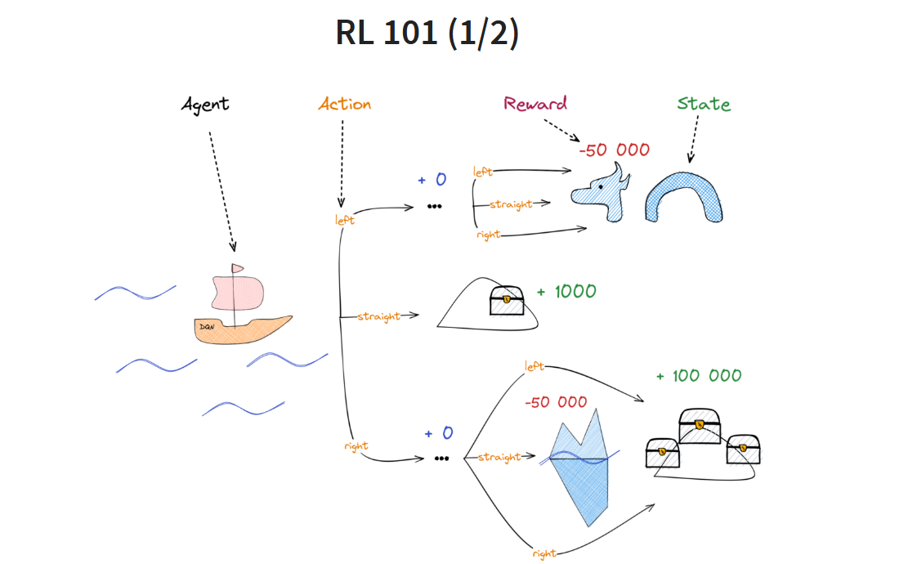
https://araffin.github.io/slides/dqn-tutorial/#/6/0/4

Slide 12
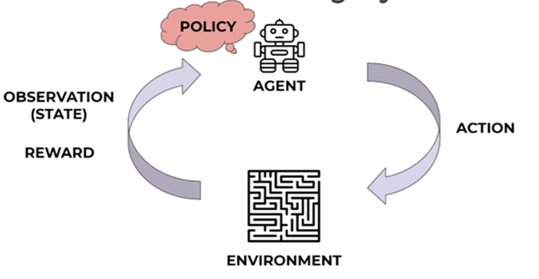

Slide 13
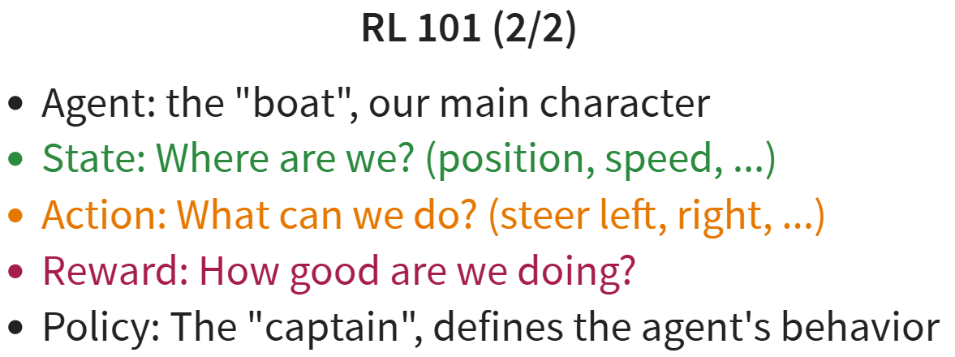

Slide 14
Agent
Perform an action (policy driven by)
It generates an observation("State") from the environment.
It gives a Reward (or penalty)
Update policy

Slide 15
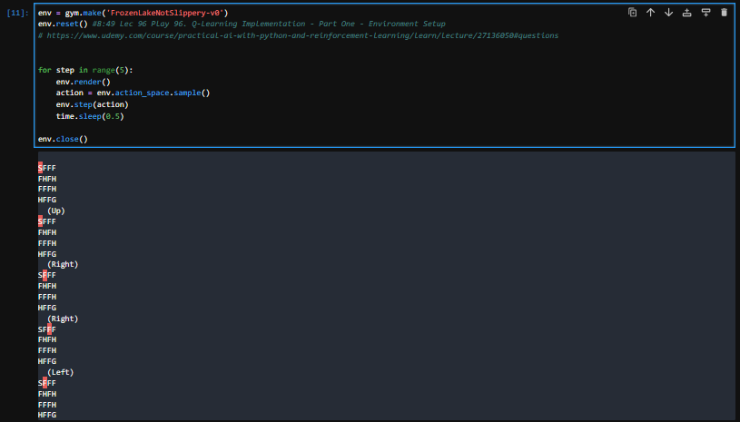
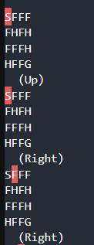
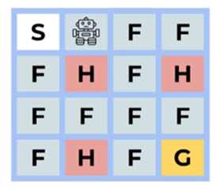

Slide 16
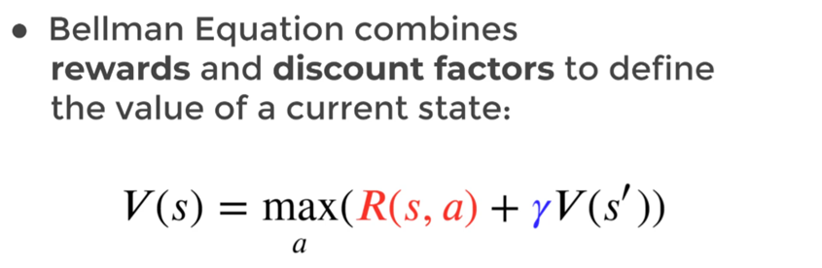
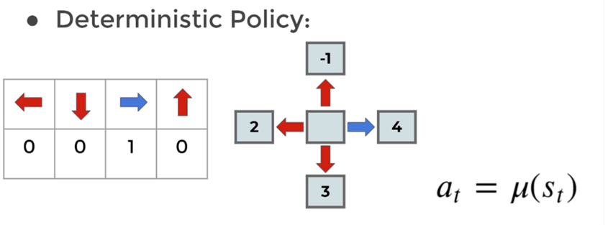

Slide 17
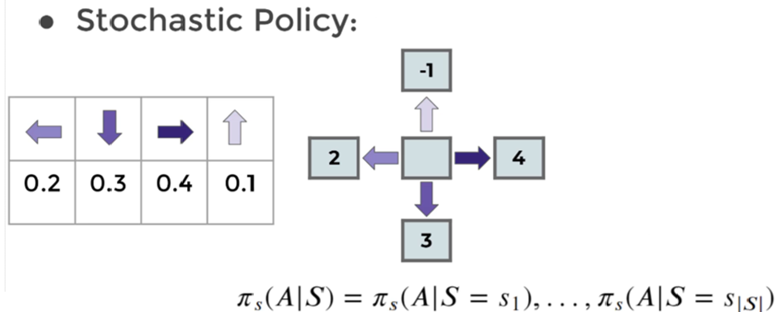

Slide 18
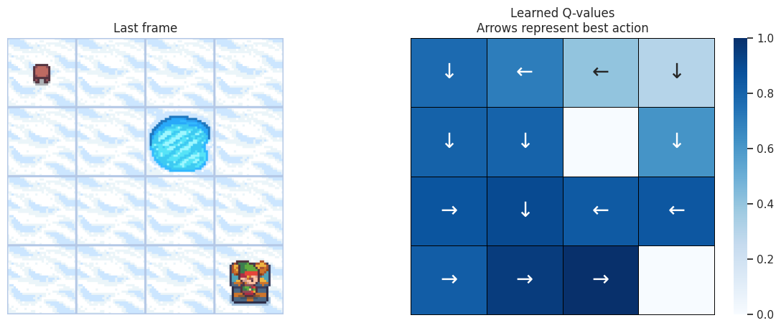
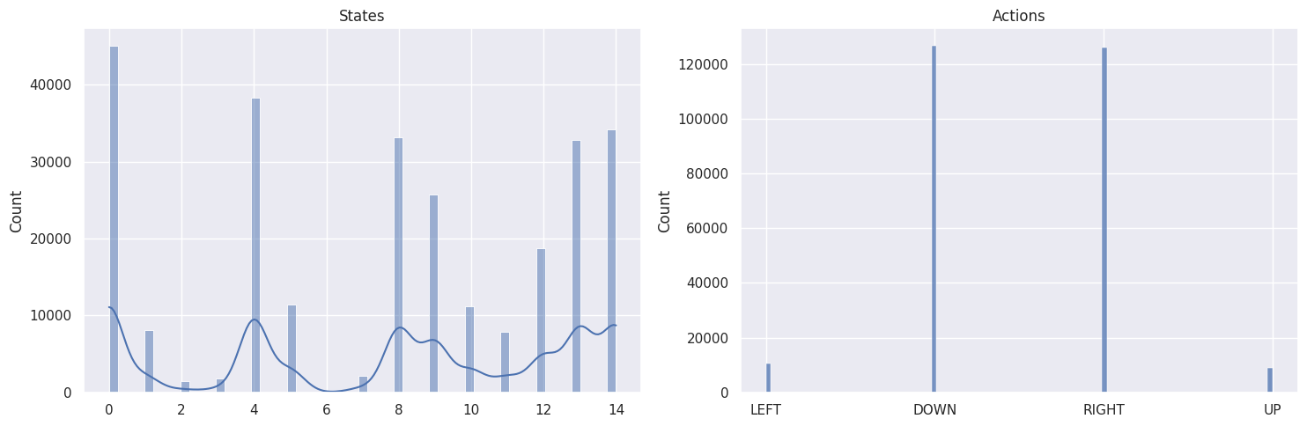
"Real" toy model.
https://gymnasium.farama.org/tutorials/training_agents/frozenlake_q_learning/

Slide 19
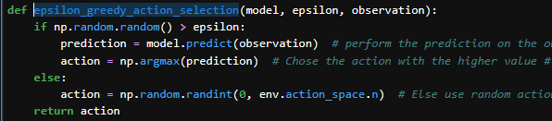
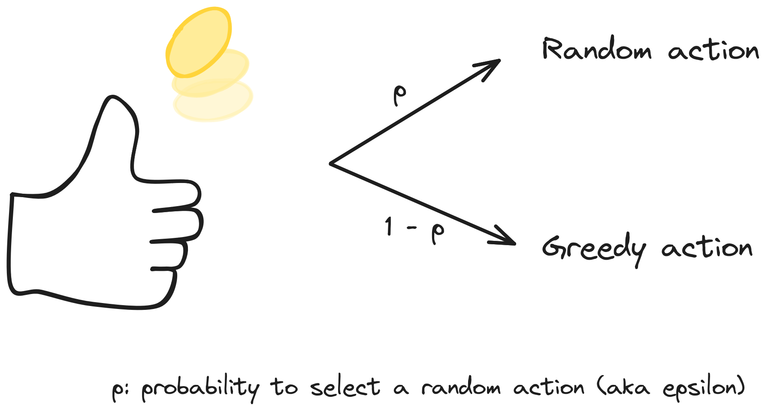
Epsilon greedy action selection
Exploration
Vs.
Exploitation

Slide 20
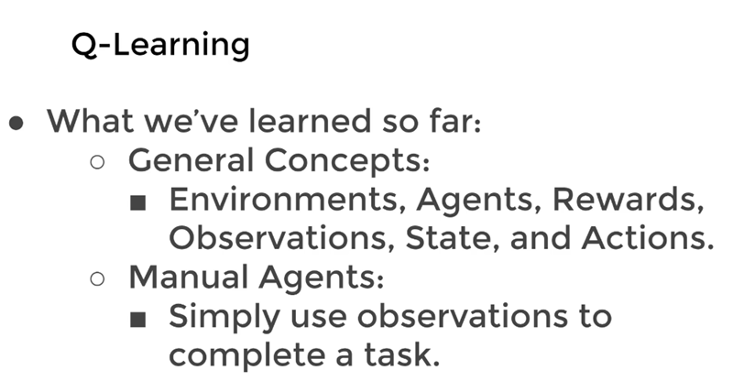

Slide 21
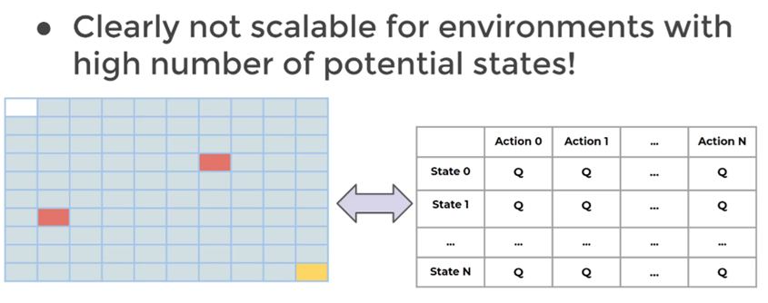

Slide 22
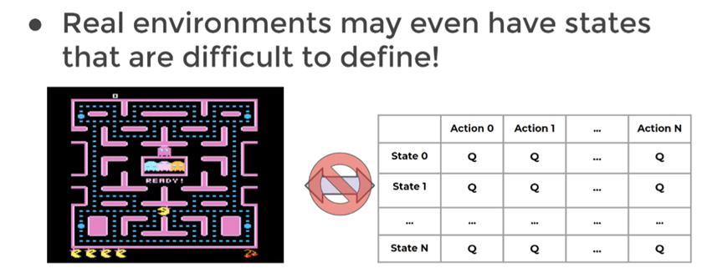

Slide 23
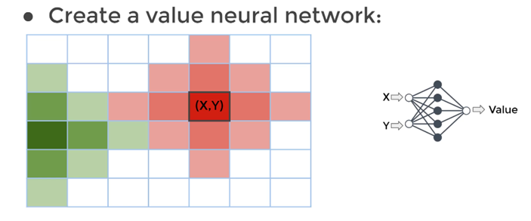
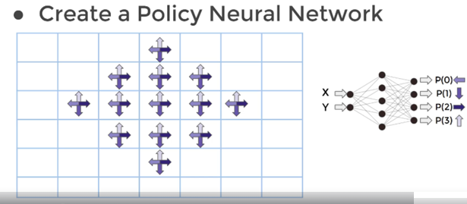

Slide 24
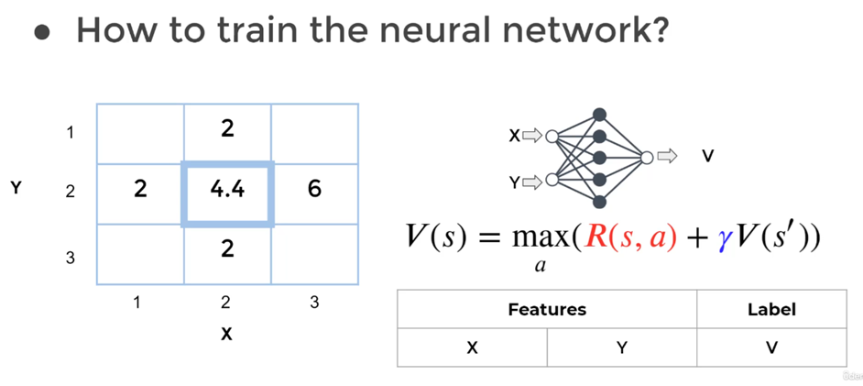

Slide 25
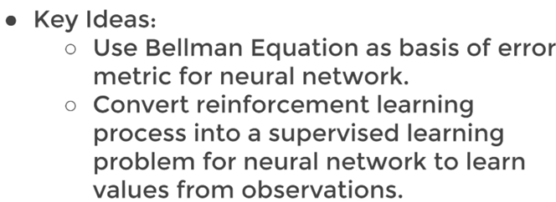

Slide 26
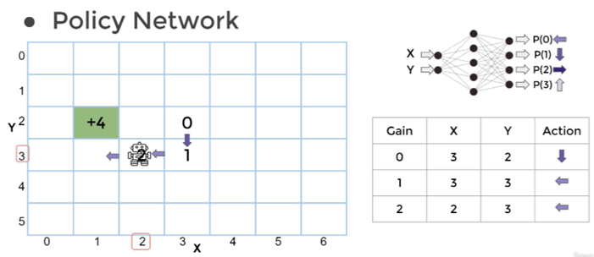

Slide 27
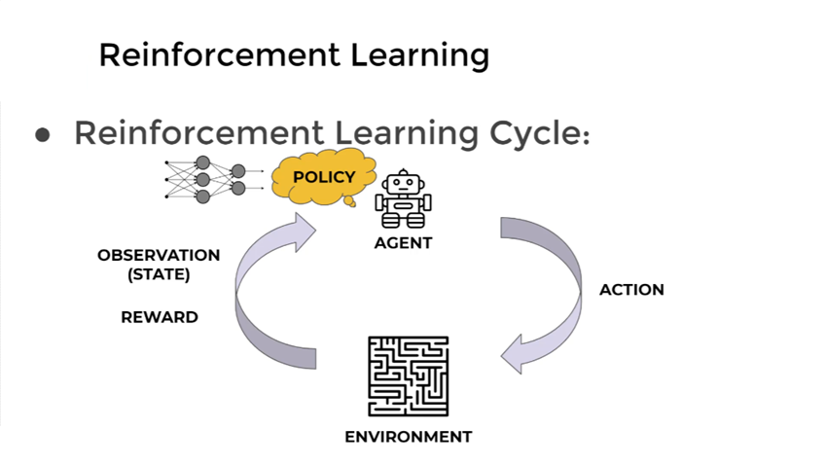

Slide 28
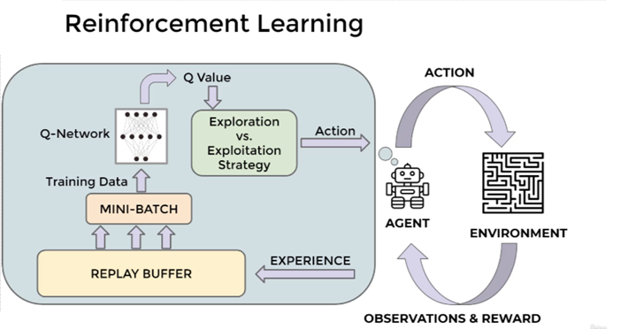

Slide 29
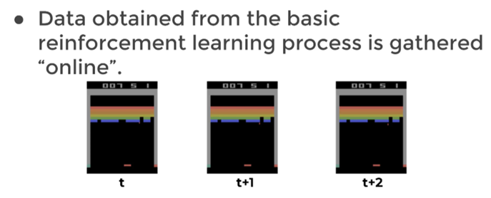
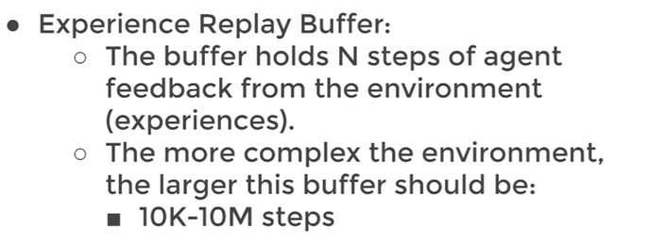
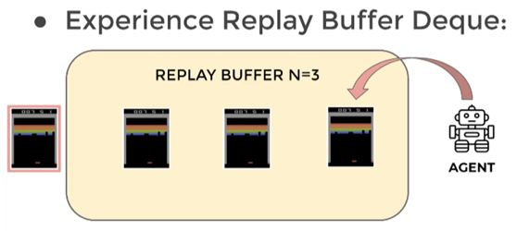
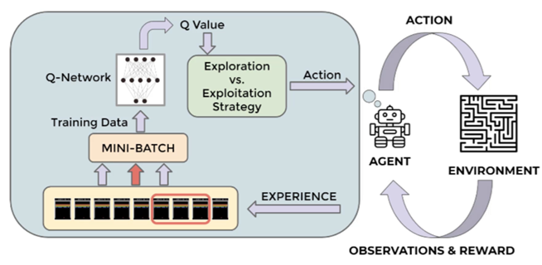
DQN Theory and Intuition
I
II
II
IV
III

Slide 30

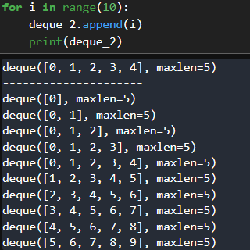
DQN Theory and Intuition
I
II
II
IV
III

Slide 31
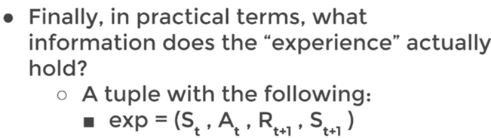
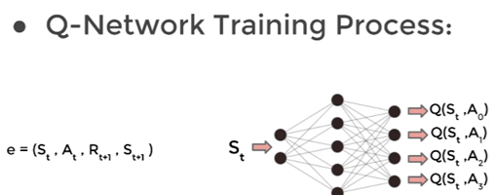
DQN Theory and Intuition

Slide 32
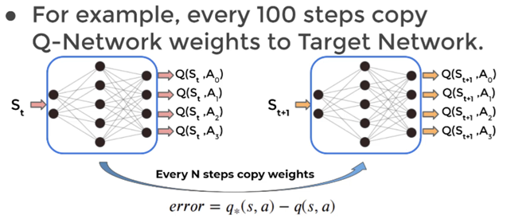
DQN Theory and Intuition

Slide 33
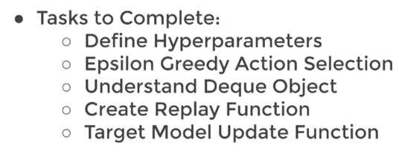
DQN Theory and Intuition

Slide 34
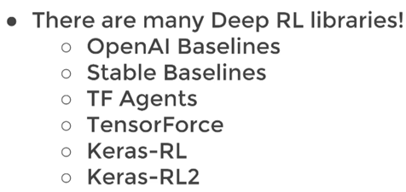
DQN Theory and Intuition

Slide 35
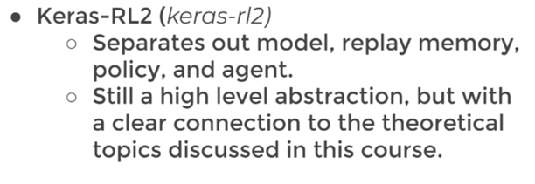
DQN Theory and Intuition

Slide 36
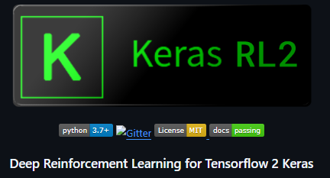


DQN: technical difficulties
Tensorflow 2.10.1
gym-0.26.2

Slide 37


Slide 38
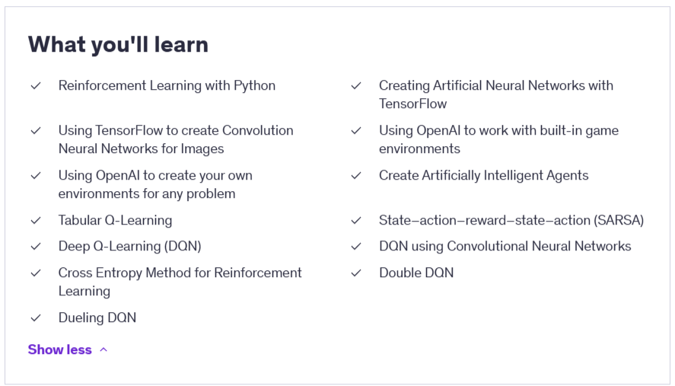

Slide 39
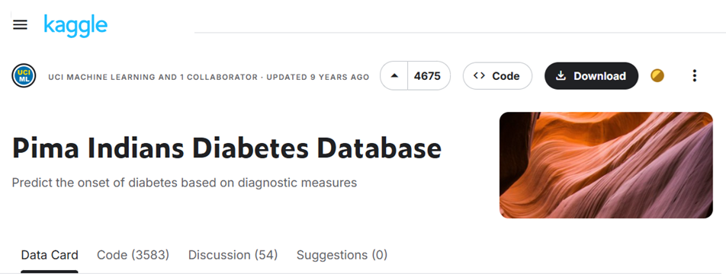
A simple problem

Slide 40
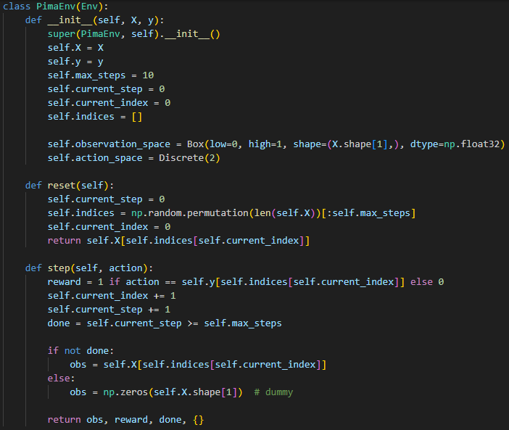
Example
Keras RL2
Tensorflow 2.10.1
gym-0.26.2
Customized Environment

Slide 41
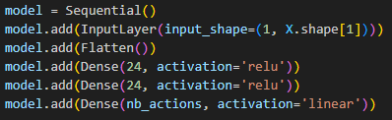
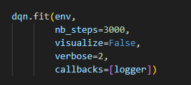
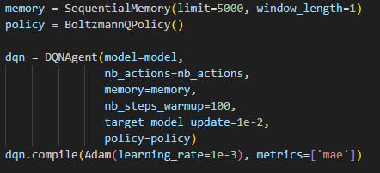
Example
Keras RL2
Tensorflow 2.10.1
gym-0.26.2

Slide 42
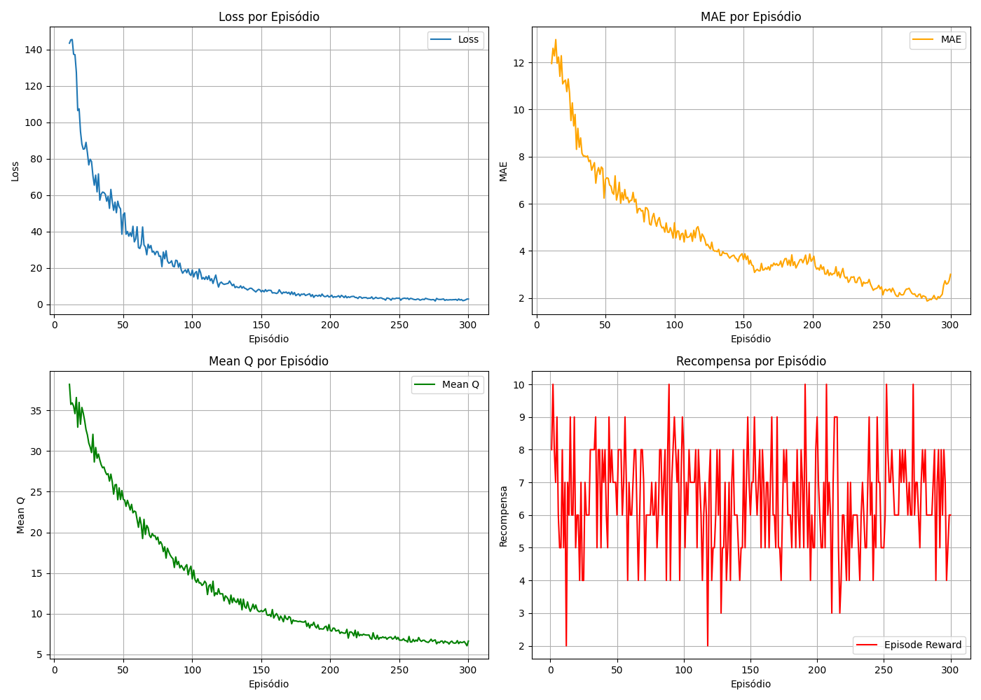
Example
Keras RL2
Tensorflow 2.10.1
gym-0.26.2

Slide 43
Conclusions
Reinforcement learning (RL) has a natural application for interaction-based learning; therefore, it can, in principle, be used for online real-time fraud detection.
On the other hand, from the literature, we know that RL does not present good scores in comparison with machine learning models (ML) such as boosted decision trees.
Due to that, an investigation about the usage of Quantum machine learning (QML) can improve the RL for this task (at least in the anomaly detection area).

Slide 44
Conclusions
Reinforcement learning (RL) has a natural application for interaction-based learning; therefore, it can, in principle, be used for online real-time fraud detection.
On the other hand, from the literature, we know that RL does not present good scores in comparison with machine learning models (ML) such as boosted decision trees.
Due to that, an investigation about the usage of Quantum machine learning (QML) can improve the RL for this task (at least in the anomaly detection area).
A first step was achieved, a first RL model were developed and roughly tested.

Slide 45
Conclusions
The next steps are:
  Fraud data set tests;
  Usage of other packages such as pytorch;
  Replication of some interesting paper applying RL to fraud detection and comparing with the state of the art of fraud detection ML methodology (classical);
  Start mixing the classical with Quantum elements of ML into Classical RL structure.

