Slide 1
Jupyter, SQL, Pandas workshop
Awesome, exactly what I wanted
Re-deployment of 3K Rice CORE Japonica structure
Beagle phasing

Slide 2
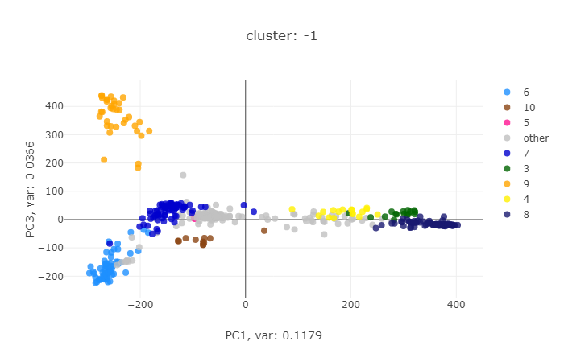
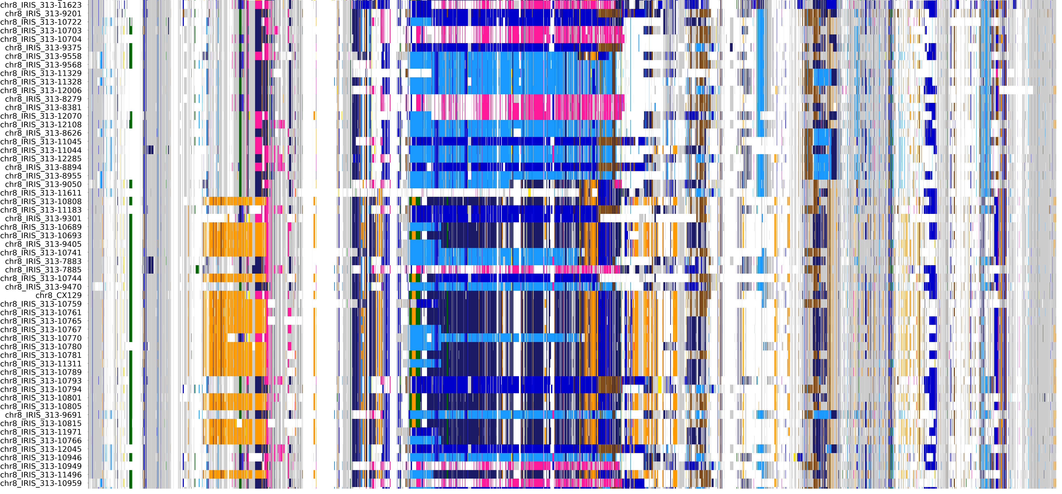
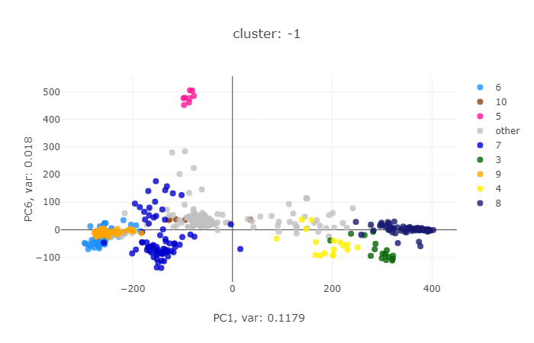
Tropical
Chromosome 8
Notes:
3K Rice CORE Japonica structure – signals of substructure clusters along the genome.

Slide 3
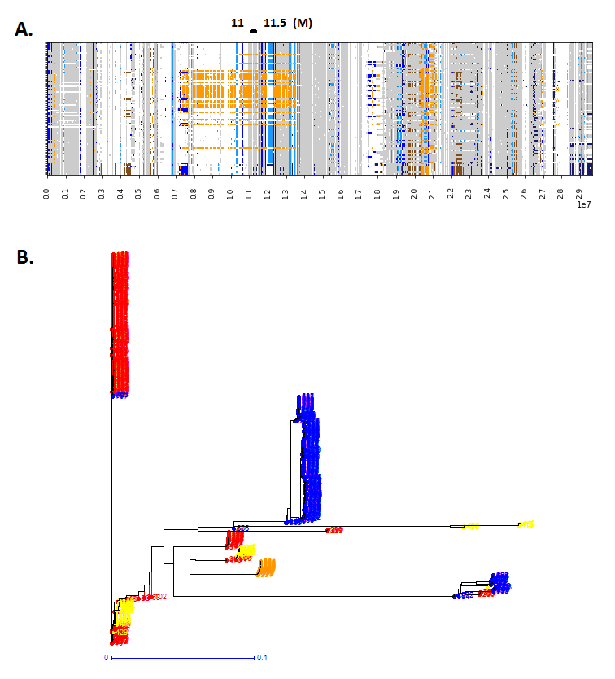
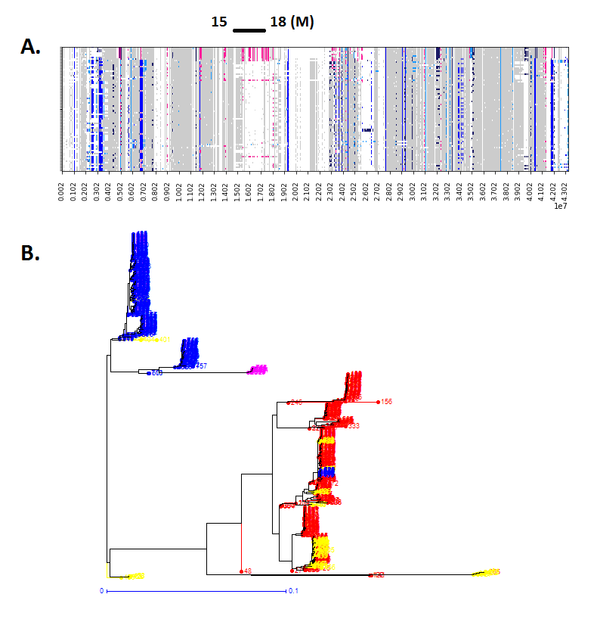
Notes:
Classification to focus on these branches, estimate divergence time (prospective).

Slide 4
Beagle 5.1
A software package for phasing genotypes and for imputing ungenotyped markers.
S R Browning and B L Browning (2007) Rapid and accurate haplotype phasing and missing data inference for whole genome association studies by use of localized haplotype clustering. Am J Hum Genet 81:1084-1097. doi:10.1086/521987

Slide 5
5,200 controls from the Wellcome Trust Case Control Consortium 2
44 HapMap3 CEU (REF. 44)
- chrom 20; 21,166 markers
Browning, S. R., & Browning, B. L. (2011). Haplotype phasing: existing methods and new developments. Nature Reviews Genetics, 12(10), 703-714.

Slide 6
BovineSNP50 (50k) The North American Holstein database
45,187 SNP; 9,266 cattle
Miar, Y., Sargolzaei, M., & Schenkel, F. S. (2017). A comparison of different algorithms for phasing haplotypes using Holstein cattle genotypes and pedigree data. Journal of dairy science, 100(4), 2837-2849.

Slide 7
**
BEAGLE is less accurate for small sample sizes (100 individuals).
not well suited for very small numbers of markers in a region (fewer than 100).
BEAGLE, accuracy is improved by combining the results from multiple runs
Browning, S. R., & Browning, B. L. (2011). Haplotype phasing: existing methods and new developments. Nature Reviews Genetics, 12(10), 703-714.

Slide 8
Demography ?
SLIM v.3
SLiM is an evolutionary simulation framework that combines a powerful engine for population genetic simulations with the capability of modeling arbitrarily complex evolutionary scenarios.
Haller, B. C., & Messer, P. W. (2019). SLiM 3: Forward genetic simulations beyond the Wright–Fisher model. Molecular biology and evolution, 36(3), 632-637.

Slide 9
BURN-IN
20k to 10k, exp: 0.97
11 sims
M: 66654 +-530
Crash
20k to 40k, exp: 1.03
9 sims
M: 188031 +-1362
Growth
20k
9 sims
M: 113639 +-935
Equilibrium
launch_SLiM_SizeChange.sh

Slide 10
Crash
Equilibrium
Growth
Watterson
Θ
Growth : 0.0080
Equilibrium : 0.0060
Crash : 0.0041

Slide 11
Structure.
Notes:
Legends are wrong here, but in blue = phased full data sets, orange = phased populations only.
Data sets with total of 100 individuals. Sampling does not seem to have an impact. Only the sampling variance changes.

Slide 12
Zou, X. H., Yang, Z., Doyle, J. J., & Ge, S. (2013). Multilocus estimation of divergence times and ancestral effective population sizes of O ryza species and implications for the rapid diversification of the genus. New Phytologist, 198(4), 1155-1164.

