Slide 1
Project Assignment
Multi-Classifier System for Face Recognition
Santosh Yadav Jada
16245773

Slide 2
AT&T Face database
This data base consists of 400 face images.
The subjects are 40 unique individuals with 10 images per subject.
Algorithm
We have used PCA, LDA algorithm for the face recognition system.
Software Used
MATLAB2017

Slide 3
Procedure
Read the data
Take the mean of the data
Find the covariance
Find the eigen values and vectors
Sort the eigen values in descending order
Compute the feature matrix
Test the data
Compute the feature matrix for the test data
Use Euclidean classifier
Create labels
Use ezroc3 function
Perform PCA
Get scores

Slide 4
Procedure
Extract data from the database using recursive function.
Normalize the data
Calculate the within class scatter
Calculate the between class scatter
Calculate the Fisher Space
Project the values into the Fisher Space
Use Euclidean classifier
Create labels
Call the ezroc3 function
Perform LDA
Get scores

Slide 5
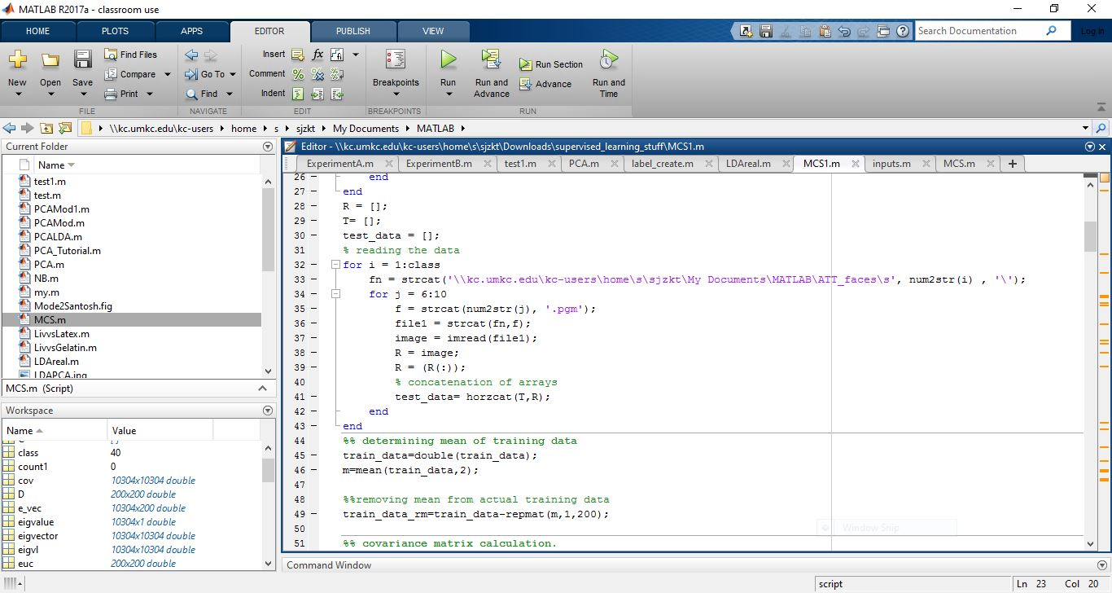
Matlab

Slide 6
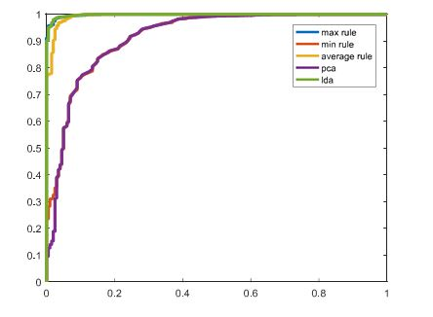
A. Multi-classifier System combining PCA and LDA at score level
This is done using the minimum, maximum and average rules
We have taken scores of PCA and LDA

Slide 7
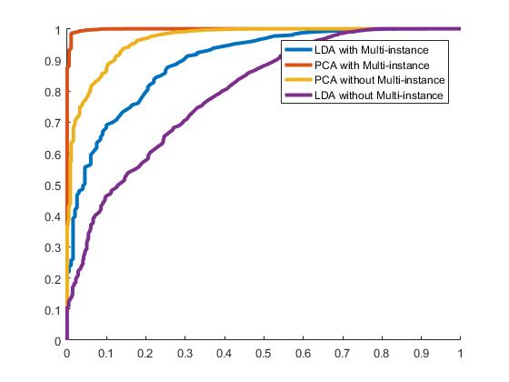
B. Multi instance system at score level on PCA and LDA

Slide 8
Result:
Here we are combining both LDA and PCA for the face recognition. This combination could be more reliable than a single classifier. First we applied PCA and then LDA. Later we took the scores and combined them using the different rules. Finally we did multi instance at score level. From the figures we understand that max rule and LDA gave good accuracy and PCA gave the least accuracy under the ROC curve. In experiment B we have performed multi level instance based classification for both PCA and LDA. One with multi instance fusion and one without it and compared the accuracies of these two cases. From the output we could tell that PCA with multi instance performed the best and LDA without the multi instance performed the worst.
For LDA+PCA (max rule): EER =0.0563, AUC =0.961
For LDA only: EER =0.0290, AUC= 0.976
For PCA only: EER =0.0152, AUC= 0.788
PCA(with multi instance): EER=0.0137, AUC= 0.986
LDA(without multi instance): EER= 0.0156, AUC= 0.771

