Slide 1
Major Project On
Smart Multi-Application
Energy Harvester Using Arduino
Guided BY:-
Presented By:-
Mr. Mukesh Bathre
GROUP NO- 11
Santosh Kumar Bhuyan (1701104040)
Sambit Kumar Behera (1701104224)
Subhashree Nayak (1701104226)

Slide 2
INTRODUCTION
Energy harvesting can be defined as power harvesting or energy scavenging which is a process that captures small amounts of energy that would otherwise be lost as heat, light, sound, vibration or movement. It uses the captured energy to improve efficiency, enable new technology, etc. which provide significant economical and environmental impact. Energy harvesting utilizes naturally occurring sources of energy and converts them into forms that can be utilized in the normal ways. Traditionally, energy has been taken from coal, gas, fossil fuels etc. which are finite and environmentally costly. However, to ensure that greenhouse gasses and other forms of pollution are not created, energy harvesting techniques can be used to overcome the climate change and global warming. Although large wind [8] generators could be termed energy harvesting, this technology typically looks more at the forms of energy harvesting that provide small amounts of power for powering low-energy electronics.

Slide 3
WORKING
The project starts when the natural energy is harvested by solar panel dynamo for kinetic energy and stored the power in lithium ion battery. The value of input is varied and the power need to be regulated to 5V storage. The period to charging the storage is limited to one hour, then will stop charging for one minute to avoid overheat. The function of Arduino is to control the capacity harvest power from mechanical part to store in storage. The users are able to use the stored power through device or as a charger. The output of the project can be used neither in DC nor AC.

Slide 4
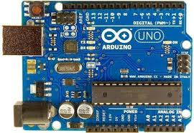
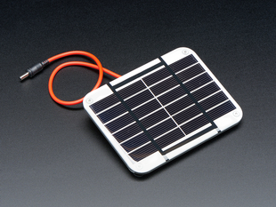
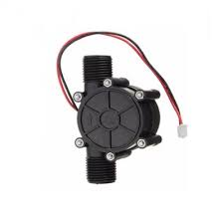
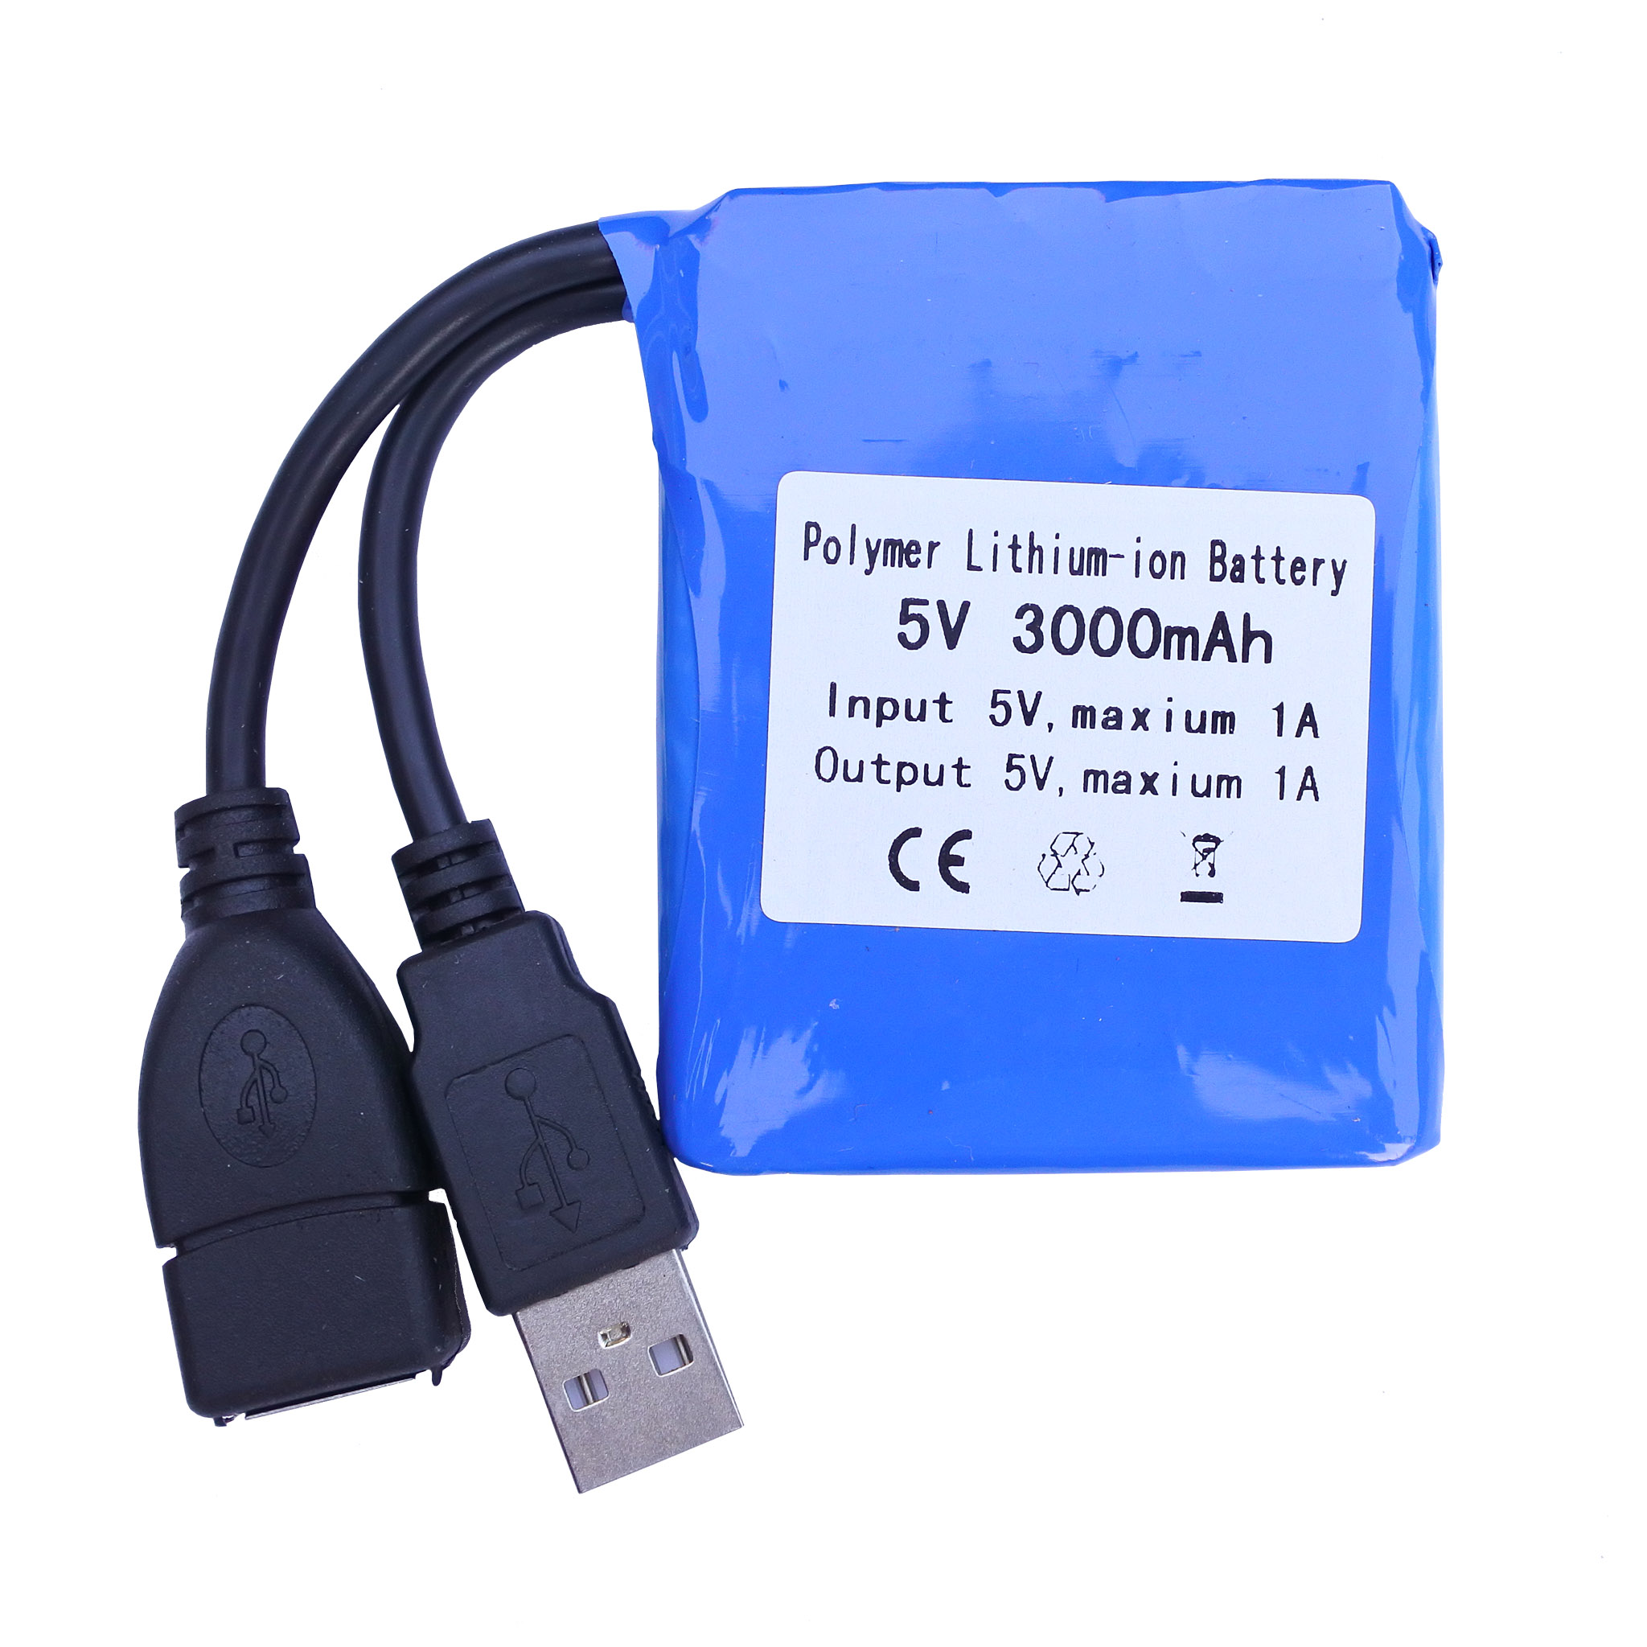
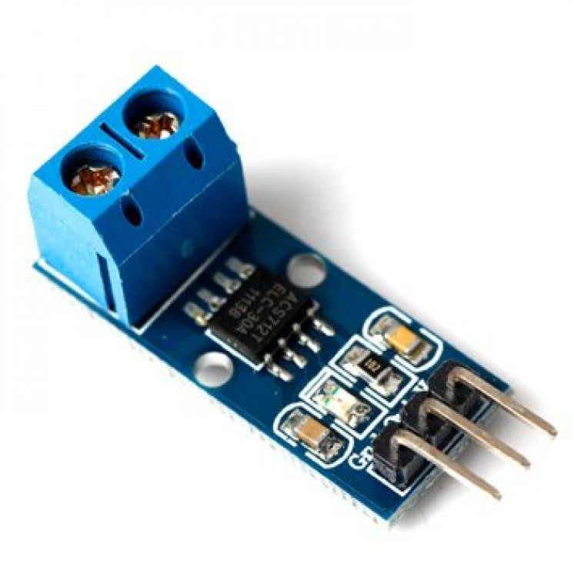
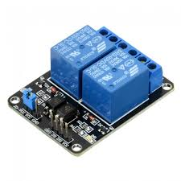
REQUIREMENTS
Arduino Uno
Solar Panel
Water Turbine
Rechargeable Lithium Battery
Voltage Sensor
Two Channel Relay

Slide 5
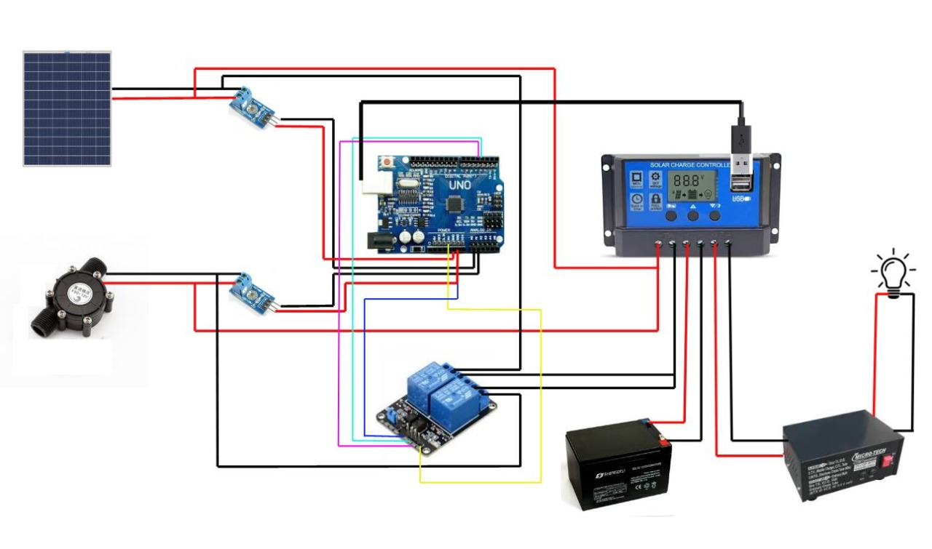

Slide 6

Working Videos

Slide 7


Slide 8
CONCLUSION
Energy harvesting has become an important aspect in the modern age because of rapid exhaustion of non-renewable sources for different applications. The concept of reducing, reusing and recycling is correctly applied in this project. Two different kinds of energy ,that is solar energy and water energy are harvested and been able to store. The stored energy has been further used to supply current to both AC devices as well as DC devices.
Many research & works has been done before & there are still active researches are going on to investigate a number of alternatives to extract energy from the environment & convert it to electrical energy to power an electronic device. With the advancement in technology and reduction in device sizes it is possible to increase the generated energy using new transducer designs or new materials, as well as innovative power conditioning circuits & energy storage elements. Also, the combination in the same device of several energy harvesting strategies will increase its capabilities to obtain energy in different situations.

Slide 9
REFERENCES
Barbosa, Tamara J.G., and Mary Jo Barbosa. "An Innovative Solution For Hybrid Energy Harvesting Available from : " HETS Online Journal, vol. 9, no. 2, 2019. [Accessed 30 Sept. 2020]
Liamputtong P. Sustainable Energy Harvesting Methodology: Principles and Practice. In: Sage Research Methods. London, UK: Sage Publications; 2011:1847879098.
Gulliver A, Griffiths KM, Christensen H. Perceived barriers and facilitators in wireless sensor networks. BMC Psychiatry 2010;10:113
Liu, H., Fu, H., Sun, L., Lee, C., & Yeatman, E. M. (2020). Hybrid energy harvesting technology: From materials, structural design, system integration to applications. Renewable and Sustainable Energy Reviews, 110473. doi:10.1016/j.rser.2020.110473

Slide 10
THANK YOU

