Slide 1
T.A.R.S
Test Automation & Reporting Suite
Comprehensive Walkthrough & Strategic Implementation Plan

Slide 2
Executive Summary
Bridging the Gap Between Requirement and Execution
Problem Statement:
Traditional manual testing is slow, error-prone, and consumes up to 40% of development cycles. Automation often requires deep coding expertise, creating a bottleneck for QA teams.
The Solution (T.A.R.S):
An AI-orchestrated suite that empowers non-technical users to record, generate, and execute enterprise-grade automated tests in seconds. T.A.R.S leverages Large Language Models (LLMs) to understand business logic and translate it into robust Playwright scripts.

Slide 3
The Strategic Plan
A phased approach to Enterprise QA excellence.
Phase 1: Foundation
Establishing the core Node.js/Express backend and a premium React-based glassmorphic UI.
Phase 2: Recording
Enabling zero-code test building via live browser session recording and selector discovery.
Phase 3: Intelligence
Orchestrating LLMs (Ollama/Gemini) to generate test logic from natural language user stories.
Phase 4: Analytics
Implementing high-fidelity data visualization for pass/fail trends and defect management.
Phase 5: CRM Live
Direct execution in secure Salesforce environments with visual failure diagnostics.

Slide 4
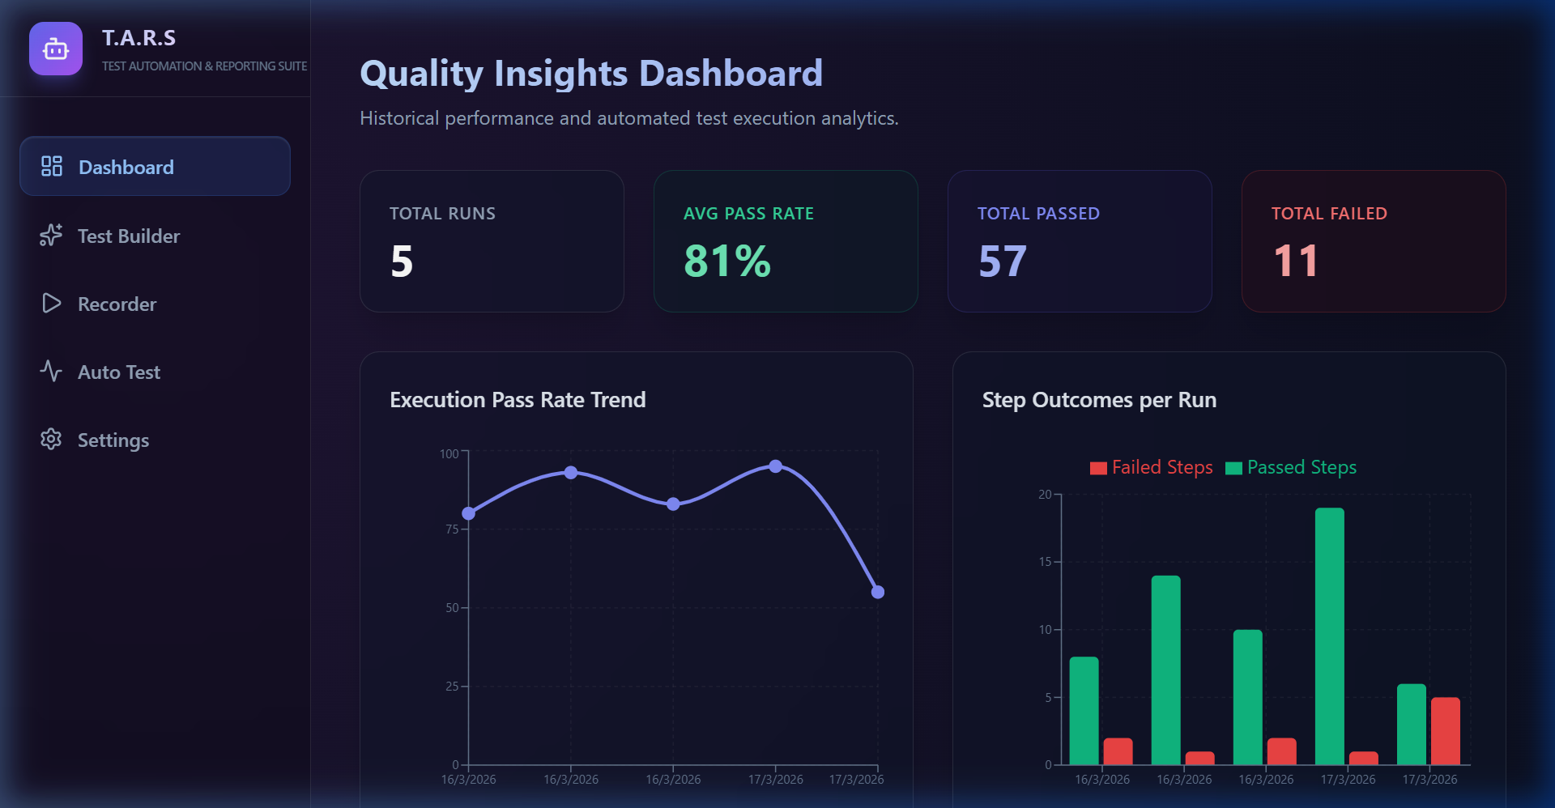
Dashboard: The Source of Truth
Data-Driven Decision Making
The Dashboard serves as the central hub for Quality Assurance visibility. It provides:
• Real-Time Metrics: Aggregate pass rates and defect counts from recent runs.
• Trend Analysis: Line charts illustrate performance stability over time, identifying regressions early.
• Defect Clustering: Distribution charts highlight failure patterns, allowing teams to prioritize critical fixes.
• Automated History: Every test run is persisted to a secure local store, ensuring a complete audit trail of testing activities.

Slide 5
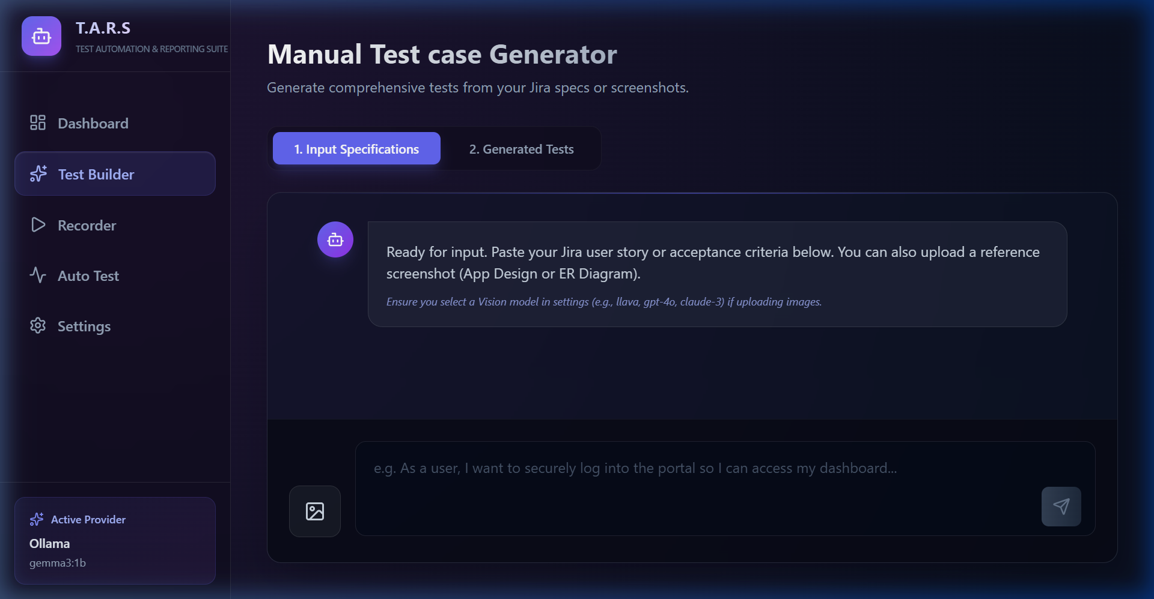
Test Builder: Requirement to Reality
LLM-Powered Logic Generation
The Test Builder eliminates the complexity of script writing. Users simply provide a natural language functional requirement, and T.A.R.S does the rest:
• Context Understanding: The engine analyzes user stories to identify key actions and expected outcomes.
• Modular Steps: Generates human-readable test steps that can be reviewed and edited before execution.
• Provider Agnostic: Integrates with Ollama (local), Google Gemini, and OpenAI to provide flexible reasoning power.
• Seamless Export: Converts requirements directly into structured test playbooks.

Slide 6
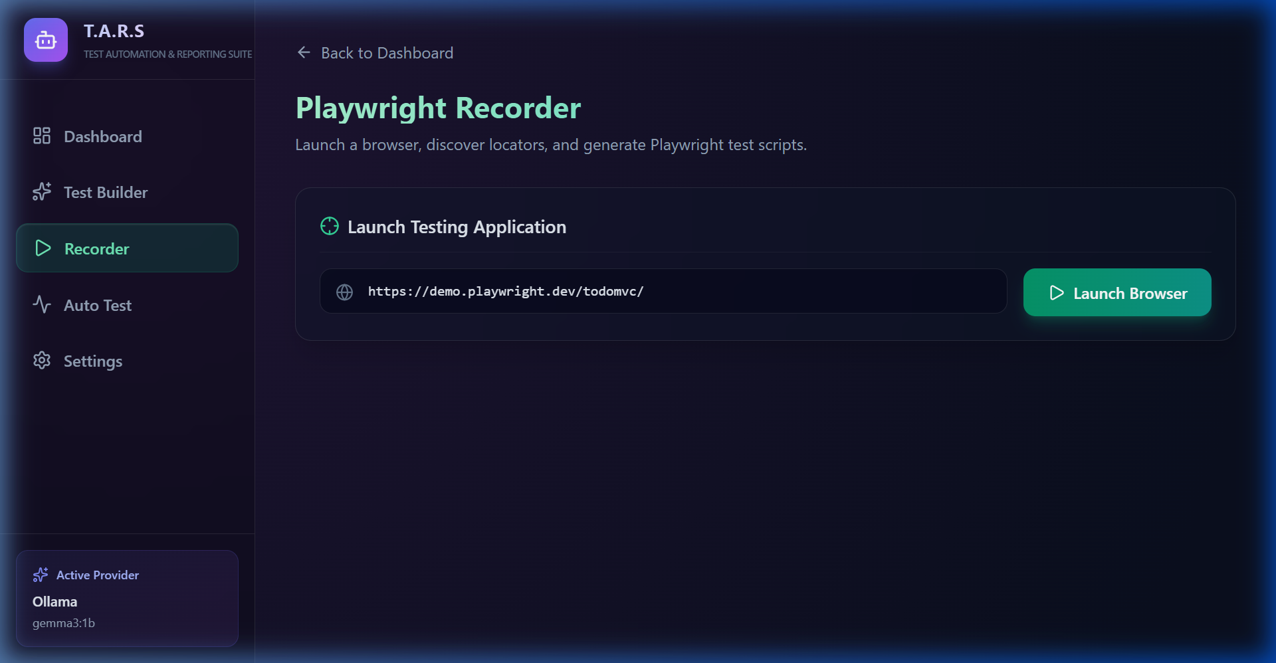
Recorder: Zero-Code Empowerment
Low-Code Test Engineering
For complex UI interactions, the Live Recorder provides a visual way to build automation:
• Precision Capture: Monitors every click, scroll, and keystroke in real-time.
• Intelligent Selectors: Automatically identifies the most stable locators (CSS, XPath, Text) to prevent "flaky" tests.
• Immediate Verification: See the generated Playwright code in real-time as you interact with the browser.
• One-Click Export: Professional test scripts are ready for integration into enterprise repositories immediately.

Slide 7
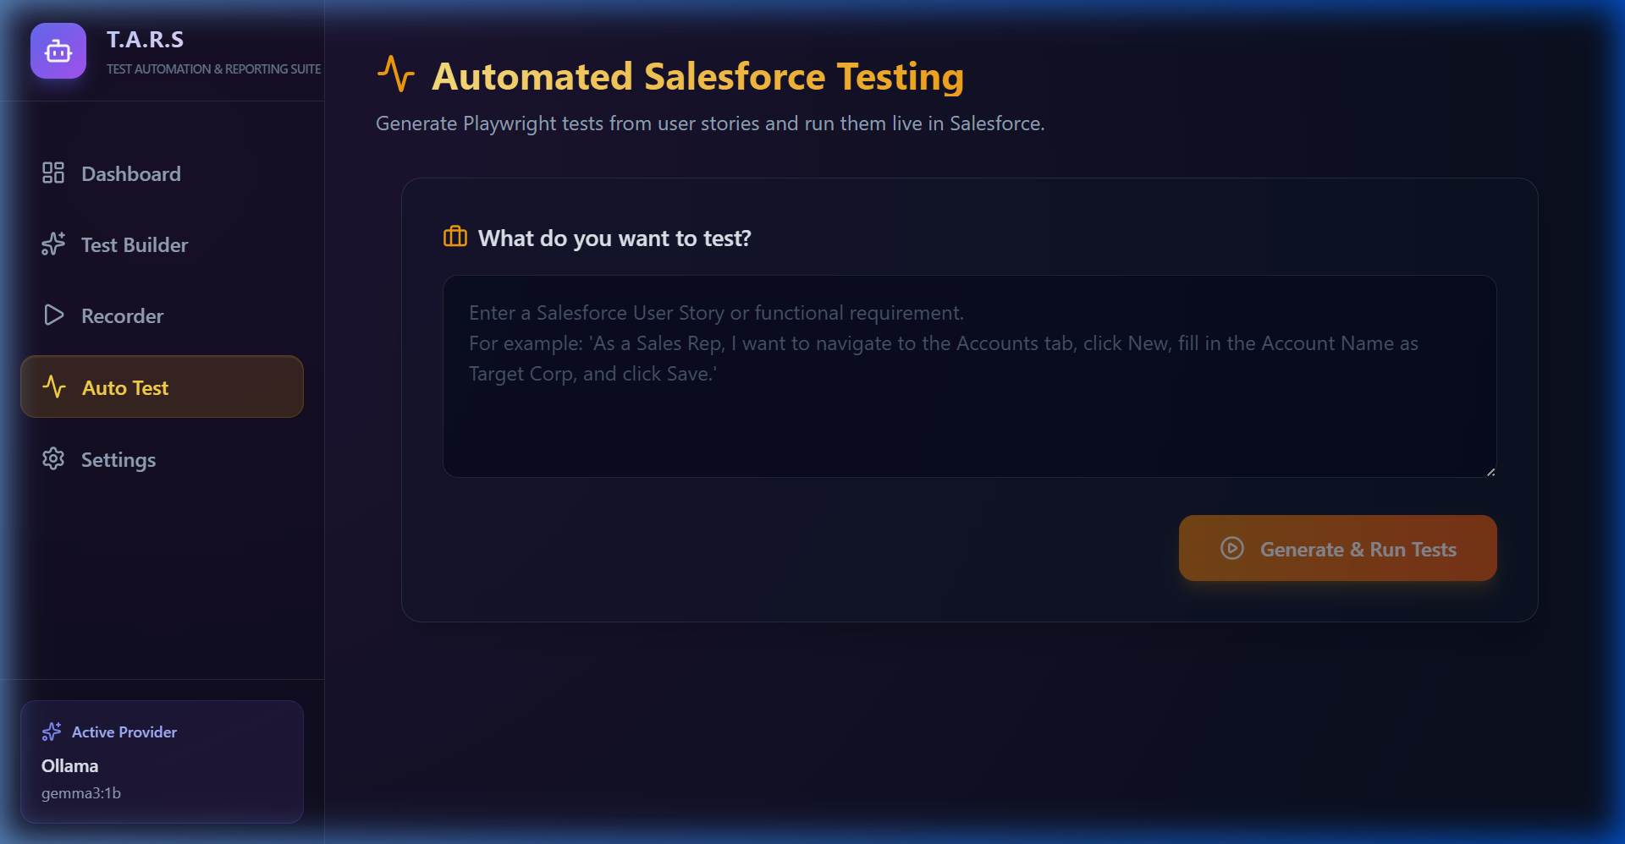
Auto Test: Live execution
Live CRM Workflow Validation
The "Auto Test" module is the execution engine of T.A.R.S, specifically optimized for complex platforms like Salesforce:
• Secure Orchestration: Handles multi-factor authentication and login flows safely.
• Visual Verification: Captures high-resolution screenshots at every failure point for rapid debugging.
• Step-by-Step Reporting: Provides a live execution log, showing exactly which action succeeded or failed.
• Jira Integration: One-click defect reporting directly from the failed test step, including logs and evidence.

Slide 8
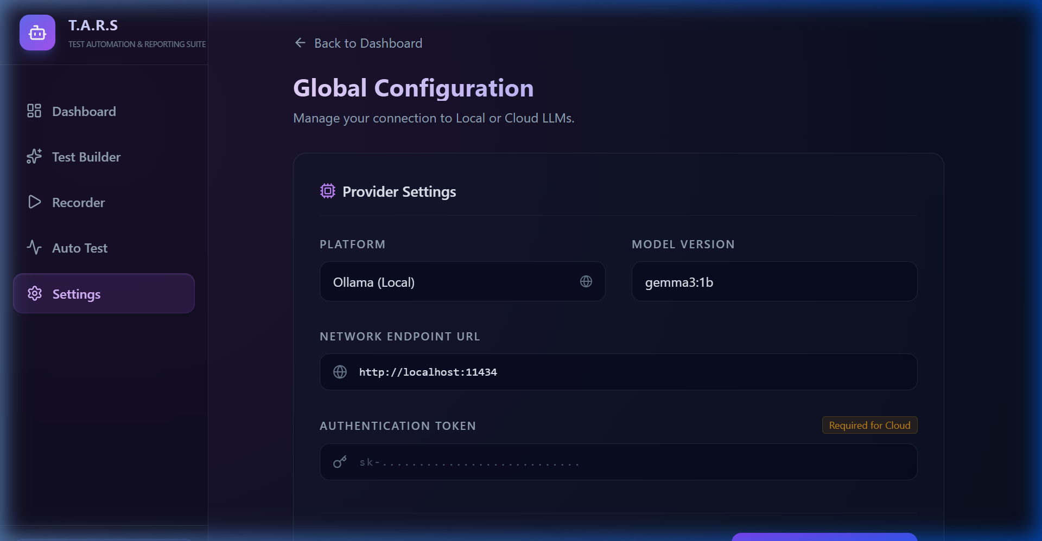
Settings: Enterprise Configuration
Control and Security
Infrastructure is managed through a streamlined Settings interface, ensuring enterprise compliance:
• Local AI: Support for Ollama allows organizations to run test generation behind a firewall, protecting sensitive intellectual property.
• Endpoint Management: Quick toggles for different environment APIs and model versions.
• Persistent Config: Settings are saved locally, ensuring a consistent user experience across sessions.
• Expandable Provider Support: Modular architecture allows for easy addition of new LLM backends.

Slide 9
The Technical Core
Scalable, Robust, and Modern
Frontend:
React 18 with Vite for lightning-fast UI responsiveness. Tailwind CSS for premium aesthetics.
Backend:
Node.js & Express for a high-performance, non-blocking asynchronous architecture.
Automation:
Playwright for industry-leading browser automation and cross-platform reliability.
Reasoning:
Orchestrated LLM layers handling everything from logic generation to self-healing analysis.

Slide 10
Business Value & ROI
Real-world impact for your organization.
• 70% Reduction in Test Authoring Time: Replace hours of manual coding with AI generation.
• Accelerated Release Cycles:
Faster feedback loops enable multiple deployments per week.
• Lower Technical Barrier:
Empower functional experts to own the automation process.
• Zero Maintenance Overload:
AI-generated scripts are consistent and easier to maintain than legacy code.

Slide 11
Roadmap: The Next Frontier
Ongoing innovation to redefine Quality Assurance.
Phase 6: Multi-CRM Support (ServiceNow, Oracle Cloud, SAP)
Phase 7: AI Self-Healing (Automatic script updates when UI changes)
Phase 8: CI/CD "No-Pulse" Integration (Automated drift detection)
Phase 9: Distributed Cloud Execution (Running 1000s of tests in parallel)

Slide 12
T.A.R.S
The Intelligence Layer for Modern QA
Transforming Software Reliability with AI.

