Slide 1
T.A.R.S
Test Automation & Reporting Suite
AI-Powered QA for Modern Enterprises

Slide 2
The Vision & Strategic Plan
Empowering software teams to bridge the gap between manual testing and robust automation with AI-driven insights.
Phase 1: Foundation (Core Engine, React Frontend, Node.js Backend)
Phase 2: Recording (Low-code Playwright session recording)
Phase 3: Intelligence (LLM-based test generation from user stories)
Phase 4: Analytics (Historical performance and defect tracking)
Phase 5: Salesforce Live (Executing automation directly in CRM environments)

Slide 3
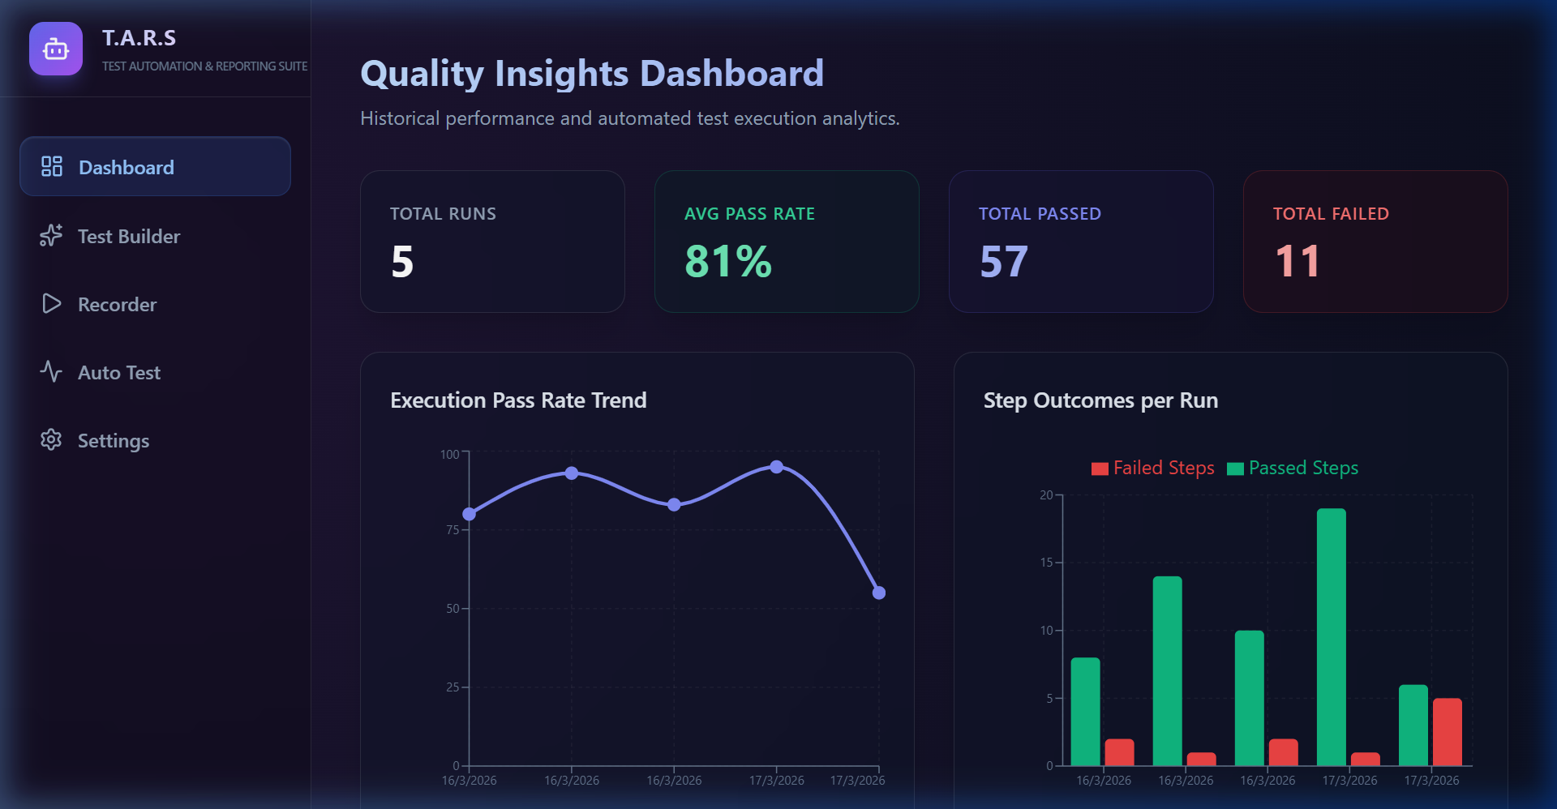
1. Quality Insights Dashboard
A central hub for measuring test effectiveness. Real-time charts track pass rates, step outcomes, and defect distribution over time.

Slide 4
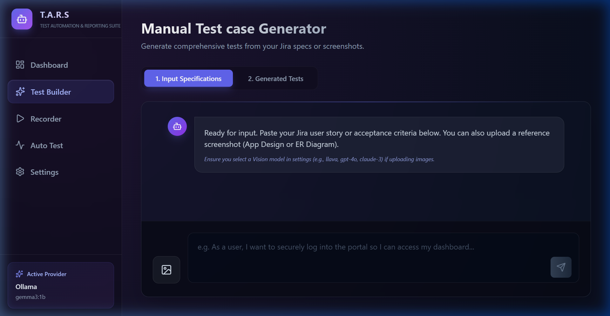
2. Intelligent Test Builder
Convert natural language requirements into comprehensive test cases using cutting-edge LLMs. Support for multiple providers including Ollama, OpenAI, and Gemini.

Slide 5
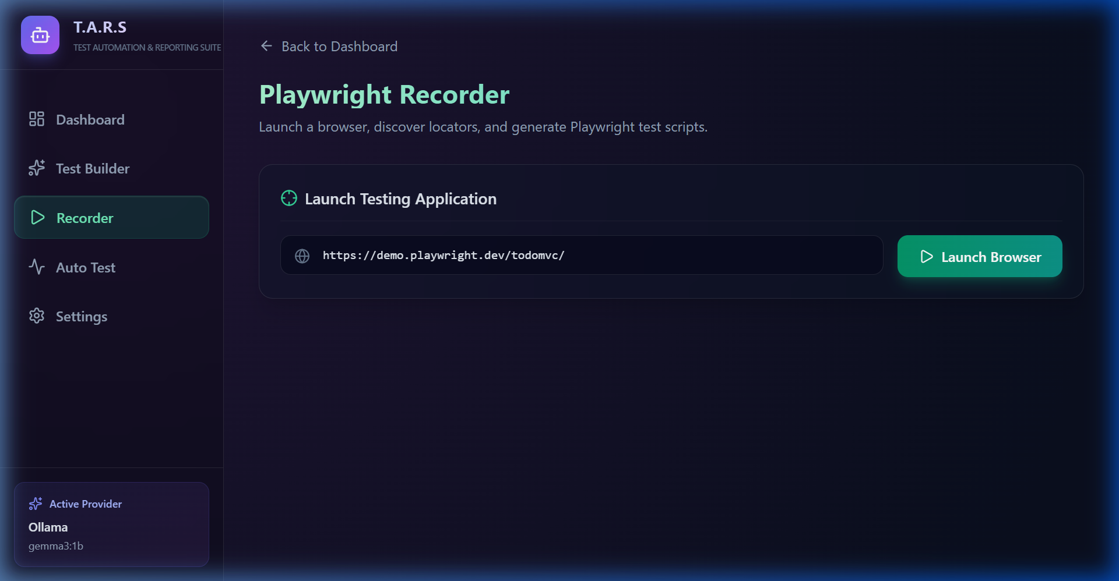
3. Action Recorder
The low-code way to build tests. Record browser interactions directly and export them into structured Playwright test scripts.

Slide 6
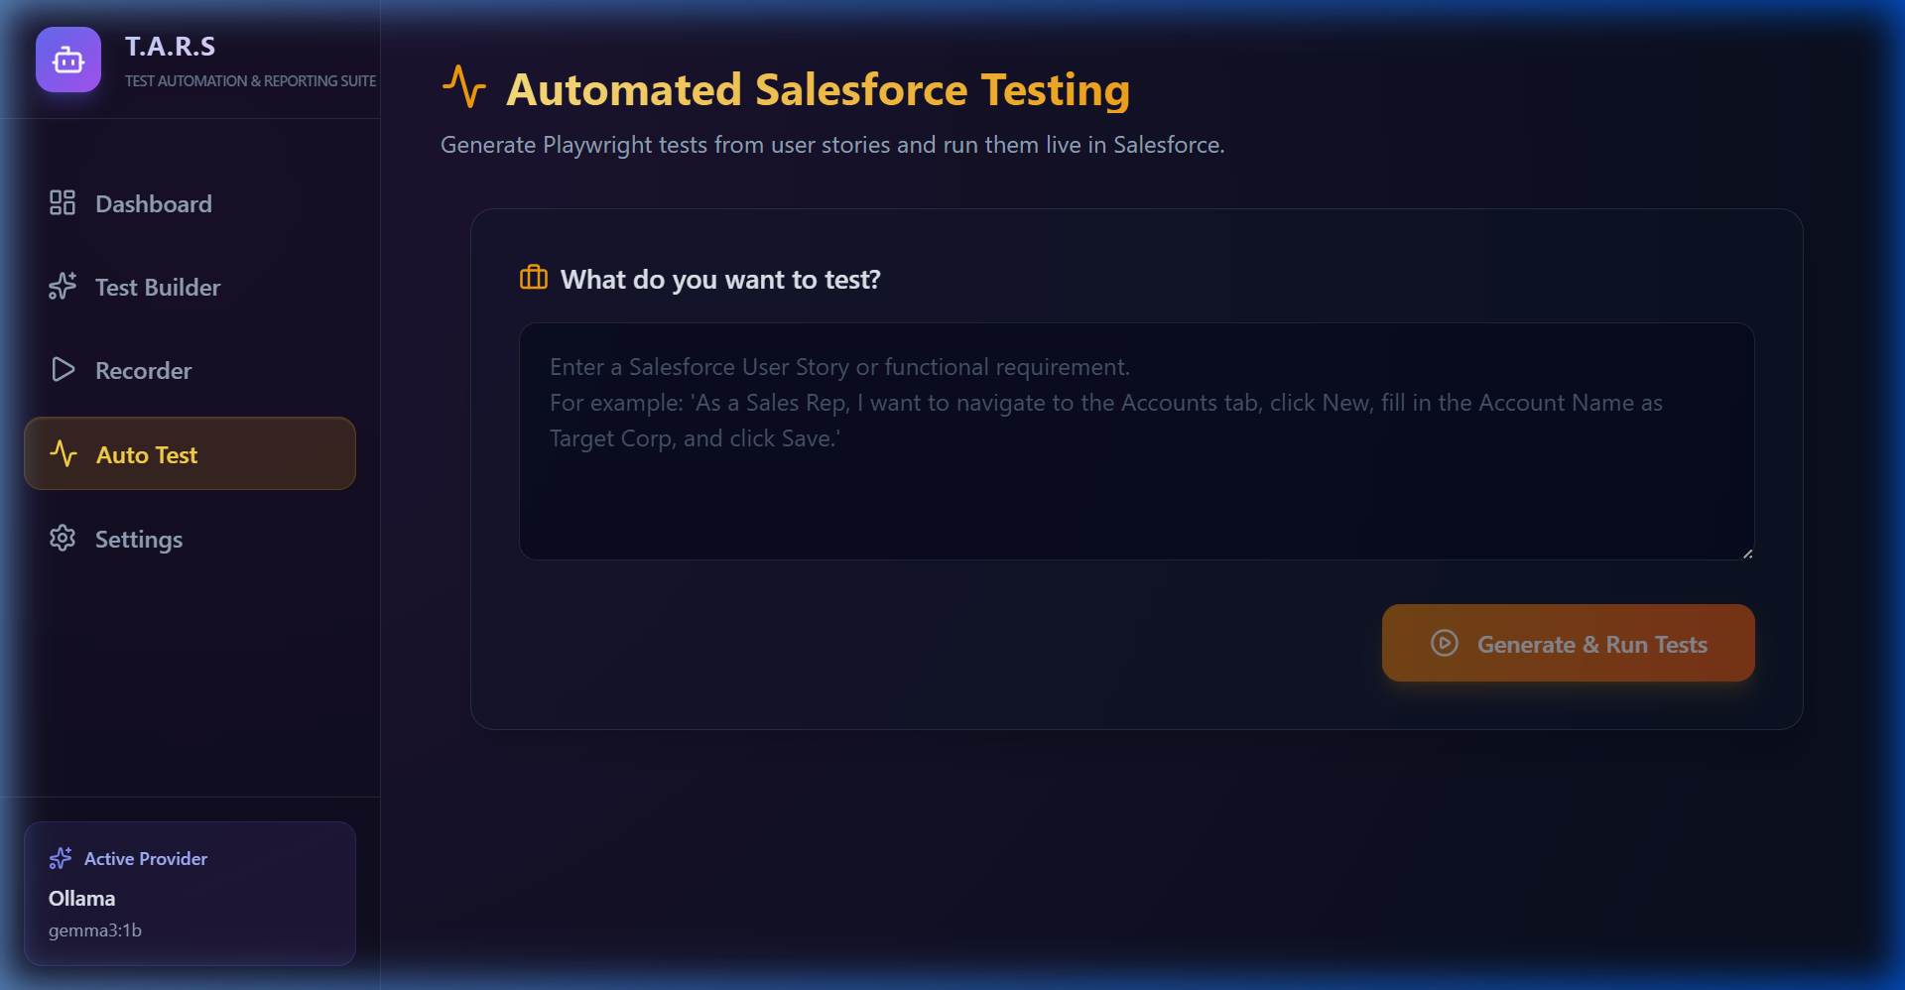
4. Live Salesforce Automation
Execute tests directly in Salesforce environments. Seamlessly handle logins, navigation, and data verification with detailed execution logs and failure screenshots.

Slide 7
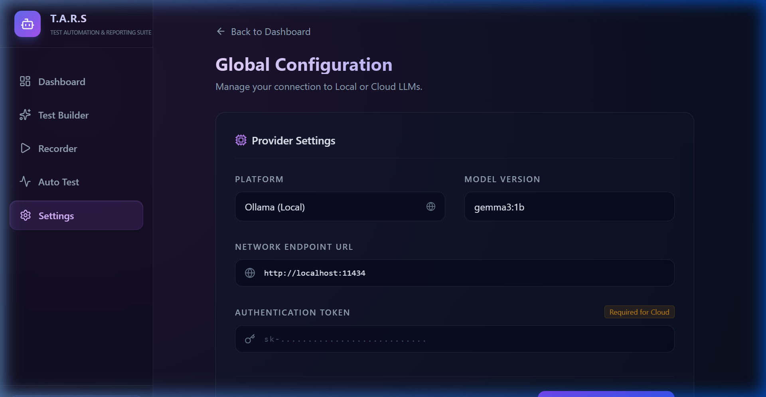
5. Enterprise Configuration
Customizable engine settings. Manage API keys, models, and provider endpoints to tailor the AI experience to your organization's infrastructure.

Slide 8
Technology Stack
Built on a modern, scalable architecture designed for speed and reliability.
Frontend:
- React 18, Vite, Tailwind CSS
- Lucide Icons, Recharts for BI
Backend:
- Node.js, Express
- Axios for API communication
Automation & AI:
- Playwright for Browser Ops
- Ollama / Gemma 2-3 for Reasoning

Slide 9
Roadmap & Future Scope
Multi-platform support (ServiceNow, Oracle Cloud, SAP)
AI-driven self-healing selectors for flaky tests
Integration with CI/CD pipelines (GitHub Actions, Jenkins)
Advanced Defect Clustering and Root Cause Analysis

Slide 10
T.A.R.S
The Future of Quality Assurance

