Slide 1
BUSINESS CONTEXT
Berau output meets ABL fleet scale.
The planning challenge is not abstract: it sits between a very large monthly cargo flow and a highly distributed marine asset network.
BERAU COAL
ABL OCEAN-FLEET PARTNER
35.9 Mt
100M+
20–55 kt
Tonnes transshipped / year
CTS throughput / day
Coal production in 2024
15
61
11
≈3.0 Mt
≈98 kt
Cargo Transfer Ships
Tug + barge sets
Ocean-going vessels
Average / month
Average / day
This is the demand rhythm the plan must absorb before one tug, barge, jetty, or CTS move is assigned.
The software has to turn this capacity into a coordinated sequence, not merely display it.
Sources: Berau Coal Energy Annual Report 2024; ABL official site.
01

Slide 2
CURRENT REALITY
Data exists. Orchestration is still manual.
Today’s operation already produces useful signals; the friction is that the plan is still assembled, reconciled, and updated by hand.
01
02
03
Excel schedule
Spinergie layer
The gap
A usable planning workspace—but one that depends on manual collation, edits, and reconciliation.
Digital daily reports, cycle KPIs, real-time AIS visibility, GPS evidence, and environmental reporting already exist around the operation.
What is missing is a governed model that turns demand, assets, constraints, and live evidence into one executable plan.
CURRENT STATE
EVIDENCE LAYER
NEEDED NEXT
The data is present.
The workflow is brittle.
Useful signals.
Not yet the planning brain.
From data presence
→ planning confidence.
The gap is not lack of data. It is lack of a single governed workspace that converts data into a plan operators can execute and revise together.
Sources: project BRD; Spinergie press release, June 2024.
02

Slide 3
OPERATING MODEL
The network has two clocks.
Demand wants certainty. Fleet operations live inside constraints. The tool exists to make those two clocks agree.
Demand side
Fleet side
Berau commercial + scheduling
ABL dispatch + operations
↔
15
61
11
35.9 Mt
≈3.0 Mt
CTS
Tug + barge
OGV
2024 output
Monthly flow
Shared constraints
shape every decision
Asset availability
CTS / floating-crane capacity
Jetty queue + loading rate
River movement + return cycle
OGV voyages and laycan
Coal grade + layer sequence
Customer commitments
Stockpile / jetty readiness
Shared constraints: tide • bridge • weather • compatibility • safety • demurrage
Sources: project docs; ABL official site.
03

Slide 4
SOLUTION SCOPE
Not a map. Not digital Excel. A planning engine.
The product turns multiple evidence streams into one auditable operating plan, while keeping planned, observed, and recommended states separate.
INPUTS
OUTPUTS
OGV demand
Grade + stockpile readiness
Fleet + jetty status
Tide / bridge / weather
AIS + later GPS evidence
Feasible schedule
Conflict list
Scenario comparison
Approval chain
Published live plan
CORE
Constraint-aware planning
Assign → validate → simulate → govern
What the planner knows
What the planner changes
Planned • Observed • Confirmed • Derived • Recommended
Product surfaces: demand board • assignment board • tide / bridge windows • simulation • approvals • published plan
Source: project planning scope and data architecture docs.
04

Slide 5
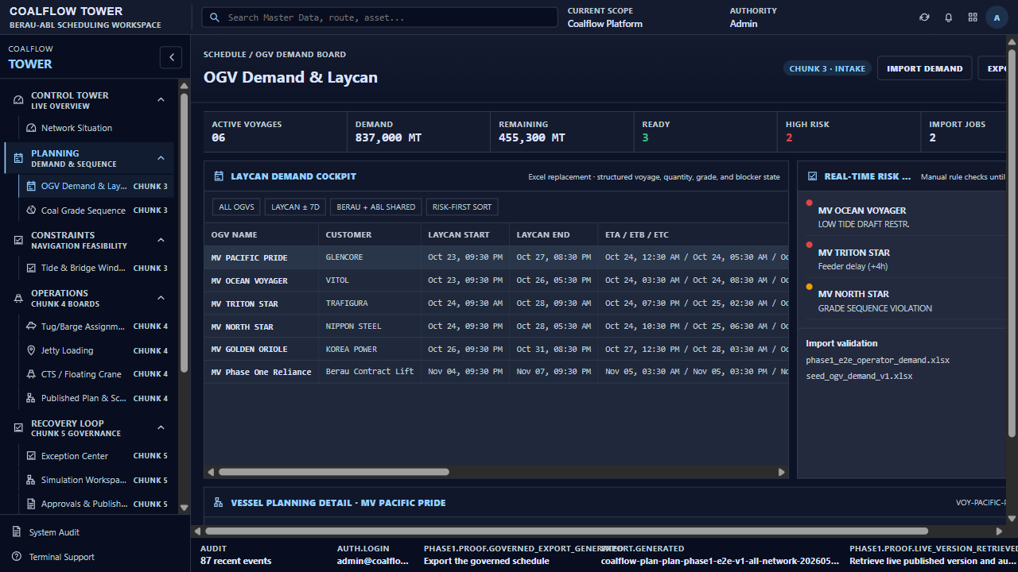
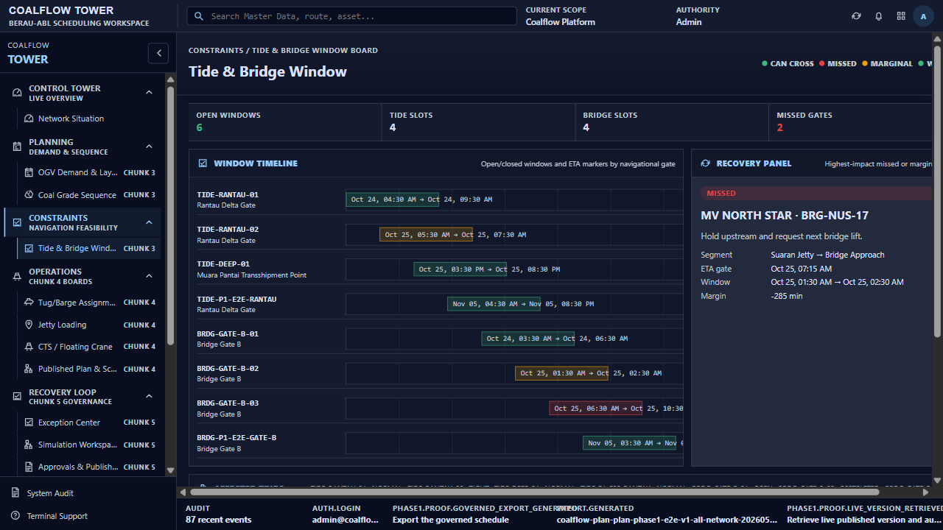
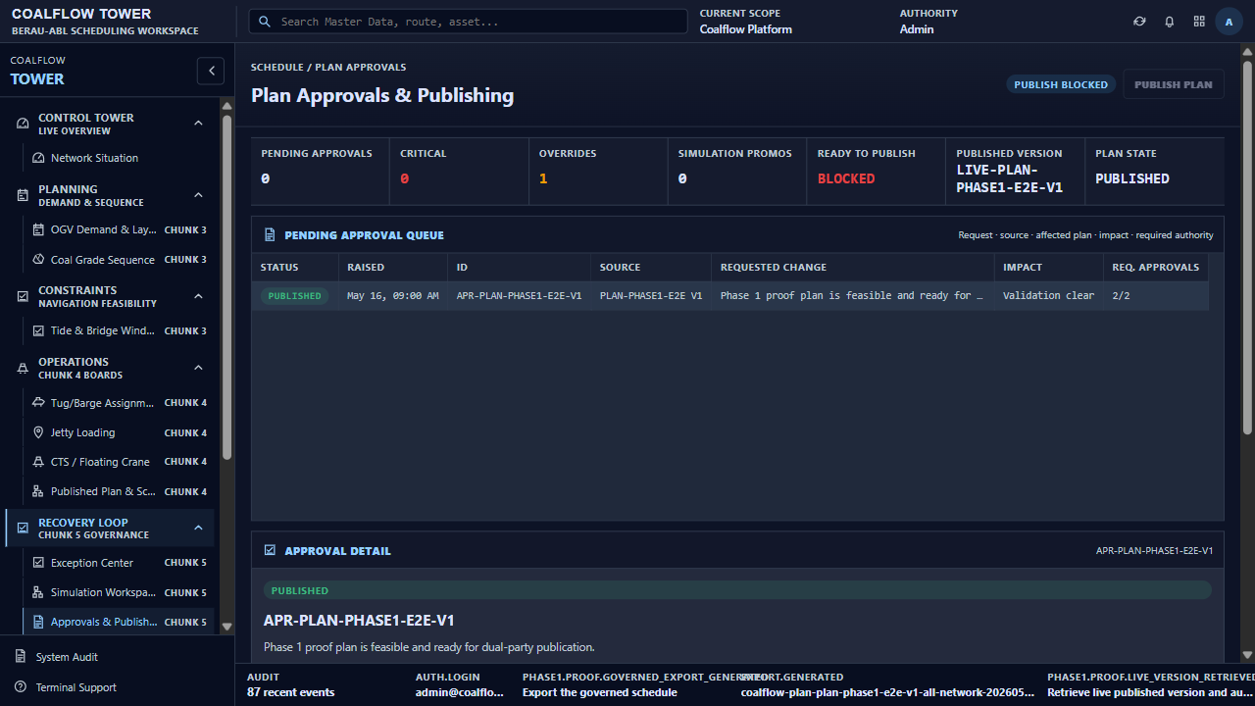
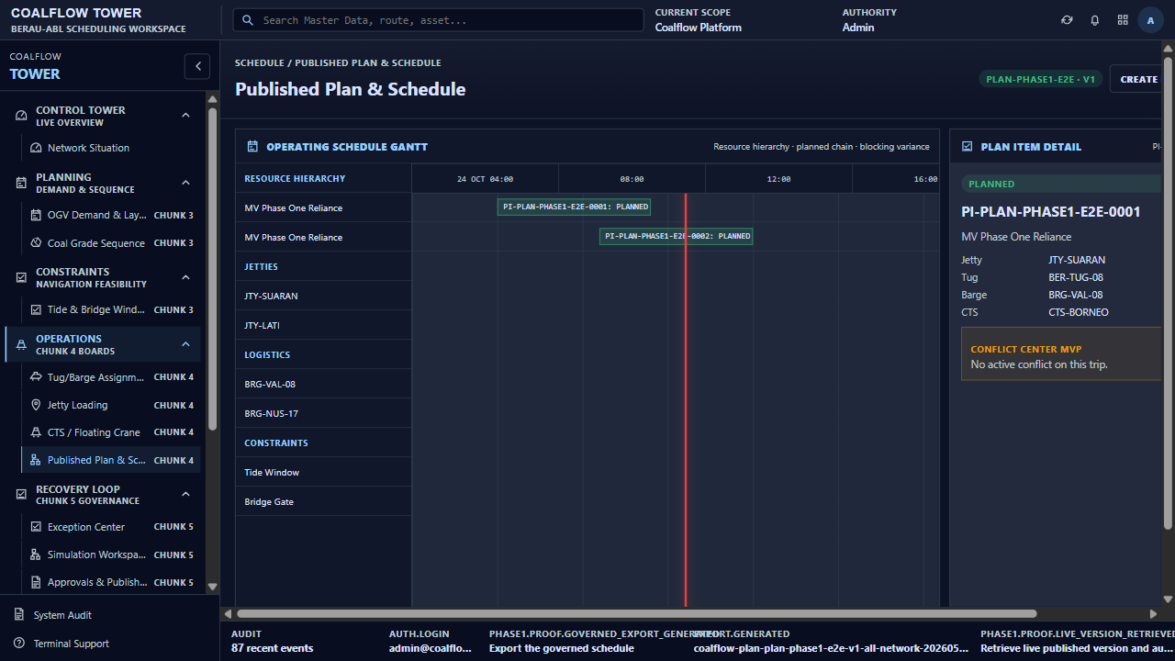
BRIDGE TO THE DEMO
When we say “constraint-aware,” this is what users will see.
The current product already exposes the spine of the operating model you just saw.
1. What demand must be served?
OGV Demand & Laycan
Tide & Bridge Window
2. Which windows constrain movement?
3. What plan is safe to publish?
4. Who approved the version now in force?
The live demo follows the same story:
OGV demand → constraints → approvals → published plan.
Approvals
Published Plan
Source: current Coalflow Tower product evidence.
05

Slide 6
SOLUTION APPROACH
Manage the asset chain, not just the asset list.
A plan is only feasible when every resource handoff survives both operational and environmental constraints.
01
02
03
04
05
Tug + barge
Jetty
River route
CTS / FC
OGV
Queue
Loading rate
Grade readiness
Rate
Queue
Downtime
Laycan
Layer sequence
Demurrage risk
Availability
Compatibility
Loaded / empty speed
Tide
Bridge window
Draft / weather
1.5–3.5k MT/h
20–55 kt/day
≈76k DWT class
Capacity is distributed across the chain. A fast CTS cannot recover a missed tide; a ready tug cannot compensate for a wrong grade sequence.
The planner’s job is not “where is the vessel?” but “which next move keeps the whole chain feasible?”
Source: project operating-model and planning-scope docs.
06

Slide 7
ROADMAP — NEAR TERM
First build the planner’s spine.
The product matures in layers: structured planning first, consequence modeling next, then live evidence.
NOW
NEXT
THEN
1. Digital scheduling model
2. Simulation + scenarios
3. GPS / AIS tracking
Replace Excel with structured demand, manual availability, conflicts, approvals, and a published plan.
Test delays, outages, and window changes before committing a new version.
Connect planned schedules to live movement, geofences, and ETA variance.
USER SEES
USER SEES
USER SEES
OGV demand • constraints • approvals
Baseline vs revised plan
Plan vs actual movement
PLANNING MATURITY
PLANNING MATURITY
PLANNING MATURITY
Manual → governed
Reactive → comparative
Planned → observable
The current demo sits at the first milestone: the governed planning spine is already visible.
Source: project roadmap docs.
07

Slide 8
ROADMAP — MATURE PRODUCT
Then let the field speak back.
The mature product does not stop at visibility; it turns trusted events into better decisions.
04
05
06
IoT operations
Optimization
Control tower
Jetty events, CTS discharge, device health, edge buffering, and sensor-backed status.
Recovery recommendations, resequencing, and conflict repair with human approval.
Role-based visibility for ABL, Berau, management, and eventually customers.
FROM
FROM
FROM
Manual status
Scenario outputs
Shared tool
TO
TO
TO
Trusted field events
Recommended action
Shared operating system
Manual inputs → live evidence → trusted events → recommended actions.
Source: project IoT and roadmap docs.
08

Slide 9
OPEN QUESTIONS
The minute nuances are where the tool earns trust.
We can build a strong first version from generic operating knowledge. The best version will come from the tacit rules only operators know.
CONSTRAINTS
OVERRIDES
Which constraints are truly hard
—and which are negotiable in practice?
What operator overrides recur often enough
to become product logic?
EVIDENCE
SIGNALS
How fresh must AIS / GPS evidence be
before dispatch trusts it?
Which environmental or safety signals
change the plan, not just the ETA?
GOVERNANCE
TRUST
Where must human approval remain explicit,
even if the system recommends a move?
What would make this feel indispensable
on a difficult day—not just elegant on a normal one?
Source: project assumptions and current build scope.
09

