Slide 1
BERAU COAL × ABL
Scheduling Simulation
& Live Planning Platform
From reactive Excel planning to constraint-aware, real-time operations intelligence
Business Context · Solution Scope · Roadmap
Notes:
Frame this as the scheduling spine, not a vessel-tracking add-on. The repo already implements the Phase 1 move away from spreadsheet planning: structured demand, constraints, approvals, audit, and governed export inside Coalflow Tower.

Slide 2
The Two Principals — Scale & Capability
BERAU COAL ENERGY — Mining Operations
ABL — Integrated Marine & Logistics Operator
108,900 ha
~300 km
40 MT/yr
11 OGVs
Mining Concession
(Berau Regency, E. Kalimantan)
North of Samarinda —
Remote River Logistics
Annual Transshipment
Throughput
Ocean-Going Vessels
(~76,000 DWT each)
4 Mines
5 Brands
15 CTS
61 Sets
Lati · Binungan
· Sambarata · Gurimbang
Ebony · Mahoni · Agathis
Sungkai · Mahoni-B
Cargo Transfer Ships
(Conveyor & Conventional)
Tug & Barge Pairs
Multi-HP Class Fleet
~36 MT/yr
Asia
54 Trains
14,000+
Berau output (2024)
Key Export Markets:
China · India · S. Korea · Taiwan
Rail Sets + 1,596
Wagons (Inland)
Containers
+ 35 Heavy Equipment
Transshipment Assets (Berau-listed)
CTS Loading Rates | Conveyor: 40,000–55,000 MT/day · Conventional: 20,000–30,000 MT/day
Asset
Capacity (MT/day)
Berau office: Tanjung Redeb, East Kalimantan — embedded local operations
FTS Bulk Borneo
32,000
FTS Bulk Sumatera
30,000
FC Chloe
30,000
FTS Bulk Java
28,000
Notes:
Use the scale figures to show why coordination matters: Berau contributes grade-specific mining and jetty flow, while ABL contributes the marine and transshipment network. Throughput depends on the full chain, not on any one asset class in isolation.

Slide 3
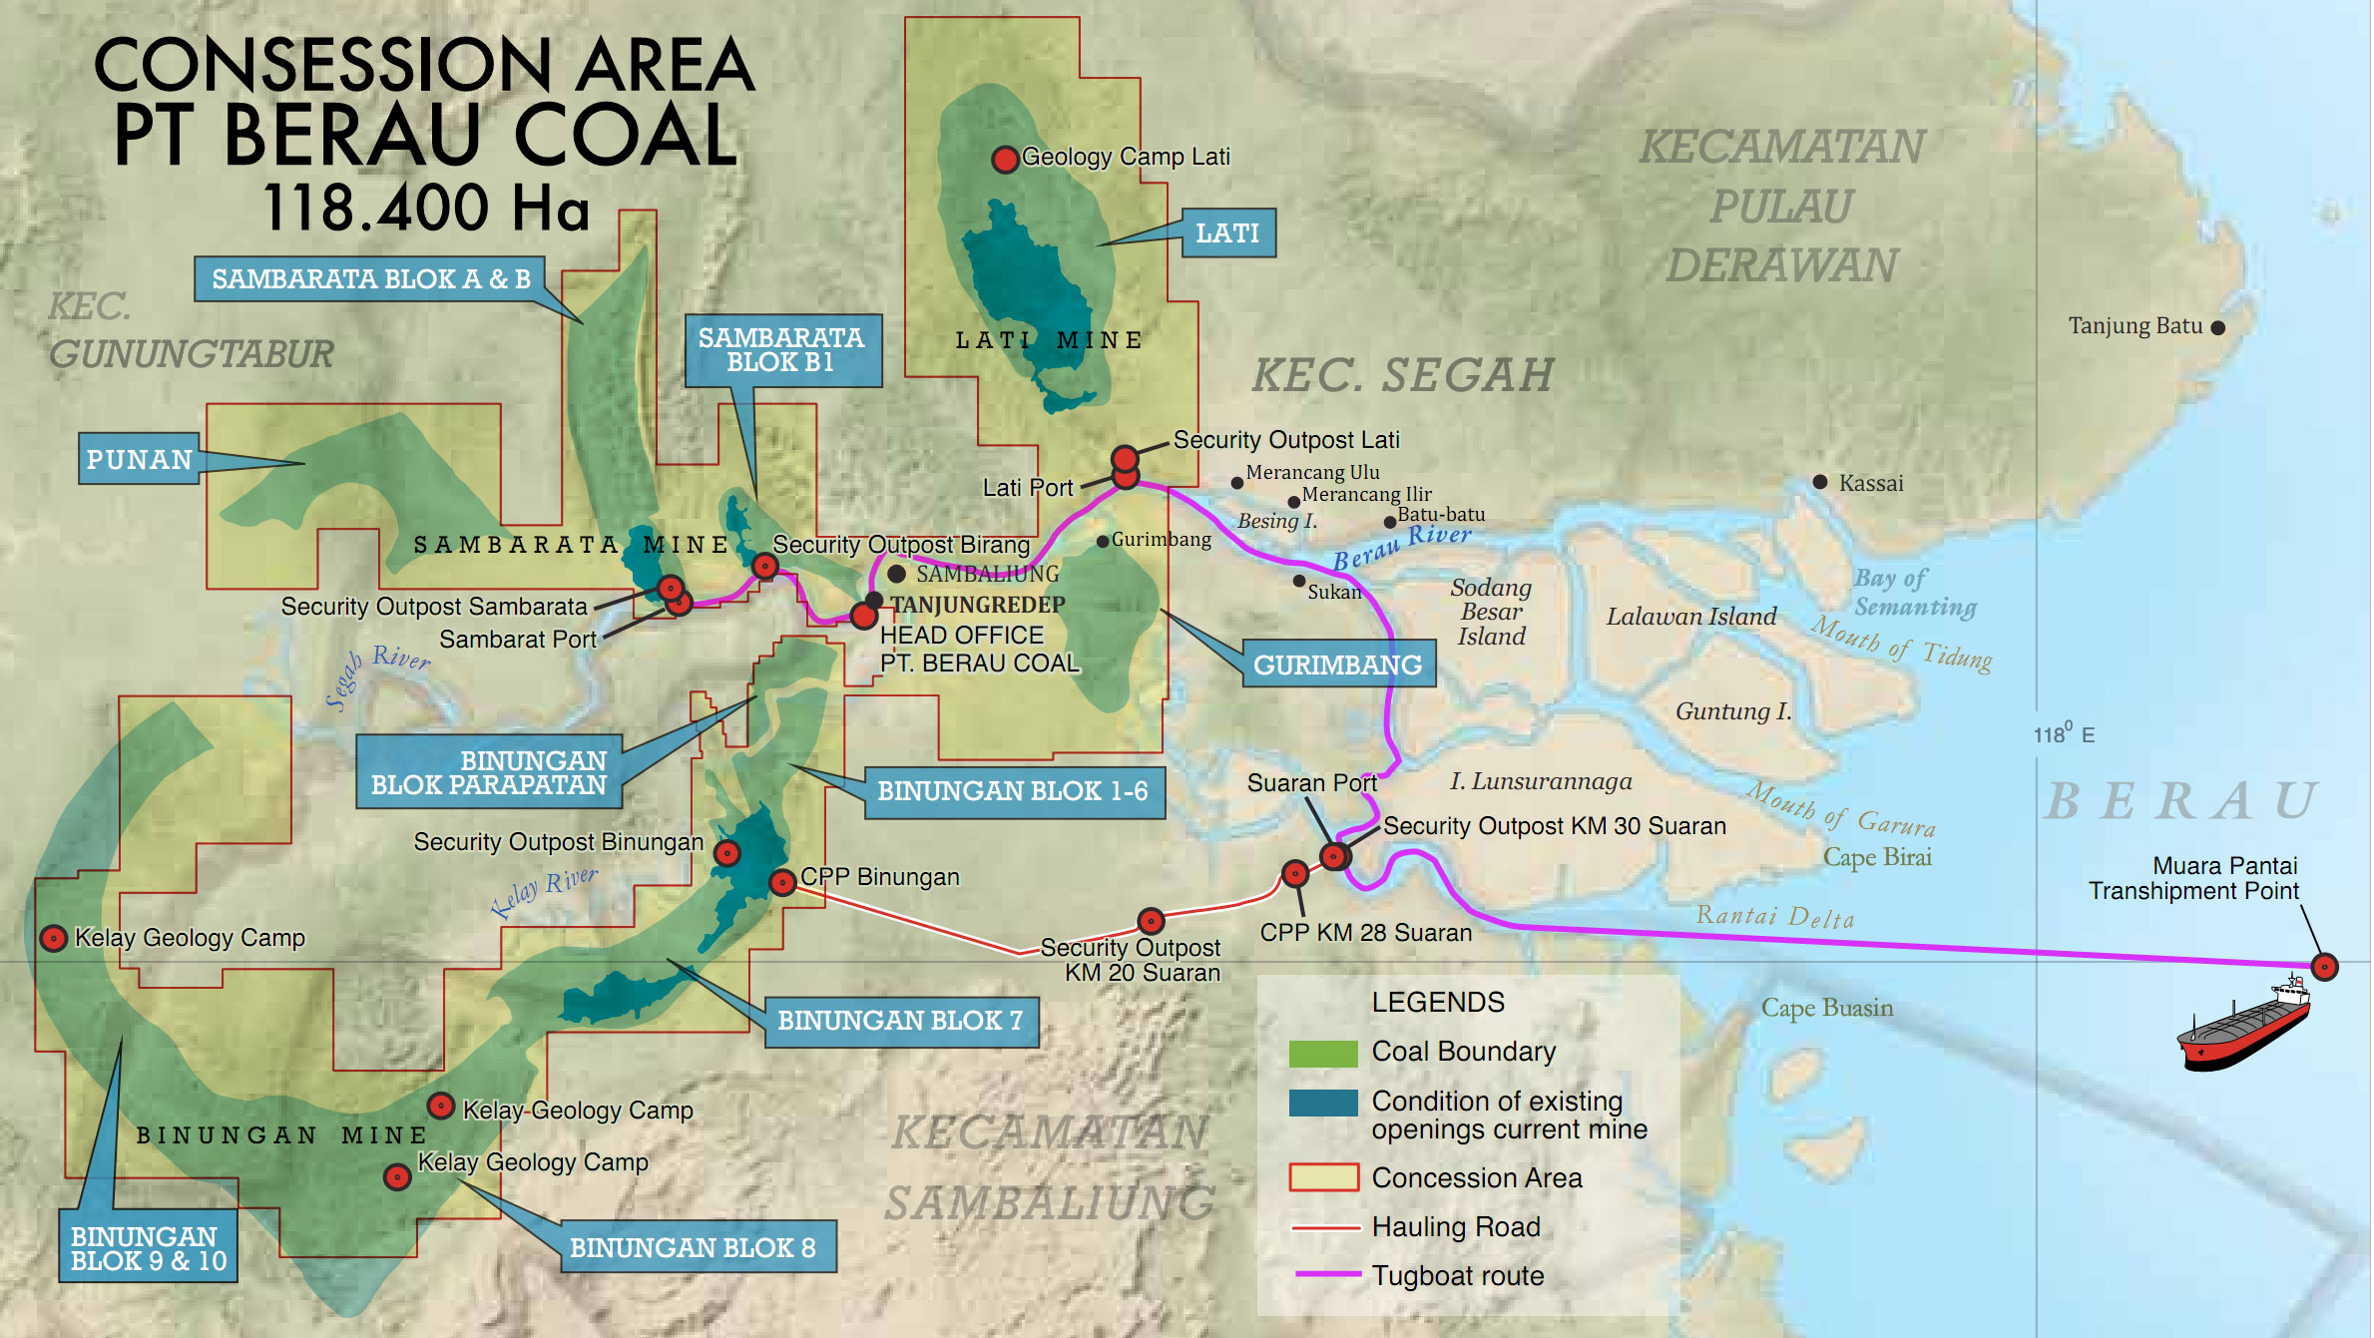

Slide 4
Today's Planning Reality — The Challenge
Excel-Based Scheduling
Where Value Leaks Today
All fleet assignments, jetty queues, tide windows and cargo sequences are manually maintained in spreadsheets. Updates are ad-hoc with no version control or conflict checks.
Missed tide windows
Barge queue congestion
Data Available, But Siloed
Grade sequence errors
Operational data exists — barge status, OGV ETAs, stockpile levels — but sits in separate files and inboxes. There is no single source of truth across ABL and Berau.
CTS underutilisation
OGV demurrage exposure
AIS / GPS via Spinergie
Manual re-scheduling effort
Vessel positions are accessible through Spinergie's platform (spinergie.com). However, live signals are not yet wired into the planning workflow, so planned vs actual ETA diverges silently.
No AIS ↔ plan reconciliation
Zero scenario versioning
Reactive, Not Proactive
Spinergie (spinergie.com) provides real-time AIS/GPS vessel tracking — but this intelligence is not yet connected to the scheduling workflow.
Disruptions — tide misses, breakdowns, grade conflicts — are handled ad-hoc via phone and WhatsApp. Recovery depends entirely on individual expertise with no scenario comparison.
Notes:
The present pain is not a lack of data; it is the lack of one governed planning truth. Phase 1 intentionally starts with manual operational inputs and leaves AIS/GPS integration for later, because the first win is eliminating spreadsheet drift and surfacing constraint conflicts.

Slide 5
End-to-End Solution Scope — The Full Chain
Mine /
CPP /
Stockpile
Jetty /
BLC
Loading
Tug +
Barge
River Run
Tide ·
Bridge
Windows
CTS /
FTS /
Float.Crane
OGV
Loading
Customer
Delivery
Grade/Brand
Compatibility
Jetty Queue
& Loader Rate
Tug HP &
Barge Capacity
River Draft
& Choke Points
CTS Type &
Discharge Rate
Hatch Plan &
Layering Seq.
Demurrage
& Priority
PLAN
SIMULATE
TRACK
ALERT
RECOVER
Demand → fleet
assignment
What-if scenario
comparison
Live AIS/GPS
vs planned
Conflict, delay
& risk flags
Re-sequence &
optimise
Planning Objects: OGV Voyage · Cargo Grade/Qty · Mine/CPP/Stockpile · Jetty/BLC · Tug · Barge · CTS/FTS/FC · River Route · Tide/Bridge Window · Live Position · Operational Event · Simulation Scenario
State:
PLANNED
LIVE / AIS
CONFIRMED
INFERRED
RECOMMENDED
Notes:
This is the product thesis: schedule the complete chain from cargo source to customer commitment while keeping planned, live, confirmed, inferred, and recommended state separate. In the repo, that discipline appears in plan versions, trips, assignments, conflicts, overrides, approvals, and audit.
Planned: what the approved schedule says should happen
Live / AIS: what telemetry shows is happening now
Confirmed: what an authorized operator has explicitly verified
Inferred: what the system derives from available evidence
Recommended: what the platform suggests as the next action
Keeping these separate preserves trust: signals do not overwrite plans, estimates do not masquerade as facts, and recommendations still require human approval.

Slide 6
Product Roadmap — Building in Layers
Phase 1
Collaborative Scheduling Architecture
Phase 2
Simulation & Scenario Planning
Phase 3
GPS / AIS Live Tracking
Now → Month 3
Month 4–7
Month 8–12
Master data model (fleet, jetty, CTS, routes, grades)
Manual OGV demand & fleet availability input
Tide/bridge calendar entry
Feasible schedule board (Gantt-style)
Constraint conflict checklist
What-if disruption engine (breakdown, delay)
OGV completion projection & demurrage risk
Asset utilisation reports (idle / active / waiting)
Version comparison (baseline vs recovery)
Manual override with full audit trail
Spinergie AIS/GPS ingestion
Geofence events (jetty arrive, CTS arrive)
Planned vs actual ETA reconciliation
Live map with fleet positions
Automated delay alerts
Notes:
Treat the roadmap as layered capability, not a rewrite. Phase 1 is already proven end to end in the repo: demand intake, tide and bridge windows, schedule generation, dual approval, publishing, audit, and governed export. Phase 2 expands the current scenario shell into real what-if planning.

Slide 7
Toward Mature Platform — IoT, Optimisation & Control Tower
Phase 4
IoT / Event-Driven Operations
Phase 5
Optimisation & Recovery AI
Phase 6
Multi-Party Control Tower
Year 2 · Q1
Year 2 · Q2–Q3
Year 2 · Q4
Jetty loading & CTS discharge events via field devices
Tide/bridge status via sensors or API
Equipment/device health monitoring
digitial event broker + local edge buffering
Trusted operational event log (replaces WhatsApp)
Assignment optimiser (tug/barge/CTS/OGV pairing)
Trip sequencing under multi-constraint solver
Resource conflict auto-repair suggestions
Recovery recommendation engine
Planner approval workflow before auto-commit
ABL dispatcher view: fleet + CTS assignments
Berau cargo/OGV view: grade, sequence, OGV risk
Customer shipment status portal
Management KPI dashboard (throughput, demurrage, OTIF)
Alert escalation & SLA tracking
P1 Model
P2 Simulate
P3 Track
P4 IoT
P5 Optimise
P6 Tower
Notes:
These later phases turn a governed scheduler into an operational control tower. The sequence is deliberate: first capture truth, then simulate, then ingest live events, then optimize and expose role-shaped views across parties.

Slide 8
Open Questions — Discovery Topics from the Questionnaire 1
Answers to these will sharpen every layer of the platform
CARGO & GRADE
INTEGRATION & DATA
What is the actual blending/substitution approval process if a planned grade is short?
Are stockpile levels shared with ABL in real-time, or only at scheduling horizon?
Which mines/CPPs can serve which jetties — is there a fixed routing or is it dynamic?
What data does Spinergie already export — raw AIS, processed events, or both?
Is there any existing ERP or TMS at Berau or ABL that could be a data source?
Who owns the master data authority for vessel specs, jetty limits, and grade compatibility?
CTS / TRANSSHIPMENT
FLEET & MAINTENANCE
Does each CTS have a fixed OGV anchorage zone, or can assignments shift by demand?
What triggers a metal-detection hold, and what is the typical resolution time?
How is the barge queue managed at the CTS today — radio, WhatsApp, log sheet?
What is the realistic cycle time (load→sail→transship→return) for each barge class?
How is maintenance planned and communicated today — spreadsheet, paper, verbal?
Is tug-barge pairing fixed or can tugs be swapped mid-assignment?
TIDE, RIVER & NAVIGATION
What is the actual tidal window data source and how far ahead is it reliable?
How many bridges have constrained windows, and which river segments are critical choke points?
Are there seasonal or weather-driven draft restrictions beyond the tidal cycle?
Notes:
These open questions are the rulebook required for faithful simulation, not loose discovery. The fastest path forward is to validate grade substitution, river windows, fleet pairing, CTS rules, and source-system ownership with operators before hard-coding assumptions.

Slide 9
Open Questions — Discovery Topics from the Questionnaire 2
These questions from the business discovery session are not yet addressed in the platform design
THE OPERATION TODAY
SCHEDULING INPUTS
Walk through a typical shipment from OGV confirmation to sailing — what are the key handoffs at each stage?
How many OGV shipments per month, and how many barges and tugs are in play at any given time?
Who owns scheduling decisions today — one person or a team — and how is the plan communicated to the fleet?
What information must be confirmed before a barge trip can be scheduled — what does a planner check first?
How is OGV arrival information received, and how far in advance and how reliable is that notice in practice?
How is current barge and tug position tracked today — GPS, phone calls, radio, or manual log?
RULES & DISRUPTIONS
CURRENT PAIN & PROCESS
Can two OGVs load simultaneously — and how is it decided which barge goes to which ship at any given moment?
When a barge breaks down or an OGV arrives late, walk through the actual recovery process step by step.
When two OGVs urgently need barges simultaneously, how is priority decided and who makes that call?
What does the current Excel schedule look like — structure, columns, how it is updated and shared with the team?
Which parts of the current process cause the most pain — where does the schedule most often break down?
What reports or documents are produced post-scheduling — are these still created manually, and who receives them?
Also: Is there anything unique or unusual about the operation we should know? Can the current Excel schedule file be shared after the call?

