Slide 1

AUTISM SPECTRUM DISORDER DETECTION TECHNIQUES USING MACHINE LEARNING
ANDHRA UNIVERSITY COLLEGE OF ENGINEERING,VISAKHAPATNAM
MASTER OF COMPUTER APPLICATIONS
PROJECT GUIDE:
DR. S. JHANSI RANI
PRESENTED BY:
NETETI VENKATA SANTOSH JAGADEESH
(321206420022)
•

Slide 2
CONTENTS
TITLE
ABSTRACT
EXISTING SYSTEM
PROPOSED SYTEM
PROBLEM STATEMENT
METHODOLOGY
RESULTS
CONCLUSION AND FUTURE WORK

Slide 3
TITLE:
AUTISM SPECTRUM DISORDER DETECTION TECHQNIQUES USING MACHINE LEARNING

Slide 4
ABSTRACT
In the current world, Detecting and curing a Disease is most important task.
Autism spectrum disorder detection is a system that integrate mathematical functions, Machine Learning and other external factors for purpose of detection of ASD with accurate results
The objective is to detect ASD in its early stages.

Slide 5
ABSTRACT
Machine Learning can play an essential role in ASD detection.
Machine learning is effectively implemented in Detection of Autism Spectrum Disorder.

Slide 6
EXISTING SYSTEM
The existing approaches to ASD detection typically lack the ability to leverage large-scale data and complex patterns that could potentially enhance diagnostic accuracy.
They may also be limited in their ability to capture subtle features and variations associated with ASD across different individuals.
These studies highlight the growing interest in utilizing machine learning techniques for ASD detection and classification.

Slide 7
PROPOSED SYSTEM
The proposed system aims to develop an innovative autism spectrum disorder (ASD) detection technique utilizing machine learning algorithms.
It Detect the ASD using various Machine Learning models.
The system implemented by following methods they are Data collection,Feature Extraction, Data Preprocessing, Model Evaluation , Interpretability.

Slide 8
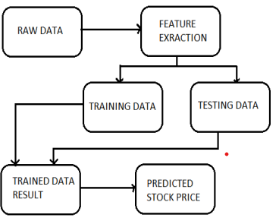


PROPOSED SYSTEM
DETECTING ASD

Slide 9
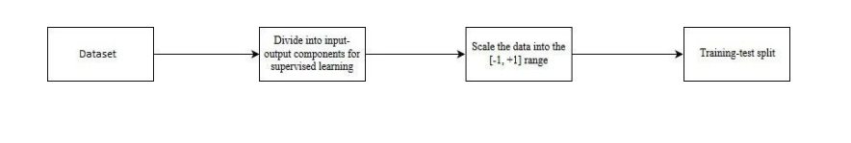
PROPOSED SYSTEM ARCHITECTURE
Pre-processing of data :

Slide 10
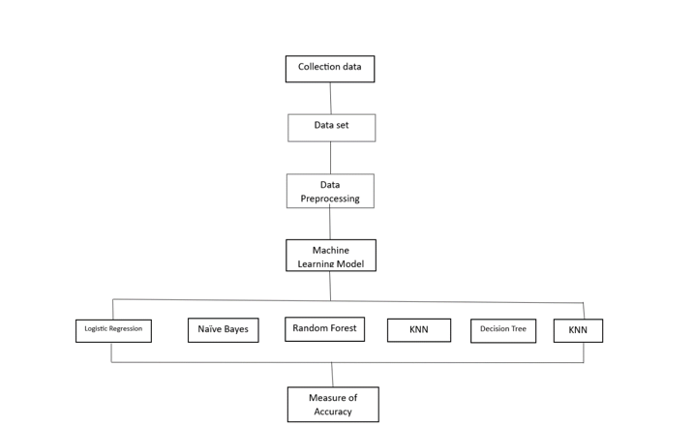
PROPOSED SYSTEM ARCHITECTURE

Slide 11
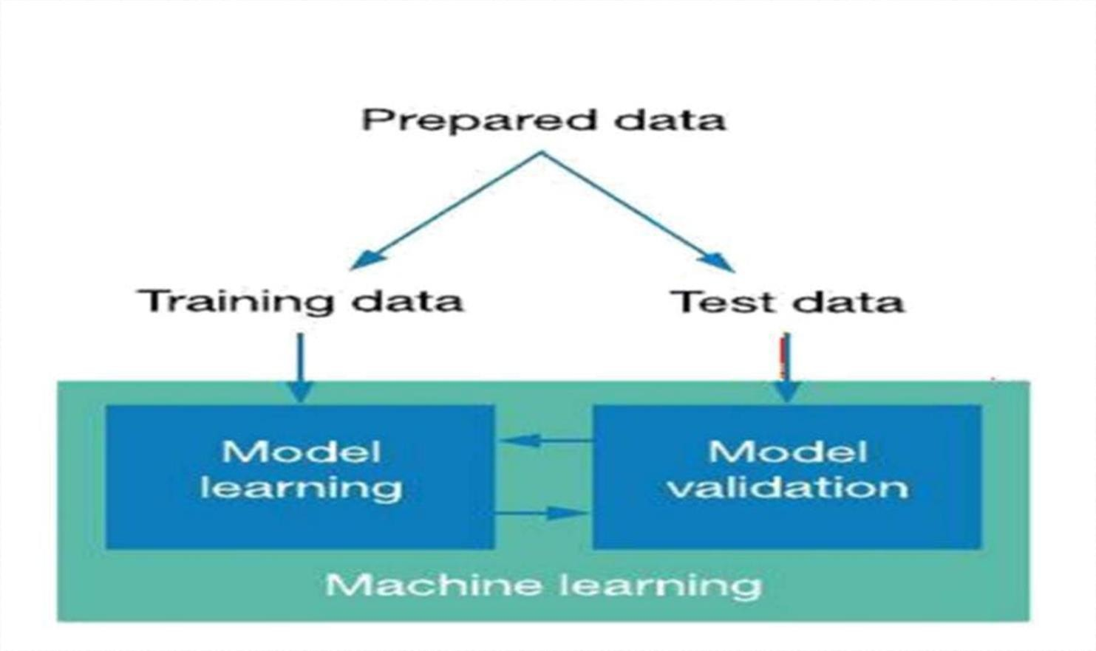
PROPOSED SYSTEM

Slide 12
PROBLEM STATEMENT
The major challenge in ASD is its detection. There are instruments available which can predict ASD but either it are expensive or are not efficient to calculate chance of Autism in human.
Furthermore,the traditional method often lack to leverage large-scale data and complex patterns that could enhance diagnostic accuracy. They may struggle to capture subtle features and variations assosciated with ASD across different Individuals.
The hidden Machine Learning patterns can be used for health diagnosis in medicinal data.

Slide 13
METHODOLOGY
The working of the system starts with the collection of data and selecting the important attributes. Then the required data is preprocessed into the required format. The data is then divided into two parts training and testing data. The algorithms are applied and the model is trained using the training data. The accuracy of the system is obtained by testing the system using the testing data.

Slide 14
RESULTS

Slide 15
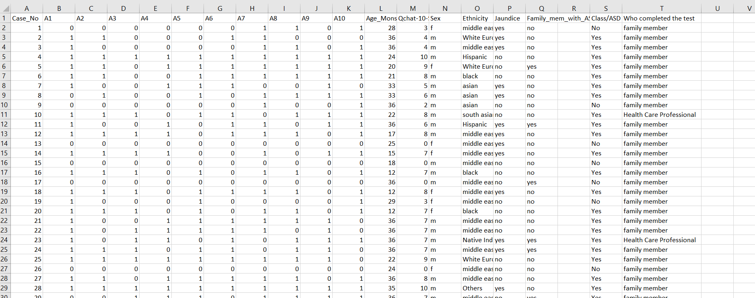
INPUT DATASET

Slide 16
Dataset Overview
We have taken dataset from toddler ASD. It contain data for different group of people. Dataset has 18 independent features which are:
Age in months: age of the individual in months
gender: gender of an individual
ethnicity: belonging of an individual to a social group
jaundice: whether individual has jaundice at time of birth
autism: whether an immediate family member of individual has autism or not.

Slide 17
Dataset Overview
6. contry_of_res: Country of Residence of the individual.
7. – 16. A1-A10 Score: 1(YES)/ 0(NO) based on the question asked in screening.
17. Qchat-10 score: Count of 1(YES) for the questions.
18.Class: Whether a individual has Autism or not(YES/NO).

Slide 18
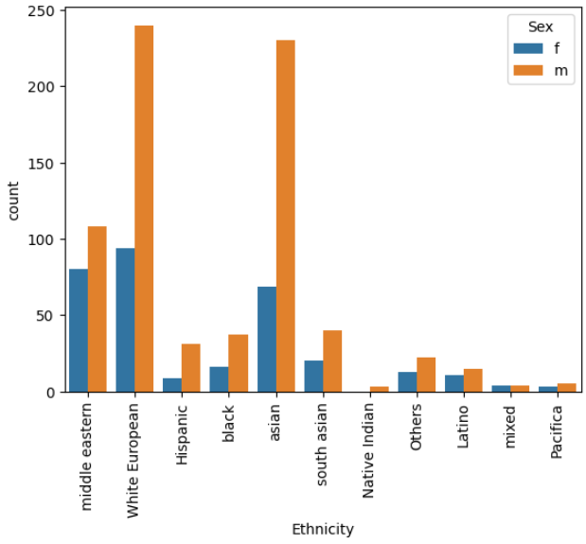
EXPLORATORY DATA ANALYSIS

Slide 19
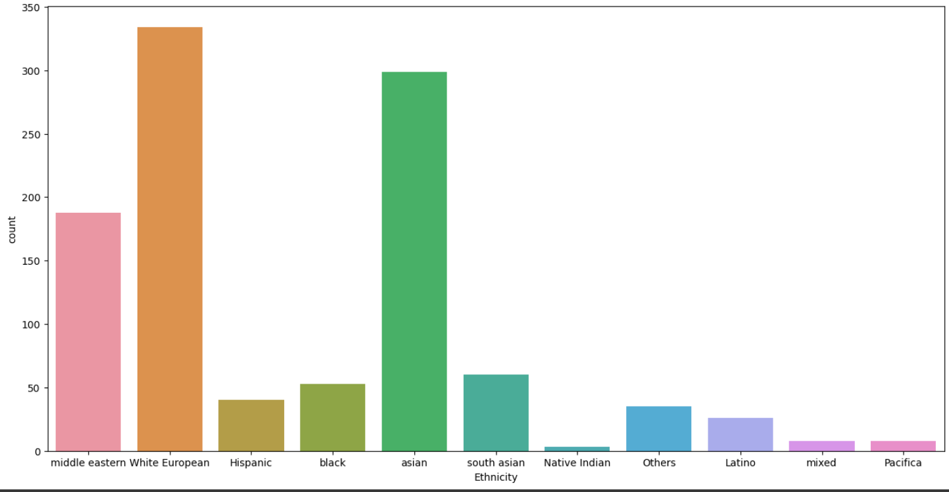
EXPLORATORY DATA ANALYSIS

Slide 20


INPUT AND OUTPUT

Slide 21
CONCLUSION AND FUTURE WORK
Screening of Autism at early age should be fundamental step towards understanding traits of Autism. Although there is no cure of Autism in terms of Medicine, but one can be benefitted by certain therapies and behavioral changes.
Talking about our project, we analyzed datasets of Child, Adolescent and Adult of Autism screening. From results, it can be derived that for this dataset Decision Trees is predicting with Good Accuracy.

Slide 22
Thank you

