Slide 1
Clustering Algorithms

Slide 2
Topics of Content
Introduction to Unsupervised Learning
Clustering
Similarity or Distance Calculation
Clustering as an Optimization Function
Types of Clustering Methods
KMeans & Meanshift
Hierarchial Clustering – Agglomerative
Density Based Clustering - DBSCAN
Measuring Performance of Clusters
Statistical Approaches

Slide 3
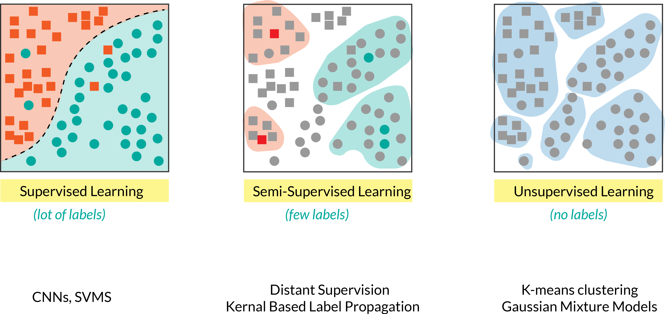
Introduction to Unsupervised Learning
ZekeLabs Research

Slide 4
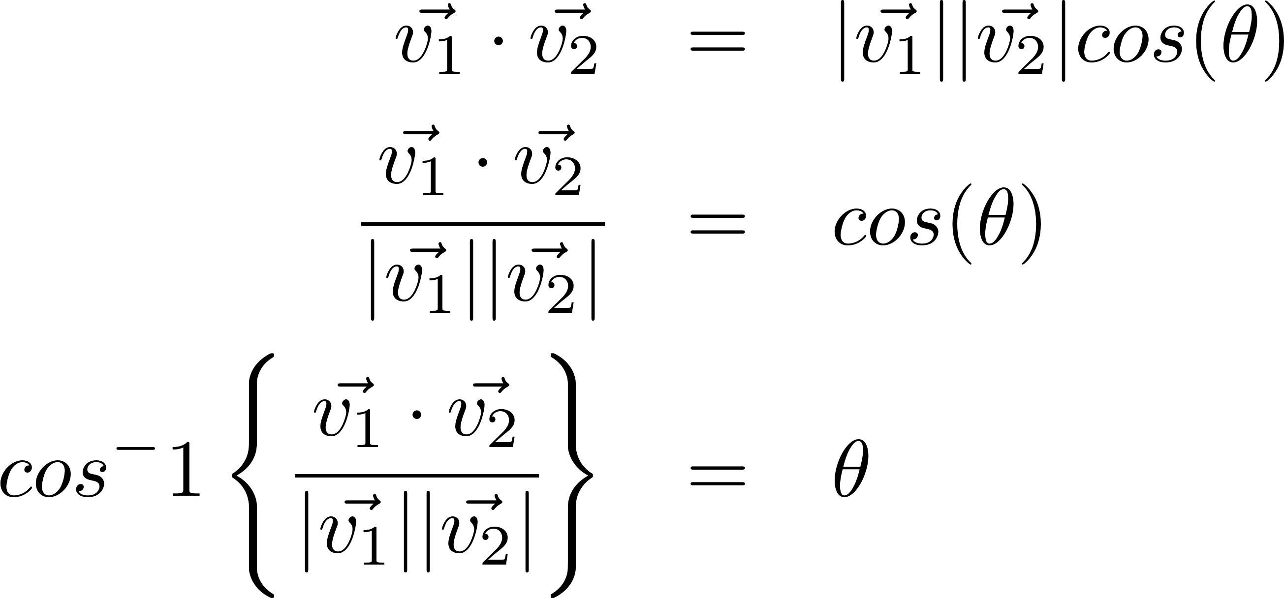
Distance Measure – Cosine Similarity

Slide 5
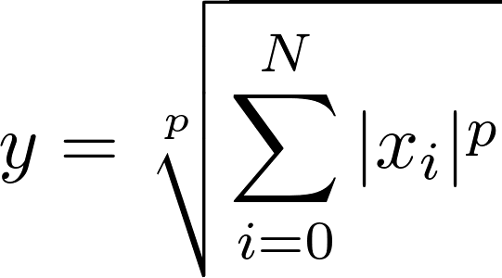
L-P Norm Based Similarity
L-1 (Manhattan Dist)
L-2 ( Euclidean Dist)

Slide 6
Clustering as an Optimization Problem
Maximize inter-cluster distances
Minimize intra-cluster distances

Slide 7
Types of Clustering
Partitioning methods – ‘kmeans’ clustering
Hierarchical methods – Agglomerative Clustering
Density-based methods – DBScan

Slide 8
K-Means Clustering

