Slide 1
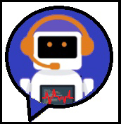
VirtualMed
By
Al-Batani Diaz
James Hamilton
Priti Pratik Gawade
Santoshkumar Dineshbhai Yadav

Slide 2
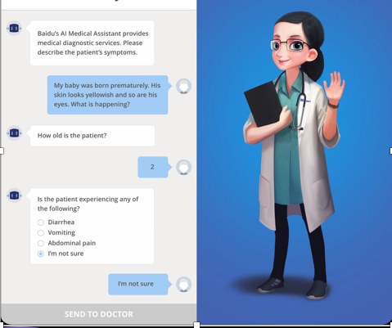
Introduction
VirtualMed is a chatbot developed for medical symptom analysis
Patients can have a conversation with VirtualMed about any health-related concerns
According to the symptoms, VirtualMed will assist with connecting the patient with the correct doctor

Slide 3
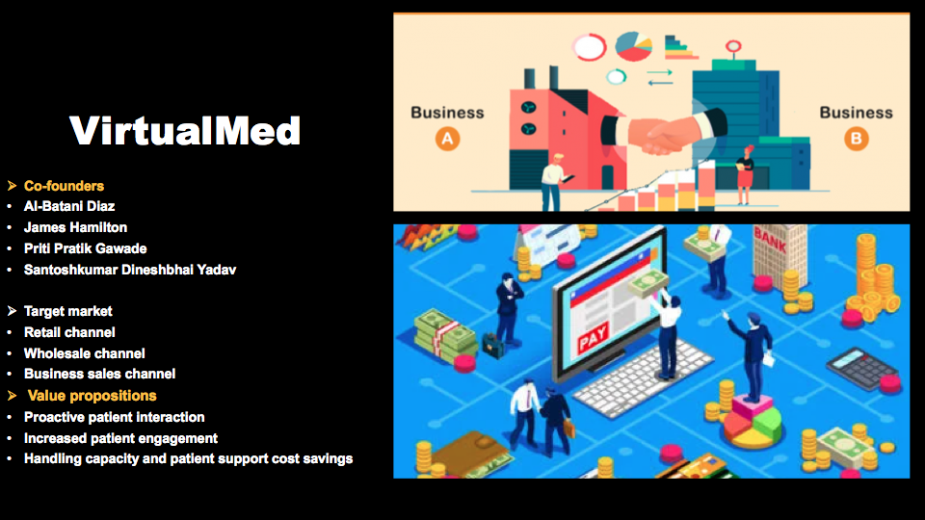

Slide 4
Issues Addressed
Increase Safety
1
Minimize exposure to the COVID-19 virus by replacing manual screenings with automated screenings
Reduce Workload
2
Healthcare systems almost collapsed in many regions during the peak of the COVID-19 pandemic
Improve Diagnostic Accuracy
3
Automate aspects of clinical decision-making by developing protocols based on data analysis
Develop Trust
4
Patients can seek advice without fear of being judged

Slide 5
How do you fix it using AI and distributed computing technology
We will be using NLP Algorithm to retrieve the keyword from the messages that we get from the user to know the possible medical problems .
Steps involved in the NLP:
Tokenization : Splitting sentences into smaller units that can be easily assigned meaning.
Stemming : Generates the root from the word .Stem of the words eating, eaten is eat.
Bag of words : describes the occurrence of word within a document.
Saas Model software as a service : a method of delivering software and application over the internet via a subscription model.

Slide 6
Conceptualization and Justification
Accessible 24/7 support through instant answers
Streamline patient and healthcare interactions by providing more accurate data collection and handling
Provide healthcare professionals the opportunity to focus on more critical and complicated tasks
Implement a multimodal solution by allowing users to choose the input modality to best suit their circumstances

Slide 7
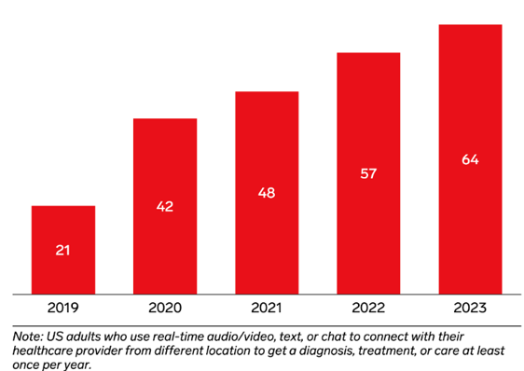
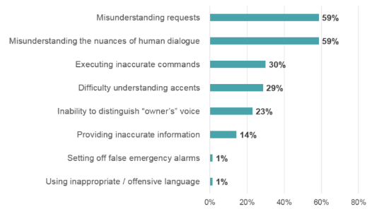
Market research on current offerings available commercially and their limitations
-The chatbot which are currently available in market does not guarantee data security
- Many applications does not extensively gather patient medical history, immunization, allergies etc.
- Most of the applications available in market does not support voice input
Use of Chatbot users, 2019-2023 in millions
Errors encountered using Chatbots in healthcare domain

Slide 8
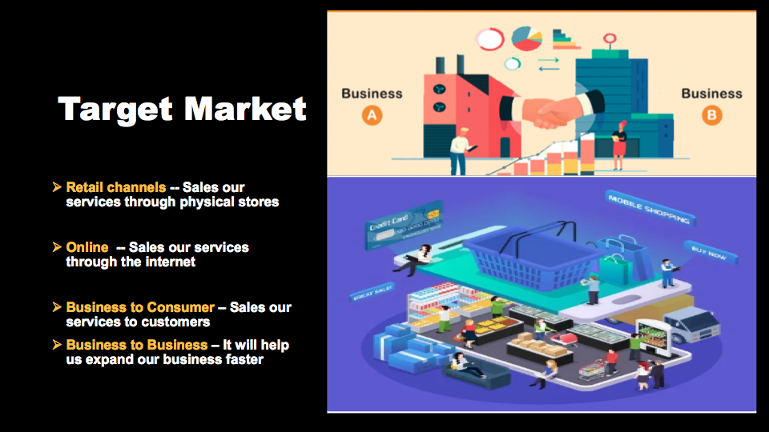

Slide 9
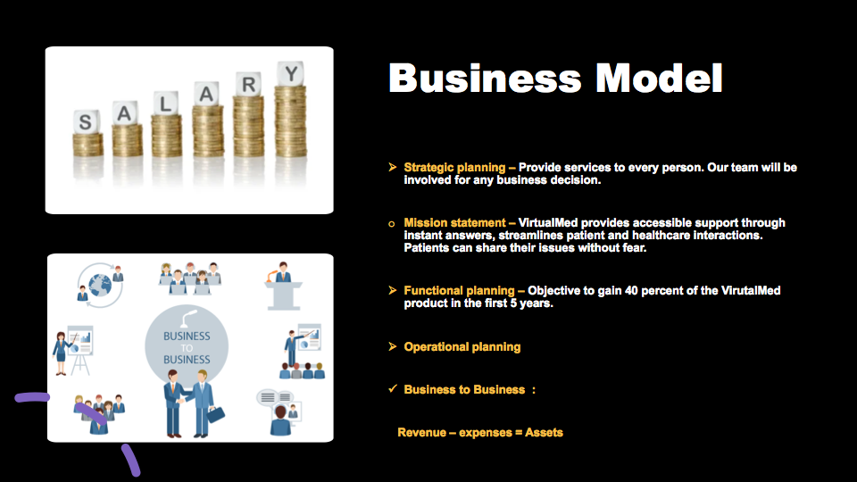

Slide 10
Expertise & Contributions
Al-Batani Diaz
Developing Business plan on how we will generate money
Give description of the target market to be used
How to advertise the business etc.
James Hamilton
Developing & implementing machine learning/artificial intelligence models
Leveraging supercomputing & distributed computing systems
Priti Pratik Gawade
Perform functional testing of application
Perform User Acceptance testing
Santoshkumar Dineshbhai Yadav
Machine Learning, Salesforce
UI/UX

Slide 11
Collaborative Tools
Discord channel for communication
OneDrive for shared editing of documents
GitHub for source control
GitHub repository

