Slide 1

Information visualization – individual project
Siva Naga Santosh Adabala
110596806

Slide 2
Chart 1: Context for “Before” Chart
Why: why was this chart created (by the chart creators)?
Response: Explain why the NYT subscriber
strategist model is hard to replicate.
Who: who was this chart created for?
Response: Created by David Tvrdon (Journalist &
Digital Strategist)
What: did the chart creators want the target audience to know/do?
Response: The chart reflects how the NYTimes is
progressing towards its goal.
How: what data/data source did the chart creators use (if you know)?
Response: NYT Co. Investor Relations

Slide 3
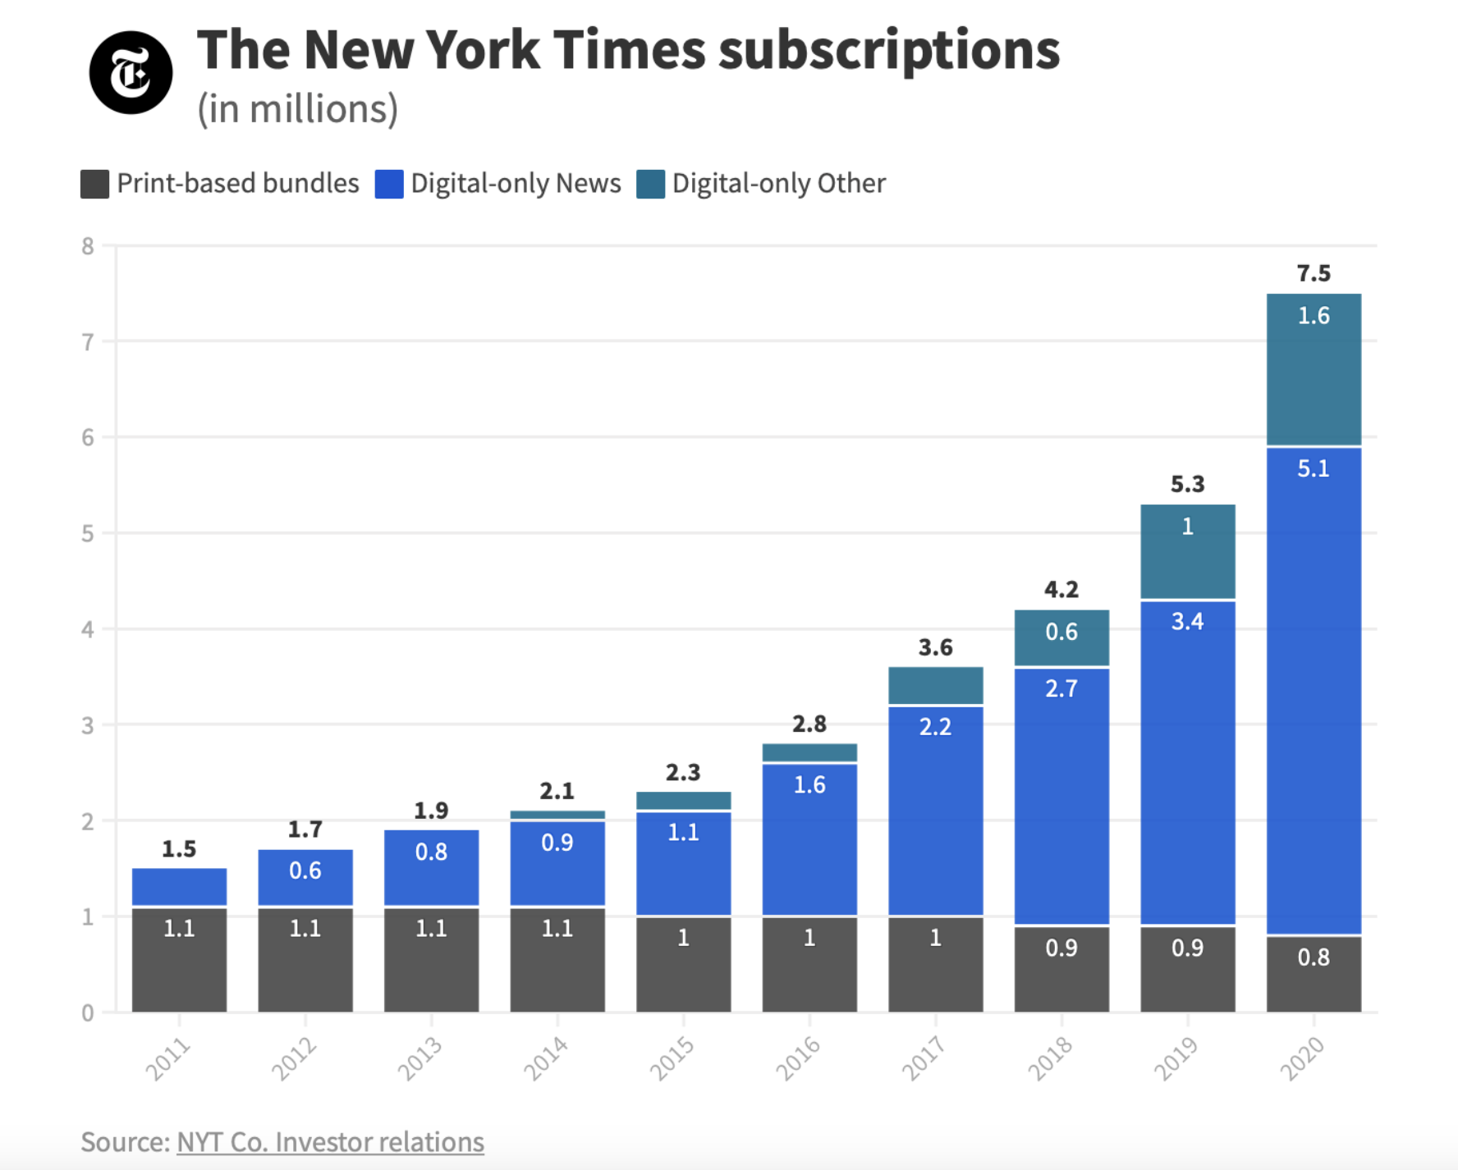
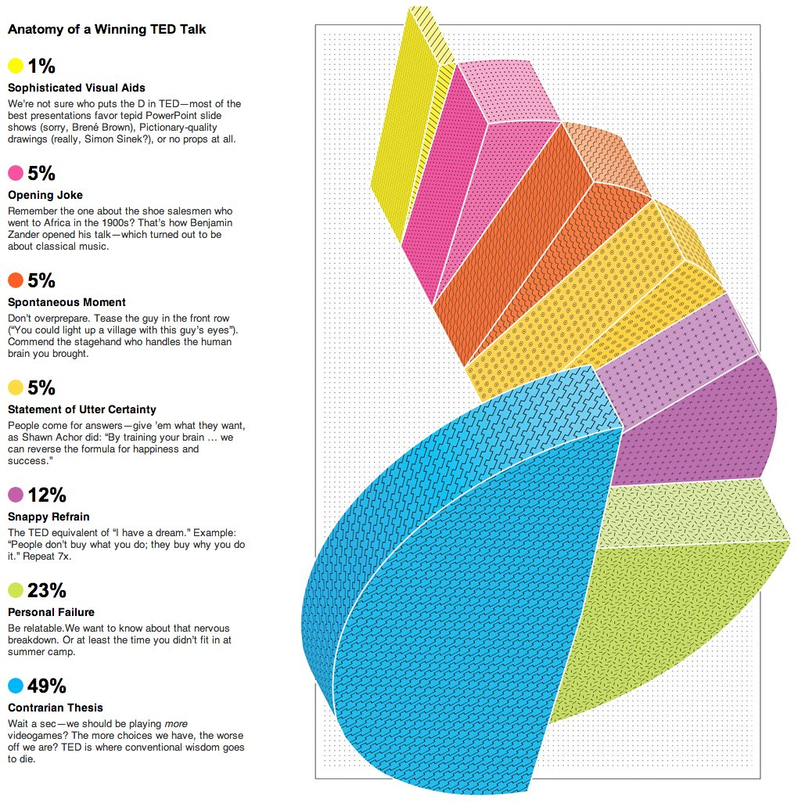
Before chart

Slide 4
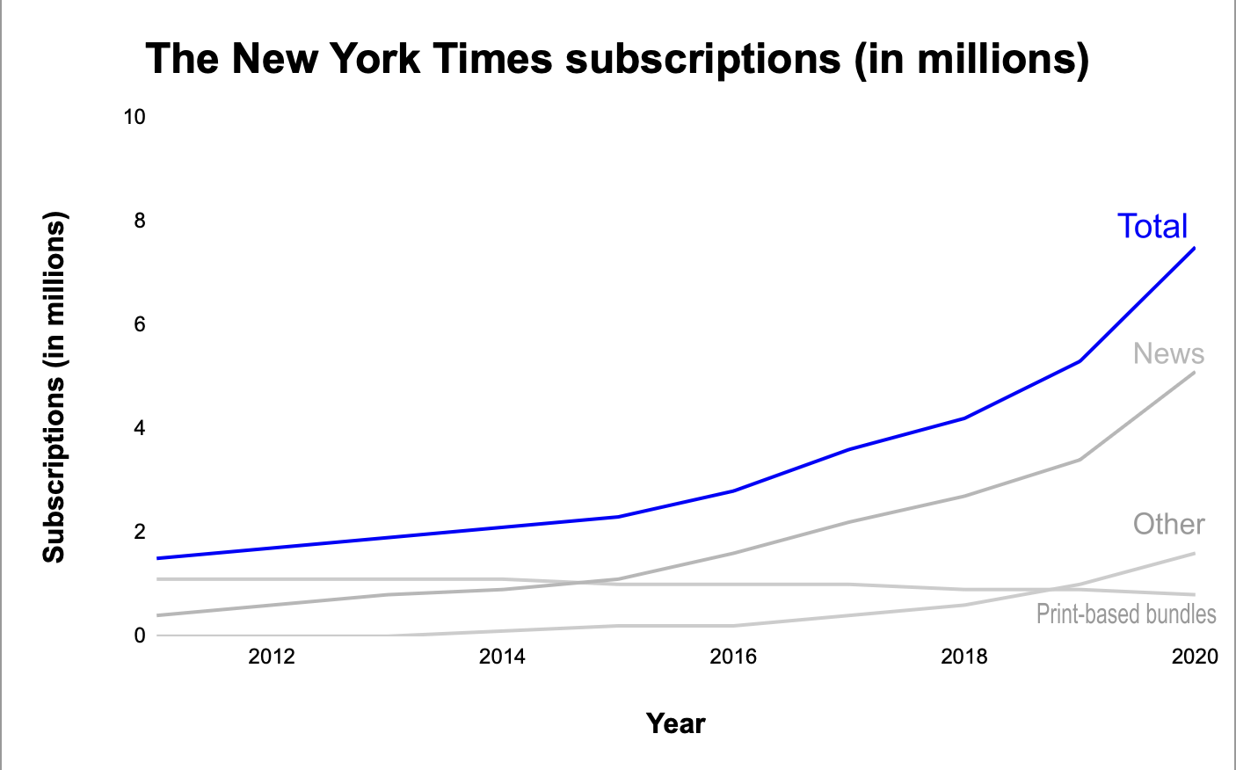
After chart

Slide 5
Before & After chart's

Slide 6

Improvements made
Transformed into a Line chart
Added X & Y – axis labels
Highlighted the total line alone.

Slide 7
Chart 2: Context for “Before” Chart
Why: why was this chart created (by the chart creators)?
Response: To help in crafting the perfect TED talk.
Who: who was this chart created for?
Response: Created by Jason Kehe, Features Editor
at Wired magazine.
What: Did the chart creators want the target audience to know/do?
Response: To learn how to optimize an individual’s
moment in the spotlight.
How: what data/data source did the chart creators use (if you know)?
Response: Wikipedia & other reports

Slide 8
Before chart

Slide 9
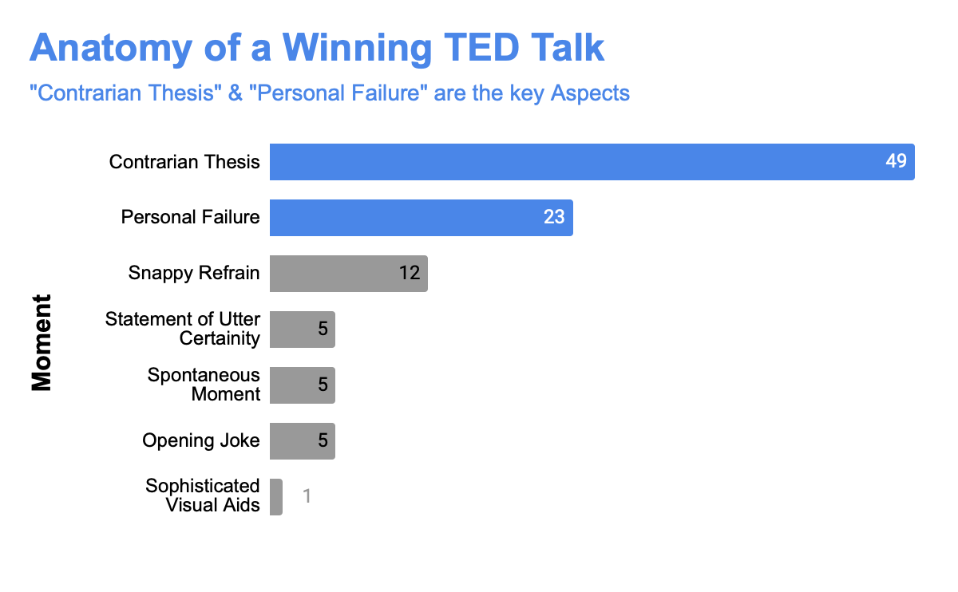
After chart

Slide 10
Before & After chart's

Slide 11
Improvements made
• Discarded 3-d spiral chart
• Made the title “BOLD” to emphasize the chart
context.
• Removed the clutter – text about each moment.

Slide 12
Chart 3: Context for “Before” Chart
Why: why was this chart created (by the chart creators)?
Response: To give an idea of several medals won by
countries in the Summer Olympics up to August
2004.
Who: who was this chart created for?
Response: Created by Erickson Times editor.
What: Did the chart creators want the target audience to know/do?
Response: To find out the top-performing countries in
the Summer Olympics over the period.
How: what data/data source did the chart creators use (if you know)?
Response: Based on the records of Agency France-
Press news service.

Slide 13
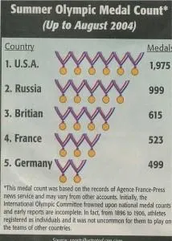
Before chart

Slide 14
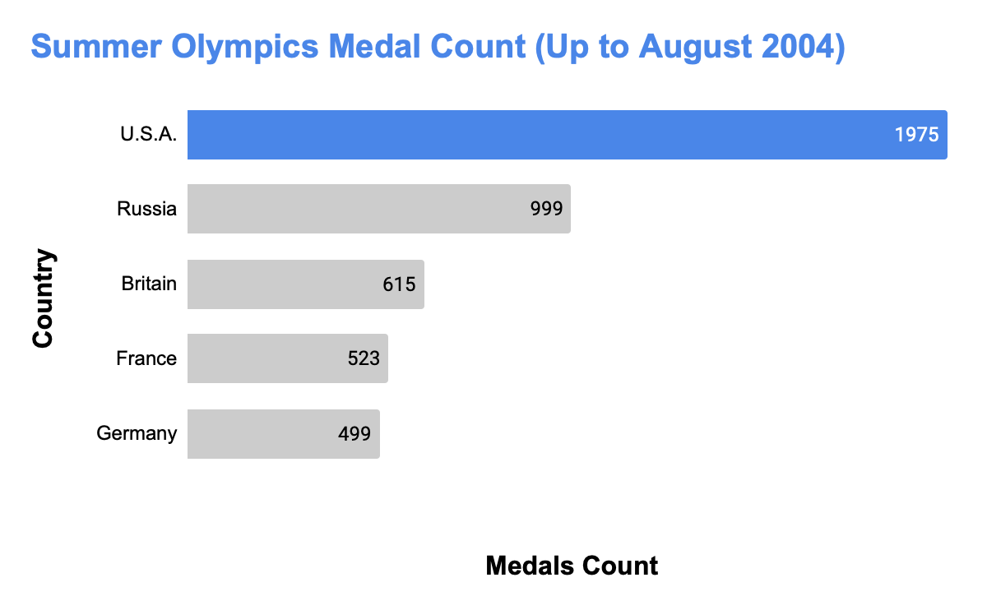
After chart

Slide 15
Before & After chart's

Slide 16
Improvements made
Corrected the spelling mistakes
Discarded the misleading infographic.
Highlighted the top country in the list.
The new chart clearly distinguishes the variation in the total count.

Slide 17

Q&A

Slide 18

Thank you

