Slide 1

Clustering
Prepared By:
Santosh Ahirrao

Slide 2
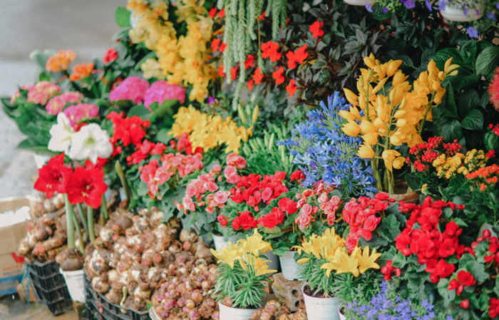
Clustering

Slide 3
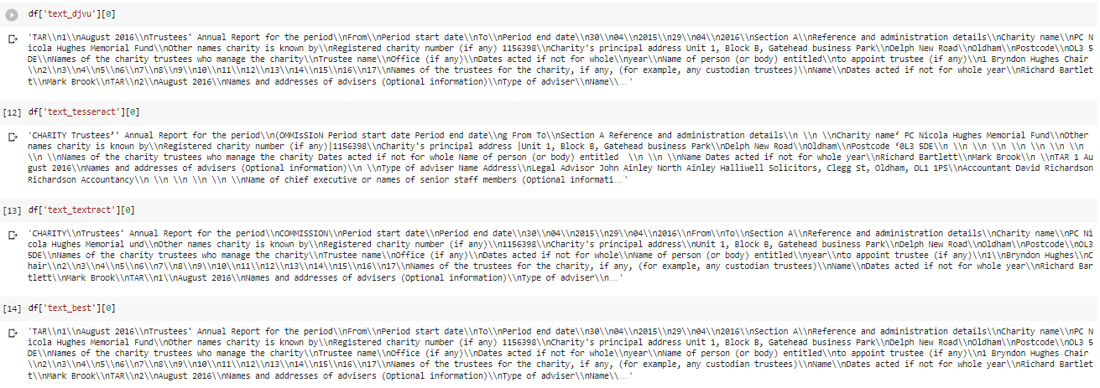

Slide 4
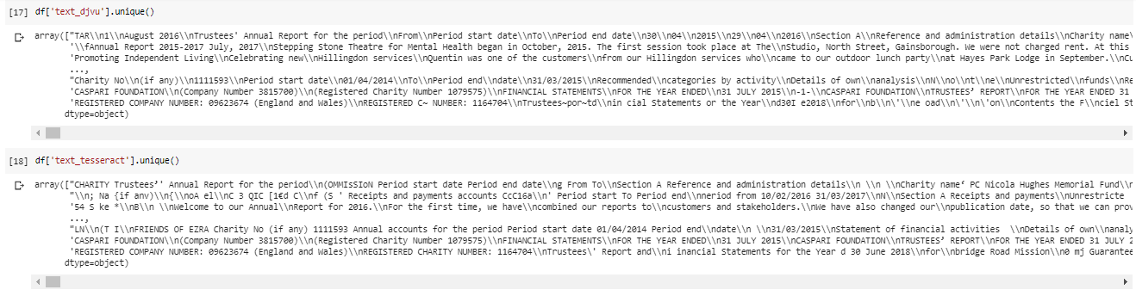
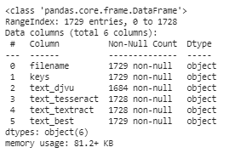
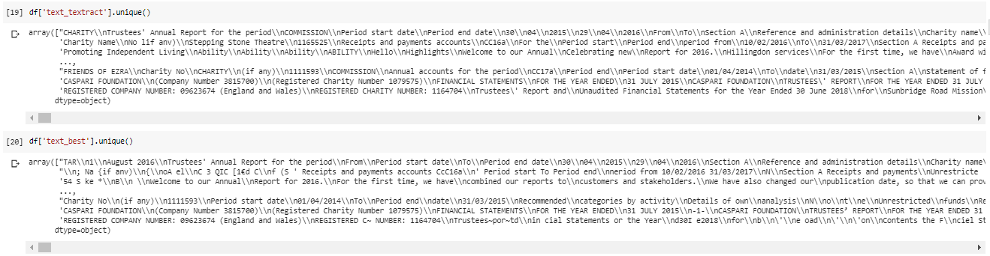

Slide 5
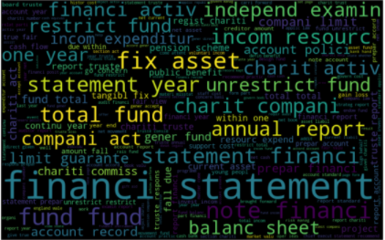
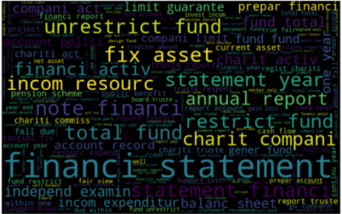
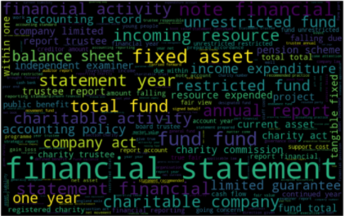
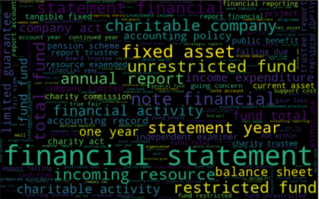
Stem-1 (textract)
Stem-2 (best)
Lemit - 1 (textract)
Lemit-2 (best)

Slide 6
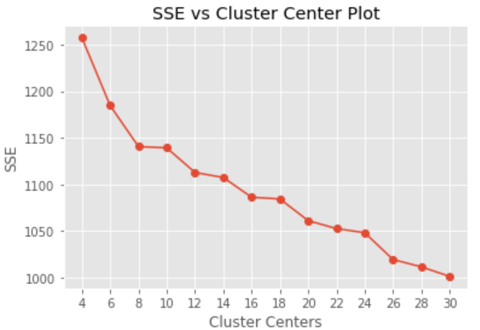
K-Means
Started with K-Means on TF-IDF vectored data

Slide 7
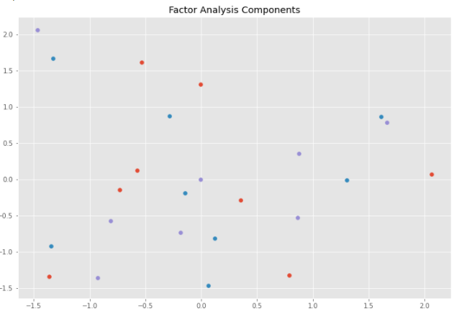
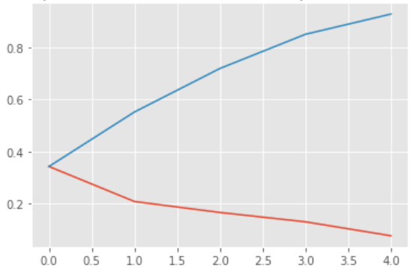
Visualizing K-Means
Factor Analysis Components
Component wise & Cumulative Explained Variance

Slide 8
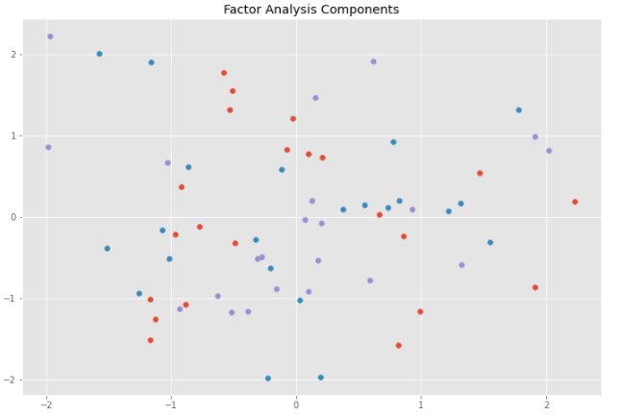
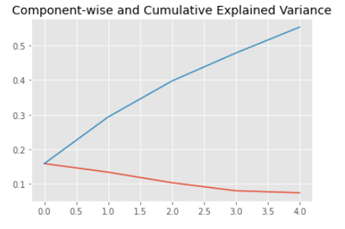
Visualizing K-Means
Factor Analysis Components
Component wise & Cumulative Explained Variance

Slide 9
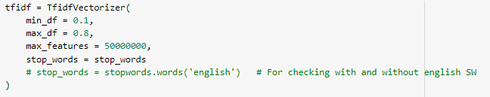
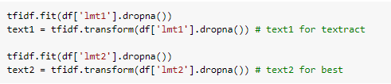
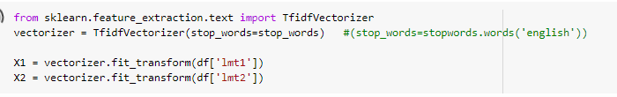

Slide 10
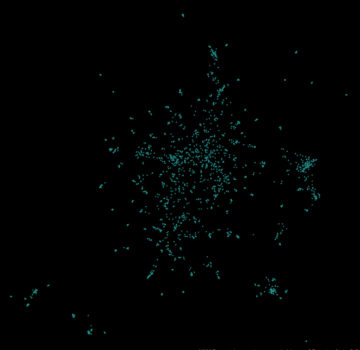
Visualizing data using UMAP

Slide 11
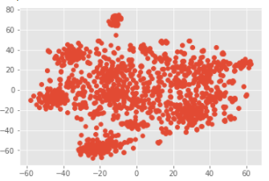
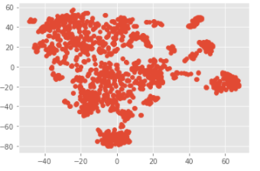
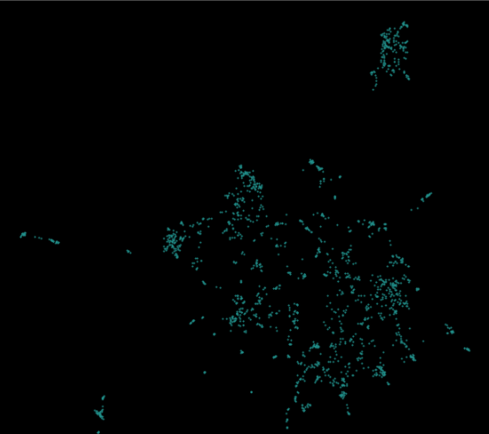
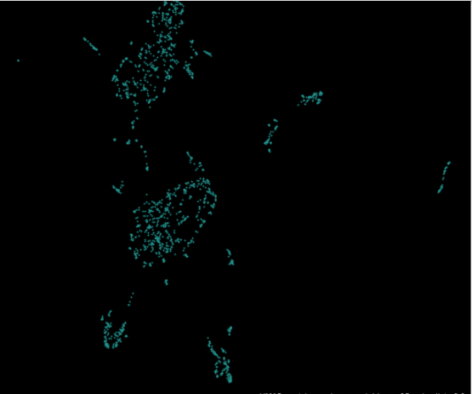
Data Visualization
With tf-idf
With tf-idf and Cosine distance
TSNE
TSNE
umap
umap

Slide 12
Clustering Results for HDBSCAN
9 Clusters formed, with 152 (8.8% ) are outliers out of total 1729.

Slide 13
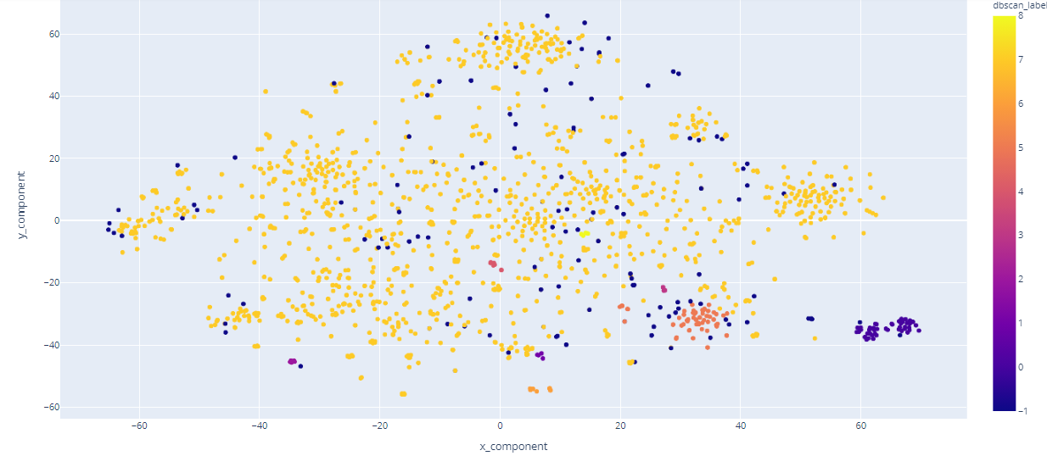
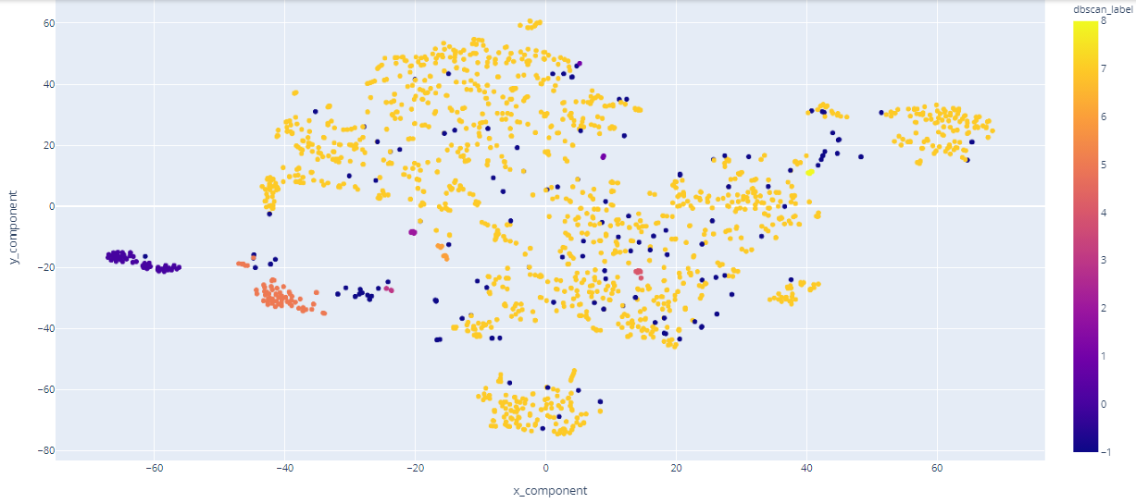
Clustering Results for HDBSCAN
TNSE – on TF-IDF
TNSE – on TF-IDF & & Cosine distance
9 Clusters formed, with 152 (8.8% ) are outliers out of total 1729.

Slide 14
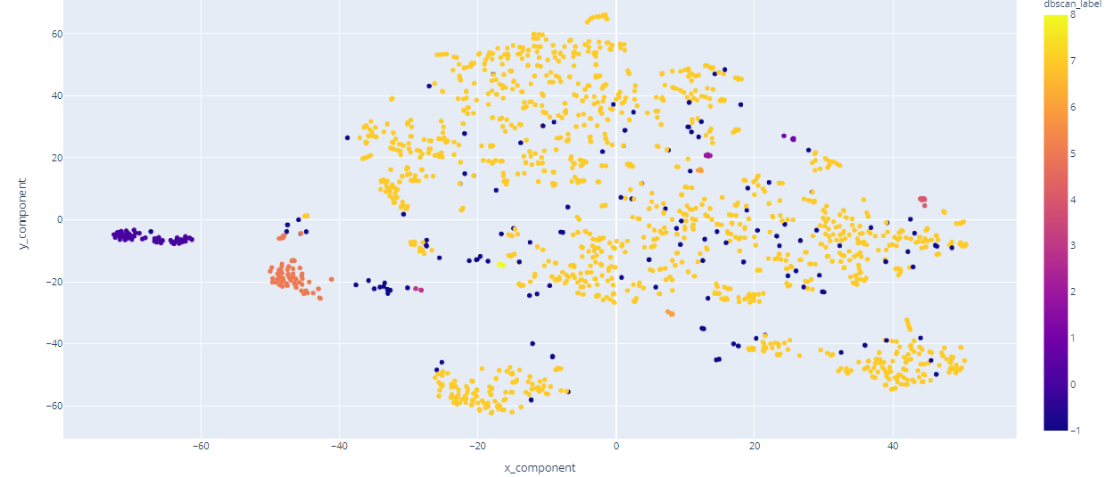
Clustering Results for HDBSCAN
TNSE – on TF-IDF & Cosine distance
PCM -100 (TNSE – on TF-IDF & Cosine distance)
9 Clusters formed, with 152 (8.8% ) are outliers out of total 1729.

Slide 15
Challenges
Majorly most of the data points falling in same one cluster
Data visualization
Hyper parameter tuning
Plan
Cluster-7 ( 1435 ) apply clustering algorithm.
Visualization of the newly formed clusters from cluster-7 (after tf-idf and cosine dist.)
Word cloud for all clusters
Exploration for Hyper parameter tuning using keras tuner and grid search cv

Slide 16
Q & A
Thank You

Slide 17
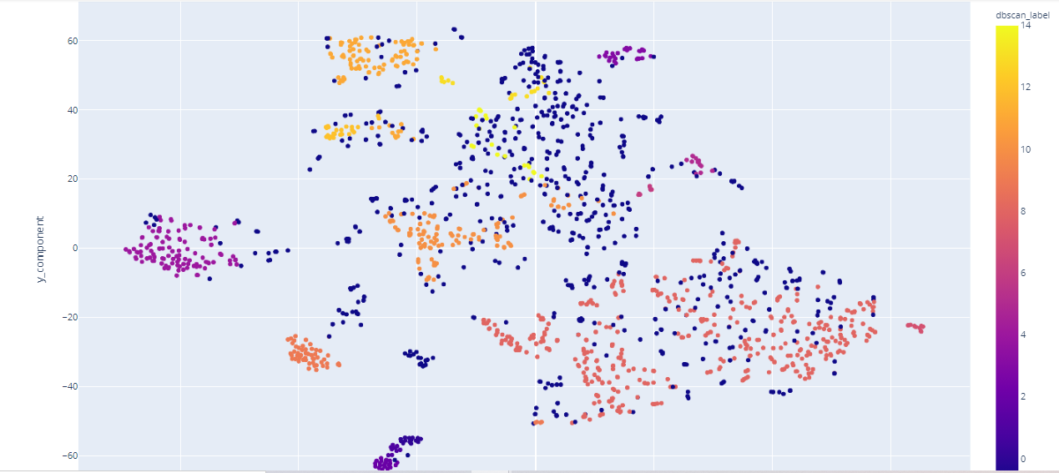

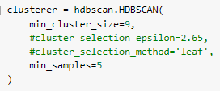

Slide 18
