Slide 1
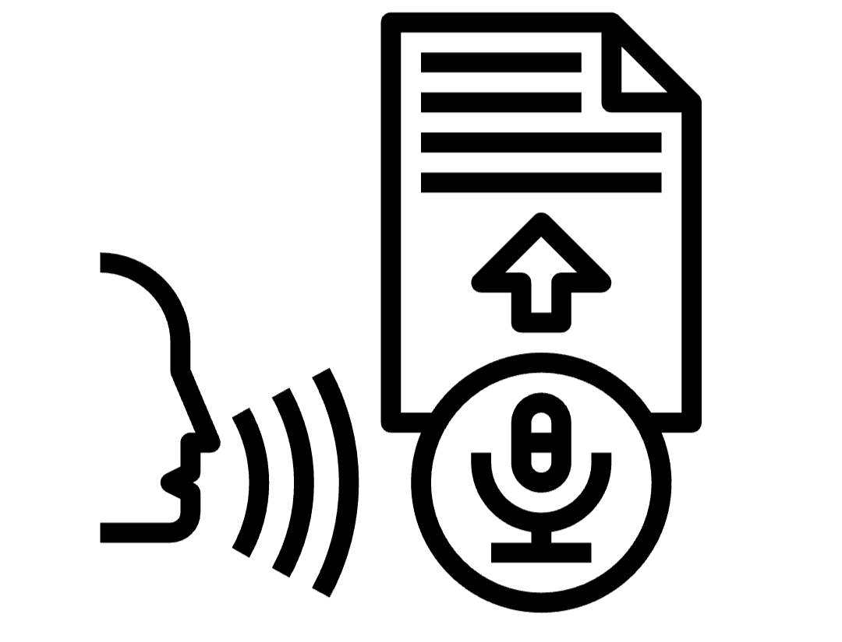
Speech Recognition

Slide 2

B. Rama Sai Santosh
B.Jathin Krishna
9920004285
9920004284
Team Mates
K.Srikanth
Ch.Sai Kiran
9920004308
9920004753

Slide 3





Applications
Working
principle
packages
and
algorithms
Advantages
Introduction

Slide 4
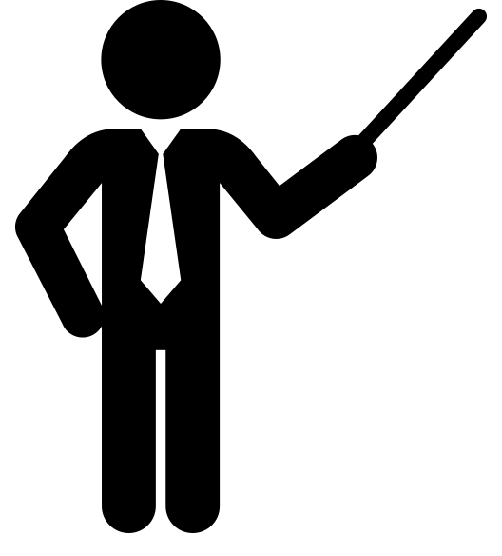
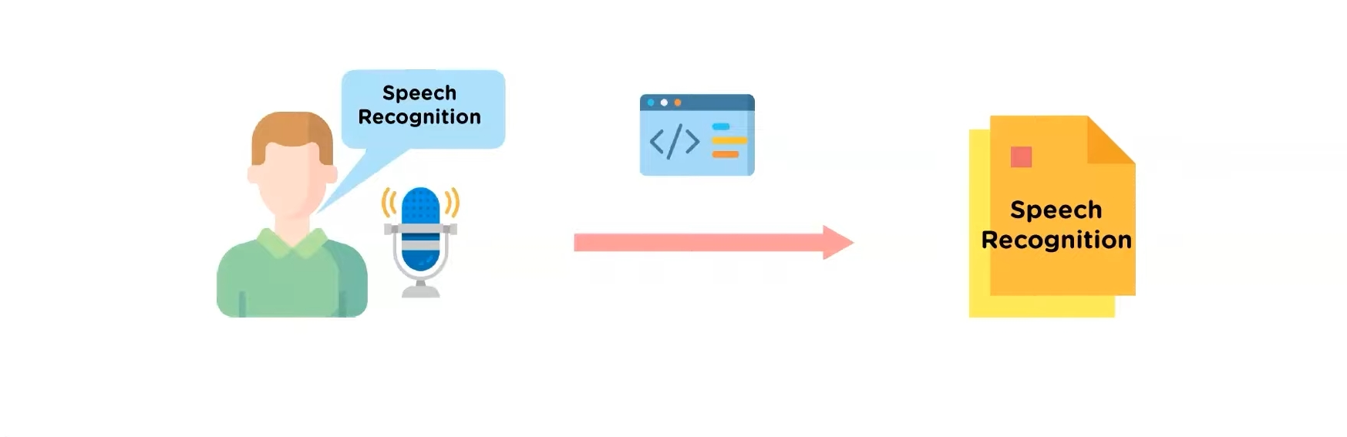
Introduction
WHAT IS SPEECH RECOGNITION
Speech recognition incorporates the field of computer science to identify spoken words and convert them into text.it allows computer to understand human language

Slide 5

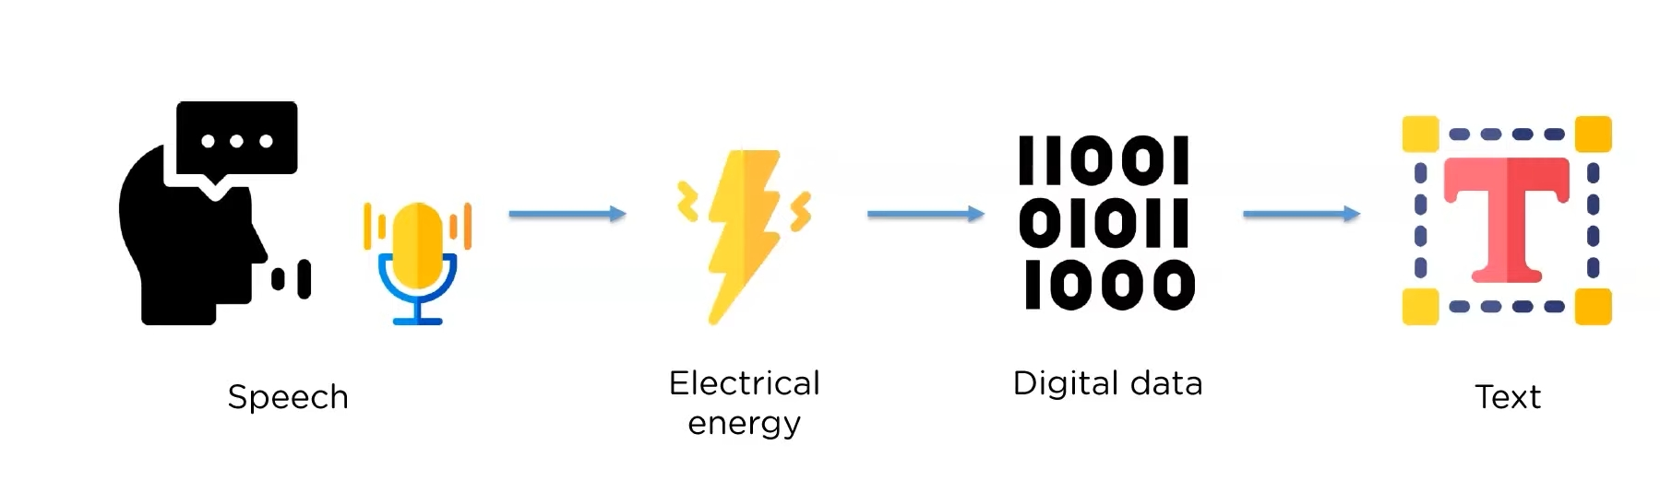
Working
principle
HOW DOES SPEECH RECOGNITION WORK
Speech is first converted from physical sound to electrical energy using a microphone and then to digital data using an analog to digital converter. This digital data can be converted to text using algorithms like Neural Networks or Hidden Markov Models

Slide 6
Introduction
PACKAGES
There are multiple Speech recognition modules available which all provide different functionalities. Some of the commonly used packages are
Apiai: Include natural language processing for identifying a speaker's intent
Google-cloud-speech: Offers basic speech to text conversion
Speech Recognition: Offers easy audio processing and microphone accessibility

Slide 7
Speech recognition algorithms
Natural language processing
Hidden markov models (HMM)
N-grams
Neural networks

Slide 8
APPLICATIONS
Customer service
Disability assistance
Emotion recognition
Hands-free communication

Slide 9
ADVANTAGES
Machine-to-human communication
Readily accessible
Easy to use
Continuous, automatic improvement

